Slide 1
Ministry of Meteorology, Energy, Information, Disaster Management, Environment, Climate Change & Environment and Communications (MEIDECC)
TONGA ENERGY ROAD MAP (TERM)
10 YEARS PLAN
(2010-2020)
TONGA ENERGY EFFICIENCY MASTER PLAN IS PART OF TERM

Slide 2
TERM
1. Policy and Institutional Strengthening[Policy and Law Refom]?
2. Hardware Renewable Energy & EE projects Implementation?.
3. Private Sector Investments, and Regulatory Reform ?

Slide 3
Ministry of Meteorology, Energy, Information, Disaster Management, Environment, Climate Change & Environment and Communications (MEIDECC)
OBJECTIVES TERM
Lay out a least-cost approach and implementation plan
to reduce Tonga’s vulnerability to oil price shocks
and achieve an increase in quality access to modern energy services in a financially and environmentally sustainable manner.
Specific objectives
renewable energy
energy efficiency
equitable access,
institutional reform
affordability
and safety of petroleum services.

Slide 4
Ministry of Meteorology, Energy, Information, Disaster Management, Environment, Climate Change & Environment and Communications (MEIDECC)
TONGA NDC, 2015 – ENERGY EFFICIENCY IS CENTRAL
50% of electricity generation RE by 2020. In 2015 renewable energy accounts for approximately 9% of total electricity generation, with confirmed and funded investments taking this to 13% in 2016. EE is helpful to achieve RE targets
70% of electricity generation from renewable sources by 2030
Improve Energy efficiency through reduction of electricity line losses to 9 percent by 2020 (from a baseline of 18 percent in 2010)
To double the 2015 number of Marine Protected Areas by 2030
Sector Emission Reduction Targets: Transport, Agriculture, Environment Friendly Waste Management and Reforestation
Other Sectors Climate Resilience: Public Infrastructures, foreshore protection, buildings and houses.

Slide 5
Ministry of Meteorology, Energy, Information, Disaster Management, Environment, Climate Change & Environment and Communications (MEIDECC)
Development of a Tonga Energy Efficiency Master Plan
(TEEMP)
GCF READINESS PROGRAMME : FIRST PROJECT FOR TONGA, 2016
CONSULTANT: CTCN/ NREL, 2016
SDGs
Goal 7: Affordable and clean energy
Goal 13: Climate action

Slide 6
Ministry of Meteorology, Energy, Information, Disaster Management, Environment, Climate Change & Environment and Communications (MEIDECC)
OBJECTIVE OF TEEMP
Developing TEEMP to help reduce the energy use and decrease emissions in buildings, transportation, power and other relevant cross cutting sectors.

Slide 7
Ministry of Meteorology, Energy, Information, Disaster Management, Environment, Climate Change & Environment and Communications (MEIDECC)
TA includes the following activities:
Conduct survey,
data collection and baseline study
Develop EE and GHG mitigation targets
Conduct need assessment on potential EE activities for Energy Sector (Power, Transport and Building)
Conduct Capacity Development and Training for Energy Staff

Slide 8
Ministry of Meteorology, Energy, Information, Disaster Management, Environment, Climate Change & Environment and Communications (MEIDECC)
EXPECTED OUTPUTS
A more organised and clear pathway for Tonga to reduce its GHG emissions and increase energy saving from all sectors
Improve the Energy Efficiency standards of technologies and applications in Tonga through the development of Energy Efficiency Standards for:
energy services
appliances,
technologies,
buildings and vehicles

Slide 9
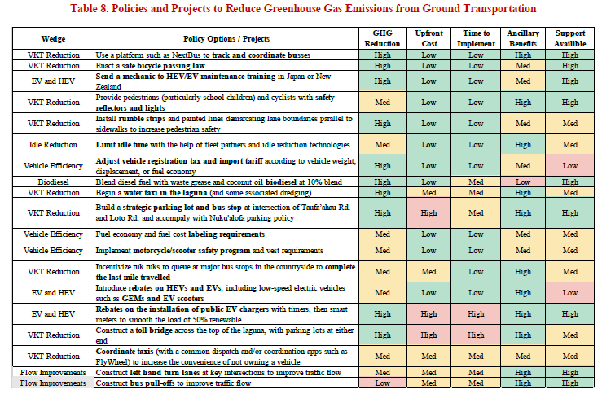
REAL OUTPUTS

Slide 10
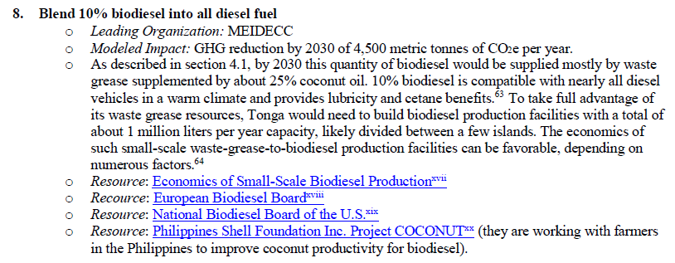
Ministry of Meteorology, Energy, Information, Disaster Management, Environment, Climate Change & Environment and Communications (MEIDECC)

Slide 11
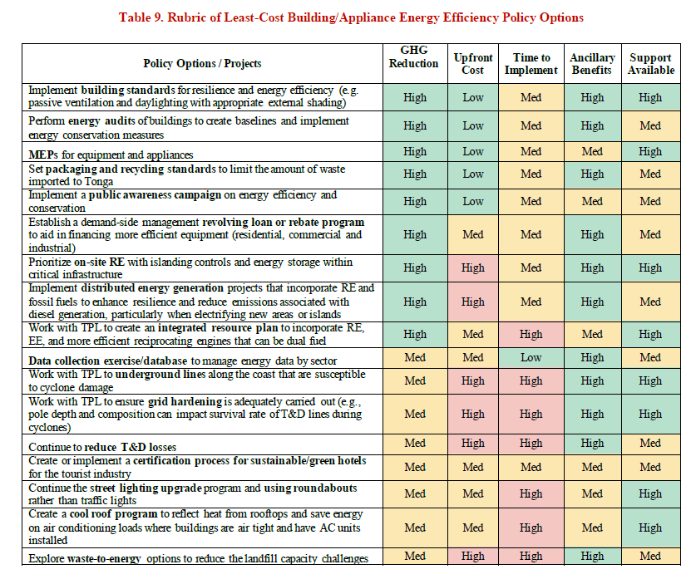

Slide 12
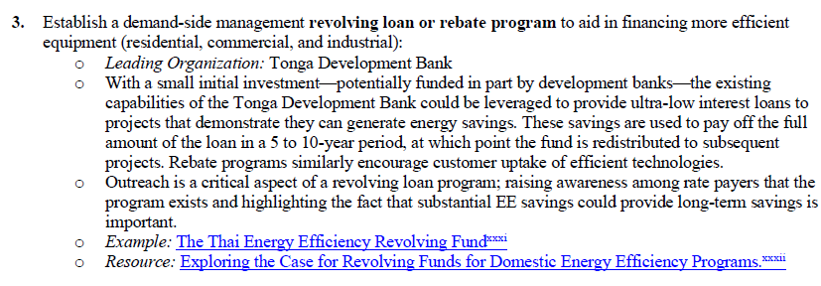
Ministry of Meteorology, Energy, Information, Disaster Management, Environment, Climate Change & Environment and Communications (MEIDECC)

Slide 13
Ministry of Meteorology, Energy, Information, Disaster Management, Environment, Climate Change & Environment and Communications (MEIDECC)
Policy and Institutional Strengthening[Policy and Law]?
Hardware Renewable Energy & EE projects Implementation?.
Private Sector Investments, and Regulatory Reform ?

