Slide 1





FIFTH PACIFIC REGIONAL ENERGY AND TRANSPORT MINISTERS’ MEETING
MOBILITY AND SUSTAINABLE TRANSPORT IN THE PACIFIC
PCREEE’s work on promoting RE & EE in the Pacific region and how it relates to sustainable transport
Solomone Fifita
MANAGER - PCREEE
8-12 MAY 2023 PORT VILA, VANUATU

Slide 2

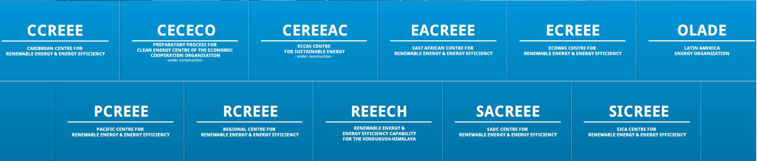
THE PCREEE
Going 7 years now
Part of a global network comprising 11 regional centres
Covering 120 countries and influencing 1.5 billion energy consumers
38 of 46 LDCs and 32 of 36 SIDS
2nd Operational Phase: 2021-2025
UNIDO, Austria, Norway & NZ funding support
Part and parcel of SPC and the GEP of the GEM Division
Notes:
No established vehicle standard in Vanuatu Fragmented institution framework (PWD – vehicle worthy checks, PLTA – public transport business permit, Customs Dept – road tax)
Lack of comprehensive policy framework on land transport (no policy and inadequate tax incentives to support hybrids and EVs)
Fragmented legislative and regulatory framework on land transport (Road Traffic Act – Police, Public Land Transport Act – PLTA, Pollution Control Act, etc)
Current transport routes not efficient and has impact on gender and social wellbeing.
High cost of EVs
Limited capacity in the country on Hibrid Vehicles and EVs

Slide 3
PCREEE
Purpose
to fill a gap in regional energy service delivery
private sector, investments, markets & entrepreneurship
Business Plan: 2020-2030
RE & EE Business start up & entrepreneurship support
RE mini-grids
EE Investments
RE & EE for Sustainable mobility
Notes:
NSDP – provide equitable and affordable access to efficient transport in rural and urban centres
NERM –improve transport (land and maritime) energy efficiency by 10% over the BAU by 2030
Updated and Revised NDC 2021 – 2030 – reduce GHG emissions from transport sector by 10% below BAU; increase share of EVs and mileage and emission standards for vehicles
LT-LEDS – recommends for the development of a national transport strategy and coordination of e-mobility pilots.

Slide 4
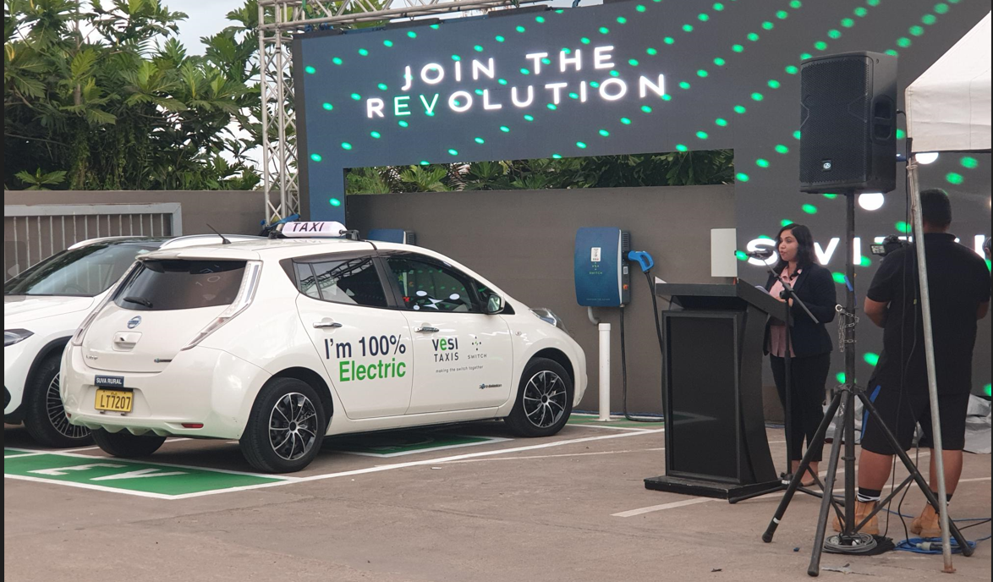


RE & EE Business start up & entrepreneurship support
TAs to support the establishment of new energy businesses [e.g legal TA to support setting up LEAF Capital / SWITCH Network in Suva]
Access to finance – [funding proposals, loans & Support to the establishment of the Transforming Island Development through Energy and Sustainability” facility - TIDES
Financial support to increase RE & EE business opportunities – PSEEF & Navara Coop Society Ltd of Vanuatu
Enabling business environment – promotion of the productive uses of energy
Support to Energy Regulators – reviews of concession contracts, trainings on tariff setting and PPAs, safety and compliance, etc
Notes:
NSDP – provide equitable and affordable access to efficient transport in rural and urban centres
NERM –improve transport (land and maritime) energy efficiency by 10% over the BAU by 2030
Updated and Revised NDC 2021 – 2030 – reduce GHG emissions from transport sector by 10% below BAU; increase share of EVs and mileage and emission standards for vehicles
LT-LEDS – recommends for the development of a national transport strategy and coordination of e-mobility pilots.

Slide 5
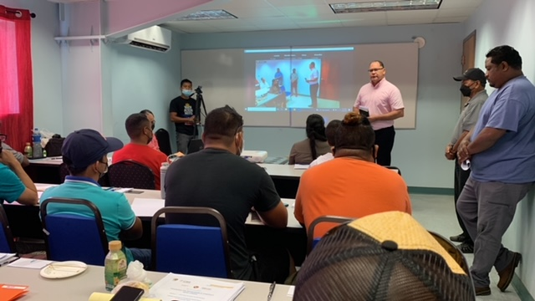
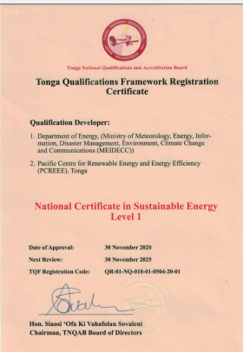
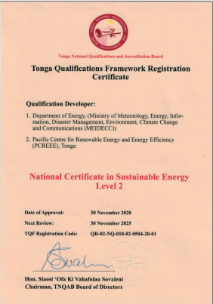
RE MINI-GRIDS
Web-based market knowledge platform
Mini-grids feasibility studies
Accredited standards for solar products, services and qualifications – STAR-C
National qualifications on SE
Capacity building and training on mini-grids
Notes:
NSDP – provide equitable and affordable access to efficient transport in rural and urban centres
NERM –improve transport (land and maritime) energy efficiency by 10% over the BAU by 2030
Updated and Revised NDC 2021 – 2030 – reduce GHG emissions from transport sector by 10% below BAU; increase share of EVs and mileage and emission standards for vehicles
LT-LEDS – recommends for the development of a national transport strategy and coordination of e-mobility pilots.

Slide 6

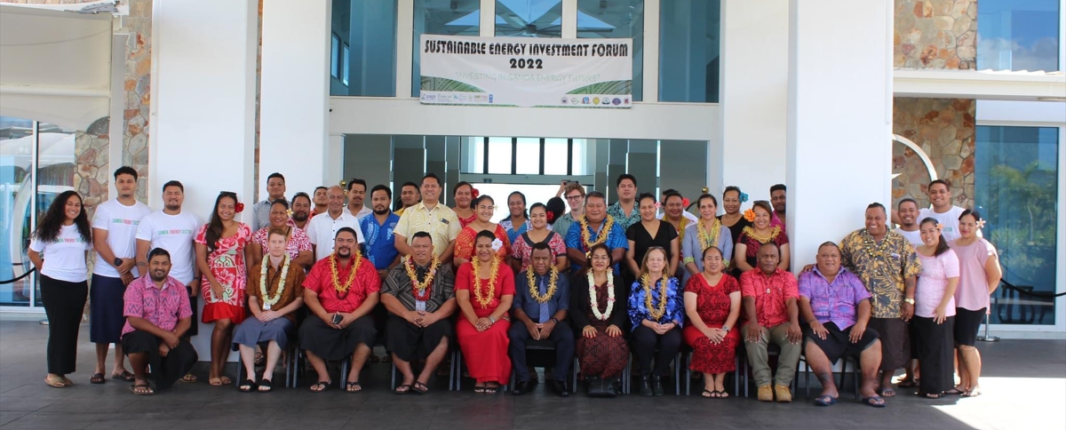
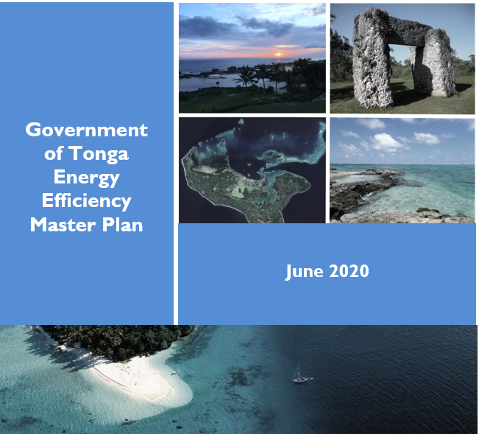
EE Investments
Energy Investment Forums – Samoa & Vanuatu
TAs to EE Master Plans & operationalising the MEPSL legislation - Finalised the Tonga Energy Efficiency Master Plan (TEEMP: 2020 – 2030) & Kiribati MEPSL
Notes:
NSDP – provide equitable and affordable access to efficient transport in rural and urban centres
NERM –improve transport (land and maritime) energy efficiency by 10% over the BAU by 2030
Updated and Revised NDC 2021 – 2030 – reduce GHG emissions from transport sector by 10% below BAU; increase share of EVs and mileage and emission standards for vehicles
LT-LEDS – recommends for the development of a national transport strategy and coordination of e-mobility pilots.

Slide 7
RE & EE for Sustainable Mobility
4th PETMM
4th PETMM Direction
…. regional e-mobility policy document
……. regional e-mobility programme to address existing barriers
…… promote SIDS-SIDS cooperation
Three Reports: Technical Background, Regional Policy & Regional Programme
https://www.pcreee.org/event/online-validation-regional-e-mobility-policy-and-program-pacific-islands

Slide 8
Summary of Target Actions of the Regional EV Program
Central Policy and Administration
Develop high-level targets and mandates concerning EV uptake. On-going Establish a staffed and funded Regional EV Hub with regional representatives responsible for coordinating national programs and collecting and sharing information and international links including those related to SIDS-SIDS cooperation. Voluntary EVWG established Support PICTs in developing and implementing national EV roadmaps. NREL-Tonga-PCREEE, PNG EV Policy/CTCN, SI emobility roadmap Identify tax levels or incentive packages to encourage the importation of desired EV goods. Establish partnerships in EVs. UNIDO-GGGI-PCCC-MCST-MTCC-NDC Hub-PRIF-WB-Industry Develop a M & E system for national EV programmes. As appropriate, introduce/amend the regulatory frameworks for transport to include EVs. Maintain a watching brief on global EV-related developments. On-going

Slide 9
Summary of Target Actions of the Regional EV Program
Standards & Guidelines
Develop and set minimum standards for EVs imports and for fitness testing. Ensure appropriate standards are in place for the retirement of EVs. Set guidelines for charging, including the specification of charging connectors. Develop criteria "EV-readiness“ in new construction and infrastructure. Develop guidelines for the use of V2H and on-site managed charging. Develop (at least voluntary) standards for low-voltage vehicles, the charging of them, and the use of "mobility batteries" for local power supply circuits. Develop and introduce accredited technical courses on EVs. Develop guidelines for e-mobility safety. Provide buyer and user guides on low-voltage e-mobility options. PRIF & UNIDO Lead

Slide 10
Summary of Target Actions of the Regional EV Program
Awareness & Promotion
Undertake social marketing research. Develop and deliver an awareness, information and promotion campaign supporting the uptake of EVs. Leaflets & brochures, IEA EV factsheet, Awareness webinars and workshops Develop, publish and promote guidelines on: EV purchase (micro-mobility through 4-wheelers); Charging (micro-mobility through 4-wheelers); Servicing and Support (micro-mobility through 4-wheelers). Collate and distribute global and PICT EV information. On-going Ensure that first responders are aware of correct procedures.

Slide 11
Summary of Target Actions of the Regional EV Program
Demonstration & Upscale
Promote government leadership in purchasing of appropriate EVs. Consider supporting electric bus demonstrations. – Fiji, Kiribati, Solomon Is & Tonga Consider supporting the demonstration of other non-passenger car EV projects if there is a good case for them. E-bikes and battery swapping in Tuvalu Consider methods to share heavy EV technical support capability across fleets and PICTs. Consider opportunities for the electrification of small marine vessels. – MTCC - Solar Powered Boat for Fiji’s Nakalawaca Women’s Group Facilitate or co-invest in public charging infrastructure. Provide facilities in support of micro through large e-mobility options, beginning with facilities at public offices. Develop EV service industry and support local capability and capacity. On-going (Support the introduction of Time of Use (TOU) electricity pricing). Conduct investment forums on EVs On sustainable energy in general Japan Green Transformation Fund

Slide 12
MALO ‘AUPITO

