Slide 1


EV Stocktake Report for PICTs (Preliminary Findings)
Presented by: Janendra Prasad
Email: prasadjay02@yahooo.com; jay.prasad@scinergypacific.com; Whatsapp:+61422152953
https://scinergypacific.com/

Slide 2
Introduction
The EV Stocktake Report for Pacific Island Countries and Territories (PICTs):
  Provides a comprehensive assessment of EV adoption and e-mobility development across PICTs.
  Highlights the critical role of EVs in advancing sustainable transport, energy security, and climate resilience.
  Outlines the current status, regulatory frameworks, key challenges, emerging opportunities, and strategic next steps.
PICTs face high dependency on imported fossil fuels, volatile energy prices, and escalating climate impacts.
Thus, transitioning to EVs supports national goals under the Paris Agreement and Sustainable Development Goals (SDGs).

Slide 3
Introduction
Why EVs Matter for PICTs:
  Energy Security: Reduce reliance on imported fuels and stabilize energy costs.
  Climate Mitigation: Lower Greenhouse Gas (GHG) emissions and promote cleaner air.
  Resilience & Health: Strengthen adaptive capacity and improve public health outcomes.
The Path Forward:
  Align EV rollout with renewable energy expansion to maximize benefits.
  Develop enabling policies, incentives, and standards for EV importation, charging, and safety.
  Promote regional collaboration and knowledge sharing to scale e-mobility solutions across island states.

Slide 4
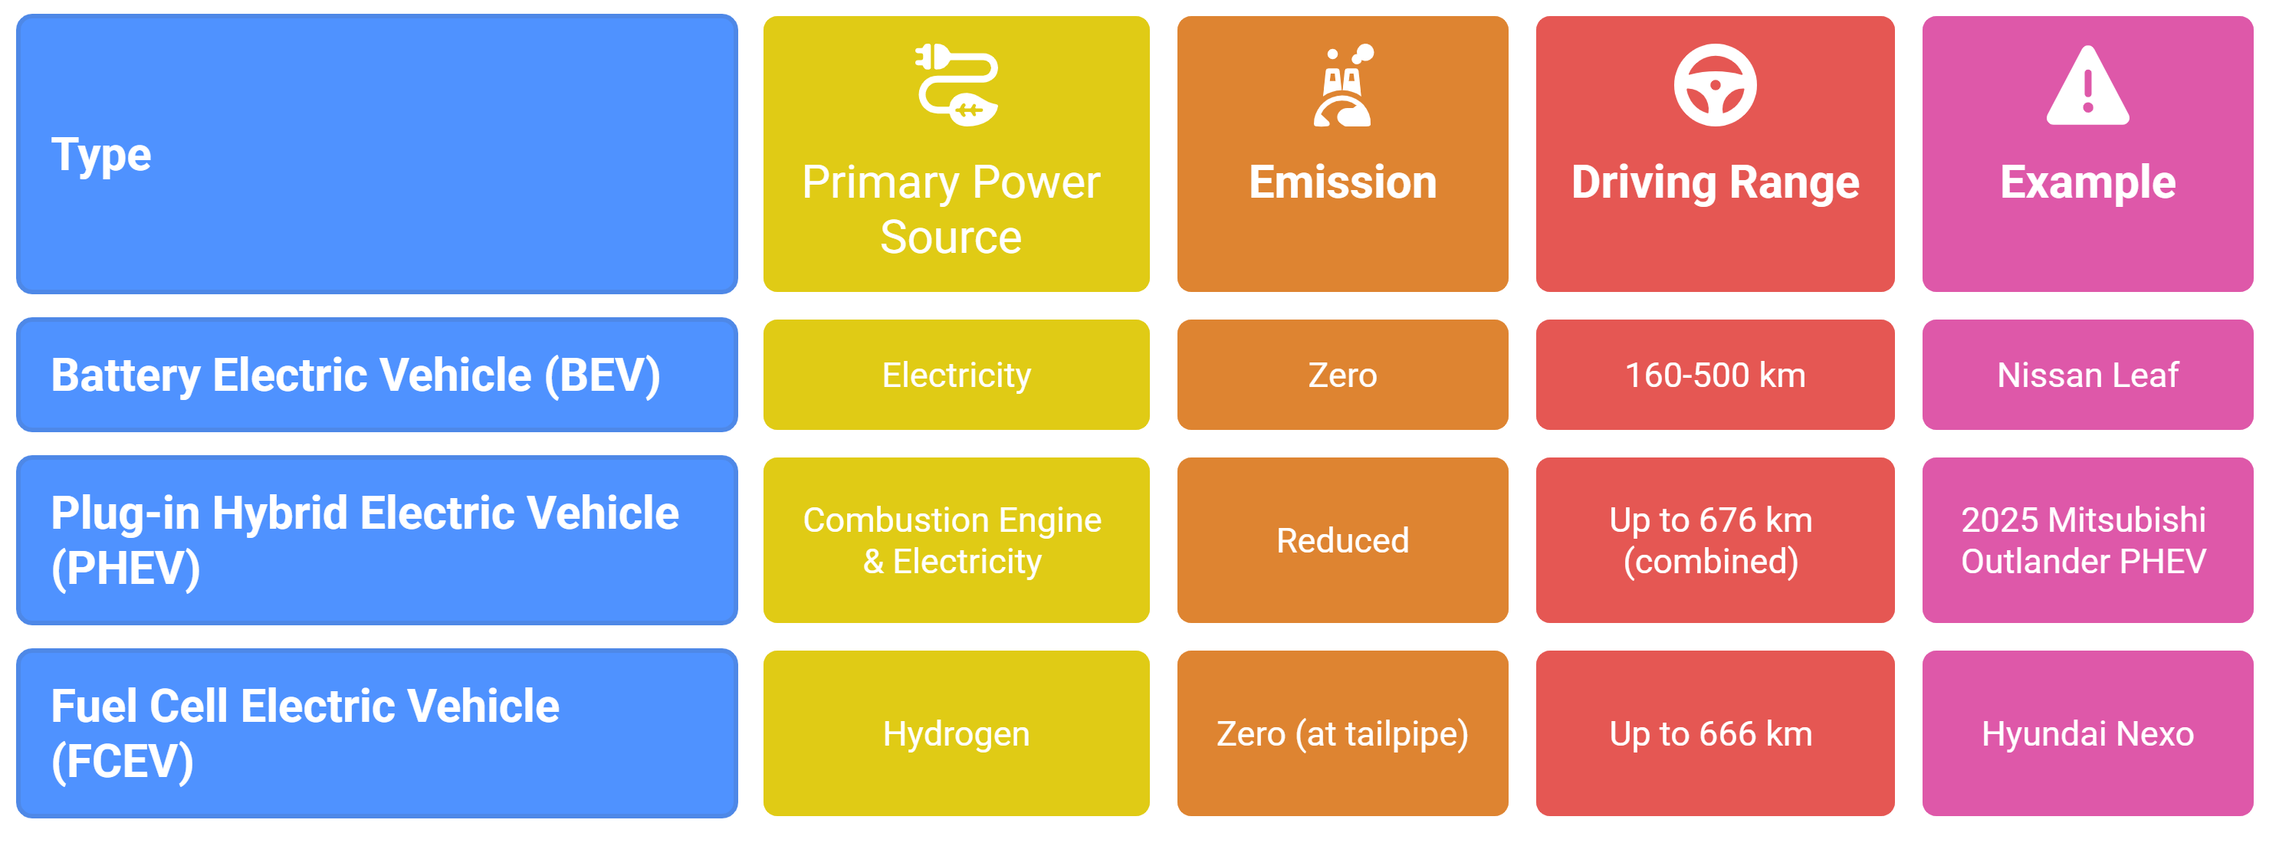
Types of EV

Slide 5
Types of EV Batteries
Battery Chemistry | Key Features
Lithium Nickel Manganese Cobalt Oxide (NMC) | High energy density, widely used in passenger EVs
Lithium Iron Phosphate (LFP) | Lower cost, longer lifespan, improved safety
Nickel Cobalt Aluminium Oxide (NCA) | High performance, used in premium models (e.g., Tesla)
Emerging Alternative
⚡ Sodium-ion (Na-ion) Batteries
Use abundant, low-cost materials and avoid critical minerals such as lithium, cobalt, and nickel.
Offer ≈30% lower cost than LFP batteries.
Trade-off: Lower energy density compared to Li-ion, limiting range applications.

Slide 6
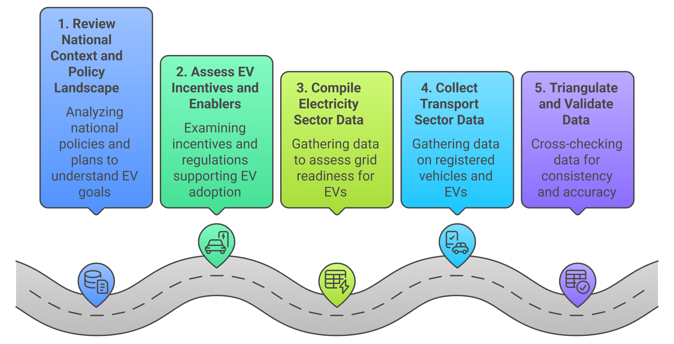
Methodology

Slide 7
Assessment Framework- Domains (Proposed)
Domain | Rationale
Policy Documents | Provide strategic direction and demonstrate political commitment by integrating EVs into national energy, climate, and transport frameworks.
Electricity Sector | Determines system readiness for EV demand, smart charging, and renewable integration to ensure real emissions reductions.
Vehicle Stocktake | Supplies essential data on vehicle types, age, and fuel use to guide policy, incentives, and infrastructure planning.
EV Regulations | Ensure safety, quality, and sustainability through standards for imports, charging, and battery management.
Incentives | Reduce upfront costs and encourage adoption through tax exemptions, rebates, and non-financial benefits.
Demonstration & Awareness | Build confidence and public understanding through pilot projects and education campaigns.

Slide 8
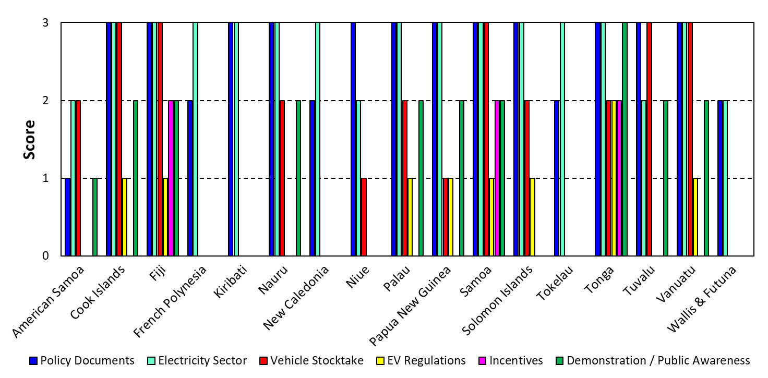
Regional Synthesis - Comparative Evaluation of EV Readiness in PICTs
Preliminary

Slide 9
Regional Synthesis - Comparative Evaluation of EV Readiness in PICTs
Category | Total Score | Key Characteristics
🥇 High Readiness | Tonga (15), Fiji (14), Samoa (14) | Comprehensive EV policy frameworks; strong alignment with electricity sector and vehicle data systems; established regulatory and incentive mechanisms; active government-led pilots.
🥈 Upper-Mid Readiness | Cook Islands (12), Vanuatu (12), Palau (11) | Solid policy and energy sector foundations; progressing in data collection and awareness; limited but emerging incentive and regulatory frameworks.
Preliminary
Notes:
Scores given in parenthesis.

Slide 10
Regional Synthesis - Comparative Evaluation of EV Readiness in PICTs
Preliminary
Category | Total Score | Key Characteristics
⚙️ Moderate Readiness | Nauru (10), PNG (10), Tuvalu (10), Solomon Islands (9) | Foundational EV or energy policies in place but limited implementation capacity; partial stakeholder coordination.
💤 Early Development Stage | American Samoa (6), Kiribati (6), Niue (6), French Polynesia (5), New Caledonia(5), Tokelau (5) | Early-stage activity focused mainly on general energy strategies; limited dedicated EV policy development.
🚫 Minimal Engagement | Wallis and Futuna (4) | Minimal EV engagement; absence of structured policies or institutional mechanisms.
Notes:
Scores given in parenthesis.

Slide 11
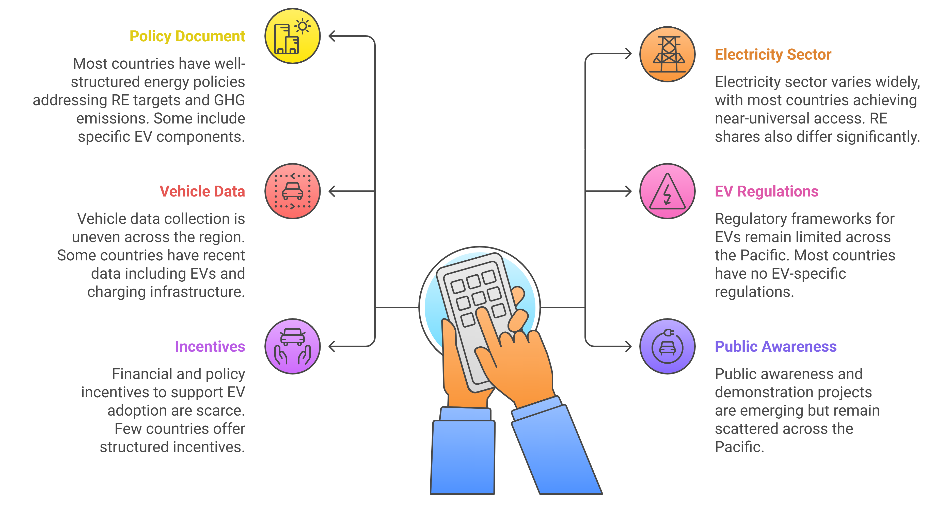
Regional Synthesis – Domain Analysis

Slide 12
Solomon Islands – Policy & Energy Context
Strong policy framework: First NDC, Second NDC, LT-LEDS (2023), SINDS 2016–2035, and National Energy Policy (2019–2030).
Targets:
  GHG reduction: 12–27% by 2025 and 30–45% by 2030 (conditional & unconditional).
  50% renewable energy by 2035.
  EVs and charging infrastructure introduced in Honiara by 2035.
Electricity sector (2022): 106 GWh generated – 91% fossil fuels, 9% renewables. Access to electricity ~76%.
CO₂ emissions (2023): 720,818 tCO₂; transport share ~217,010 tCO₂.
Preliminary

Slide 13
Solomon Islands – Transport & E-Mobility Roadmap
Vehicle stock: ~45,000 vehicles (2016), mainly urban; public transport via minibuses, minivans, trucks, plus taxis.
Feasibility study: Prioritizes buses, then minibuses, taxis, three-wheelers, two-wheelers, and private cars.
E-Mobility Roadmap (2022–2035):
  Short-term (2022–25): pilot EV adoption.
  Medium-term (2026–30): scale-up charging and fleets.
  Long-term (2031–35): mainstream EVs, integrate with RE.
Key needs: charging infrastructure, resilience to extreme weather, standardized technologies, regional harmonization.
Preliminary

Slide 14
Solomon Islands – Regulations, Incentives & Next Steps
Current status:
  No EV-specific regulations, standards, or recycling/end-of-life policy yet.
  E-Mobility Roadmap mandates development of EV guidelines.
Opportunities:
  Leverage national RE policies for transport decarbonization.
  Regional frameworks (PRIF, PCREEE) available to guide standards.
  Cross Sector Coupling- Align Emobility rollout with RE expansion programs
Next steps:
  Develop fiscal incentives (import duty/tax reforms).
  Build public awareness & demonstration projects.
Preliminary

Slide 15
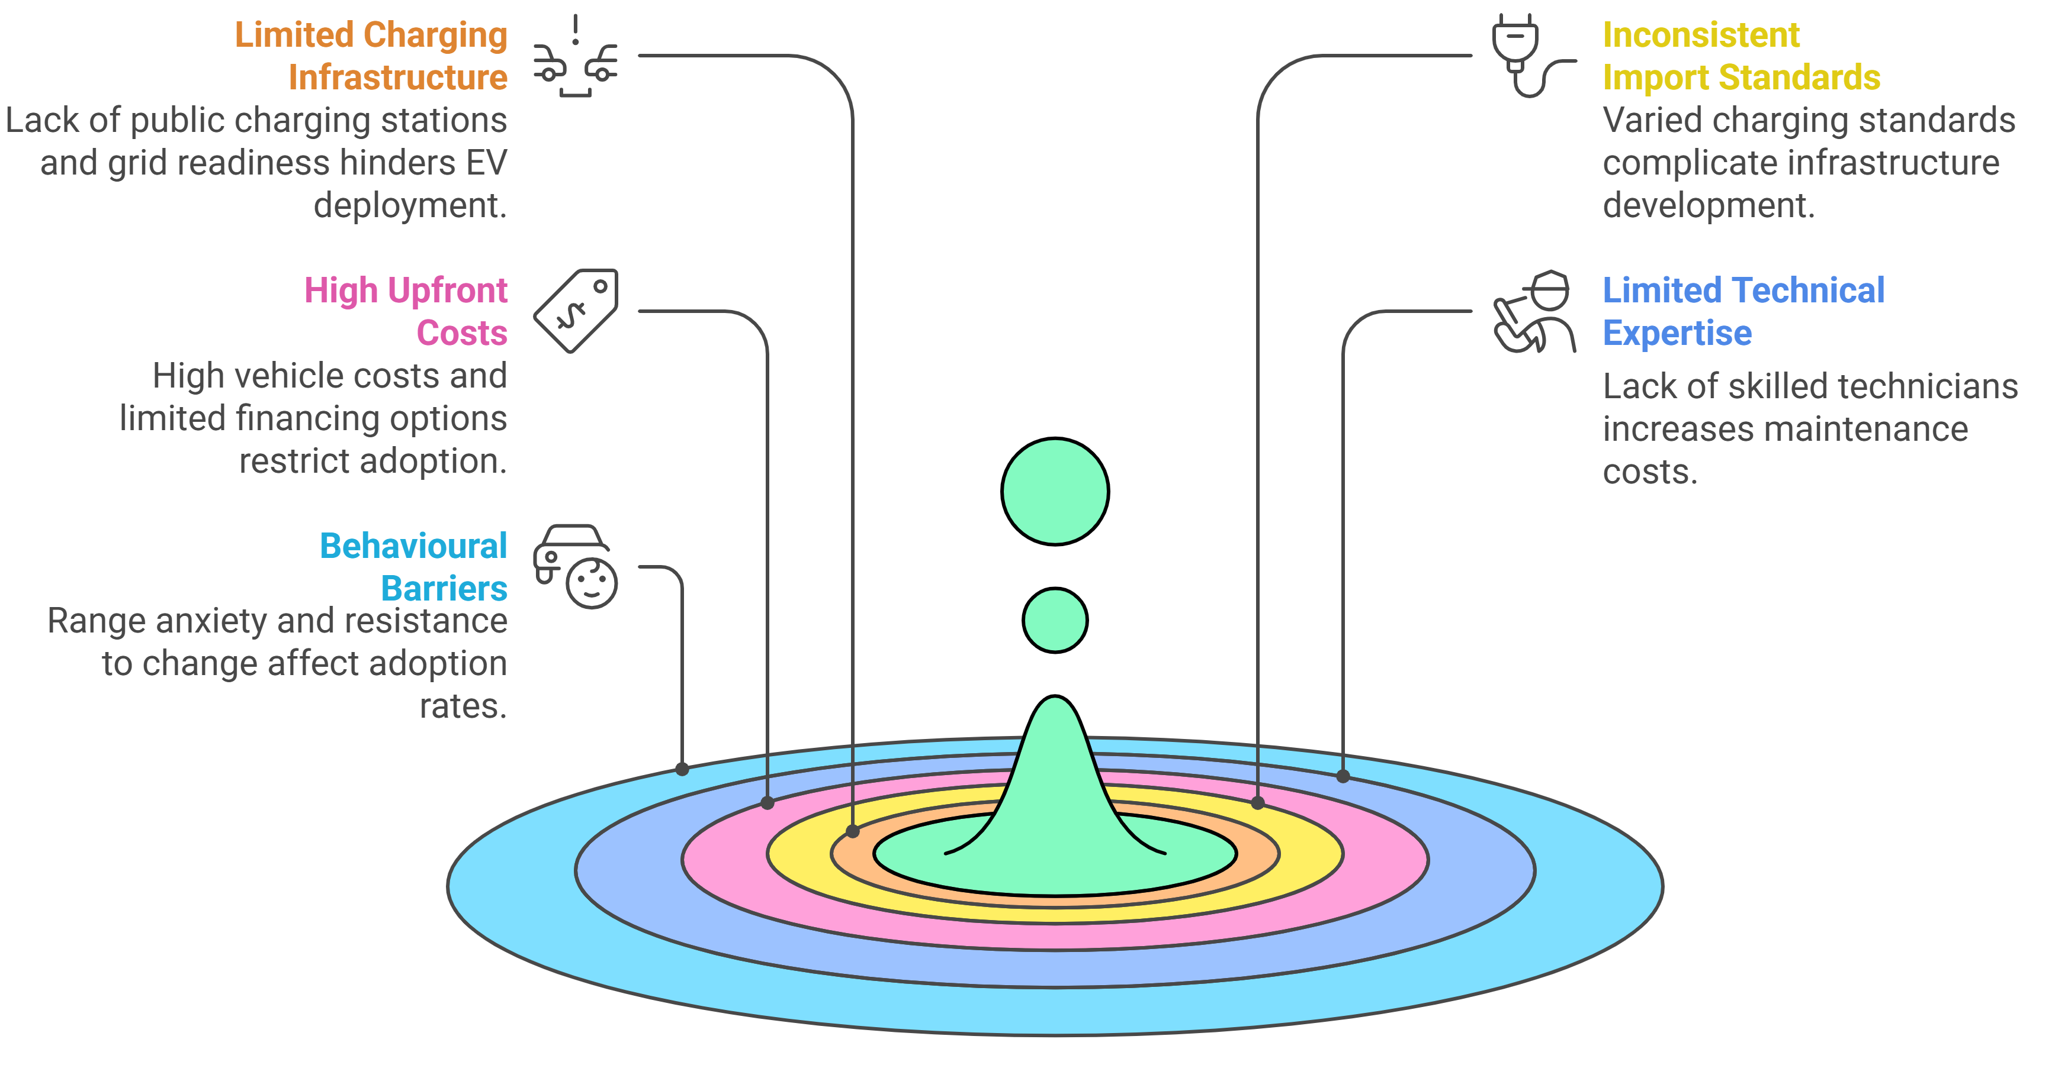
Challenges to EV Uptake

Slide 16
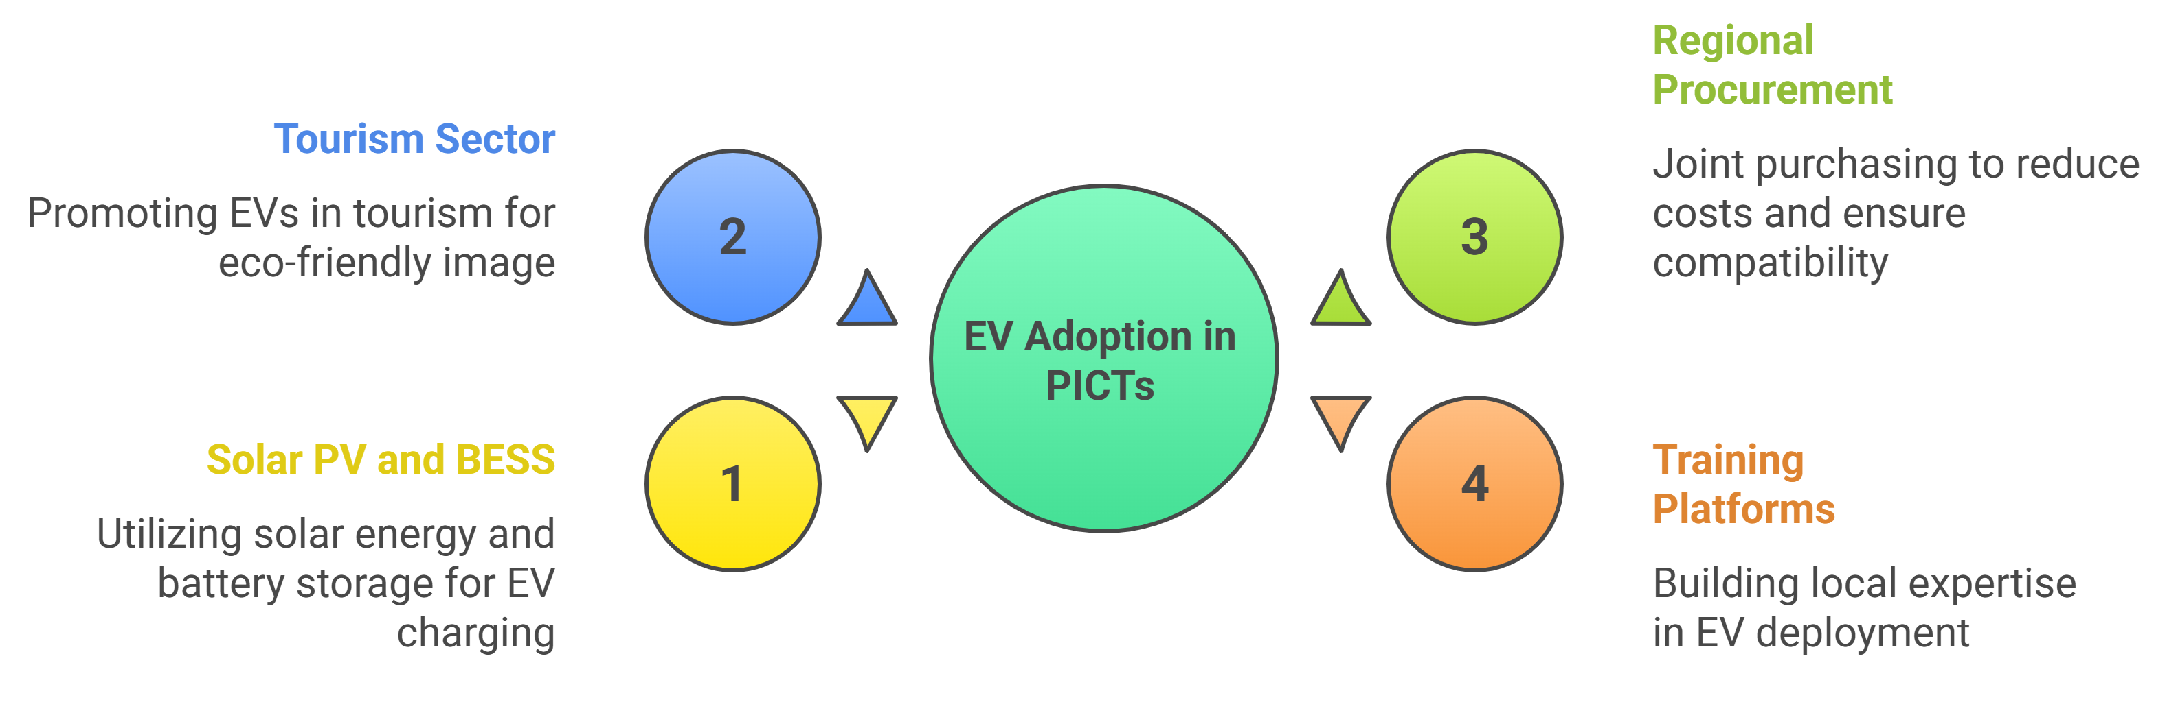
Opportunities for EV Uptake

Slide 17
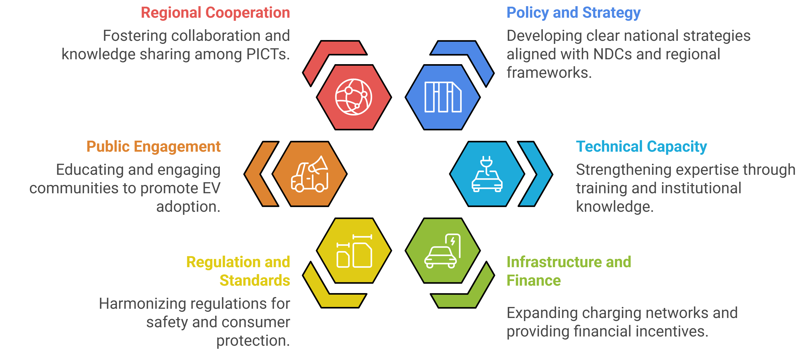
Recommendations

Slide 18
References
J. A. Sanguesa, V. Torres-Sanz, P. Garrido, F. J. Martinez, and J. M. Marquez-Barja, "A review on electric vehicles: Technologies and challenges," Smart Cities, vol. 4, no. 1, pp. 372-404, 2021.
INSIDE EVs. "Nissan Reveals LEAF e-Plus: 62 kWh Battery, 226-Mile Range." https://insideevs.com/news/341958/nissan-reveals-leaf-e-plus-62-kwh-battery-226-mile-range/ (accessed 12th June, 2025).
Mitsubishi Motors. "Balanced Power and Efficiency " https://www.mitsubishicars.com/cars-and-suvs/outlander-phev/performance (accessed 12th June, 2025).
Hyundai. "All-New Hyundai NEXO – The Future Utility Vehicle made by Hyundai." https://www.hyundai.news/eu/models/electrified/nexo/press-kit/all-new-hyundai-nexo-the-future-utility-vehicle-made-by-hyundai.html (accessed 12th June, 2025).
IEA. "Global EV Outlook 2023 - Trends in batteries." https://www.iea.org/reports/global-ev-outlook-2023/trends-in-batteries (accessed 12th June, 2025).

Slide 19
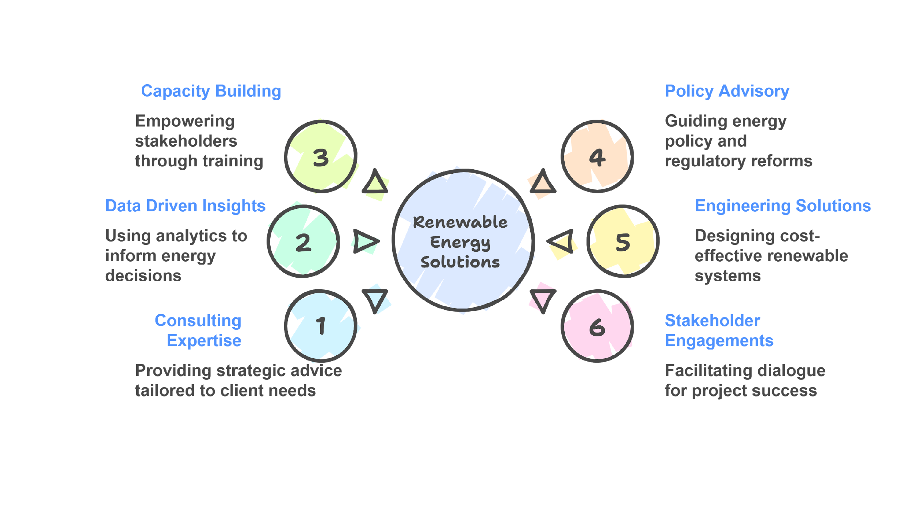
Scinergy Pacific – Contact Us
Website: Scinergypacific.com
Email: admin@scinergypacific.com
prasadjay02@yahoo.com
jay.prasad@scinergypacific.com
WhatsApp: +61 (0) 422152953

