Slide 1


DRAFT
BUSINESS PLAN FOR THE PACIFIC CENTRE FOR RENEWABLE ENERGY AND ENERGY EFFICIENCY (PCREEE)
2020 – 2030
Supported by UNIDO

Slide 2
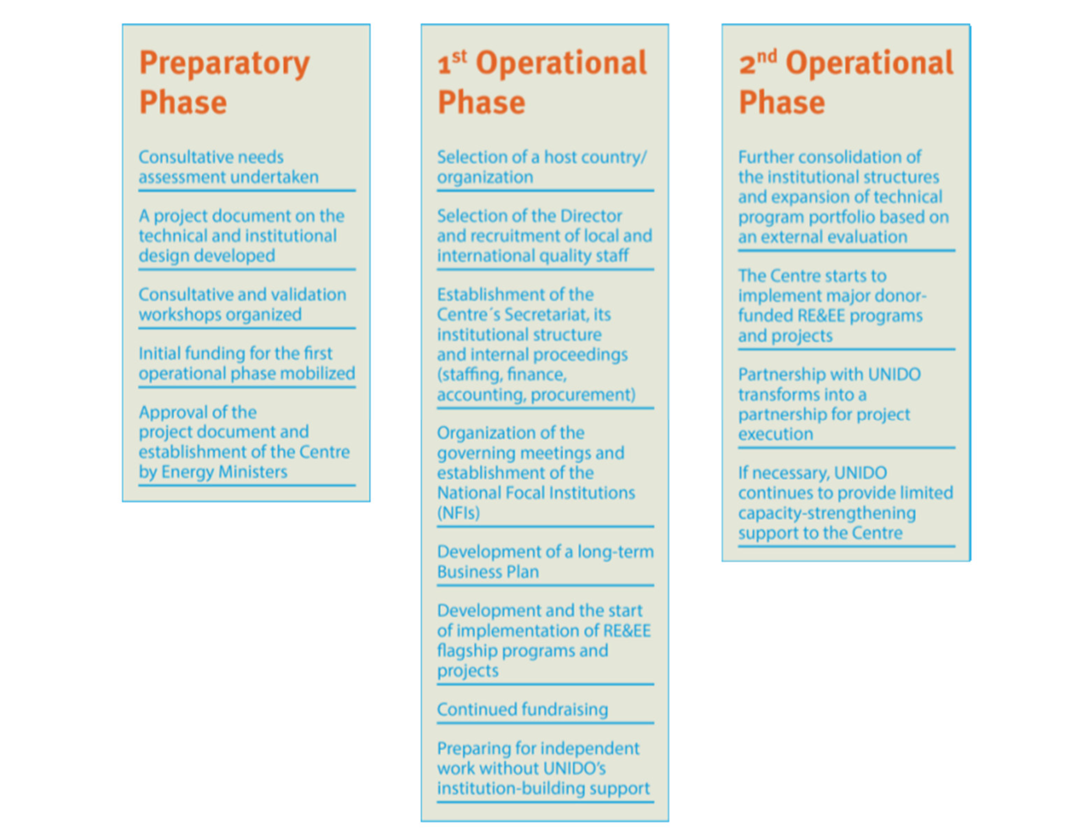
UNIDO’s 3 PHASE SUPPORT MODEL

Slide 3
PCREEE Business Plan Model
1st Operation Phase (2017 - 2020)
Establishment of Office
Development of Long term Business Plan
2nd Operational Phase (2021-2025)
Expansion of Institutional Structures and Technical Program
Implement Major Donor Funded RE&EE Programs
3rd Operational Phase (2026- 2030)
TBC
Recruitment and staffing
Continued Fundraising
Partnership with UNIDO into project execution
UNIDO’s capacity strengthening support
TBC
1. RE&EE Business Start-ups & Entrepreneurship
2. RE&EE Sustainable Mobility
3. RE Mini-grids
4. Energy Efficiency Investment
1.Efficient management of PCREEE
2.Capacity Development
3. Enhanced awareness Knowledge Management
4. Investment and Business Promotion

Slide 4
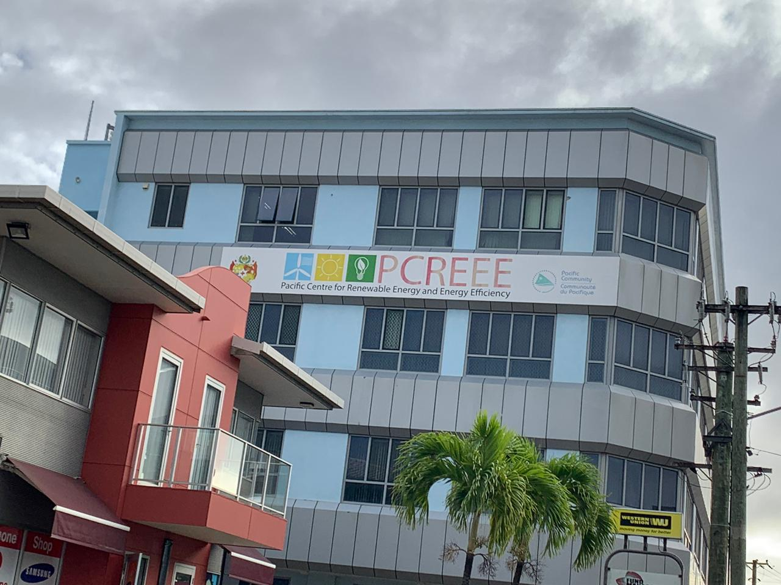
PCREEE’s First Operational Phase (2017 - 2020)
Outcome 1: Enhanced regional institutional capacities
PCREEE fully integrated with the established financial and management policies and procedures of the SPC.
Confirmed seed funding support for its Second Operational Phase (2021 – 2025).
Eight Memorandums of Understanding (MoUs) have been signed with other national/ regional institutions, providing a solid platform for an increased level of partnerships and collaboration across the region.
Increased SPC staff working fulltime on the PCREEE from one to four.
Significant increase in the centre´s recognition and awareness-raising in the region.
PCREEE comfortably housed with an office space that would cater for the future growth of up to 20 staff.
Outcome 2: Strengthen capacities of local key institutions and stakeholder groups
Provided training to more than three hundred trainees throughout the region.
The centre has supported building the capacity of Energy Regulators to manage Power Purchase Agreements and the reset of power tariffs given their impacts on the private sector investments.
Strengthening local RE&EE capacities of business and industry sector by establishment of national sustainable energy industry associations to introduce professionalism and discipline in the industry.

Slide 5
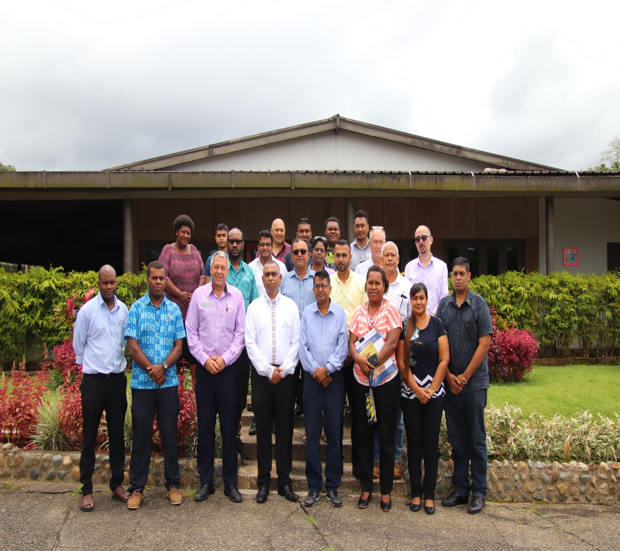
PCREEE’s Operational Achievements (2017 - 2020)
Outcome 3: Awareness and knowledge base of local key institutions and stakeholder groups
Conduct of National Energy Dialogues and capacity building and support workshops to openly discuss the achievements of countries in their RE&EE developments, the challenges, and how they can collectively be addressed as well as raising the business, investment, and employment opportunities from pursuing the national energy targets in the region.
Support the further detailing and costing of the PITCs’ Nationally Determined Contributions (NDCs), Energy Roadmaps, Energy Master Plans as well as Investment Plans.
Outcome 4: Increased RE&EE business opportunities for local companies and industry
PCREEE launched the PCREEE Sustainable Energy Entrepreneurship Facility (PSEEF), a dedicated regional financing vehicle with a special focus on support to increase RE&EE business opportunities for local Small and Medium Enterprises (SME) companies, Non-Governmental Organisations (NGOs) and industry.
PCREEE has supported postgraduate researchers on sustainable energy through its research support fund and competition on sustainable energy innovation.
Strengthening the capacity of developing and financial institutions in the Pacific.
With the support of the United Nations Industrial Development Organisation (UNIDO), PCREEE is currently developing an innovative regional programme to facilitate the uptake of e-mobility markets within PICTs´ RE expansion plans.

Slide 6
Introduction
Vision: Promoting sustainable energy markets to transform the lives of Pacific Islands People
Mission: To create, educate, and facilitate the increased awareness and development of the RE&EE Agenda in the Pacific region, with special emphasis on the private sector and local industries.
Objectives:
  To improve access to modern, affordable and reliable energy services, energy security and mitigation of negative externalities of the energy system (e.g. local pollution and GHG emissions)
  To promote renewable energy and energy efficiency investments, markets, and industries in Pacific Island Countries and Territories (PICTs).
Mandate: To support private sector investments in renewable energy and energy efficiency.
Value Proposition: Catalyst for the establishment and fostering expansion of RE&EE market in the Pacific region

Slide 7
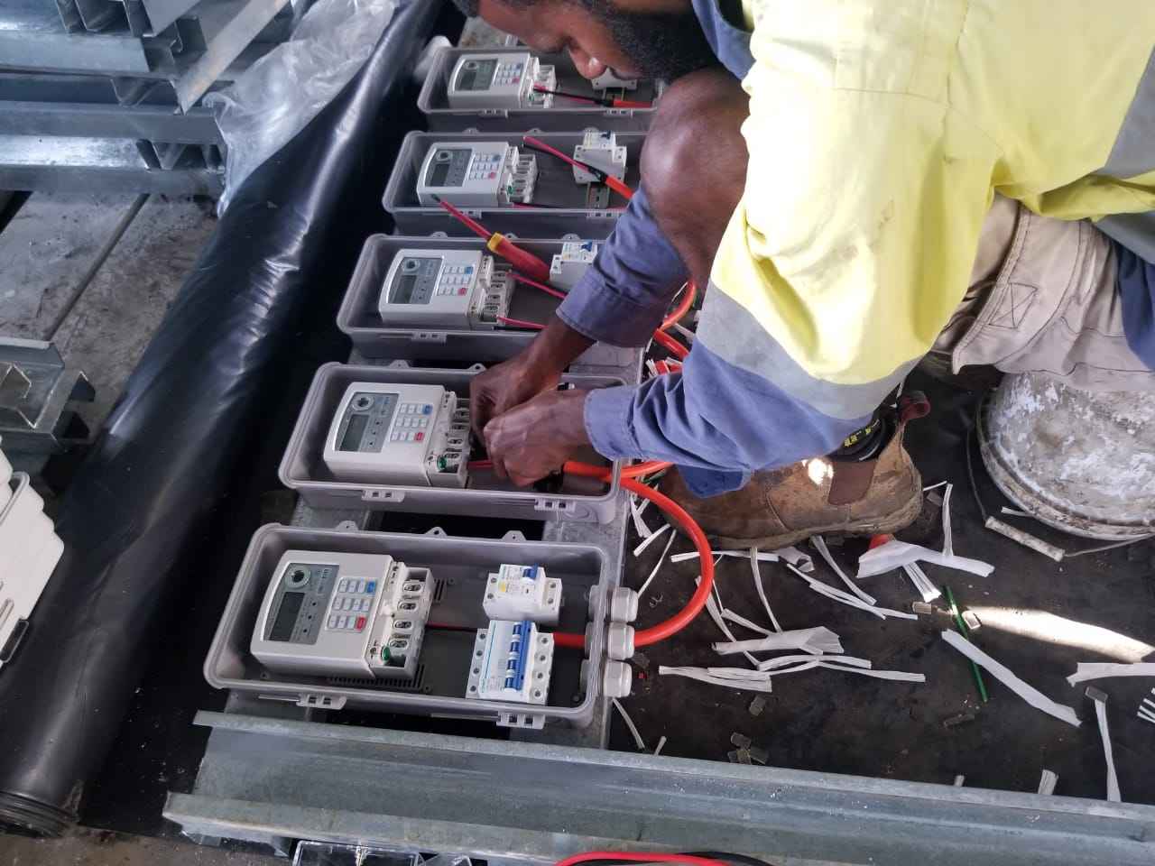
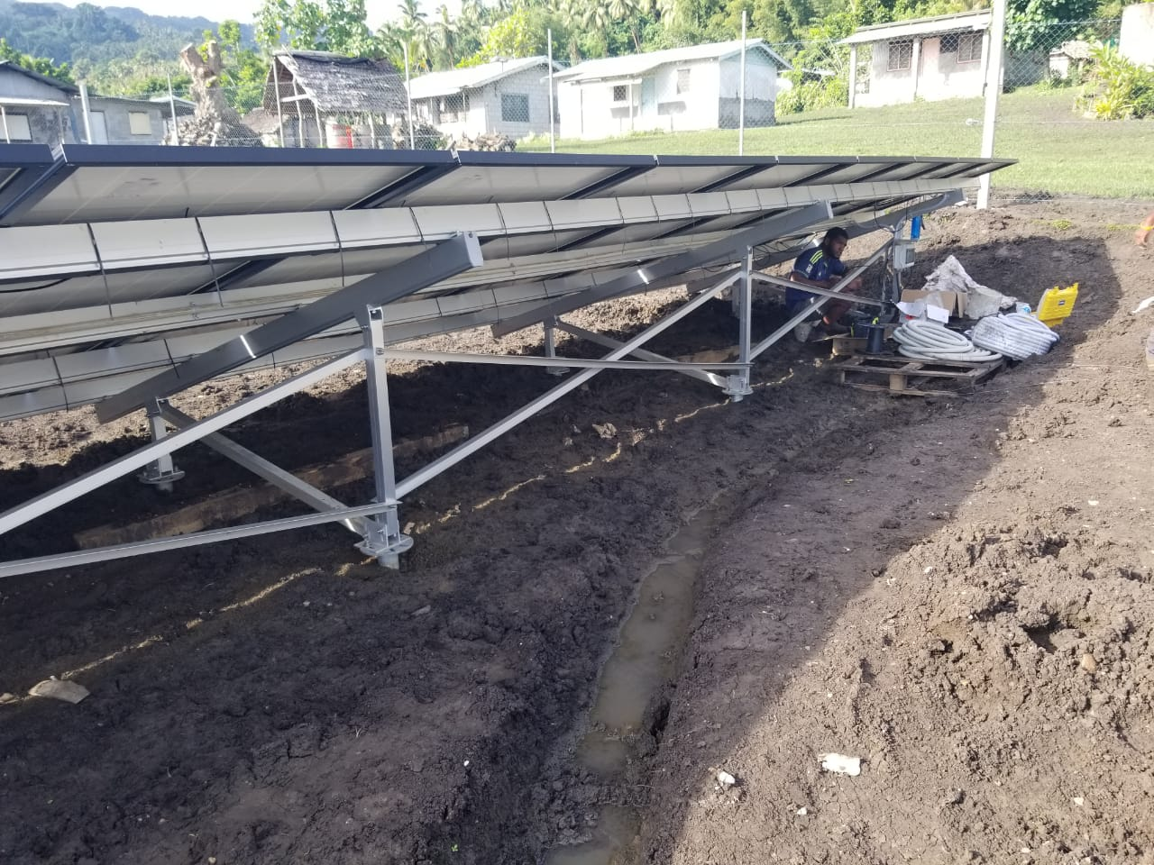
2nd Operation Phase (2021-2025)
Strategic Programmes (4)
Programme 1. RE&EE Business Start-Up and Entrepreneurship Support
Programme 2. RE and EE for Sustainable Mobility
Programme 3. RE mini-grids
Programme 4. Energy Efficiency Investment

Slide 8
1. Local RE&EE Business Start-Up and Entrepreneurship Support
Objective: Differentiated support to entrepreneurial RE&EE businesses across the enterprise development life cycle (start-up, early-stage, growth, and maturity).
Output 1: Project preparation Technical Assistance (TA) to support companies to progress until achieving financial close.
Output 2: Financial support in the PICTs to increase RE&EE business opportunities for local companies and industry.
Output 3: access to finance via different instruments, including connecting with existing financing facilities (i.e. local development banks, the Secretariat of the Pacific Regional Environment Program (SPREP), the International Union for Conservation of Nature (IUCN) or the Asian Development Bank (ADB)).
Output 4: Support to improvement of the policy and regulatory frameworks and business enabling environment both at the regional and national levels.

Slide 9
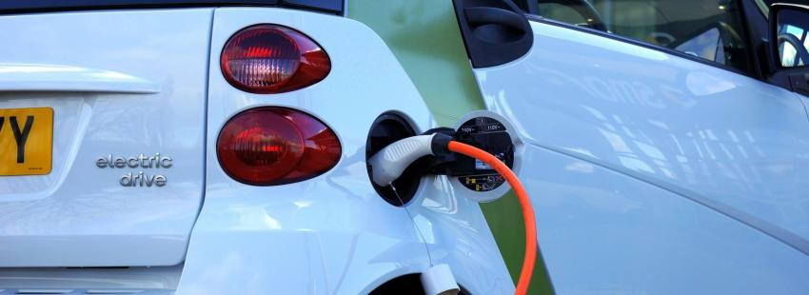
2. RE&EE For Sustainable Mobility
Objective: PICTs are best prepared for their respective sustainable mobility futures, including the uptake of EV technology in a wisely and fit-for-purpose manner and under an inclusive and well-coordinated programme, able to generate its own, stable base of capability and capacity for the region.
Output 1: Central Policy and Administration
Output 2: Standards and Guidelines
Output 3: Awareness and Promotion
Output 4: Demonstration and Upscale

Slide 10
3. RE Mini-Grids
Objective: Increased clean energy access and improved livelihoods for communities through the promotion of a mini-grid program to achieve the Sustainable Development Goals (SDGs) throughout the PICTs
Output 1: Market intelligence; enhanced awareness of mini-grid market and strengthen market knowledge through market intelligence development.
Output 2: Capacity Building and Public and Private Partnerships; empower local institutions and private sector and increased project developments through capacity building and reinforced networks and partnerships between stakeholders.
Output 3: Technical Advancement; improved sustainability of mini-grid system and implemented standardized technical equipment and design

Slide 11

4. Energy Efficiency Investment
Objective: To enhance the competitiveness of manufacturing industries in the Pacific Region while reducing Greenhouse Gas (GHG) emissions by improving and harmonizing national policies and regulatory frameworks and institutional capacity building for domestic, industrial, and commercial EE and the implementation of energy management systems.
Output 1. International standards (American Society of Heating, Refrigerating and Air-Conditioning Engineers (ASHRAE), International Organisation for Standardisation (ISO), etc.) developed or adopted for lighting, equipment, and thermal efficiency including the potential inclusion of such energy standards in building codes.
Output 2. Assistance provided to PICTs for adopting energy conservation practices for the design, construction, and utilization of energy-efficient facilities.
Output 3. Access to financing via different instruments facilitated.
PCREEE will promote and support investment mobilisation for energy efficiency investments in several areas:
  Industry and Buildings
  Energy Efficiency in the Public Sector
  The Residential Sector

Slide 12
Organisational Chart
Manager PCREEE
Programme Delivery Manager Technical FTE
Finance Manager
1 admin FTE
1. Local RE&EE industry support and project preparation facility and investment in RE&EE projects
1 technical FTE
2. Sustainable mobility
1 technical FTE
3. Financing of small and medium size electricity infrastructure
1 technical FTE
4. Financing of Energy Efficiency Investment
1 technical FTE
Admin, HR, Procurement
1 admin FTE
Finance, Accounting
1 admin FTE
M&E Support Officer
1 technical FTE
1 Junior Accountan
1 admin FTE
1 Junior Accountan
1 admin FTE
M&E Support Officer
1 technical FTE
Pool of Junior Technical Program Assistant
5 technical FTE
Two differentiated units are proposed under the BP.
1. Programmatic Unit responsible for overall coordination of the 4 programmes
2. Administrative Unit responsible for Human Resources, Procurement and Finance
The centre will aim a gender balance, including a mid-term objective of 50% of women across all positions, i.e. including management, administrative and technical senior/junior staff

Slide 13
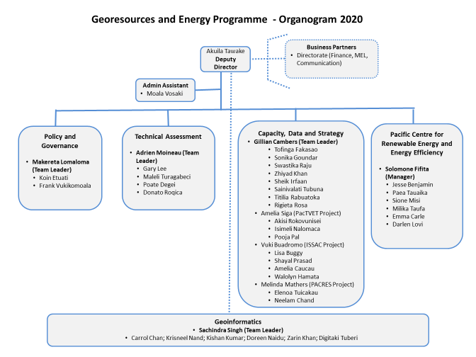
Organisational Chart

Slide 14
Thematic hubs
PCREEE
SPC
Policy and knowledge management
USP
Capacity Development and Applied Research
PPA
Power Utility Engagement
PIFS
Climate change finance coordination
SIDS DOCK and UNIDO
SIDS-SIDS Cooperation
SPREP
Climate Change Resilience
ADB and SEAPI
Investment & Business Promotion

Slide 15
Internal Procedures
Annual Work Plan and Budget to be vetted by PCREEE’s Steering Committee and final endorsement by SPC Executive
Adhere to SPC’s rules and regulations on Human Resource, Finance and Procurement
Establishment of Programme Steering Committees for its 4 selected programmes

Slide 16
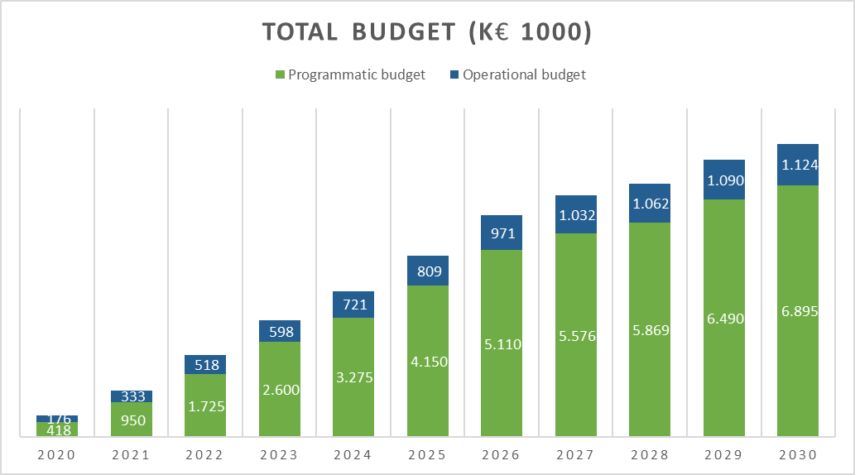

Slide 17
2. Fund Mobilisation Strategy
Multi-year flexible program funding to SPC Georesources and Energy program (GEP), which includes PCREEE activities in collaboration with the rest of GEP units;
Project funding through multilateral and bilateral donors & other agencies directly to PCREEE or PCREEE providing services/technical assistance within larger projects;
Service provider (consultancy services) when relevant to ministries with available bilateral funding;
Fundraising support by the host country, Tonga, through increasing the visibility of PCREEE’s efforts and opportunities to upscale efforts in Tonga and the region;
Foundations, Corporate Foundations, and Trust Funds.

Slide 18

Monitoring and Evaluation
Refer to Table 6, page 37 of the BP
Main Elements of the Results Framework include:
i) Development Impact (Ultimate Outcome)
ii) Indicators
iii) Baseline and Targets
iv) Means of Verification
v) Risks and Assumption
Please review the Results Framework and get back to us with your comments

Slide 19
REGIONAL PROGRAM ON INTEGRATED E-MOBILITY AND RENEWABLE ENERGY POWER SYSTEMS
Solomone Fifita, Manager, PCREEE

Slide 20
The Regional e-mobility Program
Addresses existing barriers by promoting regional interventions in the areas of:
policy and regulation
knowledge management
qualification/certification
investment, entrepreneurship and innovation
promotes SIDS-SIDS cooperation under the umbrella of the GN-SEC - https://www.gn-sec.net/

Slide 21
Barriers to E-mobility
EVs are new to PICTs and there are many barriers with associated with this “newness”” including:
  a lack of mandate to drive EV policy (opportunities in the revisions of NDCs and Energy Roadmaps);
  a lack of supporting institutional and regulatory framework
    LTAs deal mostly with vehicle registration while MoI/MoT deal with roads and bridges and Police deals with enforcing the traffic laws.
    In some countries, EVs do not fall into any of the vehicle categories, making it difficult to register them.
    Duty is based on engine size and no regards to the fuel type
  absence of standards is a safety hazards and could ruin the reputation of the technology
  a lack of charging infrastructure
  a lack of technical support capability and capacity
  a general lack of awareness of EVs (& market access).

Slide 22
The regional e-mobility programme
Objective: PICTs are best prepared for their respective sustainable mobility futures, including the uptake of EV technology in a wisely and fit-for-purpose manner and under an inclusive and well-coordinated programme, able to generate its own, stable base of capability and capacity for the region.
Output 1: Central Policy and Administration / policy regulation
Output 2: Standards and Guidelines / qualification & certification
Output 3: Awareness and Promotion / knowledge management
Output 4: Demonstration and Upscale / investment, entrepreneurship and innovation
5: promotes SIDS-SIDS cooperation under the umbrella of the GN-SEC - https://www.gn-sec.net/

Slide 23
e-mobility integration
Integrated with the RE, Transport & GHG mitigation developments of PICs
Power Utilities must be involved and consulted

Slide 24
Regional e-mobility targets
 | Proposed 2030 Regional E-Mobility Target | Proposed 2050 Regional E-Mobility Target
1. | Ten different models of manufacturer-supported, mainstream EVs are available in the marketplace. | Services provided by EVs are an integral and significant component of transport within the region and include single-person electrically assisted mobility options through to electric aircraft, trucks, buses and boats.
2. | Battery swapping for low-voltage mobility use is available on a commercial scale in the marketplace.
3. | There is good public awareness of EVs.
4. | 50% of all mainstream EVs are charged through devices that are managed-charging enabled. | 90% of grid-supplied charging of mainstream EVs is provided through managed-charging systems.

Slide 25
Summary of Target Actions of the Regional EV Program
Central Policy and Administration
Develop high-level targets and mandates concerning EV uptake. Establish a staffed and funded Regional EV Hub with regional representatives responsible for coordinating national programs and collecting and sharing information and international links including those related to SIDS-SIDS cooperation. Support PICTs in developing and implementing national EV roadmaps. Identify tax levels or incentive packages to encourage the importation of desired EV goods. Establish partnerships in EVs. Develop a M & E system for national EV programmes. As appropriate, introduce/amend the regulatory frameworks for transport to include EVs. Maintain a watching brief on global EV-related developments.

Slide 26
Summary of Target Actions of the Regional EV Program
Standards & Guidelines
Develop and set minimum standards for EVs imports and for fitness testing. Ensure appropriate standards are in place for the retirement of EVs. Set guidelines for charging, including the specification of charging connectors. Develop criteria "EV-readiness“ in new contruction and infrastructure. Develop guidelines for the use of V2H and on-site managed charging. Develop (at least voluntary) standards for low-voltage vehicles, the charging of them, and the use of "mobility batteries" for local power supply circuits. Develop and introduce accredited technical courses on EVs. Develop guidelines for e-mobility safety. Provide buyer and user guides on low-voltage e-mobility options.

Slide 27
Summary of Target Actions of the Regional EV Program
Awareness & Promotion
Undertake social marketing research. Develop and deliver an awareness, information and promotion campaign supporting the uptake of EVs. Develop, publish and promote guidelines on: EV purchase (micro-mobility through 4-wheelers); Charging (micro-mobility through 4-wheelers); Servicing and Support (micro-mobility through 4-wheelers). Collate and distribute global and PICT EV information. Ensure that first responders are aware of correct procedures.

Slide 28
Summary of Target Actions of the Regional EV Program
Demonstration & Upscale
Promote government leadership in purchasing of appropriate EVs. Consider supporting electric bus demonstrations. Consider supporting the demonstration of other non-passenger car EV projects if there is a good case for them. Consider methods to share heavy EV technical support capability across fleets and PICTs. Consider opportunities for the electrification of small marine vessels. Facilitate or co-invest in public charging infrastructure. Provide facilities in support of micro through large e-mobility options, beginning with facilities at public offices. Develop EV service industry and support local capability and capacity. (Support the introduction of Time of Use (TOU) electricity pricing). Conduct investment forums on EVs

Slide 29
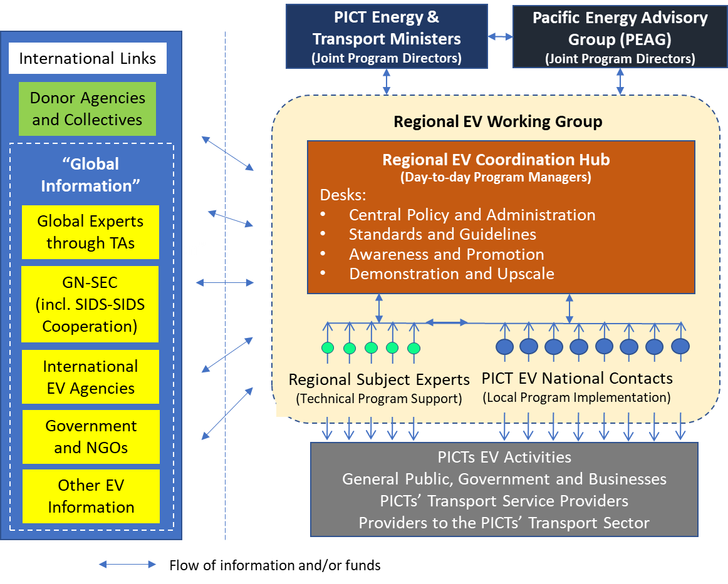
Proposed Management & Communication Structure
Options:
Regional EV Hub
FAESP coordination structure
PCREEE Steering Committee
CROP Transport Group [land, sea & air]
Multi-agencies transport group

Slide 30
Proposed Technical Assistance Projects in Support of the EV Program
Fund Type | Activity | Amount US$ | Year Deployed
TA1 | Oversee PICT development of EV roadmaps and EV mandates. | $ 30,000 | 1
TA2 | Provision of discussion document and guidelines on preferred specifications for EV-related goods and recommendations for tax/duty levels. | $ 15,000 | 1
TA3 | Provision of V2H and on-site managed charging guidelines. | $ 5,000 | 3
TA4 | Provision of low-voltage specification guidelines | $ 30,000 | 3
TA5 | Develop and provide generic courses on working with high-voltage EV systems. | $ 200,000 | 2,3
TA6 | Develop and provide generic courses on working with low-voltage EV and electricity supply systems. | $ 100,000 | 2,3
TA7 | Development of low-voltage awareness and promotion info ration. | $ 30,000 | 3
TA8 | Social marketing package, once per year (5 x $10,000) | $ 50,000 | 1,2,3,4,5
TA9 | Development of EV sector awareness and promotional campaign ($40k + 4 x $20k) | $ 130,000 | 1,2,3,4,5
TA10 | Provision of guidelines for public charging. | $ 20,000 | 2
Other | Contestable Fund Round 1 | $ 250,000 | 3
Other | Contestable Fund Round 2 | $ 250,000 | 4

Slide 31
Regional EV Program: Totals for the Staffing FTEs and Project Budget.

Slide 32





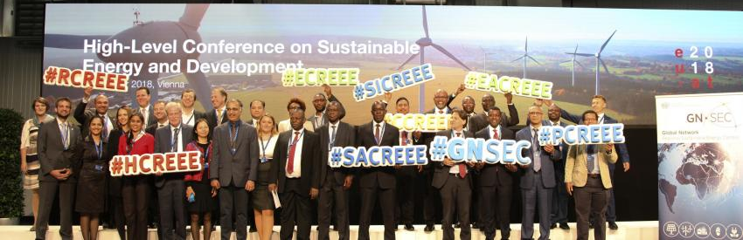

SIDS-SIDS cooperation on EV issues under GN-SEC and SIDS DOCK
Planning a webinar with CTCN on EVs in SIDS
CCREEE – developing their EV Strategy

Slide 33

Where to from here?
Completed 1 regional consultation
Completed 5 national consultations – SI, Tuvalu, Nauru, Niue & Palau
Tonga & Vanuatu in Oct
TWG Consultation
Reach out to MTCC, PIDF, MSTC & Blue Pacific Blue Shipping Partnership
Develop a EV ProDoc and Strategy
18th November - 5th PCREEE Steering Committee Meeting – adopt both docs
Extract logframe and include in the SPC-ADA Contribution Agreement: 2021 – 2025
As a courtesy to Pacific Energy and Transport Ministers, SPC will write to the Ministers informing them of the completion of the reports and the delivery of regional services based on the regional e-mobility policy and programme
SPC will publish the documents and make them available online
Meanwhile, SPC will include e-mobility in its resource mobilization effort, including developing national EE in transport proposals through the CTCN – Vanuatu & SI
SPC will also include e-mobility in its 2021 – 2023 budget preparations and donor consultations
Start delivering on the BP in 2021
Works on e-mobility will be reported to the 5th Energy and Transport Ministers meeting in Vanuatu in 2022

Slide 34
MALO ‘AUPITO

