Slide 1
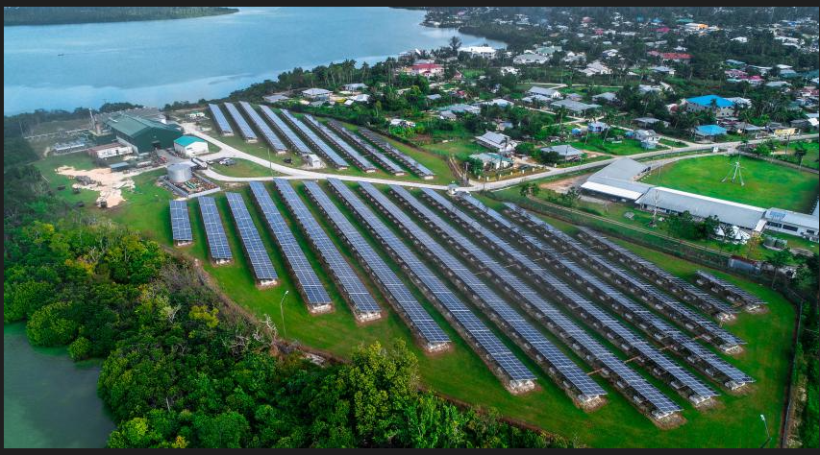
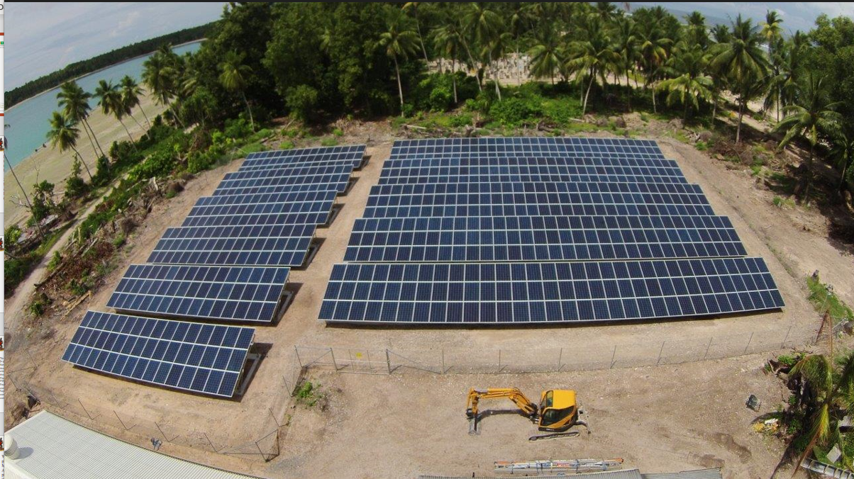
Unlocking MG for sustainable development:
PCREEE MINI-GRID PROGRAMME, CLEARPICS, ETC
Suva, Fiji
June 26th-30th, 2023
Solomone Fifita
Manager
PCREEE
solmonef@spc.int
Popua Solar Farm - Tonga
Nanumea Solar Farm - Tuvalu

Slide 2
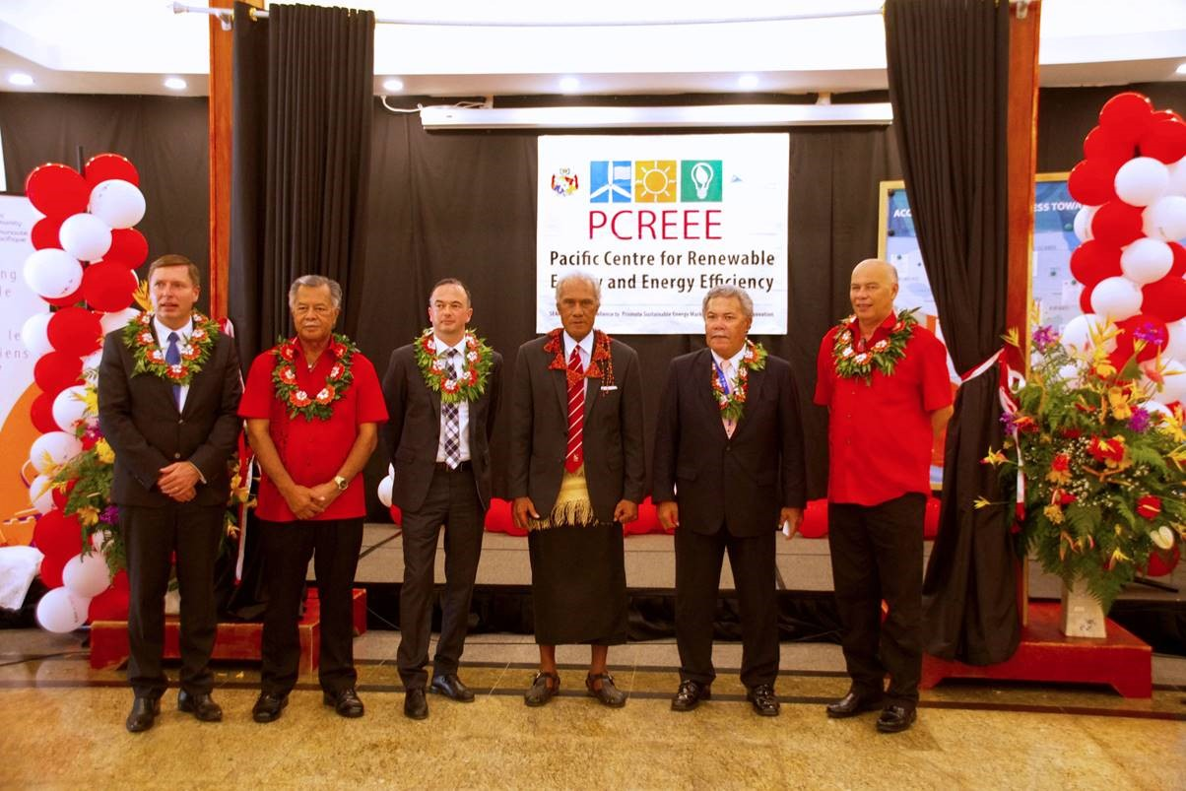
BACKGROUND
Going 7 years now
Part of a global network comprising 11 regional centres
Covering 120 countries and influencing 1.5 billion energy consumers
38 of 46 LDCs and 32 of 36 SIDS
2nd Operational Phase: 2021-2025
UNIDO, Austria, Norway & NZ funding support
Part and parcel of SPC and the GEP of the GEM Division

Slide 3
Purpose
to fill a gap in regional energy service delivery
private sector, investments, markets & entrepreneurship
Business Plan: 2020-2030
RE & EE Business start up & entrepreneurship support
RE mini-grids
EE Investments
RE & EE for Sustainable mobility

Slide 4
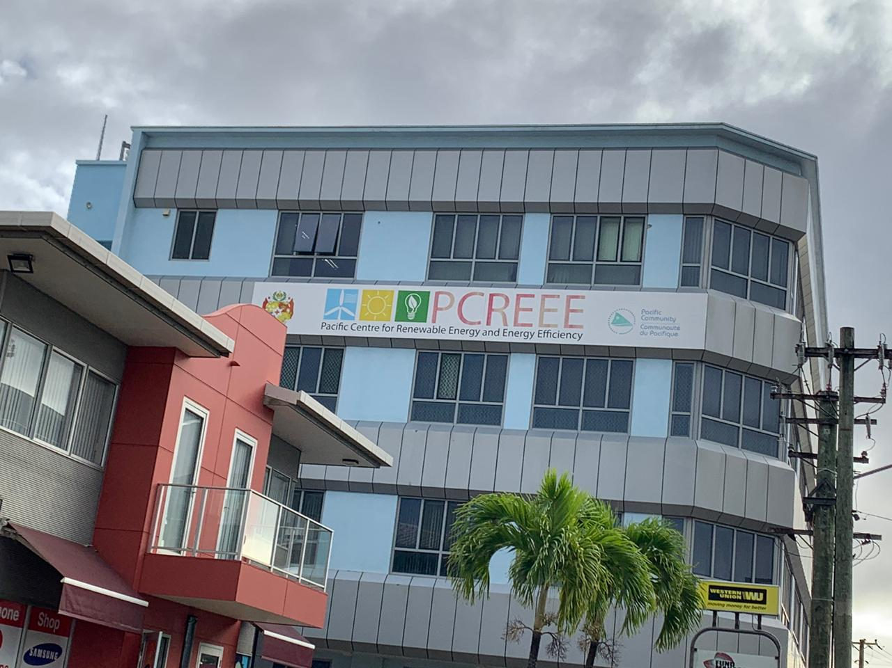
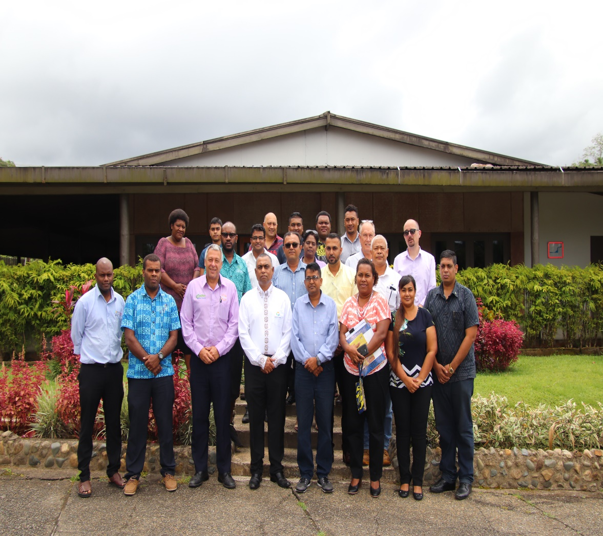
PCREEE’s First Operational Phase (2017 - 2020)
Outcome 1: Enhanced regional institutional capacities
PCREEE fully integrated with the established financial and management policies and procedures of the SPC.
Confirmed seed funding support for its Second Operational Phase (2021 – 2025).
Eight Memorandums of Understanding (MoUs) have been signed - SEIAPI, ADFIP, CAMCO, OEI, etc
Increased SPC staff working fulltime on the PCREEE from one to four
Significant increase in the centre´s recognition and awareness-raising in the region.
PCREEE comfortably housed with an office space that would cater for the future growth of up to 20 staff.
Outcome 2: Strengthen capacities of local key institutions and stakeholder groups
Provided training to more than three hundred trainees throughout the region –
The centre has supported building the capacity of Energy Regulators to manage Power Purchase Agreements and the reset of power tariffs given their impacts on the private sector investments.
Strengthening local RE&EE capacities of business and industry sector by establishment of national sustainable energy industry associations to introduce professionalism and discipline in the industry.

Slide 5
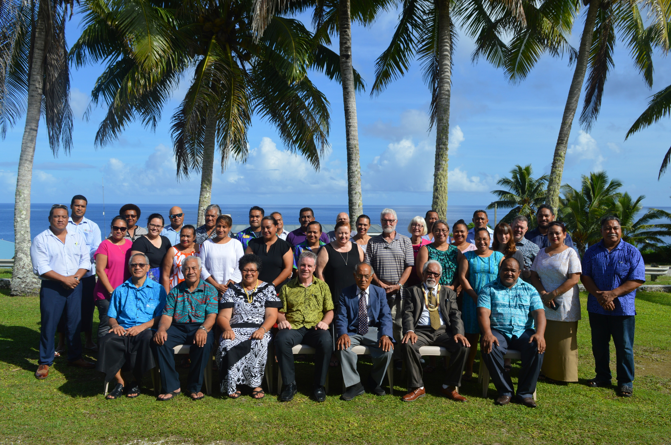
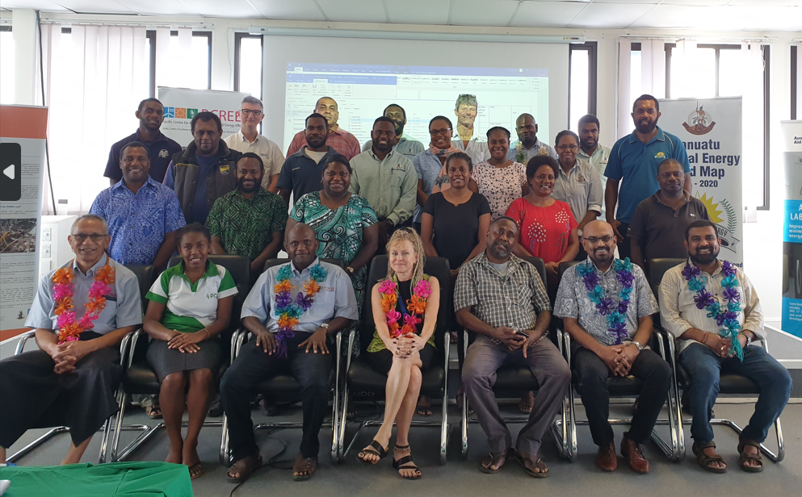
PCREEE’s Operational Achievements (2017 - 2020)
Outcome 3: Awareness and knowledge base of local key institutions and stakeholder groups
Conduct of National Energy Dialogues and capacity building and support workshops to openly discuss the achievements of countries in their RE&EE developments, the challenges, and how they can collectively be addressed as well as raising the business, investment, and employment opportunities from pursuing the national energy targets in the region. .
Support the further detailing and costing of the PITCs’ Nationally Determined Contributions (NDCs), Energy Roadmaps, Energy Master Plans as well as Investment Plans.
Outcome 4: Increased RE&EE business opportunities for local companies and industry
PCREEE launched the PCREEE Sustainable Energy Entrepreneurship Facility (PSEEF), a dedicated regional financing vehicle with a special focus on support to increase RE&EE business opportunities for local Small and Medium Enterprises (SME) companies, Non-Governmental Organisations (NGOs) and industry.
PCREEE has supported postgraduate researchers on sustainable energy through its research support fund and competition on sustainable energy innovation.
Strengthening the capacity of developing and financial institutions in the Pacific - ADFIP.
With the support of the United Nations Industrial Development Organisation (UNIDO), PCREEE is currently developing an innovative regional programme to prepare PICTs for the eventual uptake of e-mobility within PICTs´ RE expansion and EE plans.

Slide 6
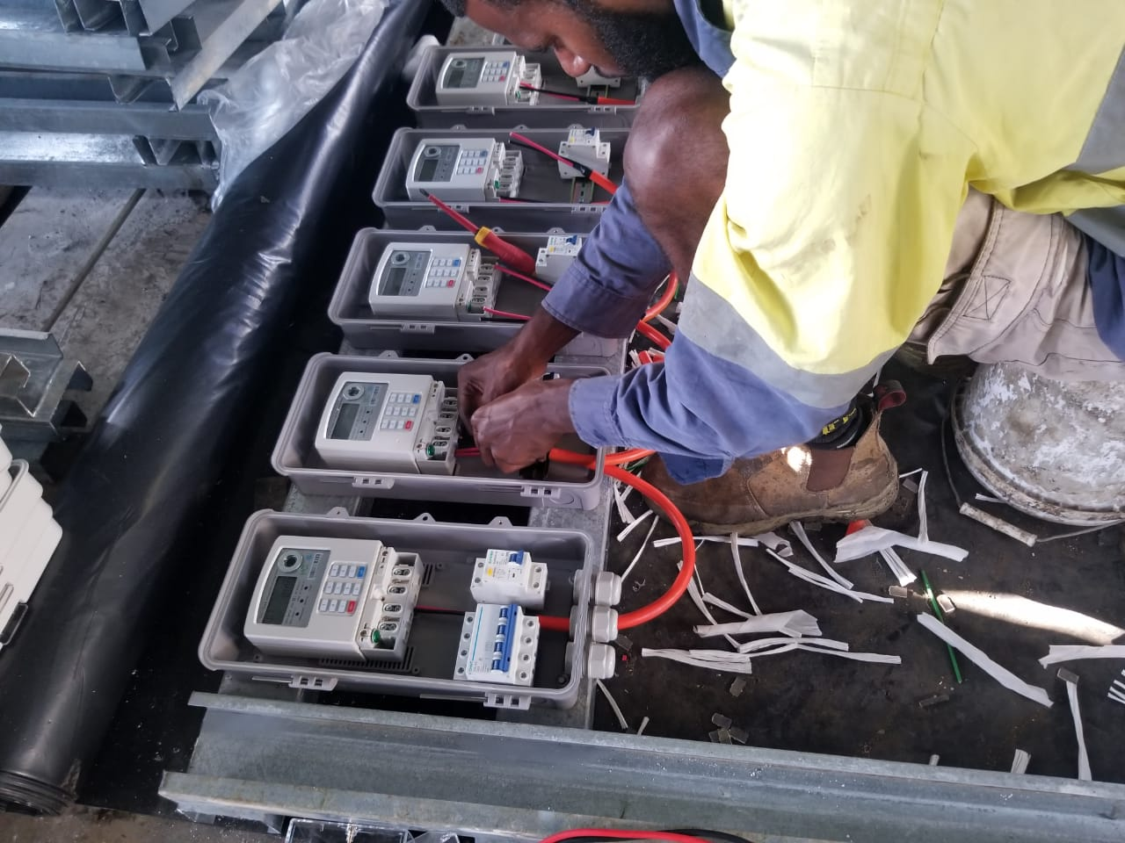
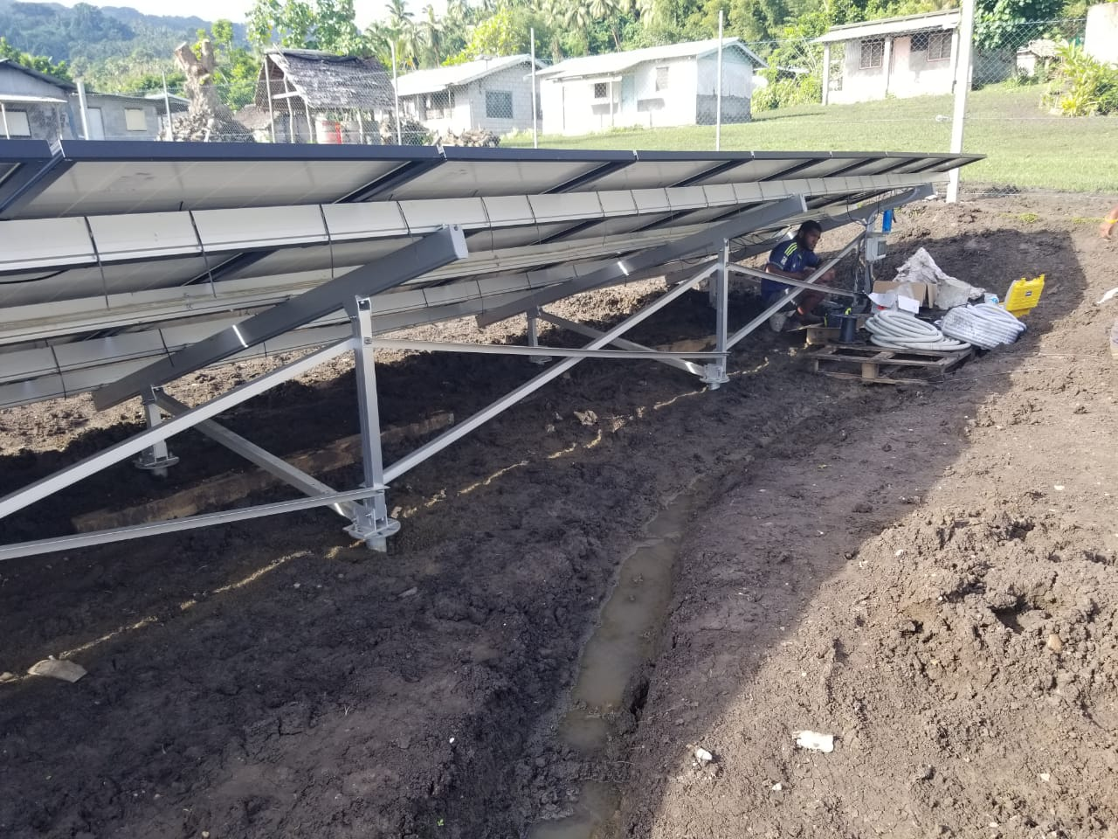
2nd Operation Phase (2021-2025) Strategic Programmes (4)
Programme 1. RE&EE Business Start-Up and Entrepreneurship Support
Programme 2. RE and EE for Sustainable Mobility
Programme 3. Energy Efficiency Investment
Programme 4. RE mini-grids

Slide 7
1. Local RE&EE Business Start-Up and Entrepreneurship Support
Objective: Differentiated support to entrepreneurial RE&EE businesses across the enterprise development life cycle (start-up, early-stage, growth, and maturity).
Output 1: Project preparation Technical Assistance (TA) to support companies to progress until achieving financial close.
Output 2: Financial support in the PICTs to increase RE&EE business opportunities for local companies and industry.
Output 3: access to finance via different instruments, including connecting with existing financing facilities (e.g Vanuatu NGEF, PCIFP, etc)
Output 4: Support to improvement of the policy and regulatory frameworks and business enabling environment both at the regional and national levels.

Slide 8
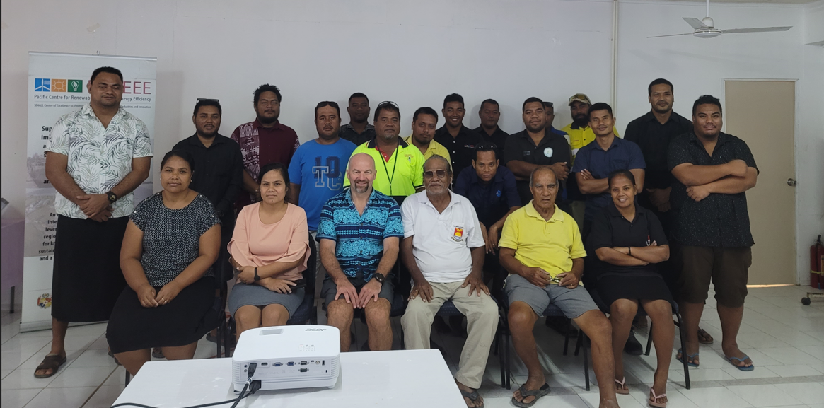
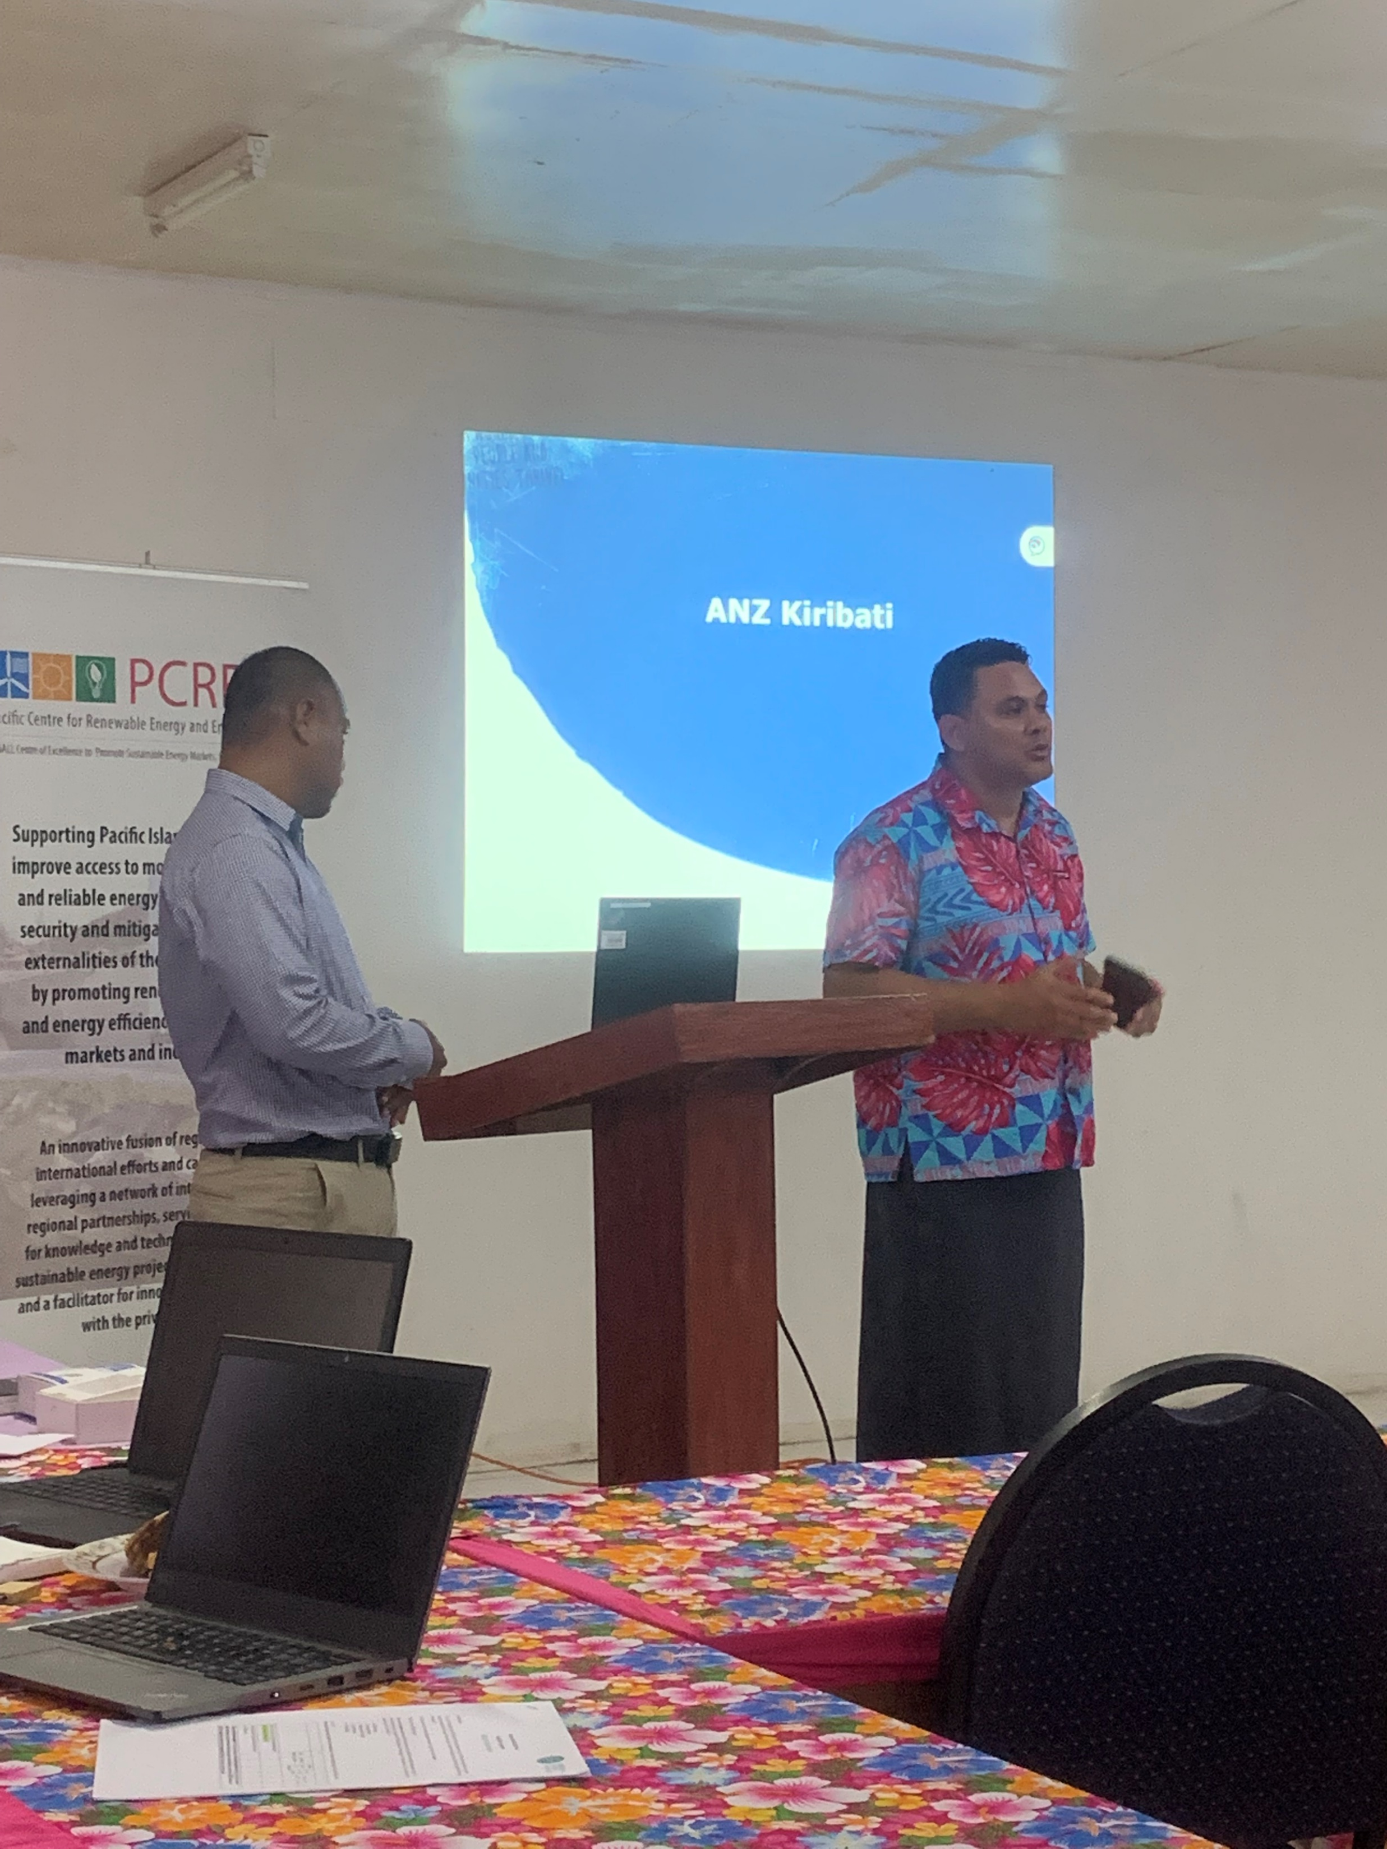
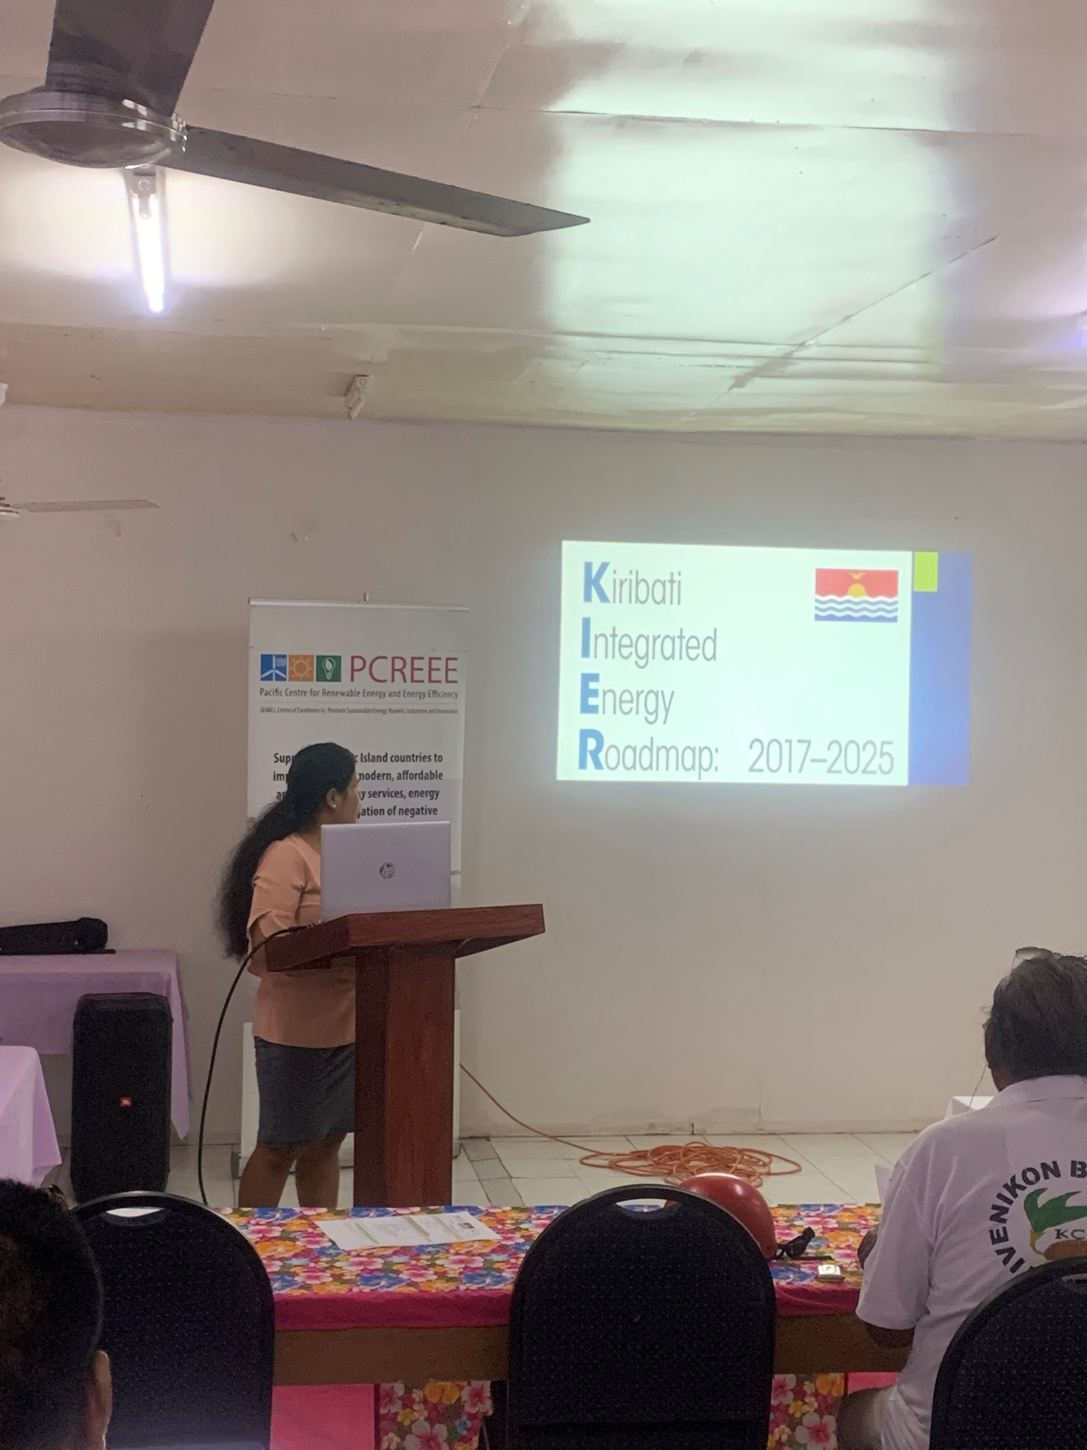

Slide 9
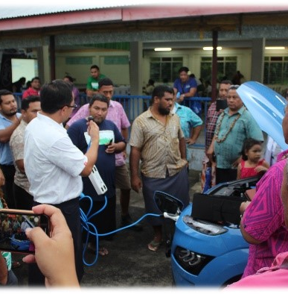
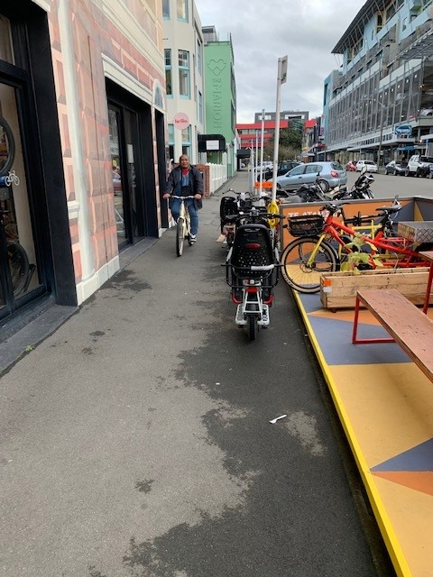
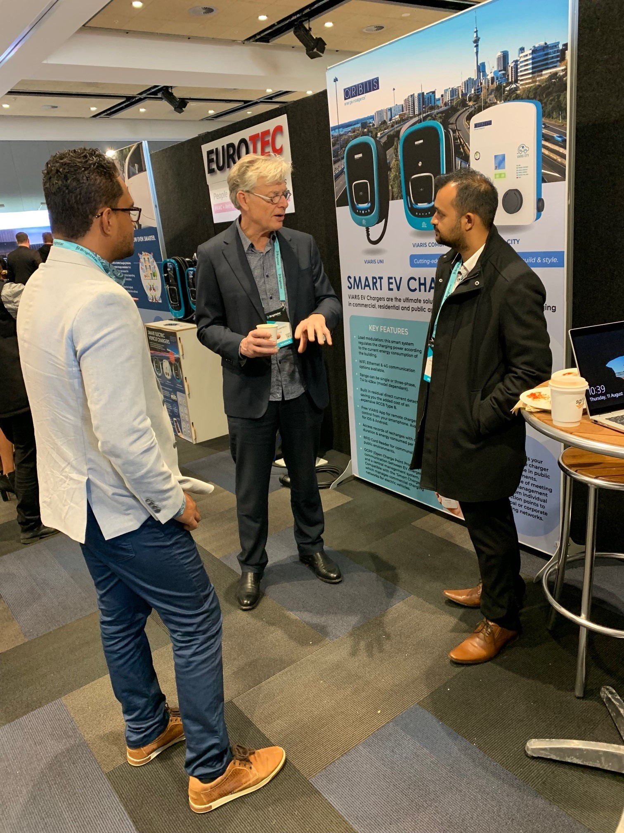
2. RE&EE For Sustainable Mobility
Objective: PICTs are best prepared for their respective sustainable mobility futures, including the uptake of EV technology in a wisely and fit-for-purpose manner and under an inclusive and well-coordinated programme, able to generate its own, stable base of capability and capacity for the region.
Output 1: Central Policy and Administration
Output 2: Standards and Guidelines
Output 3: Awareness and Promotion
Output 4: Demonstration and Upscale

Slide 10
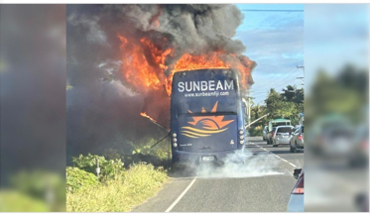
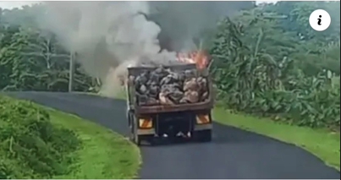

Slide 11
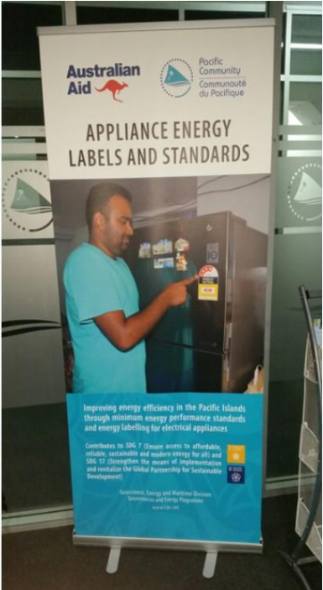
3. Energy Efficiency Investment
Objective: To enhance the competitiveness of manufacturing industries in the Pacific Region while reducing GHG emissions by improving and harmonizing national policies and regulatory frameworks and institutional capacity building for domestic, industrial, and commercial EE and the implementation of energy management systems.
Output 1. International standards (American Society of Heating, Refrigerating and Air-Conditioning Engineers (ASHRAE), International Organisation for Standardisation (ISO), etc.) developed or adopted for lighting, equipment, and thermal efficiency including the potential inclusion of such energy standards in building codes.
Output 2. Assistance provided to PICTs for adopting energy conservation practices for the design, construction, and utilization of energy-efficient facilities.
Output 3. Access to financing via different instruments facilitated.
PCREEE will promote and support investment mobilisation for energy efficiency investments in several areas:
Industry and Buildings
Energy Efficiency in the Public Sector
The Residential Sector

Slide 12
4. RE Mini-Grids
Objective: Increased clean energy access and improved livelihoods for communities through the promotion of a mini-grid program to achieve the SDGs throughout the PICTs
Output 1: Market intelligence; enhanced awareness of mini-grid market and strengthen market knowledge through market intelligence development.
Output 2: Capacity Building and Public and Private Partnerships; empower local institutions and private sector and increased project developments through capacity building and reinforced networks and partnerships between stakeholders.
Output 3: Technical Advancement; improved sustainability of mini-grid system and implemented with standardized technical equipment and design

Slide 13
Output 1: Market intelligence; enhanced awareness of mini-grid market and strengthen market knowledge through market intelligence development.
To overcome limited market knowledge and data for private sector involvement, a web-based database repository will be developed. It will allow access to regional market information that traces, records, and accumulates performance and troubles of mini-grid projects in the PICTs. The database will be a repository to facilitate the sharing of operational data for mini-grid projects between countries and the SPC and builds a comprehensive statistical database of records of key troubles including the operational performance of individual mini-grid projects. Such a database will provide a critical knowledge base for market information and optimal design with best practices guidance for future mini-grid projects in the PICTs.
Indicator O1 (a): A Web-based market knowledge platform is established.
Indicator O1 (b): Up-to-date market information is published and shared on the platform.
Indicator O1 (c): A regional Database of Mini-grid projects in PICTs is established.

Slide 14
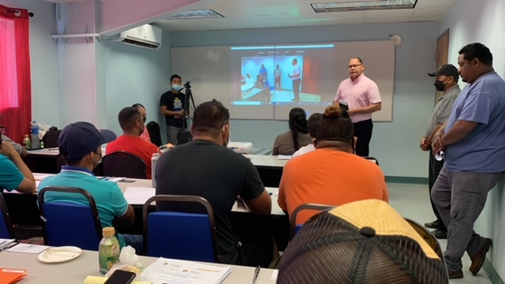
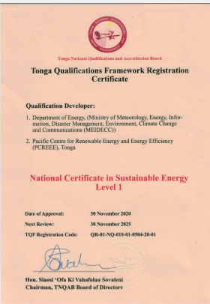
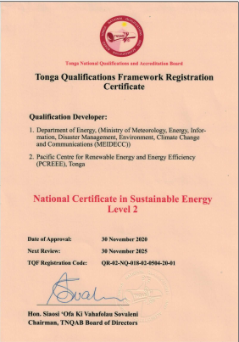
Output 2: Capacity building and public and private partnerships; empowered local institutions and private sector and increased project developments through capacity building and reinforced networks and partnerships between stakeholders.
Indicator O2 (a): A pro-poor public-private partnership (5Ps) business development model is developed for mini-grids.
Indicator O2 (b): A Capacity building program on mini-grids is delivered.
Indicator O2 (c): Number of promotions on mini-grid and public-private partnerships conducted.
Indicator O2 (d): Number of national sustainable energy industry associations established to support mini-grids.

Slide 15
Output 3: Increased entrepreneurship through productive uses of energy.
Indicator O3 (a): Number of micro and SMEs established due to the improved reliable supply of energy.
Indicator O3 (b): Increased jobs and income generation activities due to the improved reliable supply of energy.

Slide 16
CLEARPICS Clean Energy Access for remote pacific islands countries
Innovative finance and new business models to support clean energy access for the remote communities in the Pacific
Akuila Tawake
GEM Division
SPC

Slide 17
FESRIP 2021-2030
Framework for Energy Security and Resilience in the Pacific (FESRIP)
A regional framework to strengthen partnerships and coordinate actions
Jointly owned by SPC, PIFS, SPREP, USP and PPA
Jointly implemented by PICTs and partners
FESRIP Implementation Steering Group established – meeting every month to discuss project proposals, funding opportunities and partnership
Endorsed by the Pacific Leaders in August 2021
Launched at COP27 in November 2022
Other Partners: PICTs, JICA, ADB, Mana Pacific, GGGI, WB, MFAT, UNESCAP, DFAT, Power Utilities, FNU, ISA, AUT, KOICA, PIDF, IFC, ComSec, CFAN, GCF, UNDP, UNIDO, ADA, MCST, Hale & Twomey, NDC Hub, Energy Regulators, SEIAPI, GET.Invest, etc.

Slide 18
FESRIP Priority Areas
Priority Areas | Initiatives
A: Energy Policy, Planning and Capacity Development | 1. Development and implementation of robust national energy policies, plans and legislation
 | 2. Capacity development in the energy sector
 | 3. Database development with energy resilience/security indicators
 | 4. Rectifying gender imbalance in the energy sector
 | 5. Non‐commercial household energy
B: Energy Sector Finance and Cooperation | 6. Financing a regional energy framework
 | 7. Regional support to Pacific Island territories
 | 8. Cooperation in sustainable and resilient energy with other island regions
 | 9. Cooperation with the private sector in energy
C: Sustainable Electric Power Development | 10. Climate‐resilient power generation and distribution for island grids
 | 11. Overcoming technical limitations to high penetrations of renewable energy
 | 12. Financial & management mechanisms for sustainability of outer island & remote rural electrification
 | 13. Inspection and maintenance of RE technologies
 | 14. Regional RE standards for hurricanes and natural disasters
 | 15. Implementation of national goals and NDC commitments for renewable electricity
 | 16. Expanding and increasing the range of RE technologies
 | 17. Independent energy regulation
D: Low-Carbon Transport Energy | 18. Land transport energy use
 | 19. Marine transport energy use
 | 20. Air transport energy use
E: Improved Energy Efficiency | 21. Improved energy efficiency within buildings and economy wide
F: Petroleum and Other Liquid Fuel Services | 22. Petroleum advisory services: fuel pricing, contracting, monitoring and biofuels
 | 23. Petroleum advisory services: fuel storage, distribution infrastructure and miscellaneous
Notes:
The FESRIP identifies 6 priority categories that cover 23 areas of actions to address key issues that many PICTs are being confronted with and will continue to face in the coming decade and this framework constitute the priority areas for action through regional, sub-regional and bilateral approaches.

Slide 19
CLEARPICs
Innovative finance and new business models to support clean energy access for the remote communities in the Pacific
Funded by UK FCDO Transforming Energy Access programme, through Carbon Trust
1 M pound for 4 years (to be confirmed)
SPC implementation agency, in partnership with USP for the research study component
Main
Activities
Market potential mapping reports on Off-grid, mini-grids and PUE:
1 regional report on off-grid Solar Market Potential
3 country mapping report on off-grid and GMG
Suggestion of potential models for development of off-grid system and mini-grids in PICTs
Engagement with key investors, off-grid solar and mini-grids companies through the organisation of a regional investment forum
Gap Analysis and recommendation to create enabling environment for private sector investment in off grid in 3 PICs
Organisation of 3 national workshops
Development of 3 pilot projects (off-grid, GMG and PUE)

Slide 20
CLEARPICs
Proposed Activities
WP1 - Regional Liaison
WP2 - Market intelligence
WP3 – Pilot projects
WP4 – Enabling environment
SPC & PCREEE to coordinate with other TEA funded activity and TEA partners
Market potential mapping reports
Mapping current solar market potential for off-grid solar, clean mini-grids and productive use of energy
Pilots project for SHS, Mini-grids and productive use technologies
Gap analysis research and in-country workshops
Engagement with countries
Recommendations to create enabling environment for private investment in off-grid solution
Tailored Financial & Business models
Development of new business models to establish off-grid solar markets & mini-grids
Proposed Focus countries: Solomon Islands, Vanuatu, PNG, Fiji
Budget 1M£
Engaging with the off-grid & mini-grids market sector

Slide 21
CLEARPICs
WP2 - Market intelligence
WP3 – Pilot projects
WP4 – Enabling environment
Market potential mapping reports
deliverables
Pilots project for SHS, Mini-grids and PUE technologies
deliverables
Gap analysis research
deliverables
3pilots projects supported and implemented
3 Gap analysis reports and recommendations to create enabling environment
3 in country workshops
A high-level regional market report on off-grid solar and mini-grid potential across all PICTs
Country reports mapping out in detail the potential for off-grid/mini grids markets, with relevant GIS data sets
Potential different business & financial models for Off-grid& mini-grids
Market trend report on off-grid and mini-grids & supporting document on common challenges of remote areas
Regional investment forum
Tailored Financial & Business models
country workshops
Engaging with the off-grid & mini-grids market sector

Slide 22
CLEARPICs
Outputs
Increased knowledge on off-grid and mini-grids markets in the Pacific
Increased private sector participation for clean energy access in remote communities
Enhanced enabling environment for private investments
New scaling opportunities for Productive use of energy
Outcomes
Increased access to clean electricity in remote areas
Increased access to off-grid clean energy

Slide 23
Impact: Paradigm shift
Uptake of off-grid solar and clean mini-grids in remote communities in the Pacific
Outcomes and co-benefits
Increased access to clean electricity in remote areas
Increased women participation in development
Increased local business activities
Increased access to off-grid clean energy
Reduced carbon emission
Improved health and well-being
Outputs
Data and skills
Market information on off-grid and mini-grids potential in the Pacific available and shared with private sector for 3 PICs
Market building
Increased private sector engagement in off-grid and mini-grid project in remote communities (through engagement with the private sector and promotion of enabling environment in PICs)
Open calls
Increased renewable energy access for remote communities through 3 pilots projects implemented and showcased
Activities
Market potential mapping reports on Off-grid, mini-grids and PUE:
1 regional report on off-grid Solar Market Potential
3 country mapping report on off-grid and GMG
Design of potential models for development of off-grid system and mini-grids in PICTs
Engagement with key investors, off-grid solar and mini-grids companies through the organisation of a regional investment forum
Gap Analysis and recommendation to create enabling environment for private sector investment in off grid in 3 PICs
Organisation of 3 national workshops
Development of 3 pilot projects (off-grid, GMG and PUE)

Slide 24
Vinaka THANK YOU
Solomone Fifita - SolomoneF@spc.int
Florence Ventura – florencev@spc.int

Slide 27
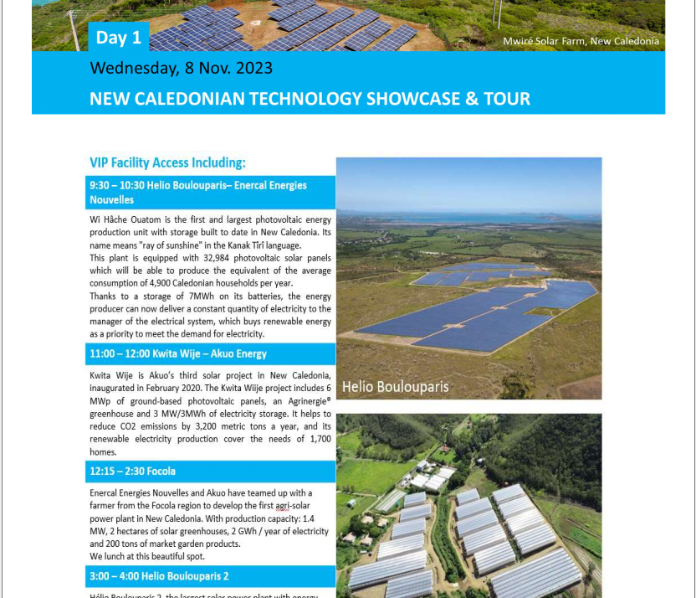

Slide 28
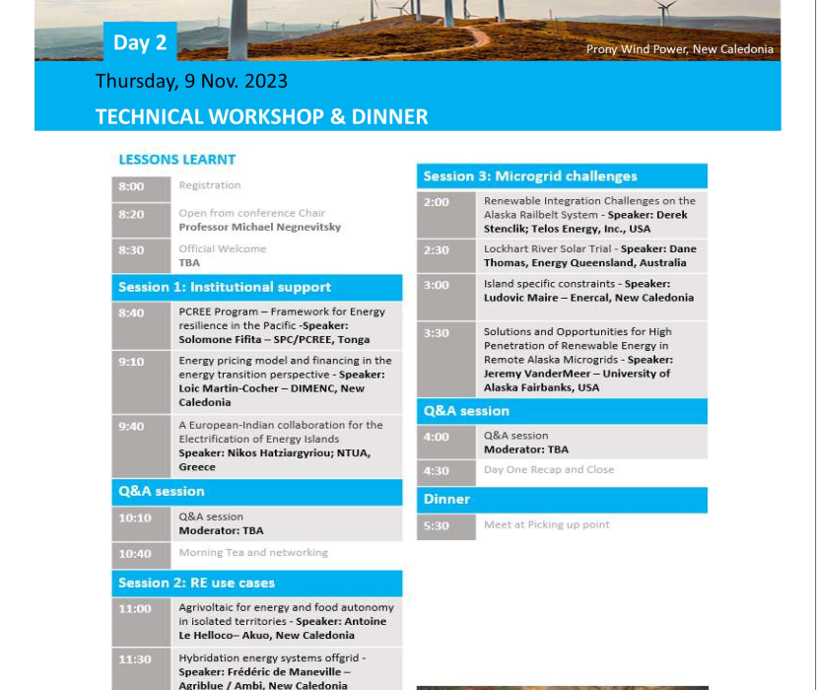

Slide 29
Output 1: Market intelligence; enhanced awareness of mini-grid market and strengthen market knowledge through market intelligence development.
To overcome limited market knowledge and data for private sector involvement, a web-based database repository will be developed. It will allow access to regional market information that traces, records, and accumulates performance and troubles of mini-grid projects in the PICTs. The database will be a repository to facilitate the sharing of operational data for mini-grid projects between countries and the SPC and builds a comprehensive statistical database of records of key troubles including the operational performance of individual mini-grid projects. Such a database will provide a critical knowledge base for market information and optimal design with best practices guidance for future mini-grid projects in the PICTs.
Indicator O1 (a): A Web-based market knowledge platform is established.
Indicator O1 (b): Up-to-date market information is published and shared on the platform.
Indicator O1 (c): A regional Database of Mini-grid projects in PICTs is established.

Slide 30
