Slide 1
UNLOCKING MINI-GRIDS FOR SUSTAINABLE DEVELOPMENT
ELECTRICITY EXPOSURE ASSETS – PCRAFI/PARTneR
Heilala Conference Room, SPC Narere Campus: Suva, Fiji: 26 – 30 June 2023

Slide 2
PRESENTATION OUTLINE
BRIEF BACKGROUND OF THE PROJECT
OVERVIEW OF EXPOSURE SURVEYS, QA/QC & DATA COLLECTION TEMPLATE
MODELLING OVERVIEW (RISK ANALYSIS & REPLACEMENT COSTS)
CONCLUSION

Slide 3
PCRAFI Brief background
Pacific Catastrophic Risk & Financing Initiative (PCRAFI) was launched in launched in 2006
Phase I started in 2007 & Phase II in 2016/2019
The Project aims to improve and update PacRIS and contribute towards strengthening the disaster risk finance and insurance capacity of PICs to provide coverage against the potential impacts of natural hazards, through the PCRAFI Program
Develop disaster risk assessments tools and practical technical and financial applications to reduce and mitigate the impacts of natural hazards in 14 Pacific Island Countries
For further information on PCRAFI II, please visit:
https://gem.spc.int/projects/capacity-building-on-the-hazard-and-exposure-database-for-pacific-catastrophe-risk

Slide 4
OVERVIEW OF EXPOSURE SURVEY, DATA PROCESS & RISK/HAZARD Modelling
1
2
3
Desktop Review & Data Preparation
(Identify & gather existing geospatial datasets & identify gaps)
Assets Exposure Data Collection Survey
Modelling of Exposure data
QA/QC
Risk Tools/Replacement Cost
Conduct Assets Exposure Data Collection Training
Uploading datasets into PacRIS

Slide 5
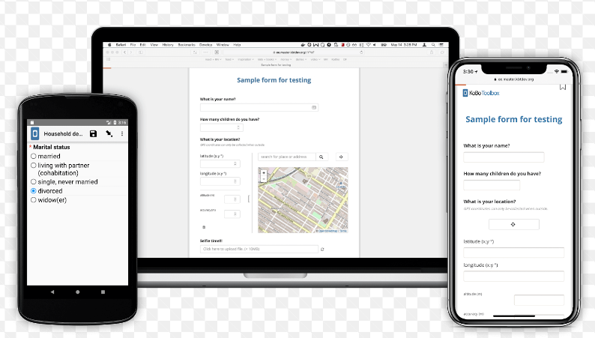
DATA COLLECTION- AIDS/MATERIALS
KoBo Toolbox (Humanitarian)
QGIS software & QField app
Smartphones/ Tablets (or TDG 600 Handheld GPS)

Slide 6
Data collection -ELECTRICITY asset attributes collected
1. General Information
Global Positioning System (GPS) Location
Name/Description
Minimum Of 2 Photos
2. Asset Type
power plant
transformer
substations
3. SOURCE TYPE
renewable
non-renewable
4. ASSET MATERIAL
a. Steel
b. Concrete
c. Steel & Concrete
d. Other
5. TRANSFORMER TYPE – MOUNTING TYPE
a. Pad mounted
b. Pole mounted
6. OWNERSHIP
a. Private - individual or organization
b. Government
c. State own enterprise – own by business arm of government
d. Independent Power Producer – private entities
7. CONDITION

Slide 7
Data collection – template
Electricity field data collection template : https://drive.google.com/file/d/1B9lxFJ5JUTN_WK_sXs81aXUtDqaBHyrs/view?usp=sharing
Sample of data collected on PacRIS : Pacific Risk Information System (spc.int)
3. Other data collected: Demography, Infrastructures, Utilities etc..

Slide 8
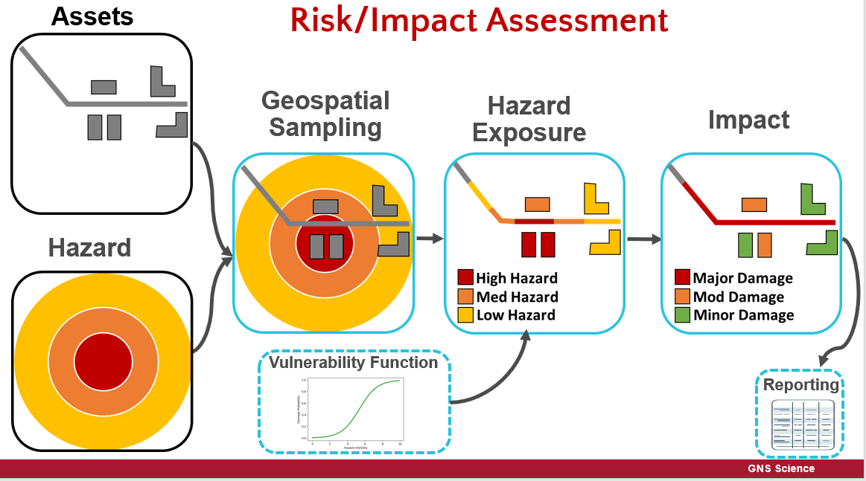
MODELLING-Risk analysis
Electricity Assets Data – Risk Analysis & Replacement Cost modelling

Slide 9
MODELLING-Risk analysis
Risk Analysis Workflow via Riskscape
Modelled Exposure Layer
PCRAFI 1/2
Nexus/risk.spc.int
Replacement Cost (UUC) Modelling
Standalone Python Process
Tools
RiskScape Hazard Analysis
Riskscape/QGIS
RiskScape software provides a risk analysis framework for calculating natural hazards consequences
Nexus/risk.spc.int

Slide 10
Conclusion
Why hazard risk assessment/assets exposure modelling
Planning
- Knowing where to set up mini-grids
Hazard areas and risk involved
The presence of infrastructures, utilities, demography, number of houses
Estimated Cost Replacement

