Slide 1
Pacific Adoption of Waste-to-Energy Solutions (PAWES)
PROJECT OVERVIEW
PCREEE Workshop
30th June 2022
Nixon Kua
GEM Division
Pacific Community

Slide 2
Workshop Objectives
Objectives of this Technical Inception Workshop are to:
Present the project to in-country technical counterparts and other partners;
Discuss project work packages, activities, partnership, work plan and budget;
Identify project partners and national technical focal points;
Discuss steering committee meeting and official launch;
Agree on ways forward and next steps.

Slide 3
Introduction
Title: Pacific Adoption of Waste-to-Energy Solutions (PAWES) Project
Duration: 14 December 2021 – 13 December 2024
Consortium: SPC & SPREP
Beneficiary Countries: Papua New Guinea, Republic of the Marshall Islands, Samoa, Solomon Islands, Tuvalu
Total Budget: 2,871,342 EUR

Slide 4
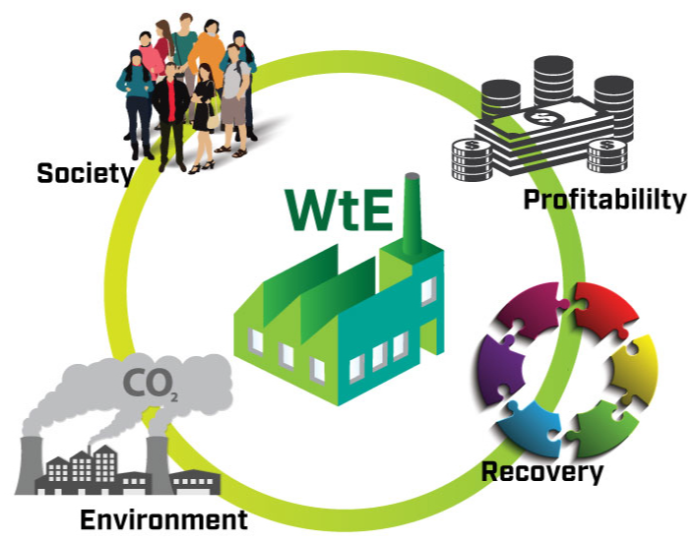
Objectives
Overall Objective: Enhanced solid waste management and energy security in the Pacific region.
Specific Objectives:
(i) National and subnational government entities able to make informed decisions on developing a sustainable Waste-to-Energy (WtE) sector.
(ii) Tertiary education providers providing updated training and performing state-of-the-art research on Solid Waste Management (SWM), Renewable Energy Technologies (RET) and WtE.

Slide 5
Project Multipliers
University of the South Pacific (USP)
Sustainable Energy Industry Association of the Pacific Islands (SEIAPI)
University of Papua New Guinea (UPNG)
PNG National Energy Authority,
Samoa Ministry of Natural Resources and Environment,
Solomon Islands Ministry of Mines, Energy and Rural Electrification, and
Tuvalu Department of Energy, Ministry of Transport, Energy and Tourism
RMI Energy Office

Slide 6
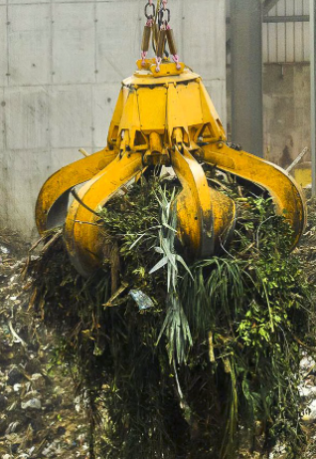
Beneficiaries
National Ministries of Environment;
Industry involved in municipal waste management, green waste management and renewable energy;
Businesses that produce a significant volume of waste;
Urban and rural communities exposed to health and environmental impacts of poorly managed landfills;

Slide 7
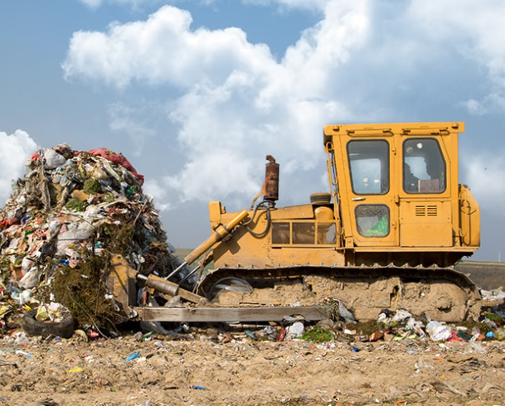
Beneficiaries (cont.)
Urban and rural communities lacking secure energy or a source of renewable energy;
Land and marine-based ecosystems;
General public;
Other atoll nations and Small Island Developing States (SIDS);
Regional research institutions.

Slide 8
Main Activities
WP1 – Capacity strengthening of government entities in the application of support tools for evidence-based decision-making in WtE.
WP2 – Collection and consolidation of data on SWM and RET in the Pacific region.
WP3 – Promotion of cross-sectoral collaboration among government entities and the educational, research and private sector.
WP4 – Adapting and developing WtE training courses for tertiary education providers.
WP5 – Developing WtE solutions through tertiary education providers.
WP6 – Project management.

Slide 9
Expected Outputs
Output 1 (O1.1): Enhanced capacity of government entities in the application of support tools for evidence-based decision-making in WtE.
Output 2 (O1.2): Increased access to data on SWM and RET.
Output 3 (O1.3): Enhanced cross-sectoral collaboration among government entities and the educational, research and private sector on WtE.
Output 4 (O2.1): Tertiary education providers adapting and developing WtE training courses on preparing students for jobs matching existing and future market demands.
Output 5 (O2.2): Tertiary education providers adapting and developing innovative WtE solutions.
Notes:
Staff expertise, capabilities and organisational sustainability underpin the implementation of the strategic plan.
Integrated teams for greater effectiveness.

Slide 10
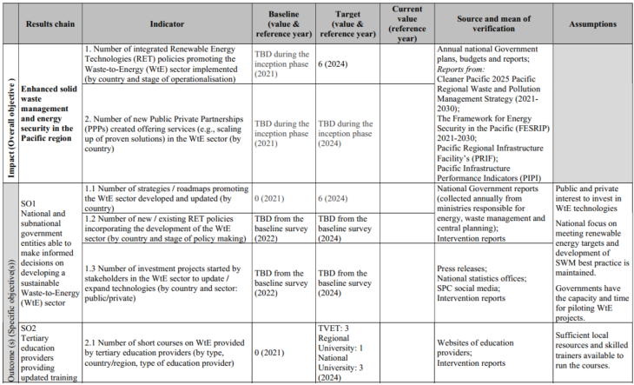
Logical Framework

Slide 11
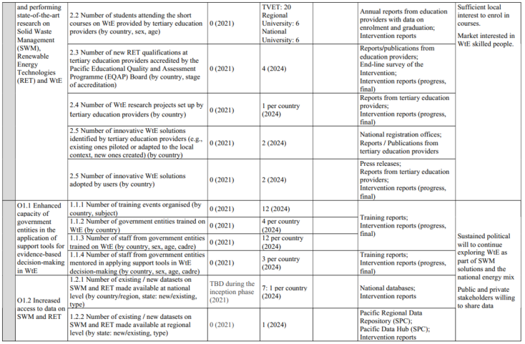
Logical Framework (cont.)

Slide 12
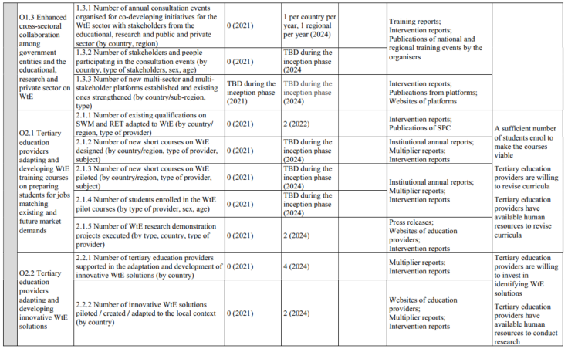
Logical Framework (cont.)

Slide 13
Project Steering Committee and Official Launch
Project Steering Committee:
1st SC meeting will be held on 28th April 2022.
Official launch of the Project will be held during this event.
Country-presentations by national technical focal points on their country priorities aligned to Project Work Packages;
Finalise and sign LOA and Grant Agreements.
Revise and agree on ways forward and next steps.

Slide 14
Waste-to-Energy Definitions and Terminologies
Inia Saula
Geoscience, Energy and, Maritime (GEM) Division
Pacific Community (SPC)

Slide 15
What is Waste to Energy
Is a broad term (same meaning as Energy from Waste);
Any process or treatment that takes waste and converts it into energy (for the primary purpose of producing electricity – or electricity and heat – for sale or own use ) using thermal or biological technology;
A variety of ‘processes’ are used, each of which has its own proprietary and intellectual property rights;
Each of these processes tends to be referred to as a “technology”;

Slide 16
What is Waste to Energy Technologies
Waste-to-Energy (WtE) technologies that process non-renewable waste can reduce environmental and health damages, while generating sustainable energy;
The World Energy Council (2016) reports that according to the current rate of waste generation, global waste is estimated to reach 6 million tonnes/day by 2025.

Slide 17
Waste to Energy Technology
Irrespective of the technology used, we have two same outcomes result:
Reduction in the mass and volume of waste disposed of to landfill; and
Production of energy from the non-reusable and non-recyclable fractions of the waste stream .

Slide 18
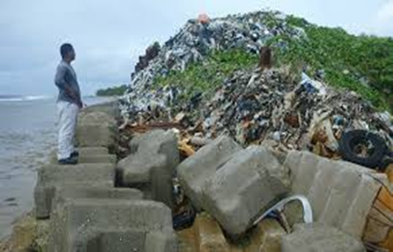
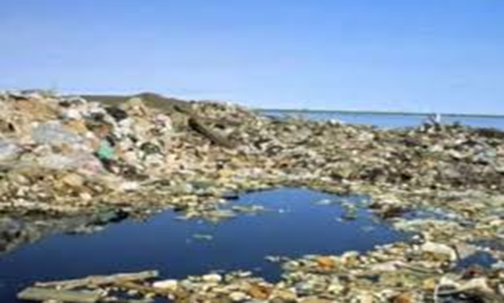
Key Waste Streams
Municipal Solid Waste (MSW) | Bagasse & Biomass
Commercial and Industrial Waste (C&IM) | Food Waste
Construction and Demolition Waste (C&CW) | Hazardous Waste
Events Waste | E-Waste
Green Waste | Medical Waste
Organic Waste | Bio-solid and Slurry Waste

Slide 19
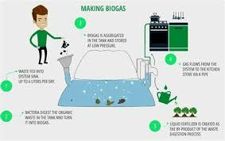
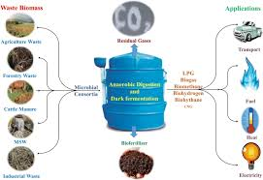
Waste-to-Energy Technologies
Biological or Thermal Technologies
Generate energy from waste take two forms (biological and thermal);
Biological technology use anaerobic digestion (AD);
Requires a consistent type of organic waste and a highly controlled environment in which to produce and combust methane gas;
Waste streams for AD are limited to Food Waste and Bio-solid and Slurry Waste;
Overall energy output is low comparison to thermal technologies.

Slide 20
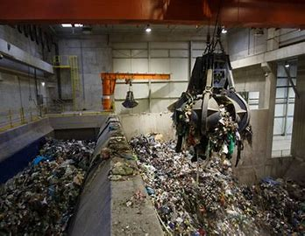
Waste to Energy - Thermal Technologies
Large scale WtE project;
The list includes:
Mass combustion;
Gasification;
Pyrolysis.

Slide 21
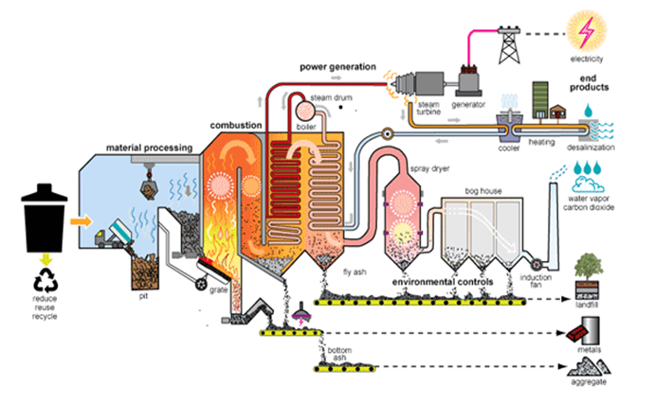
Thermal Technology – Mass Combustion
Taking large volumes of waste without any form of prior systemised sorting, separation or treatment is referred to as a "mass burn" or "mass combustion" WtE project;
Moving grate and fluidised bed are the main combustion technologies used;
Both having low emissions and high thermal efficiency.

Slide 22
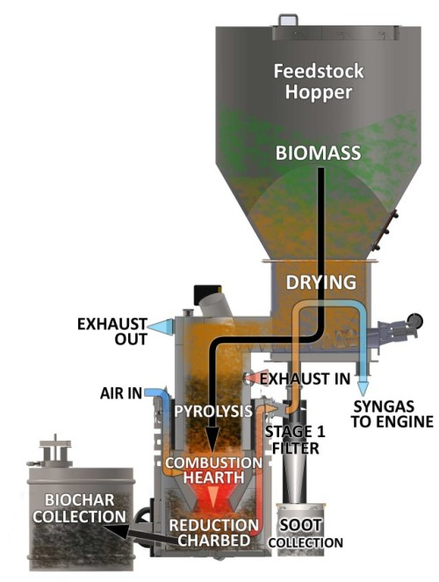
Thermal Technology - Gasification
Gasification involves deriving synthesis gas (syngas) from waste in low oxygen, high temperature chambers, and then combusting the syngas;
Type: Close-coupled gasification, slagging and plasma;
5 steps – Drying, Pyrolysis, combustion, cracking and Reduction
The use of gasification as a WtE technology continues to be developed for large-scale WtE project.

Slide 23
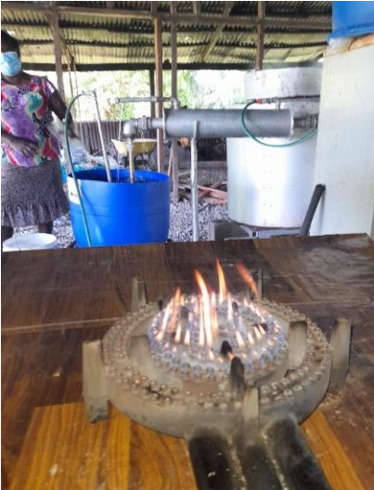
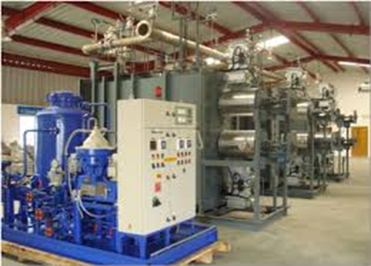
Thermal Technology - Pyrolysis
Pyrolysis involves deriving gas (and char or tar) from the sublimation of waste at high temperatures in the absence of oxygen, with the gas then being combusted;
While pyrolysis WtE plants do exist, they are not as prevalent as mass combustion or gasification plant.
Plastic Pyrolysis

Slide 24
Waste Stream and Preferred Technology
Waste Stream | Type of Waste Resource | Technology Considered
Municipal Solid Waste (MSW) | Solid wastes dumped at landfills & dumps | Thermo-chemical conversion or Landfill Gas Recovery
Sewerage Sludge | Sewerage or domestic wastewater | Anaerobic Digestion
Livestock Waste | Waste from cattle, goats, sheep, poultry & pigs | Anaerobic Digestion
Biomass Waste | Bagasse, logging & forestry industry waste | Thermo-chemical
Non-hazardous Industrial Waste Water | Organic waste from abattoirs, distilleries & breweries | Anaerobic Digestion
Agriculture Crop Residues | Organic waste residues from agricultural & farming activities | Thermo-chemical conversion
Food Waste | Left over food, kitchen wastes, pilling from vegetables, fruits and root crops | Anaerobic Digestion

Slide 25
Work Package 1: Capacity strengthening of government entities in the application of support tools for evidence-based decision-making in Waste to Energy (WtE)
Baseline Assessment
Feasibility Assessment
CBA of Potential WtE Technologies
WtE Training on Policy Making

Slide 26
Work Package 2: Collection and consolidation of data on Solid Waste Management (SWM) and Renewable Energy Technologies (RET) in the Pacific region
Objective – update existing databases including Pacific Regional Data Repository (PRDR) with all available Waste to Energy (WtE) data for the purpose of baseline, feasibility assessments and development of training materials.
Updating of existing data/databases
Development of new data/databases
Analysis of use of data

Slide 27
Work Package 3: Promotion of cross-sectoral collaboration among government entities and the educational, research and private sector.
Deliver Pacific WtE presentations at international/regional conferences
Build Pacific WtE website
Strengthening existing Private Sector-Government-Partnership initiatives
Undertake WtE Trade Missions

Slide 28
Work Package 4: Adapting & developing WtE training courses for tertiary education providers
Adaption of RET qualifications
Co-development of short courses on WtE with tertiary education providers
Co-development and facilitation of research demonstration projects with tertiary education providers

Slide 29
Work Package 5: Developing WtE solutions through tertiary education providers
Co-design and development of pilot projects with tertiary education providers

Slide 30
Work Package 6: Project Management
Setting up of the project management structure
Project meetings
Support to local multipliers
Financial management
Monitoring, Evaluation and Learning (MEL)
Communication and Visibility Strategy
Reporting

Slide 31
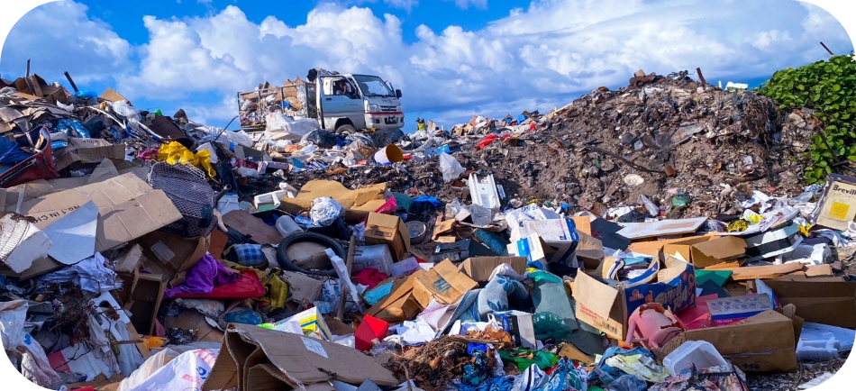
Pacific Adoption of Waste-to-Energy Solutions (PAWES) Project
CONTACT INFORMATION
For more information please contact:
The Pacific Community (SPC)
Nixon Kua – Energy Expert/Project Manager
Georesources and Energy Programme
Akuila Tawake
nixonk@spc.int | +679 337 0733

