Slide 1
Pacific Regional Capacity Building Energy Audit & Energy Management
Federated States of Micronesia
27th Feb – 3rd Mar 2023

Slide 2
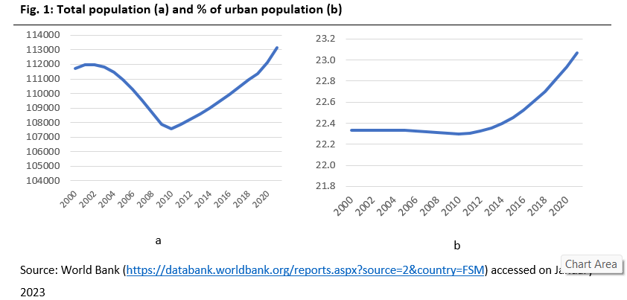
Introduction
Yap, Chuuk, Pohnpei
& Kosrae
Total population 113,000
in 2021
98% fossil fuel & 2% RE
https://www.irena.org/-/media/Files/IRENA/Agency/Statistics/Statistical_Profiles/Oceania/Micronesia-Federa,ted-States-of_Oceania_RE_SP.pdf?rev=d3aa66c3889945d0909dd6cb5e729859 (latest update: 24th August, 2022)

Slide 3
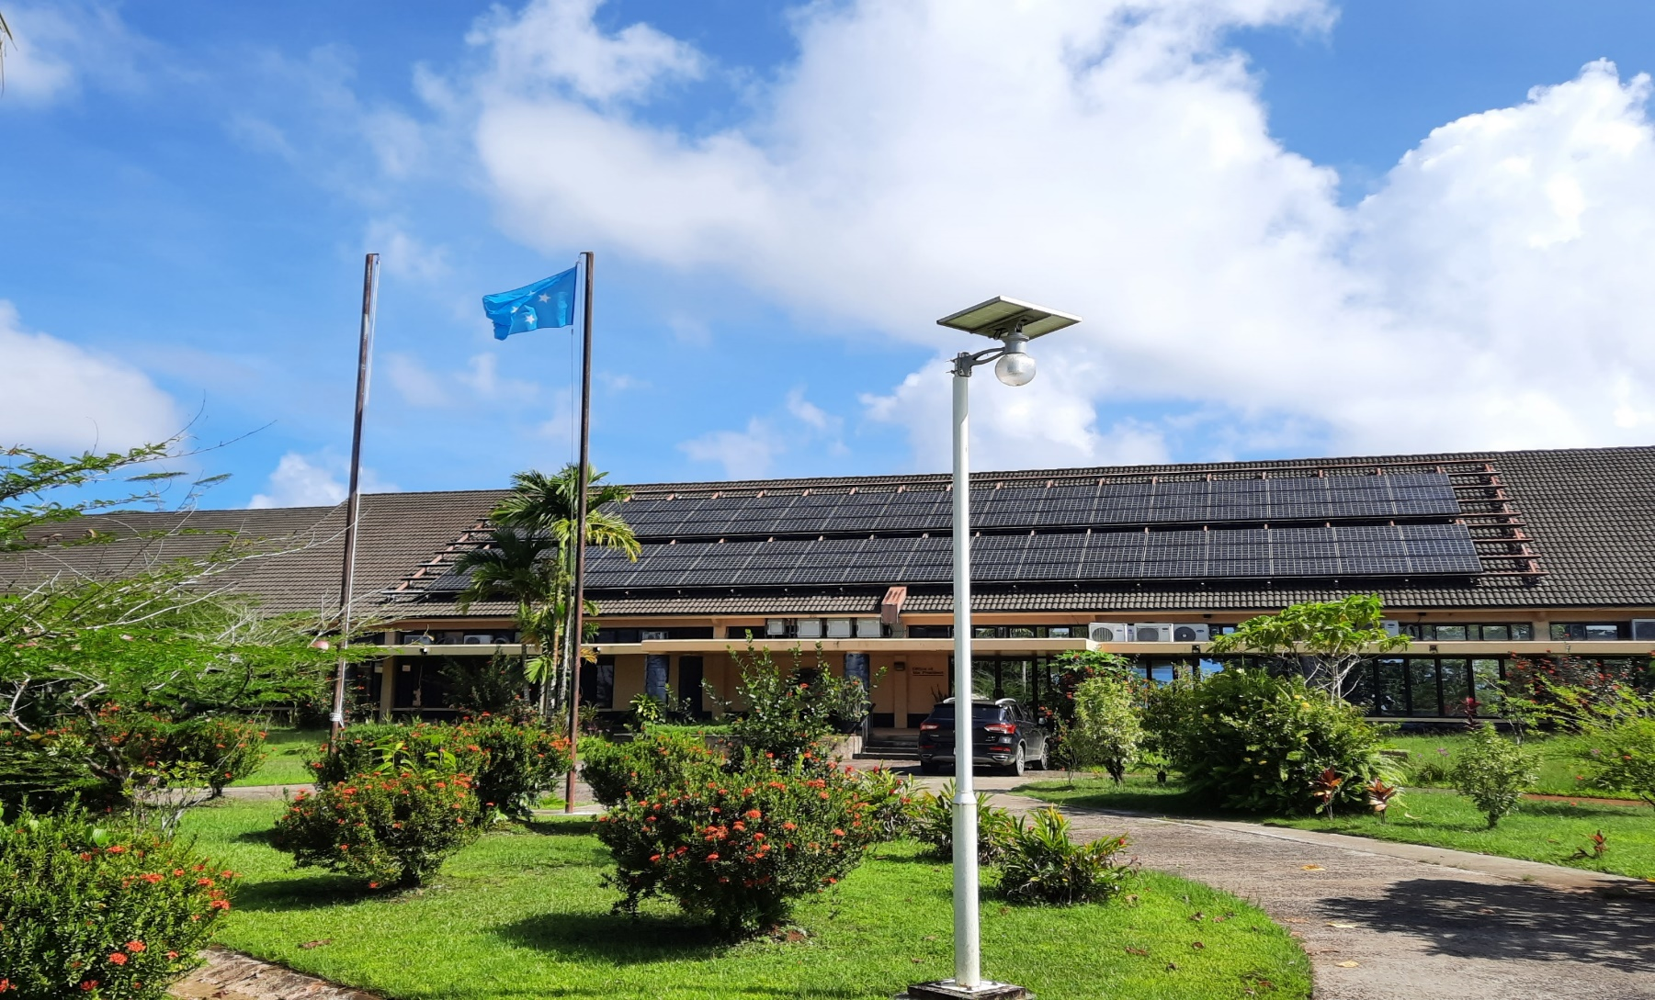
THE GOVERNANCE OF THE ENERGY SECTOR IN THE FSM
The Division of Energy, Dept. of R&D
Develop policies
Promote EE&RE
Coordination of governments
Work with regional & international counter parts
National Energy Policy (NEP) est. 2012
National Energy Workgroup (NEW)
four State Energy Workgroups (SEW).

Slide 4
Progress & Achievements for the Last 3 Years (on EE & EC Initiatives)
In FSM this knowledge has recently been developing thanks to dedicated projects
ACSE Project (EU)
FSM Energy Efficiency Retrofitting Project, NDC Hub (EU)
current project, the EU.FSM.SE, SEDAP (WB), & REDP (ADB)

Slide 5
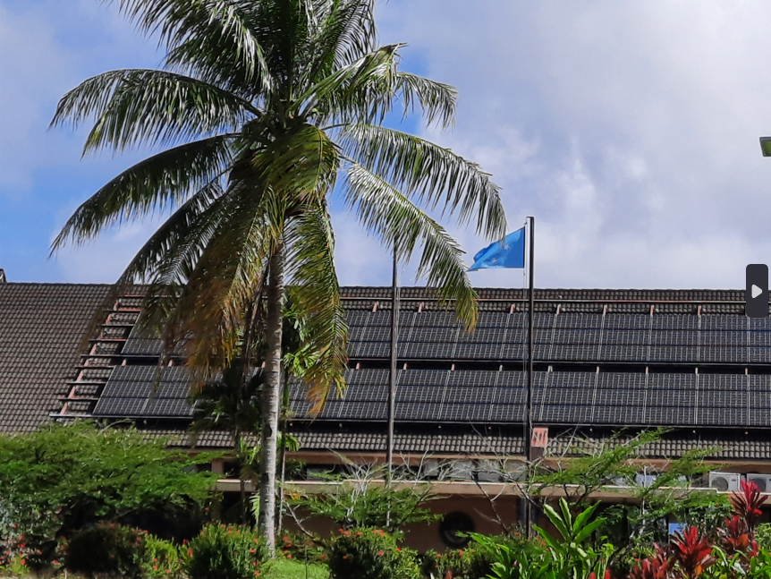
Current Awareness / Productivity in EC&EE Initiatives
Micronesia Public Sector Building Energy Efficiency (MPSBEE) Project, GEF/UNDP
Goal: Improved specific energy consumption and reduced GHG emissions in the buildings sector of the country.
Objective: Improved application of energy conserving and energy efficient techniques and practices in the design, retrofit, operation & maintenance of public sector buildings.
Project Components:
1. EC&EE Policies & Regulations Improvements in Public Sector Buildings
2. Energy Performance Monitoring and Evaluation of Public Sector Buildings
3. EC&EE Improvements in Public Sector Buildings
4. EC&EE Capacity Building in Public Sector Buildings

Slide 6
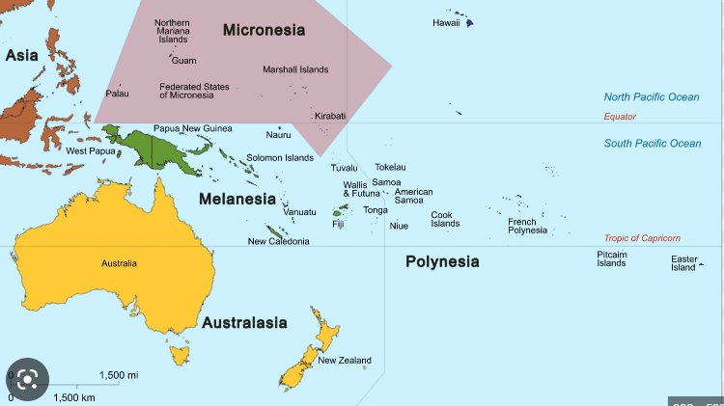
Lesson learned
Stakeholder buy in
Technical capacity
Market availability

Slide 7
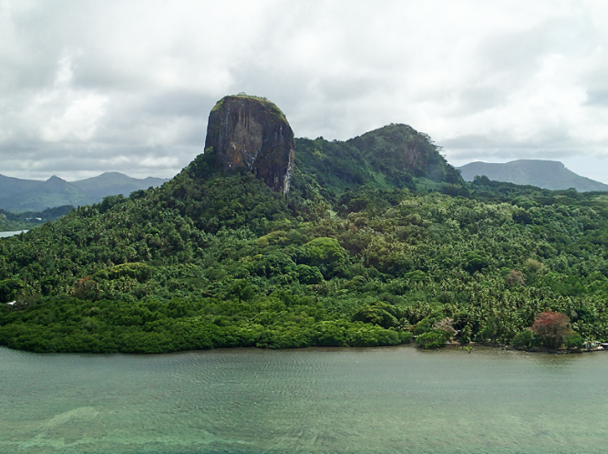
Challenges & Opportunities Encountered
The FSM National and State Energy Policy and Action Plans (2012) have a target of a 50% improvement in EE by 2020. The key barriers:
Policy/Regulatory/Institutional Barriers
Technical Barriers
Energy Monitoring & Reporting Barrier
Capacity Development Barriers
Financial Barriers

Slide 8
Plans for 2023 - 2030
Energy Master Plan and NDC Target
RE increase 70% by 2030 and 100% by 2050
EC&EE increase 70% 2030 and 100% by 2050

Slide 9
Recommendations
Increase Energy Efficiency in all sectors including all buildings and infrastructure
Increase RE contribution to the grid by way of increasing BESS and active system control (SCADA)
Strong support from community and government leaders
Support public private partnership through incentive programs for RE&EE initiative
Technical and financial support from development partners

Slide 10
Way Forward

