Slide 2
E-mobility Meeting
12 – 16 June 2023
Nuku’alaofa
Kingdom of Tonga

Slide 3
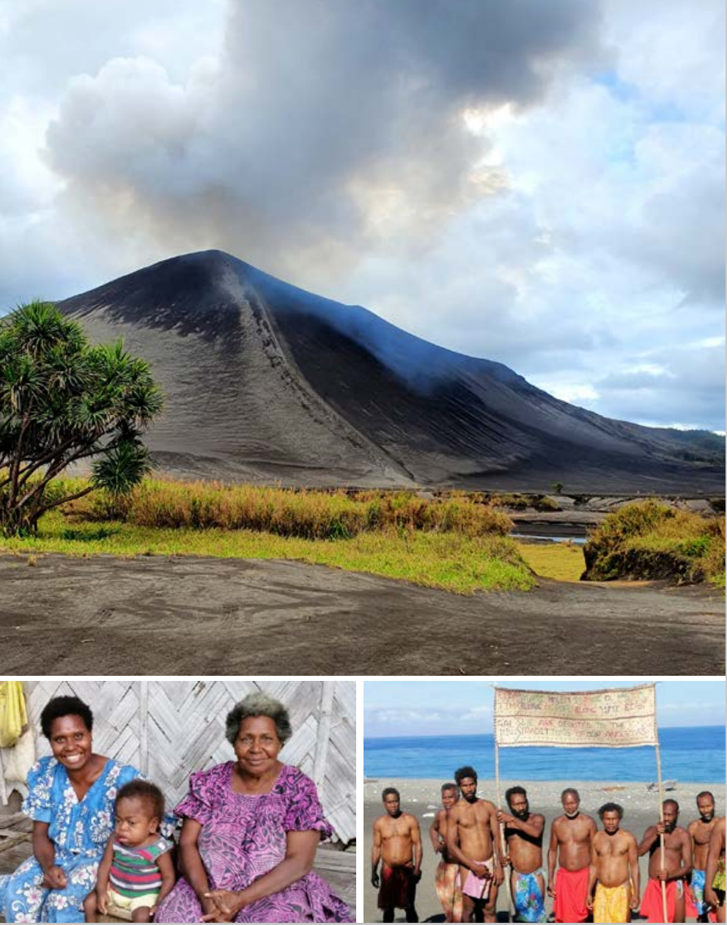
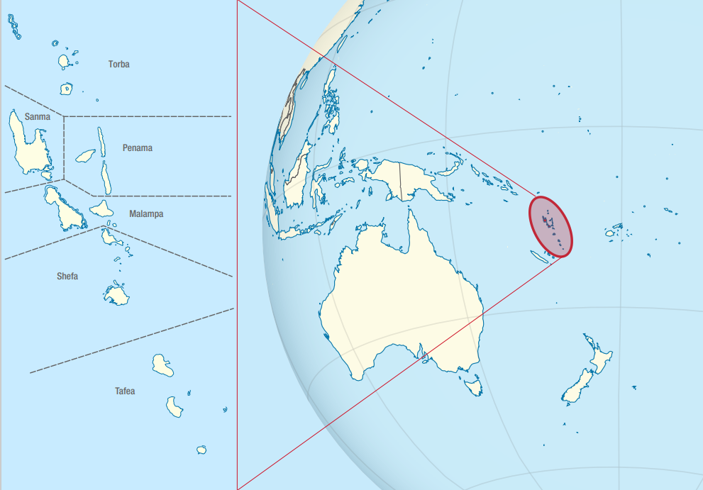

Slide 4
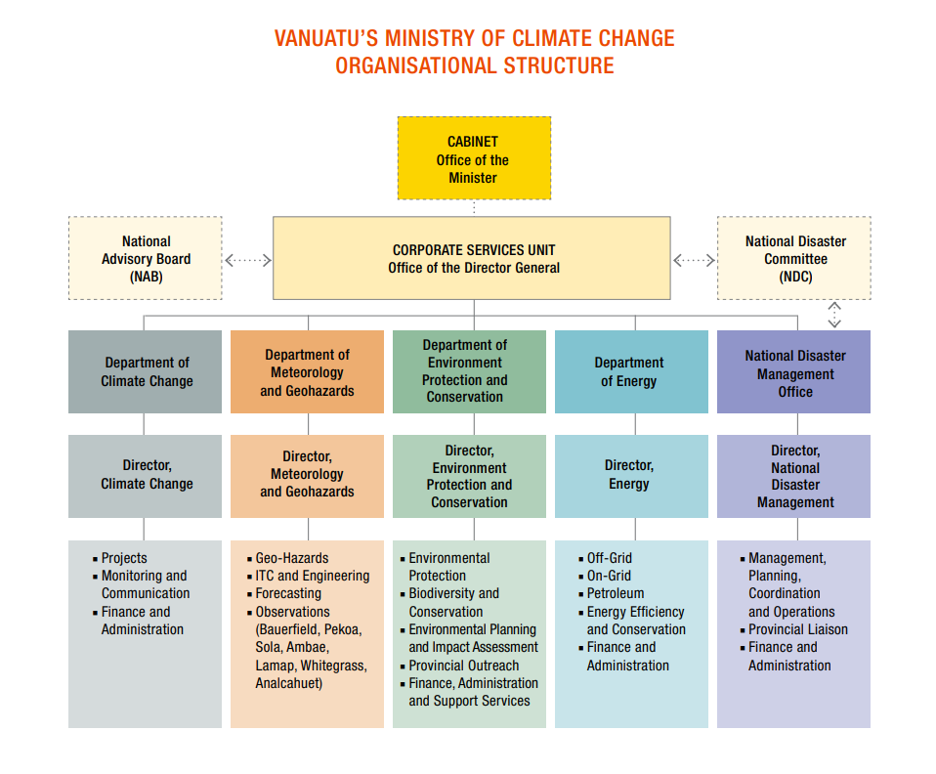

Slide 6
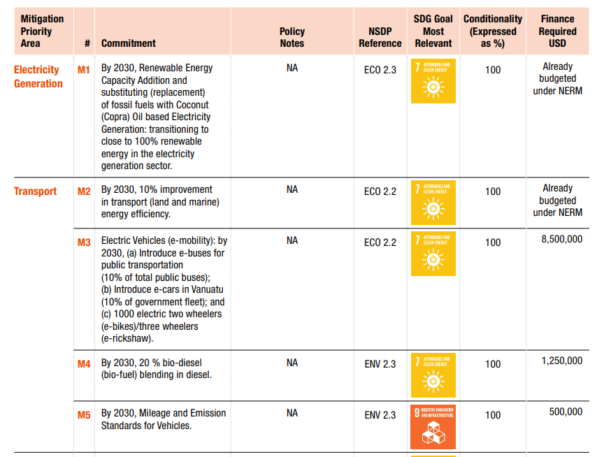
Notes:
SDG Goal 7: Affordable and Clean Energy (Ensure access to affordable, reliable, sustainable and modern energy for all) ; SDG Goal 9: Industry, Innovation and Infrastructure (Build resilient infrastructure, promote inclusive and sustainable industrialization and foster innovation)

Slide 7
CONTEXT AND BASELINE
VULNERABILITY TO CLIMATE CHANGE
HEAVY RELIANCE ON IMPORTED FUEL
NEEDS FOR ESTABLISHMENT OF AN INTITUTIONAL FRAMEWORK
CURRENT LAND TRANSPORT SYSTEM
NEEDS FOR CLIMATE CHANGE MITIGATION ACTION
POLICY AND LEGISLATION
FINANCIAL BARRIERS
EDUCTAION AND AWARENESS

Slide 8
1. VULNERABILITY TO CLIMATE CHANGE
Vanuatu most vulnerable to climate change and disaster risks
Experienced cyclones, storm surges, landslides, flooding and droughts, and becoming more intense;
Exposed to geophysical threats as volcanic eruptions, earthquakes and tsunamis, human, animal and plant diseases, and human cause disasters – (although not climate change related);
As a least developed country, climate change impacts already undermined country’s development.
Notes:
Thses impacts will continue to worsen in the future if the drivers of climate change are not addressed and if the most vulnerable sector are not supported.

Slide 9
2. HEAVY RELIANCE ON IMPORTED FUELS
~60 Million Liters of fuel imported annually;
diesel at 63%;
50% consumption in land transport sector;
38% consumption in electricity generation;
Consequently transport sector contributed 5.9% of total GHG emission (2nd National Communication on Climate Change of Vanuatu the second Country Communication on Climate Change of Vanuatu)

Slide 10
3. NEED FOR ESTABLISHMEMENT OF AN INSTITUTIONAL FRAMEWORK
Limited coordination mechanism in land transport sector;
Data management and information sharing on land transport very fragmented due to unclear institutional frameworks in place;
Therefore difficult to make evidence-based decision making in terms of policy and legislative frameworks for low carbon transport systems.

Slide 11
4. CURRENT LAND TRANSPORT SYSTEM
The nature of land transport in Vanuatu is made up of individual business owners operating public transport services, such as buses and taxi service.
Few major tour companies operating larger fleets of bus services to meet mainly the demands of tourism industry.
Nevertheless, buses and taxis dominate the mode of transportation services in Vanuatu.

Slide 12
5. NEEDS FOR CLIMATE CHANGE MITIGATION
Little to no progress in improving climate change mitigation aspects of the land transport sector in Vanuatu. This is due to a number of barriers.

Slide 13
6. POLICY LEGISLATION
There is a loophole of detailed policy and legislation regarding quantified energy efficient target in the transport sector. This is due to lack of policy framework in this regard, in the land transport sector, mitigation actions by key stakeholders, including policy makers and the private sector have been hindered to realize mitigation target in the NDC as the high-level policy

Slide 14
7. FINANCIAL BARRIERS
Vanuatu relies heavily on donor funding due to its fragile economy and limited income generation initiatives.
There is inadequate budget allocated to make improvements in the land transport sector

Slide 15
8. EDUCATION AND AWAFRENESS
The technological improvements in the land transport sector is only known and appreciated by few people. The majority of people don’t understand the climate change, environmental and economic benefits that derived from the use of low efficient land transport system.

Slide 16
Drivers for Change
National Sustainable Development Plan (NSDP) – provide equitable and affordable access to efficient transport in rural and urban centers
National Energy Roadmap (NERM 2016 – 2030) – improve transport (land and maritime) energy efficiency by 10% over the BAU by 2030
Updated and Revised NDC 2021 – 2030 – reduce GHG emissions from transport sector by 10% below BAU; increase shares of EVs and mileage and emission standards for vehicles
LT-LEDS (long-term low emission development strategies) – recommends for the development of a national transport strategy and coordination of e-mobility pilots.
Notes:
LT-LEDS stands for Long-Term Low Greenhouse Gas Emission Development Strategies. It is a term used by the United Nations Framework Convention on Climate Change (UNFCCC) to describe the long-term strategies that countries develop to reduce their greenhouse gas emissions and adapt to the impacts of climate change.

Slide 17
Fuel and Vehicle Emission Standards Project (current)
Funding: New Zealand Ministry of Foreign Affairs and Trade (MFAT)/ Global Green Growth Institute (GGGI)
OBJECTIVE: to support the development of a fuel standard and vehicle standard for Vanuatu to reduce emissions from road transport
EXPECTED OUTPUTS:
Recommendation on fuel standard
Recommendation on vehicle emission standard
DURATION: 18 months (ending August 2023)

Slide 18
Some key findings
FUEL STANDARDS
2 fuel suppliers in Vanuatu – Vanuatu Refueling Services (VRS) and Société de Service Pétroliers (SSP)
Vanuatu imports 60 Million liters of petroleum fuel annually
Approx 40 Million litres of diesel is for transport
No regulations on standards and pricing of petroleum fuel
SSP adheres to New Caledonia fuel standards (equivalent to Euro 4 standards)
VRS imports fuel from New Zealand (already adhering to Euro 4/5 standard)
Vehicle importers (new vehicles) conduct own fuel quality tests on an annual basis

Slide 19
Some key findings
VEHICLE EMISSION STANDARDS
8,517 vehicles registered in 2020 and is growing rapidly
Bulk of current imported vehicles (new and second-grade) are Euro 3&4 emission standards compliant
No quality requirements for vehicle importation apart from left-hand drives

Slide 20
Proposal
Setting age limits for vehicles on the road and imported vehicles could be an effective way to reduce emissions
Offering financial incentives/subsidies to purchase new or cleaner vehicles
Institutional and legislative review on transport sector will encourage adoption of low emission vehicles
Development of standards and guidelines on specifications, installation and safety requirement of EV charging infrastructure in Vanuatu

Slide 21
Vision/Targets of EV uptake (CTCN 2021)
Promote low emission vehicles such as EV and enhance organised and efficient public transportation, and aim to realize low-carbon, clean and sustainable land transportation throughout Vanuatu.
Proposed gradual approach by 3 phases till 2030
Planning to implement uptake 10% of all motor vehicles in 2030, corresponding to targets in “Vanuatu Nationally Determined Contribution (NDC) (Updated and enhanced NDC 2021)”
Recommended to set targets and promote various measures in the fields of electricity supply and road development which are closely related with EV uptake.

Slide 22
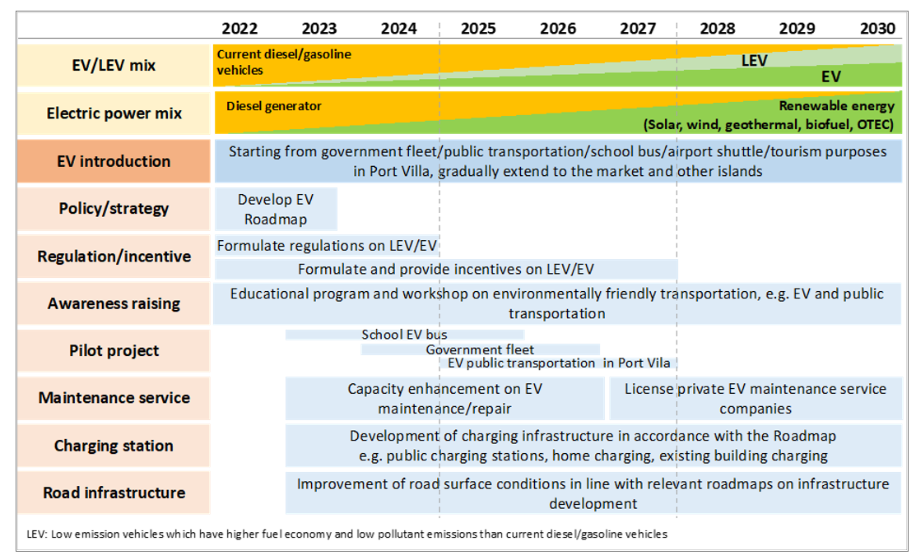

Slide 23
MEASURES ON EV UPTAKE In Vanuatu, some measures related to EV are stipulated as “additional measures of NDC” in the government document. However, currently strategies, plans or common direction have not been established for EV uptake. The identified barriers in terms of policy/legislative, institutional, technical, financial aspects, necessary measures to promote EV uptake are proposed while the project will be implemented following 11 pillars of proposed measures which are linked with major barriers and issues identified by feasibility study.

Slide 24
Details of each pillar

Slide 25
1. EV road map:
As a first step of EV uptake, it is essential to formulate and show agreed direction and set of measures on EV uptake, both soft and hard measures such as laws/regulations, incentives and infrastructures related to EV as well as low emission vehicles, and to promote them in collaboration with related parties.

Slide 26
2. Coordination body to promote EV:
In order to promote introduction of EV effectively and efficiently, for various stakeholders, such as relevant ministries, electric power companies, tourism organizations/companies, car dealers, educational institutions, and citizens, to work together with a common direction and understanding, and need to establish a cross-sectoral organization which coordinates and conduct measures.

Slide 27
3. Regulations on EV and other vehicles:
Legal development is required as lack of law or regulation regarding EV and charging infrastructure in Vanuatu has been identified. Laws such as the Road Traffic Control Act and the Public Land Transport Act need to be amended from viewpoint of introducing EV, as well as setting regulations and standards on electric vehicle registration and charging infrastructure. Additionally, by establishing and amending related laws and regulations such as on fuel efficiency and exhaust gases, imported second-hand cars as well as vehicle inspection, which urge to promote migration from existing high emission vehicles to low emission ones such as EV. Also, a framework for treatment of used EV and batteries for appropriate treatment through recycling.

Slide 28
4. Incentives to promote EV:
According to Import cost and high electricity tariff, it is considerable that EV prices and its operational costs will be higher than the existing ICE vehicle. For the time being, it is indispensable to provide incentives so that it allows consumers reasonably select low-emission vehicles such as EV.

Slide 29
5. Awareness raising:
EV and low emission transport are currently new and unfamiliar in Vanuatu. For introducing and dissemination widely, it is mandatory to have a good understanding regarding the advantages and disadvantages of EV, comparison with ICE (Internal Combustion Engine) vehicles, public transportation, GHG emission reductions and co-benefits by offering information on relation to low carbon transportation to citizens and related organizations.

Slide 30
6. Demonstrative pilot project:
Through introducing EV as a demonstrative project, for citizens and tourists to see and experience EV and enhance the momentum for EV uptake, at the same time, the issues and solutions for full-scale introduction of EV will be identified as well. The Public transport consists of privately-owned mini-buses that run unspecified routes even in Port Vila, and about 70% of these vehicles are second hand vehicles. Mini-bus system is a merry-go-round and bus drivers need to go around to look for customers which is consuming more fuels. For the future sustainable development for cities/towns/municipalities in Vanuatu, there should have fixed route buses as an efficient public transportation.

Slide 31
7. Training programs on EV maintenance:
To achieve sustainable conduction of this project, it is essential to develop human resources for maintenances for mastering know-how regarding EV and charging infrastructure. This training the consideration to integrate adaptation to climate-induced natural disasters, in particular effective utilization of enhanced transport system for early warning and back-up energy supply under constrained situation by natural disasters.

Slide 32
8. Developing public charging stations:
Developing a large number of charging stations will be required for operating EV society smoothly and they need to be established appropriately places allocated with considering characteristics of vehicle use in Vanuatu. As Vanuatu has constantly been exposed to natural disaster risks such as flooding and storms, so that infrastructure should be designed and deployed in a climate-fit manner.

Slide 33
9. Improvement of electricity supply:
Diesel power generation is the mainstream on all islands except Santo Island in Vanuatu at this moment, therefore the expected reduction of GHG emissions by introducing EVs will be limited. In order to maximize the effect of introducing EVs, it is necessary to steadily aim to achieve the government target of renewable energy ratio (100% in 2030).

Slide 34
10. Improvement of road infrastructure:
The pavement rate of roads is low (13%) and most roads are narrow in Vanuatu. The road pavement/surface and condition affect fuel efficiency (electricity cost) of vehicles so that to improve the condition and to expand areas for vehicles are identified as a demand for promoting introduction of a wide variety of EV for future.

Slide 35
11. Studies and research:
Large-scale deployment of EV has not yet progressed much in island countries in the world, however some issues will be raised in proportion as gradually progress of EV uptake accordingly. It is important to study and research best ways to deal with these issues in collaboration with experts, donors, and advanced countries/cities on EV uptake, and to establish a model case of EV uptake model which is unique to the situations of Vanuatu.

Slide 36
Thank you

