Slide 1
DTRONICS
SECURITY PTE LIMITED
electronic security system specialists
-FIJI-

Slide 2
Core business
CCTV SYSTEMS
DOOR MANAGEMENT SYSTEMS
INTERCOMS
BROADCAST TECHNOLOGY - STUDIOS & TX. SITES
SATELLITE COMS – IRRIDIUM

Slide 3
CONTINENTAL ACCESS

Slide 5
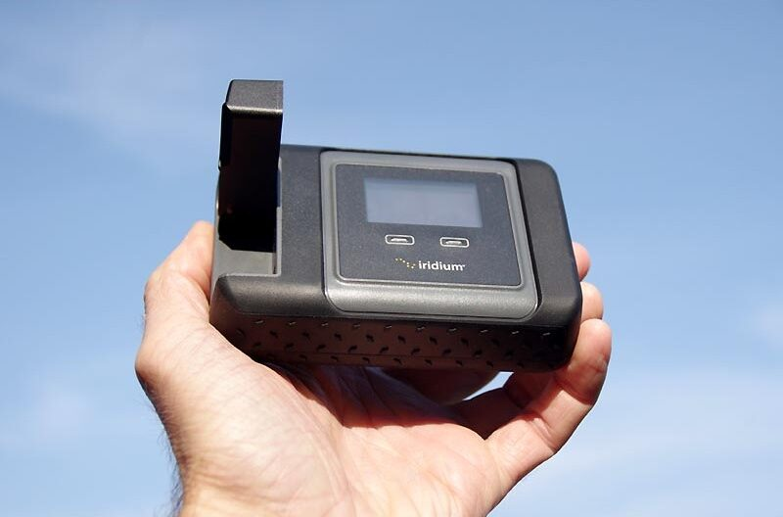
IRRIDIUM GO

Slide 6
Point – point comms
Mobile comms
- Pole – to pole coverage

Slide 7
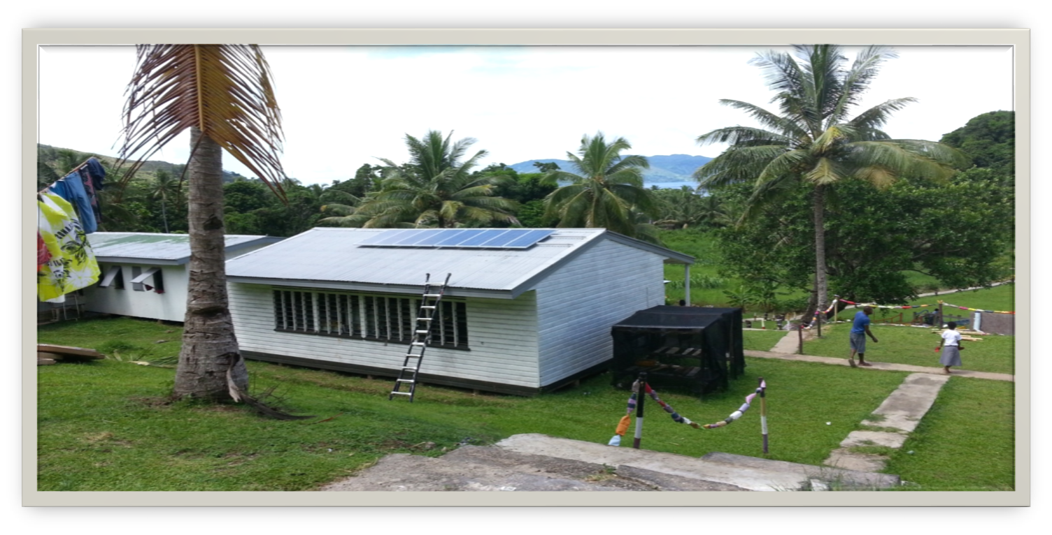
Vabea mini - grid

Slide 8
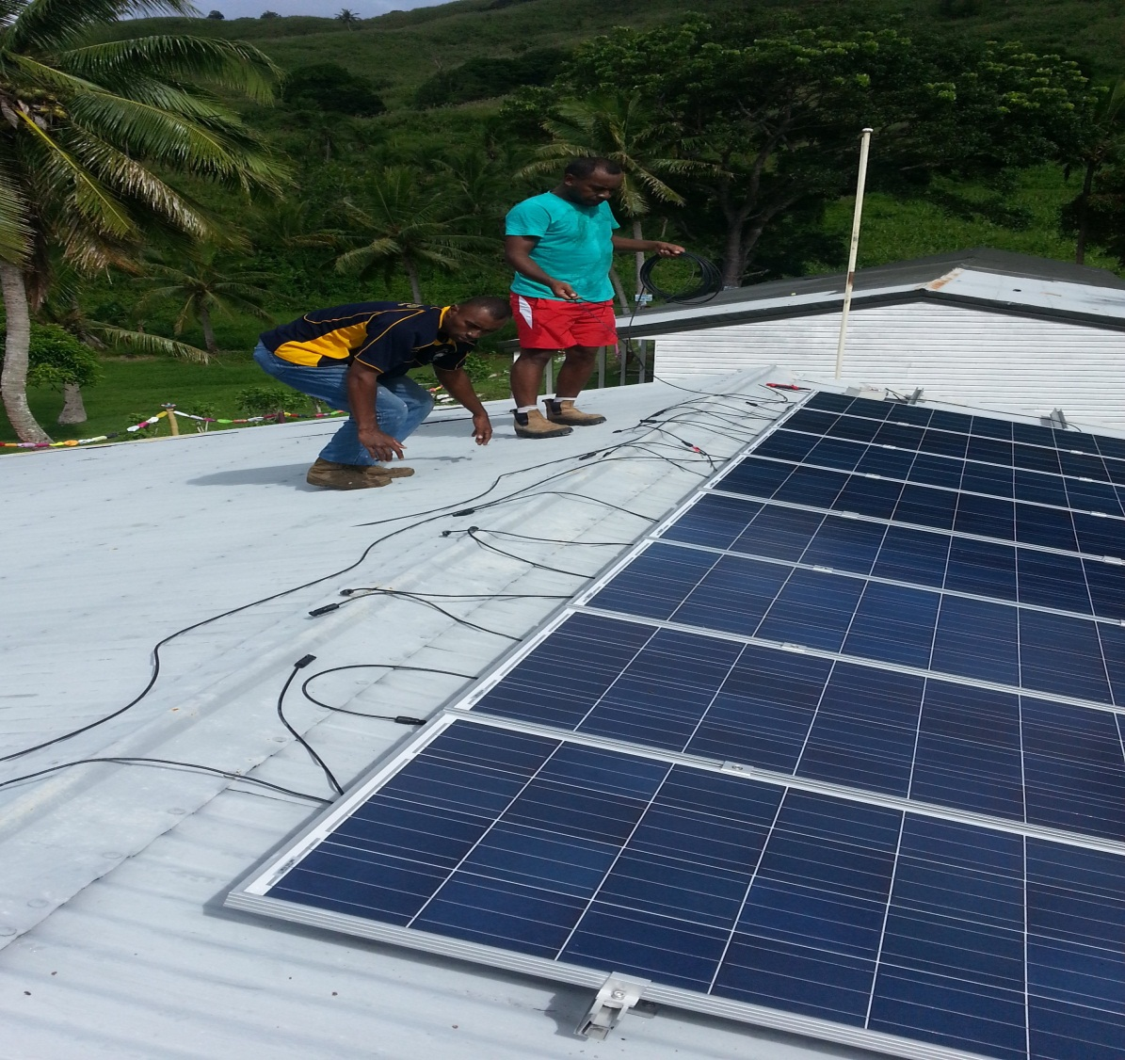
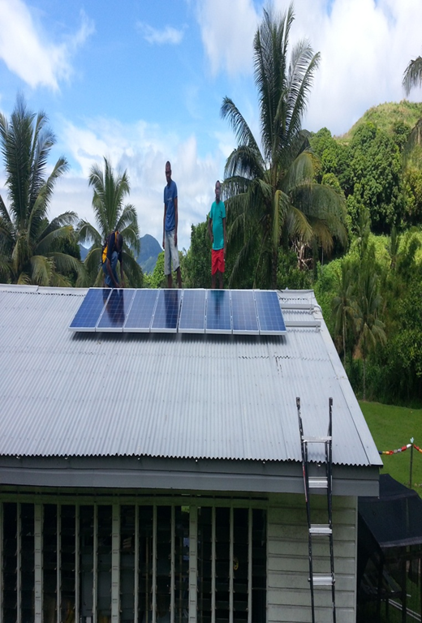

Slide 9
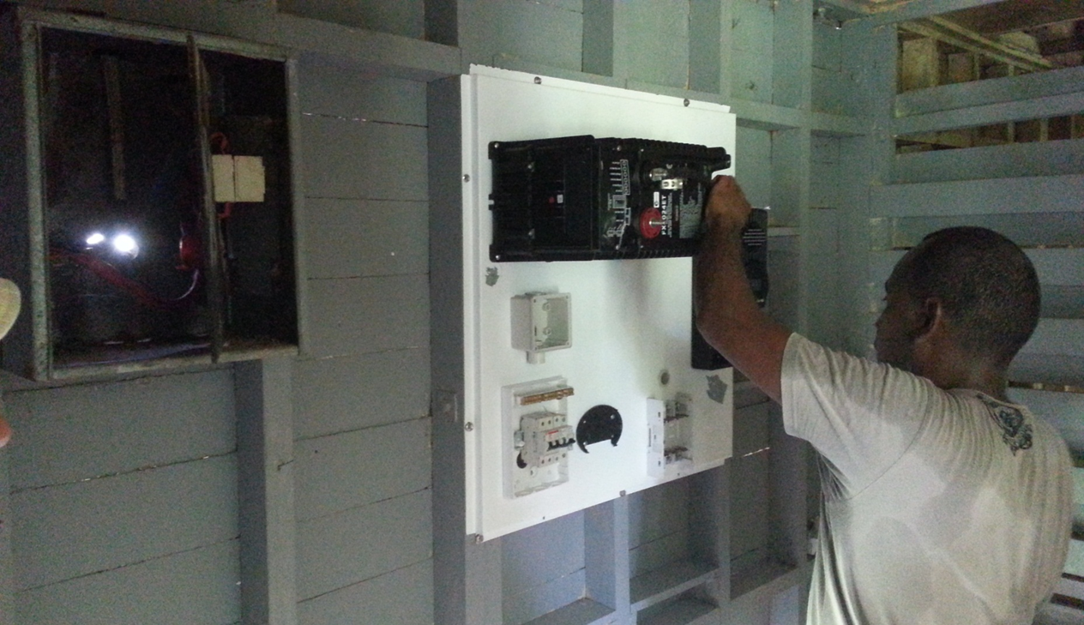
1.2 kW solar system
Average: 4 kWh per day

Slide 10
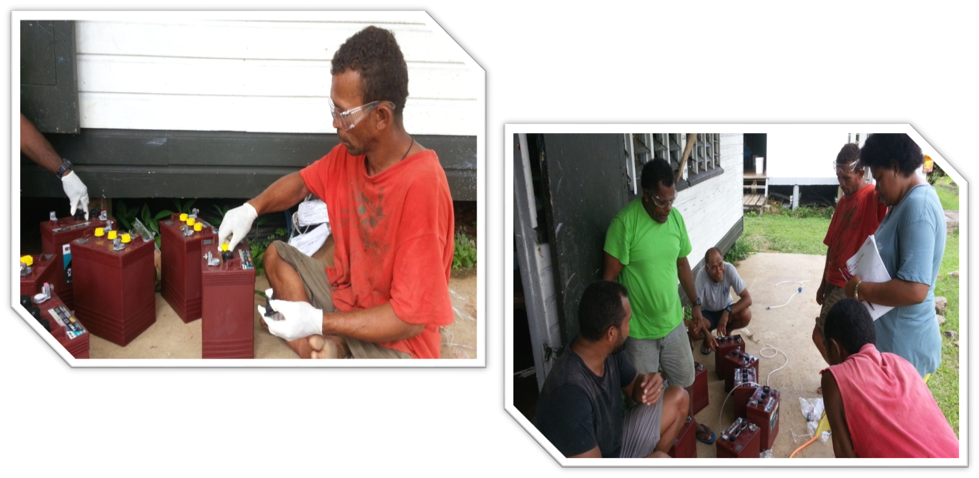

Slide 11
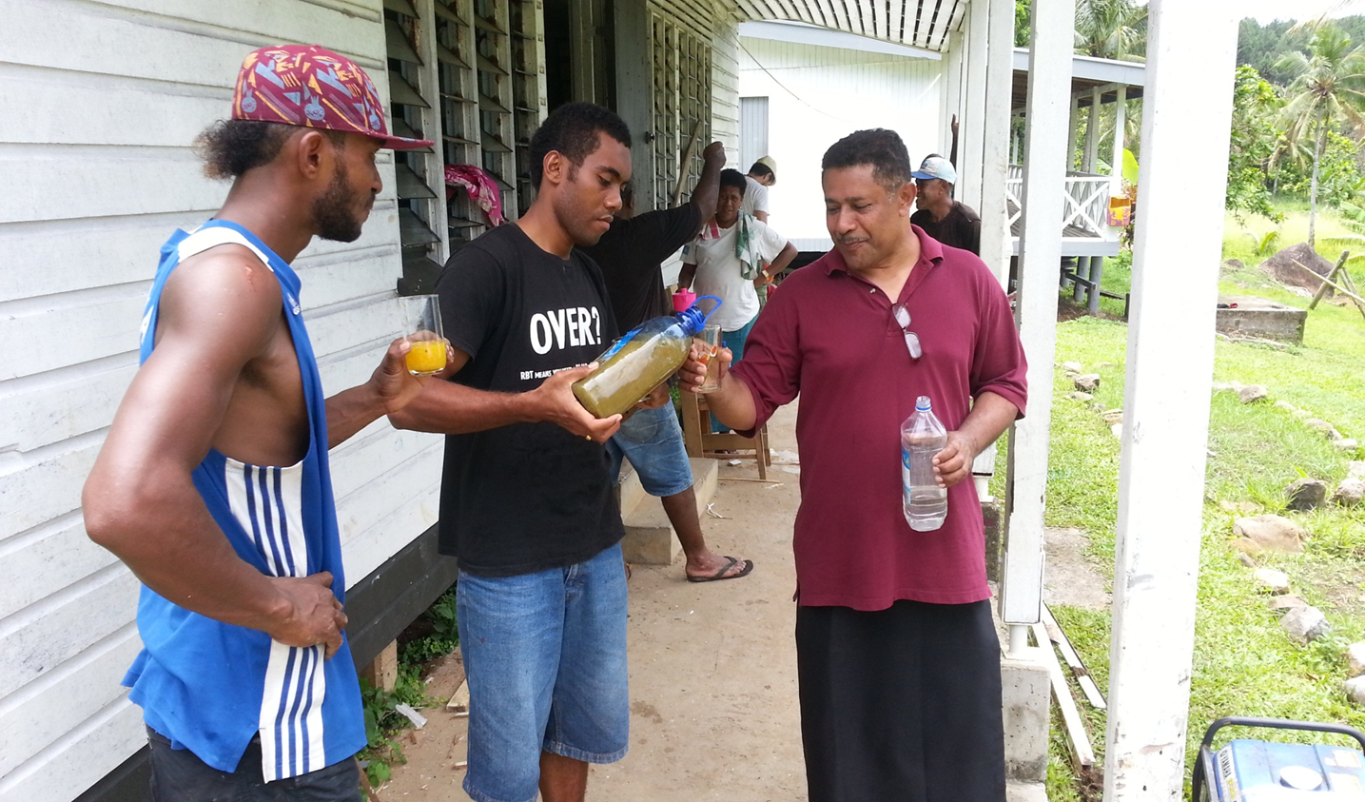

Slide 13
NODA SOLA INITIATIVE
a rural women empowerment program

Slide 14
PROJECT DEVELOPER
Dtronics Security PTE Limited
Grace trifam ministry
Fiji National university
Government of fiji

Slide 15
PROJECT DEVELOPERS
Fiji National university
Ms Salaseini Ligamamada
Snr. Lecturer Electrical Engineering
Dr. Ravita D. Prasad
HoS, School of Applied Science
Dtronics Security PTE Limited
Ms Kuini Rabo
- M3P Programme Manager – SPC
(Melanesia Million Miracles Program)
Grace trifam ministry
Mrs Safaira Tagivuni
- co- founder of GTM NGO.

Slide 16
PROJECT ROLES
DTRONICS LTD
GRACE TRIFAM
FNU
DEVELOPMENT
AND COMMUNITY SUPPORT
Ms KUINI RABO
PAULA TUIVANUYALEWA
Manage project
Deliver
Monitor
Commission
CAPACITY BUILDING
Mrs Safaira Tagivuni
Design and conduct the capacity building component of the project.
DATA ANALYSIS & DOCUMENTATION
Ms Salaseini L
Dr. Ravita Prasad
Conduct trainings in electrical/solar technology.
Document the project outcomes.

Slide 17
DTRONICS LTD
GRACE TRIFAM
FNU
DEVELOPMENT
AND COMMUNITY SUPPORT
Ms KUINI RABO
PAULA TUIVANUYALEWA
Manage project
Deliver
Monitor
Commission
CAPACITY BUILDING
Mrs Safaira Tagivuni
Design and conduct the capacity building component of the project.
DATA ANALYSIS & DOCUMENTATION
Ms Salaseini L
Dr. Ravita Prasad
Conduct trainings in electrical/solar technology.
Document the project outcomes.
The 2021-2030 NEP highlights energy access for all and gender equity, equality and empowerment for women and girls.
1.Ministry of Women – 2.Ministry of Trade & Investment – 3.Ministry of Energy
GOVERNMENT NATIONAL PROGRAM

Slide 18
Project components
SOLAR HOME SYSTEM INSTALLATION
BUSINESS TRAINING
ELECTRICAL TRAINING
CAPACITY BUILDING

Slide 19
CAPACITY BUIDLING
LOCAL
&
OVERSEAS MARKETS
BANKING SERVICE
ONLINE TRANSACTION
RESOURCE MAPPING
BUSINESS TRAINING

Slide 20
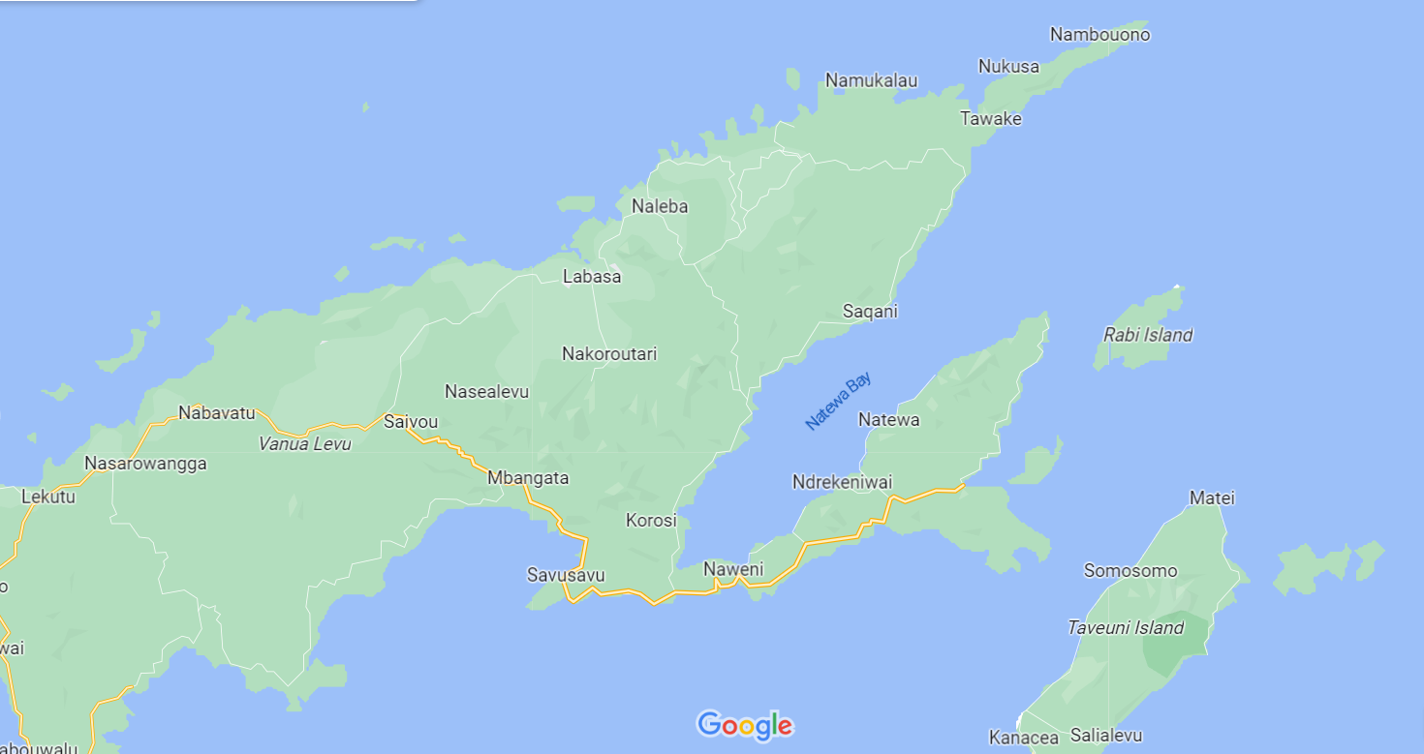
TARGET AREA

Slide 21
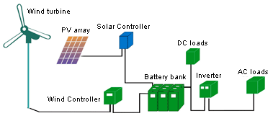
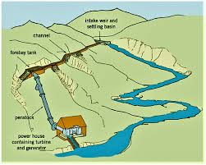
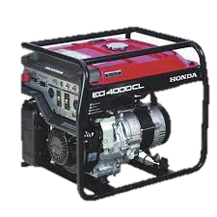
FUTURE GROWTH
Micro-wind hybrid
Mini - hydro

Slide 22
NASOKI MINI-GRID
It was the first PPP (Private-Public-Partnership) with the Dept of Energy.
PV panels + battery components self funded while the DoE funded the mini-grid + generator backup.

Slide 23
12kW peak Solar Panels,
18kW battery Inverters,
40kWh Battery Capacity
Cloud based prepay billing system
Prepaid -$21 for 10kWh per month.
NASOKI MINI-GRID

Slide 24
NASOKI MINI-GRID
Mini-grid serving 54 metering points:
48 Households
4 class-rooms
1 village hall
1 church

Slide 25
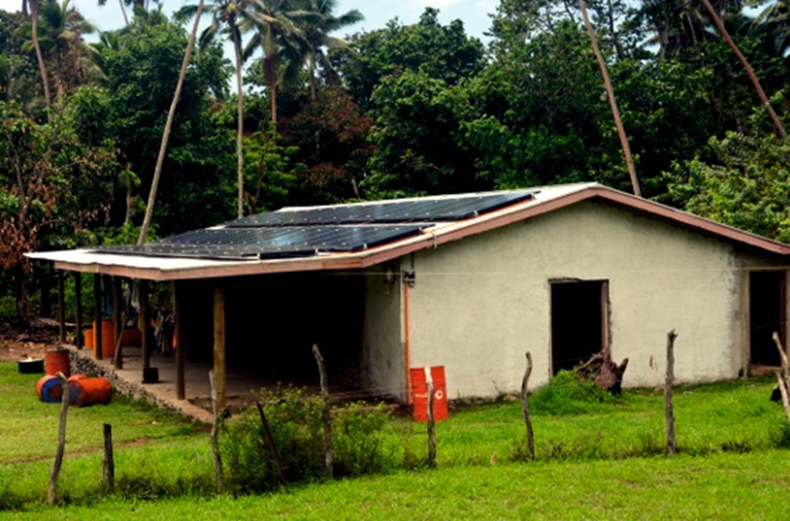
NASOKI MINI-GRID

Slide 26
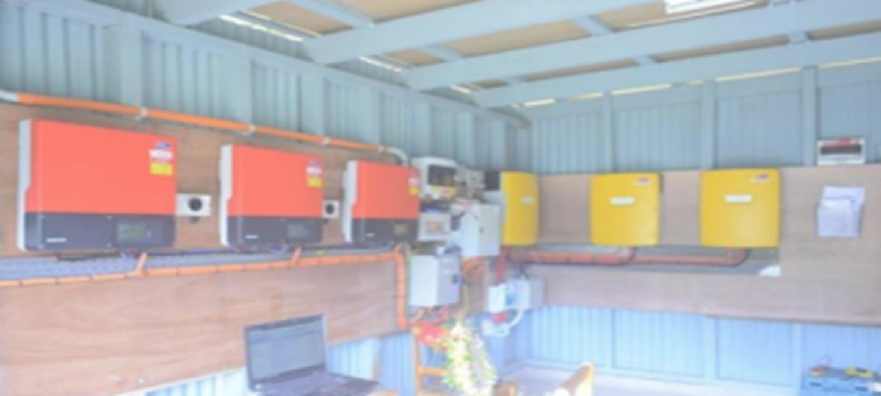
NASOKI MINI-GRID

Slide 28
Lessons learnt
COMMUNITY ENGAGEMENT AT THE INITIAL STAGE IS KEY:
Watts and Kilowatts
Whr and kWh
Limits
Equipment used and their useful life
Solar PV
Inverter
Battery

Slide 29
Lessons learnt
FINANCIALS – SUSTAINABILITY
Cost
Capital Expenditure (Capex)
Operational Expenditure (Opex)

Slide 31
VINAKA VAKA LEVU

