Slide 1
Training on Minimum Energy Performance Standards and Labelling (MEPSL)
13 – 15 March 2023
Kiribati
“Overview on the Pacific Appliance Database (PAD)”
Mr. Sosefo Tofu
Pacific Island Energy Professional
PCREEE

Slide 2
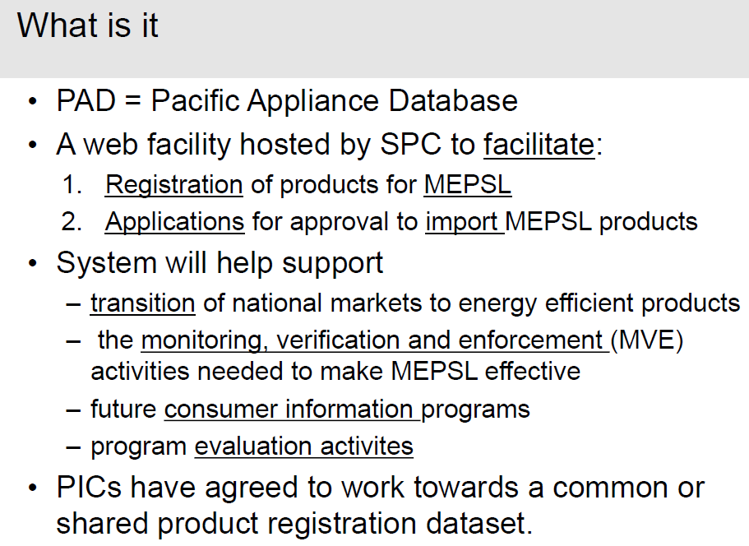

Slide 5
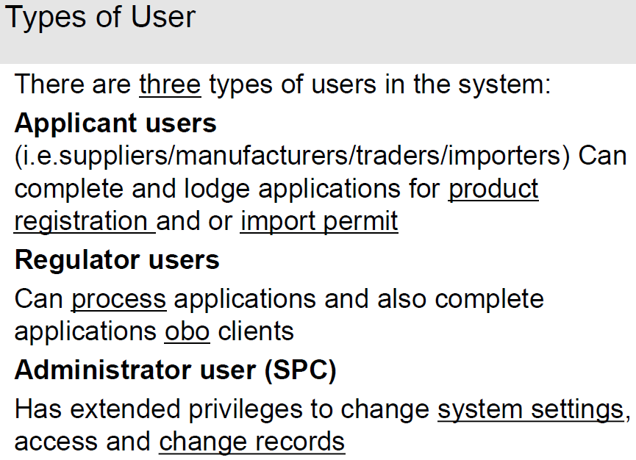

Slide 8
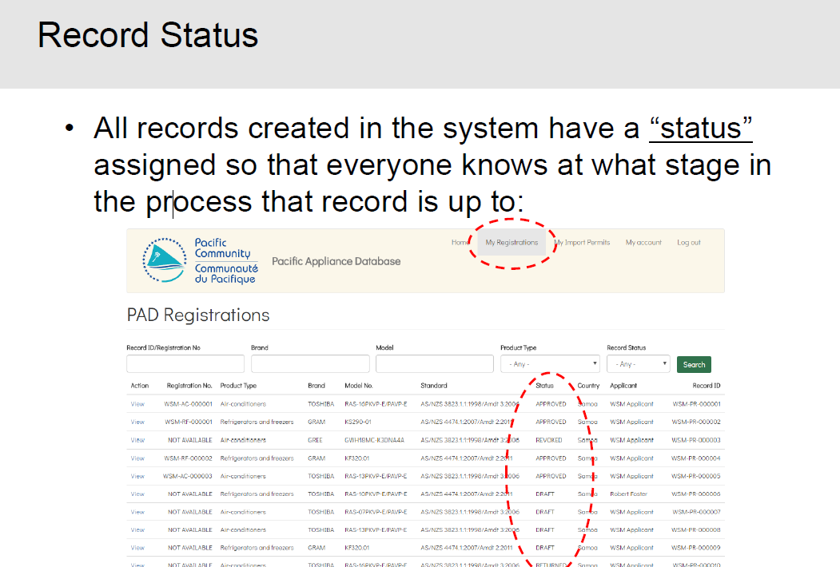

Slide 9
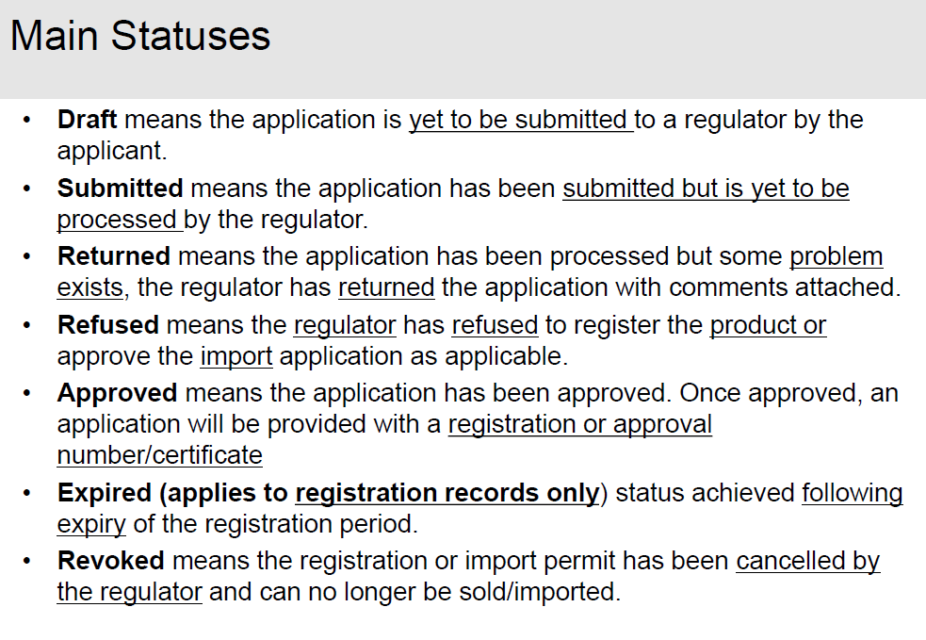

Slide 11
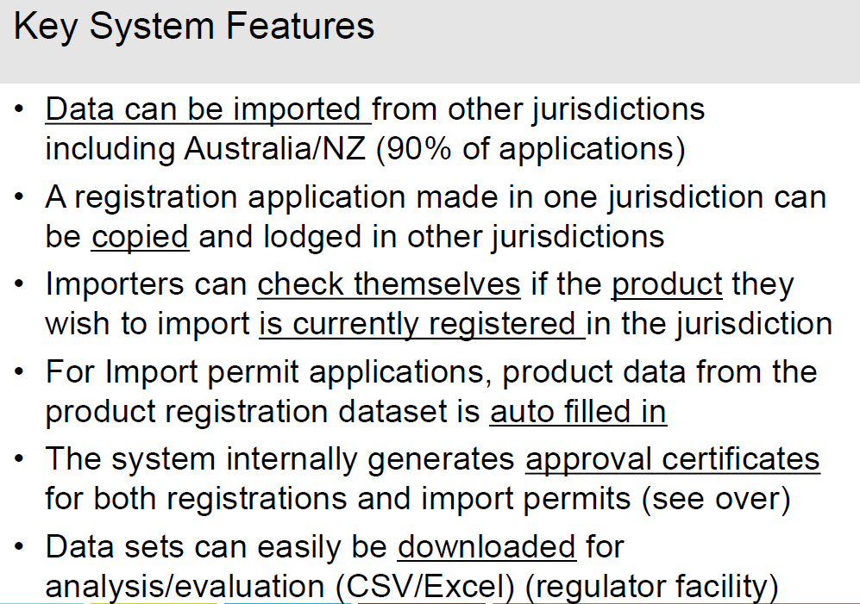

Slide 13
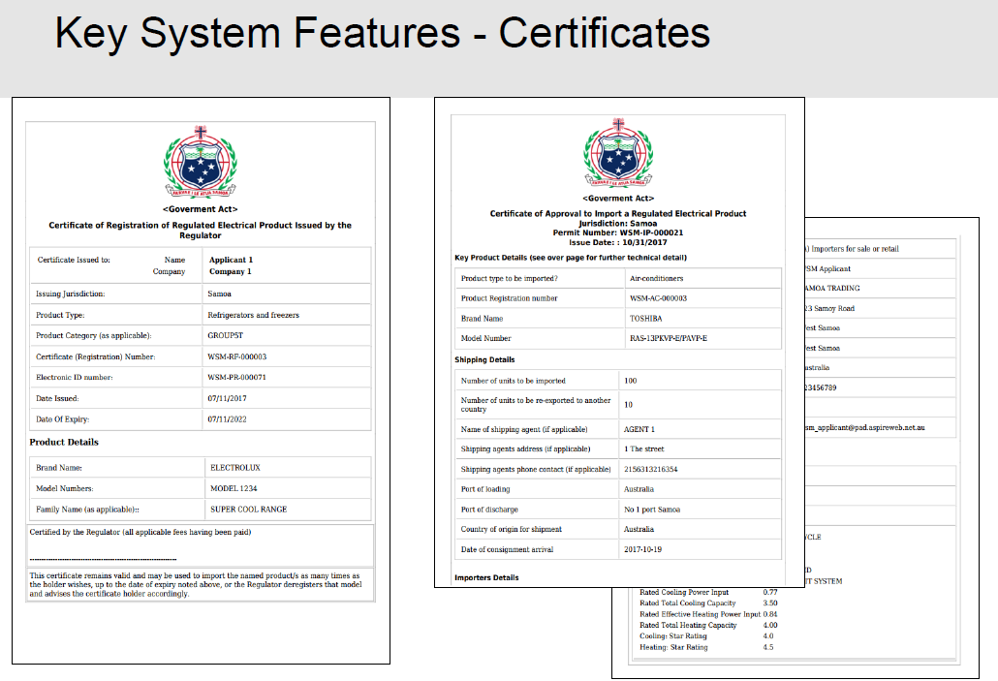

Slide 14
