Slide 1
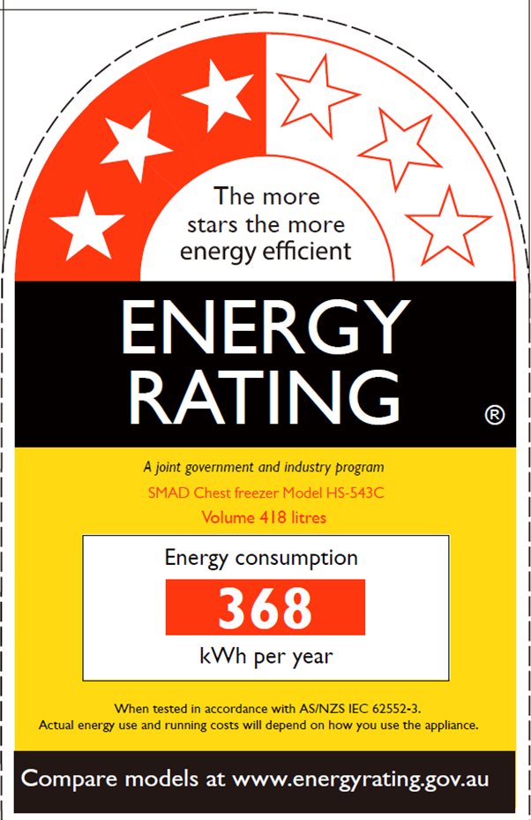
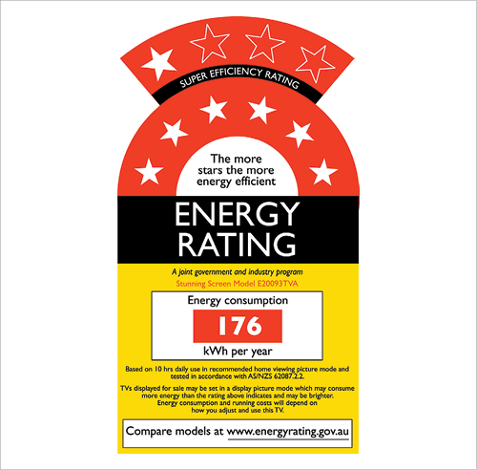
Ministry of Public Works, Meteorological Services and Transport
DEPARTMENT OF ENERGY
MEPSL FIJI – Standard Operating Procedure (SOP)

Slide 2
Roles of DOE
Department of Energy (DoE)
Sole regulator of MEPSL
Conduct inspection and issue permits
Making, amending, suspending or revoking guidelines in relation to the energy labeling and standards.
Legal proceedings and offences
Carry out disposal process.
Promote and awareness to general public
Conduct retailer/ customs trainings
Carry out shop floor audits

Slide 3
Adopted Standards
As of 1st of January 2012 it is mandatory for All Household Freezers and Refrigerators being imported into Fiji to comply with MEPSL
FS/AS/NZS 4474.1: Energy Consumption and Performance.
FS/AS/NZS 4474.2: Energy Labeling and Minimum Energy Performance Standard Requirements.

Slide 4
Key Stakeholders
Stakeholders | Functions
Shop Retailers | Retailers and importers of MEPS regulated goods
The Fiji Revenue and Customs Services | Point of contact at the Border Appoints custom officers to examine, flags and detains MEPSL regulated goods Assists DoE in temporary storage of detained items
Ministry of Trade, Co-operatives and SMEs . | Custodians of MEPSL regulation Fiji’s National Standards Body
The Solicitor Generals Office | Legal advise Drafting and Gazettal of Legislation
Department of Environment | Supervisors disposal of confiscated goods. Provides permit for Landfill

Slide 5
Testing and Registration of Goods
The importers have to ensure that all goods are/have been tested and comply with MEPS before importation into the country.
Importer shall first ensure that the goods is/has been tested according to the AS/NZS standards 4474.1 and 4474.2.
If Yes, the Importer can then proceed with the Importation Process.
If No, then arrangements will have to be made for testing of the goods either through a laboratory.
Once tested, the Importer can then proceed with the Importation Process and register through either:
Australian or New Zealand Regulators (Category A) or
Fiji Regulators (Category B and Category C)
The registration shall be rejected if the goods do not meet the standards.
Every import will require an permit from DOE

Slide 6
Flow Chart: Registration of goods
Importer ensures good is tested before importing
If test report is available proceed to submit application to regulator for import
If not tested arrangments to with labrotory
Proceed to submit application to regulator for import

Slide 7
Process of Registration
The Regulator will classify products into three categories for registration purposes.
Category A - products are already registered in GEMS and EECA
Category B - products are identical to products already registered with GEMS, but will be imported under a different brand name and/or model number.
A declaration from the product’s manufacturer saying that the product is identical to a specific model.
The registration number [ARFxxxx]
The declaration of statement from the retailer
Energy Rating Label
Model specifications (volume, dimensions, etc.)
Category C - products are not registered or new registrations
An application letter
Full Test Report
Energy Rating Label
Registration turn around time is 10 working days

Slide 8
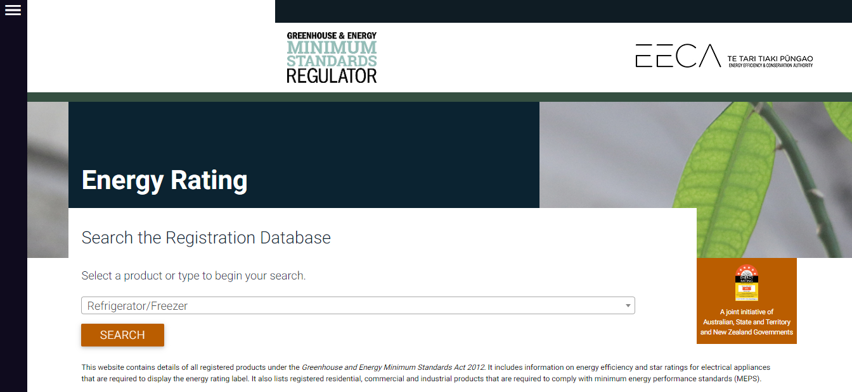
Verifying Cat A Products
Go to → https://reg.energyrating.gov.au/comparator/product_types/

Slide 9
Verifying Cat A Products

Slide 10
Verifying Cat A Products

Slide 11
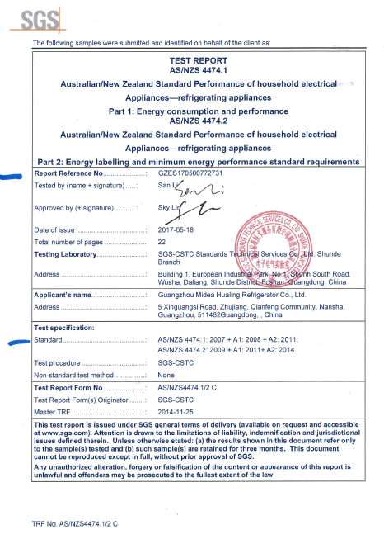
Verifying Test Reports

Slide 12
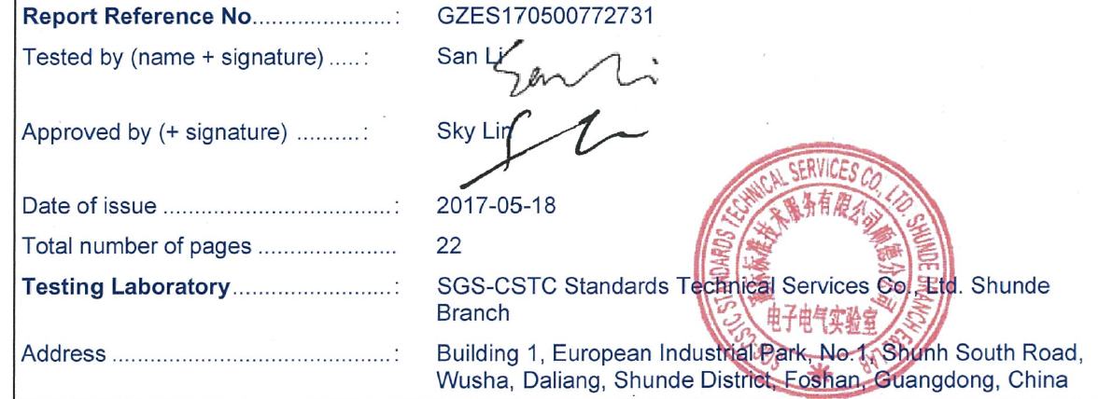
Verifying Test Reports
Test Report Lab and Unique Reference No.

Slide 13
Verifying Test Reports
✓ Check → Standards

Slide 14
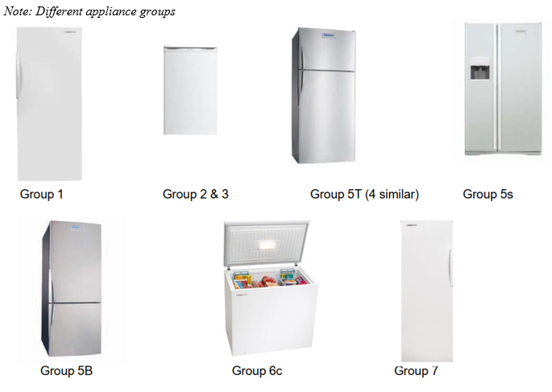
Verifying Test Reports
✓ Check → Brand, Model, Volume & Group

Slide 15
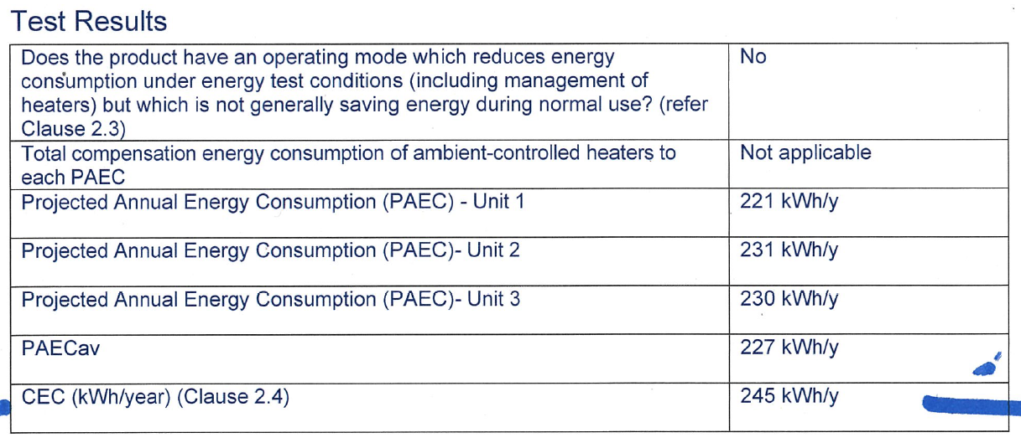
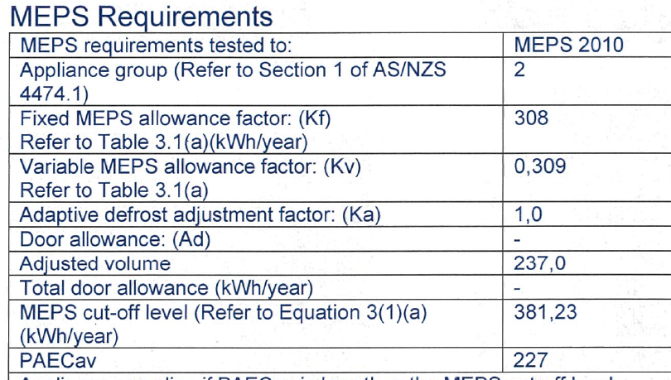
Verifying Test Reports
✓ Check → Test Results
For Compliance:
PAECav (kWh/y) should be less than MEPS (kWh/y) cut-off level

Slide 16
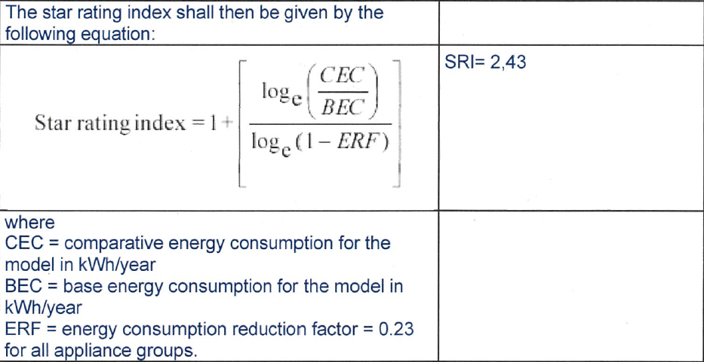
Verifying Test Reports
✓ Check → Star Rating
Therefore the appliance will have a Star Rating of 2

Slide 17
Process of Import Applications
The Importer shall submit an prior application to the Regulator seeking approval to import Household Electric Refrigerator and Freezers for each import.
Retailers (letter head)
Individuals (application forms)
DoE shall verify, scrutinize and screen the application of any anomalies and conduct a physical inspection when the good arrives.
The permit will be denied if the goods do not meet the relevant standards or if there is any discrepancy found during inspection.
All imports are monitored by FRCS.
Applications processing time is 2 to 3 working days

Slide 18
Application Form-Refrigerator

Slide 19
Screening of Applications
The following particulars needs to be verified:
Details of the Importer or Owner
Description of goods:
Brand, Model, Category, Quantity, Purpose of Import, etc.
Country of Origin
Date of arrival in Fiji
Details of Shipping Agent.

Slide 20
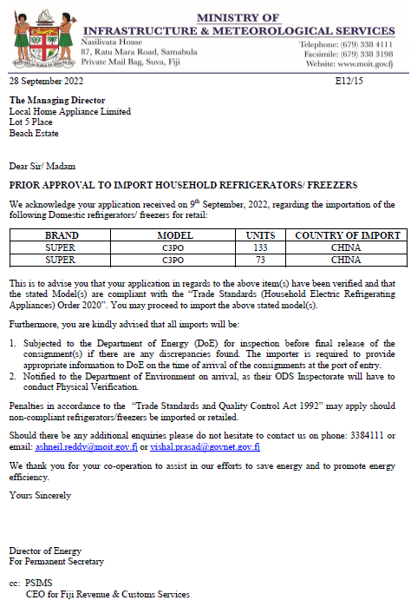
Sample Permit

Slide 21
Physical Inspection of Goods - Refrigerator
Inspections are carried out both at border and shop floors:
Brand and Model of the appliance
Star Rating and Energy Consumption
Quantity
Specification
Refrigerant

Slide 22
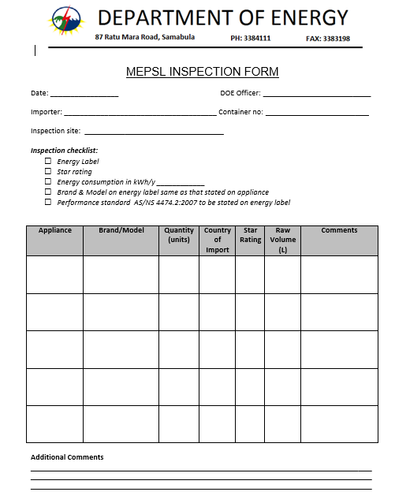
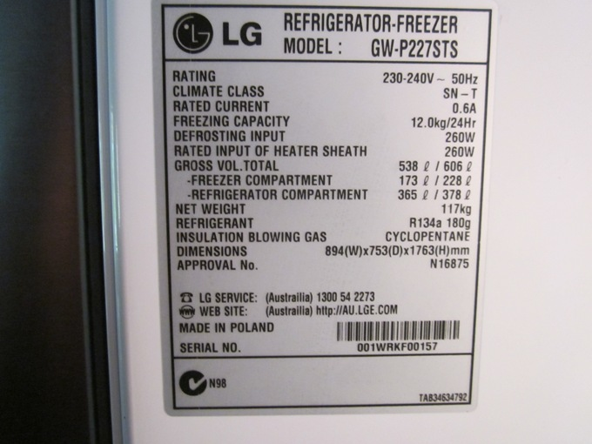
Cont.
Specification Labels - Refrigerators

Slide 23
Identifying Energy Rating Labels
Stars shows the efficiency of the appliance
Brand and the specific Model Number
States the energy consumption rate in kWh per year
Must state the AS/NZS 4474.2 Test Standards

Slide 24
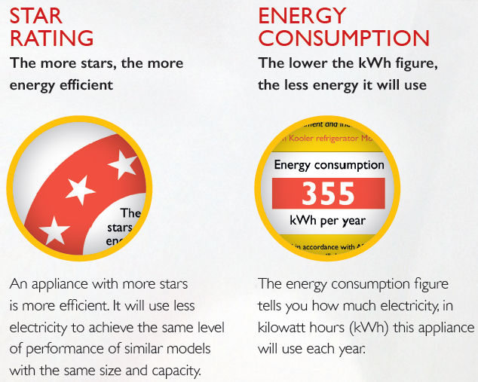
THE ENERGY RATING LABEL
How the information on the label helps you

Slide 25
THE ENERGY RATING LABEL
Calculating Cost to Run [Compare the labels on two similar sized fridges]:
Annual Cost to Run = Energy Consumption (kWh) x Electricity Tariff (FJD/kWh)
Example - Let’s say you want to buy a new fridge in Fiji, where the electricity tariff is 33.10 cents per kWh.

Slide 26
Shop Floor Audits
Scheduled to be taken every quarterly basis.
The focus is mainly on the major retailers in city and town areas such as Suva, Navua, Nadi and Labasa.
During store visits the following aspects are covered:
Does the product have an energy label affixed
Is the product properly registered?
Do the energy label details match the registered details
Issues identified
Most common → missing, obscured or faded labels
Least common → non-compliant goods evading border surveliance

Slide 27
Cont.
If upon examination any deficiency is identified a detention notice will be issued to the importer.
For Retailers, it is mandatory to have correct energy rating labels affixed.
3 months is given for remedial actions
Failure or unwillingness on part of the importer to return substandard/non-compliant goods results in DoE detaining the goods
There is a fine not exceeding $5,000.00 for a first offence and $10,000.00 for a second or subsequent offence. The maximum penalty for an offence committed by a body corporate is five times the fine.

Slide 28
Procedure Overview

Slide 29
Procedure for Re-exporting Non-Compliant Item
Customer needs to notify DoE prior (10 working days) to re-exporting date.
All paper works needs to be submitted for evidence purpose.
FRCS and DoE needs to be present to witness the loading of items.

Slide 30
Disposal Process
DOE seeks a formal approval of disposal from Ministry of Trade, Co-operatives and SMEs (MTCS).
All environment legislations such as Environment Act must be complied with.
Officers from MTCS and Department of Environment must be present to supervise the disposal process.
DOE to date has disposed 213 refrigerators and freezers at cost of FJD 27,400.
There are 2 parts to disposal:
Recovery of Refrigerants
Disposal of appliance components and body to landfill

Slide 31
Disposal-Recovery of Gas
A compliant company with valid refrigerant storage permit - recovery of refrigerants from the refrigerators.
Company is responsible for safe storage of gas.
Abide by all regulations of the Department of Environment and Energy.
Follow OHS regulations at all times.
Provide a report after the successful delivery of service.

Slide 32
Disposal-Scrapping
A compliant company with valid waste permit - scrap the Refrigerators and transport it to Naboro Landfill for disposal.
Gate fees and other miscellaneous fees are to be covered by the contractor.
Contractor is to liaise with relevant authorities and make arrangements for disposal.
Abide by all regulations of the Department of Environment and Energy.
Follow OHS regulations at all times.
Provide the report after the successful delivery of service.

Slide 33
Challenges
MEPSL Team is centralized therefore mobilization for inspections, trainings and shop audits in the Western and Northern Division is challenging.
Despite having adequate awareness, importers still fail to apply for permits prior to importation.
Staff turnover/transfer to other positions within Department
Customers seeking assistance from higher authority with regards to release of non-compliance appliances.
Obsolete standards → Due to DOE not being the custodians of the regulation the time duration for adoption or amendments of the legislation is out of control for the Fiji Department of Energy.
Constricted storage space to house detained appliances.

Slide 34
THANK YOU!!

