Slide 1
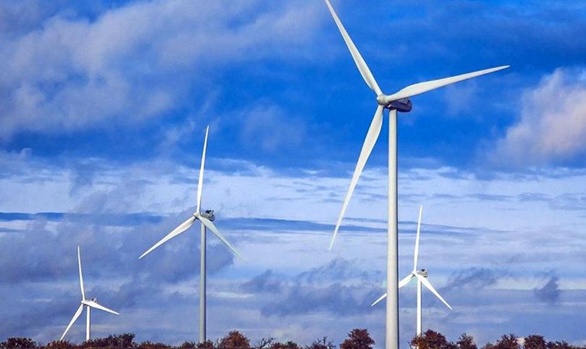
SIDS PPA Finance
Morten Hørmann, RE Finance Specialist, COWI A/S

Slide 2
Day 2
Financial modelling of PPA contracts and tariff pricing
Technical aspects: Wind and Solar Energy Production Profiles, Curtailment, Descriptions of the concept and importance of P50 versus P90/P95 estimates of yield.
PPA contract elements: penalties, capacity incentives, curtailment, payment lag and indexation
Public funding during project construction and/or operations
Exercises focused on PPA modelling

Slide 3
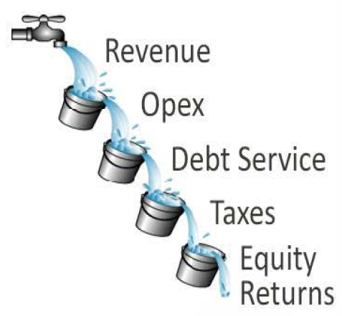
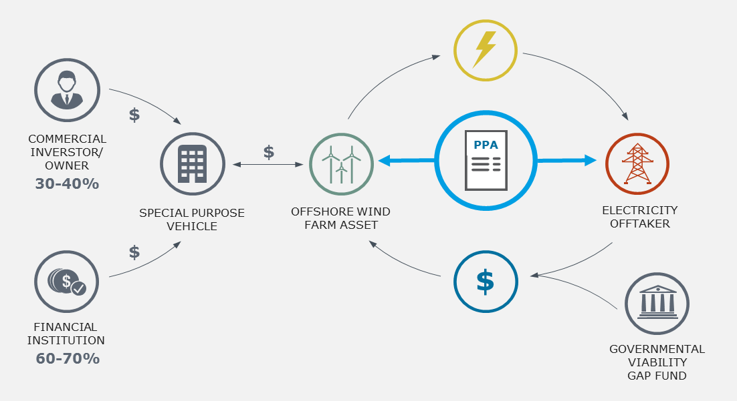
Recap of Day 1

Slide 4
Renewable energy generation

Slide 5
Dispatchable vs non-dispatchable generation
Dispatchable energy generation refers to technologies where the energy production is controllable
  The production can be adjusted within a short period of time to match consumption
Non-dispatchable (variable) generation refers to technologies where the energy production cannot be adjusted to meet demand (at least not 100%).
  Production can be curtailed which leads to loss of revenue
  Vital that curtailment is kept to a minimum
  Little value in requiring non-dispatchable technologies to comply with pre-defined production schedules
Many RE technologies are non-dispatchable
  High investment costs per unit of capacity and low operating costs
Dispatchable units such as fossil-fuelled thermal power have a much lower investment cost per unit of capacity
  High fuel/operating costs
  Less sensitive to the total energy generation.

Slide 6
Wind
Has been deployed in many countries to convert the energy form the wind into electricity
  Large variation in size from one application to another
  Small wind turbines sizes start at 50 kW
  The largest two-digit MW models are deployed in large/utility scale offshore wind projects
  Can be a very cost-effective technology for variable electricity generation.

Slide 7
Solar
One of the fastest growing energy sources in the world
  Is expected to overtake all other RE sources during the next decades
    Steep cost reduction curve
    Modularity features
    Low operational impacts (e.g. no noise, emissions, moving parts)
  Small distributed rooftop energy production to large scale solar plants of 200 MW and more
Resource is readily available
Non-dispatchable i.e. variable production
Energy storage to even out day-night cycle is feasible

Slide 8
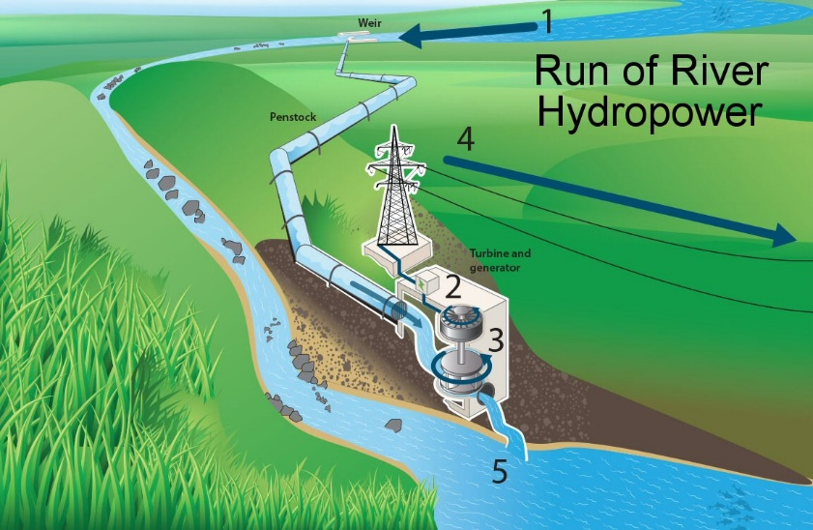
Hydro
Hydropower plants are a well matured technology based on natural water cycles
Hydropower alone contributes to approximately 15% of the world’s electricity production and a very large portion of the world’s RE generation
When a reservoir is present, hydropower can benefit from storage and power production regulation with minute-by-minute responses to demand fluctuations and grid stability needs
Plant sizes can vary from single turbines for localized generation to several GWs such as the 14 GW Itaipu project in Brazil and the 22.4 GW Three Gorges project in China.
Requires a quite steep gradient and a source of water
Dispatchability depends on type and water source
  Reservoir allows for dispatchability and scheduling
CAPEX can be high if building a reservoir in additional to higher environmental impacts incl. flooded areas

Slide 9
Thermal biomass
Consists of converting the energy from feedstock sources into electricity and potentially heat as well
The most common of biomass-to-energy technology are combustion plants using a water/steam boiler
  Plant sizes typically vary from 1 to +40 MWe
Types of biomass/feedstock sources:
  straw, bamboo, corn cobs, manure, banana peels, etc
  Each with different calorific values and application processes
Best with a local source of sustainable biomass
  Certification!
Production is predictable IF! feedstock is available

Slide 10
Pxx estimates
Uncertainty of variable renewable energy generation
The uncertainty of RE generation is managed by probability exceedance estimations (the PXX values)
Uncertainty sources include:
  Resource data and yield modelling
  Electrical loss and performance estimates
The expected energy yield is calculated for different probability levels
  P50: is the net yield before uncertainties i.e. the median value
  P90: accounts for uncertainty (in the form of a standard deviation, σ) and denotes the expected yield in the 10th percentile case
    90% probability of being exceeded

Slide 11
Variable energy production and contractual obligations
Variable generation presents a challenge in terms of balancing and system integrity
  PPA contracts will often specify commitments in terms of energy and capacity
The variation in generation is specific to each technology
  Commitments and penalties need to take this into account
In the Excel tool, variation is reflected in the “AEP time series” option under energy production
  This replaces the static Pxx estimate with an annual time series
  Does not capture all aspect of variability, but it is an approximation
Time horizon | Solar PV | Wind | Hydro | Biomass
Intra/inter day variation | Binary day/night variation | No consistent day/night variation | May depends on precipitation | Dispatchable in the short term
Weekly/seasonal variation | Cloud cover may be more prevalent in some seasons | High seasonal variation | Dry/wet seasons | Depends on the supply of biomass
Inter annual variation | Little variation | Little variation | Droughts and dry/wet years | Depends on the supply of biomass

Slide 12
PPA contracts

Slide 13
PPA tariff
The price per unit of electricity that the developer requires to engage in the project
A guarantee of reliable project revenue as a basis for loan financing
The main – but not the only – parameter of competition between developers
A PPA tariff higher than the base tariff in the grid may lead to considerations on public funding such as a VGF
  Viability Gap Funding can be applied specially for new technologies, demonstration or strategic projects

Slide 14
Committed energy and capacity
PPA contracts may require the developer to commit to production targets and availability of capacity
Commitments can have different time resolution
  Hourly, daily, weekly, monthly, annually
  Higher resolution means more predictability for the utility but more risk for the developer
Not meeting committed targets will often be met with penalties
Commitments of energy and capacity are difficult for non-dispatchable technologies

Slide 15
Incentives/Penalties
PPA contracts will often define a number of penalties for non-compliance
  Over-/underproduction relative to committed targets
  Under-delivery relative to committed capacity
  Delays in commissioning
A PPA contract can also provide economic incentives
  Compensation for curtailment
  Indexing of the PPA tariff

Slide 16
Payment lag
In some countries, there is a considerable delay from delivery of electricity to payment
Puts a considerable strain on the developer’s cash flow
Delaying revenues by as little as a few months will impact key indicators like NPV and IRR
The lack of cash flow in the first months of operation may lead to loan financing considerable cash reserves to pay operational costs and service debt

Slide 17
Indexing
There is no clear consensus on correcting the PPA tariff for inflation
Over a potentially 25-year long PPA contract, the lack of indexing can constitute a major loss of revenue
The developer will require a higher PPA tariff to compensate for the lack of indexing

Slide 18
Key principles in risk allocation via PPAs
Most risk are allocated, not “created or deleted”
Allocating risk leads to change in bidder behaviour (including risk premiums)
Perceived risk and actual risk can be very different
  Knowledge tends to bring the two closer together
  So does the ability to manage/control the risk
Each of the PPA contract terms mentioned lets us allocate risk to the developer (or not)
Before simply allocating risk it is important to consider where that risk is best managed
The Excel model provides the opportunity to assess the impact on the PPA tariff of allocating risk to the developer

Slide 19
What risks are the developers familiar/comfortable with – and not?
Variable generation and commitments
  They know their technology
  Depends on the time resolution
Construction time
  At least partially in their control
Curtailment
  Within limits it is a base condition
Inflation
  Outside their control
Payment lag
  Highly critical for financing
  Speaks to the creditworthiness of the off-taker
Real time balancing responsibility
  Most RE is not suited for dispatchable generation
Curtailment
  Developer has little influence on grid strengthening, dispatching choices etc..

Slide 20
Public co-funding & grants

Slide 21
Likely need for gap funding

Slide 22
Pay-as-you-go
Pay out the difference between PPA tariff and Base tariff on a per MWh basis
  Sometimes called Generation Based Incentive (GBI)
Spreads out the government/public expenditure over many years
Easy to manage and rationalize
  “A small premium to get RE”

Slide 23
Investment incentive
Pay out a subsidy on CAPEX to achieve a PPA tariff equal to the Base tariff
  Sometimes called an Investment Tax Credit (ITC)
Requires substantial public funding up front
Issues of ownership of assets

Slide 24
Why not GBI?
GBI is the more expensive solution
NPV of GBI is higher than NPV of the Investment Incentive
Money up front is worth more than money later

Slide 25
Grants
Grants are common for pilot projects
They can replace or supplement private equity
Can be used as an investment incentive
  What size grant would we need?
Alternatively as zero cost equity
  We have a grant to cover the 30% equity
  What will the PPA price be?

Slide 27
PPA contract elements in the Excel tool

Slide 28
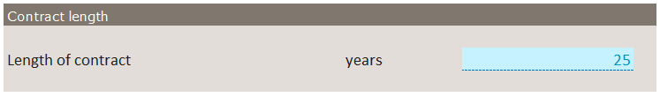
Contract duration
The length of the contract will impact project revenues
Technical life can be longer than the contract
  Price of electricity reverts to base tariff after end of contract
Loan financing is often tied to the PPA contract
  Contract duration will likely impact loan tenor

Slide 29
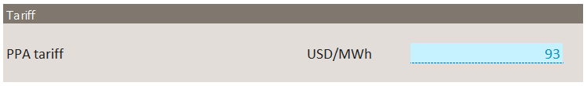
Tariff
The payment per unit of electricity to the developer
The PPA tariff is an input
  BUT: can be estimated by using the calibration/”goal-seek” module in the model

Slide 30
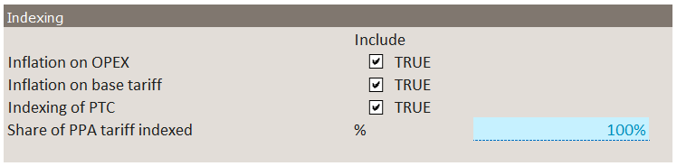
Indexing
Inflation impact several cost and revenue items
  OPEX is typically impacted by inflation
  Base tariff could potentially be impacted by inflation
  The production tax credit is a revenue and might be indexed
  The PPA tariff is sometimes partially indexed

Slide 31
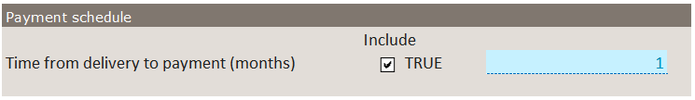
Payment schedule
Payment lag can have a big impact on project profitability
Payment lag is denoted in months
Payment lag can be switched on and off by the check box

Slide 32
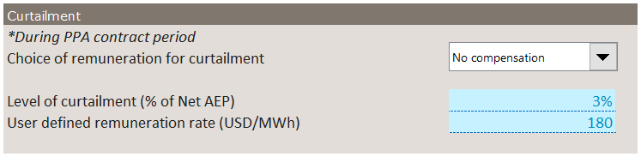
Curtailment
The Excel tool offers three option on curtailment
  No compensation
  User defined compensation
  PPA tariff, i.e. full compensation
Share of net AEP that is curtailed is an input
The user defined compensation is an input

Slide 33
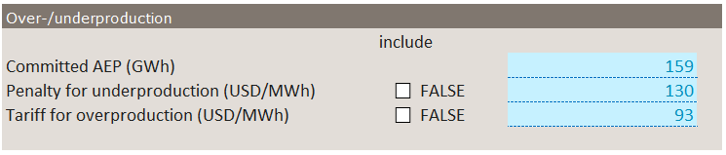
Over-/ underproduction
This functionality is tied to the use of a time series of AEP rather than a fixed Pxx AEP
Committed annual energy production determines over- and under production
  Underproduction is penalized by a fixed penalty per unit of energy
  Overproduction is paid a tariff that is potentially lower than the PPA tariff
  Both options can be switched on and off using the tick boxes

Slide 34
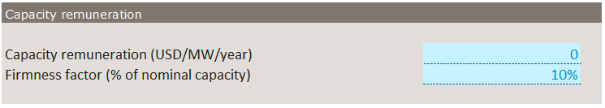
Capacity remuneration
Capacity remuneration pays out a fixed amount per year per unit of capacity available at all times
  Remuneration per unit of capacity is an input
  Firmness factor is an input. Often low for variable RE

Slide 35
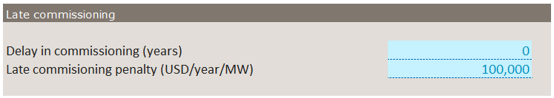
Late commissioning
Late commissioning is a problem for the developer AND the grid
  Delay is input in years
  Penalty is input per unit of capacity per year

Slide 37
Exercises Day 2

Slide 38
PPA contract
Set the contract length to the technical life
Change the PPA tariff
  If the results show error messages the PPA tariff is typically too low
  Don’t worry about it too much we will get back to the PPA tariff
Experiment with the various contract elements to see the effect on project KPIs

Slide 39
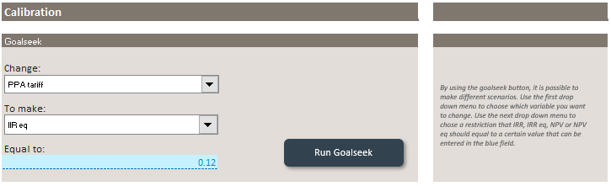
Calibrating the model
This is a key function in the model
  Select “Change:” PPA tariff
  Select “To make:” IRR eq
  Set “Equal to:” the cost of equity set under financing
Click the button “Run Goalseek” to find the PPA tariff which provides the developer with the required return on equity
Change a setting, e.g. a PPA contract element
Click the button again

Slide 40
Basic setup
Wind
Production based on AEP time series
Choose your own capacity
first year of construction 2020
2 years construction time
Technical life 25 years
Base tariff 40 USD/MWh
VAT and duties excluded
No PTC
No GBI
No investment subsidy
30/70 equity/senior debt split
12% return on equity
6% interest on senior debt
15 years loan tenor

Slide 41
Scenario analysis

Slide 42
Contract setups
Length 15 years
Inflation on OPEX
  No indexing of Base tariff, PTC or PPA tariff
3 months delay in payment
5% curtailment with no compensation
No production penalties
No capacity remuneration
No late commissioning
Lenght 25 years
Inflation on Opex and indexing of Base tariff, PTC and PPA tariff
1 month delay in payment
5% curtailment with no compensation
Production penalties both valued at the Base tariff
No capacity remuneration
No late commissioning

Slide 43
Compare the two contracts
Set up 1 contract
Find the PPA tariff using goal seek
Note the PPA tariff
  e.g. write it down or copy paste value to an empty cell
Set up the other contract
Find the PPA tariff using goal seek
how do the PPA tariffs compare?

Slide 44
Creating advanced plots using the model

Slide 45
Creating advanced plots using the model
Decosting the PPA tariff
  removing risks from the project
  Visualisation of the cost of PPA contract terms

Slide 46
Establish the base
Make sure all basic data on the project are in place
  Technology
  Uncertainty
  Construction start and duration
  Technical life
  CAPEX and OPEX
  Energy production
  Curtailment level
  Funding: Loans and equity

Slide 47
Activate worst case/most expensive PPA contract
PPA length shorter than technical life
Inflation on OPEX
Indexing turned off
Long delay in payment, e.g. 6 months
No compensation on curtailment
Penalties on under- AND overproduction
No capacity remuneration
Commissioning delayed 1 year and penalized
Find reasonable values for penalties and remuneration
  Underproduction costs base tariff?
  Overproduction only paid base tariff?
  Compensation for curtailment?
  Capacity remuneration?
  Penalty for delayed commissioning 5% of CAPEX/MW?

Slide 48
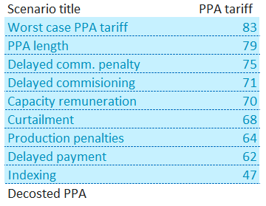
Generating data
Goal seek the PPA tariff in the worst case
Copy paste the resulting tariff to the table in “Results” – top row
Remove a cost driver, e.g. PPA length (make the PPA length = technical life)
Goal seek the PPA tariff
Copy paste the resulting tariff to the table in “Results” – next row down
Remove the next cost driver – repeat

Slide 49
Public funding

Slide 50
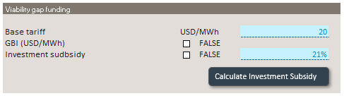

GBI vs Investment subsidy
Goal seek the PPA tariff
Include only investment subsidy
Indicate a Base tariff lower than the PPA tariff
Calculate investment subsidy
De-select Investment subsidy
Select GBI
Goal seek the PPA tariff
Select Investment subsidy

