Slide 1
The Private Financing Advisory Network E-Mobility Workshop
28th November to 2nd December 2022

Slide 2
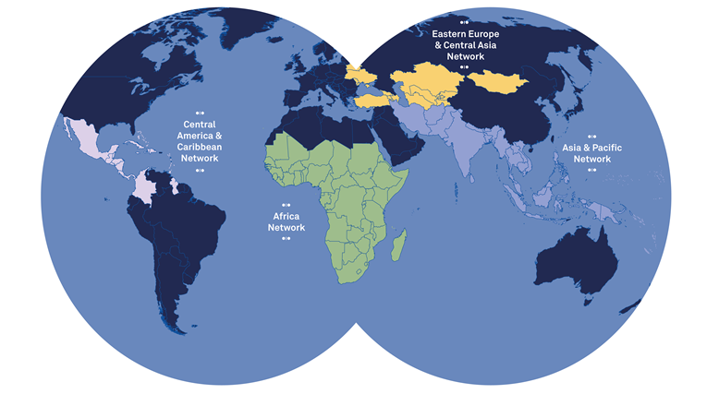
What is PFAN: A Global Network
Pakistan: 8 PFAN Advisors
EECA:
23 PFAN Advisors
More than 160 climate, clean energy & finance experts
Hosted by UNIDO and REEEP since 2016, initiated in 2006​
Unique and proven public-private partnership business model ​
Funded by a Multi-Party Trust Fund supported by:​
Latin America:
20 PFAN Advisors
South & Southeast Asia:
38 PFAN Advisors
Africa:
71 PFAN Advisors

Slide 3
Value Proposition
Addressing Barriers — Bridging the Gap
The
“Missing Middle”
Limited supply of
investor-ready projects
Low investment levels
Oversupply of poorly structured projects
Project developers lack financial & commercial skills
Unrealistic expectations
Large supplies of capital
Lack of formal financing products for SMEs
Low familiarity with technologies & business model
Underdeveloped investment cultures and risk assessment

Slide 4
PFAN’s Track Record
PFAN has supported nearly 1,000 projects with more than 300 projects in the current pipeline
PFAN mobilizes financing to reduce GHG emissions and contributes to the Paris Agreement and Sustainable Development Goals (SDGs):
SDGs 7 (Energy), 9 (Industry), 13 (Climate Action), and 17 (Partnership)
Main achievements since inception in 2008:
$
2.0
173
17%
BN
Total investment leveraged by PFAN-supported projects
Number of projects that raised capital
Success rate
2046
4.3
MW
MT
Clean energy generation capacity added
Annual CO2 emissions mitigated

Slide 5
PFAN Market Positioning
Filling the Gap for Transition to Scale
AECF/REACT/EEP/CTC/ GCIP , Challenge Funds
DFIs /RDBs
Impact
Investors
Corporate investors
Commercial investors
Seed Funding
Prototyping and early Proof of Concept
Grants
Project Preparation
Market Creation
De-risking for sustained Growth and Scale-Up
Providing Finance to advanced Business Models
Credit Enhancement
Commercial Finance
Blended Finance
Stages of Maturity

Slide 6
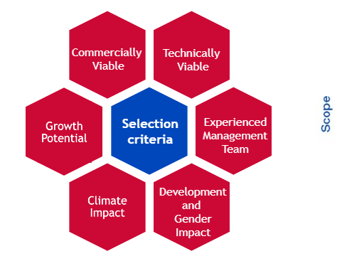
Project Selection Criteria & Scope
Transaction Size
Sweet spot USD 1-50 million
Micro Projects (<USD1 million)
Viability
Projects commercially and technically
viable
Project type
Clean Energy & Climate Adaptation
Technology Neutral
Market Segments Prioritized
Projects on clean energy and energy access
Preference will be given to specific market segments in clean energy
Apply today: https://climate-invest.fluxx.io/user_sessions/new

Slide 7
How the Pipeline Works
Origination
Quarterly Project Selection
Pipeline Induction (contracting)
Investment Facilitation
Projects
Development Pipeline Projects
Investment Forums
Investor Roadshows
Investor Introductions
Project Development Framework
Tipping Point
TA
Financial Close

Slide 8
PFAN Service Offering
Project Origination
Roadshows & Outreach
Investment Potential Assessment (IPA)
Development Pipeline
Business coaching / De-risking Bus. Model
Preparation of Business Plan
Investment Structure & Ask
Preparation of Investment Pitch & Teaser
Financial Structuring & Matchmaking
Investment Forum Stream
Supplementary Coaching
Investment Facilitation
Valuation
Investor Identification & Introductions
Transaction Advisory
Negotiation & Closing
Tipping Point Technical Assistance (TPTA)
To address specific investor requirements
Financial Advisory
DD / CPs / Audit / Legals / Study Updates
PFAN Investor Outreach
Investor Database & Active Partnership Management
Build Investor Capacity
Investor Forums
Investor Roadshows
1-1 Investor Introductions
Project Referrals
Origination & Engineering of Customised Portfolios

Slide 9
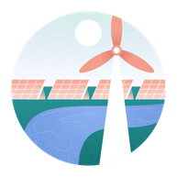
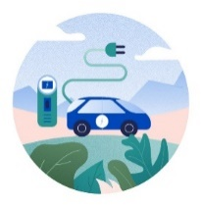
Sectors & Technologies supported by PFAN
Agriculture & Agribusiness
Biodiversity & Eco-system Services
Clean Cooking
Clean Technology
Climate Change Adaptation
Climate Resilience Infrastructure
Cooling
Energy Efficiency & Demand Reduction
Energy Storage & Conservation
Renewable Energy
Rural Electrification & Energy Access
Tourism
E-mobility
Water & Sanitation
Waste Treatment

Slide 10
PFAN in the Pacific – Areas of Focus
Clean Energy
Energy Access / Rural Electrification
B2B distributed & captive generation
Maritime mobility (EVs & green hydrogen)
W2E
Selective IPPs especially with partners
Climate Change Adaptation
Waste treatment & marine waste
Coastal defences & marine ecosystems
Fishing & aquaculture
Up & downstream agriculture
Water;
Tourism
Focus on working with and through partners (eg FDB / FREF).

Slide 11
Types of Partnerships
Investment Partner - comprise of range of investors and financiers
Impact and philanthropic investors
Corporate and institutional investors
Commercial and development banks;
Development Finance Institutions and Multilateral (Regional) Development Banks
Network Partner – entities that address issues connected to enabling environments; promote innovation; provide technical assistance and development funding; fund technical impact and feasibility studies;
Government agencies such as rural electrification agencies (FREF)
National development banks (FDB etc.)
Regional institutions such as the Regional Centers for Renewable Energy and Energy Efficiency, or national institutions and associations (PCREEE)

Slide 12
PFAN - E-Mobility in Fiji (1)
Our role help facilitate the following:
Complementary Technical Assistance
Introduction to PCREEE’s Sustainable Energy Entrepreneurship Facility (PSEEF) facility that enabled the legal review around the electricity tariff.
Introduction to UNDP’s Blue Accelerator Grant Scheme (BAGS)
Our work with the developer helped open doors with entities such as locations including two key of the sites where charging infrastructure is located
Introduction of the developer to potential fleet partners (current model is being developed for public charging). There exists a large potential for a fleet conversion model.
Helped Leaf Capital in the process to secure debt with the Fiji Development Bank
Other financing opportunities are being explored as the program to scale up progresses.

Slide 13
PFAN - E-Mobility in Fiji (2)
Other comments:
As the first of its kind in Fiji had risks of ideas being “stolen” by vertically/horizontally integrated businesses and as a new entrant in the market
Rising fuel prices helped highlight the discussion as the concept was being shared with various stakeholders including Taxi operators, Fleet Owners and Car Dealerships.
Budget submissions
A budget submission put in by Leaf Capital was passed in which an incentive of FJD10k cash back on e-vehicles imported into Fiji.
Fiji already had a zero-duty scheme in place for electric vehicles but the GoF also waived VAT on e-vehicle imports.
Had conversations with the utility that talked about capacity issues but cleared the air around the ability to sell power of charging.
A budget submission for LPG Generation for electricity was also adopted in the last budget which could be explored further around charging for an EV network in areas where grid capacity may be an issue. There is an established network of LPG Autogas dispensing stations around the country.
Other E-Mobility Initiatives:
There’s a retro-fit opportunity for marine transport sector (outboard motors)
Some suppliers are interested in setting up an ICE conversions facility in Fiji for trucks

Slide 14
Thank you!
Peter Storey Global Coordinator peter.storey@pfan.net
David Eyre Regional Coordinator Pacific david.eyre@pfan.net +679 833 5156
more information at
http://pfan.net
Follow us on:
@PFAN_Global
https://www.linkedin.com/company/pfan/

