Slide 1


UNIDO’s Experience on E-Mobility
PACIFIC ISLANDS WORKSHOP ON ELECTRIC MOBILITY
28 November 2022
Suva, Fiji Islands

Slide 2
Global E-mobility – Continued…

Slide 3
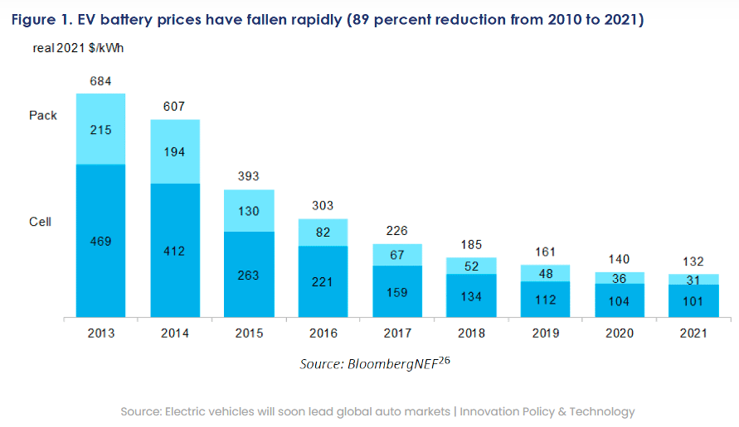
EV battery prices have fallen rapidly
Notes:
Due to rapid battery innovation, the last decade has seen a revolution in EV economics, causing the price of EV batteries to plunge by 89%. This has resulted in total lifetime costs for EVs being less than for a comparable ICE vehicle, due to EV savings on fuel and maintenance. Even though EVs are still slightly more expensive, the up-front cost difference is shrinking. In a couple years, most EVs are expected to cost less than comparable ICE cars.

Slide 4
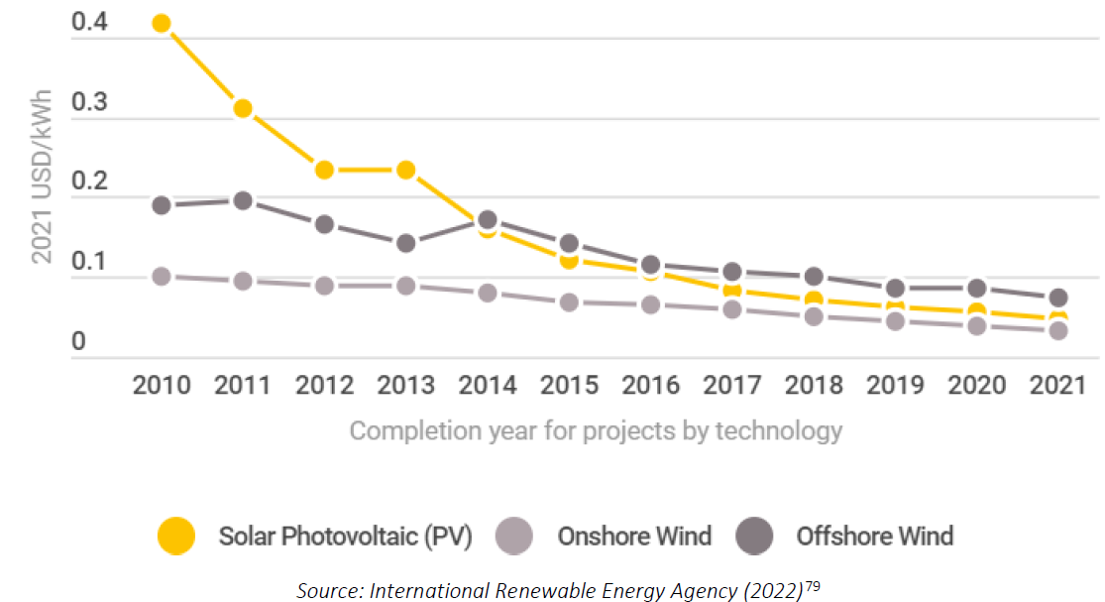
Learning curves for renewables (levelized cost of electricity generation)
Notes:
Over the last decade, learning curves have produced remarkable effects for solar, wind, energy-efficient LED lighting, and batteries. Figure 10 below illustrates learning curve effects for renewable technologies for electricity generation, focusing on solar PV along with onshore and offshore wind. The global weighted average cost of newly commissioned utility-scale plants declined 88 percent for solar PV, 68 percent for onshore wind, and 60 percent for offshore wind from 2010 to 2021. These learning curve effects mean that the average cost of renewable electricity has fallen below the average cost of electricity from plants burning coal and natural gas across the globe.viii,78

Slide 5
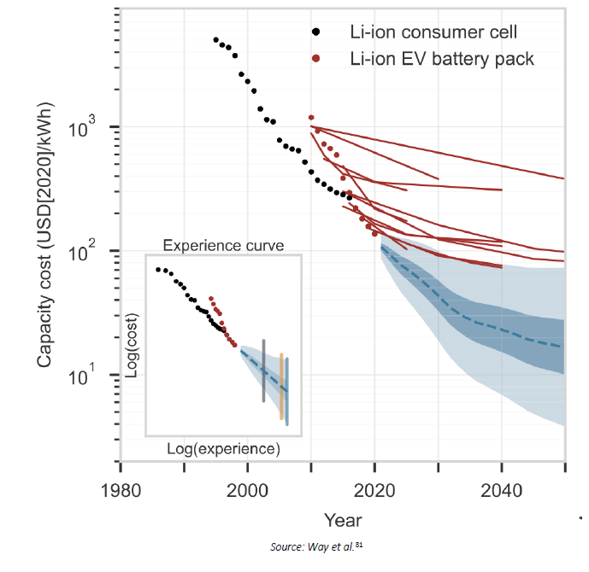
Battery electric storage learning curve
Notes:
Figure 11 reproduces Way et al.’s battery learning curve, denoting historical prices for lithium-ion (Li-ion) consumer battery cell prices and Li-ion EV battery packs with black and red data points, respectively, while red line segments trace historical forecasts for the most optimistic scenarios by leading energy-economy modelers such as the IEA.
The larger graph charts price over time, a more accessible perspective but one that glosses over the fact that learning curves are properly understood as a function of cumulative production. The smaller inset graph uses cumulative production, instead of time, along the horizontal axis. Another difference relates to units, with the smaller inset graph using the logarithm of price along the vertical axis and the logarithm of cumulative production along the horizontal axis, creating what is known as a “log-log graph.” In a log-log graph, a straight-line learning curve effect would represent a constant learning curve effect with increasing cumulative production, an advantage for visual intuition into learning curve effect trends over time.
New Battery Chemistries
Promising sources of learning curve effects for battery electric storage include emerging, next-generation options as well as more incremental innovation.
Starting with the latter, incremental improvements in current technology are expected from continued learning curve effects. Future investments in battery factories will dwarf those to date, yielding continued economies of scale in production.

Slide 6
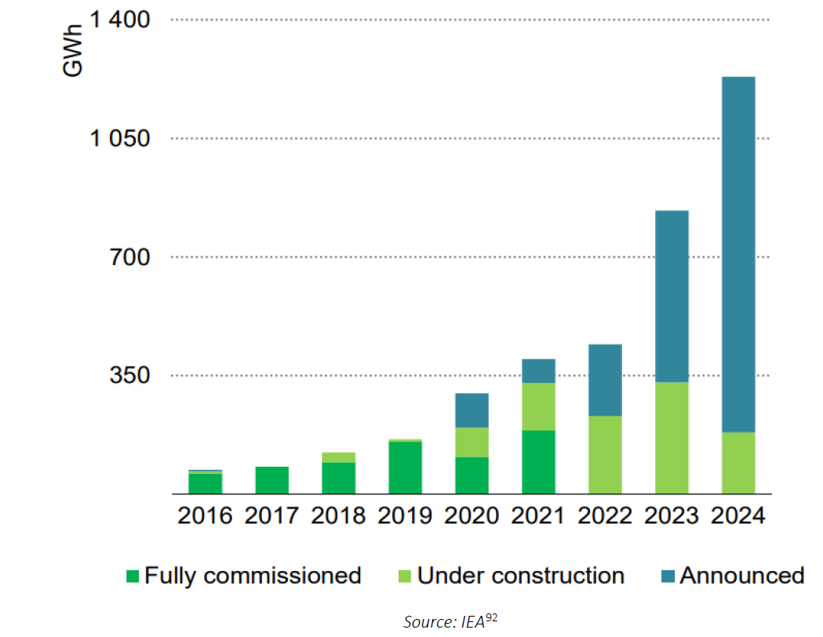
Battery manufacturing capacity additions
Notes:
Battery production stood at just shy of 200 gigawatt-hours in 2019. Factories under construction and announced investments will increase production capacity by six times, assuming all projects are successful, as Figure 12 illustrates.

Slide 7
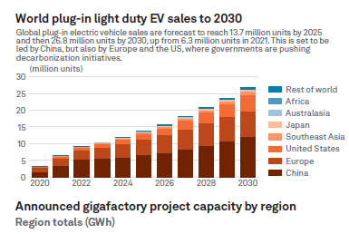
Global battery factory plans increase on high EV demand - 1
Source: S&P Global Commodity Insights, S&P Global Market Intelligence
Notes:
Global electric vehicle demand is set to rise exponentially by 2030 as governments develop their energy transition policies, and battery makers worldwide have responded by increasing their gigafactory plans in the past year. Total capacity is now forecast at around 7 TWh, almost triple the project capacities announced as of September 2021 and five times the current operating capacity.
Global plug-in electric vehicle sales are forecast to reach 13.7 million units by 2025 and then 26.8 million units by 2030, up from 6.3 million units in 2021. This is set to be led by China, but also by Europe and the US, where governments are pushing decarbonization initiatives.
Copyright © 2022 by S&P Global Inc. All rights reserved. Developed by Jacqueline Holman, designed by Melenie Yuen
Source: S&P Global Commodity Insights, S&P Global Market Intelligence, Company Announcements

Slide 8
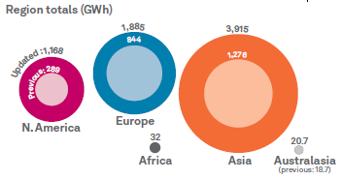
Announced gigafactory project capacity by region
Source: S&P Global Commodity Insights, S&P Global Market Intelligence
Notes:
Global electric vehicle demand is set to rise exponentially by 2030 as governments develop their energy transition policies, and battery makers worldwide have responded by increasing their gigafactory plans in the past year. Total capacity is now forecast at around 7 TWh, almost triple the project capacities announced as of September 2021 and five times the current operating capacity.
Global plug-in electric vehicle sales are forecast to reach 13.7 million units by 2025 and then 26.8 million units by 2030, up from 6.3 million units in 2021. This is set to be led by China, but also by Europe and the US, where governments are pushing decarbonization initiatives.
Copyright © 2022 by S&P Global Inc. All rights reserved. Developed by Jacqueline Holman, designed by Melenie Yuen
Source: S&P Global Commodity Insights, S&P Global Market Intelligence, Company Announcements

Slide 9
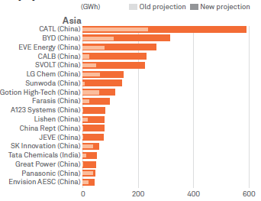
Asia top developers’ previous vs new announced capacity by 2030
Source: S&P Global Commodity Insights, S&P Global Market Intelligence
Notes:
Global electric vehicle demand is set to rise exponentially by 2030 as governments develop their energy transition policies, and battery makers worldwide have responded by increasing their gigafactory plans in the past year. Total capacity is now forecast at around 7 TWh, almost triple the project capacities announced as of September 2021 and five times the current operating capacity.
Global plug-in electric vehicle sales are forecast to reach 13.7 million units by 2025 and then 26.8 million units by 2030, up from 6.3 million units in 2021. This is set to be led by China, but also by Europe and the US, where governments are pushing decarbonization initiatives.
Copyright © 2022 by S&P Global Inc. All rights reserved. Developed by Jacqueline Holman, designed by Melenie Yuen
Source: S&P Global Commodity Insights, S&P Global Market Intelligence, Company Announcements

Slide 10
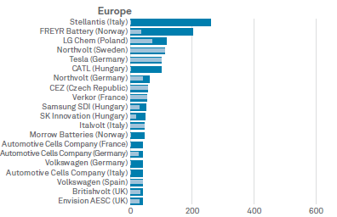
Europe top developers’ previous vs new announced capacity by 2030
Source: S&P Global Commodity Insights, S&P Global Market Intelligence
Notes:
Global electric vehicle demand is set to rise exponentially by 2030 as governments develop their energy transition policies, and battery makers worldwide have responded by increasing their gigafactory plans in the past year. Total capacity is now forecast at around 7 TWh, almost triple the project capacities announced as of September 2021 and five times the current operating capacity.
Global plug-in electric vehicle sales are forecast to reach 13.7 million units by 2025 and then 26.8 million units by 2030, up from 6.3 million units in 2021. This is set to be led by China, but also by Europe and the US, where governments are pushing decarbonization initiatives.
Copyright © 2022 by S&P Global Inc. All rights reserved. Developed by Jacqueline Holman, designed by Melenie Yuen
Source: S&P Global Commodity Insights, S&P Global Market Intelligence, Company Announcements

Slide 11
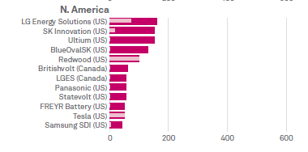
N. America top developers’ previous vs new announcedcapacity by 2030
Source: S&P Global Commodity Insights, S&P Global Market Intelligence
Notes:
Global electric vehicle demand is set to rise exponentially by 2030 as governments develop their energy transition policies, and battery makers worldwide have responded by increasing their gigafactory plans in the past year. Total capacity is now forecast at around 7 TWh, almost triple the project capacities announced as of September 2021 and five times the current operating capacity.
Global plug-in electric vehicle sales are forecast to reach 13.7 million units by 2025 and then 26.8 million units by 2030, up from 6.3 million units in 2021. This is set to be led by China, but also by Europe and the US, where governments are pushing decarbonization initiatives.
Copyright © 2022 by S&P Global Inc. All rights reserved. Developed by Jacqueline Holman, designed by Melenie Yuen
Source: S&P Global Commodity Insights, S&P Global Market Intelligence, Company Announcements

Slide 12
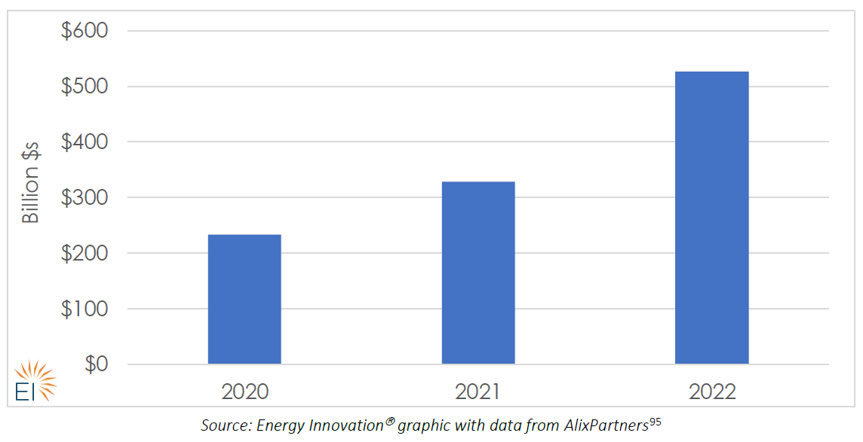
Planned EV investments looking five years forward for major automakers
Notes:
Battery production stood at The EV transition is garnering a large amount of investment and an increasing share of industry investment. Whether considering IEA’s estimate of $90 billion in EV-related spending in 2020 or the $105 billion average annual implied by AlixPartners’ assessment of automakers’ future five-year plans, current investment levels appear equal to the challenge. Rapid electrification under the IEA’s Net Zero by 2050 Scenario requires $315 billion invested from 2021 to 2025 ($63 billion annually) and $675 billion from 2026 to 2030 ($135 billion annually).96 Comparing these to 2020 actual investments of $90-$135 billion shows current investment appears to be running above current need, and even approaching the higher levels required later in the 2020s under the IEA’s Net Zero by 2050 Scenario.

Slide 13
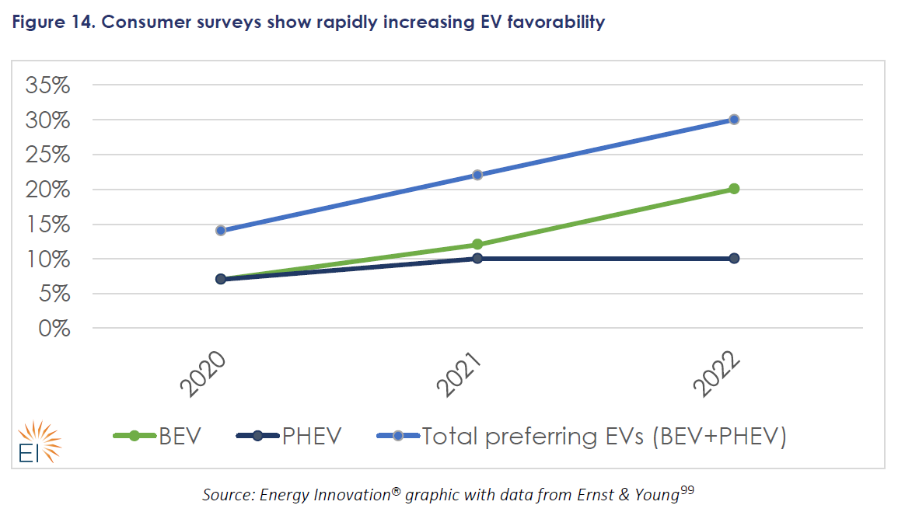
Consumer surveys show rapidly increasing EV favorability
Notes:
As of 2022, 37 percent of Chinese consumers expect their next purchase to be an EV.100 In California, 59 percent of current residents are likely to choose an EV for their next vehicle purchase.
Increasingly positive consumer sentiment is evident in growing willingness to pay for EVs, demonstrated by data showing retail profit margins for EVs exceeding conventional car margins. U.S. data from early 2022 showed an average sale price for a fully electric vehicle was marked up 2.6 percent over the manufacturer’s suggested retail price, compared to 1.6 percent for a weighted average of all new car sales.102

Slide 14
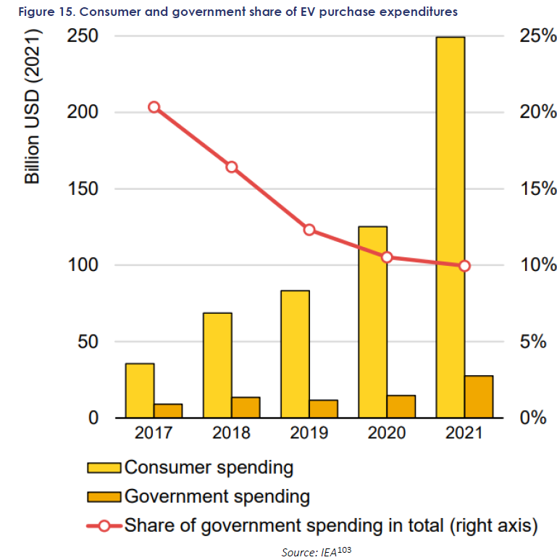
Consumer and government share of EV purchase expenditures
Notes:
A final point of evidence demonstrating the positive trend in consumer sentiment tracks the share of EV purchase costs borne by consumers versus the government. From 2017 to 2021, on a global average basis, the share of EV purchase costs paid for by public funds dropped by about half, from 20 to 10 percent, illuminated in Figure 15. The fact that EV purchases have soared even as government support has dropped is proof of increasing consumer demand.
EVs offer superior acceleration, owing to their ability to instantly deliver peak torque even from a complete standstill. Typical street driving, as opposed to highway travel, frequently involves acceleration from a standstill, making this an important advantage. Though the industry is still scaling up, one EV—the Tesla Model S—is already the fastest car in the world, measured by time to reach 60 miles per hour.104 EVs’ performance advantage leads to headlines in mainstream media such as the following example from Barron’s, a financial news outlet: “EVs Can Turn Anyone into Race Car Drivers—Including Me
Electric motors are also inherently more energy efficient than ICEs, which suffer losses to waste heat. Conventional cars only convert 12 to 30 percent of the energy stored in gasoline to power at the wheels, compared to more than 77 percent converted for electrical energy in the case of an EV.106

Slide 15
UNIDO EXPERIENCE ON E-MOBILITY

Slide 16


The GN-SEC Map - support “from the region for the region”
Envisaged agreement in 2022

Slide 17
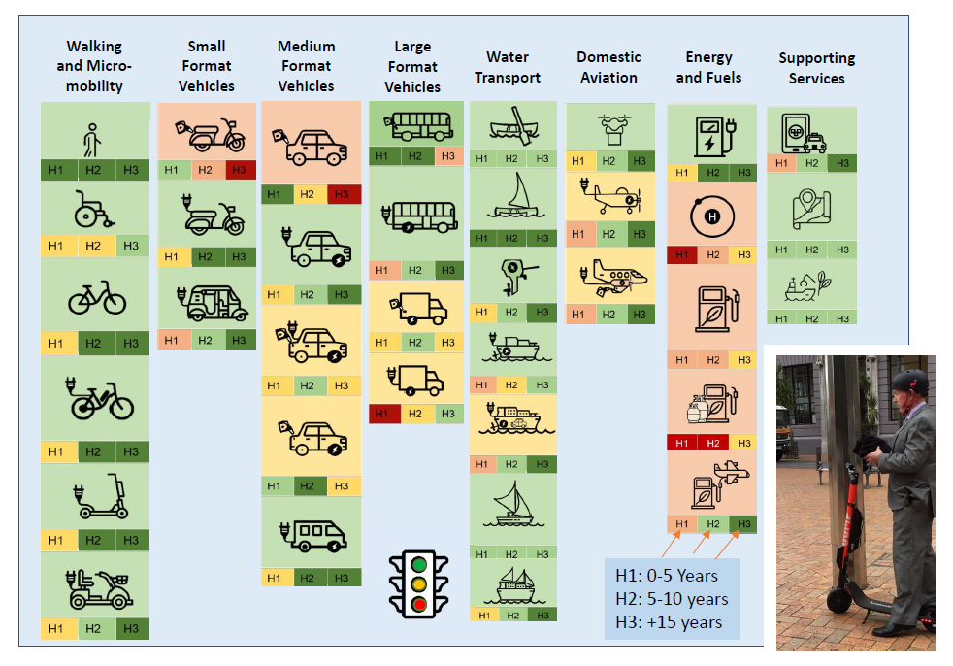

Slide 18


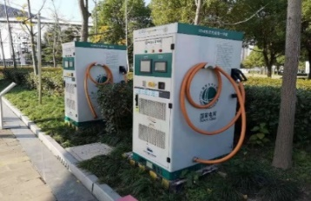
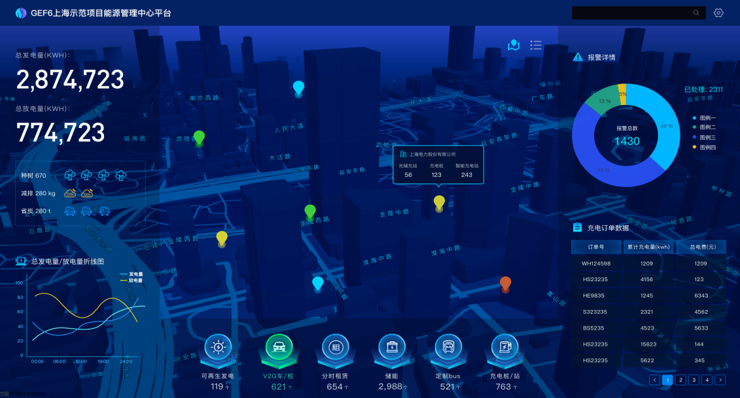
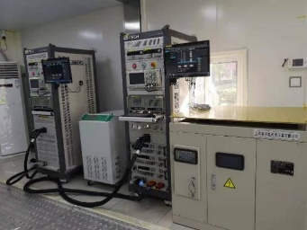
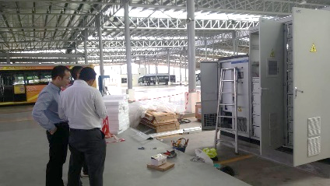
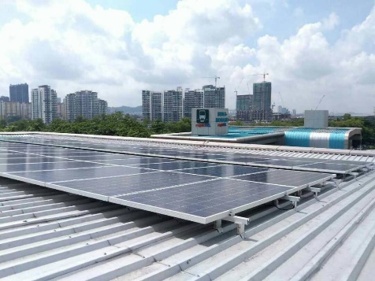

Selected E-mobility Projects
Legend
Completed
Implementing
Albania
China
Developing/Preparatory Phase
Tunisia
Jordan
Bhutan
Egypt
India
Thailand
Cabo Verde
Philippines
Malaysia 1
Malaysia 2
Pacific Regional EV Framework
South Africa
Notes:
UNIDO is implementing or implemented 13 projects covering e-mobility in various settings, mainly focusing on EV-RE integration. These projects are in different settings in Asia, Pacific region, Africa and Europe. We work with cities and industries (mainly MSMEs) to develop sustainable and viable solutions for new mobility and sustainable cities.
It is critically important Evs are powered with clean energy - meaning no GHG emissions to produce it, but the need for clean electricity imposes some challenges - RE are intermittent sources which require energy management solutions to incorporate them into the grid. In our projects we focus on demonstrating viable solutions of coupling RE with EV charging systems. And for this we also utilize second life batteries, which are not good enough for EVs (e.g. buses), but still perform well as an energy storage for electricity produced in RE.

Slide 19


Bhutan Project Example:
Entitled: “Promoting Green Electric Mobility (e-mobility) Solutions for Urban Transport in Bhutan and the Wider Hindukush-Himalaya Region”
Working with the country’s Transport Working Group to develop a 2030- and 2040-vision for transport in Bhutan.
Consider how best to prepare for those futures and create an enabling environment for that preparation.
  Development of supporting policy targeting identified barriers and knowledge gaps.
  Capacity development – Bhutanese EV Team currently
  here in Vienna as part of EV development program.
  Technology transfer alongside the e-bus demonstration.
  Development of an awareness and marketing campaign.
  Planning, for the e-mobility components of the future
  transport plan, captured by an EV Roadmap.
Developing enabling environment for the uptake of e-bus use for public passenger transport.
Related awareness and capacity building.
Procuring, deploying and operating e-buses in the City of Thimphu; and
Sharing of related information across the Hindukush-Himalaya Region.

Slide 20


Bhutan Example - Processes:
Long term vision of electric Bus Rapid Transport (e-BRT).
Require local experience of e-buses to de-risk that vision, and provide:
  confidence in an e-bus solution.
  operational information for planning.
Demonstration of a modern city-style e-bus, supported by modern public transport services.
e-Bus and chargers specified for rapid, during-the-day, charging.
Procurement process resulted in international equipment suppliers providing through a local Bhutanese entity.
Expect to be fully commissioned December 2022.
Next version of the EV Roadmap due to be finalised
September 2022.
→ Sharing of information across HKH and other regions.
Developing enabling environment for the uptake of e-bus use for public passenger transport.
Related awareness and capacity building.
Procuring, deploying and operating e-buses in the City of Thimphu; and
Sharing of related information across the Hindukush-Himalaya Region.

Slide 21
Electric Mobility Service Package
Module 1: Diagnostic Assessment
Module 2: Policy Support & Institutional Strengthening
Module 3: Capacity Building of Industries & Market Actors
Module 4: Building an investment pipeline
UNIDO E-mobility Service Package
Module 8: Communication & Outreach
Module 5: Financing & business models for deployment
Module 7: Technology demonstration
Module 6: Value chain development
Notes:
UNIDO offers comprehensive support to countries, which is based on the diagnostic of country’s actual needs.

Slide 22
UNIDO Core Expertise and Strengths
Policy
Multisectoral
& All-inclusive
Technology Transfer
Tailored Application
Engineering & Delivery
UNIDO
‘Hotspot’
Project
Space
Capacity Building & Knowledge Transfer
Comprehensive & Sustainable

Slide 23


UNIDO Core Expertise and Strengths
From concept to deployment, including:
  Project inception
  Demonstration.
  Capacity building.
  Technology & knowledge transfer.
  Behaviour change management.
  Project management.
  Upscale and replication.
Robust solutions:
  Tailored application engineering.
  Country/cultural understanding.
  Integrated, multisectoral responses.
  Standardization.
  Local team focus to ensure sustainability.

Slide 24
PFAN’s credentials in E-Mobility
Experience in advising e-mobility projects since 2014
8 projects have mobilized finance for a total of more than USD 370 million
Majority private investments from domestic investors
Currently 28 projects in PFAN pipeline
Big concentration in Asia but other regions picking-up especially Africa
PFAN region | Number of projects | Countries
Asia | 9 | India, Vietnam, Sri Lanka
Pakistan | 8 | Pakistan
East Africa | 6 | Kenya, Uganda
Southern Africa | 2 | Namibia, Zambia
West Africa | 1 | Benin
EECA | 1 | Ukraine
Pacific | 1 | Fiji

Slide 25
PFAN pipeline – financial closures
Project name | Country | Project type
GerWeiss Motors Corporation | Philippines | Three-wheeled electric rickshaws
SkyTran | India | Elevated cable car transportation system
Ather Energy Pvt Ltd | India | Electric scooters
Selex Motors JSC | Vietnam | Smart, electric scooters
QIQ Vietnam | Vietnam | Electric bicycle and scooter
ezbike | Pakistan | Electric bike-sharing service
Zembo | Uganda | Leasing (rent to own) of electric motorcycles
Torgovyj dim "Energy" | Ukraine | Electric car chargers

Slide 26


PFAN pipeline – success story
Ather was shortlisted by PFAN in 2014, when they were in a proto-type testing stage
PFAN supported the project in preparing their business plan, financial projection and investor presentation
Ather Energy has to date raised more than US $300 million, mainly in equity funding from investors like HeroMotor Corp, Tiger Global Management, Innoven Capital
Ather has set up its own charging network and Grid, in Bangalore & Chennai.
Company has 3 models and so far sold more than 50,000 electric scooters in India in the last 4 years
Ather factory has an annual capacity of 110,000 scooters and 120,000 battery packs. The company currently has a presence in 27 cities across 15 states

Slide 27
PFAN pipeline – some examples
Project Name | Country | Project type
e-car Namibia | Namibia | EV Centre to support electric vehicles in Namibia
Eride GmbH | Zambia | Development and distribution of a solution combining solar home systems and electric motorbikes
Randeepa Agrarian (pvt) Ltd | Sri Lanka | Electric Scooters and Electric Cars
Ona Mobility | Pakistan | Electric vehicles and battery as a service
Leaf Capital Pte Ltd | Fiji | Establishing the Pacific’s first national EV charging network

Slide 28
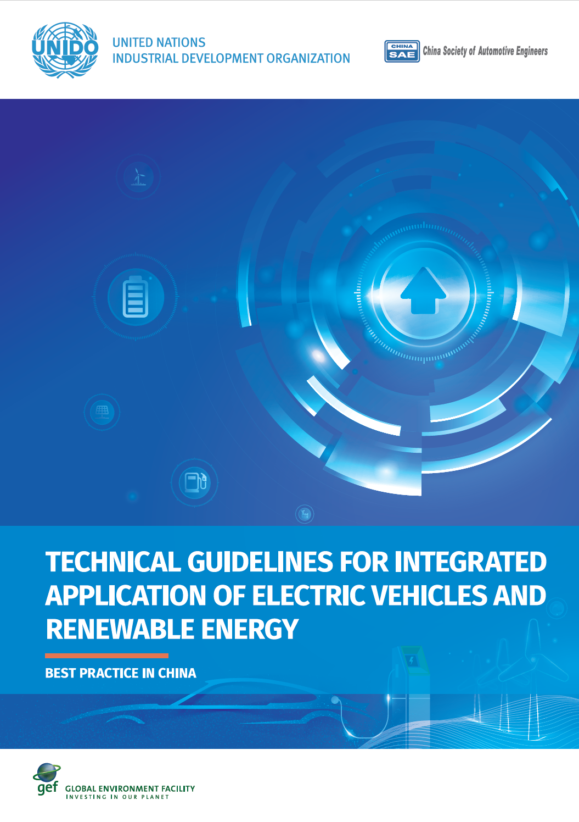
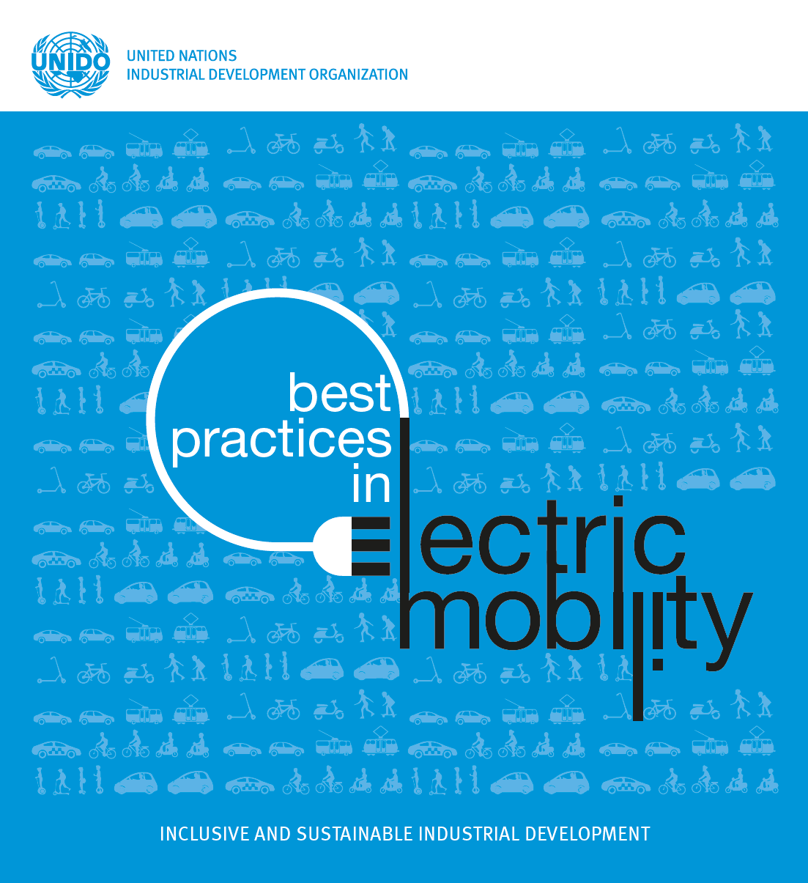
Notes:
UNIDO has extensive expertise in integration of RE and EV, based on China, Malaysia ans South Africa projects
Other areas cover EV industry ecosystem development – from the policy perspective and MSMEs
Batteries is also another area of expertise – with manufacturing and testing development in the countries
Technical standards development and implementation in the countries

Slide 29




Thank you!
Andrew Campbell
Senior Electric Vehicle Specialist
a.campbell@unido.org
Gentjan SEMA
Project Administrator
g.sema@unido.org
David Eyre
Regional Coordinator Pacific
david.eyre@pfan.net
Tel/WhatsApp: +679 833 5156
Energy Systems and Infrastructure Unit
Division of Decarbonization and Sustainable Energy
United Nations Industrial Development Organization
Vienna International Center,
Austria
The sun never goes down in the GN-SEC!

Slide 30
Annexes

Slide 31
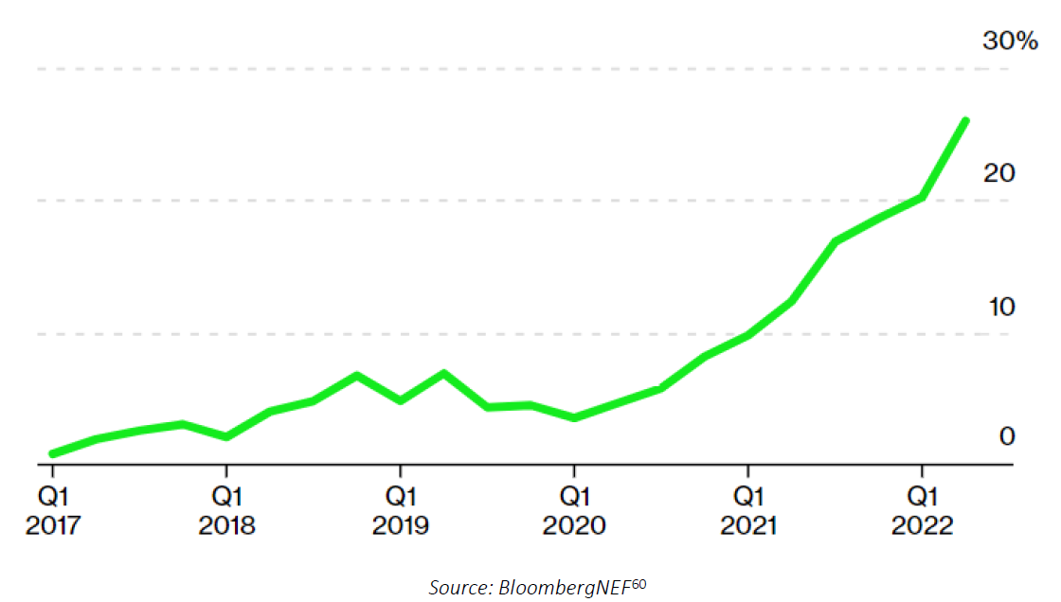
EV sales in China reached 24 percent in 2022’s second quarter

Slide 32
EV battery prices have fallen rapidly
Notes:
Due to rapid battery innovation, the last decade has seen a revolution in EV economics, causing the price of EV batteries to plunge by 89%. This has resulted in total lifetime costs for EVs being less than for a comparable ICE vehicle, due to EV savings on fuel and maintenance. Even though EVs are still slightly more expensive, the up-front cost difference is shrinking. In a couple years, most EVs are expected to cost less than comparable ICE cars.

Slide 33
Learning curves for renewables (levelized cost of electricity generation)
Notes:
Over the last decade, learning curves have produced remarkable effects for solar, wind, energy-efficient LED lighting, and batteries. Figure 10 below illustrates learning curve effects for renewable technologies for electricity generation, focusing on solar PV along with onshore and offshore wind. The global weighted average cost of newly commissioned utility-scale plants declined 88 percent for solar PV, 68 percent for onshore wind, and 60 percent for offshore wind from 2010 to 2021. These learning curve effects mean that the average cost of renewable electricity has fallen below the average cost of electricity from plants burning coal and natural gas across the globe.viii,78

Slide 34
Battery electric storage learning curve
Notes:
Figure 11 reproduces Way et al.’s battery learning curve, denoting historical prices for lithium-ion (Li-ion) consumer battery cell prices and Li-ion EV battery packs with black and red data points, respectively, while red line segments trace historical forecasts for the most optimistic scenarios by leading energy-economy modelers such as the IEA.
The larger graph charts price over time, a more accessible perspective but one that glosses over the fact that learning curves are properly understood as a function of cumulative production. The smaller inset graph uses cumulative production, instead of time, along the horizontal axis. Another difference relates to units, with the smaller inset graph using the logarithm of price along the vertical axis and the logarithm of cumulative production along the horizontal axis, creating what is known as a “log-log graph.” In a log-log graph, a straight-line learning curve effect would represent a constant learning curve effect with increasing cumulative production, an advantage for visual intuition into learning curve effect trends over time.
New Battery Chemistries
Promising sources of learning curve effects for battery electric storage include emerging, next-generation options as well as more incremental innovation.
Starting with the latter, incremental improvements in current technology are expected from continued learning curve effects. Future investments in battery factories will dwarf those to date, yielding continued economies of scale in production.

Slide 35
Battery manufacturing capacity additions
Notes:
Battery production stood at just shy of 200 gigawatt-hours in 2019. Factories under construction and announced investments will increase production capacity by six times, assuming all projects are successful, as Figure 12 illustrates.

Slide 36
Global battery factory plans increase on high EV demand - 1
Source: S&P Global Commodity Insights, S&P Global Market Intelligence
Notes:
Global electric vehicle demand is set to rise exponentially by 2030 as governments develop their energy transition policies, and battery makers worldwide have responded by increasing their gigafactory plans in the past year. Total capacity is now forecast at around 7 TWh, almost triple the project capacities announced as of September 2021 and five times the current operating capacity.
Global plug-in electric vehicle sales are forecast to reach 13.7 million units by 2025 and then 26.8 million units by 2030, up from 6.3 million units in 2021. This is set to be led by China, but also by Europe and the US, where governments are pushing decarbonization initiatives.
Copyright © 2022 by S&P Global Inc. All rights reserved. Developed by Jacqueline Holman, designed by Melenie Yuen
Source: S&P Global Commodity Insights, S&P Global Market Intelligence, Company Announcements

Slide 37
Announced gigafactory project capacity by region
Source: S&P Global Commodity Insights, S&P Global Market Intelligence
Notes:
Global electric vehicle demand is set to rise exponentially by 2030 as governments develop their energy transition policies, and battery makers worldwide have responded by increasing their gigafactory plans in the past year. Total capacity is now forecast at around 7 TWh, almost triple the project capacities announced as of September 2021 and five times the current operating capacity.
Global plug-in electric vehicle sales are forecast to reach 13.7 million units by 2025 and then 26.8 million units by 2030, up from 6.3 million units in 2021. This is set to be led by China, but also by Europe and the US, where governments are pushing decarbonization initiatives.
Copyright © 2022 by S&P Global Inc. All rights reserved. Developed by Jacqueline Holman, designed by Melenie Yuen
Source: S&P Global Commodity Insights, S&P Global Market Intelligence, Company Announcements

Slide 38
Asia top developers’ previous vs new announced capacity by 2030
Source: S&P Global Commodity Insights, S&P Global Market Intelligence
Notes:
Global electric vehicle demand is set to rise exponentially by 2030 as governments develop their energy transition policies, and battery makers worldwide have responded by increasing their gigafactory plans in the past year. Total capacity is now forecast at around 7 TWh, almost triple the project capacities announced as of September 2021 and five times the current operating capacity.
Global plug-in electric vehicle sales are forecast to reach 13.7 million units by 2025 and then 26.8 million units by 2030, up from 6.3 million units in 2021. This is set to be led by China, but also by Europe and the US, where governments are pushing decarbonization initiatives.
Copyright © 2022 by S&P Global Inc. All rights reserved. Developed by Jacqueline Holman, designed by Melenie Yuen
Source: S&P Global Commodity Insights, S&P Global Market Intelligence, Company Announcements

Slide 39
Europe top developers’ previous vs new announced capacity by 2030
Source: S&P Global Commodity Insights, S&P Global Market Intelligence
Notes:
Global electric vehicle demand is set to rise exponentially by 2030 as governments develop their energy transition policies, and battery makers worldwide have responded by increasing their gigafactory plans in the past year. Total capacity is now forecast at around 7 TWh, almost triple the project capacities announced as of September 2021 and five times the current operating capacity.
Global plug-in electric vehicle sales are forecast to reach 13.7 million units by 2025 and then 26.8 million units by 2030, up from 6.3 million units in 2021. This is set to be led by China, but also by Europe and the US, where governments are pushing decarbonization initiatives.
Copyright © 2022 by S&P Global Inc. All rights reserved. Developed by Jacqueline Holman, designed by Melenie Yuen
Source: S&P Global Commodity Insights, S&P Global Market Intelligence, Company Announcements

Slide 40
N. America top developers’ previous vs new announcedcapacity by 2030
Source: S&P Global Commodity Insights, S&P Global Market Intelligence
Notes:
Global electric vehicle demand is set to rise exponentially by 2030 as governments develop their energy transition policies, and battery makers worldwide have responded by increasing their gigafactory plans in the past year. Total capacity is now forecast at around 7 TWh, almost triple the project capacities announced as of September 2021 and five times the current operating capacity.
Global plug-in electric vehicle sales are forecast to reach 13.7 million units by 2025 and then 26.8 million units by 2030, up from 6.3 million units in 2021. This is set to be led by China, but also by Europe and the US, where governments are pushing decarbonization initiatives.
Copyright © 2022 by S&P Global Inc. All rights reserved. Developed by Jacqueline Holman, designed by Melenie Yuen
Source: S&P Global Commodity Insights, S&P Global Market Intelligence, Company Announcements

Slide 41
Planned EV investments looking five years forward for major automakers
Notes:
Battery production stood at The EV transition is garnering a large amount of investment and an increasing share of industry investment. Whether considering IEA’s estimate of $90 billion in EV-related spending in 2020 or the $105 billion average annual implied by AlixPartners’ assessment of automakers’ future five-year plans, current investment levels appear equal to the challenge. Rapid electrification under the IEA’s Net Zero by 2050 Scenario requires $315 billion invested from 2021 to 2025 ($63 billion annually) and $675 billion from 2026 to 2030 ($135 billion annually).96 Comparing these to 2020 actual investments of $90-$135 billion shows current investment appears to be running above current need, and even approaching the higher levels required later in the 2020s under the IEA’s Net Zero by 2050 Scenario.

Slide 42
Consumer surveys show rapidly increasing EV favorability
Notes:
As of 2022, 37 percent of Chinese consumers expect their next purchase to be an EV.100 In California, 59 percent of current residents are likely to choose an EV for their next vehicle purchase.
Increasingly positive consumer sentiment is evident in growing willingness to pay for EVs, demonstrated by data showing retail profit margins for EVs exceeding conventional car margins. U.S. data from early 2022 showed an average sale price for a fully electric vehicle was marked up 2.6 percent over the manufacturer’s suggested retail price, compared to 1.6 percent for a weighted average of all new car sales.102

Slide 43
Consumer and government share of EV purchase expenditures
Notes:
A final point of evidence demonstrating the positive trend in consumer sentiment tracks the share of EV purchase costs borne by consumers versus the government. From 2017 to 2021, on a global average basis, the share of EV purchase costs paid for by public funds dropped by about half, from 20 to 10 percent, illuminated in Figure 15. The fact that EV purchases have soared even as government support has dropped is proof of increasing consumer demand.
EVs offer superior acceleration, owing to their ability to instantly deliver peak torque even from a complete standstill. Typical street driving, as opposed to highway travel, frequently involves acceleration from a standstill, making this an important advantage. Though the industry is still scaling up, one EV—the Tesla Model S—is already the fastest car in the world, measured by time to reach 60 miles per hour.104 EVs’ performance advantage leads to headlines in mainstream media such as the following example from Barron’s, a financial news outlet: “EVs Can Turn Anyone into Race Car Drivers—Including Me
Electric motors are also inherently more energy efficient than ICEs, which suffer losses to waste heat. Conventional cars only convert 12 to 30 percent of the energy stored in gasoline to power at the wheels, compared to more than 77 percent converted for electrical energy in the case of an EV.106

Slide 44
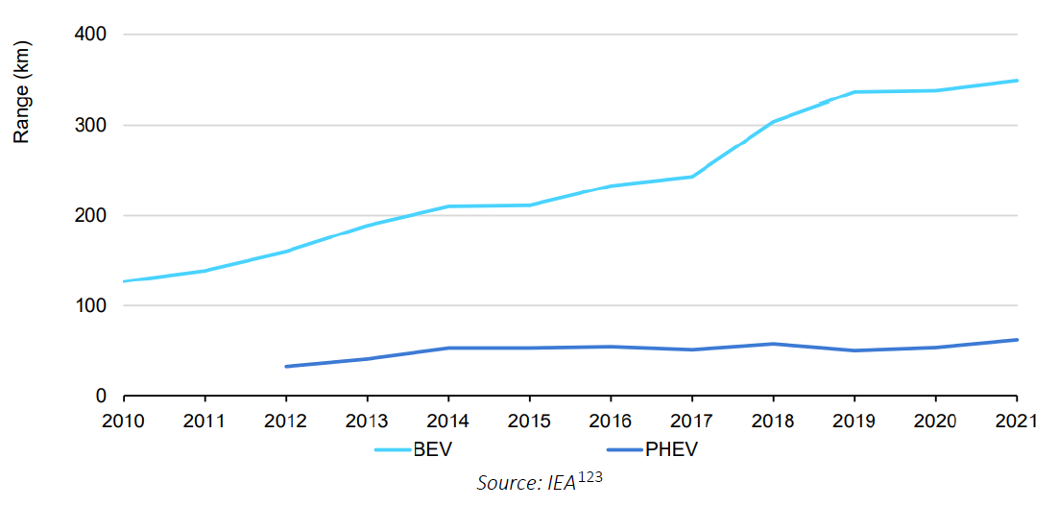
Increasing range for EVs (annual weighted average by powertrain)
Notes:
Charging
To support a rapid EV transition, public charging needs to become more convenient and refill time needs to continue to improve, as it is expected. Yet, the challenges associated with charging are easily overstated. For one reason, as discussed, many consumers place a premium on the convenience of electric charging at home.
Moreover, comparison to actual driving habits shows the need for fast or public charging is unlikely to be a concern for most trips. For example, a U.S. survey finds that EVs are well suited to the daily driving habits of most drivers, with 87 percent of drivers travelling less than 100 miles (161 km) daily.xvi,121 Just 4 percent of car owners reported driving 250 miles (403 km) per day or more on average.
Such daily needs compare favorability to the steadily improving range for EVs. By 2021, an all-electric EV offered an average range of 350 km per charge, as shown in Figure 16. 122

