Slide 1
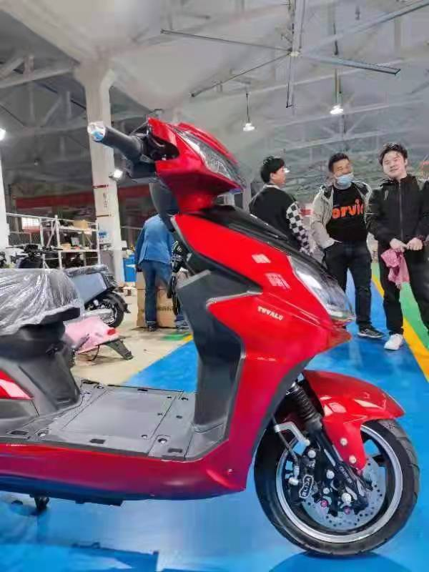
Pacific Island Workshop on Electric Mobility
Mafalu Lotolua
Tuvalu Electricity Corporation
28 – 30 November 2022
Notes:
Presenting of what we are doing in Tuvalu on e-mobility
We are just starting introducing e-mobility with a pilot programme and this is through e-motorcycle and funded by the World Bank.

Slide 2
Relevant Policy
National Strategy for Sustainable Development 2021-2030
Key Strategic Action
5.19.2 – Strengthen efforts on decreasing the high dependency on costly fuel imports.
TNEP under review
Old Version - 3.0 Transport
Policy 3.1
Ensure that the sea and land transport sectors promote fuel conservation and efficiency measures.

Slide 3
Objective of the Pilot Programme
Is to evaluate the technical and economic feasibility of deploying e-mobility at a larger scale while creating synergies with the renewable energy power plants in a harmonized energy system; and
The Construction Supervisory Consultant (CSC) will carry out the Technical and Economic Evaluation of e-mobility in Tuvalu through the Electric e-motorcycle Pilot.
Notes:
Thinking of moving at larger scale and we are thinking to start small to learn the pros and cons of the technology.
At the end of the programme the CSC will carry out the technical and Economic Evaluation of e-mobility in Tuvalu.

Slide 4
TEC e-Motorcycle Pilot Programme
Background
An activity of the Tuvalu Energy Sector Development Project (TESDP)
Funded by – World Bank
Total Funding - USD$35K (including spare parts and training)
Contractor – EastWest, China
No of e-Motorcycles - 12

Slide 5
Specifications
Notes:
What’s important is for the bike to enable to take you around.

Slide 6
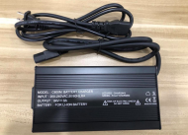
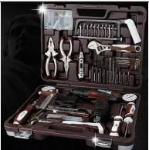
Other Accessories
BATTERY CHARGER (4A)
WORKSHOP TOOLS AND INSTRUMENT
SPARES | 2 x Lithium batteries (60V-20AH) 8 x Front Wheel spare tyre 8 x Real Wheel spar tyre 24 x Helmet
Notes:
Ensure that you have spare parts to get the programme moving forward.

Slide 7
Distribution of the e-Motorcycles
7 x for TEC
2 x for Energy department
3 x available for the Public
- forms under developed and fill in by people using the bikes.

Slide 8
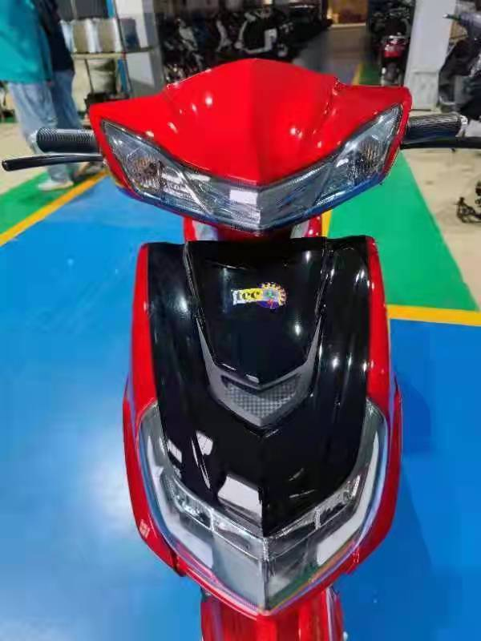
Where up to Now
Clearance from customs is under process

Slide 9
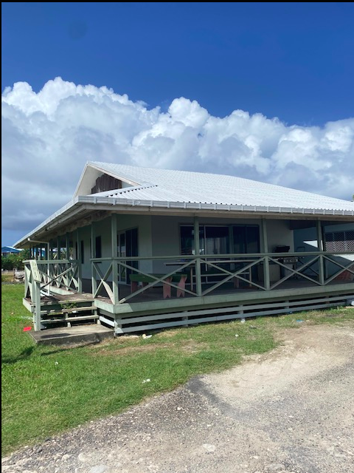
Other Financial Assistance
Some Leftover Finance from the Facilitation of the Achievement of Sustainable National Energy Target of Tuvalu(FASNETT) Project – GEF Funded Project.
Solar Panels to install on the demonstration Fale rooftop at TEC compound.
10 or more Waterproof sockets in an enclosure mounted to the posts as indicated.
The installation will also showcasing solar PV rooftop technology.
Finance an Hybrid or EV Car

Slide 10
Way Forward
Energy Act is under develop:
Part 8: E-Mobility
35. Promotion of e-mobility
The Minister shall provide regulations for the promotion, importation and sale of e-mobility transports, including the transition period from the use of vehicles operates by internal combustion engine to electric vehicles (Evs); and
The department of Energy must develop policies to promote and increase public awareness of E-Mobility in Tuvalu
Notes:
The Energy Act is under developed.
There is a Section in the Act for E-Mobility.

Slide 11
Thank You

