Slide 1
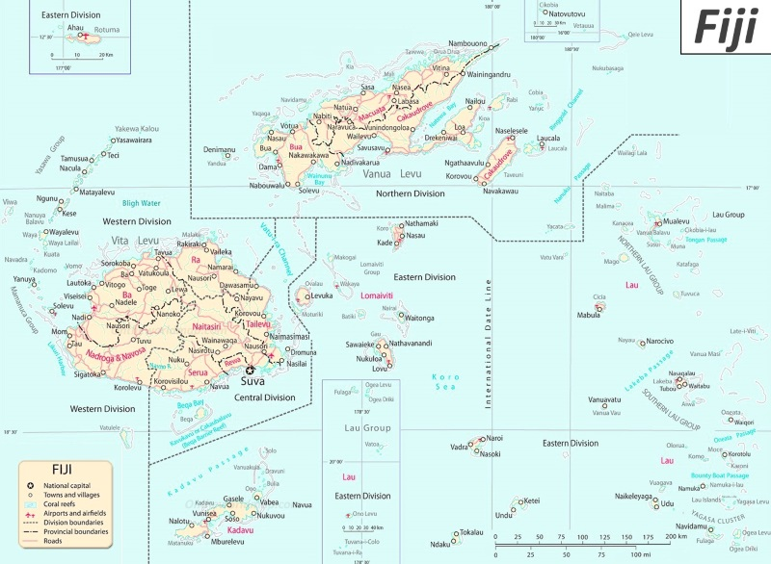
UNLOCKING MIN-GRIDS FOR SUSTAINABLE DEVELOPMENT
FIJI
Presenters;
Davend Chetty
Jonacani Veiqati

Slide 2
TABLE of CONTENT
Generation Mix
Electricity Status
Role of Mini-Grids
Current Mini grids – Existing Systems
Management/Institutional structure for rural electrification and mini-grids
Business models/tariff settings for mini-grids
Experience and challenges with mini-grids systems
Lesson Learnt

Slide 3
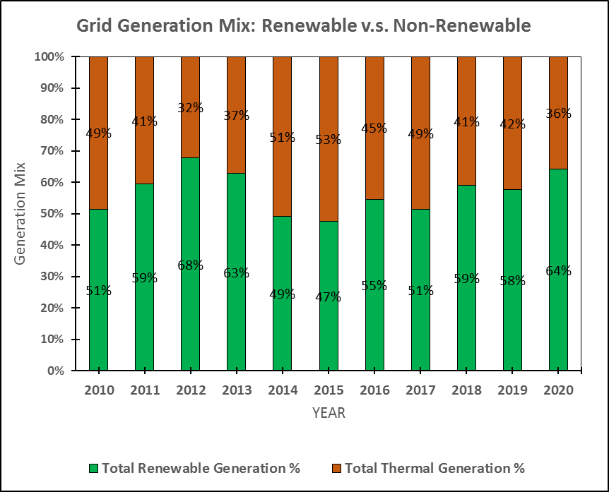
GENERATION MIX
POWER GENERATION MIX
2020’s power-generation mix was 57.30% hydro, 35.84% industrial diesel oil and heavy fuel oil and 0.12% wind. The remaining 6.87% was provided by the Independent Power Producers (IPPs), namely Tropik Wood Industries Limited (TWIL), Fiji Sugar Corporation (FSC) and Nabou Green Energy Ltd.

Slide 4
Current Electricity Access and Electrification and Climate targets
Households in VitiLevu yet to be Electrified
Fiji’s access to electricity was reported as 96% in a Census of Fiji’s population conducted in 2017. This was an increase in access from 89% in 2007. As of now, it stands at 96.2%.
Access to electricity was assisted by the Fiji Government’s programme to extend the National Grid to rural areas as well assisting rural communities in off grid electricity systems.
The services being rendered, is done in a way that we align our work to the SDG 7 target, which is;
100% access to some form of electricity (SDG 7.1)
100% renewable electricity supply by 2036 (SDG 7.2)
Strengthen ‘Government – Community’ partnerships in developing rural and maritime infrastructure and accessibility to entice economic growth
Households in VanuaLevu yet to be Electrified

Slide 5
Role of Mini-grids
Mini-grids have the potential to reliably serve small enterprises in rural areas that rely heavily on diesel, and do not have access to adequate, high-quality electricity. They reduce emissions by providing users, with clean source of energy which is reliable.
Under the Department of Energy in Fiji, Mini-grid technologies include, hydropower systems, and solar photovoltaic (PV) modules.

Slide 6
Current Mini-grids systems ( sites, capacity & technologies) on the ground and planned systems. Solar Mini-Grids
 | SITE | LOCATION | CAPACITY
1 | Tukavesi | Tukavesi Vill, Cakaudrove | 60kW
2 | Solevu | Solevu High School, Yasawa | 30kW
3 | Yasawa | School, Naviti, Yasawa | 30kW
4 | Lakeba | Tubou Village, Lakeba, Lau | 153kW
5 | Kadavu | Vunisea, Kadavu | 225kW
6 | Namara, Kadavu | Namara Vill, Sanima, Kadavu | 30kW
7 | Rotuma | Ahau, Rotuma | 153kW
8 | Nakoro | Nakoro Vill, Naikoro, Navosa | 50kW
9 | Lautoka | Vio | 30kW

Slide 7
Hydro Mini-grids
 | SITE | ISLAND | CAPACITY
1 | Bukuya | Viti Levu | 100kW
2 | Kadavu Koro | Kadavu | 20kW
3 | Muana | Vanua Levu | 30kW
4 | Buca | Vanua Levu | 30kW

Slide 8
Management/Institutional structure for rural electrification and mini-grids
Rural Electrification Managerial Structure;
Electrification is set up in the community, and they are encouraged to have members that represents, women, youth and those living with special needs.
Committees are trained to be the conduct minor operation and maintenance, and main contact point with the Department.
The above structure is for both that are assisted with government diesel generators and Solar Home System.
Mini-grids Managerial Structure;
Villages to form power committee. They are responsible for the basic management of the system. Normal operation, handling of revenue. Recent change to management committee, is the inclusion of women, for better management of the committee.

Slide 9
Business models/tariff settings for mini-grids
IPP model (Private company model)
Cooperative model (Community Committee model)
Community agreed on the
tariff, in consultation with
Department of Energy
Tariff is agreed by IPP and
Department of Energy with
consideration on;
Pre-paid
system.
Example:
Bukuya mini
hydro Project;
Payback
period(to recognize the investment costs of the system).
Communities
ability of paying
for the said tariff.
Cooperative was registered to manage the Bukuya mini
hydro, then the Department of Energy, later signed an
Agreement with Bukuya mini hydro Cooperative for
assistance under Rural Electrification Programme.

Slide 10
Experience and challenges with mini-grids systems

Slide 11
Managerial issue. Example with Bukuya Mini Hydro Project.
Cooperative constrains, that lead to upgrading and maintenance work being brought to a haul.
DOE, then stepped in and cover the cost of upgrade.
Later, DOE engaged UNDP (FREPP), to formulate a way forward for the sustainability of Bukuya Mini Hydro Project.
Educating public on proper utilization of the system.
Basic business skills on proper business practice, since we ourselves are not business experts, we tend to assume that the committee will somehow find a way to make it work in that community.
Development partners coming with their own model but less consideration of local context is taken into account.
Consumer’s ability to pay
Cover capital cost (CAPEX)
Consumer’s willingness to pay
Cover O&M costs (OPEX)
Tariff’s main challenge
Tariff should aim to:
Attract private parties to invest in MGs
Make MGs financially viable and sustainable
Pursue to support economic development and improve living standard in the villages
Enable understanding of mini-grid operation
Balance sustainability vs Affordability

Slide 12
Brief of local models, pro’s and con’s
Model | Advantages | Disadvantages
Community | Sense of ownership and responsibilities is on them(becoz of sustainability of the project). | Communities may lack technical and business stills Governance of the system may not be well managed
RE company | Responsibility lies with experienced organization Their scale means that they may have better access to spare parts and maintenance | Market driven
Note:
Ideas shared in the table is based on personal opinion

Slide 13
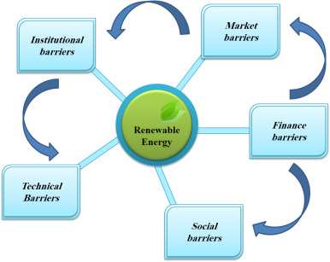
Lesson Learnt
Need for feasibility studies to be thoroughly carried out, factoring in;
Technical
Economic
Financial
Environment and social
Institutional and Regulatory
Project sustainability;
Customers view point
Willing to pay
Ability to pay
Technical support
limited local capacity and technical
knowledge summed to unclear definition
of roles and responsibilities among
stakeholders(community manage system),
causing inefficiencies and plants shutdowns.
With community participation in energy projects, there is a need to understand the conditions for effective community involvement and how responsibilities among stakeholders can be distributed in order to ensure their long-term operation

Slide 14
Vinaka (Thank you for your attention)

