Slide 1




Department of Energy
Renewable Energy Mini Grids Systems

Slide 2
TABLE OF CONTENTS
Current electricity access
Sites, Capacity & technology
Management / Institutional structure
Tariff setting

Slide 3
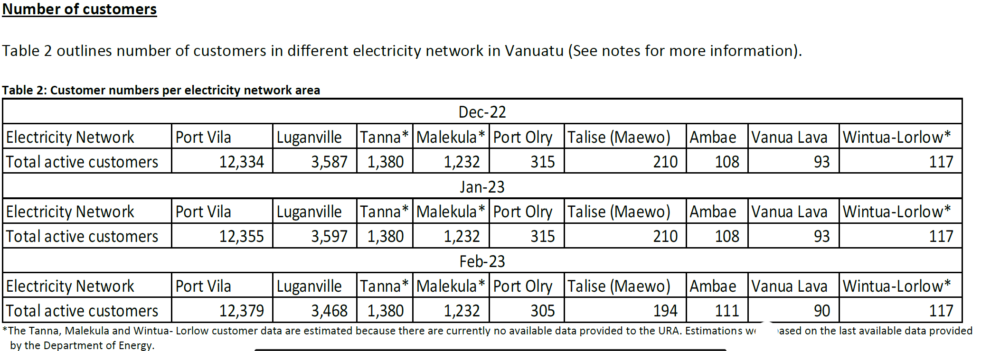
1. Current electricity access
VANUATU MONTHLY ENERGY MARKET SNAPSHOT OF FEBRUARY 2023
Note: Per URA Monthly Energy Market Snapshot of February 2023, total number of people connected to the grid per Table 2 above is 19276 (19276/5Head per HH =3855HH).
Therefore % of HH access to the Grid is: 3855/62,876 Total HH x 100% = 6%

Slide 4
Current electricity access
% Population using home RE systems
Note:
Off grid Access to RE system per table above, combined stats of Solar Lamp & Solar Home System give approximately 42,688 HH (19699 + 22,969)
% Estimate of Home usuage of RE systems: 42,688/62876 Total HH x 100% = 67.8%
However, overall total % of People having access to Energy irrespective of the generation source in 2020 is 85%

Slide 5
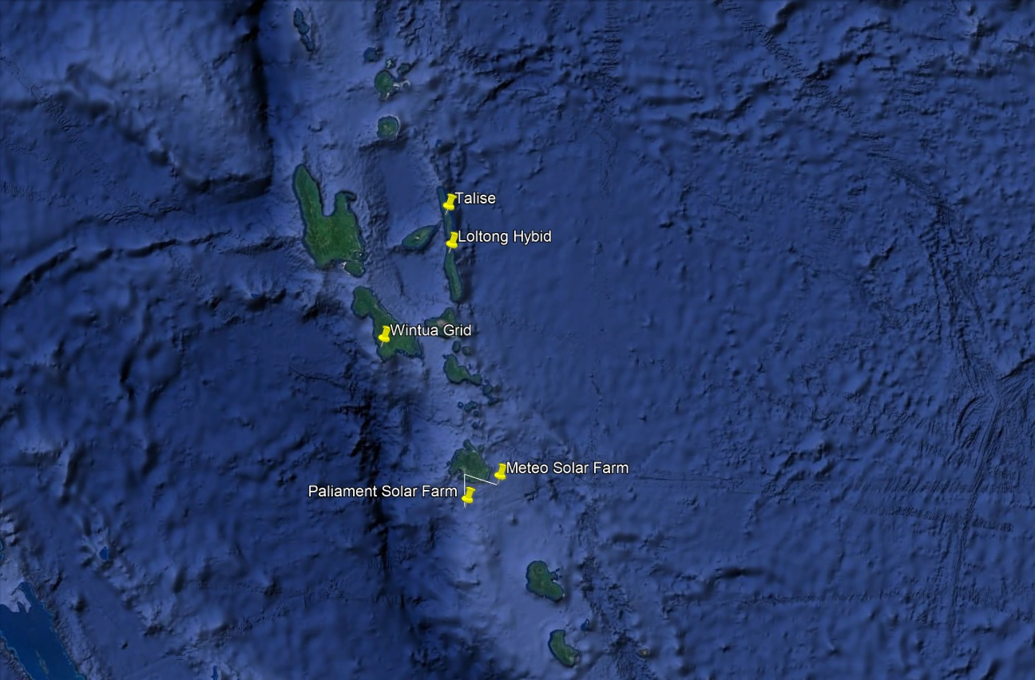
2. Site location

Slide 6
2. Capacity
Renewable Energy Implementation
 | Existing Renewable Energy Sytems | Capacity (kW) | Battery size | Inverter | No# HH + Business | Costs | Donor
1 | Talise Hydro | 75 kW |  |  | 235 | 32M vatu | IUCN
2 | Loltong Pico hydro_Solar hybrid | 8.8 kW ( 6.2 kW hydro + 2.6 kW Solar) | 34kWh | 15kW | 98 | 220,000USD | UNDP + Van Gov
3 | Wintua Solar PV | 65 kW | 499kWh | 3 x 15kW | 125 | 70M vatu | Austrian Gov
4 | Solar PV ( Meteo + Parliament ) | 767 kW |  | 120kW 600kW |  | 500M vatu | UAE

Slide 7
Management / institutional structure
Renewable Energy Implementation
 | Existing Renewable Energy Systems | Management model
1 | Talise Hydro | Vanuatu Utility Infrastructure
2 | Loltong Pico hydro_Solar hybrid | Community Management Model
3 | Wintua Solar PV | Electrical Cooperative
4 | Solar PV ( Meteo + Parliament ) | Department of Energy & Unelco
Note:
Tariff setting are done by the Utility regulatory authority

Slide 8
Tariff
Tariff setting
 | Site | Tariff ( Vatu )
1 | Talise Hydro | 52.32vt/kwh (0.4397 USD)
2 | Loltong Pico hydro_Solar hybrid | 88.46vt/kwh (0.7435 USD)
3 | Wintua Solar PV | 41.42vt/kwh (0.3481 USD)
4 | Solar PV ( Meteo + Parliament )
Note:
Tariff setting are done by the Utility regulatory authority

Slide 9
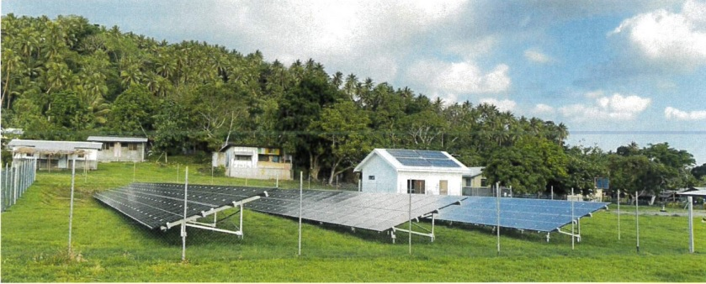
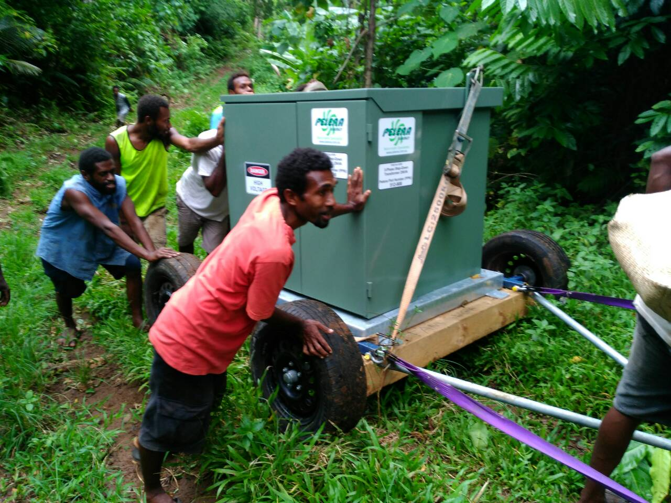
Photos
Wintua
Talise

Slide 10
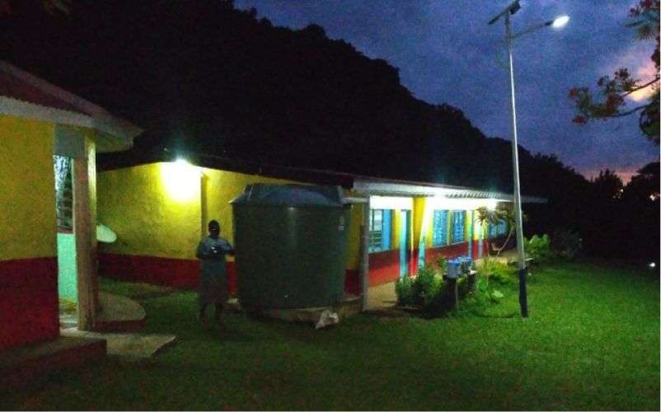
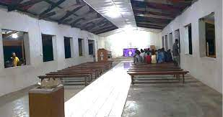
Photos
loltong

Slide 11
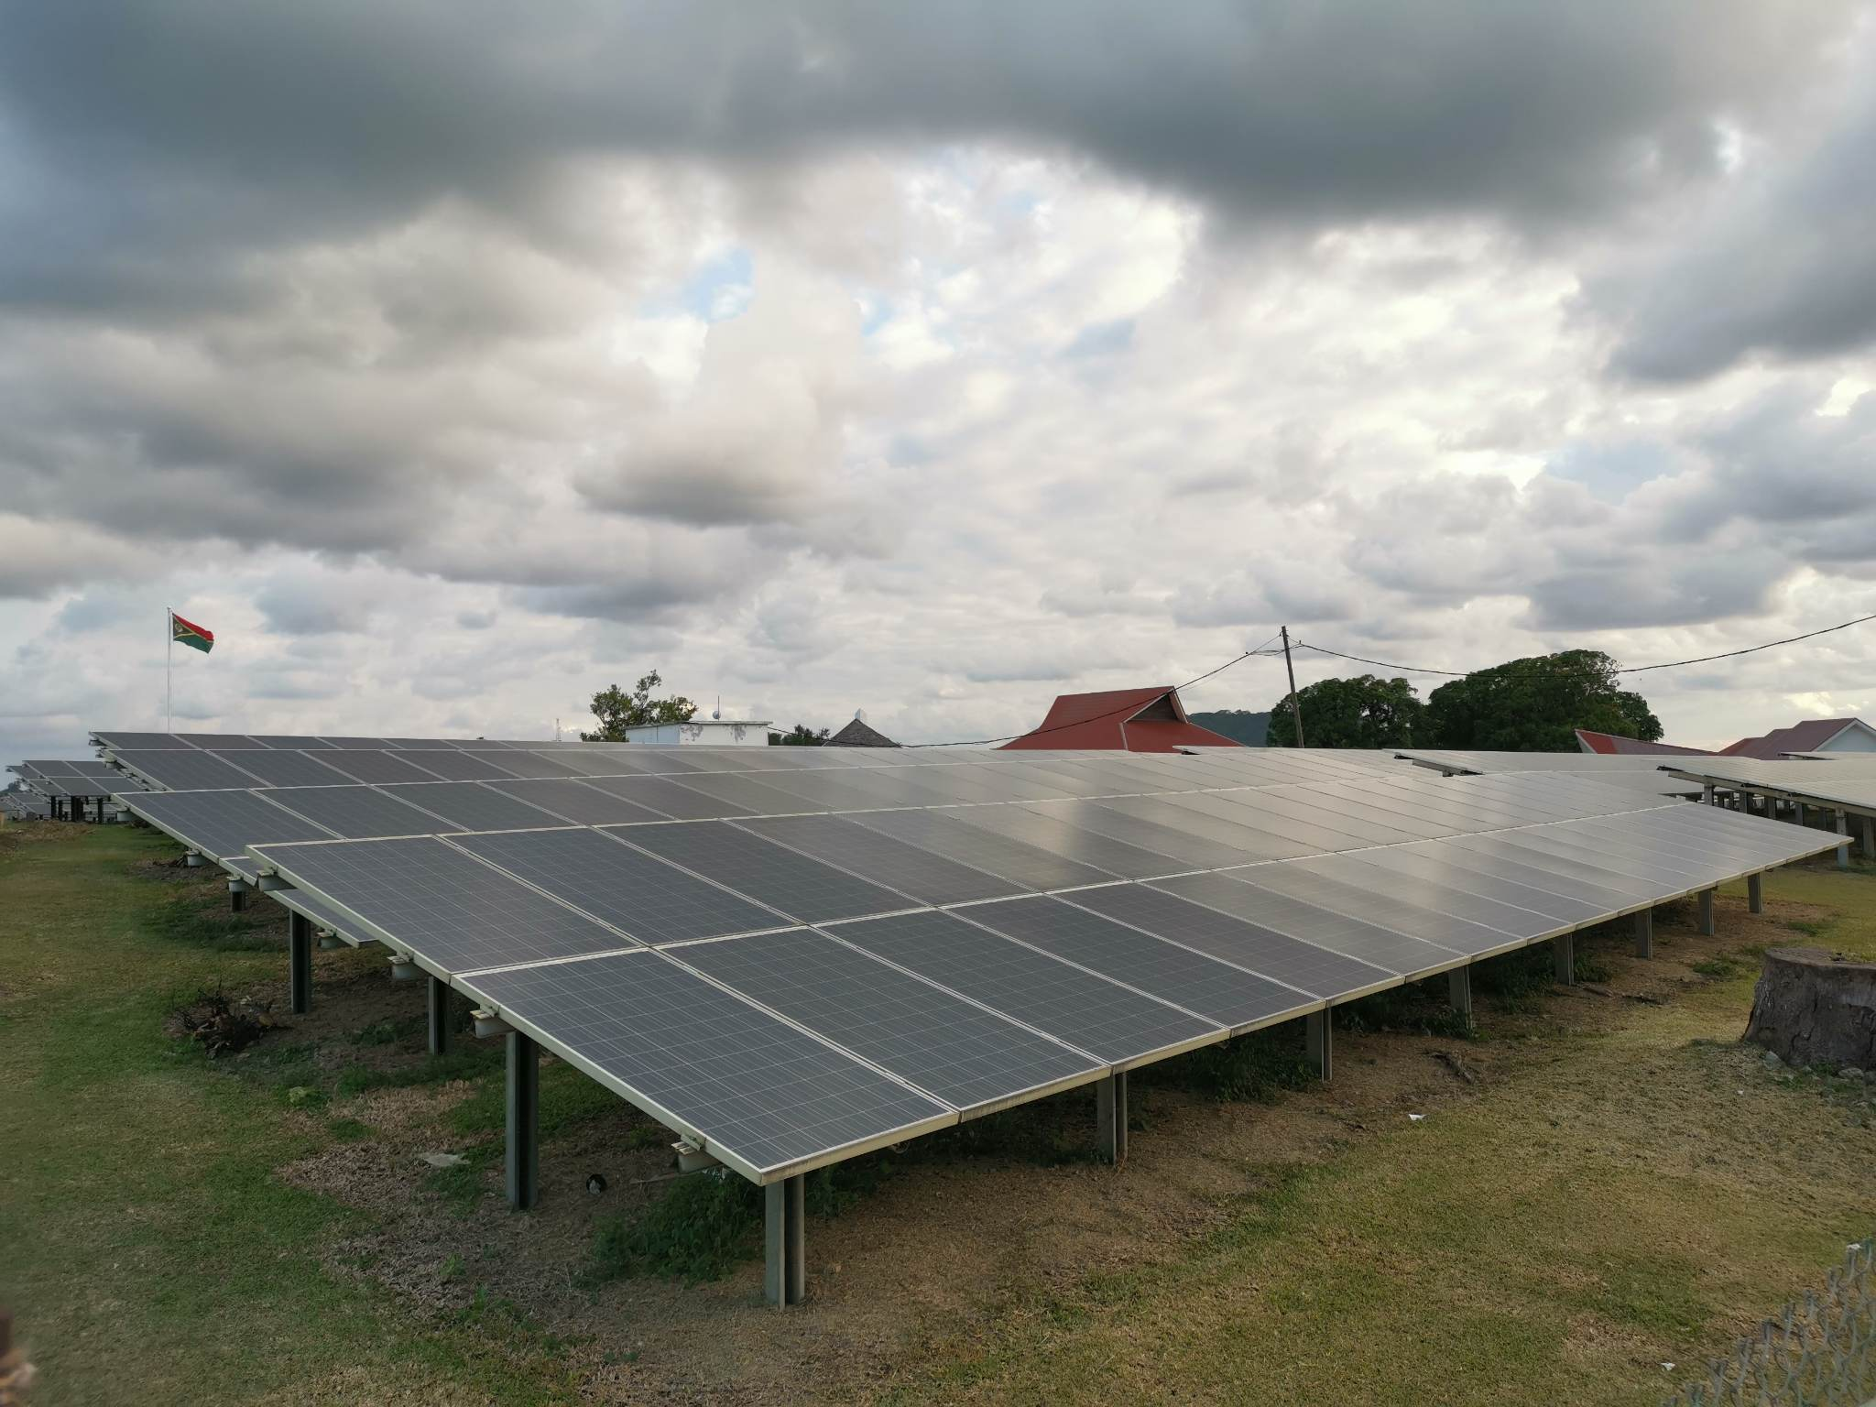
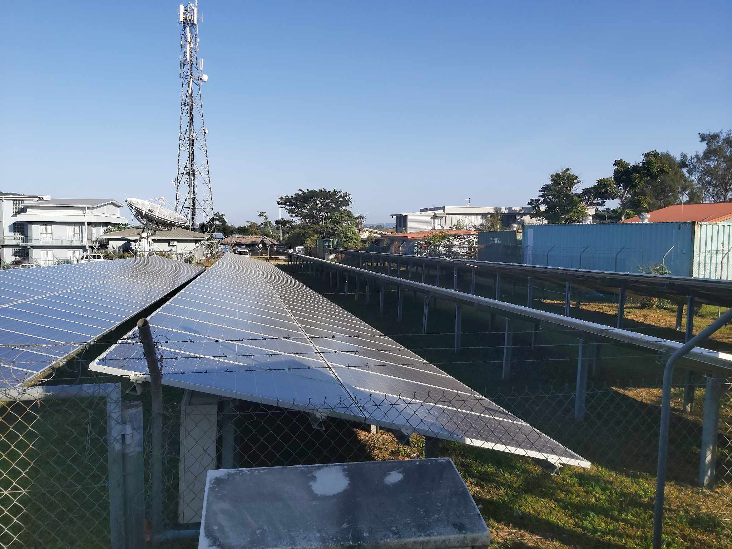
Meteo
Parliament

Slide 12
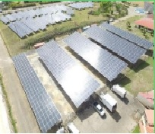
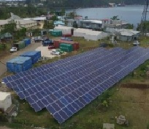
Ministry of climate change
Parliament

Slide 13
Lesson learnt
Time period from feasibility study to The detailed design usually takes up to 12 months, Limited study will result in poor design.
Inconsistent data collection during the feasibility phase.
Logistics of items/material from overseas to rural areas can be difficult if not well coordinated.
Implementation timeframe usually takes 6 – 8 months.
Managing more than 3 contractors on site can be difficult if poorly managed.
Community labour work at no cost due to limited funds
Unfavorable weather conditions during implementation period
Limited technical & management skills in the rural areas
Limited network coverage on site
Business/management model must be workable if it will be managed by the community.
Difficult to attract independent operators in rural areas

Slide 14
Thank yu tumas!

