Slide 1
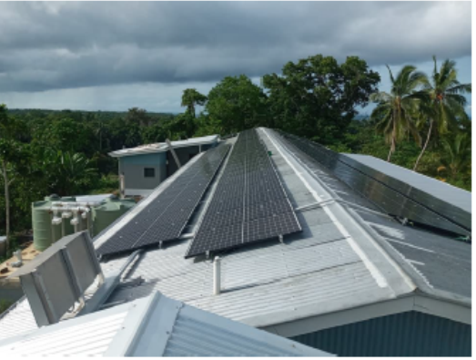
Unlocking MG for sustainable development:
1.1. Course Introduction
Suva, Fiji
June 26th-30th, 2023
Jerry Willie Zutu
Solomon Islands

Slide 2
TABLE OF CONTENTS
Electrification access
National Electrification plan
Electrification plan
Challenges
Benefits
LESSON LEARNT
way forward

Slide 3
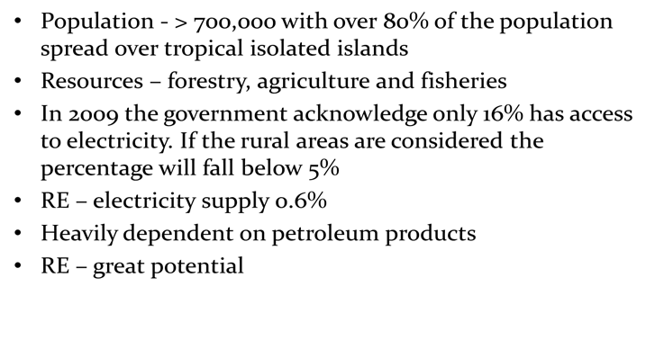
Brief outline of Solomon Islands

Slide 4
Current electricity access & climate target
Urban – 54 %
Rural – 2%
SINEP targets 2025 - Urban -80%
- Rural -40%

Slide 5
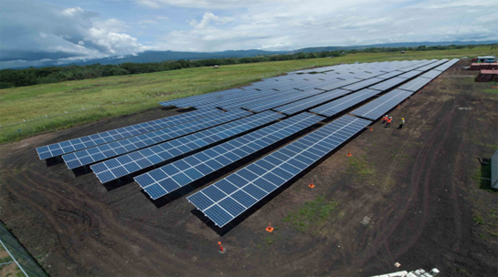
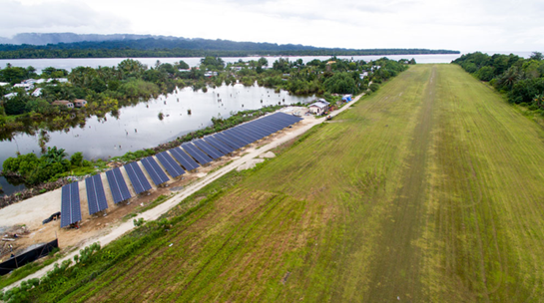
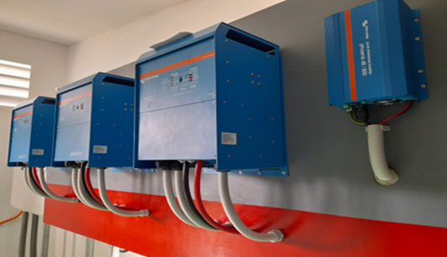
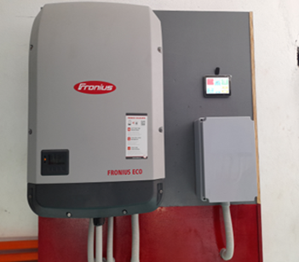
Grid and mini-grids

Slide 6
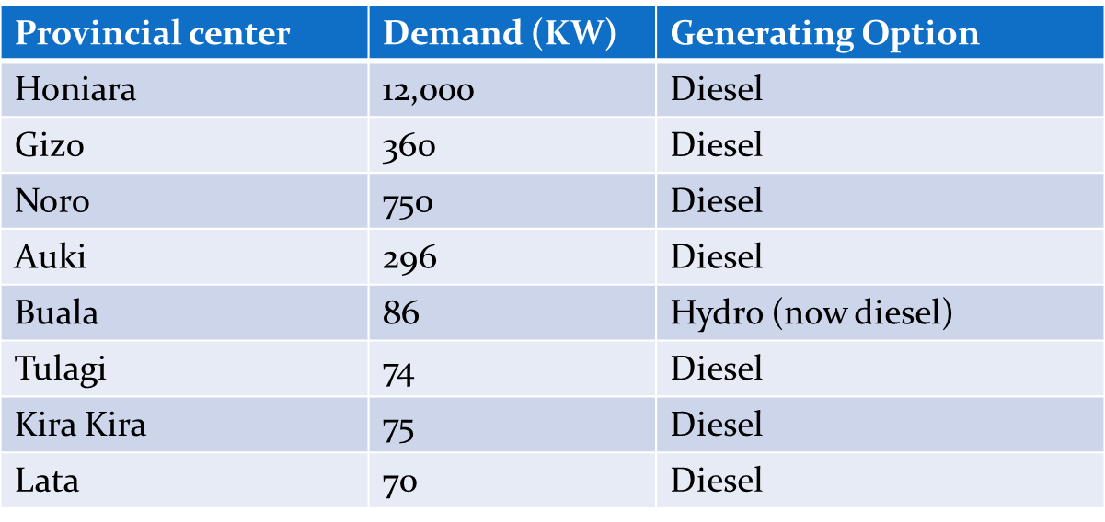
Energy consumption
Total energy demands by provincial centre's(5% of country's population):

Slide 7
Electrification Plan
Urban – Power Utility; and the main aim is to access to grid connected electricity in the urban areas increase to 80% by 2025. The electricity sector is managed by the government-owned company, the Solomon Islands Electricity Authority (SIEA). SIEA is totally dependent on diesel for power generation; 80% of energy is produced for Honiara while 20% is for outstations in eight provincial center's.
PLAN
Improve the capacity and condition of the Honiara and outstations network
Extend existing networks to surrounding rural communities where feasible
Develop and implement energy efficiency & conservation
Rural – SIG, Private sector, Partners;
Access to electricity in rural households (Mainly on RE like Mini-Grid ,Hydro, Off-Grid) and institutions increased to 35% by 2025
PLAN
Increase the supply of modern energy services in rural schools, telecommunication and health centers.
Improve and increase the use of solar and hydro power.
Encourage public / private partnership for power generation
Planned and sustainable energy development consistent with government objective
Develop a renewable energy policy and rural electrification policy
Uterlise –
-Urban & Rural to uterlise Mini Grids
– grid extension
- stand alone system.

Slide 8
Coordination - Electrification
SIG- Thru Energy Division
Power Utility - Solomon Power(SP)
All to be guided under the SINEP – National Electrification plan

Slide 9
Challenges
Renewable energy deployment in the Solomon Island faces significant challenges such;
Geographical make of SI – Isolated islands
Sustainability issues
High Capital costs
Maintenance issues
Low penetration of private sector

Slide 10
Benefits of mini-grids in s.i context
Best suited for isolated islands.
Cost effective compared to Hydro system
Availability of SIG expertise to implement

Slide 11
way forward
SINEP & NATIONAL ELECTRIFICATION TO GUIDE THE PENETRATION OF RE IN THE URBAN AND RURAL AREAS.
NETWORK WITH REGIONAL INITIATIVE TO BOOST ACCESS
BOOST PRIVATE SECTOR PARTICIPATION IN ELECTRIFICATION
AMEND UTILITY ACT TO PROVIDE WAY FOR PRIVATE SECTOR PARTICIPATION (CURRENTLY ONGOING)

Slide 12
Thank you
Jerry Zutu
Energy Department
Solomon Islands Government

