Slide 1
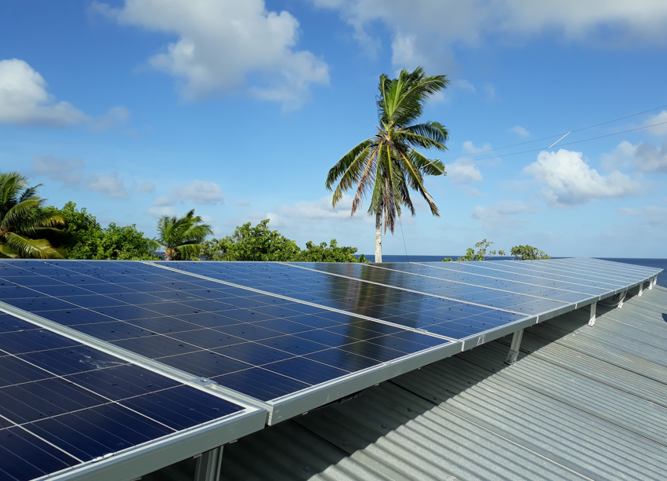
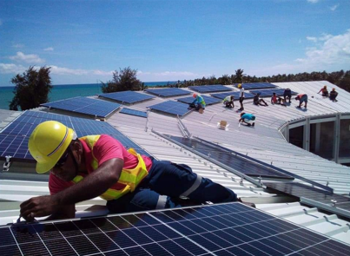
Unlocking MG for sustainable development:
Country Presentation – Kiribati
Ministry of Infrastructure and Sustainable Energy MISE – Energy Division
Suva, Fiji
June 26th-30th, 2023
Teweiariki Tebuka
t.tebuka@mise.gov.ki

Slide 2
TABLE OF CONTENTS
Ministry/Energy Division role and responsibility
MG Electrification – urban & rural islands Kiribati
Role of mini grid
Mini grid system
Business models/tariff settings for mini-grid
Experiences and challenges with mini-grids systems
Lessons learnt

Slide 3
1. Ministry/Energy Division Role and responsibility
The Ministry of Infrastructure and Sustainable Energy (MISE) is a leading Government of Kiribati agency that is responsible to overlook any development plans and activities to improve infrastructure development and provides sustainable energy in the country.
Energy Planning Division (EPD) is one of the Ministry’s unit that is responsible for coordination and implementation of energy policies and providing necessary technical advice and assistance on all energy activities and energy related matters.
Under the Energy Act 2022, the EPD within the Ministry of Infrastructure and Sustainable Energy is mandated to regulate all energy related matters.

Slide 4
2. Kiribati MG Electrification – urban & rural area

Slide 5
2. MG Electrification – urban & rural islands Kiribati cont…..

Slide 6
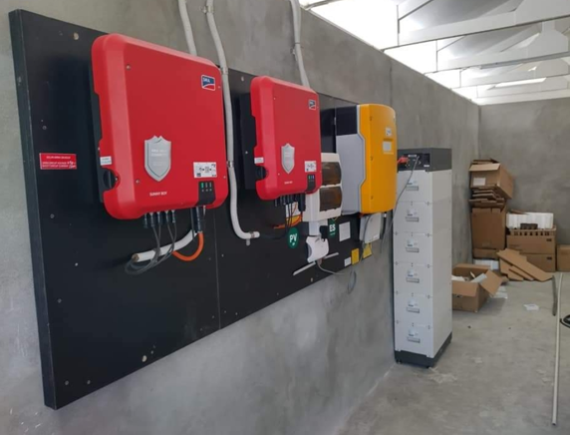
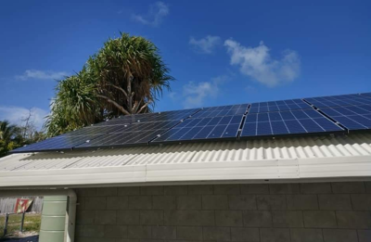
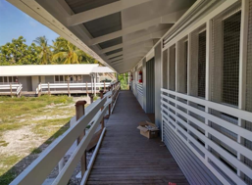
3. Mini grid Junior Secondary School
Supplies Electricity to classroom, and office
MG Improve the educational services
Reduce the reliance of fossil fuel generator

Slide 7
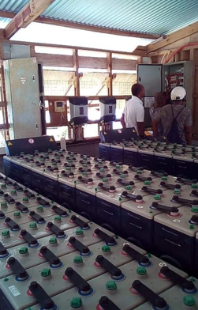
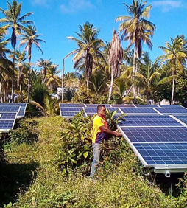
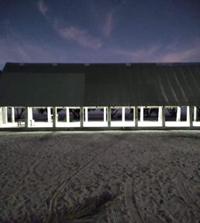
Boarding Schools
Extending learning time
MG support the operation of computers to student and internet access
Substitute diesel generators

Slide 8
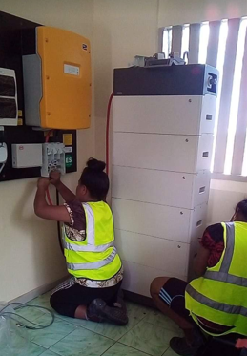
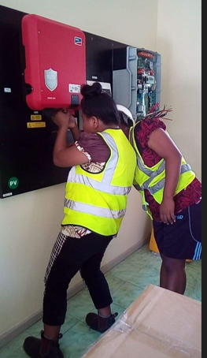
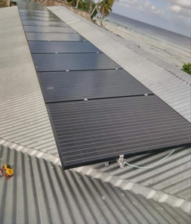
HM Residence
Setting an example to nation as leaders contributing to the green environment
Achieve national target on renewable energy
Cost saving for paying cheaper tariff

Slide 9
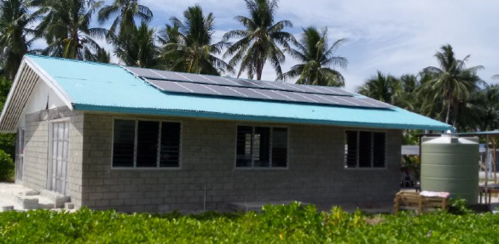
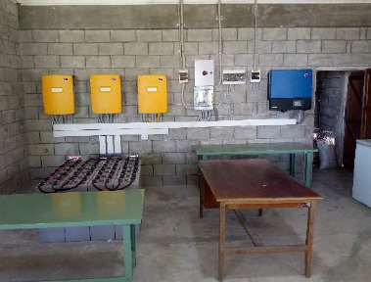
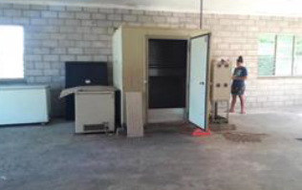
MG for Ice plant
Support the operation of fish centers and in particular the operation of ice-maker machine for block ice for chilling fish catch before storing in freezer.

Slide 10
MG for Ice plant Detail of System capacity

Slide 11
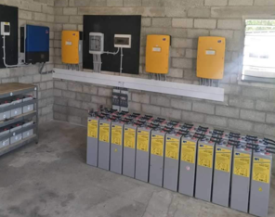
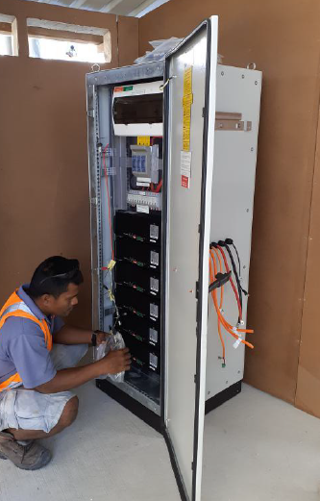
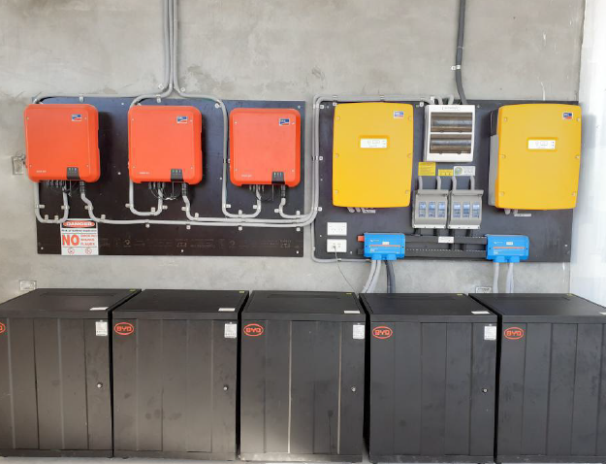
4. Mini grid system

Slide 12
6. Business models/tariff settings for mini-grid
Utility model - Pilot project for two Islets Nuotaea and Tebikerai funded by the government of Italy and implemented by the MISE in collaboration with Kiribati Green Energy Solution (KGES)
The project was hand-over to KGES for operation in 2020
Tariff was set by KGES using the LCOE formula
0.30 cent for domestic users
0.70 cent for commercial users

Slide 13
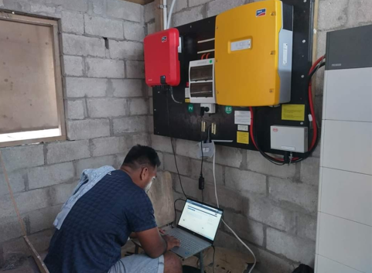
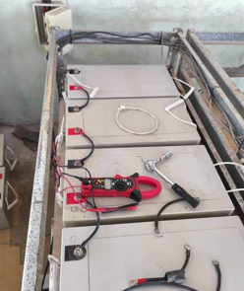
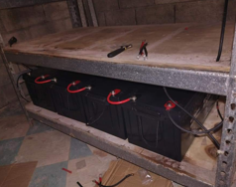
7. Experiences and challenges with mini-grids systems
System Configuration
Battery Issues
SMA software update

Slide 14
8. Lessons learnt
Technical capacity is required for local technician
Upgrading to 3phase system as the demand increase
Lead Acid batteries need to upgraded/replaced
Project sites where wind would be assessable is another option that can integrate with the existing system

Slide 15
Vinaka!
Teweiariki Tebuka
t.tebuka@mise.gov.ki

