Slide 1



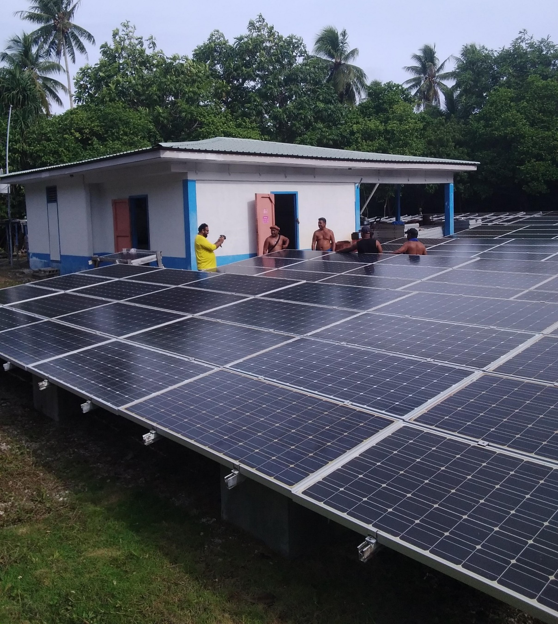
Unlocking MG for sustainable development:
Mini-grids in FSM
MG in Ethiopia by TTA

Slide 2
TABLE OF CONTENTS
Demographic context of FSM
Current electrification levels and national targets
Current mini-grids systems [sites, capacity & technologies] on the ground and planned systems
  Management / institutional structure for rural electrification and mini-grids
  Business models / tariff settings for mini-grids
  Experiences and challenges with mini-grids systems – Lessons learnt

Slide 3
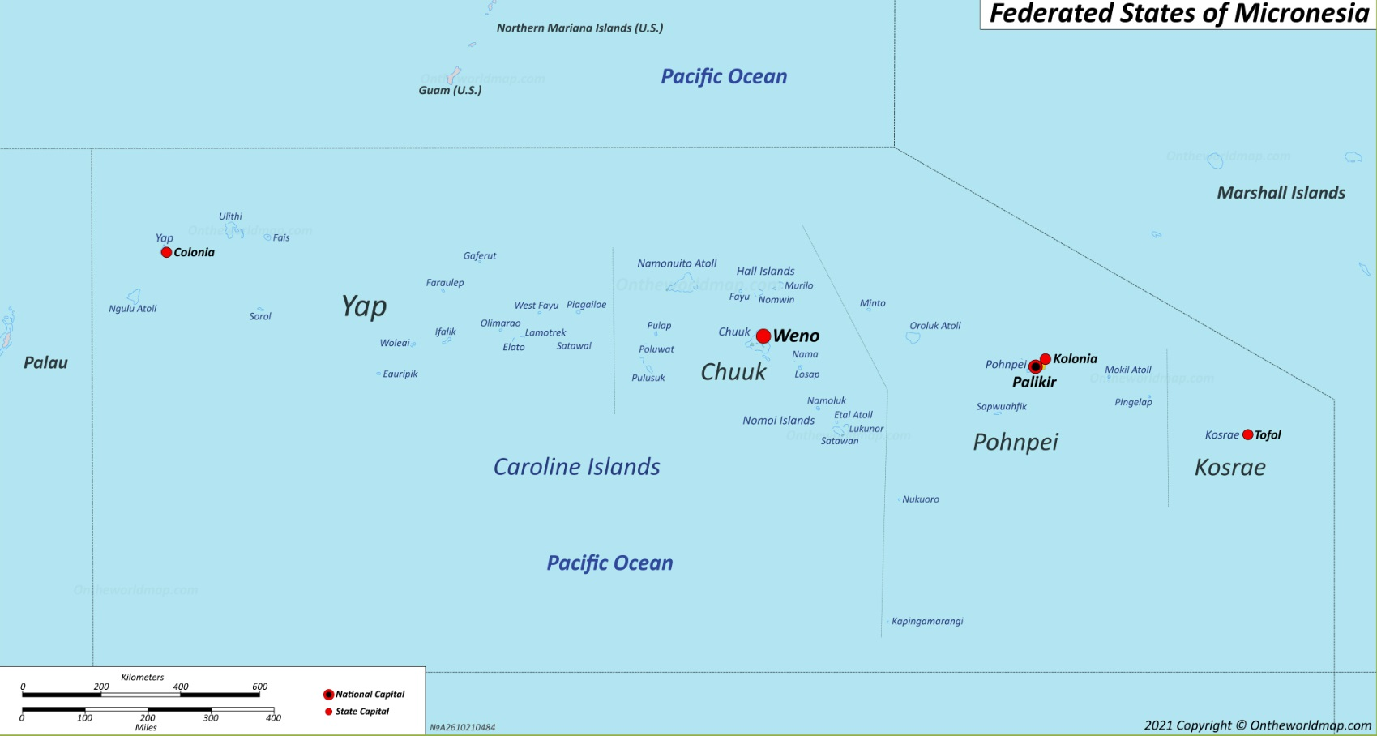


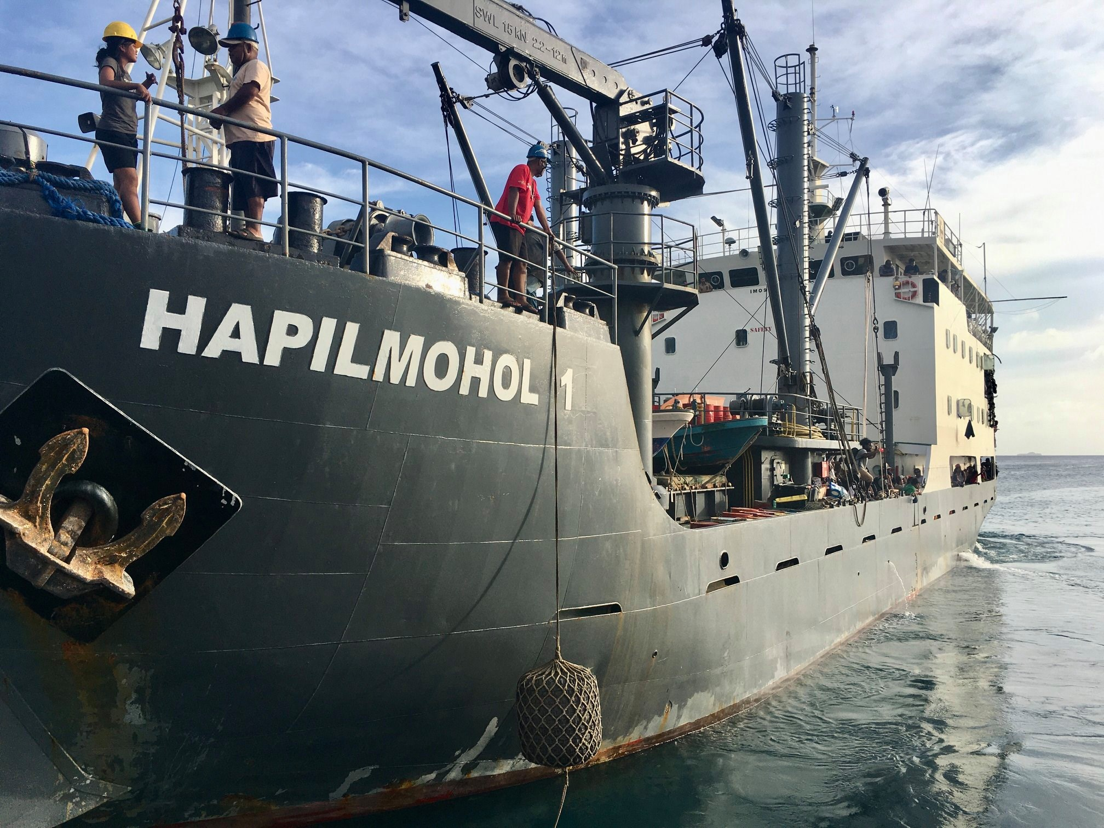

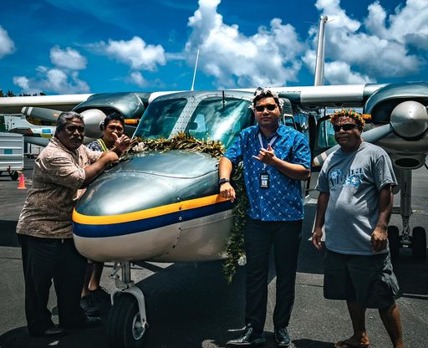
Notes:
State Vessels - 3 Mortlocks, 1 North West
Private vessels – North Star, Vital Carrier
National Vessel – Navigator and Voyager
Kor – Pni 570km
PNI-Chu – 710 km
Chu-Yap
Kosrae – Yap (2800km)

Slide 4
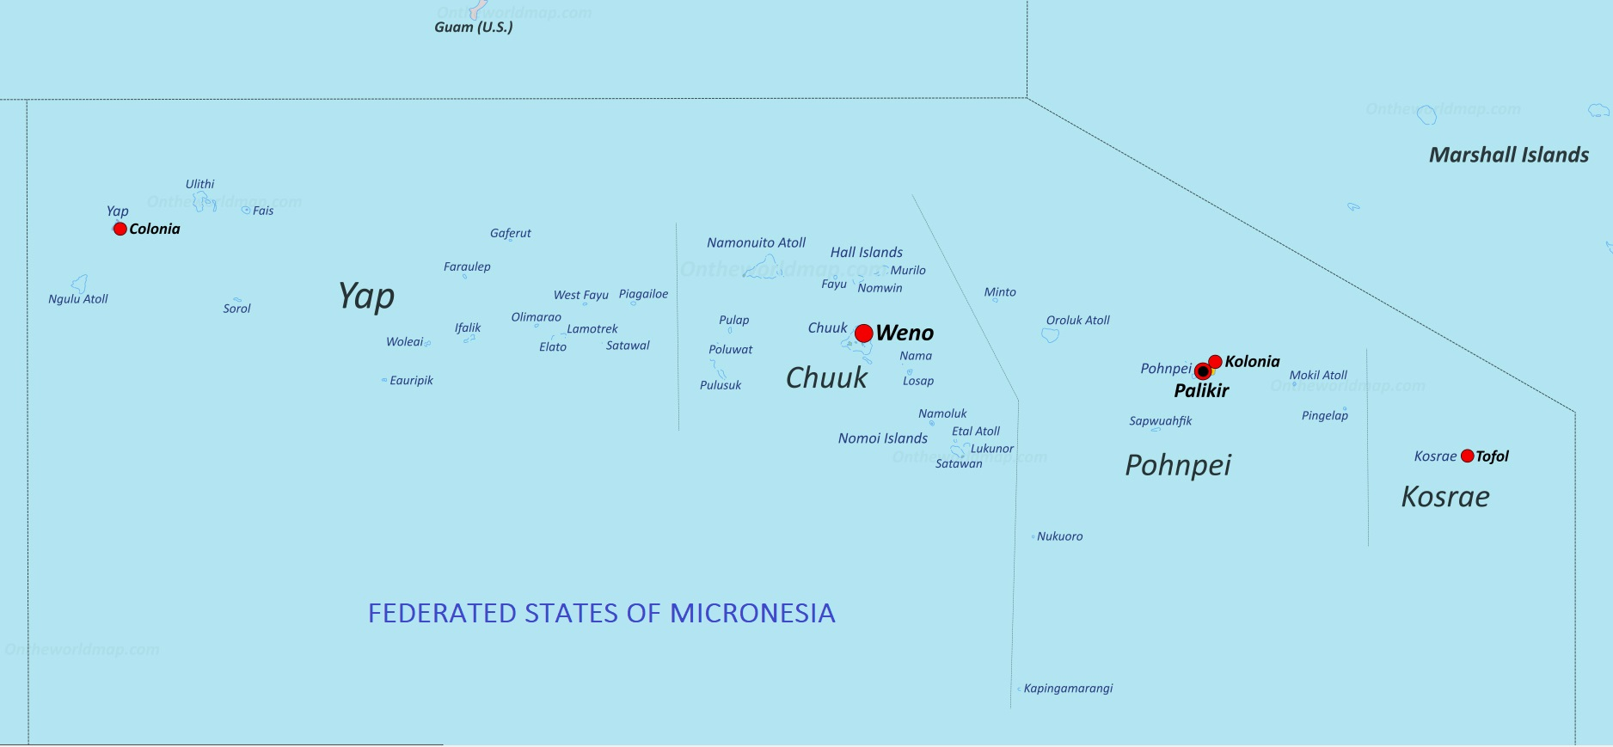
Electrification Level
Pohnpei State
Tot HH – 6289
% HH in Pohnpei Proper – 94%
Electrification level – 97%
5 Islands with SHS with Microgrid systems for Schools, dispensary and Municipal office
4 MG
1 MG
SHS
SHS
SHS
1 MG; 4SHS
SHS
SHS
1 MG
SHS
SHS
Yap State
Tot HH – 2311
% HH in Yap proper – 72%
Electrification level - 82.8%
7 island has Mini grids
9 Islands with SHS
SHS
SHS
SHS
1 MG
Chuuk State
Tot HH – 7024
% HH in Weno – 30%
% HH in Lagoon Is – 48%
Electrification level – 30% - 55%
SHS
Kosrae State
Tot HH – 1102
Electrification level – 96%
Walung – 51 HH
SHS
Notes:
Chuuk DOE – Annual Agreement fees. 12kW
1.20 6.40 2.82 1.80

Slide 5
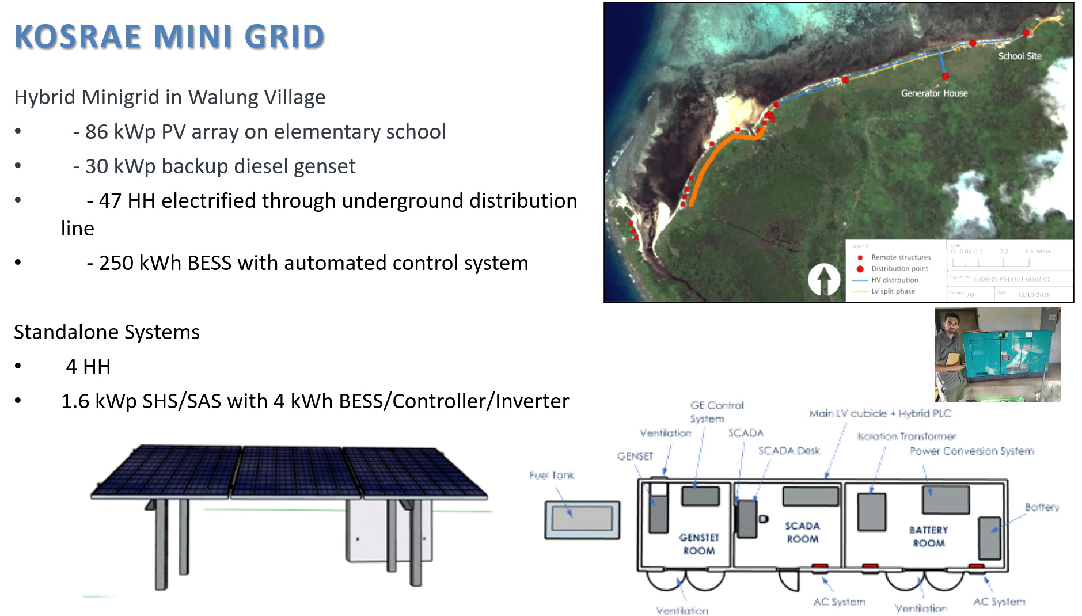

Slide 6
Pohnpei mini grids

Slide 7
Chuuk mini grids

Slide 8
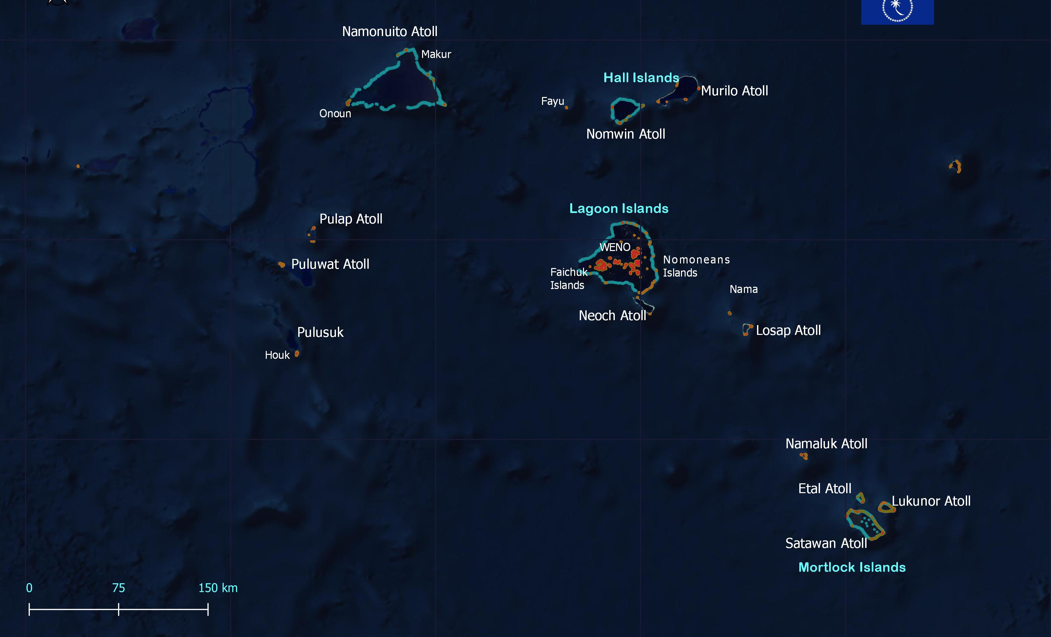
Chuuk State
Made of 5 regions with 40 municipalities covering some 200 villages
48 Islands - 19 volcanic Island and 29 Atoll islands
Of the 40 Municipalities, only Weno and Tonoas is electrified
North west Islands

Slide 9
Yap mini grids

Slide 10
Yap mini grids

Slide 11

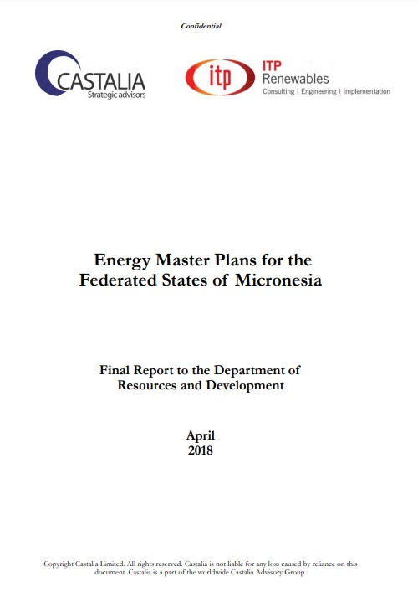
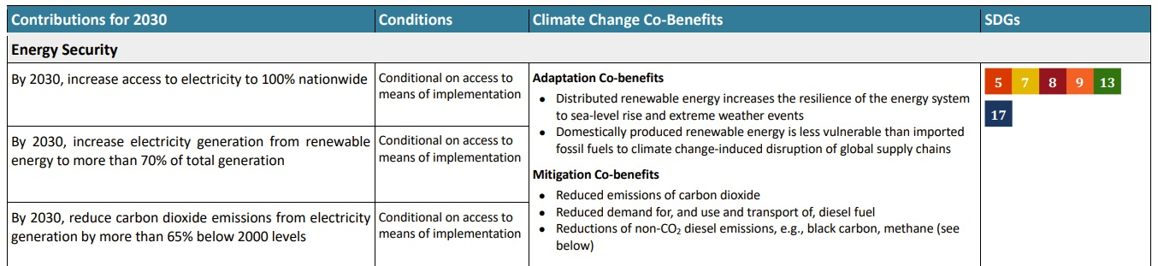
FSM national targets

Slide 12
Monitoring and Evaluation

Slide 13



Current mini-grids systems
Management / institutional structure for rural electrification and mini-grids
  Supply of power, Water and Sanitation all fall under the respective state utilities

Slide 14
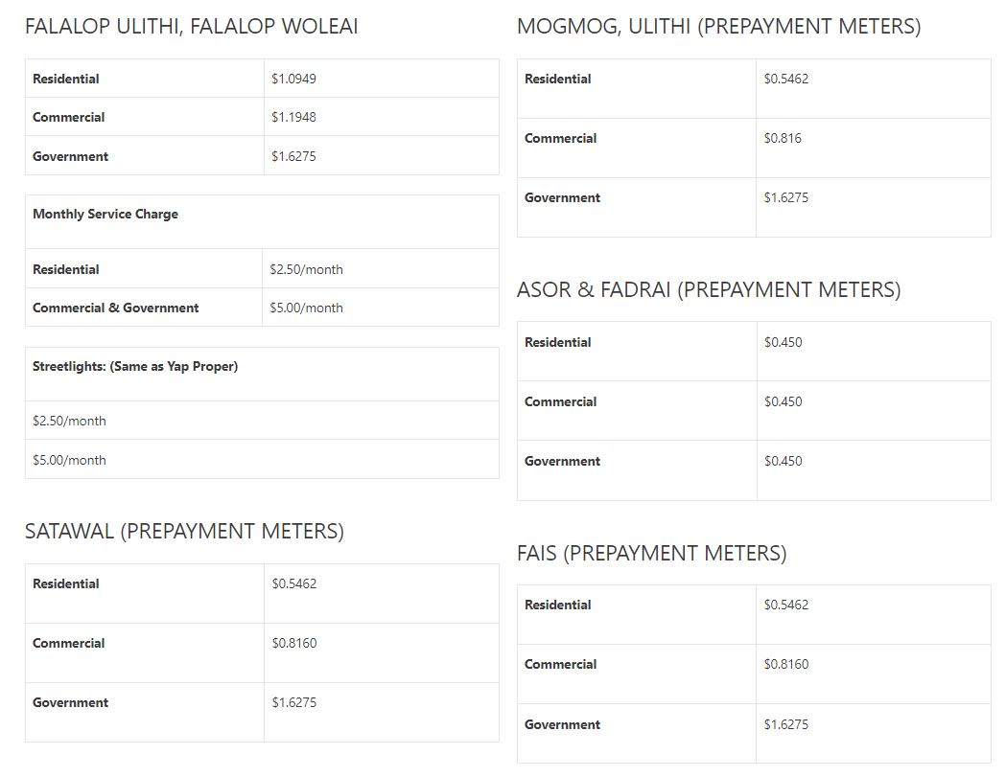
Current mini-grids systems
Business models / tariff settings for mini-grids
  Only in Yap.

Slide 15
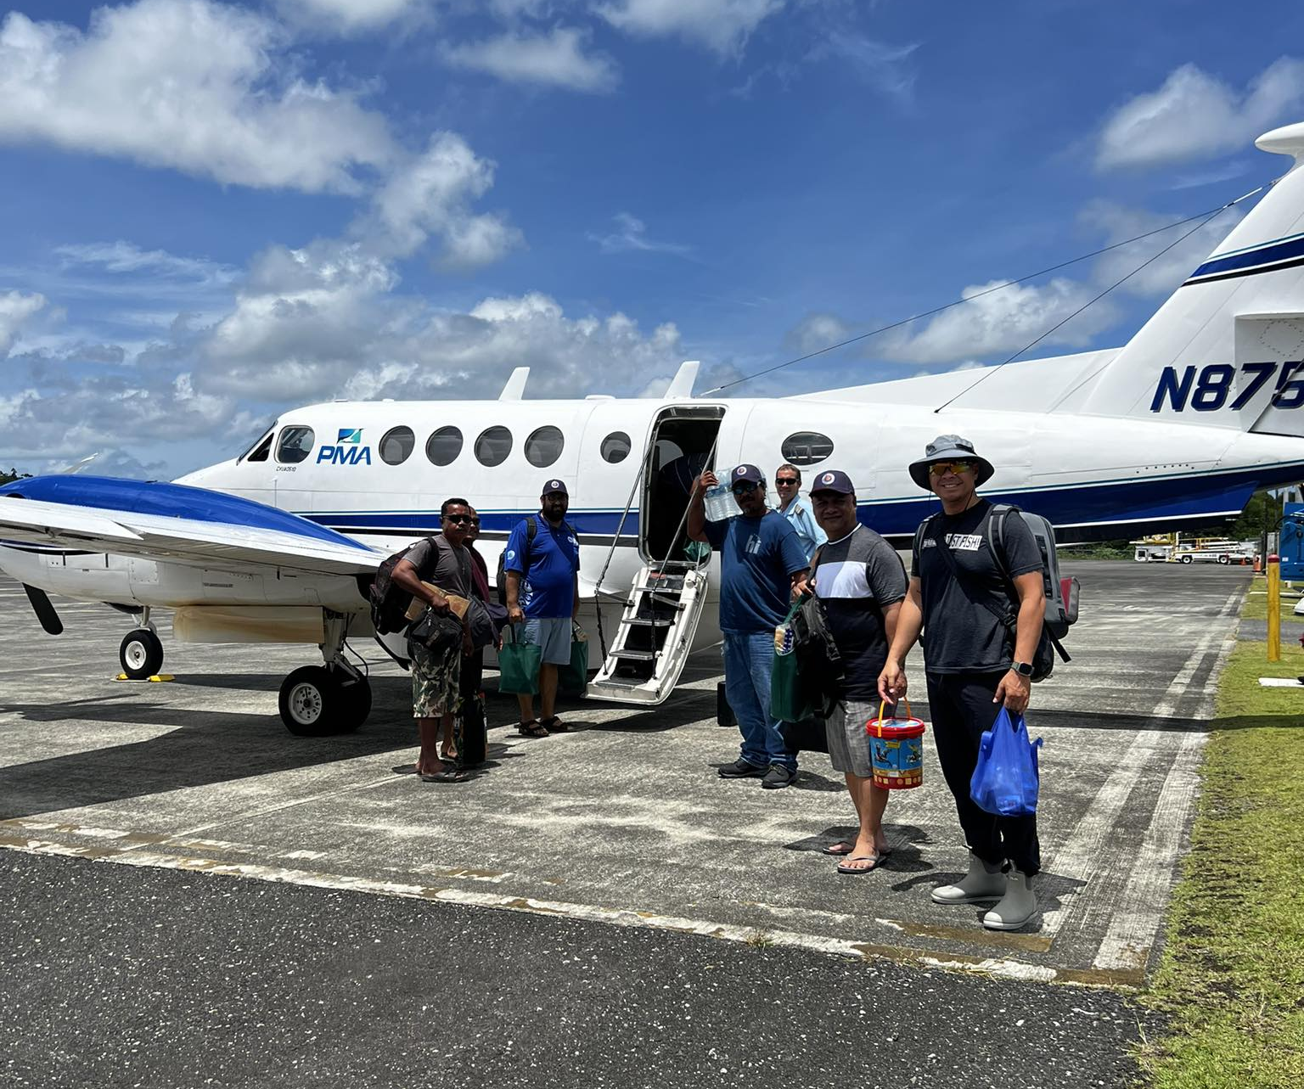
Lessons learnt with mini-grid systems

Slide 16
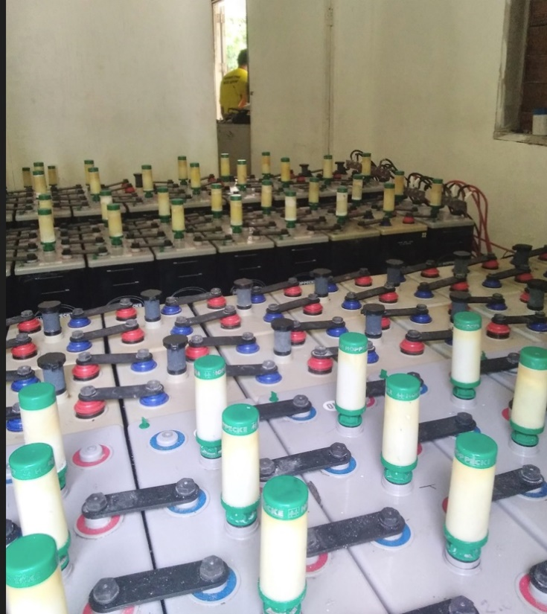
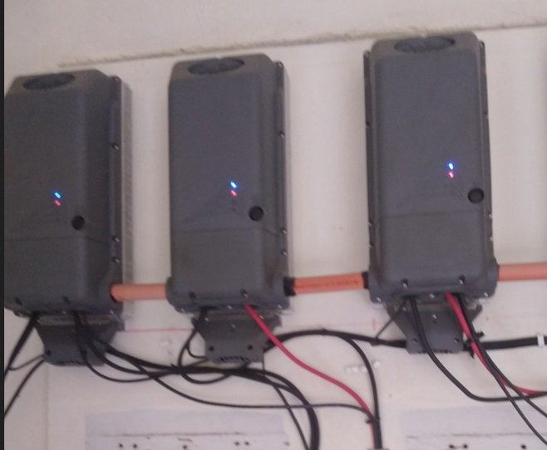
Lessons learnt with mini-grid systems
  Land Acquisition - Church and government properties, incentives for the private landowners.
  Ownerships - Working with the communities
  Durable assets:-
    Battery – preference for lead acid Batteries assuring more than 12 years
    Inverter types and models of preference for YAP – Outback types
    Preference for non-complicated equipment’s where an island technician can easily manage

Slide 17
Lessons learnt with mini-grid systems
Warranty concerns
    Replacement (takes more than a year)
    Performance warranty – not fully monitored.
Prepayment meters for 120V system
Environment
    High temperatures effect on roof top panels
    Corrosion in roofs much quicker or leaks in roof.

Slide 18
Lessons learnt with mini-grid systems
Spare part concerns
    Different models
    Outdated/absolute models
Procurement: multiple projects different procurement requirements
    Logistics
    Ownership of the installation

Slide 19
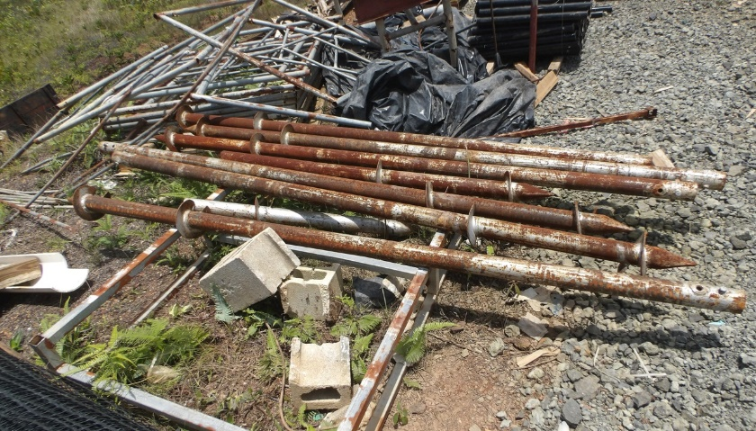
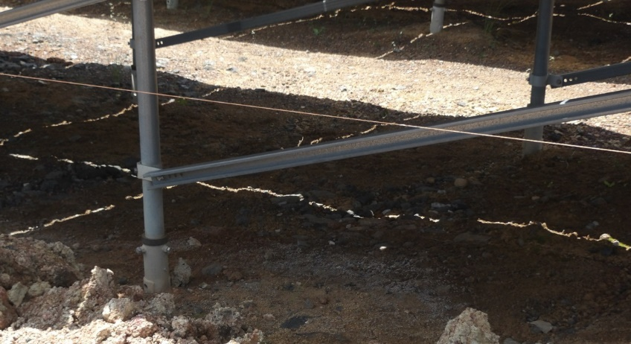
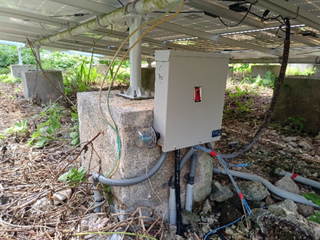
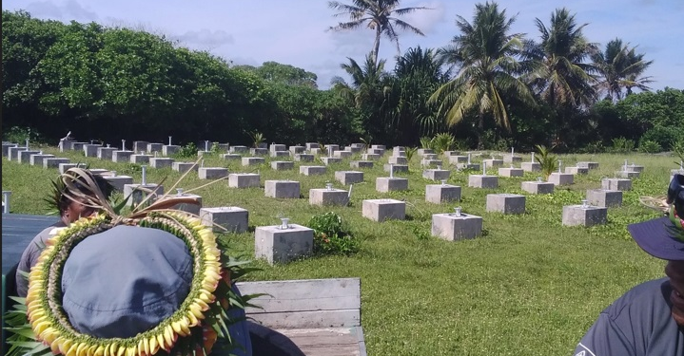
Interest towards expanding mini-grid systems
Salvaging and ensuring full usefulness of existing equipment’s
  Interconnecting small grids or standalone units into a bigger mini grid?
  Re-using Salvageable panels and batteries?
Recycling approaches
  Footing – is it worthy to install a heavy structure footing
  Panel, battery and inverters

Slide 20
Kinisou! Kalagan! Komoagar!Konuo!Vinaka!
Albert Francis
Albert.francis@cpuc.fm

