Slide 1
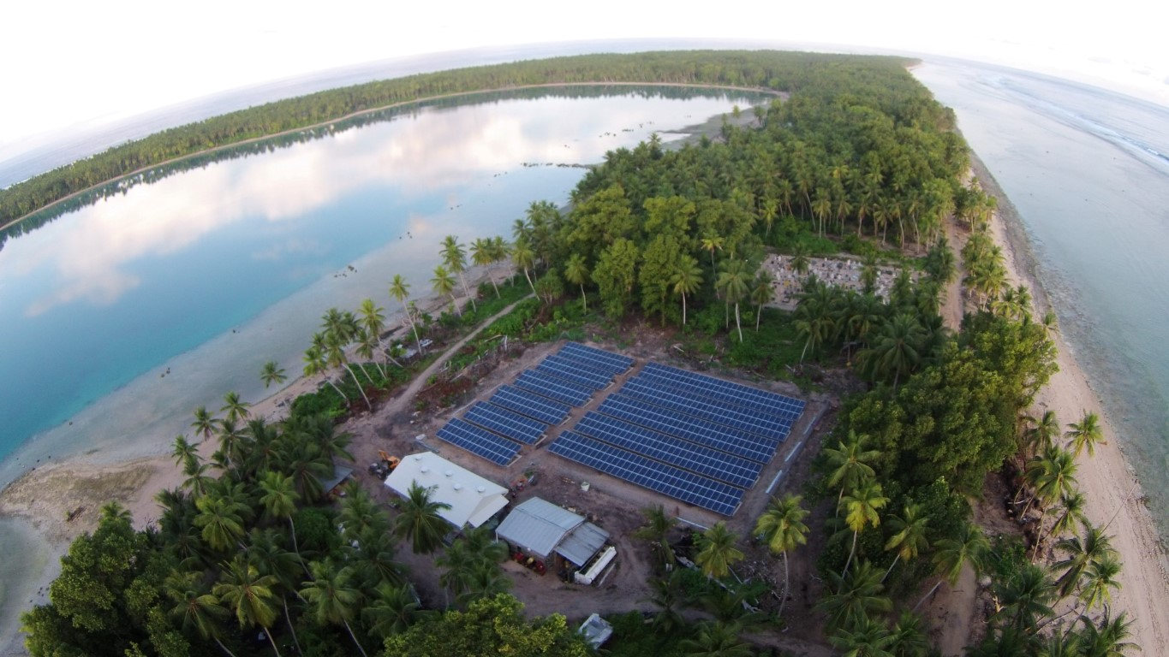
Unlocking Mini-Grids for Sustainable Development Training
Mafalu Lotolua
Suva, Fiji
26 – 30 June 2023

Slide 2
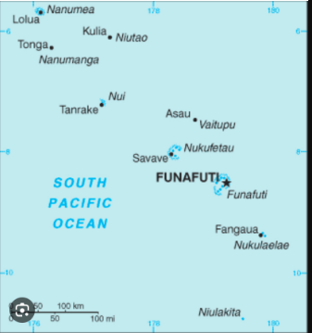
Background Information
Nine (9) atoll islands and Funafuti the Main Island
Access between the islands ONLY by boat
Distance between the islands:
From Funafuti to the most Northern Island – 462kms
From Funafuti to the most Southern island – 119kms
Seven (7) islands on mini-grid + two (2) other sites, one on SHS, and the main island on grid-connected systems
Six (6) islands on LV 3-phase and one (1) island on 11kV system network
Access rate to electricity – ~100%
Outer Islands electricity supply – from 2000 18hrs/day and in 2015 - 24/7
Climate Target – 100% RE by 2020, 2025 and recently to 2030.
Present Share of RE – only 19%
Most Northern Island
Most Southern Island

Slide 3
Solar PV Mini-Grid & SHS System in Tuvalu

Slide 4
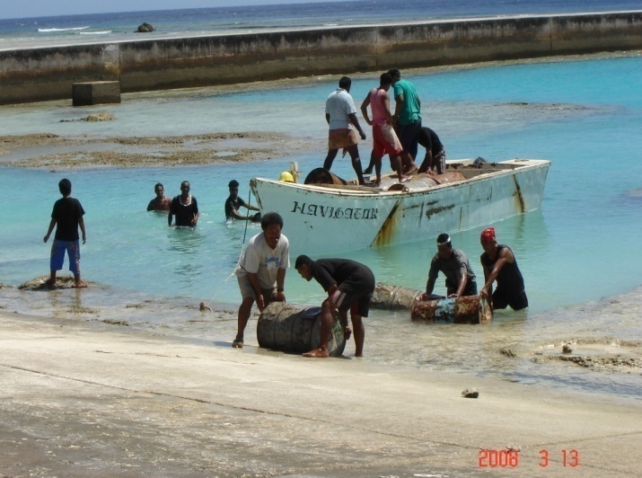
1. Role of Solar PV Mini-Grid
In 2000, Outer Island communities were powered by diesel generators 18hrs/day
In 2015, solar PV Mini-Grids installed and provide the communities with 24/7 power supply
Living standard greatly improved
availability of internet connectivity
proper facilities for storage of vaccines
- kids able to study at night etc
Contribute to the Country RE and EE target
Minimize the use of diesel fuel

Slide 5
2. Current Mini-Grid System
Site | Capacity |  |  | Installation | Comm | Type of Battery (Lead Acid) | Planned System
 | PV (kWp) | Battery (kWhr) | Gen (kVa)
Nanumea | 195 | 1,440 | 160 | Ground | 2015 | Maint. Free | Battery replacement
Nanumaga | 205 | 1,584 | 160 | Ground | 2015 | Maint. Free | Battery replacement
Niutao | 230 | 1,728 | 160 | Ground | 2015 | Maint. Free | Battery replacement
Vaitupu | 400 | 2,880 | 160 | Ground | 2015 | Maint. Free | Battery replacement
Nui | 80 | 864 | 180 | Ground | 2015 | Maint. Free | 125kWp September install 2023
Nukufetau | 97 | 1,008 | 180 | In the Estuary | 2015 | Maint. Free | 118kWp install August 2023
Nukulaelae | 45 | 586 | 114 | Ground | 2015 | Maint. Free | 40kWp install July 2023
Maritime Institute | 8 | 96 | 120 | Rooftop | 2017 | Maint. Free | Increase Capacity & storage
Motufoua Sec. School | 46 | 576 | 114 | Ground | 2009 | Wet Batt | Battery Replacement

Slide 6
2. Current Mini-Grid System
Site | Capacity |  |  | Installation | Donor | Total Cost
 | PV (kWp) | Battery (kWhr) | Gen (kVa)
Nanumea | 195 | 1,440 | 160 | Ground | NZ MFAT | NZ$20million
Nanumaga | 205 | 1,584 | 160 | Ground | NZMFAT
Niutao | 230 | 1,728 | 160 | Ground | NZMFAT
Vaitupu | 400 | 2,880 | 160 | Ground | NZMFAT
Nui | 80 | 864 | 180 | Ground | EU | EU2.4million
Nukufetau | 97 | 1,008 | 180 | In the Estuary | EU
Nukulaelae | 45 | 586 | 114 | Ground | EU
Maritime Institute | 8 | 96 | 120 | Rooftop | Finland | USD$30k
Motufoua Sec. Sch. | 46 | 576 | 100 | Raised Structure | Italy | USD$700,000
TEC is now working with ADB on Phase II of our existing project for 1MW Floating Solar PV, and
To include the replacement of batteries for the stations, and ONLY possible if funding is available.

Slide 7
3. Role of Mini-Grid – Share of RE
SHARE OF PV
Stations | 2016 (%) | 2017 (%) | 2018 (%) | 2019 (%) | 2020 (%) | 2021 (%) | 2022 (%)
Nanumea | 94 | 95 | 93 | 79 | 55 | 36 | 45
Nanumaga | 96 | 93 | 93 | 81 | 64 | 35 | 46
Niutao | 93 | 91 | 90 | 78 | 74 | 13 | 67
Vaitupu | 77 | 88 | 88 | 61 | 50 | 37 | 56
Nui | 73 | 59 | 38 | 44 | 49 | 48 | 61
Nukufetau | 83 | 73 | 53 | 47 | 42 | 52 | 2
Nukulaelae | 14 | 67 | 70 | 49 | 36 | 52 | 67
Outer Islands | 81 | 81 | 77 | 63 | 54 | 39 | 53
Funafuti | 14 | 12 | 9 | 11 | 8 | 10 | 11
Overall | 25 | 25 | 21 | 20 | 17 | 17 | 19

Slide 8
Mini Grid Vs Diesel Consumption
Installation of mini-grid in 2015, diesel consumption decreases and after 2018, diesel consumption increases again
Due to the deterioration of batteries in all the stations

Slide 9
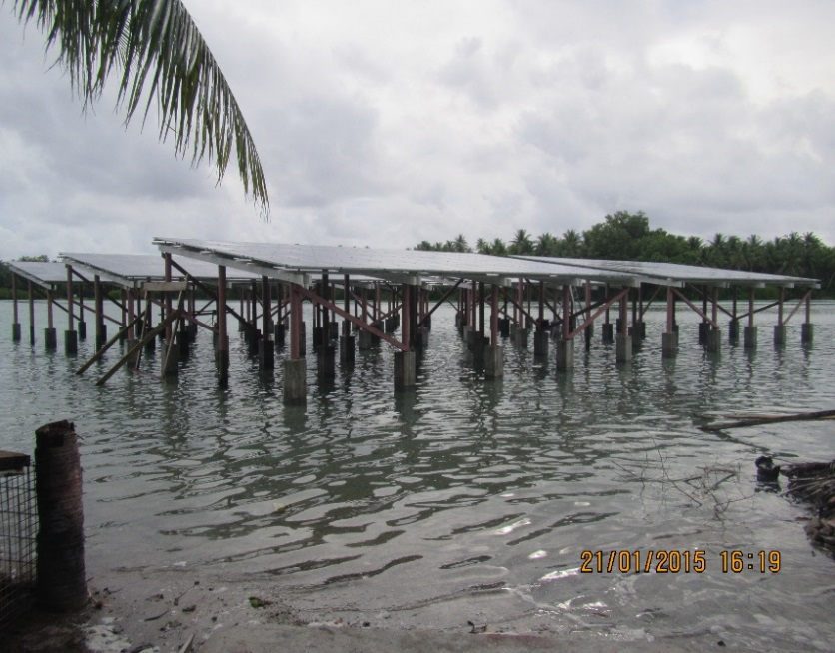
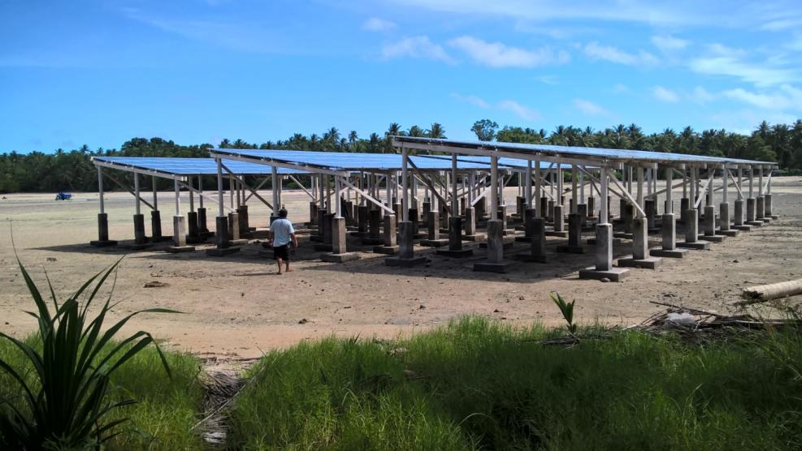
4. Management/Institutional Structure
TEC main office at Funafuti, Manage and Operate Outer Island Mini-Grid Systems
2-staffs on each station to look after the system
Supervisor and Operator
Also have a relieve staff on each island
Island Council involve in the monitoring of staff
to represent TEC on the island and can report staff performance to main office and Management will deal with the matter accordingly.

Slide 10
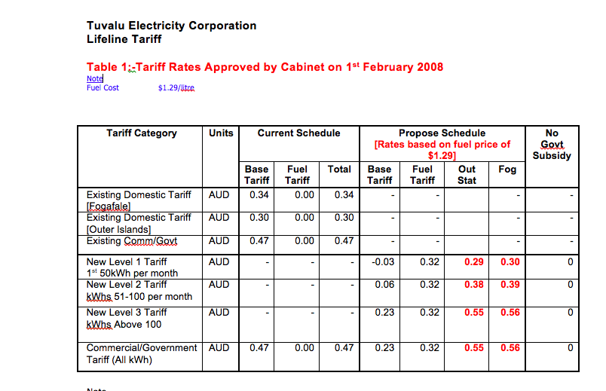
5. Business Models/Tariff Setting

Slide 11
Business Models/Tariff Setting
 | Existing |  | Propose
Category | Outer-Islands | Fogafale | New Tariff | O/Islands | Fogafale
Residential
1st 50kWh | 0.29 | 0.30 | 0.56 | 0.85 | 0.86
2nd 50kWh | 0.38 | 0.39 | 0.56 | 0.94 | 0.95
Above 100kWh | 0.55 | 0.56 | 0.56 | 1.11 | 1.12
Government & Commercial | 0.55 | 0.56 | 0.56 | 1.11 | 1.12
By law, all Government SOE’s to submit Community Service Obligations (CSO) to Government on yearly basis
CSO - to cover all unprofitable activities carried out by the SOE.
In May 2023 Cabinet has agreed in principle for Government to subsidies whatever amount is required by TEC based on current tariff rate.
Directed the Ministry to review calculation of tariff so as to determine a more realistic level of subsidies required in light of other RE solar projects current in progress and resubmit.

Slide 12
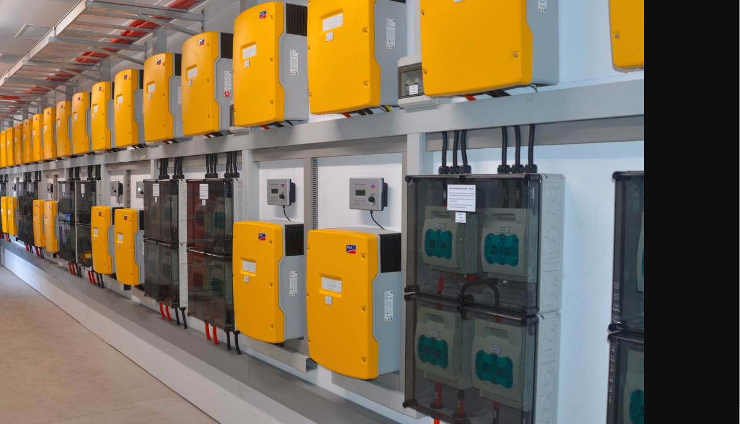
6. Experience & Challenges with Mini-Grid System
Complex system set up
Only few staff for O&M
Reliable supply, rapid increase of demand
Limited transport to the islands – every 3weeks
Distance between the islands, only access by boat
From Funafuti to the most Northern Island – 462kms
From Funafuti to the most Southern island – 119kms
Common issues with the system component:
Panel connector got on fire
Cables insulation eaten by termites
Inverters failed - fans or electronic cards

Slide 13
6. Experience & Challenges with Mini-Grid System
Deterioration of batteries
Monitoring of staffs
High cost of communication
resulted in removing of on-line monitoring
Difficult environment for electrical and mechanical equipment
Tariff not cover operation
spare parts not readily available etc

Slide 14
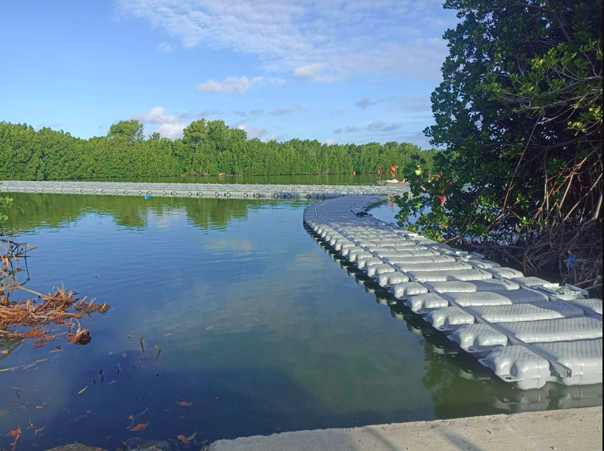
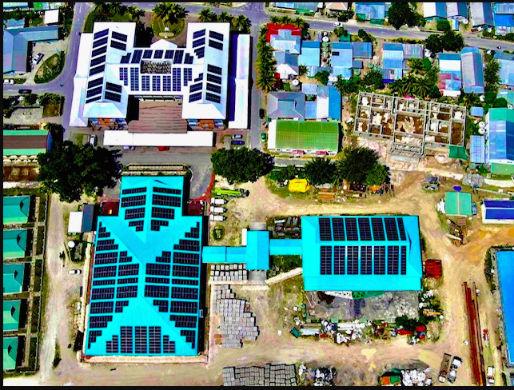
7. Lesson Learnt
Could have done differently, lots of coconut trees were cut down
Alternative means of installing PVs – rooftops, floating PV.
Battery Failure
Oversized System - to able to cater for the increasing demand
Depend on the availability of finance
Minimize growth of demand
Using of prepayment meters
- limit demand
- improve collection
Identify right staff for O&M

Slide 15
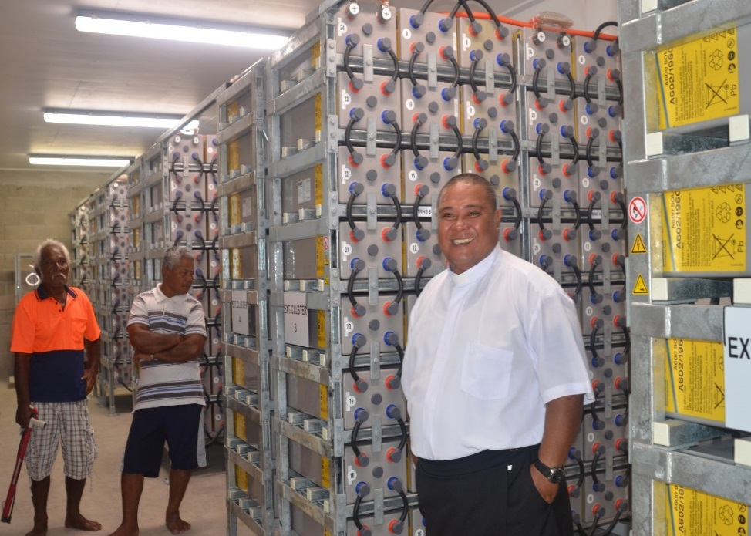
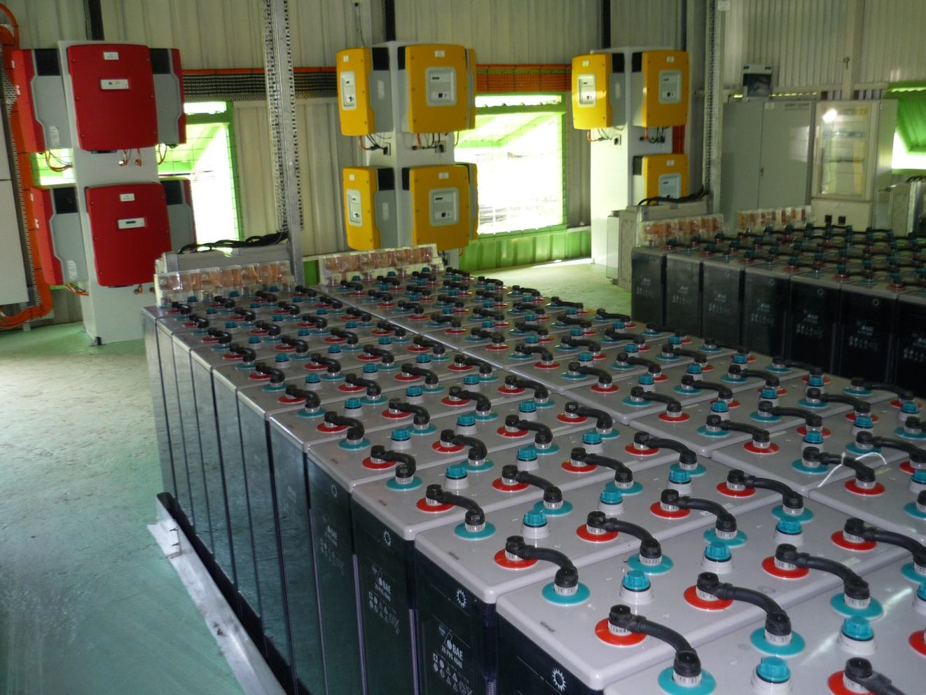
7. Lessons Learnt
Monitoring of Staff
Get to involve Island Council/Other bodies with authority on the island
Communication is a need
On-line monitoring is necessary
VHF radio’s for all station
Frequent visit to the islands
Invest in human resources to enable to maintain the systems
Right tariff setting – need Government support.
regular presenting your case to Cabinet for finance support

Slide 16
Standalone Home Solar (SHS) System

Slide 17
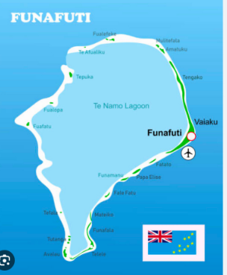
Background Information
Aim – To improve livelihood and drive economic activities
Project Site – Niulakita (most southern island) and Funafala (an islet in Funafuti)
Donor – Italy
Total Project Fund – US$300k
Niulakita – 19 systems
Funafala – 17 systems
Commissioned – June 2017
Funafala
Niulakita

Slide 18
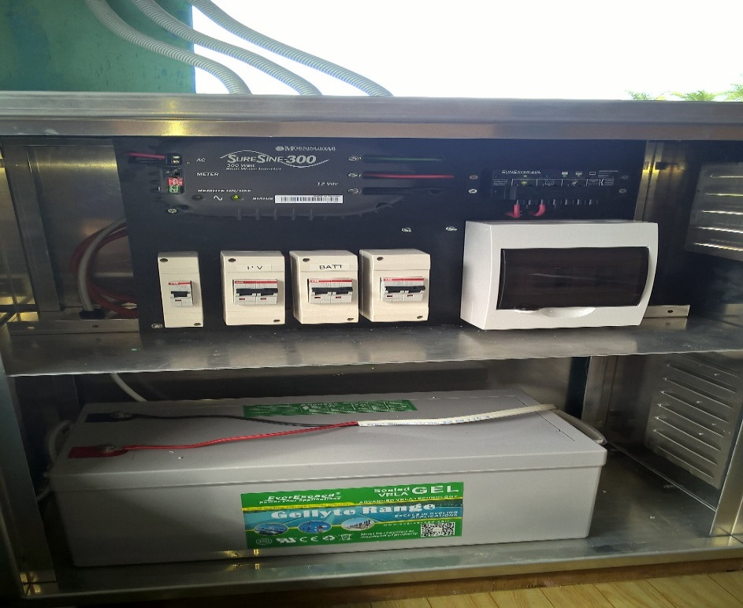
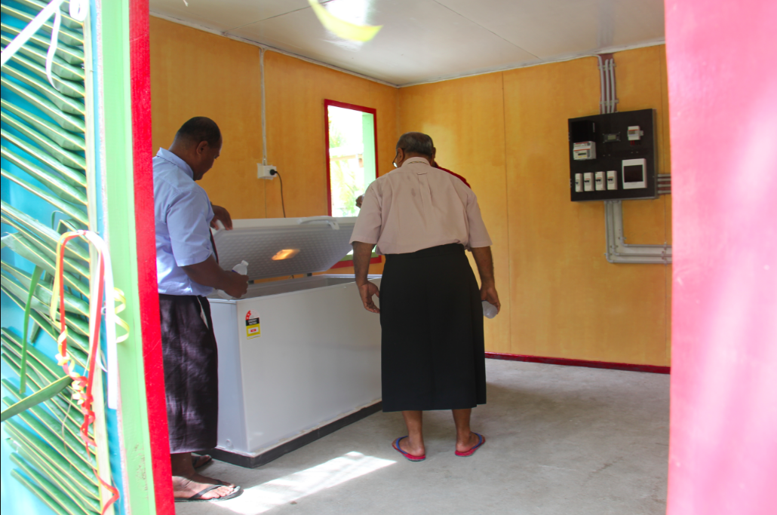
Two Parts of the Project
Part 1 - SHS System for household, Meeting Hall and Church
Part 2 – Community Deep Freezer to drive economic activities

Slide 19
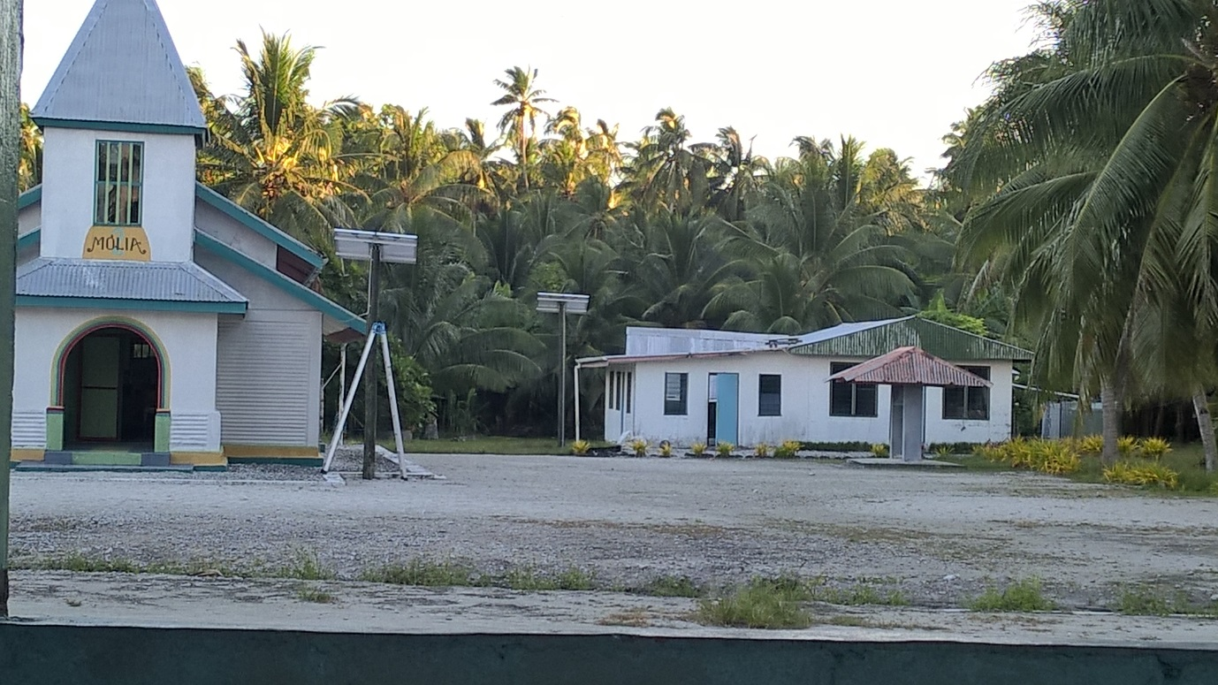
System Component
1. Household
- 2 x 140watts panel
- Inverter – 12v 300watts
- Sunsaver Controller
- 12v 250AH deep cycle VRLA battery
2. Community Deep Freezer (415ltrs, 3-star)
- Panels - 3 x 380 watts
- Inverter – 24v 800watts
- Charger Controller – Tristar MPPT
- Battery – 12 x 2volts 600AH VRLA battery

Slide 20
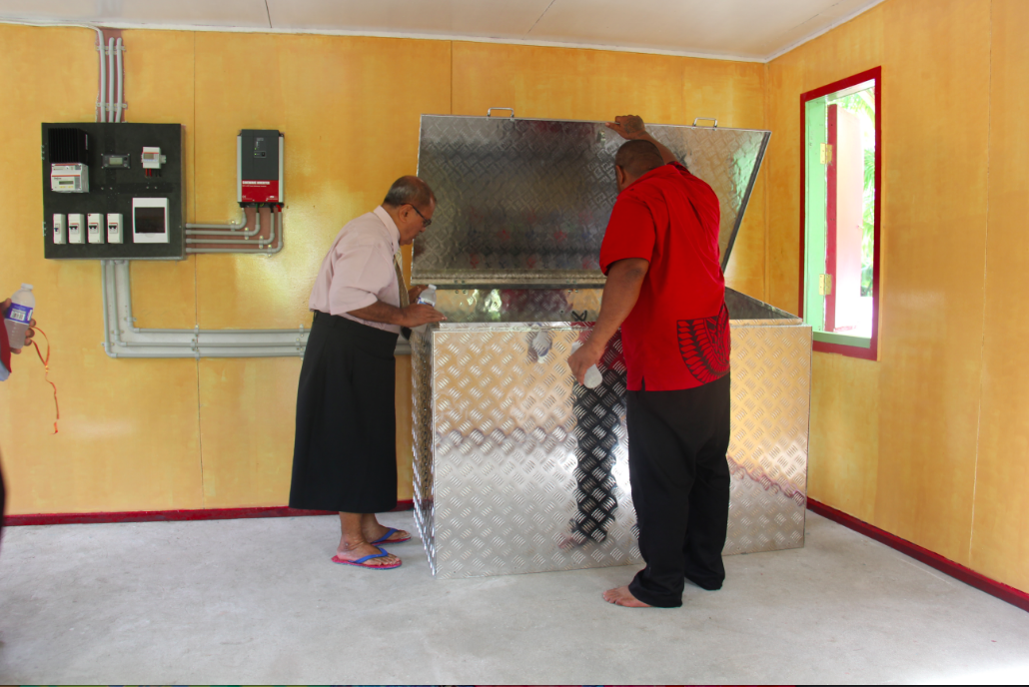
Management/Institutional Structure
Ownership arrangement - Individual household to look after their own system
Maintenance – TEC is doing the maintenance without any cost

Slide 21
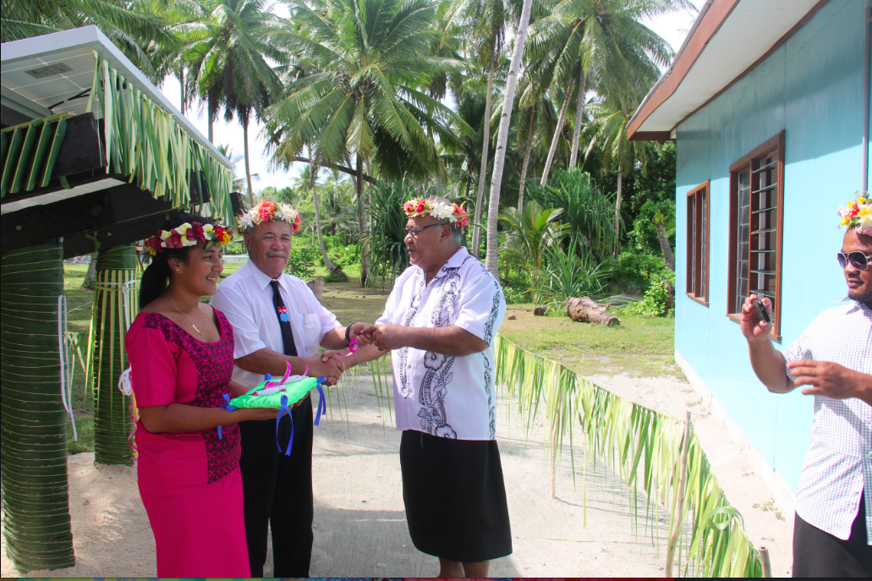
Business Models/Tariff Setting
On trial of Ownership arrangement
TEC looks after the main component
Owner, responsible for internal items.

Slide 22
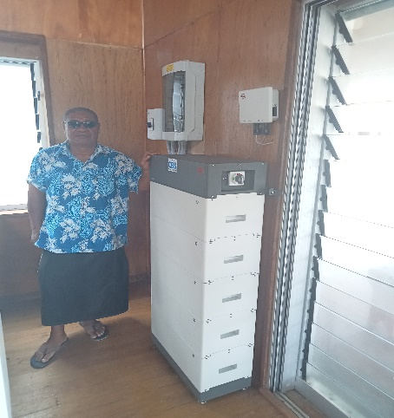
Experience & Challenges with SHS
Residence need more solar PV capacity
Still some residence not able to look carefully after their system
Deterioration of Batteries
Movement of personnel elsewhere
Additional new residence
20kWh lithium-ion battery

Slide 23
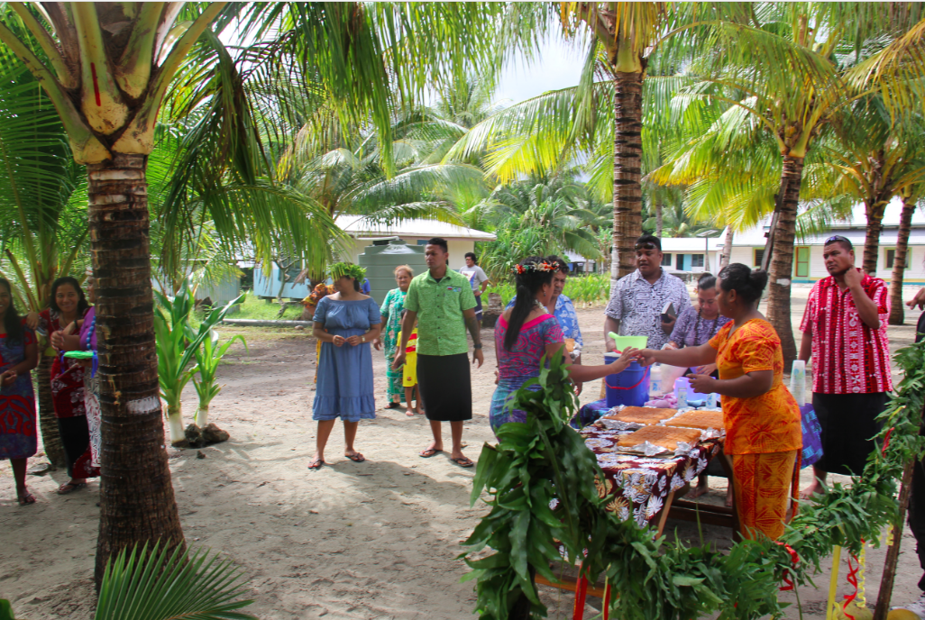
Lessons Learnt
Education program for residence to live within their means
Training residence for business opportunities
Awareness program on the importance of SHS and its limitation
System Sustainability - To involve the Island Council to manage and operate the system
TEC is available to offer the technical expertise.

Slide 24
Way Forward for PV Installations

Slide 25
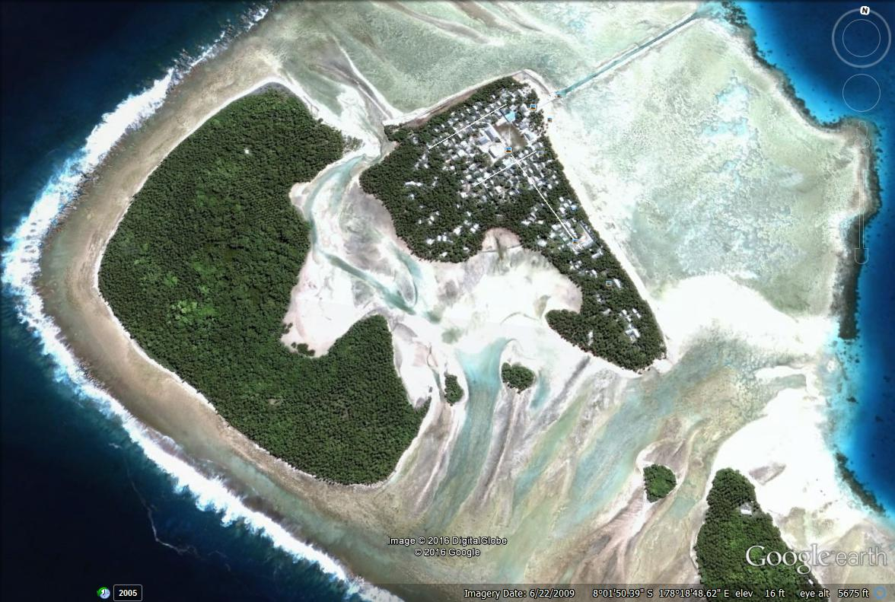
Some Innovative Ways to Install Solar PV
Existing Installations at Nukufetau Island
Reef channel
Installation since 2015
Power station
Site for PV installation

Slide 26
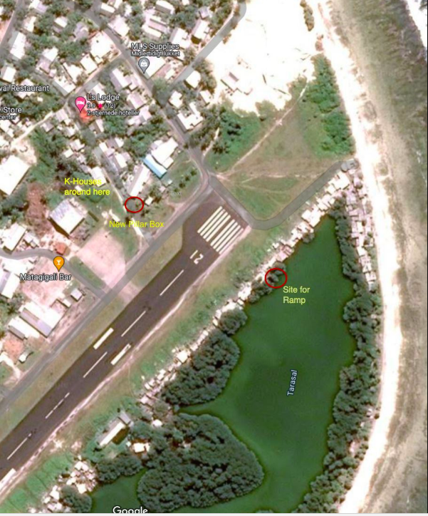
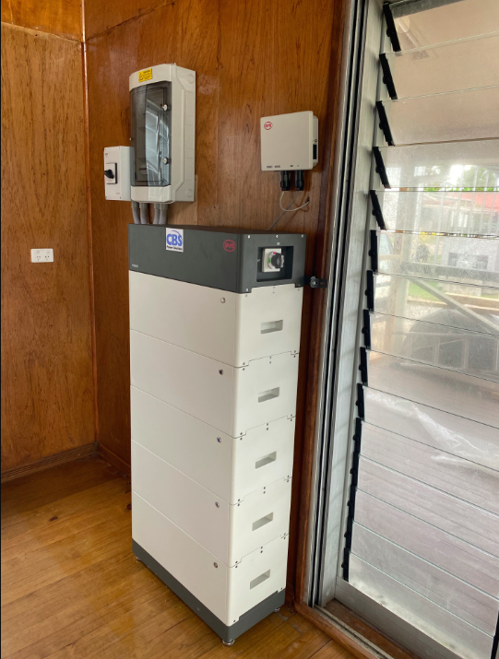
Floating Solar PV – Tafua Pond
Demo Fale Rooftop Solar PV – SHS System
26kWp PV and 20kWh lithium-ion battery
On-Going 100kWp PV

Slide 27
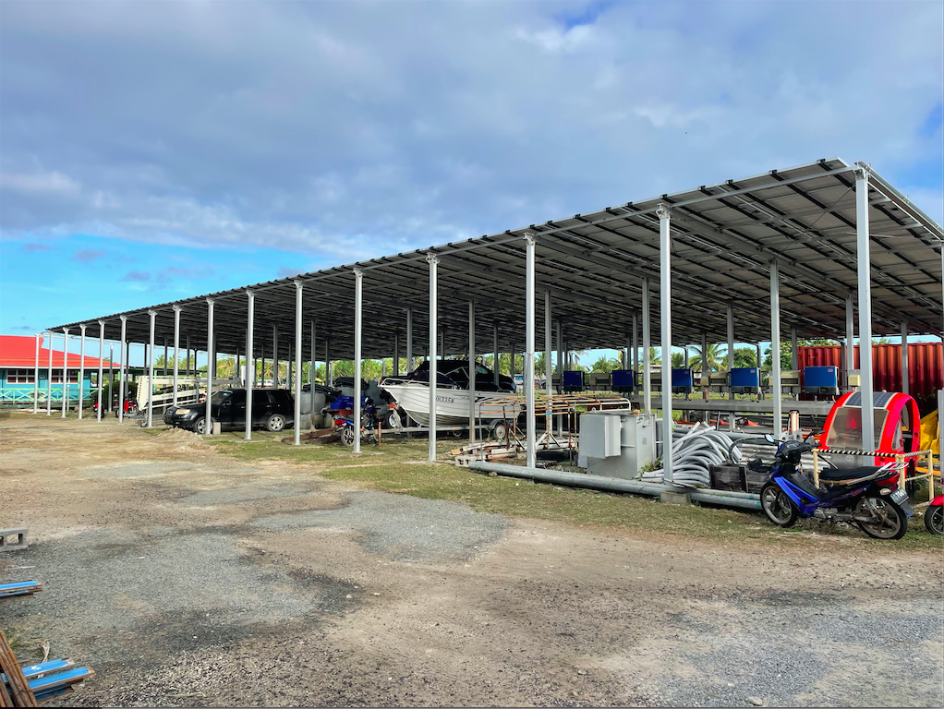
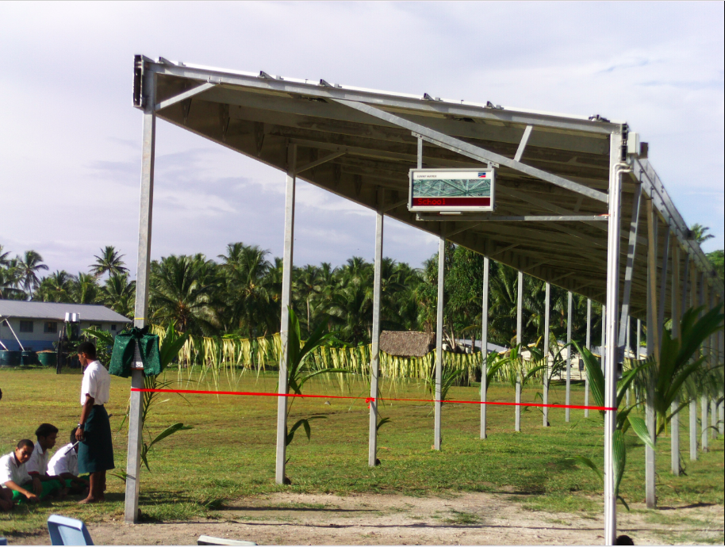
Space Creation
46kW solar PV at Motufoua Sec. School
100kW solar PV at TEC compound

Slide 28
Thank You

