Slide 1
5th PCREEE STEERING COMMITTEE (PSC) MEETING 18th NOVEMBER 2020 MODE: VIRTUAL
AGENDA ITEM 6 – FINANCIAL STRUCTURE
To update the PSC on the Financial Structure of the PCREEE.
Jesse Benjamin – Programme Delivery Officer, PCREEE

Slide 2
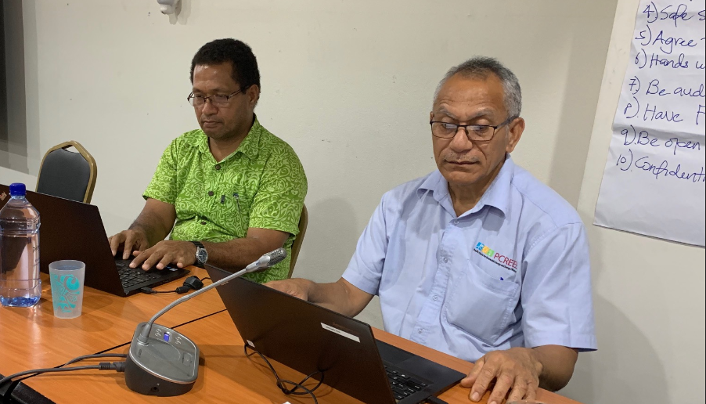
Background
A cornerstone to the effective operation of any organization is the effectiveness of its financial structure, ensuring that resources are effectively utilized and they are accounted for in a timely manner.
The PCREEE operates under the Financial rules and policies of the SPC. SPC is an accredited entity of the EU and the GCF and this is proof of the compliance of SPC’s financial structure with internationally accepted standards and norms.
Funds received from PCREEE’s donors are deposited at a PCREEE account with SPC. To facilitate spending in Tonga, a SPC Project account was opened with ANZ Bank in Tonga. Funds are then transferred from Suva to Tonga based on PCREEE’s work plan. The signatories were the Manager of PCREEE, the Finance Manager and the Deputy Director General from SPC in Suva plus the Director of Energy and CEO of MEIDECC in Tonga. Two (2) signatories were needed for every payment of which one (1) must be from SPC.
At the end of every month, PCREEE will submit a financial report to be cleared from SPC in Suva. Requests for advance / top up were also submitted to be cleared from Suva too.

Slide 3
Current Status
The above arrangement proved to be too cumbersome, time consuming and delays were always experienced.
In March 2020, SPC Finance introduced some changes whereby the ANZ TOP account was added to a Transactive System which then enabled SPC Finance to view the Tonga account online and do the top up and payments accordingly.
The SPC account was therefore opened to all SPC payments in Tonga, regardless of programme and projects, and Suva Finance will record each payment in Tonga to the appropriate project and programme account in Suva. All payments are now done through internet banking. This has proven to be more efficient and involve less work for all concerned, while maintaining and strictly complying with SPC’s Financial rules and procedures.
To ensure PCREEE continues to operate efficiently, a Petty Cash has been set up to cater for small and urgent payments needed by the office.
To strengthen PCREEE’s accountability, an Asset Register is maintained by the office and is updated and submitted to Suva on a monthly basis and attached to the progress reports to donors.

Slide 4
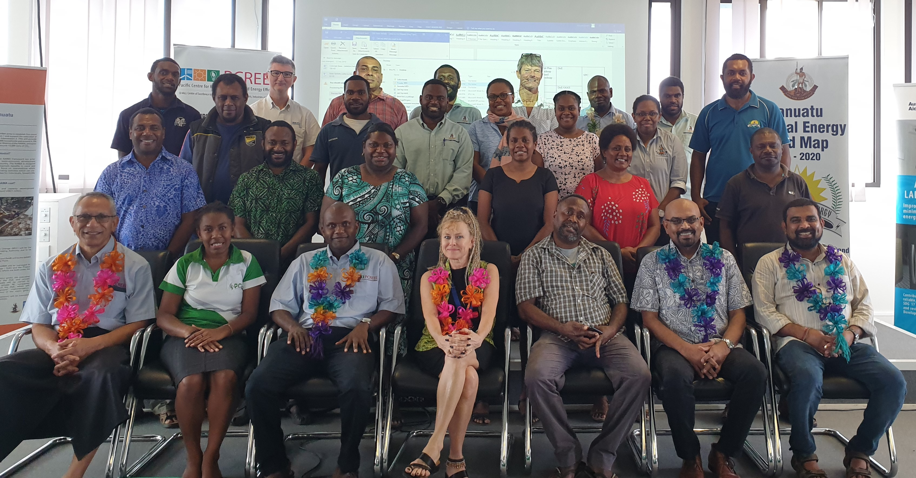
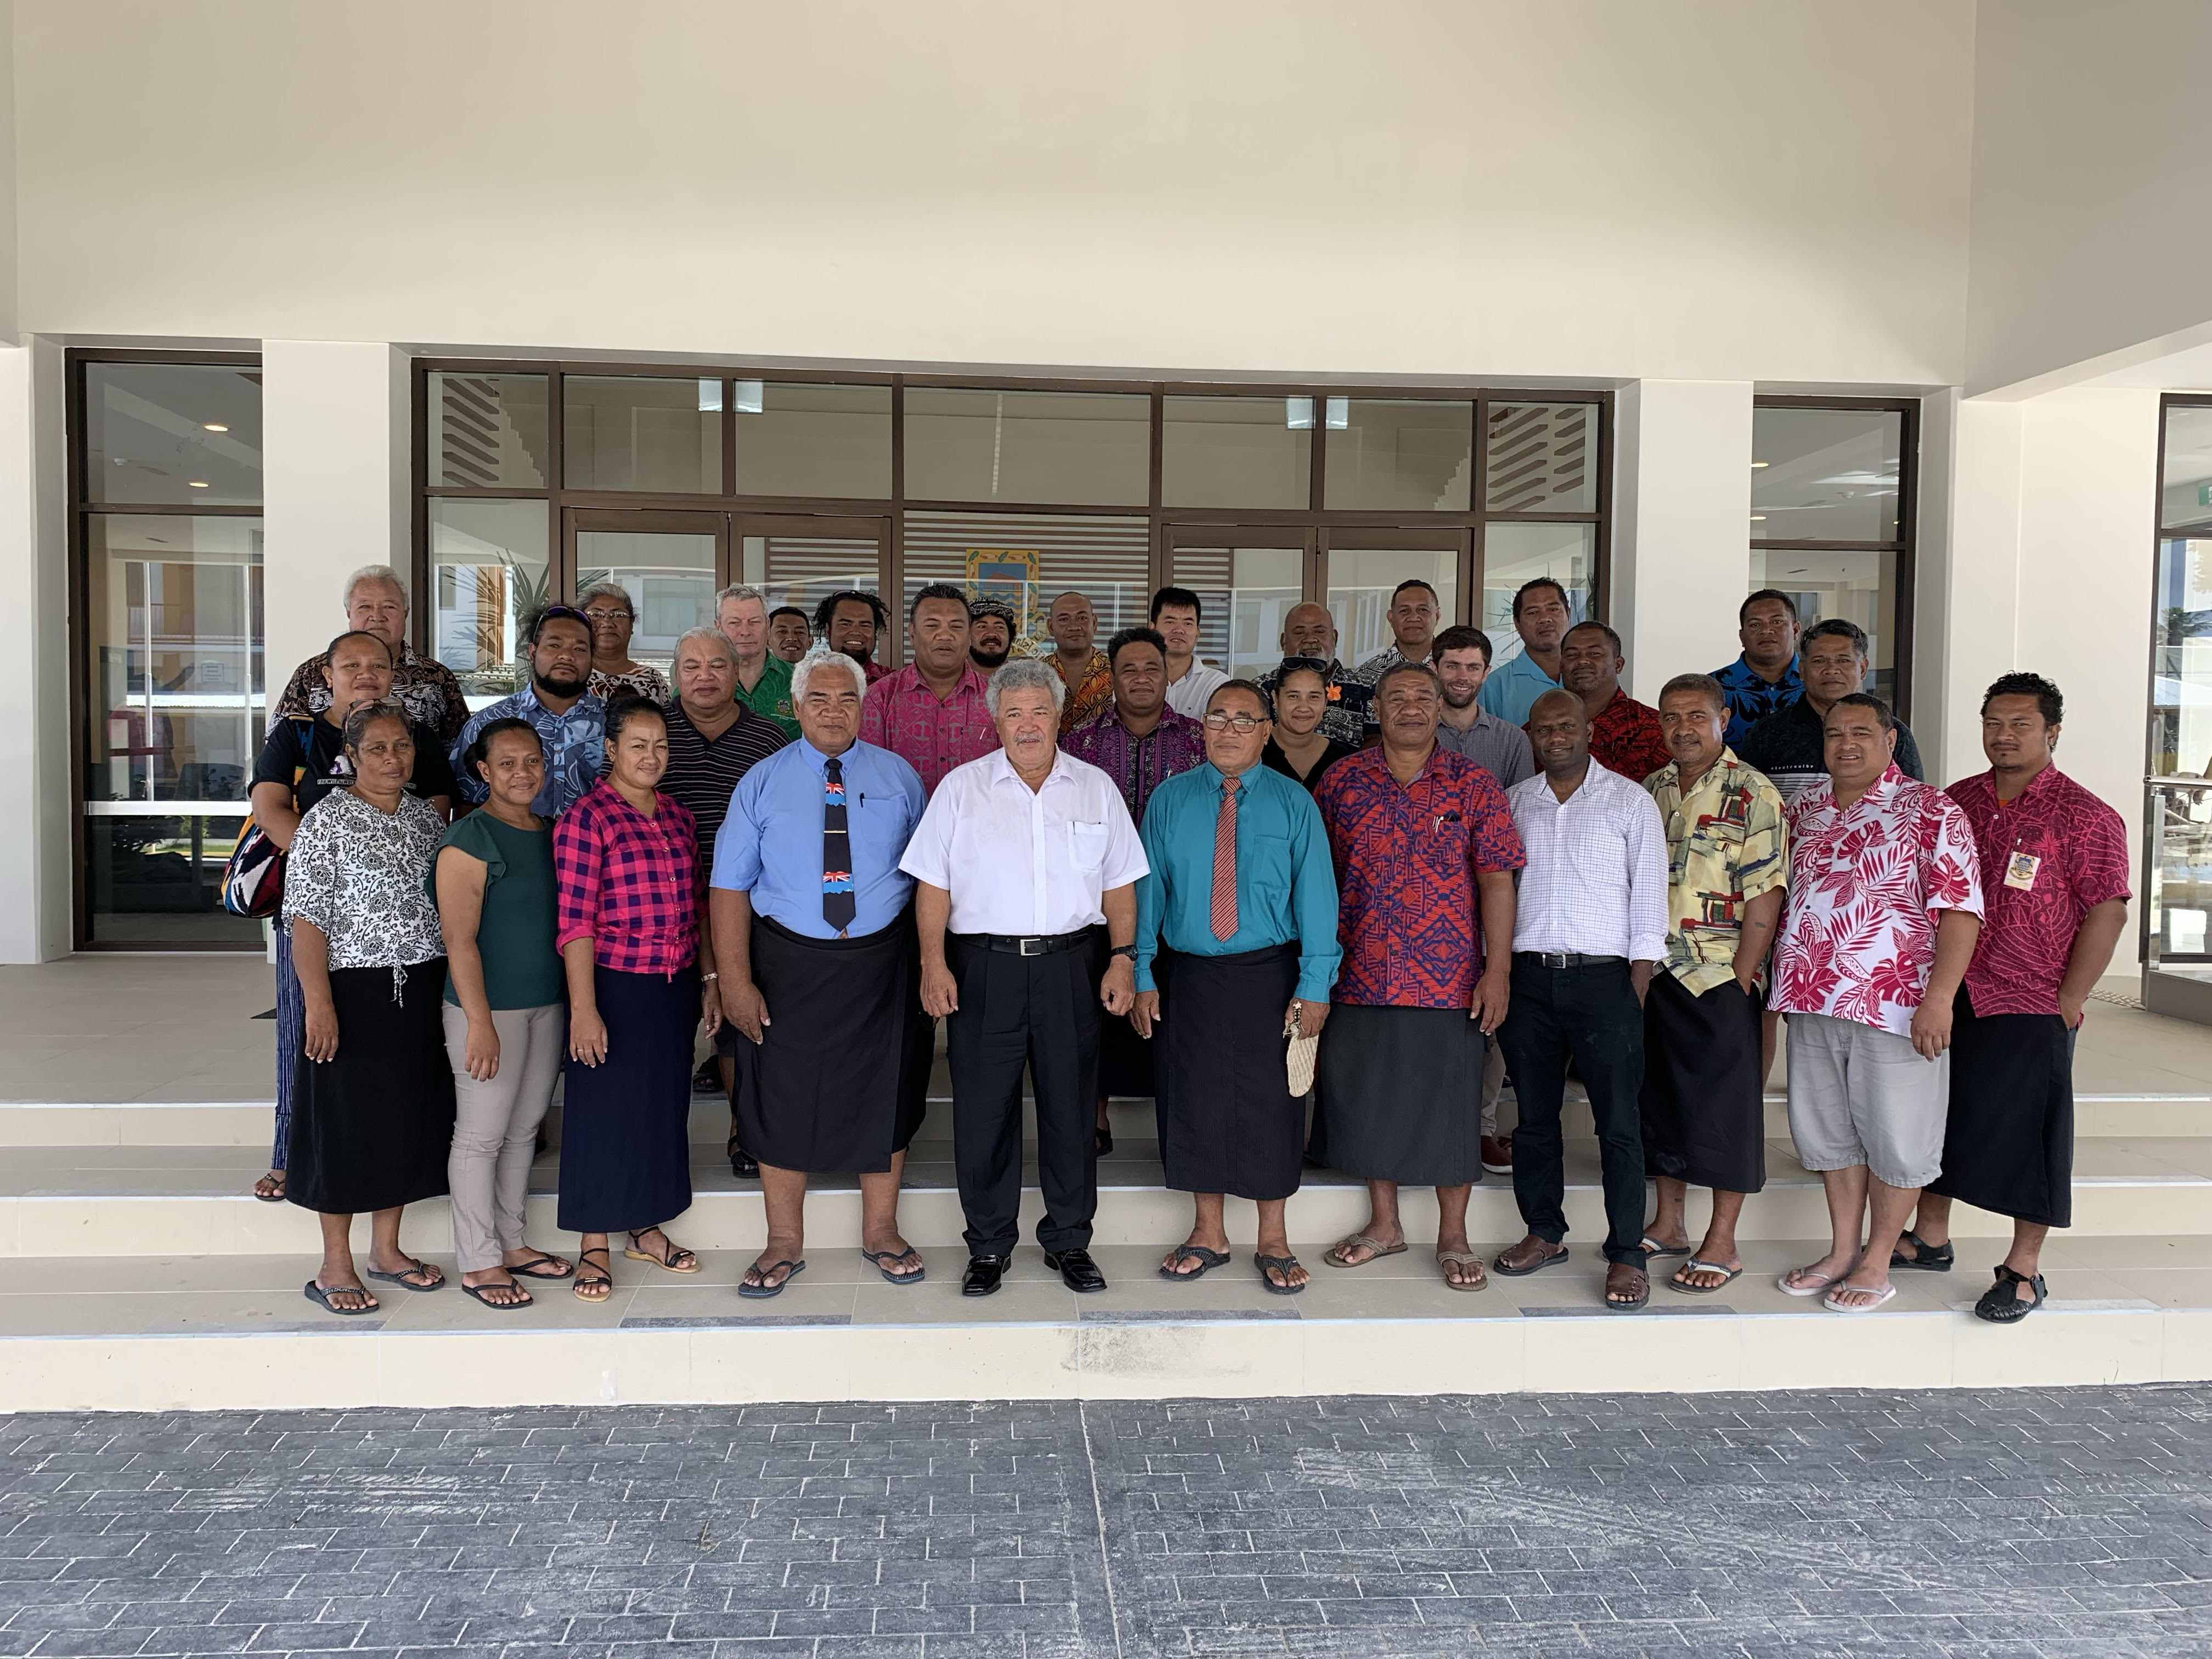
Issues
The PCREEE has experienced some delays to payments, particularly on the catering and venue costs for the conduct of national consultations on the Business Plan and e-mobility programme. This is an issue that is continuously raised through meetings of the Georesources and Energy Programme.
As PCREEE plan to carry out its 2021 activities virtually and with the involvement of local consultants and coordinators, it is very important that delays to payments of local goods and services are minimized. In-country support are assured if payments are made quickly and received on time.

Slide 5
Recommendations
The meeting is invited to:
i. Note the change to the financial structure of the PCREEE.
ii. Request SPC Finance to address delays in the payments of local services and personnel to ensure efficient delivery of the PCREEE’s 2021 work plan.

