Slide 1
5th PCREEE STEERING COMMITTEE (PSC) MEETING 18th NOVEMBER 2020 MODE: VIRTUAL
AGENDA ITEM 2 – MINUTES OF PSC 4 AND MATTERS ARISING
To seek PSC’s endorsement on the 4th PSC Meeting Minutes

Slide 2
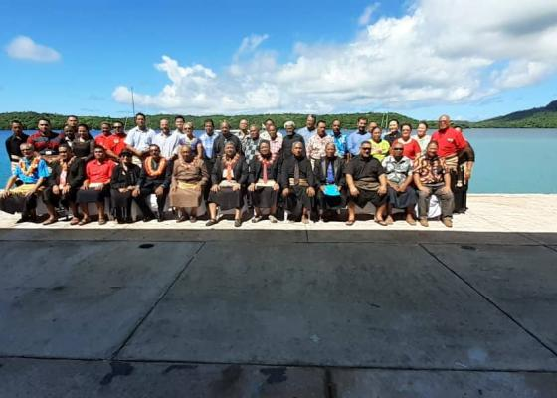
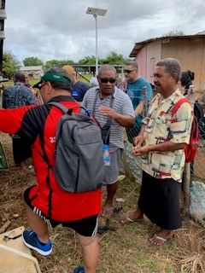
Background
PSC 4 was held on 4 Dec at Vava’u, Tonga
Back-to-back with the Tonga Energy Sector
Stakeholder & Joint Development
Partners Meeting
American Samoa, Cook Is, Tonga (chair), Tuvalu and Vanuatu
EU, ADB & WB

Slide 3
Current Status
1) Minutes of SC3
Minutes of SC3 | Progress
Endorsed the minutes of SC3, noted the progress with the implementation of matters arising from SC3 and acknowledged the highlights of PCREEE’s deliverables in 2019. | 2020 Progress Report will highlight progress on deliverables in 2019

Slide 4
Current Status
ii) Endorsed inter-alia the strategic emphasis of the PCREEE on the following 5 areas in 2020:
Strategic & Future Direction | Progress
TA to the Energy Regulators Accreditation and adoption of national qualifications on RE and EE 1 – 2 National Energy Dialogues & Investment Forums Support to the formation of SE industry associations Design and seek funding for E-mobility, clean cooking & solar heating and cooling | Just about to complete TA to review TEC’s EEC Level 1 & 2 are just about to be registered by the TNQAB No national energy dialogues. Conducted a series of 3 webinars on accelerating investments in RE, EE & smart mobility in the PICs & Completed two roundtables on energy access and private financing in Fiji Established the SE Association of Vanuatu in March Completed developing the response plan for a low carbon transport proposal in Vanuatu

Slide 5
Current Status
ii) Institutional Structure
Meeting Outcome | Progress
Noted that SC 5 in 2020 will select new members of the SC Endorsed the amendments and updates to the PCREEE’s NFIs and THs contacts. Encouraged PCREEE to strengthen and foster new partnerships through formalizing relationships with ISA, IEA and other partners by way of signing MoUs and similar official documents. Acknowledged SPC’s current effort to modernise its Staff Regulations and Policies in order to achieve its Strategic Plan's organisational objective to enhance the capabilities of its people systems and processes. Noted the staffing structure and the recruitment of the next PIJP has been advertised on the PCREEE/SPC website and encouraged member countries to apply. Noted the 4th Pacific Energy and Transport Ministers Meeting decision on PCREEE’s fund raising effort. Noted PCREEE’s hosting of interns and encouraged member countries and partners to use the Centre as a base for training, research, internships and etc. | To be done during PSC 5 Updated and will be continuously updated Signed MoU with EcoCARE Pacific Trust. Discussed joint workshops with ISA. SPC staff can now appeal to the ILO Administrative Tribunal PIJP from PNG has been with PCREEE since March 2020 Fund raising is continuing with consultancies work for PacTVET, MFAT, CTCN, etc No Interns this year due to COVID.

Slide 6
Current Status
iii) TECHNICAL STRUCTURE
Meeting Outcome | Progress
Noted the progress of the seven pipeline projects being developed and supported by the PCREEE Noted the progress on the national energy dialogues and entrepreneurship workshops Endorsed the conduct of an Energy Investment Forum in the Solomon Islands and the conduct of national energy dialogues in American Samoa and in a country in the North Pacific either Palau, Marshall Islands or FSM in 2020 Noted the Progress with the establishment of the Sustainable Energy Industry Associations in the Pacific and noted the effort to establish one in the Solomon Is and Vanuatu Noted the PCREEE three funding initiatives to promote awareness and private sector participation in Sustainable Energy and urged NFIs & THs to disseminate and promote the three initiatives in Member Countries in the PICTs. | Noted Planned dialogues were postponed Solomon Is wants investment forum postponed to 2021. A/Samoa and North Pacific events got postponed. Completed national consultation in Palau. Established the SE association of Vanuatu. SI postponed to 2021. No takers on the scholarships / research support. PSEEF interests from SI and Vanuatu but not deal signed yet.

Slide 7
Current Status
iv) Capacity Building
Meeting Outcome | Progress
Noted that the final date for the EU-PacTVET project implementation is 30 August 2020. Noted the rather slow progress of the EU-PacTVET project in Tonga and the required urgency for project deliveries Acknowledged the PCREEE’s support to the implementation of the PacTVET project in Tonga and the possible continuation of the technical assistance after the end of the PacTVET in September / Dec 2020. | Noted PacTVET ICC has speed up implementation Planning of continuing on assisting PICs to have NQs on SE in 2021

Slide 8
Current Status
v) Global Network of Sustainable Energy Centres
Meeting Outcome | Progress
acknowledged UNIDO’s effort to establish the global network of regional sustainable energy centres 2. noted the mission, vision and functions of the GN-SEC platform | UNIDO will provide the update on Agenda Item 8.

Slide 9
Current Status
vi) Annual Work Plan & Budget
Meeting Outcome | Progress
Welcomed the private sector-focused workplan and budget for 2020. Endorsed the PCREEE 2020 Workplan & Budget to the amount of Euro 692,218 [418,500 for operations plus 273,718 for personnel]. | Delivery was affected by COVID 2. Funding agreement for 600,000 was signed with UNIDO and 80% has been transferred to SPC

Slide 10
Issues
Covid restrictions affecting delivery on the outcomes of PSC 4
Time difference between Pacific & Europe make it difficult for the donors to participate

Slide 11
Recommendations
The meeting is invited to:
Note and endorse the 4th PSC meeting minutes.
Note the progress with the implementation of matters arising from the minutes of PSC 4.

