Slide 1
Australian Infrastructure Financing Facility for the Pacific
Off-Grid Program
Enabling quality, climate-resilient renewable energy across the Pacific and Timor-Leste
aiffp.gov.au

Slide 2
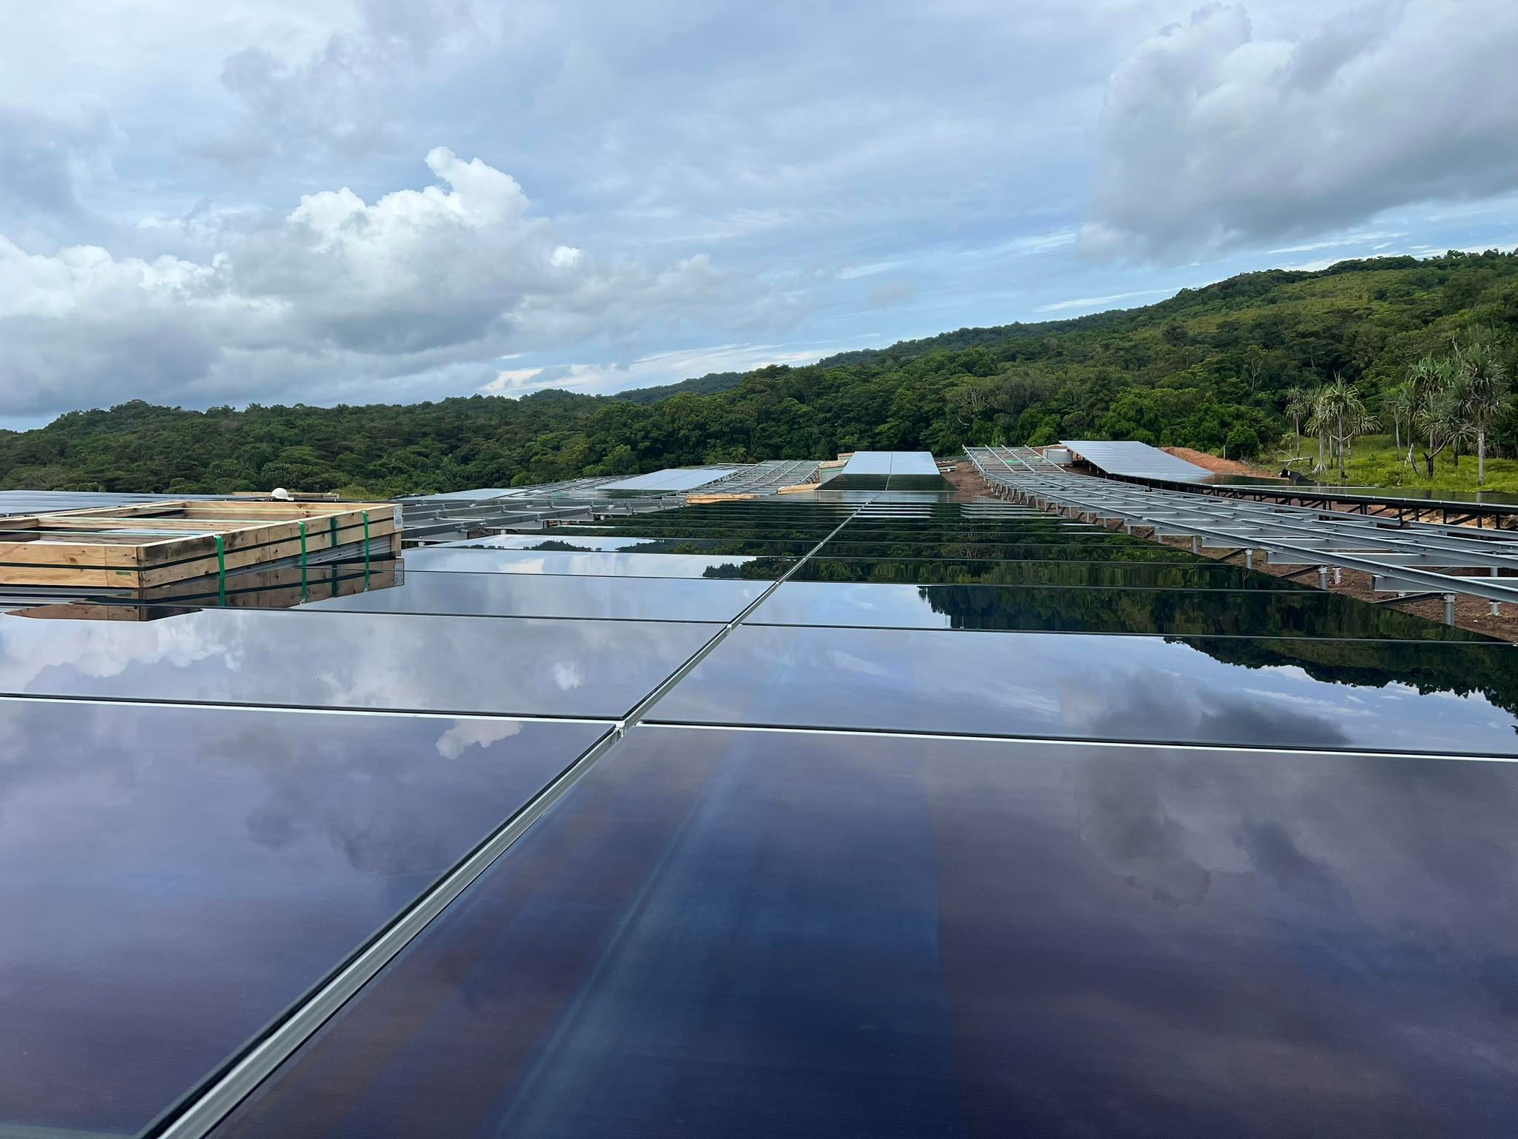
AIFFP Climate Partnerships
The Australian Government took a commitment to establish the Pacific Climate Infrastructure Financing Partnership (PCIFP) within the AIFFP to the recent federal election.
Three core components:
  Increasing the number of medium to large scale climate projects
  Greening AIFFP investments with dedicated grant finance
  Supporting the small scale, off grid and community-based renewable energy sector
Construction of solar panels, Palau Solar Investment

Slide 3
Objectives
Improve remote energy access in the Pacific while mitigating/avoiding carbon emissions
Utilise new energy access for adaptation and development in remote areas of the Pacific
Leverage private and climate financing for Pacific climate infrastructure
Demonstrate Australia’s commitment to global climate action
Develop new partnerships with Pacific countries in renewable energy

Slide 4
Off-Grid Program: Rural and remote access to renewable energy
Program is intended to deliver small-scale, off-grid and community-based renewable energy projects
A substantial program to help deliver renewable energy access to rural and remote communities in the Pacific
Significant opportunity for NGOs, philanthropic and church-based organisations and the private sector to engage and leverage resources, knowledge, and connections across the Pacific

Slide 5
Off-Grid Program – Stakeholder Engagement
Pacific stakeholders:
  Australian Government representatives in the Pacific
  Pacific Governments
  Regional organisations and bodies (SPREP, PRIF, SPC, PIF)
  Key small-scale renewable energy sector proponents
Australian stakeholders:
  Government (DFAT, AIFFP Board, First Nations Taskforce, DoF, Treasury, PM&C, DCCEEW),
  Not-for profit organisations and representative bodies (ACFID, ANCP)
  Private sector and industry
  First Nations groups
  Philanthropic organisations
  Academia

Slide 6
Market Study – ITP Renewables
Demand – key findings:
  Demand for mini-grids and SHS is significant in countries with lower levels of electrification and a more dispersed population. Key countries are Solomon Islands, Vanuatu, the FSM, and PNG.
  Want to better understand needs for off grid reach in all Pacific countries
  Donor finance is a key to project delivery in many contexts
  Small scale RE program could achieve social and economic development outcomes
Supply – key findings:
  Solar a stand-out technical solution (wind, biomass, hydro have specific challenges but are applicable in certain contexts)
  Cost competitiveness a key issue for some international suppliers – quality and supply chains are a key consideration for the Australian Government
  Opportunities for local contractors to partner with international contractors to deliver projects
  Could be opportunities to partner with large private sector firms and corporations

Slide 7
Key Steps
Consultation (domestic and Pacific) – series of meetings, roundtables, private briefings, and visits to the region to promote the PCIFP.
Call for proposals in 2023 – prospective partners to submit proposals for delivering small-scale renewable energy projects in remote and rural areas in the Pacific.
Dedicated program launch in 2024 – drawing on lessons learnt from CfP1 to enable scale-out across the Pacific.
Reach out to us – we want to work with capable Pacific partners

Slide 8
Q&A

Slide 9
Prompts for Discussion
What are the strengths and weaknesses of our support for climate action in your country? Does the action on the ground meet our rhetoric?
What do you know about access to energy in rural or remote parts of the country? Which parts have the worst access at present?
Are you aware of proponents working in small-scale renewable energy projects in-country? Which organisations/enterprises are involved? Any successes or failures you can point to?
Do you see value in DFAT supporting remote small-scale renewable energy projects in your country and if so where would you like to see it roll out?
Are there any existing proposals for renewable access that you would advocate for early PCIFP financing as we set the program up?
What are your preferences or views on engagement with government and non-government stakeholders in your country?

