Slide 1
Tonga Energy Sector Stakeholders and Joint Development Partners Meeting
3 – 6 Dec 2019 | Puataukanave, Vava’u
“Tonga Energy Pipeline Projects”
Mr. Sosefo Tofu.
Department of Energy.
Ministry of MEIDECC

Slide 2
Outline of the Presentation
Linkage of the national energy initiatives to Global/International framework
Tonga Energy Efficiency Master Plans Project
Background
Project Deliverables/Output
Project’s status
Tonga Circular Economy Project – Biogas Feasibility Study
Background
Project Deliverables/Output
Project’s status

Slide 3
Sustainable Development Goals (2015-2030)
Goal 7: Affordable and Clean Energy
By 2030, ensure universal access to affordable, reliable and modern energy services
By 2030, increase substantially the share of renewable energy in the global energy mix
By 2030, double the global rate of improvement in energy efficiency

Slide 4
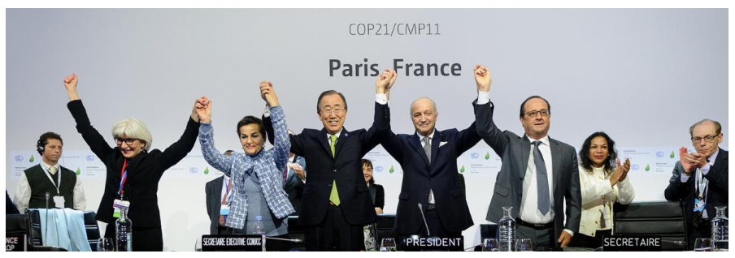
Paris Agreements
Central Aim: to Strengthen the global response to the threat of Climate Change by keeping the global temperature rise this century well below 2 degree celcius above pre-industrial levels and to pursue efforts to limit the temperature increase even further to 1.5 degrees Celsius
During COP21 in Paris, on 12th December 2015. a landmark agreement to address climate change and its negative impacts

Slide 5
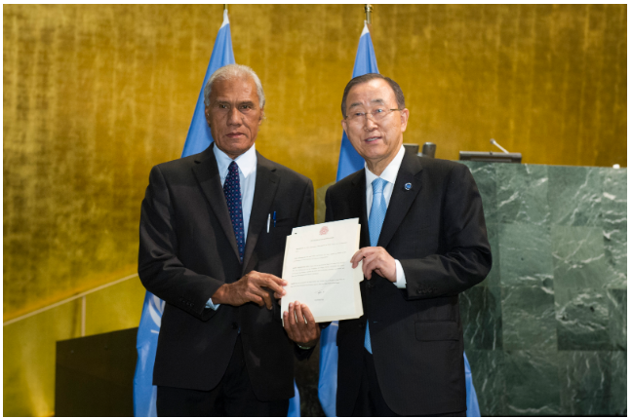
Kingdom of Tonga ractified the Paris Agreement on the 21st September, 2016

Slide 6
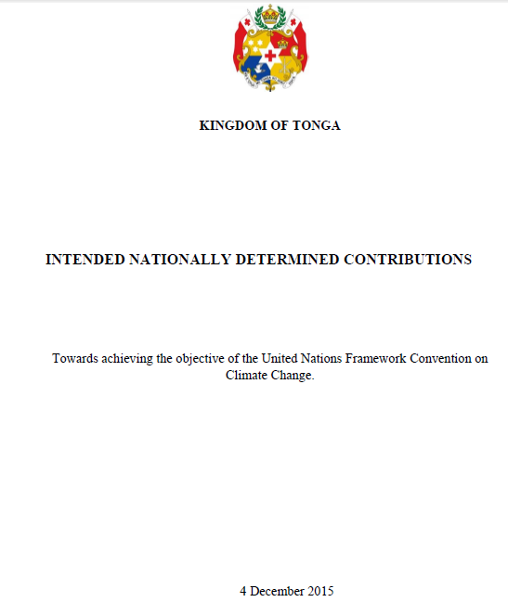
How Tonga contributes to Paris Agreement?
* Paris Agreement requires all Parties to put forward their best effort through “Nationally Determined Contribution”
*Tonga submitted the Intended Nationally Determined Contributions (NDC) to the UNFCCC Secretariat on 4th December, 2015.
*Same document was endorsed and submitted as the 1st Nationally Determined Contributions on 21st September 2016.
50% of electricity generation from renewable sources by 2020. In 2015 renewable energy accounts for approximately 9% of total electricity generation, with confirmed and funded investments taking this to 13% in 2016.
70% of electricity generation from renewable sources by 2030
Improve Energy efficiency through reduction of electricity line losses to 9 percent by 2020 (from a baseline of 18 percent in 2010)
Sector Emission Reduction Targets: Transport, Agriculture, Environmental Friendly waste Management and Reforestation

Slide 7
Paris Agreement
SDG7
GCF
*Green Climate Fund
Provide Readiness and Preparatory Support Programme
Tonga NDC
Tonga Energy RoadMap (TERM)
TECHNICAL ASSISTANCE ($)
CTCN
*Climate Technology Center & Network
focus of this Presentation!!!
Tonga Energy Efficiency Master Plan Project
Tonga Circular Economy Project – Biogas Feasibility Study

Slide 8
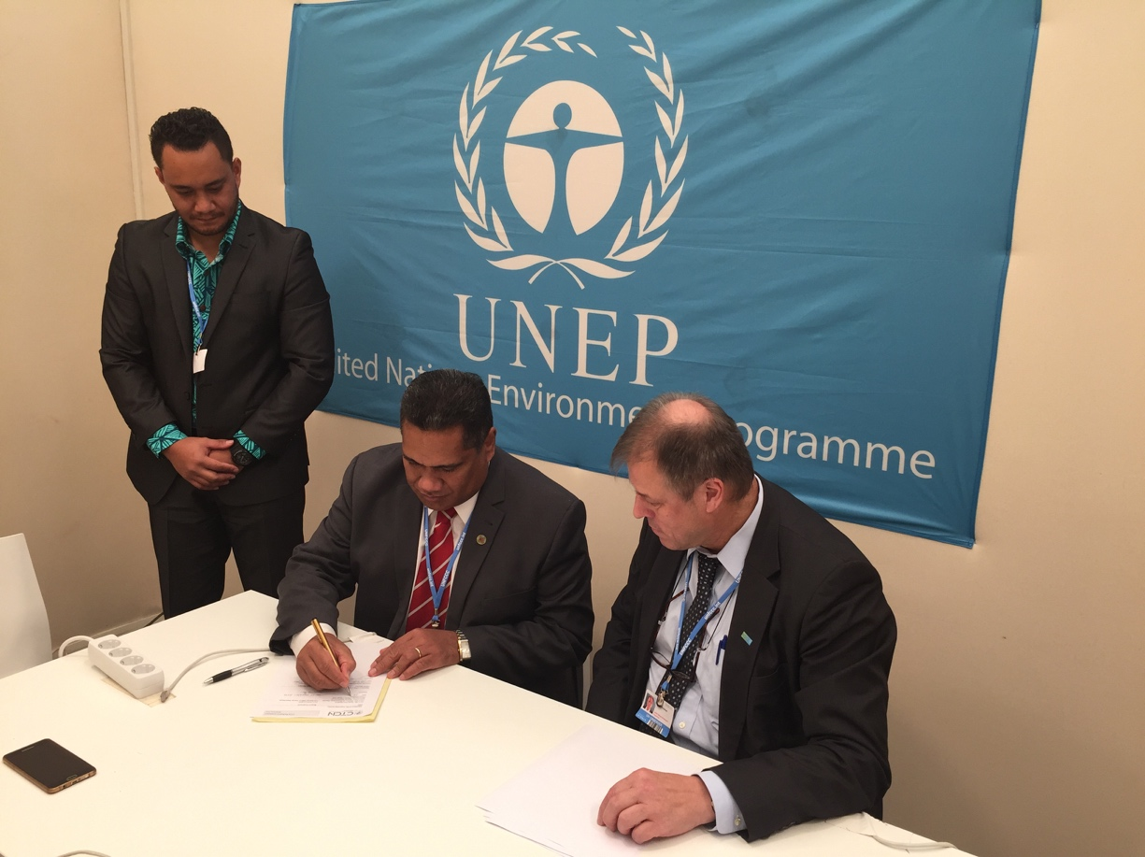
Tonga Energy Efficiency Master Plan Project
Background
17th Dec 2016, Director of the CTCN and CEO for MEIDECC signed the TEEMP’s response plan during the COP22 in Marrakesh, Morocco.
Sealed the agreement of 177, 000USD
Project Duration: 9 months (Nov 2017 – July 2018)
Implementers: National Renewable Energy Laboratory (NREL)
TEEMP targeted all energy efficiency related sectors (Power, Transport, Infrastructure, Tourism, Agriculture) to identify most appropriate energy efficiency intervention activities and solutions;
To Achieve TERM’s target but also to achieve Tonga’s NDC and other energy related targets.

Slide 9
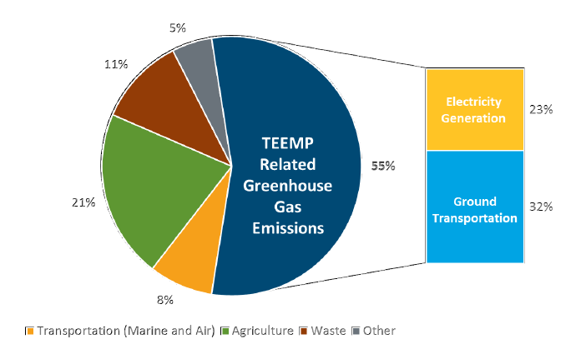
Con’t
Specific Objectives of the activities in Tonga
1. Conduct data collection, benchmarking and baseline study and develop baseline
2. Identify potential least cost options with supporting enabling environment options
3. Development of EE master plan with GHG and EE targets
4. Identify EE projects in TEEMP with software to monitor the TEEMP progress
5. Develop and conduct capacity building and training for MEIDECC staff and stakeholders.
TEEMP focus on two sectors
Electricity Generation
Ground Transportation/Lands Transport

Slide 10
Electricity Generation
Tonga’s electricity consumption is driven by building design, appliance use, and energy consumption behavior.
Given Tonga’s tropical climate, cooling commercial, government and non-governmental buildings with air conditioning is widespread and increasing.
Proposed initiatives for Electricity Generation were considered these:
Increased deployment of RE
Implementation of Minimum Energy Performance Standards
Implement buildings standards for resilience and energy efficiency (incorporated Energy efficiency measures into Tonga existing building code
Land Transport
Key policy options are
Vehicle import tariffs or registration fees aimed at improving fuel economy
Restrictions in heavy-duty vehicle idle time
Deployment of electric vehicles

Slide 11
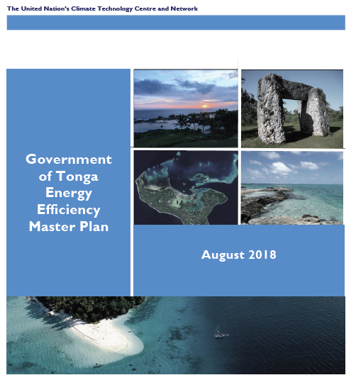
STATUS of TEEMP………..
TEEMP (Final draft) submitted from NREL to MEIDECC on August 2018.
Additional funding from CTCN secured by early 2019, to further revise the TEEMP before submitting to Cabinet.
PCREEE was officially contracted to conduct the revision exercise for two months.
DOE and PCREEE agreed to host the 1st national consultation workshop towards end of this year.

Slide 12
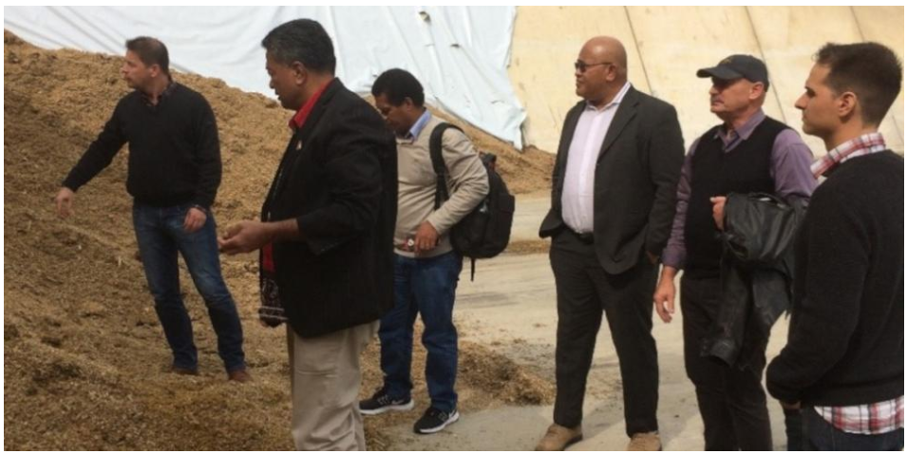
2. Tonga Circular Economy Project – Biogas Feasibility Study
Background
In August, 2018 Minister for MEIDECC and Director for Energy as well as 2 representatives from the SPC visited biogas plants in Germany.
This brings interest to Tonga to seek financial resources to conduct feasibility study for a commercial biogas plant in Tonga to assist in reducing power tariff.
Proposal submitted to CTCN in early 2019 – min industrial scale of 0.5MW
Funding secured 179,100USD from CTCN by mid-2019 and response plan signed on 6th November, 2019.
Contractor to Implement the signed Response Plan is currently tendered.

Slide 13
Project Deliverables:
Baseline and resource assessment to support industry scale biogas plant in Tonga
Undertake feasibility study and technical designing for biogas-based energy plant at an industrial scale in Tonga
Biogas technologies at industrial scale will be identified
Capacity development on biogas technologies.
Support provided for GCF proposal development

Slide 14
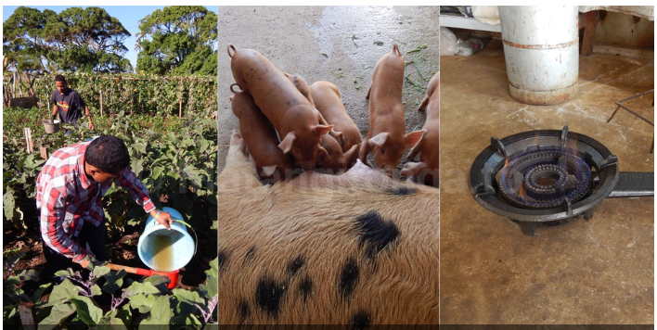
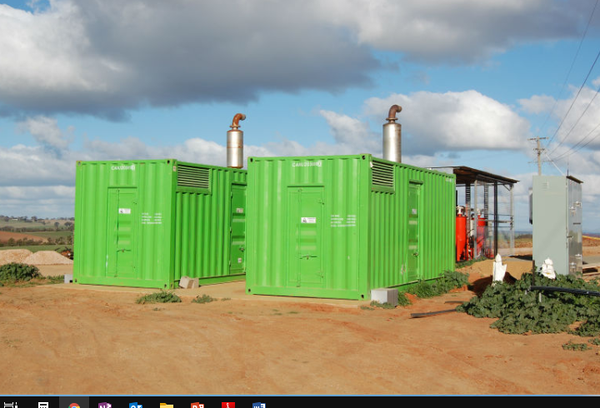
EXISTING BIOGAS SYSTEM IN TONGA (Tupou College)
Proposed BIOGAS SYSTEM for TONGA (min of 0.5MW)

Slide 15
MALO ‘AUPITO – Q&A

