Slide 1
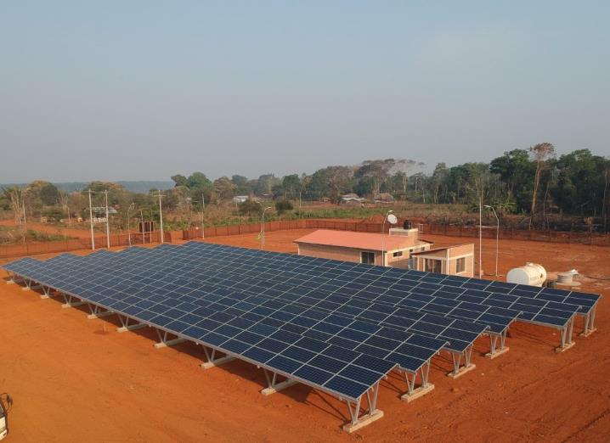
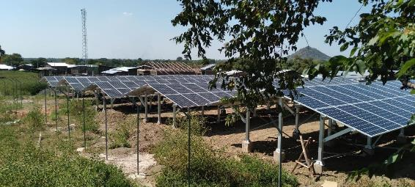
3.2. Subsidies for MG
MG in Bolivia by TTA
Unlocking MG for sustainable development
Suva, Fiji
June 26th-30th, 2023
MG in Ethiopia by TTA
Roger SALLENT Regional Team Leader for Asia – Pacific Trama TecnoAmbiental, S.L.
roger.sallent@tta.com.es

Slide 2
CONTENTS
Session objectives
Why do mini-grid need subsidies?
Types of subsidies
Additional Resources

Slide 3
1. Session objectives

Slide 4
SESSION OBJECTIVES
Understand the need of subsidies for mini-grid projects
Distinguish the types of subsidies commonly used in mini-grid projects and understand their differences

Slide 5
2. Why do minigrid need subsidies?

Slide 6
WHY DO MG NEED SUBSIDIES. Cost-reflective tariffs
Why are cost-reflective tariffs important?
To ensure the long-term sustainability of the project (be able to offer good service, conduct proper maintenance, secure spare parts, etc)
To ensure the financial viability of the operator (public or private)
To promote efficient use of energy amongst consumers
To incentivize the expansion of the service to unconnected customers

Slide 7
WHY DO MG NEED SUBSIDIES. Viability gap
The LCOE of minigrids is typically above the ATP/WTP:
Cost side: Rural electrification is costly even if mini-grid is the least cost electrification option. That is why the candidate locations for mini-grids are typically not electrified by the main grid in the first place. Candidate communities are often remote and small.
ATP/WTP side: In general terms, mini-grid projects are developed in rural and remote communities, where the economic capacity is often limited.

Slide 8
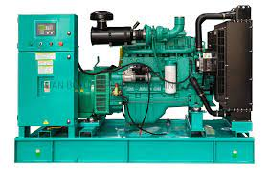
WHY DO MG NEED SUBSIDIES. Diesel vs RE-based MG
Diesel mini-grids are characterized by lower upfront capital costs, but higher operational costs due to the cost of fuel.
→ Recurrent subsidies might be needed. Long-term financial sustainability is at risk
Renewable energy –based minigrids, on the contrary, require higher capital costs, but limited operational costs, as there is little or no fuel costs at all.
→ If capital costs are supported through subsidies or other financial support mechanisms, the ATP/WTP might be sufficient to cover the operational expenditures

Slide 9
WHY DO MG NEED SUBSIDIES. How should subsidies be?
The subsidy amounts and design should respond to the needs of the following three groups*:
• Households and firms, which want an affordable combination of initial (connection and internal wiring) costs and usage charges;
• Mini grid developers, who are looking for financial viability;
• Subsidy fund providers, who want subsidies to be properly targeted, easy to administer, and not be a financial Burden
(*) Energy Sector Management Assistance Program. 2022. Mini Grids for Half a Billion People:
Market Outlook and Handbook for Decision Makers. Washington, DC: World Bank. www.esmap.org/
mini_grids_for_half_a_billion_people.

Slide 10
3. Types of subsidies

Slide 11
TYPES OF SUBSIDIES. Categorization
The WB ESMAP suggests the following categorization of subsidies*:
(*) Energy Sector Management Assistance Program. 2022. Mini Grids for Half a Billion People:
Market Outlook and Handbook for Decision Makers. Washington, DC: World Bank. www.esmap.org/
mini_grids_for_half_a_billion_people.
First-category subsidies: Helping developers and customers finance their costs
Preinvestment subsidies
Capital cost subsidies
Second-category subsidies: Reducing the financial costs of mini grid developers
Absorption of some costs by government
Wage, employment, and training subsidies
Connection cost subsidies
Usage subsidies
Reducing subsidies over time

Slide 12
TYPES OF SUBSIDIES. Helping developers and customers finance costs
PREINVESTMENT SUBSIDIES
These costs are incurred before the developers deciding whether they will build a mini-grid at the site being considered.
The main elements of pre-investment subsidies include the following:
General market and resource assessments, including geospatial planning → Governments can undertake these assessments for potential mini-grid sites and provide the relevant information to interested developers.
Prefeasibility and feasibility studies → the costs can be shared among firms shortlisted by the relevant government agency.
Technical and financial information assistance → this can help local developers in the early years to develop bankable business plans.
CAPITAL COST SUBSIDIES
Capital cost subsidies can be preset as a share of “reasonable” capital costs in contexts where the tariff is not pre-defined or is based on lowest-subsidy bids in cases where the tariff is predefined.
Results-based capital cost subsidies: relying exclusively on final output makes it difficult for developers to finance the initial, up-front capital costs.
Thus, designing some “intermediate” results as a basis for some of the subsidy payments, such as when goods arrive on site, is important.

Slide 13
TYPES OF SUBSIDIES. Helping developers and customers finance costs
CONNECTION COST SUBSIDIES
Significant up-front connection and internal wiring costs might make the connection to a mini-grid unaffordable.
The subsidy should include all the costs to connect, which can vary depending on the service tier.
Interest-free loan programs can be made available to low-income households to help them cover the costs of connecting to the mini-grid.
Should the subsidy be paid to the household or the developer?
Typically, it is administratively easier to make a single subsidy payment to the developer, which covers the payment of the contractor who does the internal household wiring.
USAGE SUBSIDIES
Although mini-grid customers may initially agree to pay higher tariffs, they may later change their minds and ask to pay a lower tariff.
This can threaten the financial viability of the mini-grid and deter future private investments.
Thus, the government must be prepared to increase the subsidies provided to the private developers.
Regardless of the tariff scheme applied, ensuring that lifeline rates can be provided for poorer households is crucial. Such rates charge a low fee for the first few kilowatt-hours used per month.
Caveat: this may reduce their incentives to limit energy consumption, leading to the purchase of energy-inefficient appliances.
A potential solution is to provide subsidies for the most efficient appliances and end-use equipment.

Slide 14
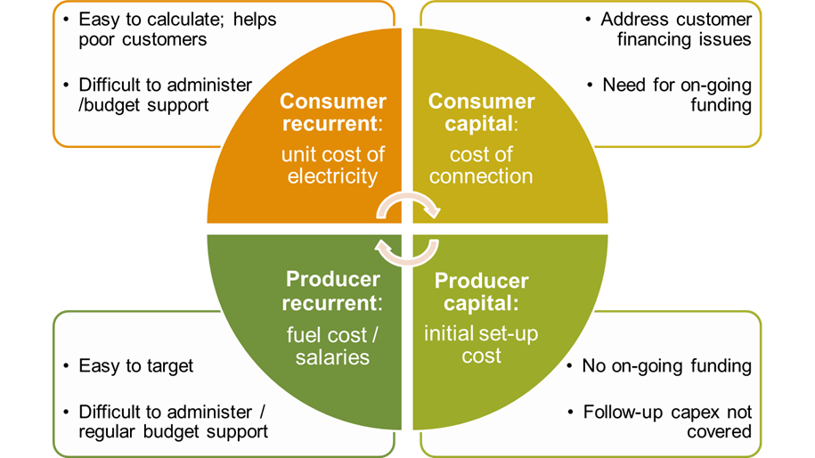
TYPES OF SUBSIDIES. Helping developers and customers finance costs
Options for funding these subsidies include: subsidies from operator’s other customer categories (cross-subsidies) and external sources (development partners).
External subsidies can target either consumers or producers and be either recurrent or one-off expenses but are often difficult to administer and implement.

Slide 15
TYPES OF SUBSIDIES. Reducing the financial costs of MG developers
ABSORPTION OF SOME COSTS BY THE GOVERNMENT
Governments can reduce some of the capital costs of developers by owning part of the mini-grid.
Example: split-asset business model → the entrepreneur finances and owns the generation facility.
The government (potentially using a grant by a DFI) pays to build the distribution grid, which is owned by the government.
The government then leases the distribution grid to the entrepreneur, with the lease payment possibly subsidized.
A second way governments could absorb some of the financial costs is through such schemes as tax breaks, import-tax waivers, and tax holidays. Although these schemes are
Disadvantage: these schemes are subject to change because of competing priorities in a country’s budget.
WAGE, EMPLOYMENT AND TRAINING SUBSIDIES
Rural employment opportunities are created when new technologies are introduced on a large scale.
Subsidy schemes that incentivize or support new employment created by mini-grids are crucial.
These would support firms and entrepreneurs engaged in productive uses of electricity, which in turn creates jobs.
Support would also be given to individuals for training that is relevant to the mini-grid project cycle.

Slide 16
TYPES OF SUBSIDIES. Recomendations
Capital rather than recurrent subsidies – non discriminatory one-off grants to enable more mini-grid users to benefit from lower tariffs
Subsidies to catalyse complementary financing – leverage capital contributions from project promoters to support more mini-grid projects
Incentive-based subsidies through competitive selection (number of connections or subsidy level) and RBF
Subsidies for Productive Uses of Energy to facilitate demand stimulation
Subsidies adopted and evolve in syntony with the market development

Slide 17
5. ADDITIONAL RESOURCES

Slide 18
ADDITIONAL RESOURCES
Energy Sector Management Assistance Program. 2022. Mini Grids for Half a Billion People: Market Outlook and Handbook for Decision Makers. Washington, DC: World Bank. www.esmap.org/ mini_grids_for_half_a_billion_people.

Slide 19
Vinaka!
Roger SALLENT
Regional Team Leader for Asia – Pacific Trama TecnoAmbiental roger.sallent@tta.com.es

