Slide 1



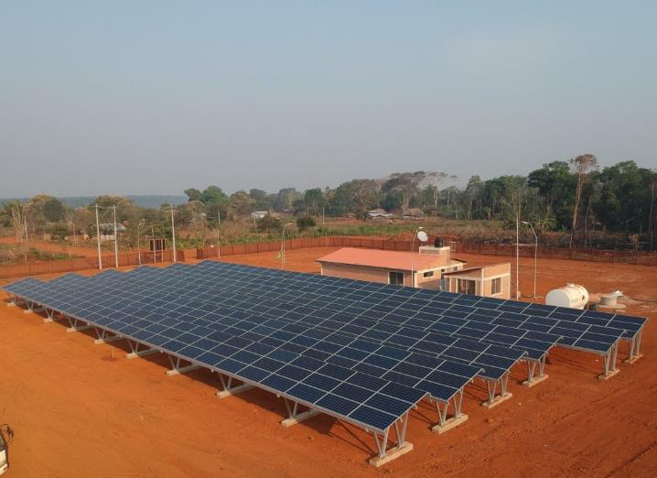
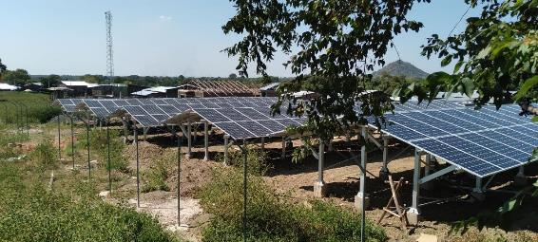
3.1 Tariff Definition
MG in Bolivia by TTA
Unlocking MG for sustainable development
Suva, Fiji
June 26th-30th, 2023
MG in Ethiopia by TTA
Roger SALLENT
Regional Team Leader for Asia – Pacific
Trama TecnoAmbiental, S.L.
roger.sallent@tta.com.es

Slide 2
CONTENTS
  Session objectives
  ATP / WTP
  Average tariff definition
  Types of tariffs
  Additional resources

Slide 3
1. Session objectives

Slide 4

SESSION OBJECTIVES
Understand the process of defining tariffs for mini-grids
Distinguish the types of tariffs commonly used in mini-grid projects and understand their differences

Slide 5
2. Ability and willingness to pay (atp/wtp)

Slide 6

ABILITY TO PAY (ATP) AND WILLINGNESS TO PAY (WTP)
Willingness-to-pay is typically estimated with surveys, generally accomplished through at least one of following two approaches*:
A survey of expressed willingness to pay. This is the maximum amount that a person says he or she is willing to pay for electricity.
A survey of revealed willingness to pay (sometimes referred to as “ability to pay”). This is the actual amount people already pay for kerosene lamps, candles, flashlight batteries, diesel for a home generator or other substitutes for mini-grid electricity.
(*) USAID Mini-grid support toolkit.
https://www.usaid.gov/energy/mini-grids/economics/willingness-to-pay
Notes:
- During Project design,
- WTP very related to reliability. Customers in countries with poor or no Access to electricity are willing to pay more for reliable power Service.

Slide 7
ATP AND WTP. Estimation of WTP and ATP
Expressed Willingness to Pay. Generally determined through a process, called “contingent valuation,” in which researchers describe a hypothetical electricity service and then ask survey respondents to state the maximum amount they would be willing to pay for that level of service. This methodology can consider a variety of tiers of service, soliciting willingness to pay for each level. Contingent valuation can be used either in individual household surveys or in focus groups. Researchers should be aware that respondents may not understand the service and its limitations and benefits enough to offer a realistic response.
Revealed Willingness to Pay
In gauging revealed willingness to pay, researchers ask respondents what they currently pay for candles, kerosene and dry-cell batteries, or for electricity from a local diesel generator in the case of households that own their own generator or connect to a neighbor’s generator.
It is also useful to ask questions that augment data on whether the target population has enough income to pay for electricity services. This process generally includes questions about expenditures on telecommunications such as cell phones, housing, education, health, transportation and food.
Finally, the survey can be an opportunity to ask the community about community organizations or businesses, their feelings about their provision of electricity service and what impact (if any) they anticipate it having on their daily lives.

Slide 8

ATP AND WTP. Estimation of WTP and ATP
WTP Through Service levels
 |  | Price (USD)*
1 |  | 15
2 |  | 25
3 |  | 35
4 |  | 50
(*) Prices are indicative

Slide 9
ATP AND WTP. Estimation of WTP and ATP
Estimation of ATP and WTP
WTP estimated through Price Sensitivity Meter approach:
  At which price on this scale are you beginning to experience electricity as too expensive, that you would not buy it?
  At which price on this scale are you beginning to experience electricity as expensive but you would consider it?
  At which price on this scale are you beginning to experience electricity as a great bargain?
  At which price on this scale are you beginning to experience electricity as too cheap, that you would question its quality?

Slide 10
ATP AND WTP. Key Parameters
Main parameters defining ATP and WTP:
  Current energy expenses: candles, kerosene lamps, private/public genset, etc
  Income level
  Resource of income and stability (seasonal or permanent)
  Family relatives that might have migrated and, thus, can share experience of other (electrified) communities or are an income source
  Previous experience with electricity
  Household assets (such as fridge, TV and other major appliances)
  Vehicle assets (motorbikes and cars)
  Ownership and/or rental of solar pico and solar home systems
  Other renewable energy experiences

Slide 11
3. AVERAGE TARIFF DEFINITION

Slide 12
TARIFF DEFINITION. Methodology
ITERATIVE PROCESS
Costs Estimation
Projection of the financial statements
Balance Sheet
Investment (CAPEX)
Power Plant and users’ Behaviour
Load profiles
Energy generation
Operation (OPEX)
LCOE Calculation
Guidance value for tariff setting
Profit and Loss
Cash flow
Notes:
First step: load profile and power plant sizing will be discussed in the technical sessions tomorrow

Slide 13
TARIFF DEFINITION. Costs Estimation
Investment fixed costs
Capital expenditures (CAPEX)
Replacement costs
Levelized Cost of Energy (LCOE)
Variable/ marginal costs
i.e. genset overall, oil, fuel
Operation expenditures (OPEX)
Operation fixed costs
Notes:
For mini grids, LCOE pertains to the cost of electricity on a per kilowatt-hour (kWh) basis delivered to mini grid customers over the lifetime of a mini grid. LCOE considers project development costs (engineering, obtaining permits, management), initial costs (for example, equipment and installation), the costs of operations (for example, staff and fuel), and equipment replacement over the lifetime of the project. As such, it is equivalent to the minimum average tariff that electricity must be sold for in order to cover project costs, including project financing.
We calculate LCOE in two different ways: financial and economic.
- The financial perspective on a project is from the point of view of the developer, and incorporates all costs
reported by developers in constructing and operating a mini grid, including import duties and taxes.
The simplified economic perspective endeavors to remove the influence of taxes, duties and subsidies, and thus represents the cost to society at large, or equivalently, the cost of mini grid electrification if a country were to impose no duties or taxes or subsidies on mini grids.
A private sector operator competing in the marketplace and paying import duties and taxes must consider the financial cost.
Policy makers deciding among approaches to electrification, meanwhile, are most concerned by the economic cost.

Slide 14
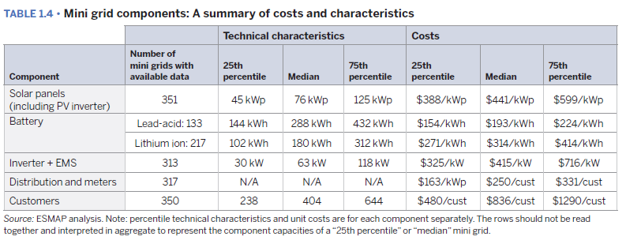
TARIFF DEFINITION. Capital Expenditures (CAPEX)
CAPEX includes:
Hard costs
Cost of equipment
Logistics
Installation costs
…
Soft costs
Project management
Engineering
Permits
Land Access
Training
…

Slide 15
TARIFF DEFINITION. Replacement costs
Component | Year of amortization | Comments
Batteries | 10 years (Li-ion) Depends on operational mode | Measured in cycles or years
Inverters | 5-10 | In case of failure
PV modules | 25 | After 20 years they reach 80% of rated power output
Power network | >25 | Distribution lines, droplines, transformers, etc

Slide 16
TARIFF DEFINITION. OPEX costs
Component | Description
Replacements | All batteries, inverters, 1% PV modules, management and control system
Management | Salaries: management, training and technical assistances, financial and maintenance audit
Operation and Maintenance | Salaries: Transactions/ fee collection, Up-keeping, maintenance, etc. Gratification for detection of illegal connections
 | Diesel generators: Overhauls, Fuel, Oil, Air and oil filters.
Taxes | Depending on country
Others | Rentals, financial costs, etc.

Slide 17
TARIFF DEFINITION. LCOE Calculation
Load profile
Households
Businesses
Public Institutions
Connection rates
Evolution of # customers
Financial parameters
Discount rate
Inflation
Cost of fuel (if any)
Initial connection rate
CRITICAL assumptions!!
If not reality does not match the forecast, they can jeopardize the investment

Slide 18
TARIFF DEFINITION. Financial model
Profitability and tariffs are two sides of the same coin… each of them can be modelled as input or output:
Tariff as input
Profitability as output
Generally more useful for mini-grid developers
Generally more useful for government, donors, regulator, etc.
Profitability as input
Tariff as output

Slide 19
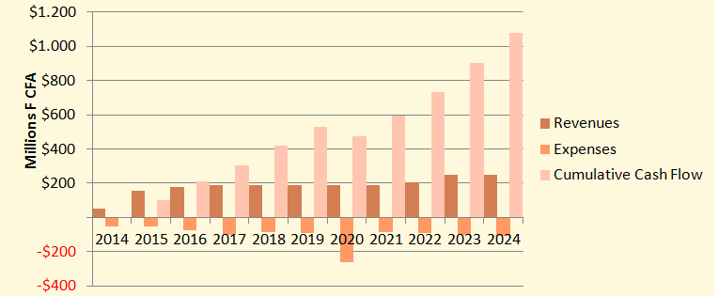
TARIFF DEFINITION. Projection of financial statements
Results with selected tariff
Cover all running expenses
Cover the required capital expenses (additional meters, service drop)
Surplus to be reinvested in the service

Slide 20

TARIFF DEFINITION. Risk Analysis
What if the expected connections are not attained or the consumption of the users is lower than forecasted?

Slide 21
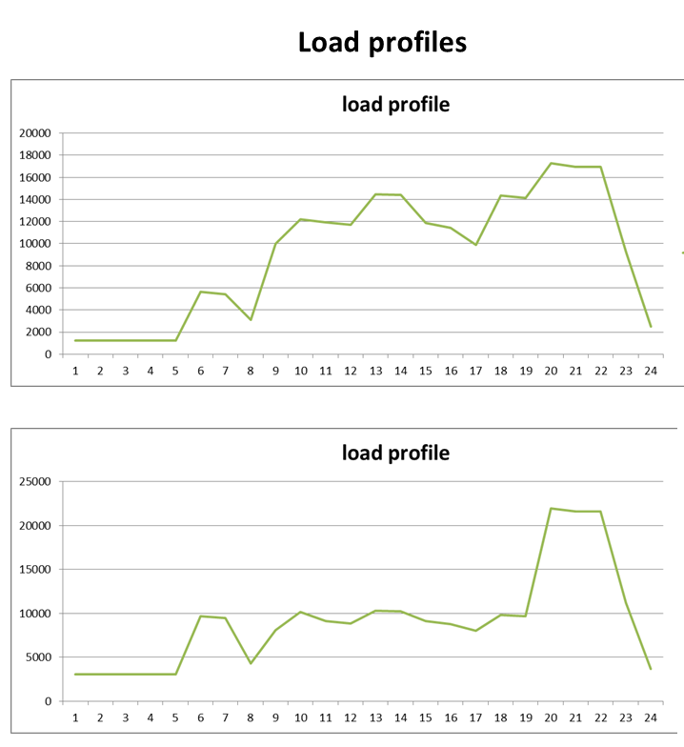
TARIFF DEFINITION. Risk Analysis
Main risks:
Real demand < forecast
Connection rate < forecast
Increase of fuel cost (if any)
Notes:
Discuss importance of demand characterization:
- Load factor: a measure of the mini grid’s utilization rate, defined as average load divided by peak load over a year. 20 to 80%. The higher the better.
- Importance of sun following load factor

Slide 22
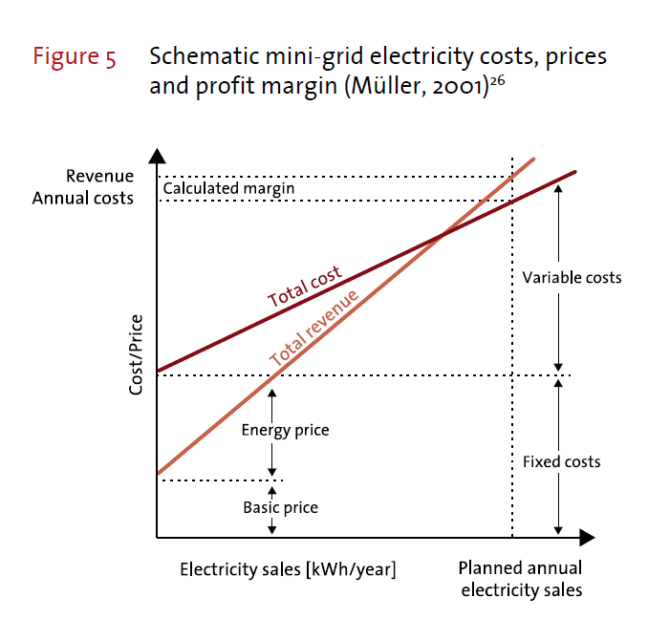
TARIFF DEFINITION. Risk Analysis
Main risks:
Real demand < forecast
Connection rate < forecast
Increase of fuel cost (if any)
Notes:
DISCUSS DIFFERENT REVENUE FUNCTIONS AND HOW THEY SHOULD MIMIC THE COSTS…
EXPLAIN WHAT HAPPENS WHEN YOU HAVE TO RUN THE DIESEL: STEEPER COSTS -> LOSING PROFIT?

Slide 23
4. Tariff structure

Slide 24
TARIFF DEFINITION. Tariff schemes
Depending on charging approach
Flat tariff. USD/month
Power-based tariff. USD/kW
Energy-based tariff. USD/kWh
Two-part (power+energy) tariff. USD/kW + USD/kWh
Service-based Tariff. USD/tier of service
Depending on payment system:
Pre-paid
Post-paid

Slide 25
TARIFF DEFINITION. TTA’s Observations
 | MAIN GRID | OFF-GRID
GENERATION COSTS | Dominance of VARIABLE costs: primarily fuel costs. | Dominance of FIXED costs: primarily CAPEX costs. There are little or no fuel costs at all.
TARIFF APPROACH | → Variable (USD/kWh) to recognize the marginal cost of energy or → Two-part (USD/kW/month + USD/kWh) if fixed costs are to be reflected also | → Fixed (USD/month)* to recognize the investment costs of the system, or at least two-part tariff (USD/kW/month + USD/kWh) , but never variable only. (*) with different levels depending on demand.

Slide 26
TARIFF DEFINITION. TTA’s Observations
Preferred TTA’s approach: SERVICE-BASED TARIFFS
Monthly flat tariffs per tier of service. Advantages of Service-Based tariffs:
Predictable revenues/expenses. Service-Based tariffs ensure revenue stability for the Service Provider, thus facilitating financial planning. Consumers also benefit from knowing in advance how much they are going to pay for.
Alignment with flat generation costs of RE. Flat tariffs adjust better to the Renewable Energy cost structure.
Alignment with tiered approach. Service-based tariffs align very well with the concept of tiers of service and EDA. The inclusion of a multi-tiered approach allows adapting the tariff levels to the willingness and capacity to pay from consumers.
Energy efficiency incentives transferred to Service Provider. Service-based tariffs transfers part of the incentives for energy efficiency to the operator. Operators can increase the number of customers being served by installing to their customers energy efficient appliances. This is a relevant aspect in remote locations, where the customer might have limited awareness on how to implement energy efficiency measures.
Simplicity: Easier to understand for customers.
Politically more palatable. Service-based tariffs can be politically more palatable as they are less comparable to per kWh rates of the main grid.

Slide 27
TARIFF DEFINITION. Example of Service-based tariffs
Energy packages with different daily energy needs are defined, with special focus on residential customers.
For these packages service-based tariffs (flat tariffs) are applied. They have a limited load (Amps) and limited energy daily allowance (EDA).
Flat tariffs allow operator covering O&M costs and major replacement costs.
Above a certain energy threshold, a two-part tariff aplies. This targets comercial or small industrial customers.
Type | EDA Wh/day | Power (Amp) | Type of payment | Subscription Fee (USD / Month)
Package 1 | 275 | 2 | Pre-paid | 4
Package 2 | 550 | 3 | Pre-paid | 8
Package 3 | 2,200 | 5 | Pre-paid | 36
Package 4 | 3,850 | 8 | Pre-paid | 68
Customized | Variable (> Package 4) | Custom | Post-paid | Variable

Slide 28
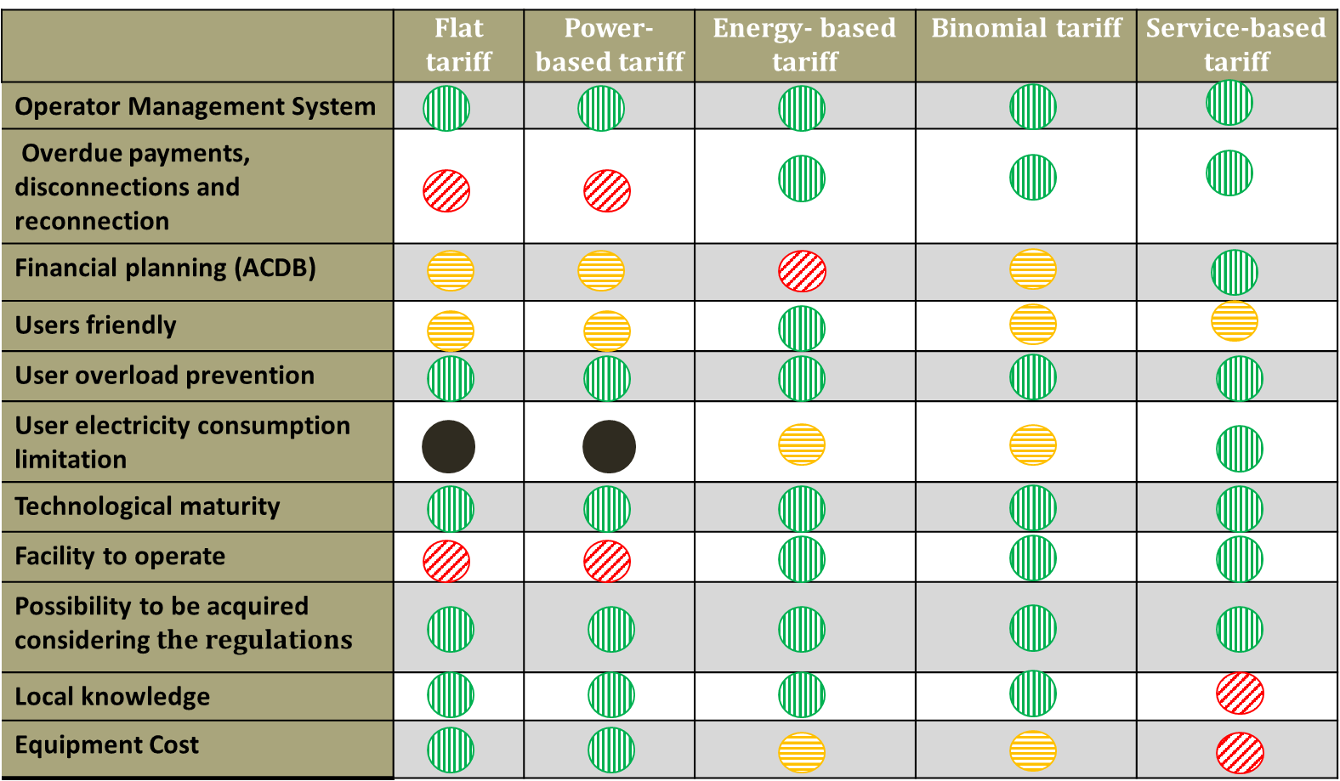
TARIFF DEFINITION. Tariff schemes
Available tariff schemes: comparison

Slide 29
5. ADDITIONAL RESOURCES

Slide 30
ADDITIONAL RESOURCES
Energy Sector Management Assistance Program. 2022. Mini Grids for Half a Billion People: Market Outlook and Handbook for Decision Makers. Washington, DC: World Bank. www.esmap.org/ mini_grids_for_half_a_billion_people.
USAID Mini-grid support toolkit. https://www.usaid.gov/energy/mini-grids
Energypedia. Impact of Tariff Structures on the Economic Viability of Mini-Grids. https://energypedia.info/wiki/Impact_of_Tariff_Structures_on_the_Economic_Viability_of_Mini-Grids#Examples_of_Different_Tariffs

Slide 31
Vinaka!
Roger SALLENT
Regional Team Leader for Asia – Pacific Trama TecnoAmbiental
roger.sallent@tta.com.es

Slide 32
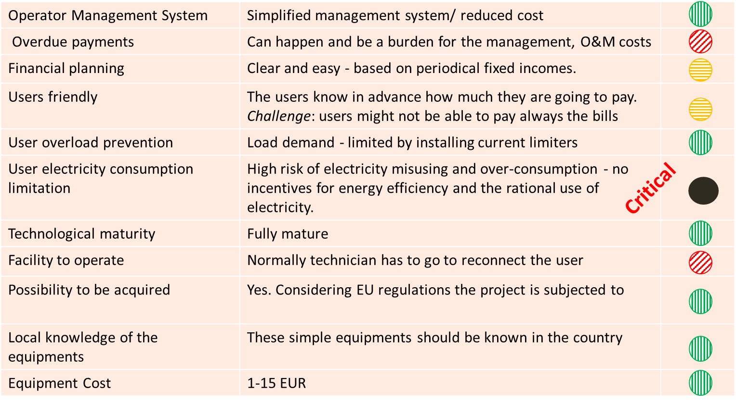
Available tariff schemes: flat tariff

Slide 33

Available tariff schemes: power-based tariff

Slide 34
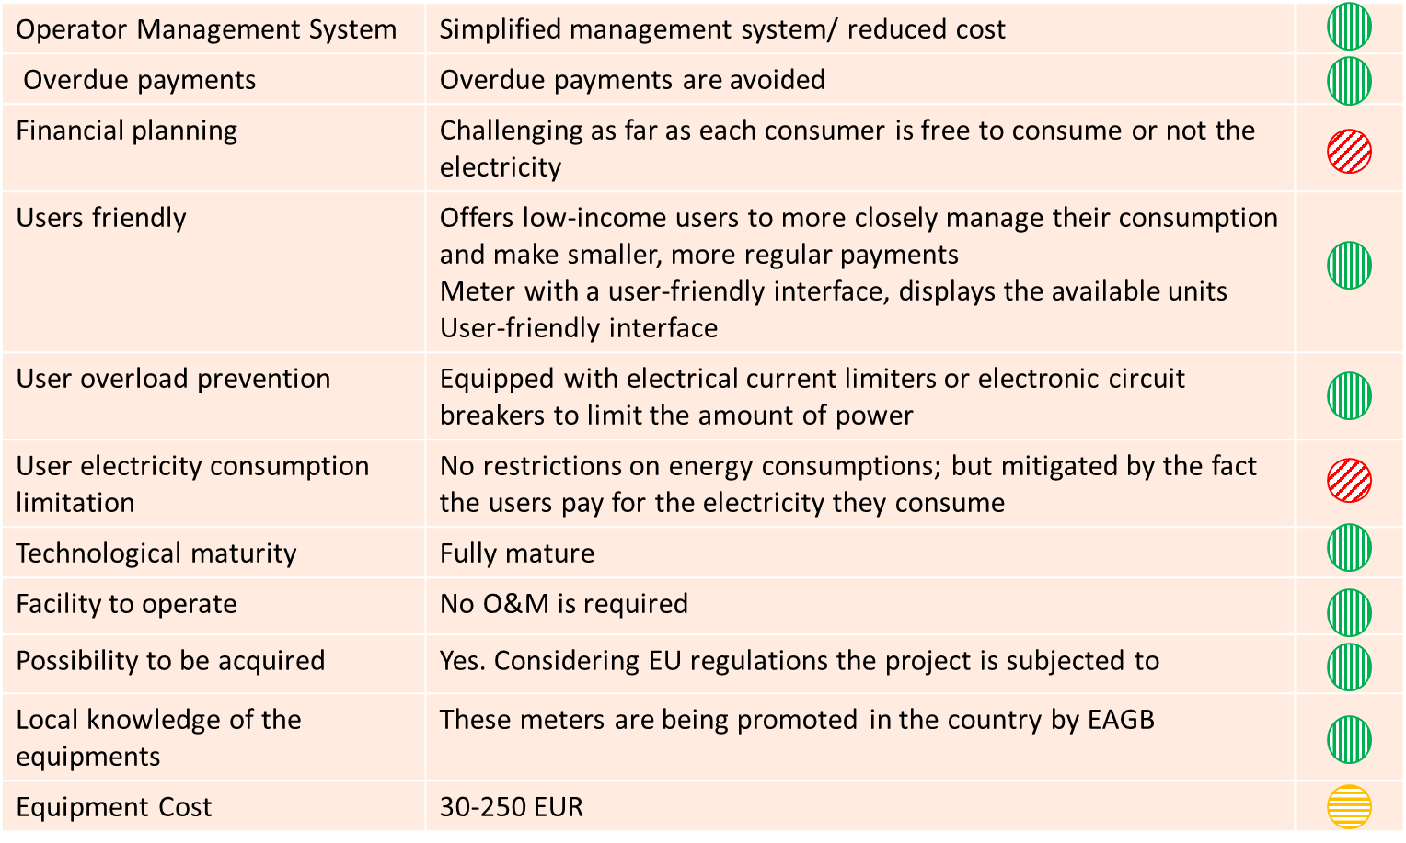
Available tariff schemes: energy-based tariff

Slide 35
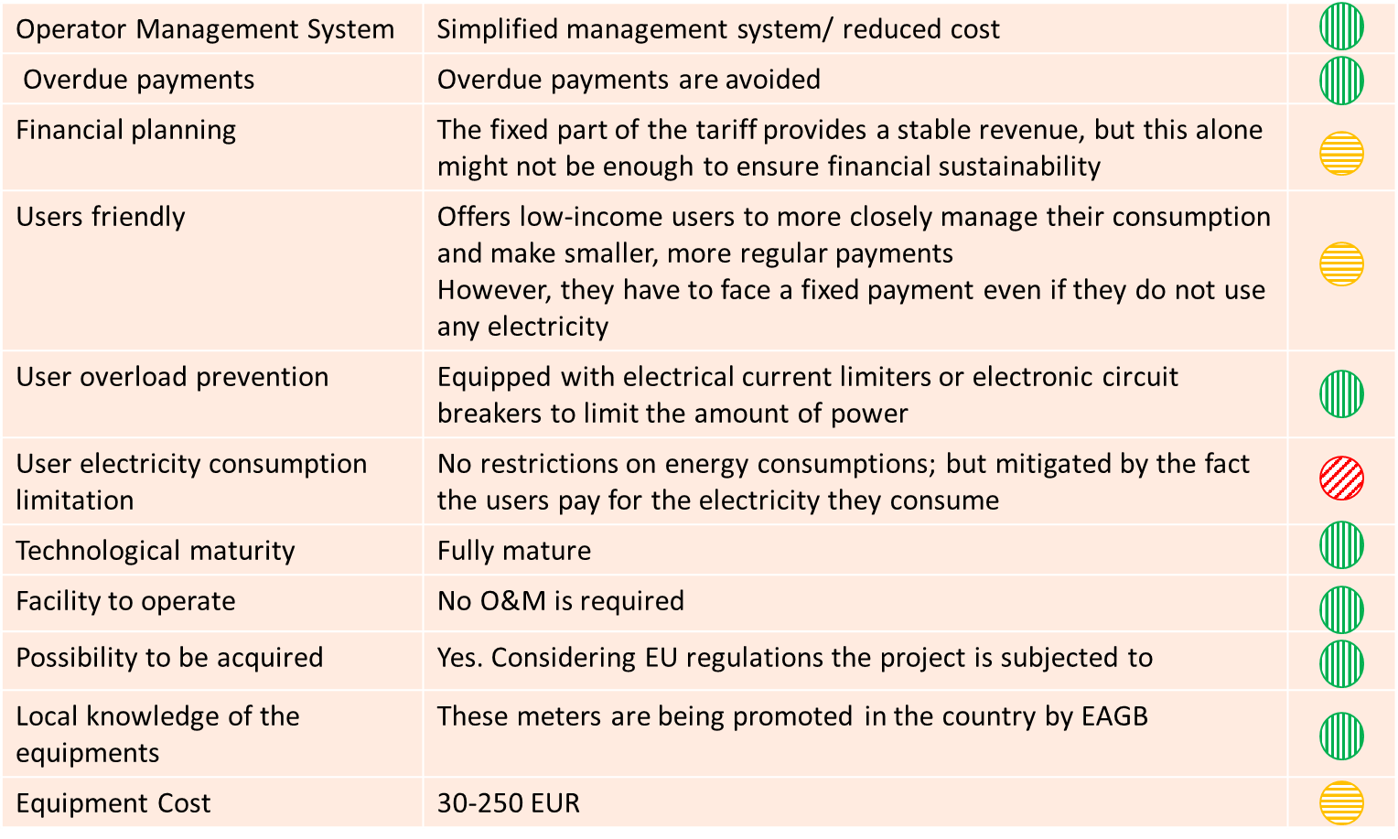
Available tariff schemes: binomial tariff

Slide 36
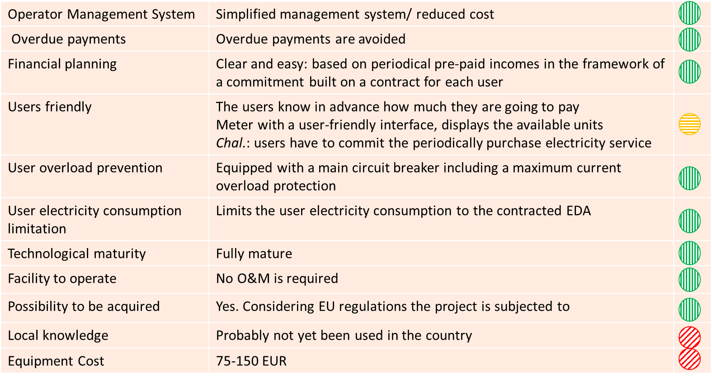
Available tariff schemes: service-based tariff

