Slide 1
Pcreee supported initiatives towards term progress
Jesse benjaman
Pacific centre for renewable energy and energy efficiency

Slide 2
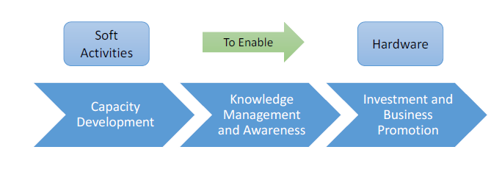
ABOUT PCREEE –Pacific Centre for Renewable Energy and Energy Efficiency
Part of the Pacific Community (SPC), located in Nukualofa, Tonga
A SE4ALL Centre of Excellence to Promote Sustainable Energy Markets, Industries and Innovation
Part of the regional network of sustainable energy centres for SIDS in Africa, Caribbean, Pacific and Indian Ocean (eg. CCREEE, ECREE, etc)
Inauguration in April 2017, just over 2 years in operation
Goal: Accelerate the deployment of feasible RE and EE technologies in the Pacific Islands by supporting the private sector to lead and to invest.
Intervention Logic of the Centre :

Slide 3
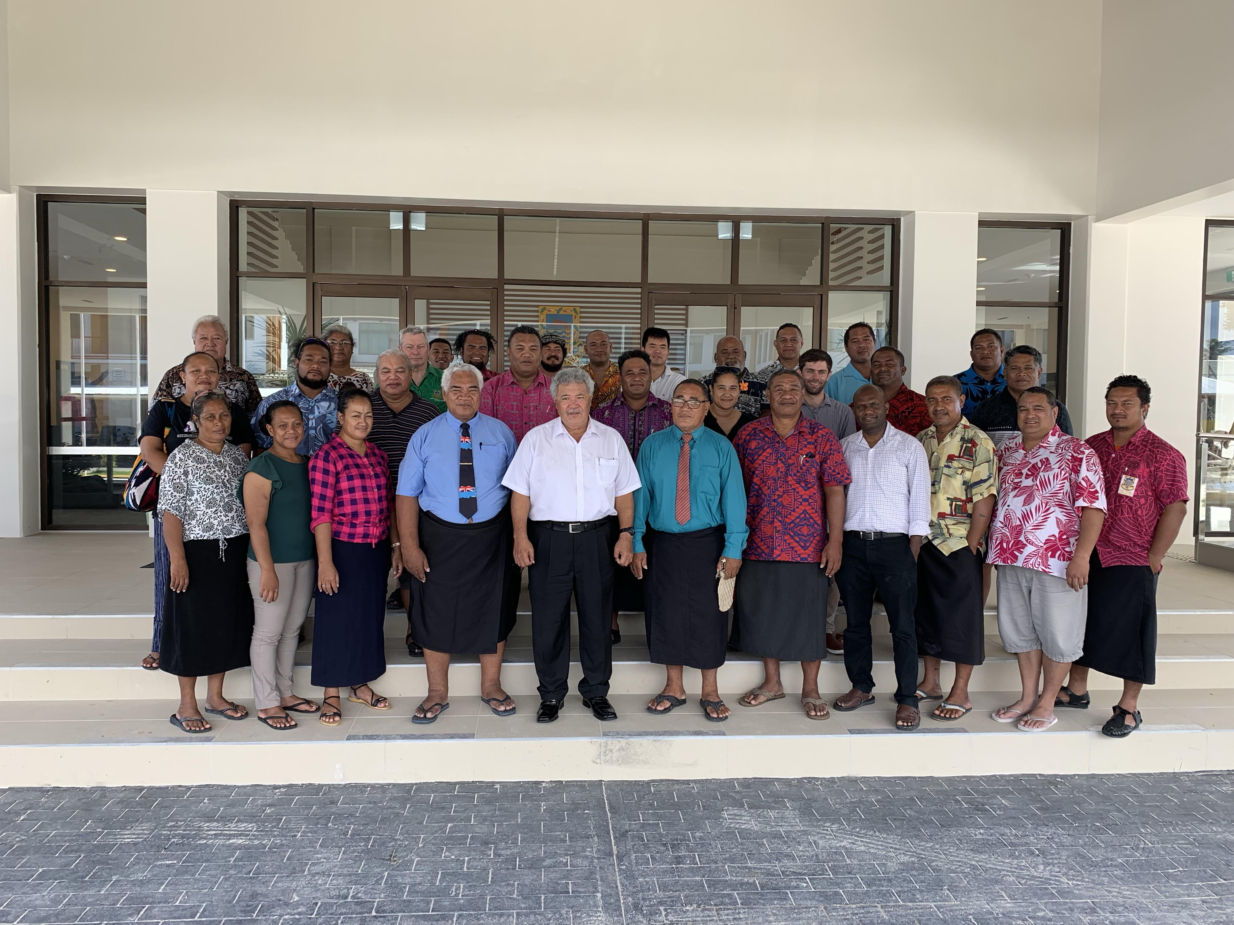
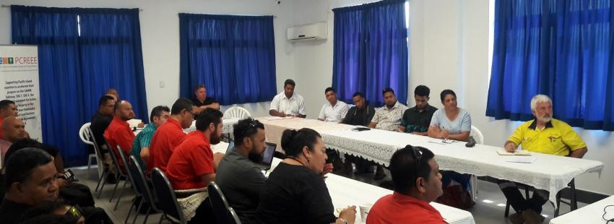
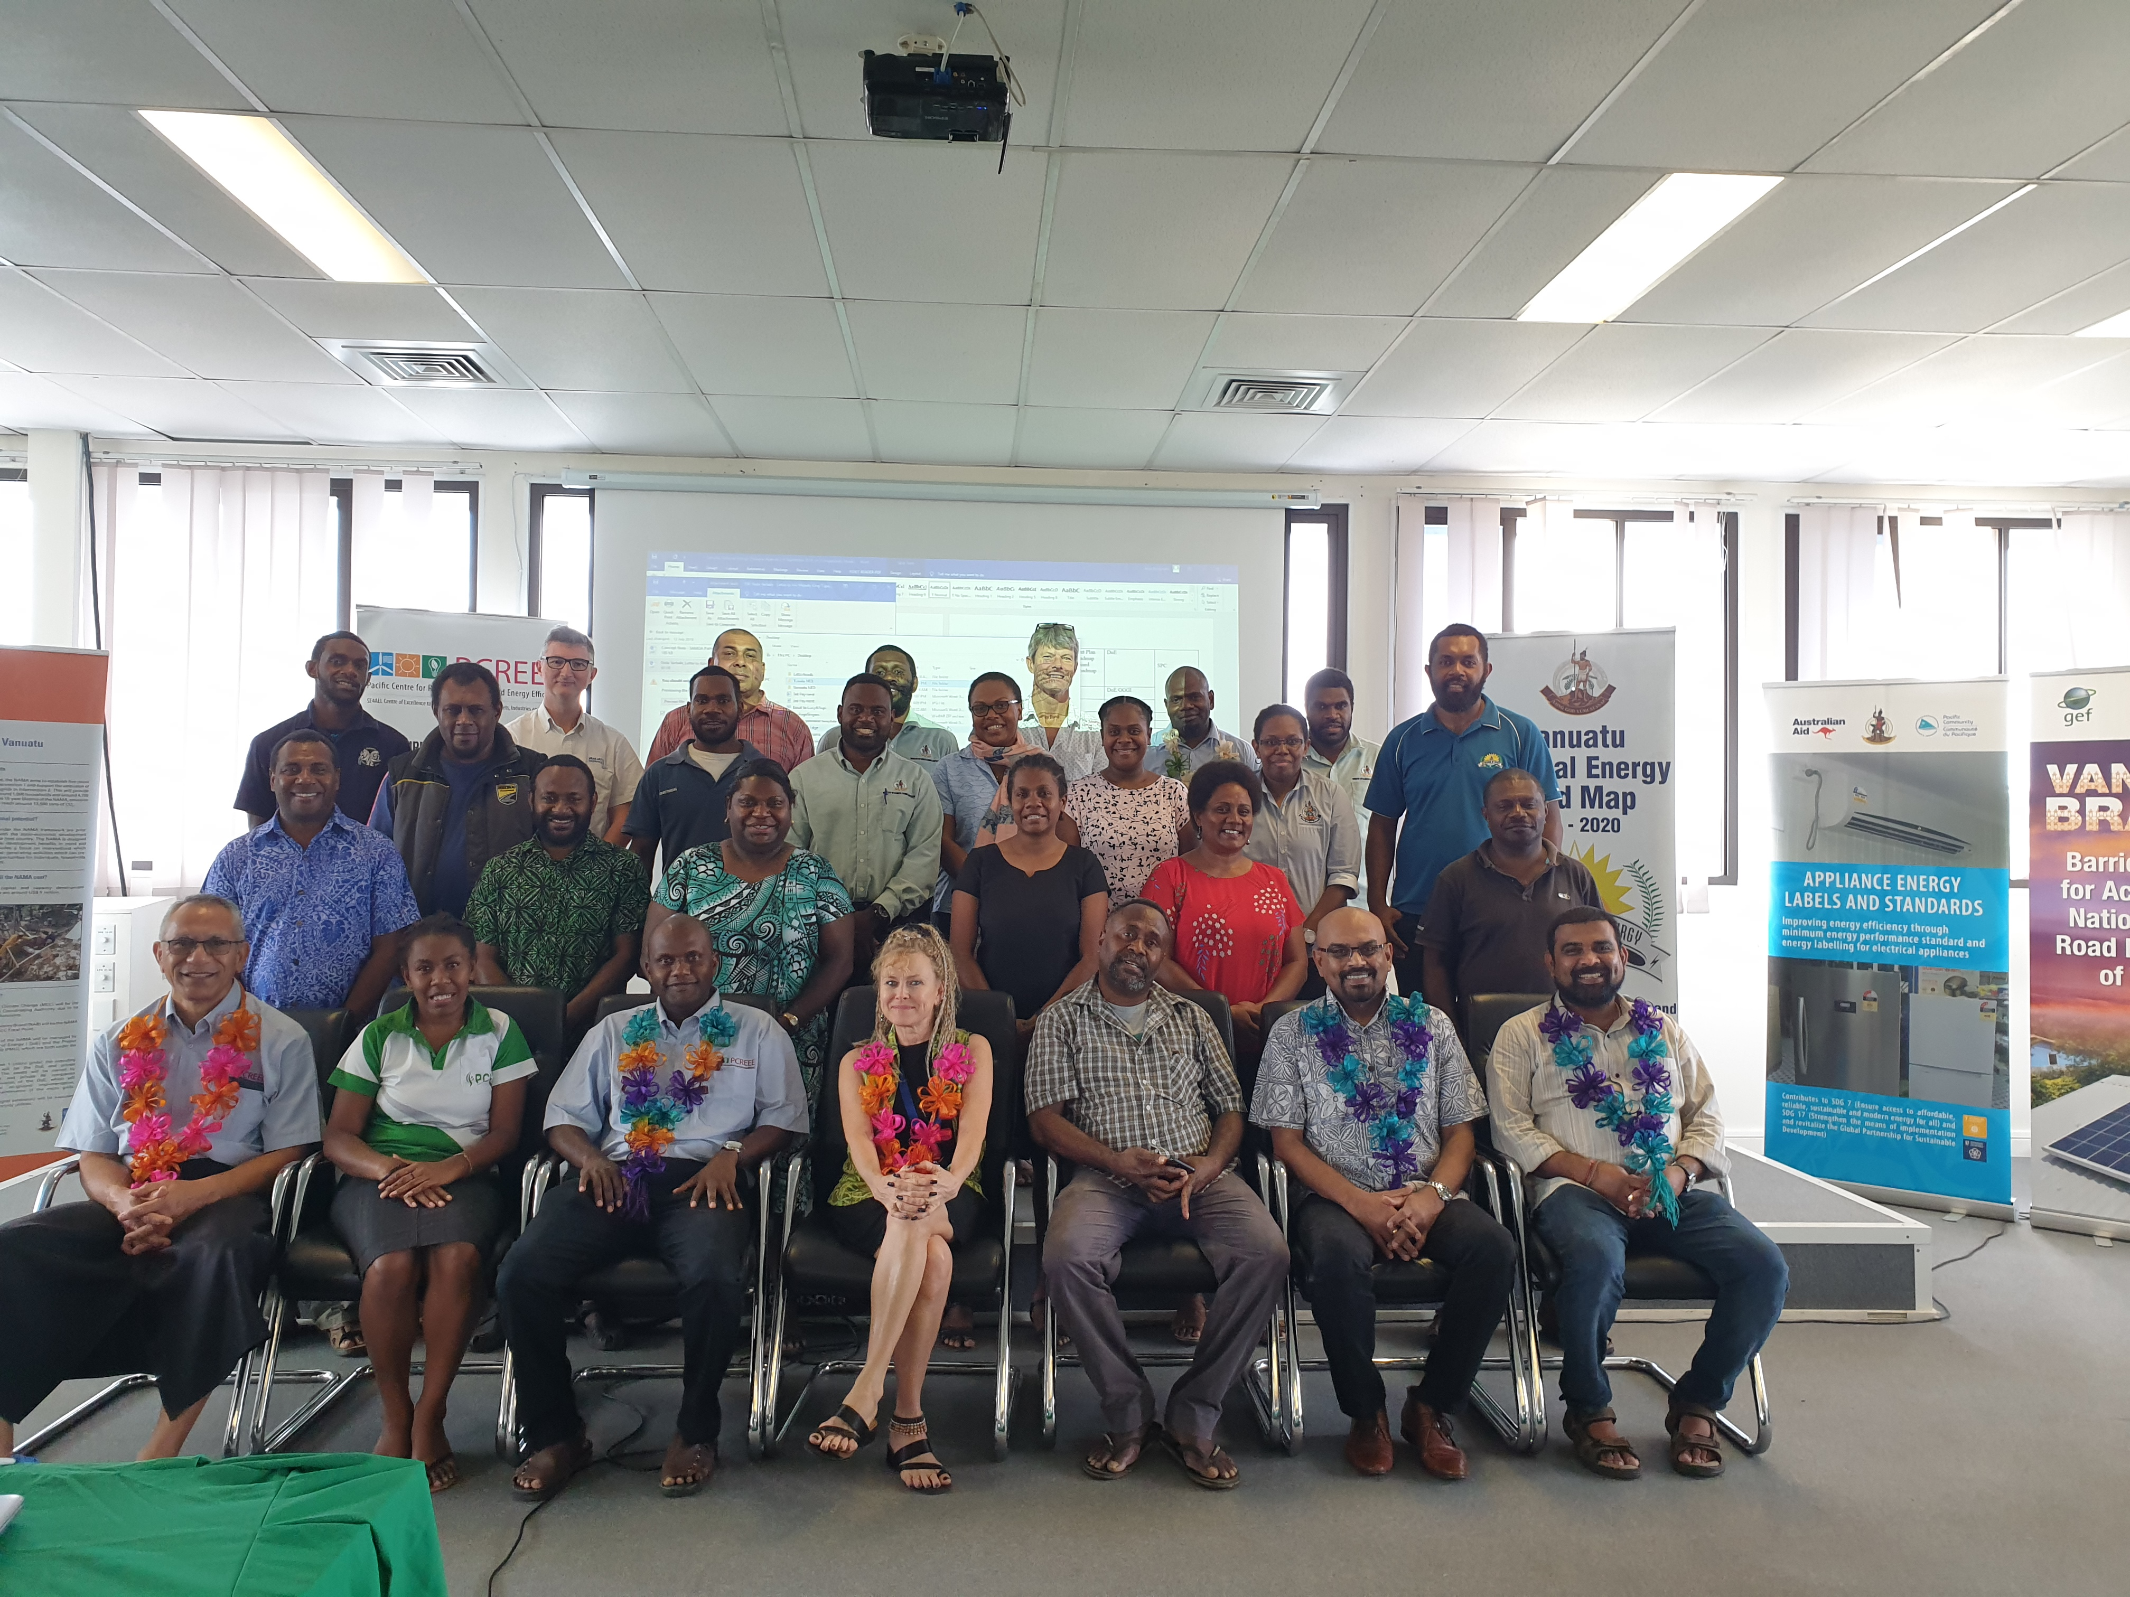
NATIONAL ENERGY DIALOGUES AND ENTREPNEURSHIP WORKSHOPS
TONGA
April 2019
SUSTAINABLE ENERGY ENTREPNEURSHIP WORKSHOP

Slide 4
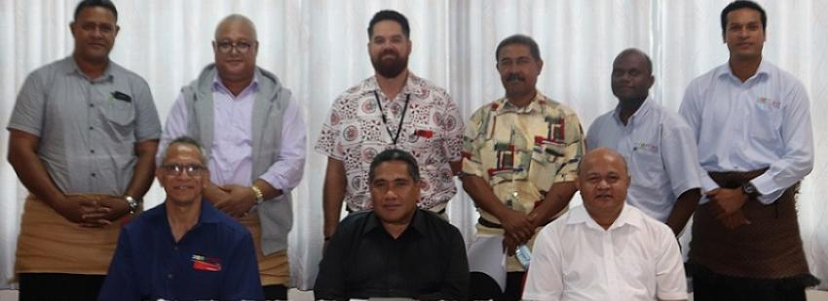
Capacity building
Revival of the PacTVET Project in Tonga – October 2019
EU PacTVET PROJECT - To build the regional and national capacity and technical expertise to respond to climate change adaptation(CCA) and sustainable energy(SE) challenges.
PCREEE housed the Tonga In-country coordinator and provided technical back-stopping support to the project
Develop Tonga’s own National Qualification in SE Cert 1-4 and registered by TNQAB
2. Strengthen TIST to be accredited by TNQAB as a registered Technical Institution to Offer SE Cert Level 3 or 4.
Project ends in September 2020 and needs additional funding to continue

Slide 5
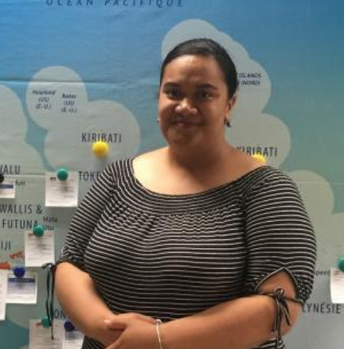
Capacity building
PCREEE Interns
Ms. Tiueti Fangupo
Nationality: Tongan
Internship Duration: December 2018 – February 2019
“This is a great experience for me as I learnt more about Tonga’s Renewable Energy and Energy Efficiency developments and their economic and environmental impacts. I was particularly interested in the structural integrity of the renewable energy installation and their resilience to extreme weather events,” Tiueti.

Slide 6
PCREEE Support Research Fund Awardees
+Second
+First
+Third
Mr. Vinal Vishal Prakash
Master student at the Faculty of Science, Technology and Environment, USP
Topic- Sustainable Island Community and role of Renewable Energy in providing access to Energy services in a remote island.
Research Paper has submitted, done defence , correction is done and submitted for printing, The paper will soon be out for public before graduation.
Mr. Sione Folau
Master in Climate Change at the Faculty of Science, Technology and Environment, USP
Topic- Carbon Footprint mitigation strategies for the Kingdom of Tonga
Research Paper: Final write up paper has Submitted for printing before i
Mr. Kakau Moe Loa Foliaki
PhD student at the Centre for Sustainability, University of Otago
Topic – “Understanding the Energy Cultures profile for the residential sector of Tonga and how to inform effective energy efficiency policy.

Slide 7
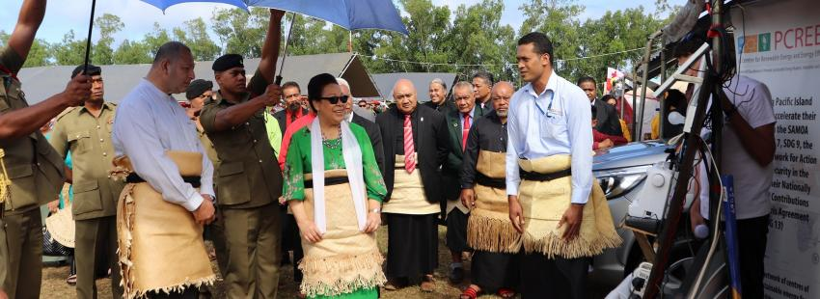
Awareness
June 2019
Demonstrating the productive uses of energy during the Royal Agricultural Show

Slide 8
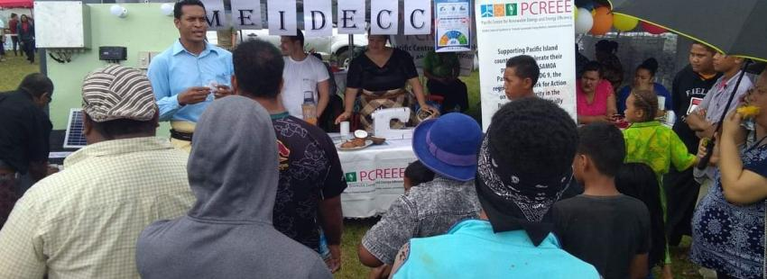
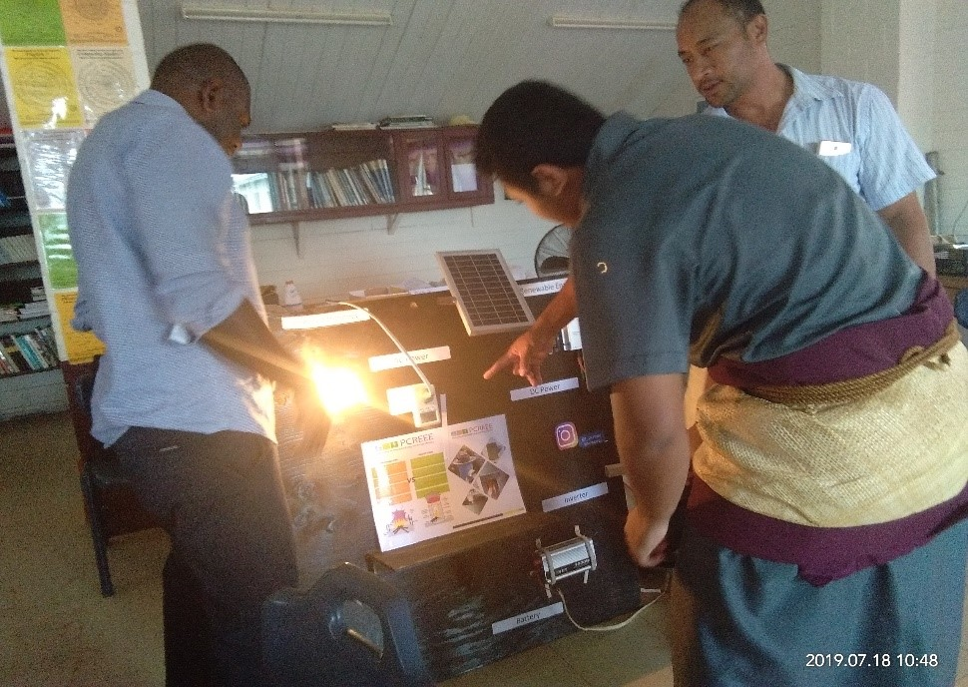
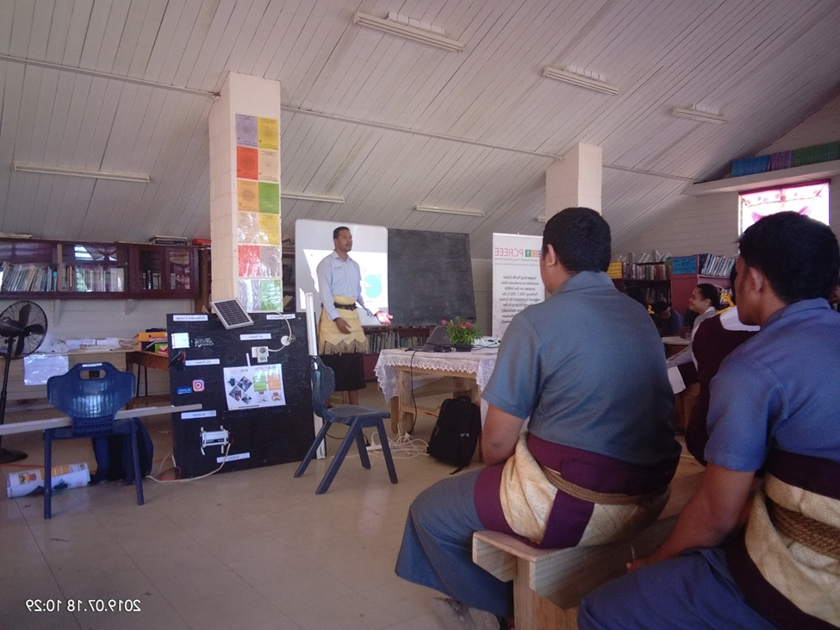
July 2019
Vava’u Agricultural Show & Vava’u High School lecture

Slide 9
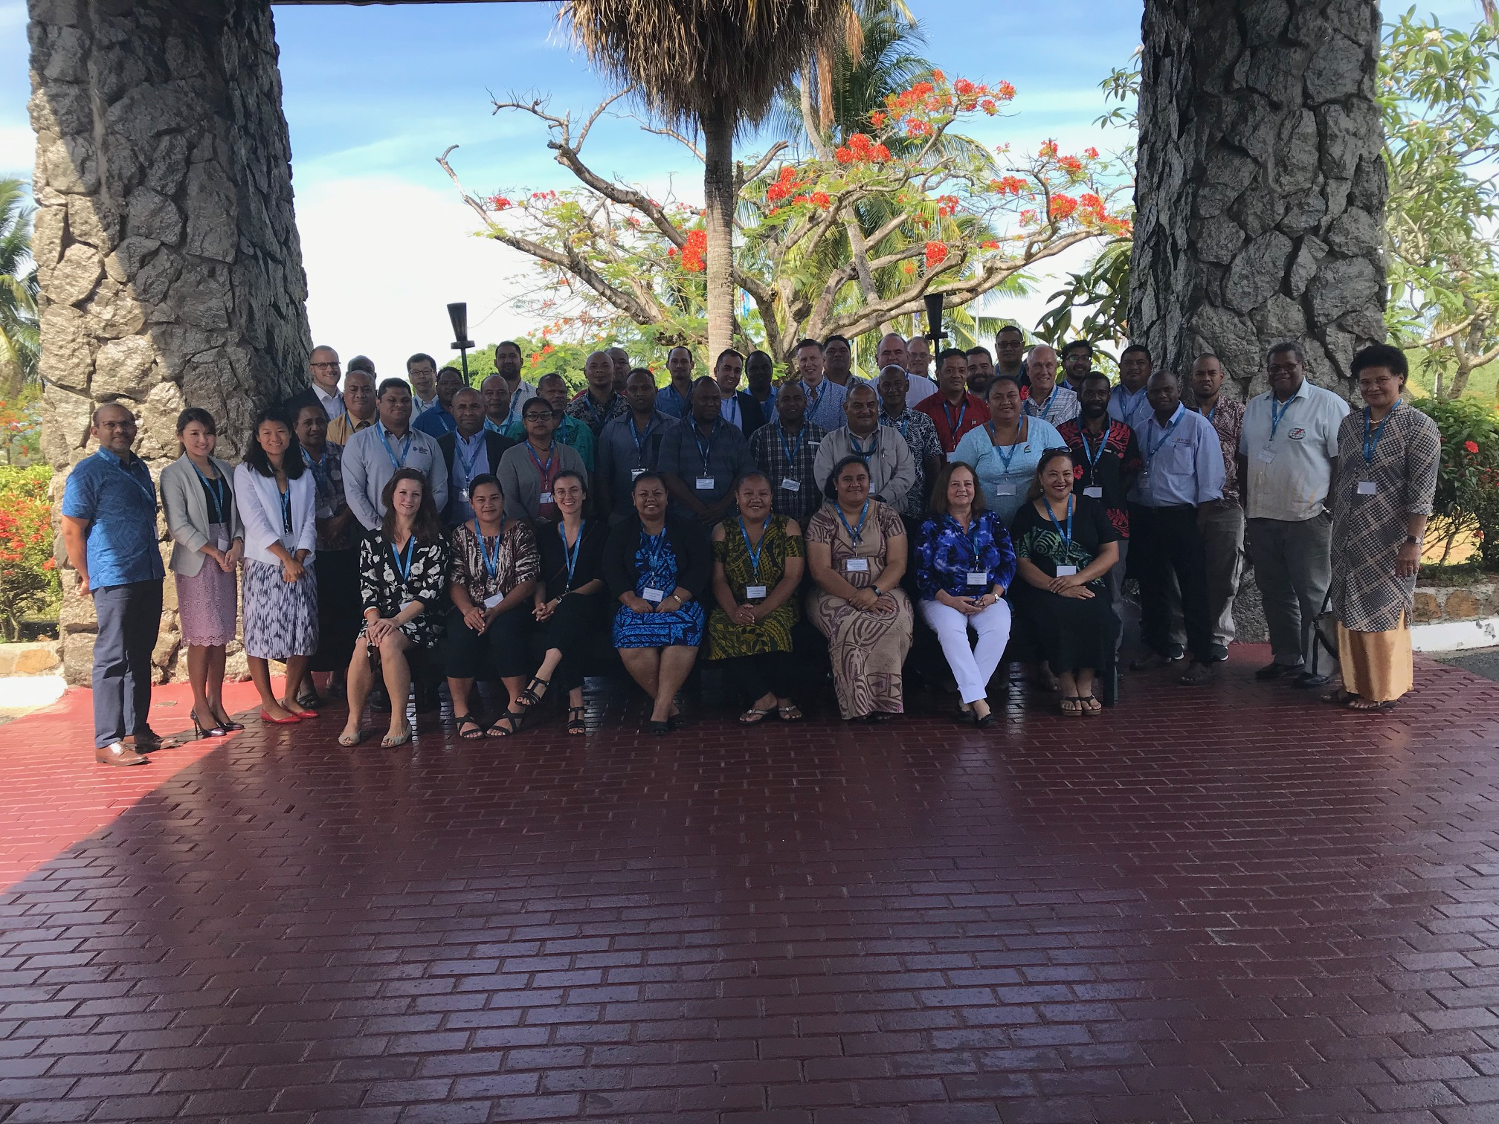
Electricity Regulation
Sign 81k Euro TA to the TEC
The objective of the TA is to strengthen the capacity of the TEC in negotiating and setting the tariff parameters and baselines for the power tariff in Tonga and in effect promote investments in renewable energy and energy efficiency while maintaining affordability, safety and reliability.
PCREEE-PPA-IRENA & IFC Joint workshop on Power Purchase Agreements (PPAs)

Slide 10
Project development support
Funding Proposals Writing Workshop – July 2019
Enhancing Energy Efficiency Appliances in the Pacific Island Countries
Global Cleantech Innovation Program (GCIP) for PICTs
Capacity Building on Sustainable Energy (PacTVET Plus)
Biogas and Circular Economy
Enhancing Access and Services of Small Islands Electricity through Solar Micro-grid
Low Emission through Energy Efficiency in Land Transport in PICs
Results-Based Financing Facility

Slide 11
PCREEE CONTACTS
PHONE
LOCATION
EMAILS
WEBSITE
Direct Line : (+676) 25209
Land Line: 20100 (EXT 812)
4th Floor, O.G. Sanft Building
Nukualofa
info@pcreee.org
https://www.pcreee.org/

