Slide 1
PCREEE Internship Programme
Sione Misi – Energy Efficiency Officer

Slide 2
Background
The Pacific Community (SPC) is the principal scientific and technical organisation in the Pacific region, supporting development since 1947.
The Geoscience Energy and Maritime Division provides advice, technical assistance, research and training support to Pacific Island countries and territories (PICTs).
Geo-resources and Energy Programme – Strengthening the management of the Earth’s non-living resources through responsible harnessing of mineral resources, including metalliferous and development minerals, and clean and renewable energy resources such as solar, wind, and geothermal for sustainable development.
The internship is part of PCREEE’s capacity building and youth entrepreneurship activities in the region.

Slide 3
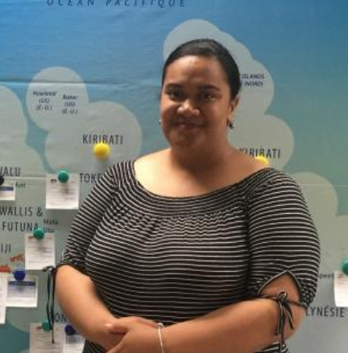
PCREEE Interns
Ms. Tiueti Fangupo
Nationality: Tongan
Internship Duration: December 2018 – February 2019
“This is a great experience for me as I learnt more about Tonga’s Renewable Energy and Energy Efficiency developments and their economic and environmental impacts. I was particularly interested in the structural integrity of the renewable energy installation and their resilience to extreme weather events,” Tiueti.

Slide 4
The internship is a collaboration between the PCREEE, the Auckland-based Pacific Co-operation Foundation (PCF) and the New Zealand Ministry of Foreign Affairs and Trade. The internship is part of PCREEE’s capacity building and youth entrepreneurship activities in the region
Ms Tiueti Fangupo is a final year student studying Bachelor of Engineering (Structural) at the University of Technology, Auckland, NZ.
Her internship included working with the Tonga Department of Energy exposing her to some of the small scale and community-based Renewable Energy projects the department is working on.
She also spent a few weeks with Tonga Power Limited that included assessing and visits to their grid-connected solar and wind farms.

Slide 5
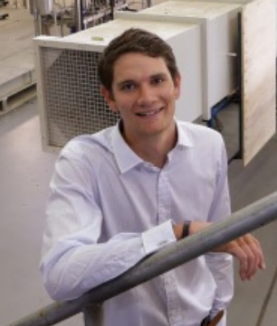
PCREEE Interns
Daniel Hay-Hendry
Nationality: Australian Internship Duration: 17th June 2019 – 18th July 2019
“I have been lucky enough to finish my scholarship program with an internship at the PCREEE. Here I have been able put some of the skills I have gained from previous experiences to use, while building upon my knowledge base and developing new skills.” Daniel

Slide 6
Daniel is an Environmental Engineering student from Murdoch University in Perth, Australia
Completed a 6 weeks internship with the PCREEE as part of his New Colombo Plan (NCP) Scholarships. The NCP Scholarship is an initiative by the Australian Department of Foreign Affairs and Trade to increase the knowledge of the Indo-Pacific region within Australia
He gained knowledge in the energy sector, policy, public awareness campaigns and Tongan culture.
Daniel have been involved in two major projects:
Conducting an energy audit on the MEIDECC building which act as a case study for future Ministry audits.
RE and EE workshops for secondary schools across Tongatapu
promote RE and EE as well as highlighting the energy sector as a career path for students and the importance of gender equality within it
Mr Hay-Hendry planned the program to be expanded to the outer islands and other Pacific Countries in the future.

Slide 7
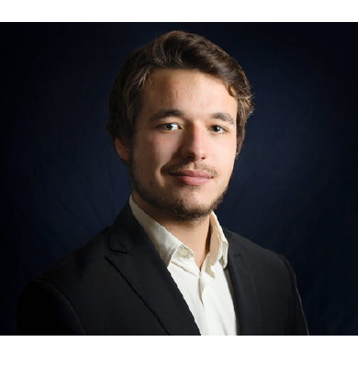
PCREEE Interns
Nicolas Meier
Nationality: German
Internship Duration: 1st July 2019 – 1st August 2019

Slide 8
Research Background
University of Natural Resources and Life Sciences (Msc)
Exchange student at the LU – Lincoln University, New Zealand
Master-thesis aim to investigate the possibilities of the island state of Tonga to move towards a maximum solar energy generation with reference to “state of the art” solar technologies and battery solar system.
Research scope divided into technical, economic and social parameters.
Site visits and determining technical parameters for rooftop/ floating solar in Nuku’alofa.
Conducted meetings with public energy distribution managers for discussion of Tonga’s proposed future solar projects/ PPA
Joint the PCREEE Entrepreneurship Promotion team at the Tonga Royal Agriculture and Tourism Show

Slide 9
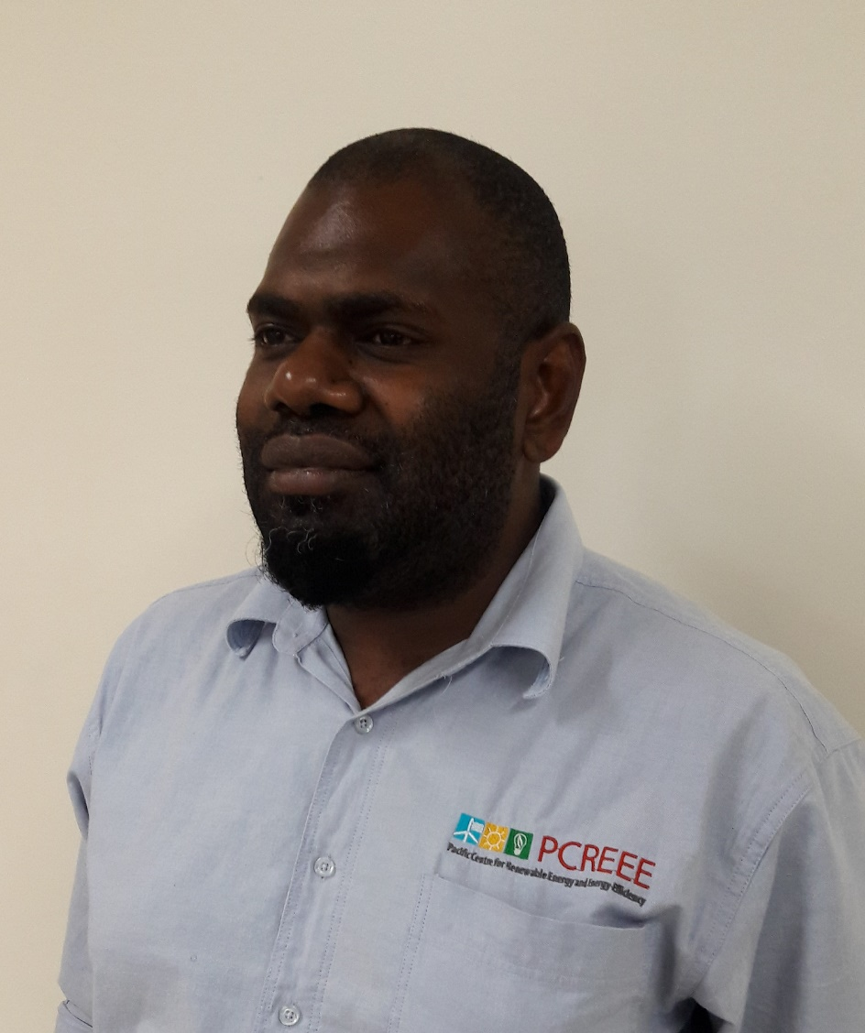
Pacific Islander Junior Professional (PIJP)
Joseph Temakon
Nationality: Ni-Vanuatu
Attachment Duration: 16th May 2019 – 16th November 2019

Slide 10
PIJP is an initiative by the PCREEE:
aims to build the capacity of the national energy agencies on the regional energy programmes, activities, initiatives
support the PCREEE Manager, Programme Delivery Officer and PCREEE Experts
providing support and advice to governments, stakeholders and the private sector in planning and implementing PCREEE activities, focusing on entrepreneurship, investment promotion and capacity development relating to RE and EE

Slide 11
The PIJP key responsibilities:
Regional Collaboration, Coordination and Communication:
Assists with conducting and updating of needs assessments, with the data collection and analysis effort of the PCREEE
Assist with the visibility effort of the PCREEE and with the updating of the PCREEE website.
Technical Cooperation and Services:
Assist in the implementation of the PCREEE entrepreneurship activities,
Assist in the planning an conduct of business, investment promotion activities and PCREEE training activities.
Resource mobilisation:
Draft funding proposals to internal resources in SPC as well as to external sources,
Draft bids and proposals to consultancy works in member countries and those offered by regional and multilateral stakeholders,
Assist in the production of progress and acquittal reports on resources provided to the PCREEE.

Slide 12
PIJP Achievements
Regional Collaboration, Coordination and Communication
Developed the Pacific Energy Datasheet,
Compiled the GCF and GEF projects for the PICs for use by PCREEE.
Developed the Concept Note for the PCREEE Regional EE and RE Awareness Campaign.
Technical Cooperation and Service
Designed sustainable energy display board to use for promotional activities and awareness.
Conducted public awareness and promotional activity
Initiated networks between the SPC-PCREEE and BRANTV project
Provided advice on an energy audit activity
Assisted with Vanuatu Energy Dialogue,

Slide 13
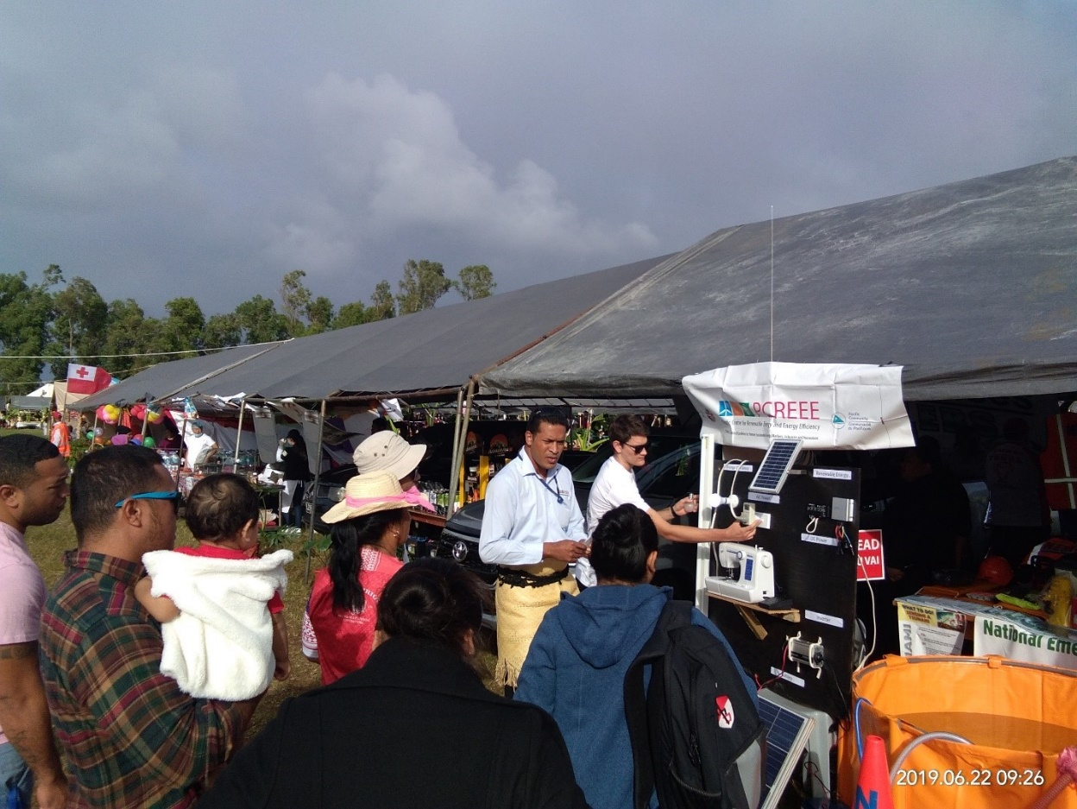
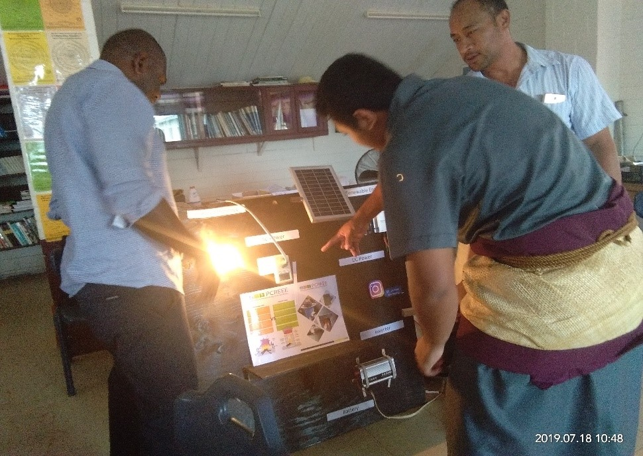
PIJP Achievements

Slide 14
PIJP Advertisement
Visit the PCREEE Website for more details at: https://www.pcreee.org/
Applicants must apply online through the link: http://careers.spc.int/job/pacific-islands-junior-professional-pcreee-geoscience-tonga-al000240/12ff0433-0044-11ea-9ddc-42010a8a0024

Slide 15
Thank you

