Slide 1

Global Network of Regional Sustainable Energy Centers
(GN-SEC) Program
– Looking back and going forward –
Think globally, act regionally, implement nationally!

Slide 2






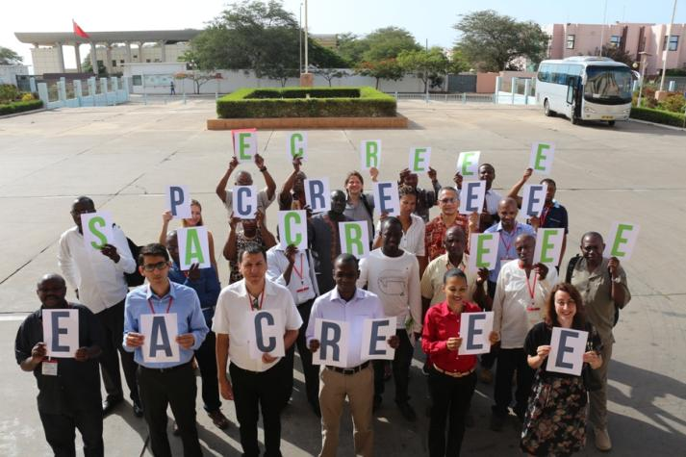






Under a common programmatic framework UNIDO supports regional economic communities in developing countries in the creation and operation of regional sustainable energy centers
Sub-Network Africa and Arab region
Sub-Network for SIDS
New centre in Central America
New centre in Himalaya-Hindukush
New centre with ECO in Central Asia

Slide 3
Benefits of regional energy and climate cooperation
Missing link between int. climate agreements (instruments) and national implementation
Address barriers jointly at lower cost with shared resources and “makerspace”
Economies of scale through common markets following harmonized standards
Strengthen regional capacities to plan, coordinate, implement and monitor
Promote equal progress between countries
Ownership and priority-setting by the region for the region
De-risking through joint standards/regulation
Donor harmonization and coordination
Enhanced inclusiveness through regional local content requirements, entrepreneurship and innovation support
Global
Regional
National
Missing link

Slide 4
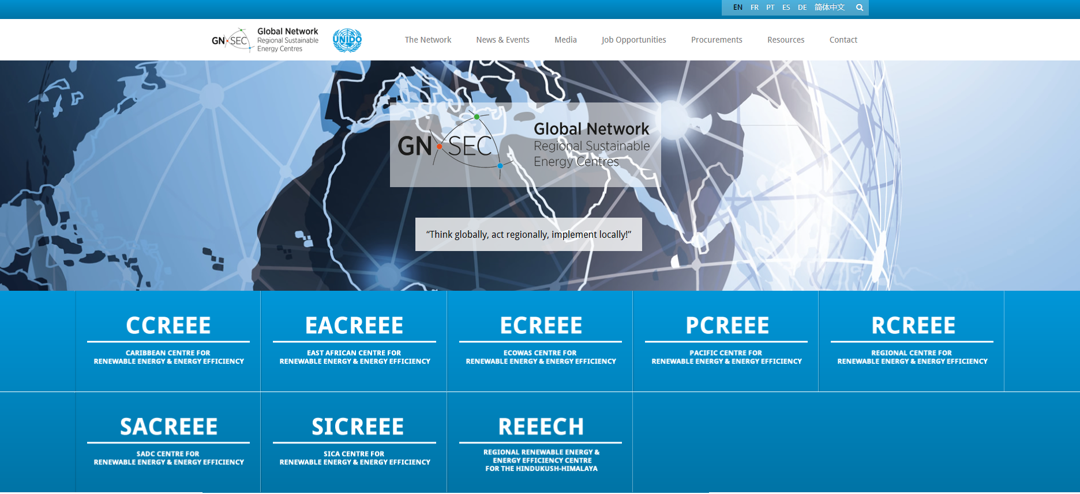



GN-SEC South-South Cooperation Platform: www.gn-sec.net
The sun never goes down in the GN-SEC!
Core partners

Slide 5
Functions of the GN-SEC Platform:
Raising the profile and visibility of the network on global level;
Advocating for SDG-7, SDG-9 and SDG-13;
South-south cooperation on common issues and solutions (e.g. SIDS, LDCs)
Advocating for more inlusive SECT technology transfer processes;
Joint policy inputs for international energy and climate processes;
Effective communication, public relations and cooperate identity;
Lessons learned and joint learning on technical and institutional aspects;
Joint quality assurance and monitoring of results;
Provision of global services and promote joint products;
Promote Joint programs and projects;
Joint fund raising;
Strategic partnerships with int. organizations, industry, civil society, investors and foundations;

Slide 6
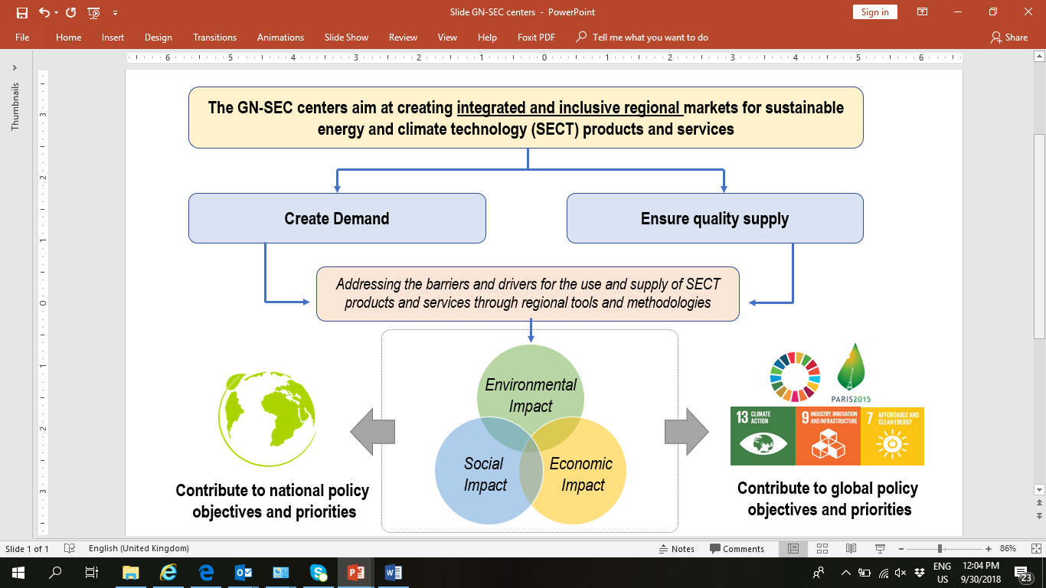
Mission and Vision

Slide 7
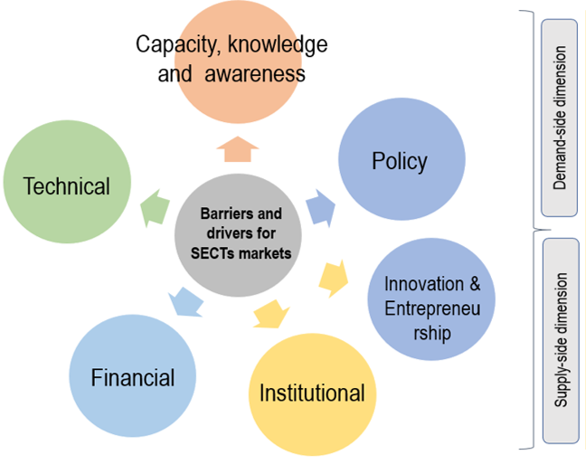
Addressing the barriers for inclusive sustainable energy and climate technology markets regionally
Addressing the barriers on the demand and supply side simultaneously

Slide 8
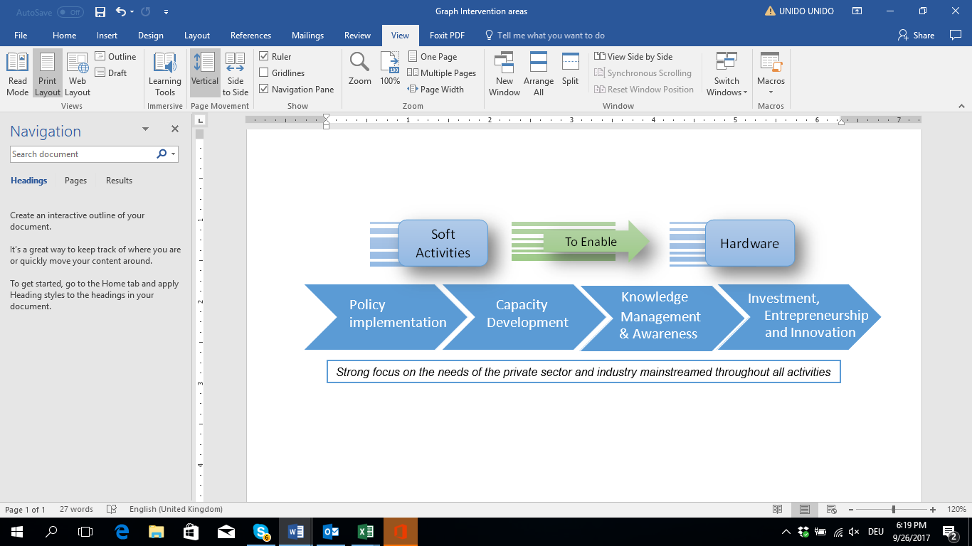

Complement, upscale and replicate national efforts through regional tools and methodologies – Theory of Change

Slide 9
Selected results/impacts
Innovated the regional institutional set-up for RE&EE in 6 regions mainly covering LDCs and SIDS with population of more than 1,1 billion
Adopted by more than 97 Ministers of Energy and Heads of State in mostly LDCs and SIDS
Employs around 90 regional staff (excl. consultants and temporary assistance)
Leveraged more than USD 300 million direct funding for GN-SEC Programs (excl. investment leveraged through these activities)
Developed 4 regional RE&EE policies (incl. one on gender) and 15 national action and investment plans
Develops regional EE standards covering more than 50 countries (e.g. appliances, solar thermal)
Operates 3 regional RE&EE information systems with more than 2.000 documents/studies and GIS data
Global
Regional
National

Slide 10
Selected results/impacts
3 regional GIS based small hydro, solar and wind power potential assessments in 15 countries
At least 15.000 participants in GN-SEC RE&EE Conferences and events (excl. trainings)
At least 5.000 experts and trainers on various RE&EE issues trained (excl. train the trainers effects)
At least two regional RE&EE certification schemes on PV and solar-thermal established
Operated three regional facilities to promote RE&EE projects and entrepreneurship
National RE&EE Investment Plans with a volume of several billions developed
Global
Regional
National

Slide 11
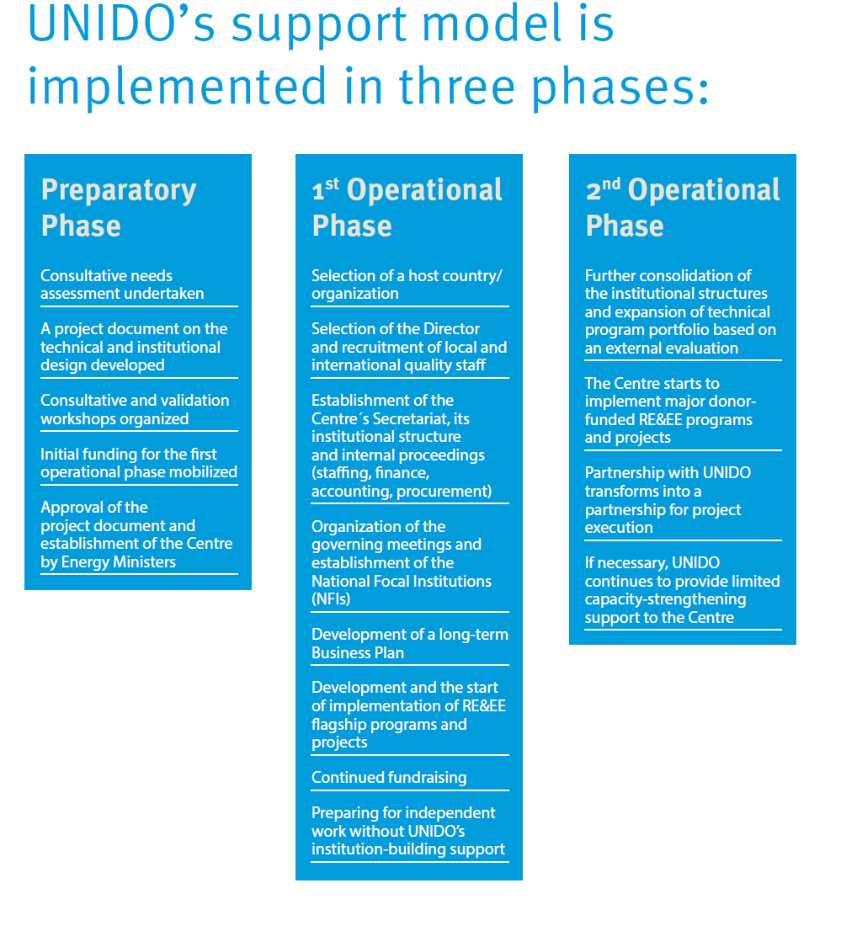

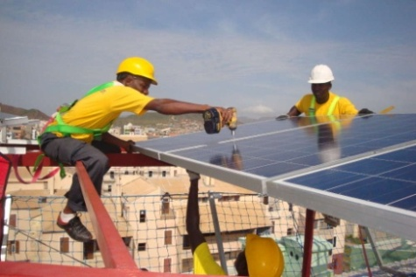



Slide 12

Guiding GN-SEC Principles – A „new deal“ for inclusiveness
Programmatic approach (individual centres are part of a wider program);
Demand-driven (based on requests by the regions);
„No blueprints“ and tailored design to the individual needs of the region;
Ownership and leadership by the regional organisation and their Member States;
Hosted by an existing domestic institution or a Member State;
High level of legitimacy based on legal agreements and approval by Ministers;
Well embedded in sub-regional decision-making and policy processes;
Well-connected to national Ministries and policies;
Complementary to existing regional energy institutions (e.g. utility organizations);
Use of domestic processes and systems (e.g. procurement, recruitment);
Sustainability through domestic contributions, int. partnerships, fee-for-service and participation in call for proposals;
„Small is beautiful“ and „form follows function“;
Institutional "check and balances" through Governance (e.g. Executive Board);
Timely-limited UNIDO support for institution building;

Slide 13
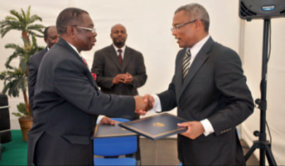
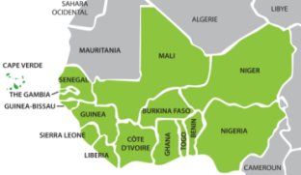

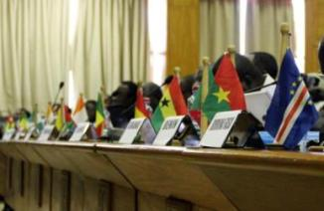
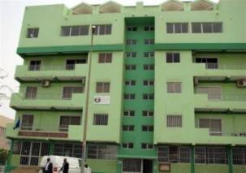
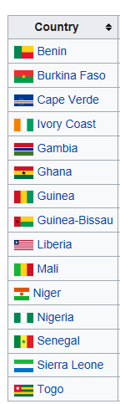
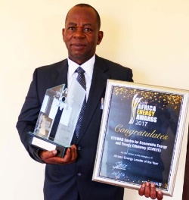
ECOWAS Centre for Renewable Energy and Energy Efficiency (ECREEE)
– Third Operational Phase
Specialized agency of ECOWAS
Covers 15 Countries with 376 million energy consumers
Established by the ECOWAS Commission with support of UNIDO
Based on the Ouagadougou Declaration adopted on 12 November 2007 and a regulation passed by the ECOWAS Council of Ministers in November 2008
ECREEE officially inaugurated Praia, Cabo Verde in July 2010
National Focal Institutions among all ECOWAS countries
Around 50 staff employed
Comprehensive technical program
Core partners: ADA, AECID, EU, GIZ, USAID, WB, AfDB, IRENA
Website: www.ecreee.org
Mr. Mahama Kappiah, Executive Director

Slide 14
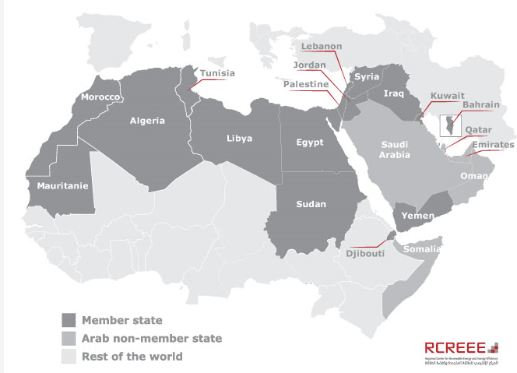
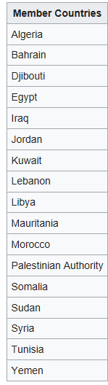

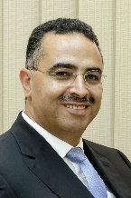
Regional Centre for Renewable Energy and Energy Efficiency (RCREEE)
– Third Operational Phase
Intergouvernmental organisation with diplomatic status
Covering 17 Arab Countries (mostly MICs)
Based on the Cairo Declaration singed in June 2008
Established in alliance with the League of Arab States with initial support of GIZ and DANIDA
Host country agreement signed with Egypt in August 2010
National Focal Institutions among all Member countries
Around 20 staff employed
Comprehensive technical program
Core partners: GIZ, DANIDA, NREA, UNIDO, WB, IRENA, UNEP
Website: www.rcreee.org
Mr. Ahmed Badr
Executive Director

Slide 15

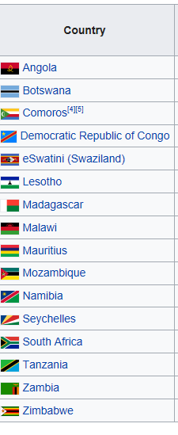
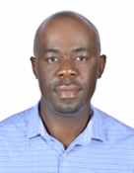
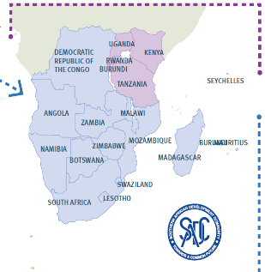
SADC Centre for Renewable Energy and Energy Efficiency (SACREEE) – First operational phase
Specialised SADC agency based on a legal agreement
Represents 16 Member States (many of them LDCs) and represents around 300 million energy consumers
Established by SADC in partnership with UNIDO
Approval in principle by the SADC Energy Ministers at their 33rd and 34th meetings held in May 2013 and July 2015
Nomination of Namibia as host country in August 2015
Launch of first technical SACREEE operations in 2016
Official Inauguration on 24 October 2018
National Focal Institutions among all SADC countries
Core partners: ADA, SIDA, EU, USAID, IRENA
Website: www.sacreee.org
Mr. Kudakwashe Ndhlukula
Executive Director

Slide 16

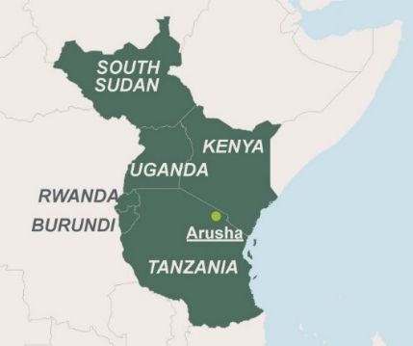
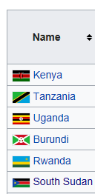
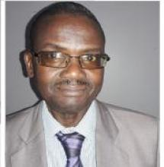
East African Centre for Renewable Energy and Energy Efficiency (EACREEE)
– First operational phase
EAC Centre of Excellence based on Ministerial decisions
Represents six Partner States with a population of 171 million energy consumers
Established by the EAC Secretariat in partnership with UNIDO
Validation workshops: 11 to 12 March 2013 in Arusha, Tanzania, and 6 to 7 May 2013 in Kampala, Uganda
Decision to establish EACREEE at the 9th Meeting of the EAC Sectoral Council on Energy, 21 April 2014 in Kenya
33rd EAC Council of Ministers, held on 29th February 2016 in Tanzania, decided to establish EACREEE at CEDAT in Kampala, Uganda
Since 2018 full legal identity as non-profit company of CEDAT
National Focal Institutions in all EAC Partner States
Core partners: ADA, SIDA, ISA
Website: www.eacreee.org
Mr. Mackay Okure, Interim-Director

Slide 17


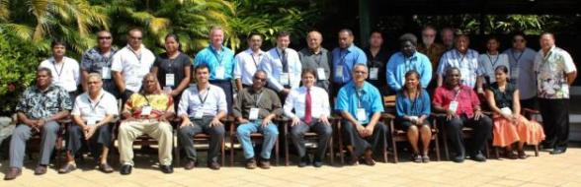
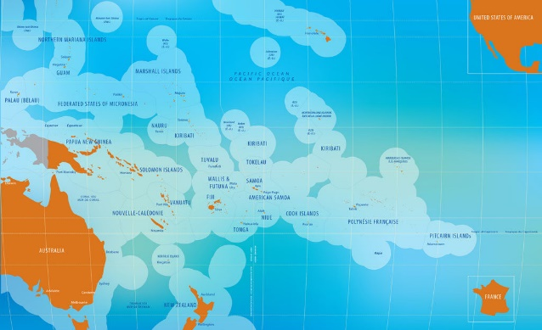
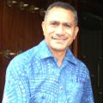
Pacific Centre for Renewable Energy and Energy Efficiency (PCREEE)
– First Operational Phase
22 Pacific Island States and Territories (PICTs) with around 10 million energy consumers
Established by SPC, SIDS DOCK and UNIDO as part of a SAMOA Pathway Partnership
Validation workshop, 12 to 13 March 2014, in Fiji, Nadi
Endorsement at the Meeting of Pacific Ministers of Energy, 2 to 4 April 2014, in Nadi, Fiji
Decision to host PCREEE at the SPC hub in Nuku’alofa, Tonga
Inauguration of PCREEE at the 3rd Meeting of Pacific Ministers of Energy in April 2017 in Tonga
National Focal Institutions in 22 PICTs
Partners: SPC, Austria, Norway, Republic of Korea
Website: www.pcreee.org
Mr. Solomone Fifita, Manager

Slide 18



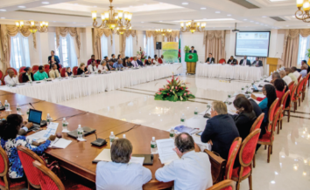
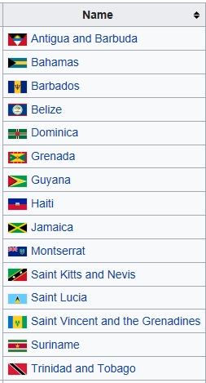

Caribbean Centre for Renewable Energy and Energy Efficiency (CCREEE) – First operational phase
Covering 15 CARICOM countries with 18 million energy consumers
Established by CARICOM, SIDS DOCK and UNIDO as part of a SAMOA Pathway Partnership
Validation workshop, 21 to 22 July 2014 in Dominica
Adoption and host country decision at the 36th Meeting of the CARICOM Heads of Government, held in Barbados, 2-4 July 2015
Launch of interim-phase during a high-level ceremony in October 2015
CCREEE legal agreement went into force on 19 May 2018
Headquarters Agreement between CCREEE and Barbados signed on 22 May 2018
National Focal Institutions in all CARICOM countries
Core Partners: ADA, AECID, EU, GIZ
Website: www.ccreee.org
Mr. Gary Jackson, Executive Director

Slide 19


Civil society
Private sector & associations
Ministries and agencies
Utilities and regulators
International private sector & assiciations
Development partners
International civil society
International organisations (IFIs, UN)
National level
National level
Makerspace
Regional Utility Organisation
Regional Regulators
Regional Associations
Regional Organisations
Regional civil society
International level
Regional level

Slide 20
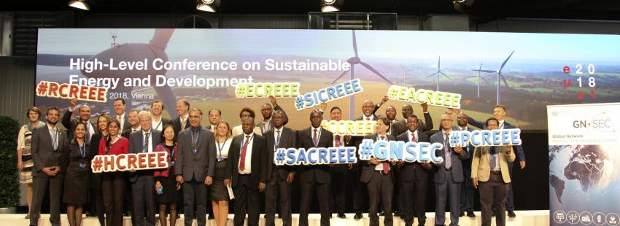
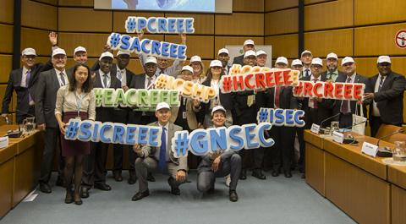
Two GN-SEC meetings/Conferences in 2018

Slide 21

Welcome to the GN-SEC makerspace!
Where the day has more than 24 hours!
Mr. Martin Lugmayr,
Climate Policy and Partnerships Division
UNIDO
GN-SEC Contact:
info@gn-sec.net
www.gn-sec.net

