Slide 1
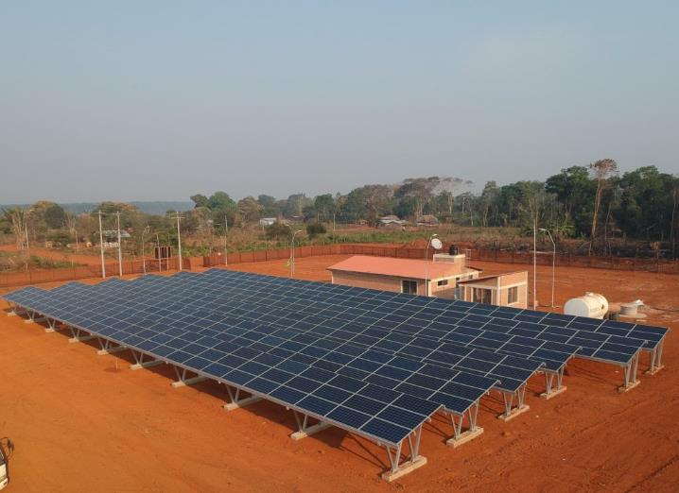
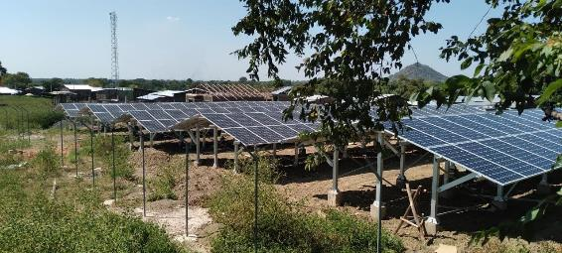
2.1 Regulation of Minigrids
MG in Bolivia by TTA
Unlocking MG for sustainable development
Suva, Fiji
June 26th-30th, 2023
MG in Ethiopia by TTA
Roger SALLENT Regional Team Leader for Asia – Pacific Trama TecnoAmbiental, S.L.
roger.sallent@tta.com.es

Slide 2
CONTENTS
Session Objectives
Introduction
Policy and Planning
Retail Service Regulation
Technical Standards
Additional Resources

Slide 3
1. Session objectives

Slide 4
SESSION OBJECTIVES
Identify the key components of a typical mini-grid regulation
Understand the important decisions when preparing the regulatory framework and their implications.

Slide 5
2. introduction

Slide 6
INTRODUCTION
Common regulatory barriers to mini-grids:
A lack of rural electrification planning and strategy;
Political and legal uncertainty regarding mini-grid investment decisions;
Unclear or complicated regulatory processes and approvals;
Lack of retail regulations; and
Lack of technical standards.
Mini-grid Regulatory frameworks should address market barriers and help overcoming challenges faced both by developers and final users. They should be a supportive instrument rather than an additional burden.
Notes:
Most mini-grid projects in nascent markets have slim or non-existent profit margins, as projects require significant resources for pre-feasibility relative to potential revenue, driven by the need to engage communities and the remoteness of sites. A supportive policy and regulatory framework that de-risks projects for developers is therefore critical, as nascent markets are particularly sensitive to overly-burdensome regulation. Above all, the goal of a regulatory framework for mini-grids should be to promote good service at the lowest cost-recovery tariffs, while remaining predictable but flexible enough to evolve as the market does.
Power supply in off-grid settings typically results in prices that are not affordable for most customers. Consequently, public funding is required to fill the affordability gap, and this funding comes with conditionality to ensure that the resources are used efficiently and fairly. Generally, the off-grid sector is not very commercially attractive due to the remoteness of customers, limited revenues, low ability to pay, etc. unless there is some form of external subsidy to enable off-grid developers to meet revenue requirements and close the financing gap. As an example, in PNG, despite the fact that current regulation does not forbid private off-grid development, the sector has still yet to emerge. In this context, appropriate regulation should be designed in a way that it does not become an additional burden to developers. Instead, the PNG Off Grid Code should be envisioned as a supportive instrument to facilitate the sector’s development.
To that end, it is important that regulation is designed in a way that addresses market barriers and overcomes challenges faced by operators and end-users. Before preparing the regulations, it is therefore important to assess how the regulations will catalyze the sector’s development and be able to overcome key challenges.
Practical Guide to the Regulatory Treatment of Mini-Grids, National Association of Regulatory Utility Commissioners, 2017.

Slide 7
LEVEL OF REGULATION
Two competing philosophies on mini-grid regulation*:
government regulation should be light-handed, in order to minimize barriers to the sector’s development,
Government regulation should be comprehensive, in order to ensure that mini-grid projects are deployed systematically, are responsive to rural energy needs, protect consumers, and provide electricity service that is in line with the performance and technical standards of the national grid.
(*) Source: Practical Guide to the Regulatory Treatment of Minigrids. USAID. NARUC.

Slide 8
LEVEL OF REGULATION
Table 1. Pros and Cons of light-handed and comprehensive regulatory approaches
Practical Guide to the Regulatory Treatment of Minigrids. USAID. NARUC.
Regulation | Benefits | Drawbacks
Light-handed Regulation | • Minimizes barriers to private sector development of mini-grid solutions. • Reduces regulator’s time and resources dedicated to approving each mini-grid project. | • Projects less standardized. • Regulator has less control over development of the sector. • May result in limited customer protection from issues such as price-gouging or unaffordable electricity rates.
Comprehensive Regulation | • Ensures mini-grid projects are developed and deployed systematically and customers are protected. | • Creates barriers to private sector development and may slow down the deployment of mini-grids. • Requires more regulatory resources to review and approve each project.
Notes:
Neither view is necessarily the correct one. However, two “golden rules” of regulation can be helpful as regulators and policy makers design the regulatory system for mini-grids (Reiche et al., 2006):
Regulation is a means to an end. What matters ultimately is the outcome, not the rules. For emerging economies, the desired outcome is often sustainable, reliable, and affordable electricity access for households and businesses.
The benefits of regulation should exceed the costs. If complying with regulatory requirements leads to excessive costs for mini-grid developers, mini-grid development will not take place, and the country will struggle to meet its electrification goals.
In practice, the choice between light-handed regulation and comprehensive regulation is not always clear; instead, regulators and policy makers must choose a point somewhere between the two. In general, mini-grid regulation should aim to (Tenenbaum et al., 2014):
Minimize the additional workload of regulatory staff.
Minimize the amount of information a regulator requires.
Minimize the number of separate regulatory processes and decisions.
Use standardized documents or similar documents created by other agencies, and make documents available on the internet.
Use applicable rules and decisions made by related government or community bodies, when possible.

Slide 9
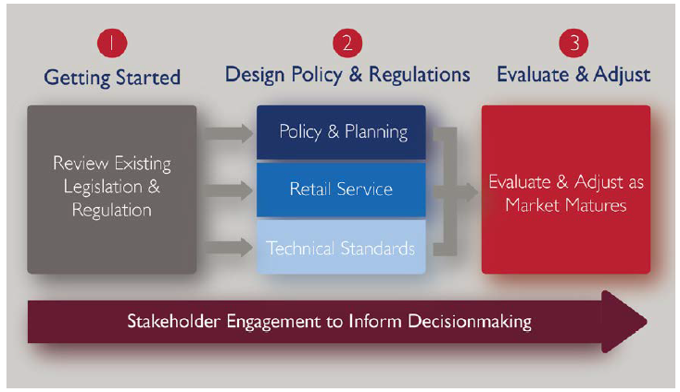
TYPICAL REGULATION COMPONENTS
Figure 1. Process of regulatory definition
Practical Guide to the Regulatory Treatment of Minigrids. USAID. NARUC.

Slide 10
3. Policy and planning

Slide 11
POLICY AND PLANNING. Key regulatory decisions
Table 2. Key regulatory decision in policy and planning
Practical Guide to the Regulatory Treatment of Minigrids. USAID. NARUC.
Key Regulatory Decision | Description
1.1 Approach to Mini-Grid Planning | Decide between a decentralized, centralized, or mixed approach to mini-grid planning.
1.2 Mini-Grid Regulatory Authority | Assign one or more public agencies regulatory authority over mini-grids (Central approach, Regional approach, or Decentralized approach).
1.3 Developing Definitions | Define the term mini-grid in a country’s relevant laws, plans, policies and regulations. Consider holistic definitions
1.4 Developing Classes or Categories of Mini-grids | Develop classes or categories of mini-grid projects based on the capacity and/or other factors such as technology, DC vs. AC mini-grids.
1.5 Ownership Model | Decide which organizations will be legally allowed to own and operate mini-grids.
1.6 Fiscal Support for Mini-Grids | Design fiscal policies to provide grants and subsidies to encourage mini-grid development.
1.7 Approval Process and Procedures | Establish a clear and transparent approval process (for entities both within and outside the electricity sector) for mini-grid projects.

Slide 12
POLICY AND PLANNING. Key regulatory decisions
Table 2 (continuation). Key regulatory decision in policy and planning
Practical Guide to the Regulatory Treatment of Minigrids. USAID. NARUC.
Key Regulatory Decision | Description
1.8 Licensing | Establish a clear and transparent licensing process for mini-grid projects.
1.9 Environmental Regulation | Outline an environmental review process for mini-grid projects.
1.10 Technology Requirements | Decide whether to require or incentivize certain generation technologies for mini-grids.
1.11 Reporting and Filing Requirements | Determine whether to require mini-grid operators to submit regular reports on technical and business operations.
1.12 Ownership Following Connection to the National Grid | Define how mini-grids will be treated in the event of interconnection with the national grid.

Slide 13
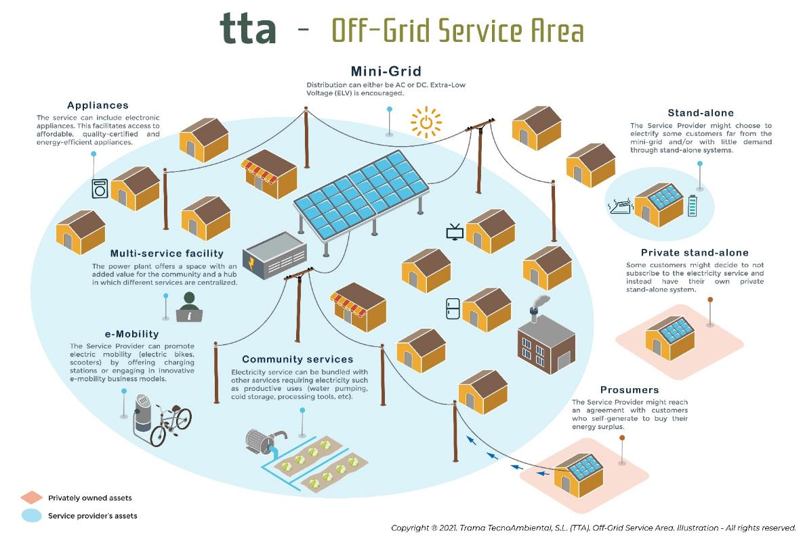
POLICY AND PLANNING. Definitions
RECOMMENDATION:
Promote holistic approaches that can incorporate:
Different electrification approaches:
Mini-grids
Stand-alone systems
Solar kiosks
Different services
Electricity
E-mobility
Productive uses
Water, telephone, etc.
Figure 3. Service-Area as defined in PNG Off-Grid Regulation
Trama TecnoAmbiental (TTA)

Slide 14
POLICY AND PLANNING. Approach to Mini-Grid Planning
Table 2. Key regulatory decision in policy and planning
Trama Tecno-Ambiental (TTA)
Key Regulatory Decision | Description
Top-Down (“Government driven”) | During the initial stages of market development, under a top-down approach, the government identifies sites for mini-grid development and leads procurement of developers for each site; this approach often includes a governmental role in the development and/or ownership of mini-grid assets. This is often a good approach to promote pilot projects and offer learning opportunities and best practices to the market. In these initial stages, pilot projects typically rely on the participation of international firms to bring international best practices.
Bottom-up (“Developer driven”) | In later stages of market development, as local firms and institutions build some capacity, the market can transition to a bottom-up approach, which relies on developers to take the initiative to identify and develop sites. Under this approach, the government still manages the regulatory framework for site development (e.g. by developing eligibility requirements for projects) but usually does not procure developers. A very good example of an ongoing bottom-up program in PNG is the Pawarim Komunti Program from the PNGAus Partnership.

Slide 15
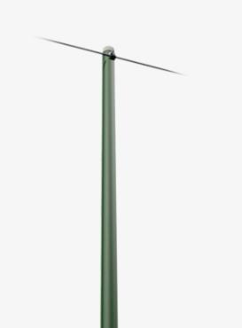
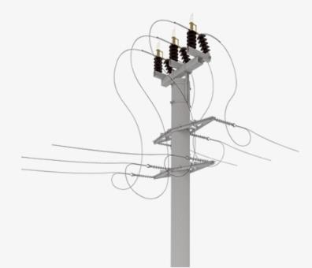
POLICY AND PLANNING. Licensing
Example: Streamlining application procedures in PNG Off-Grid Regulation for Small Power Systems
REGISTRATION:
No approval needed from regulator.
REQUIREMENTS:
Low Voltage. Highest voltage in the Service Area is within the range of Low Voltage (or Extra-Low Voltage)
- AND -
No retail exclusivity. The service provider is not seeking exclusive right to sell Electrification Services.
- AND -
Outside Utility Exclusive zone.
LICENSE:
Approval needed from regulator.
REQUIREMENTS:
High Voltage. Highest voltage in the Service Area is within the range of High Voltage
- OR -
Retail exclusivity. The service provider is seeking exclusive rights to sell Electrification Services.
- OR -
Inside Utility Exclusive zone
15

Slide 16
POLICY AND PLANNING. Social and Environmental Regulation
SOCIAL:
Land rights
Community consultation
Grievance and dispute resolution mechanisms
Gender
Indigenous
…
ENVIRONMENTAL:
Construction waste management
Electronic waste management (PV, Batteries, appliances)
….

Slide 17
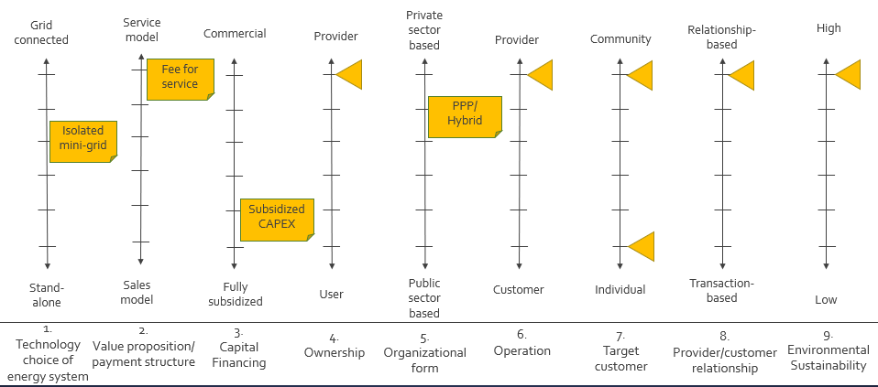
POLICY AND PLANNING. Ownership model
Figrue 2. Key attributes defining the delivery model
Trama TecnoAmbiental (TTA)

Slide 18
4. RETAIL SERVICE REGULATION

Slide 19
RETAIL SERVICE REGULATION. Key regulatory decisions
Table 3. Key regulatory decision in retail service regulation
Practical Guide to the Regulatory Treatment of Minigrids. USAID. NARUC.
Key Regulatory Decision | Description
2.1 Retail Tariff Oversight | Decide whether to regulate retail tariffs and oversee customer retail relationships.
2.2 Retail Tariff Level | Select an approach to retail rate setting and decide whether to place restrictions on retail rate levels for mini-grids.
2.3 Consumer Subsidies | Decide whether to establish subsidies designed to lower mini-grid customers’ cost of connection and/or retail rate.
2.4 Retail Tariff Structure | Decide whether to require a specific retail tariff structure and metering systems for mini-grids.

Slide 20
TARIFF REGULATION. Options
OPTION | DESCRIPTION | EXAMPLES
Willing Buyer-Willing Seller | • Tariff set at a price that the mini grid and the customer agree on • Variants include: i) individually-negotiated agreement; ii) tariff set by mini grid and customer choses to sign up or not; iii) tariff agreed between mini grid and community | • Cambodia (pre 2001) • Uttar Pradesh (mini grids without state subsidies—all as of 2017) • Nigeria (isolated mini grids below 100kW of distributed power) • Tanzania (below 100kW)
Efficient New Entrant Price Cap | • A single benchmark tariff is used for all mini grids • Regulator sets this benchmark tariff at a level estimated to be the cost of service of an efficient new entrant in the market | • Bangladesh (all solar PV-diesel mini grids must charge a tariff capped at BDT 30 (US$0.36) per kWh)
Individualized Cost-Based Tariff Limits | • Regulator sets limits on tariffs for each mini grid individually, based on an estimate of the costrecovery tariff for that mini grid | • Cambodia (as of 2017) • Nigeria (isolated mini grids above 100kW of distributed power) • Kenya (all mini grids as of 2017) • Tanzania (mini grids above 100kW)
Bid Tariffs | Mini grid investor gains the right to serve an area by bidding the lowest tariff in a competitive tender | • Madagascar (as of 2015, 65 mini grids projects bid out) • Uganda (one tender in 2003, and one in 2017 to electrify 25 villages)
Uniform National Tariff | • Mini grid tariff is set at the national main grid tariff | • Cambodia (grid-connected SPDs as of 2017)
Source: World Bank. June, 2019. Mini-grids: regulations, subsidies, and grid integration and exit strategies for low cost and timely access to electricity services

Slide 21
TARIFF REGULATION. Options: Application
OPTION | SUITABLE WHERE? | DISADVANTAGES
Willing Buyer-Willing Seller | Mini grids are unlikely to make supernormal profits if given pricing freedom Policy objective to expand electrification quickly Distribution company provides unreliable supply of electricity Willingness to maximize tariff flexibility and investors’ returns Low administrative capacity | x Could result in monopoly pricing x May be difficult to adjust tariffs over time x Asymmetry between customers and developer x One-sided adhesion contracts difficult politically
Efficient New Entrant Price Cap | Cost of service expected to be uniform across communities Monopolies need to be controlled without the cost and complexity of individualized utility-style control Moderate to high administrative capacity | x Costs will vary between service areas, so a single tariff will not reflect cost everywhere x Monopoly pricing may remain in some areas x Level of tariff may be controversial
Individualized Cost-Based Tariff Limits | Monopolies need to be protected against while allowing reasonable returns Cost of service not expected to be uniform across communities High regulatory capacity | x Setting individual tariffs is labor and time intensive x Creates risk of misuse of regulatory discretion
Bid Tariffs | Centrally coordinated approach to scale up electrification through mini grids Monopolies need to be protected against while allowing reasonable returns Enough mini grid developers to compete for each area High administrative capacity | x Changing the tariff over time cannot be done through bidding x Running a tender can be costly and complex
Uniform National Tariff | Strong political pressure for uniform electricity prices Subsidy provider is creditworthy Expanding electrification quickly is not a priority High administrative and financial capacity that can be sustained over time | x Requires ongoing subsidy x High risk of not attracting investment and not sending efficient price signal x Administratively complex x Driven by political considerations
Source: World Bank. June, 2019. Mini-grids: regulations, subsidies, and grid integration and exit strategies for low cost and timely access to electricity services

Slide 22
5. TECHNICAL STANDARDS

Slide 23
TECHNICAL STANDARDS.
Why do we need Technical Standards?
Without technical standards, decisions are left to mini-grid developers and operators.
Even with good intentions, developers’ and operators’ decisions may lead to electrical safety issues, suboptimal quality of service, technical standards that do not align with national grid-extension goals, or connection and service costs that are prohibitively high for many potential customers.
Laying out transparent regulations on technical standards can improve the quality, consistency, and reliability of mini-grid projects for developers, operators, and customers.

Slide 24
TECHNICAL STANDARDS. Key regulatory decisions
Table 4. Key regulatory decision in technical standards
Practical Guide to the Regulatory Treatment of Minigrids. USAID. NARUC.
Key Regulatory Decision | Description
3.1 Interconnection to the National Grid | Determine whether mini-grids must adhere to technical standards that will ease interconnection to the national grid.
3.2 Technology Standards for Equipment and Functionalities | Determine whether mini-grid equipment will be subject to technology standards.
3.3 Electric Power Quality | Determine whether to require specific grid codes to standardize the technical operation of mini-grids.
3.4 Service Quality: Availability, Capacity, and Reliability | Decide whether to adopt specific criteria or requirements for quality of service.

Slide 25
TECHNICAL STANDARDS. Interconnection to the main grid
Table 4. Interconnection requirement options
Practical Guide to the Regulatory Treatment of Minigrids. USAID. NARUC.
Option | Description | Pros | Cons
1. Do not require mini-grids to be grid-ready. | Regulators may choose not to require mini-grids to meet the national grid technical requirements. | • Significantly lowers the costs for mini-grid developers, particularly in case of smaller systems. • Simplifies the application processes for licenses and concessions. • Provides developers with more system design flexibility and leaves room for innovative solutions. • No need for regulators to dedicate resources to defining procedures, standards, and requirements. | • Can make interconnection more difficult and expensive due to lack of technical regulations. • May result in conflicts between mini-grid developers and the national utility and may complicate or delay the interconnection process—and ultimately impact customers. • Regulators may propose costly and time-consuming interconnection studies in the absence of regulations.

Slide 26
TECHNICAL STANDARDS. Interconnection to the main grid
Table 4. Interconnection requirement options
Practical Guide to the Regulatory Treatment of Minigrids. USAID. NARUC.
Option | Description | Pros | Cons
2. Develop interconnection requirements based on project classes or categories. | Regulators can establish standard technical regulations for mini-grid interconnection depending on project classes, which can include capacity, location, technology or other characteristics, and determine whether mini-grids have to meet the standards from the outset. | • Protects mini-grid developers from having to comply with excessive requirements for very small projects, or for projects that might never be interconnected to the national grid. • More flexible standards can make the regulatory process more accessible and support mini-grid deployment. • A standard process can lead to quicker response times to interconnection requests. • Relieve mini-grid developers of uncertainty when interconnecting, thereby reducing project costs and risks. | • Can result in a more cumbersome and unpredictable regulatory process, requiring regulators to expend significant resources defining different mini-grid types, establishing different standards and levels of implementation, and addressing other aspects of interconnection. • Setting boundaries between one class of mini-grid and another can be challenging.

Slide 27
TECHNICAL STANDARDS. Interconnection to the main grid
Table 4. Interconnection requirement options
Practical Guide to the Regulatory Treatment of Minigrids. USAID. NARUC.
Option | Description | Pros | Cons
3. Require all mini-grid projects to be capable of interconnection to the national grid. | • Mini-grids will be ready for interconnection and will not require upgrades or major investments when the grid arrives. • The quality of the electricity provided can generally be expected to be the same across mini-grids and the main grid. • Simplifies the work of regulators, who can implement the same standards and procedures across all mini-grids. • Knowing the national standards upfront, mini-grid developers will have more clarity on investment returns. • The added cost can be built into retail rates under cost-reflective tariffs (if permitted). | • Requires larger investments from mini-grid developers, who will need to dedicate more resources to equipment, testing, and commissioning. • Higher costs will have an impact on retail tariffs, unless they are reduced through government subsidies. • May impose a barrier for smaller-scale projects. • Regulators may face difficulties in implementing the same standards across the wide spectrum of mini-grid types. • Stringent standards may slow down innovation in the mini-grid sector. | • Make national-grid technical standards available to all mini-grid developers. • Incorporate adherence to national-grid technical standards into the licensing and approvals process. • Establish a streamlined monitoring process for ensuring that mini-grids comply with national-grid standards, including in the testing and commissioning process. • Undertake periodic monitoring to ensure that all mini-grids are operating within the technical parameters of the national grid.

Slide 28
TECHNICAL STANDARDS. Interconnection to main grid: Business options
Table 5. Business option in case of mini-grid interconnection to the main-grid
Tenenbaum, Bernard, Chris Greacen, and Dipti Vaghela. 2018. Mini Grids and the Arrival of the Main Grid: Lessons from Cambodia, Sri Lanka, and Indonesia. Energy Sector Management Assistance Program (ESMAP) Technical Report 013/18. Washington, DC: World Bank.
Business option | Description
Small power producer (SPP) | The mini-grid converts to a main grid–connected Small Power Producer (SPP), becoming another power plant on the grid. The mini-grid operator sells electricity to the grid while utility takes over the distribution to retail customers. Distribution assets can be scrapped, salvaged for use at a new location, or purchased by utility. Generation assets’ ownership is not transferred.
Small power distributor (SPD) | The mini-grid converts to a Small Power Distributor (SPD) that buys its full supply at wholesale from the main grid and sells its purchased electricity to villagers at retail. The local generator is kept for use solely as backup for the local mini-grid when the main grid goes down. Distribution assets’ ownership is not transferred. They are used by SPD to resell electricity purchased at wholesale. Generation assets can be scrapped, relocated, or maintained for use solely as backup for the local mini-grid when the main grid goes down.
SPP + SPD | The mini-grid continues to sell electricity to its retail customers with its own generated electricity, selling the electricity surplus to the main grid. It continues to sell electricity to retail customers, some of which may be purchased from the utility. Distribution and generation assets’ ownership is not transferred.
Side-by-side but not interconnected | The mini-grid continues to serve customers even when the grid arrives, with no electrical interconnection between it and the main grid, even though both operate in the same village. They compete against each other in the same market. Distribution and generation assets’ ownership is not transferred.
Compensation and exit | The mini-grid goes out of business, and the developer receives compensation for assets taken over by the main grid operator. Distribution and generation assets’ ownership is transferred to the main grid operator.
Small power producer (SPP) | The mini-grid converts to a main grid–connected Small Power Producer (SPP), becoming another power plant on the grid. The mini-grid operator sells electricity to the grid while utility takes over the distribution to retail customers. Distribution assets can be scrapped, salvaged for use at a new location, or purchased by utility. Generation assets’ ownership is not transferred.

Slide 29
TECHNICAL STANDARDS. Interconnection Readiness Levels (by TTA)
Index introduced to quantify the need for mini-grids to be grid-ready depending on factors like proximity to the public grid, voltage level and electricity form (AC/DC).
Table 4. Interconnection readiness levels (IRL)
Trama TecnoAmbiental (TTA)
 | IRL0 | IRL1 | IRL2
Conditions | Distance from the Utility grid > 10 km. | Distance from the Utility grid ≤ 10 km. Community is not part of grid extension plan. | Distance from the Utility grid ≤ 10 km. Community is not part of grid extension plan.
Requirements | No interconnection requirements. | Shall comply with interconnection requirements within a specific notice period. | Shall comply with interconnection requirements from the start of the service provision.

Slide 30
TECHNICAL STANDARDS. Service Categorization
There are three main references to categorize the electrification service provision:
IEC TS 62257. Recommendations for small renewable energy and hybrid systems for rural electrification. International Electrotechnical Commission (IEC) Technical Specification (TS).
Multi-Tier Framework: Beyond Connections. Energy Access Redefined. World Bank Energy Sector Management Assistance Program (ESMAP). The so-called Multi-Tier Framework;
Quality Assurance Framework. The National Renewable Energy Laboratory (NREL) and U.S. Department of Energy (DOE) Quality Assurance Framework for Mini-Grids.
Figure 3. Technical Framework for service categorization
Trama TecnoAmbiental (TTA)

Slide 31
TECHNICAL STANDARDS. Service Quality: Capacity
Quantity of energy made available to the user. Combination of total energy available over a period (kWh) and the maximum power that can be used (kW).
IEC | Category I | Category II | Category III | Category IV
 | P ≤ 100 W E ≤ 0,5 kWh | 100 W < P < 500 W E ≤1,5 kWh | 500 W ≤ P < 2 kW E < 4 kWh | 2 kW ≤ P E < n x 10 kWh
 | - Individual services: lighting and audio/video - Collective services: low energy consumption (places of worship, community center, administrative premises, communication systems, etc.) | - Individual services: Same as category 1 + freezer(s) and household appliances - Collective services: health and care center: lighting and freezer(s), etc. | - Individual services: same as category 2 + freezer(s), washing machine, odd jobs, etc. - Collective services: Public Lighting | - Collective services: pumping etc. - Business activities: motors, etc.
MTF | Tier 1 | Tier 2 | Tier 3 | Tier 4 | Tier 5
 | 3 W < P < 50 W 12 Wh ≤ E < 200Wh/d | 50 W ≤ P < 200 W 200Wh/d < E < 1 kWh/d | 200 W ≤ P < 800 W 1 kWh/d < E < 3.4 kWh/d | 800 W ≤ P < 2kW 3.4 kWh/d < E < 8.2 kWh/d | 2 kW ≤ P E ≥ 8.2 kWh/d
 | Task lighting AND Phone charging | General lighting AND Phone Charging AND Television AND Fan (if needed) | Tier 2 AND Any medium-power appliances | Tier 3 AND Any high-power appliances | Tier 2 AND Any very high-power appliances
QAF | Level 1 | Level 2 | Level 3 | Level 4 | Level 5 | Level 6
 | 3 W < P < 50 W 12 Wh ≤ E < 200Wh/d | 50 W ≤ P < 200 W E < 1 kWh/d | 200 W ≤ P < 800 W E < 3.4 kWh/d | 800 W ≤ P < 2kW E < 8.2 kWh/d | 2 kW ≤ P < 5 kW E < 200 kWh/d | P > 5 kW E ≥ 200 kWh/d

Slide 32
TECHNICAL STANDARDS. Service Quality: Availability
Total number of hours when electricity is available each day
IEC | E | D | C | B | A
 | h/day < 4 | 4 ≤ h/day < 8 | 8 ≤ h/day < 16 | 16 ≤ h/day < 24 | = 24 h/day
MTF | Tier 1 | Tier 2 | Tier 3 | Tier 4 | Tier 5
 | 4 ≤ h/day < 8 h/evening* > 1h | 4 ≤ h/day < 8 h/evening* > 2h | 8 ≤ h/day < 16 h/evening* ≥ 3h | 16 ≤ h/day < 23 h/evening* ≥ 4h | 23 ≤ h/day < 24 h/evening* ≥ 4h
 | (*) Evening Availability considers daily hours of service between 7pm-7am
QAF | Level 1 | Level 2 | Level 3
 | No guarantee of availability | Variable certainty: x hours a day with y certainty | Full certainty: planned continual availability

Slide 33
TECHNICAL STANDARDS. Service Quality: Reliability
Frequency and length of unpredictable outages
IEC | 3 | 2 | 1
 | ≥ 95 %/year | ≥ 98 %/year | ≥ 99 %/year
MTF | Tier 1 | Tier 2 | Tier 3 | Tier 4 | Tier 5
 | - | - | - | Max 14 disruptions/week | Max 3 disruptions per week of total duration <2h
QAF | Base Level of Service | Standard Level of Service | High Level of Service
 | - Unplanned-SAIFI: <52/year - Unplanned-SAIDI: <876h (90% reliability) - Planned-SAIFI: No requirement but should be defined. - Planned-SAIDI: No requirement but should be defined. | - Unplanned-SAIFI: <12/year - Unplanned-SAIDI: <438h (95% reliability) - Planned-SAIFI: No requirement but should be defined. - Planned-SAIDI: No requirement but should be defined. | - Unplanned-SAIFI: <2/year - Unplanned-SAIDI: <1.5h (99.99% reliability) - Planned-SAIFI: <2/year - Planned-SAIDI: <30 min (100% reliability)

Slide 34
TECHNICAL STANDARDS. Service Quality: Power Quality
Compatibility of the power voltage, frequency, and waveform with electrical loads, generation sources, and distribution networks.
Quality requirements are set to protect the customer’s appliances.
If appliances are included as part of the service, the Service Provider could be lifted from meeting the PQ requirements and take on the risk of equipment damage.
IEC | 3 | 2 | 1
 | |±ΔU| ≤ 20 % UN |± Δf| ≤ 3 Hz THD ≤ 10 % | |±ΔU| ≤ 15 % UN |± Δf| ≤ 2 Hz THD ≤ 5 % | |±ΔU| ≤ 10 % UN |± Δf| ≤ 1 Hz THD ≤ 3 %
MTF | Tier 1 | Tier 2 | Tier 3 | Tier 4 | Tier 5
 | - | - | - | Voltage problems do not affect the use of desired appliances | Voltage problems do not affect the use of desired appliances

Slide 35
TECHNICAL STANDARDS. Service Quality: Power Quality (2)
QAF | Base Level of Service | Standard Level of Service | High Level of Service
 | AC Power Quality: - Voltage imbalance: <10% - Transients: No protection - Short voltage-duration variations: <5/day - Long voltage-duration variations: <10/day - Frequency variations: 48 Hz < f <52 Hz DC Power Quality - Resistive voltage drop: <10% - Percent ripple: 50% pk-pk - DC ripple & switching noise: Unfiltered - Transients: No protection - Faults allowed per day: <5/day | AC Power Quality: - Voltage imbalance: <5% - Transients: Surge protection - Short voltage-duration variations: <1/day - Long voltage-duration variations: <5/day - Frequency variations: 49 Hz < f < 51 Hz DC Power Quality - Resistive voltage drop: <5% - Percent ripple: 20% pk-pk - DC ripple & switching noise: Transient noise minimized - Transients: Surge protection - Faults allowed per day: <2/day | AC Power Quality: - Voltage imbalance: <2% - Transients: Surge protection - Short voltage-duration variations: <1/week - Long voltage-duration variations: <1/day - Frequency variations: 49.5 Hz < f < 50.5 Hz DC Power Quality - Resistive voltage drop: <2% - Percent ripple: 10% pk-pk - DC ripple & switching noise: Ripple noise also minimized - Transients: Surge protection - Faults allowed per day: <1/day

Slide 36
6. ADDITIONAL RESOURCES

Slide 37
ADDITIONAL RESOURCES
USAID. NARUC. Practical Guide to the Regulatory Treatment of Minigrids.
Tenenbaum et al. 2014. From the Bottom Up. Chapter 3: The Regulation of Small Power Producers and Mini-grids: An Overview. https://openknowledge.worldbank.org/bitstream/handle/10986/16571/9781464800931.pdf?sequence=1&isAllowed=y
EUEI PDF. 2014. Mini-grid Policy Toolkit.

Slide 38
Vinaka!
Roger SALLENT
Regional Team Leader for Asia – Pacific Trama TecnoAmbiental roger.sallent@tta.com.es

