Slide 1
Solar Technology and Application Resource Centres (STAR-C) Validation Workshop
Renewable Energy Resilience in the Pacific Islands
Baseline assessment findings
Francis Sakato
Consultant and Regional Expert

Slide 2
Objectives of the assessment
Evaluate existing Solar QI framework
  Assess current systems in SPC regions using international benchmarks to identify strengths and weaknesses.
Examine regulations, standards, and capacities
  Review regulatory landscapes, standards adherence, and institutional capacities at national, regional, and continental levels in Africa.
Assess compliance with IEC/ISO standards
  Identify gaps in alignment with international standards and suggest necessary adjustments.
Recommendations for solar QI framework
  Proposes strategies to improve quality assurance based on global best practices.
Establish contacts and highlight key players
  Build a stakeholder network, ensuring 40% women and 30% youth participation, including regulatory bodies, training institutes, and industry leaders.

Slide 3
Methodology

Slide 4
Methodology
1. Desk research | Existing International and regional QI frameworks for solar PV Existing standards for solar PV products and services
2. Stakeholder mapping | Identify and map of key stakeholders in the solar QI process at national, regional, and global levels Design interview guides for stakeholder consultations
3. Data collection | Engage stakeholders through interviews Collect data on existing local and regional solar QI frameworks, compliance with international standards, and stakeholder perspectives.
4. Gap analysis and conformity check | Identify discrepancies between existing practices and international standards. Conduct a conformity check of local practices and frameworks against international requirements
5. Recommendation Formulation | Design recommendations for the design of an effective solar QI framework. Consider best practices from international frameworks and methodologies. Integrate insights from stakeholder engagements and gap analysis.

Slide 5
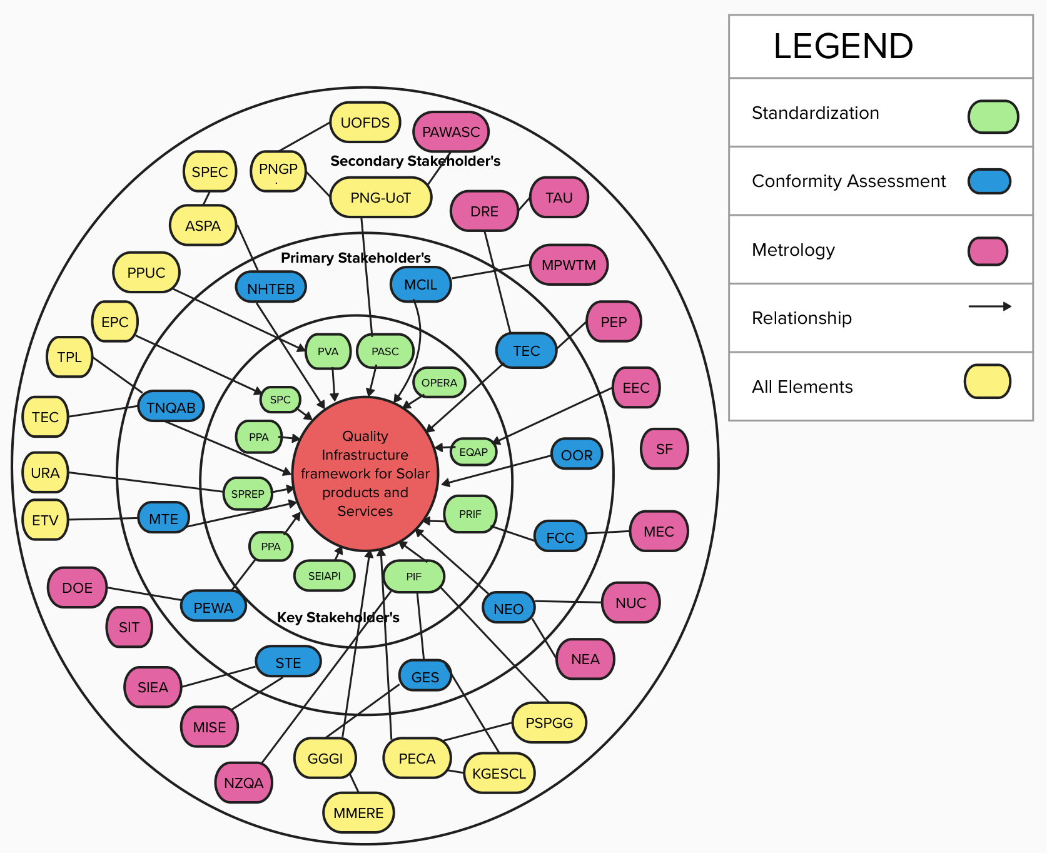
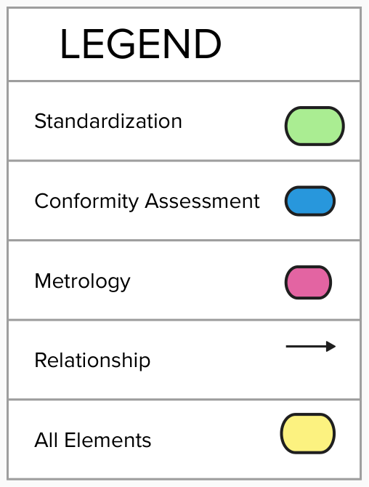
Methodology
Stakeholder mapping
  The SPC consists of various partner states and territories, reflecting a wide range of stakeholders, including
              Governmental entities
              Regulatory authorities
              Private sector entities
              Civil society organisations.
              A total of 54 stakeholders were identified, 11 key stakeholders participated
  Gender, digitalization and climate change adaptation
              SPC revives the Pacific Energy and Gender Network with PEGSAP 2020–2030, promoting women's role in clean energy.
              UN Women & UNDP train Kadavu women as solar engineers through the Rural Women Light Up the Pacific Programme.

Slide 6
List of Stakeholders Interviewed
Methodology
# | Stakeholder | Date of Interview
1 | Pacific Regional Infrastructure Facility (PRIF) | 20th December 2023
2 | Pacific Regional Environmental Program (SPREP) and the Samoan Ministry of Natural Resources and Environment | 20th December 2023
3 | Sustainable Energy Industry Association of the Pacific Islands (SEIAPI) | 8th January 2024
4 | Energy Efficiency and Conservation Authority | 16th January 2024
5 | Individual Consultant (Freelance) | 17th January 2024
6 | The Pacific Community (SPC) – Regional | 18th January 2024
7 | Pacific Power Association (PPA) | 19th January 2024
8 | Pacific Energy Regulators Alliance (OPERA) | 22nd January 2024
9 | PV Lab Australia | 5th February 2024
10 | The Pacific Island Forum (PIF) | 8th February 2024

Slide 7
Assessment Results

Slide 8
Regulations & Standards for Solar PV in PICs
Assessment results
Regulatory Oversight
  Solar PV regulations vary across Pacific Island Countries (PIC), governed by national regulatory authorities.
  Most PICs have a state-owned entity (SOE) under a vertically integrated system.
  Regulatory bodies (e.g., NEA in PNG) enforce compliance, develop policies, and oversee grid-connected solar PV integration.
  Consideration of Feed-in-Tariff (FiT) policies for solar PV in certain jurisdictions.
Grid Codes & Integration
  Grid codes define technical rules for integrating solar PV into national electricity grids.
  Countries with grid codes (e.g., PNG) require solar PV systems to follow specified technical guidelines.

Slide 9
Regulations & Standards for Solar PV in PICs
Assessment results
Standards Compliance (IEC/ISO)
  Certain PICs follow international and regional standards for solar PV:
      IEC 61215 – PV module design qualification & type approval.
      IEC 61730 – PV module safety qualification.
      UL 1703 – Flat Plate PV modules & Panels
      AS/NZS 4509 – Stand-alone power systems
      AS/NZS 5033 – PV installation & safety requirements.
      UL (IEC) 61646 – Thin-film PV module qualification.

Slide 10
Assessment Results
Status Quo
Category | Findings
Standards / Technical Regulation | Existing frameworks are based on a regional standard developed by SEIAPI. Solar panels must adhere to AS/NZS 5033 standard. Inverters must meet AS 4777.1 standards. Certificate of Compliance (CoC) are issued for completed solar power. Different components of QI have been covered in all the 18 States of the Pacific Region. Work has been done on Standards, metrology, and conformity assessment. There is a relevance of IEC 61215 for design qualification and type approval. ISO 2859 is used for sampling purposes. It is based on the acceptance quality limit (AQL), which is the maximum percentage of defective items that can be considered acceptable. There is a potential to adopt a revised AS/NZS 5033:2021 by New Zealand in the future). There is variation in standards application across region, with some countries adopting US-based standards. There is lack of awareness regarding specific solar PV standards development in the region. There is ongoing development of solar PV standards within individual Pacific communities. The standards for solar controllers are perceived as complex.

Slide 11
Assessment Results
Status Quo
Category | Findings
Testing Procedures / Facilities | There is scarcity of testing for solar PV system components in the region. The only General Society of Surveillance (SGS) in Auckland is NATA accredited for testing. Testing procedures and facilities for PV products are lacking in the region. Inspections are using AS/NZS 3000 from the AC side of the solar system. Lack of local testing for parts or components of solar PV systems. Lack of awareness regarding testing procedures and facilities for PV products in the Pacific region.
Regional Conformity Assessment Bodies and PV Certification | Absence of regional conformity assessment bodies for solar PV products. Certification processes typically handled through the CoC process. IEC 61730 certification is required for solar panels in the region. Accreditation process for conformity assessment still in the developmental phase. Existing certifications for PV products based on internationally recognized frameworks.
Accreditation Process for Conformity Assessment Bodies | Accreditation process for conformity assessment bodies align with IEC 61730 and is still in the developmental phase. Regional specialization in solar PV accreditation is lacking. There is compliance with AS/NZS 3000 for consistency in system designs).

Slide 12
Assessment Results
Challenges in the implementation of Technical Regulations
Area | Findings
Human Capacities | Smaller markets (e.g., NZ) highlight need to build demand and capacities. Lack of training for competent operation/maintenance. Limited capacity in the government. & the private sector leads to substandard products entering the market. Standards development needs technical expertise.
Metrology & Testing | Reliance on manufacturers’ standards, lack of resources for independent testing. No local facilities (e.g., Fiji, most PICs), dependence on external certificates. PV Lab Australia is the only lab in the Pacific.
Accreditation & Conformity Assessment | Absence of accreditation, conformity assessments, and standards affects safety and quality.
Market Surveillance | Capacity/resource constraints hinder monitoring. Communication gaps, lack of standards, and weak capacity undermine surveillance.
Critical Challenges | Human capacity gaps, small market issues, lack of testing facilities, weak enforcement, poor awareness, inadequate regulation, and missing accreditation/conformity assessment.

Slide 13
Interventions required for the promotion of QI
Assessment results
Interventions | Details
Strategic Resource Allocation | Conduct due diligence to prevent duplication of programs and ensure efficient us of regional resources.
Strengthening Certification & Compliance | Prioritize certification of products, services, and designs, ensuring approvals from regulatory bodies such as the Energy Commission.
Regulatory Enforcement & Market Surveillance | Implement stricter regulations for product imports and sales, supported by accreditation and conformity assessment authorities.
Capacity Building & Infrastructure Development | Train and certify regulators, develop testing facilities, and enhance human and technical capabilities.
Collaboration & International Partnerships | Establish QI networks, conduct regional workshops, and foster cooperation for advancing renewable energy technologies.

Slide 14
Assessment Results
Limitations of assessment
Limitation | Findings
Limited availability of solar QI documents | Scarcity and difficulty in accessing documents hindered comprehensive desk research and full understanding of existing frameworks
Data availability and Quality | Incomplete or outdated data reduced accuracy
Biases in stakeholder responses | Interviews were susceptible to personal perspectives or organisational interests, affecting objectivity
Limited representation in stakeholder engagement | Shortlisting stakeholders risked leaving some sector perspectives underrepresented
Resources and time constraints | The assessment's thoroughness and depth were constrained by limitations in resources and time

Slide 15
Findings from Stakeholder Interviews
Assessment results
Category | Findings
Standards/Technical Regulations Implemented | Certificate of Compliance (CoC) issued for completed solar power installations. Variation in standards application across the region, with some countries adopting US-based standards. Regulatory measures in Samoa include Energy Efficiency (EE) Acts and Building Code for solar PV installations. Lack of awareness regarding specific solar PV standards development in the region. - Ongoing development of solar PV standards within individual Pacific communities. Perceived complexity of standards for solar controllers.
Testing Procedures and Facilities for PV Products | Scarcity of testing for solar PV system components in the region. Lack of local testing for parts or components of solar PV systems. Lack of awareness regarding testing procedures and facilities for PV products in the Pacific region.

Slide 16
Assessment results
Findings from Stakeholder Interviews
Category | Findings
Accreditation Process for Conformity Assessment Bodies and PV Certification | Absence of regional conformity assessment bodies for solar PV products. Certification processes typically handled through the CoC process. Accreditation process for conformity assessment still in the developmental phase. Existing certifications for PV products based on internationally recognized frameworks. Regional specialization in solar PV accreditation is lacking
Challenges and Necessary Interventions | Limitations in human capacities, small market challenges, absence of test facilities, weak enforcement and monitoring, lack of awareness, inadequate regulation, lack of accreditation and conformity assessments are critical challenges in regional implementation of QI framework.

Slide 17
Main Findings & Recommendations
Assessment results
Aspect | Findings | Recommendations
Institutional framework | There is a lack of a common regional framework for QI. Many countries cannot still enforce the regional framework for QI. | For the long-term implementation of QI, the establishment of a regional QI organisation for the Pacific Region (QIPR) is recommended. The first step in QIPR is to establish – the Regional Technical Committee (RTC) for QI.
Certification and Conformity Assessments | Certification processes are typically handled through the Certificate of Compliance (CoC) process. Regional specialisation in solar PV accreditation is lacking. | Integrate conformity assessment bodies to the RTC and the QIPR. Develop regional guidelines for the certification of PV products and services. These guidelines can be the existing CoC framework.

Slide 18
Main Findings & Recommendations
Assessment results
Aspect | Findings | Recommendations
Technical Regulation and Standardisation | A significant deficiency in established technical regulations. The existence of regional guidelines for standardization but not implemented | Establish regional standardization organisations and provide a clear action plan for standard implementation. Develop new regional guidelines for standardization.
Testing Facilities | Limited capacity and availability of testing infrastructures Lack of facilities for testing crucial components like inverters and batteries. Absence of privately run laboratory for solar products. | Establish new testing laboratories and foster partnerships with the private sector and academic institutions. Invest in local and regional testing infrastructure Encourage privately-run labs to complement the efforts of government agencies

Slide 19
Main Findings & Recommendations
Assessment results
Aspect | Findings | Recommendations
Accreditation Processes | Key bodies such as national standards and conformity assessment bodies are absent. | Establish national standards organisations and a harmonised accreditation procedure framework that is consistent with international standards and promotes mutual certification recognition among region countries.
Human Resources and Certification Clarity. | Lack of human resources dedicated to regional standardizations Lack of clarity in certification processes for professionals | Invest in specialised training programs and infrastructure. Simplify certification processes for professionals.

Slide 20
Critical Stakeholders for QI Implementation
Assessment results
Stakeholder | Roles | Involvement
National Government Agencies and Ministries e.g. Ministry of Transport and Energy – Tokelau | Oversee and regulate the solar energy sector at the national level, ensuring compliance with standards | Collaboration with government agencies for the establishment of national standards bodies for roadmap implementation
NGOs and Donor Organizations e.g. ISA, UNIDO, IRENA, World Bank | Provide support, funding, and expertise for capacity-building programs and infrastructure development | Collaboration with NGOs and donor organizations for financial and technical support in implementing the roadmap
Trade associations and alliances e.g. SEIAPI, PPA, PECA, OPERA, PASC. | Facilitate collaboration and information exchange among Pacific Island Countries (PICs) through networks and alliances. | Active participation in the establishment of networks, trade associations, and alliances to develop and harmonize regional QI framework.

Slide 21
Assessment results
Critical Stakeholders for QI Implementation
Stakeholder | Roles | Involvement
Private sector and consumer advocacy groups e.g. Kiribati Green Energy Solution Company Limited- Kiribati | Represent the interests of consumers in ensuring the quality and safety of solar products | Collaboration with consumer advocacy groups to advocate for and enforce adherence to international standards
Regional government bodies e.g. PRIF, PIF, SPC and, PCREEE | Work together with national governments to facilitate a coordinated regional initiative, encouraging and backing private sector investments in renewable energy (RE) and energy efficiency across the SPC region. | Active participation in regional collaborations and initiatives to align QI framework across the region
National standards bodies e.g. Standards New Zealand | Responsible for overseeing and developing standards for solar products at the national level | Collaboration with national standards bodies to align regional standards with global best practices.

Slide 22
Assessment results
Critical Stakeholders for QI Implementation
Stakeholder | Roles | Involvement
International Standards Organizations e.g. IEC, ISO | Guide on global best practices and standards for the solar energy sector. | Collaboration with international standards organizations to align regional standards and ensure compliance with global benchmarks.
Metrological Centers e.g. PV lab Australia. | Essential for ensuring accurate measurements and adherence to standards in the solar energy sector. | Collaboration with metrological centers for the accreditation of testing facilities and enhancement of scientific and industrial metrology.
Universities and Educational Institutions e.g. National Higher and Technical Education Boards, EQAP. | Responsible for the development and implementation of capacity-building programs for individuals in the solar energy sector. | Collaboration with universities to design and deliver certification opportunities and training sessions.

Slide 23
Assessment results
Critical Stakeholders for QI Implementation
Stakeholder | Roles | Involvement
Conformity assessment bodies e.g. Tonga National Qualifications and Accreditation Board | Responsible for systematically evaluating and certifying solar products against established standards | Active participation in the formation of a conformity assessment body and adherence to international accreditation standards
Certified Testing Laboratories e.g. PV lab Australia | Conduct testing for solar PV system components to ensure compliance with standards | Collaboration with certified testing laboratories for accreditation and adherence to international testing standards

Slide 24
Questions and Comments

Slide 25
THANK YOU
Contact:
Regional expert: Francis Sakato francis.sakato@gmail.com
Consultant: Diego Garcia diego.garcia@microenergy-international.com
Implementing partner: MicroEnergy International
http://www.microenergy-consult.com/

