Slide 1


6th Pacific Regional Energy & Transport Ministers Meeting (PRETMM6)
“Scaling Connectivity for a Prosperous Blue Pacific”
Senior Energy Officials Meeting (SEOM)
4th – 5th May 2026
Port Moresby, Papua New Guinea
Global Programme on Climate Resilient Renewable Energy Systems for SIDS – Launch of the Pacific Component (Paper UNIDO/PCREEE)
Session 5 : Priority Area B: Energy Sector Finance and Cooperation
Presenter Name: Martin Lugmayr
Designation: Industrial Development Expert, UNIDO

Slide 2
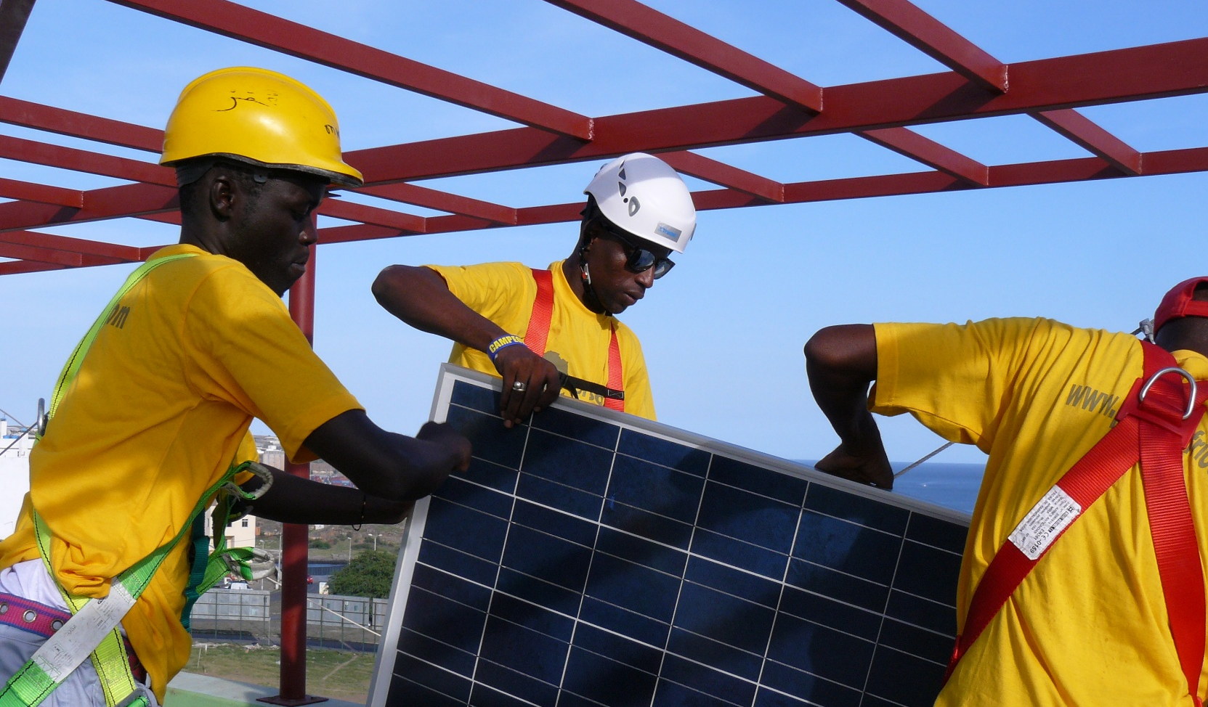

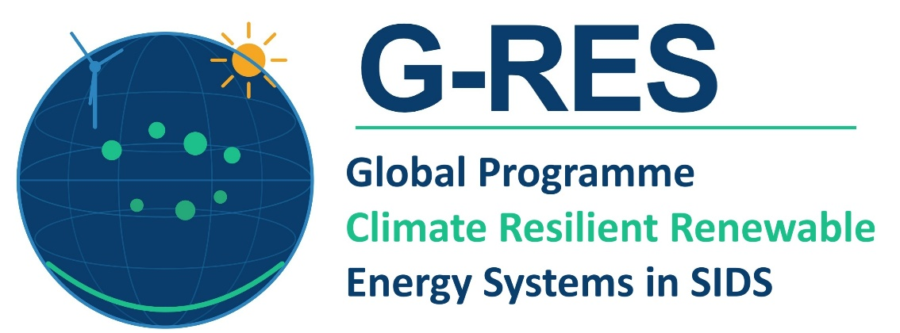
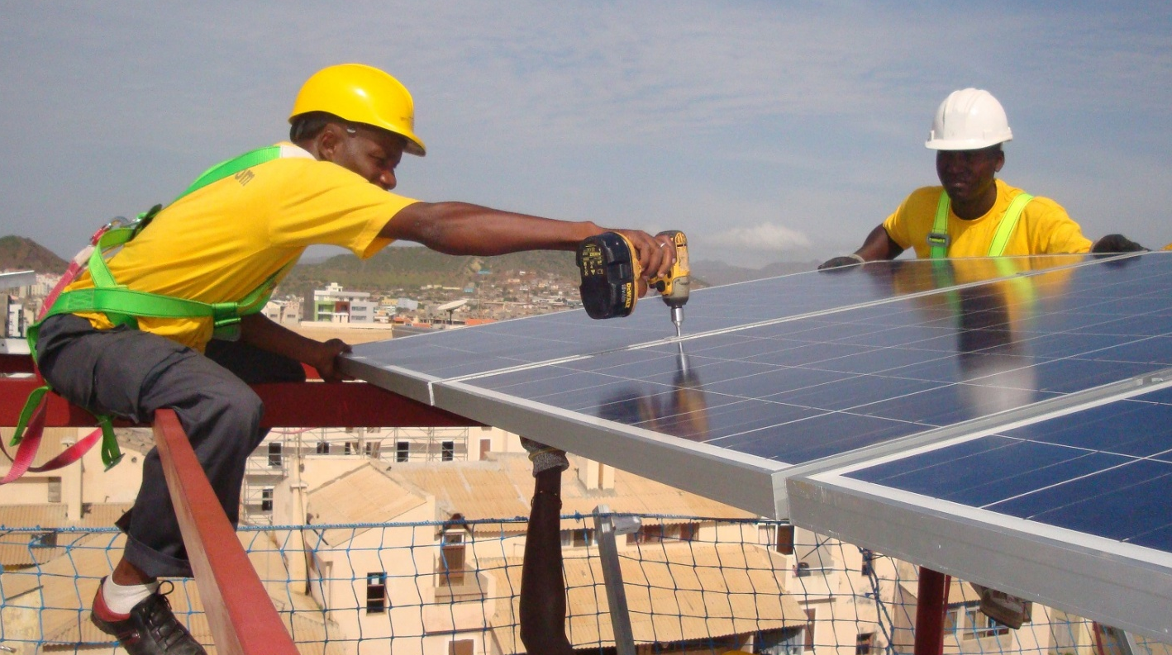

Global Programme on Climate Resilient Renewable Energy Systems in SIDS (G-RES) – Launch of the Pacific Component
With funding from:

Slide 3
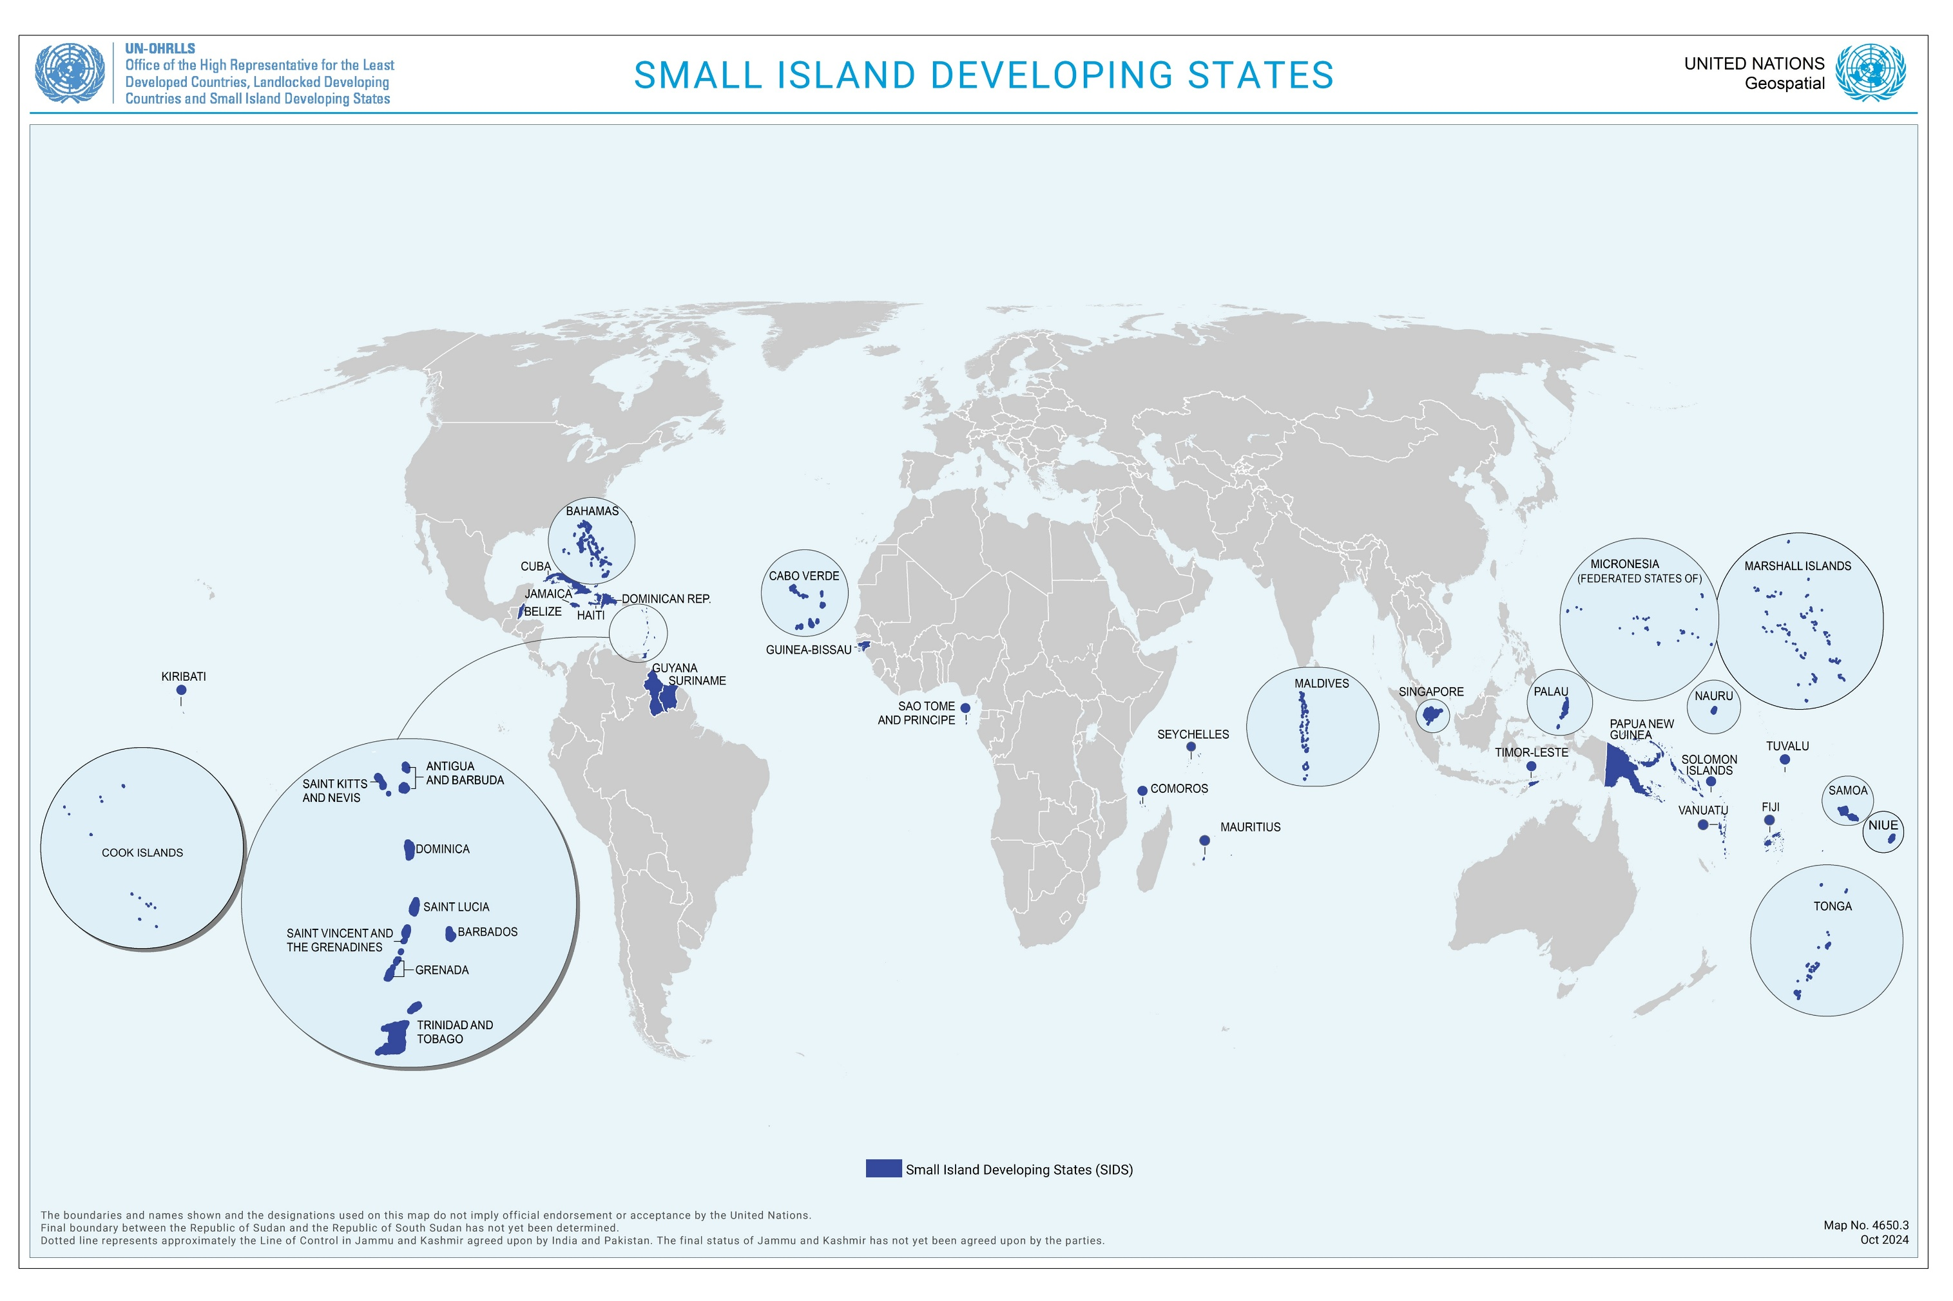
G-RES supports just transitions to climate-resilient renewable energy systems in SIDS across
the Caribbean, Pacific and the Atlantic, Indian Ocean and South China Sea (AIS)
(with a particular focus on ODA eligible SIDS)

Slide 4
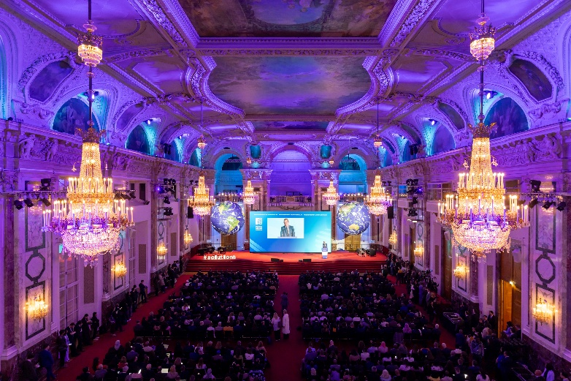
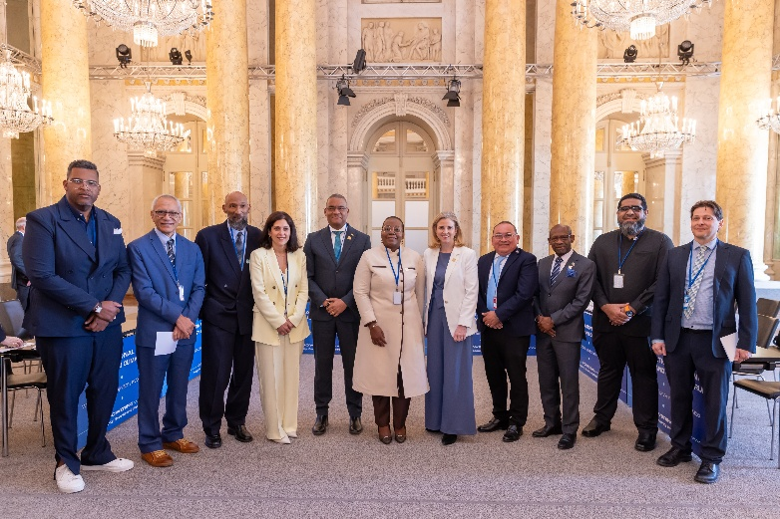
Brazil Hubs Flagship Deliverables​
Contribution of the Pacific G-RES to national regional and international policies
Pacific policies
2050 Strategy for the Blue Pacific Continent
Port Vila Call for a Just Transition to a Fossil Fuel Free Pacific” adopted in May 2023 in Vanuatu
Framework for Energy Security and Resilience in the Pacific (FESRIP) 2021-2030 - Priorities B, C, D, E
Framework for Resilient Development in the Pacific: An Integrated Approach to Address Climate Change and Disaster Risk Management (FRDP) 2017 – 2030
National energy policies, NDCs and NAPs
International policies
Antigua and Barbuda Agenda for SIDS (ABAS)
Agenda 2030 - SDG 7, 9, 13
Paris Climate Agreement
Part of the Call to Action of the International Vienna Energy and Climate Forum (IVECF), held from 9 to 10 April 2026

Slide 5
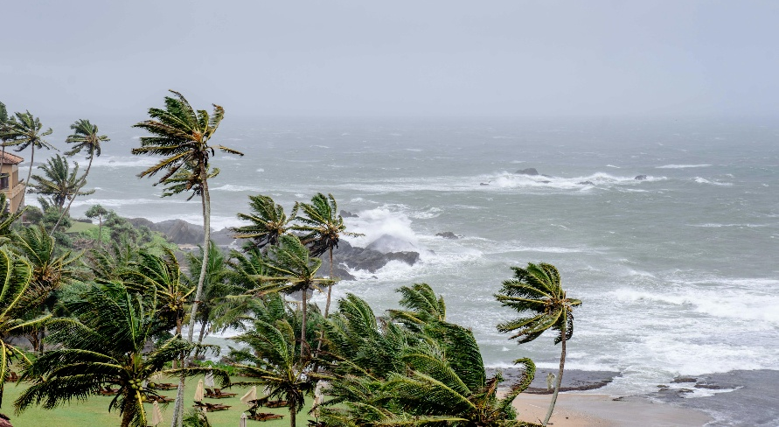
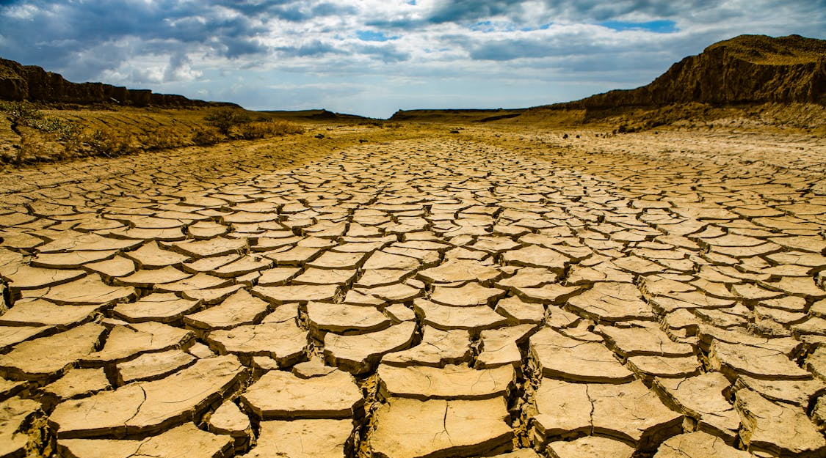
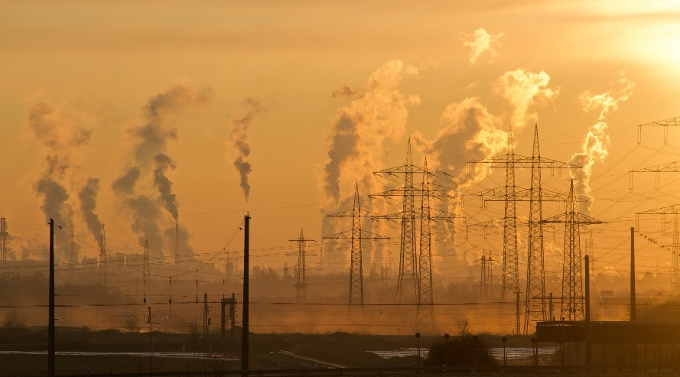
Integrated approach to address climate change mitigation, adaptation and fossil fuel dependence
SIDS bear the incremental upfront costs of the dual transition to renewables and climate‑resilient infrastructure
Address immediate climate impacts that threaten energy security and the transition
Tropical cyclones, storm surges, wildfires, heatwaves and flooding directly impact fuel supply chains, power generation, transmission and storage infrastructure. Coastal diesel generators with water-based cooling systems are particularly vulnerable. Coastal assets valued at up to 25% of GDP are at risk and recovery costs from cyclones have exceeded 200% of annual GDP in SIDS. Renewable assets are in danger to become stranded assets.
Address long-term climate impacts on aging energy infrastructure
Gradual climate shifts, such as temperature rise, saltwater intrusion and water scarcity exacerbate existing challenges of aging energy infrastructure — increasing cooling demand, creating longer peak load periods, placing additional stress on fragile grids and forcing utilities to invest heavily in peak generation capacity.
Decouple key value chains from fossil fuel imports and decarbonization
SIDS need to transition to renewables, energy and resource-efficiency to enhance the resilience to external supply-chain, market and climate shocks and to increase the productivity and adaptability of MSMEs in key island value chains (e.g. fishery, tourism, agri-food, blue economy). In SIDS, fossil fuel imports consume 8 to 30% of GDP and electricity tariffs range from USD 30 to USD 50 per kwh. Energy sectors account for 40% to 80% of national GHG emissions.

Slide 6
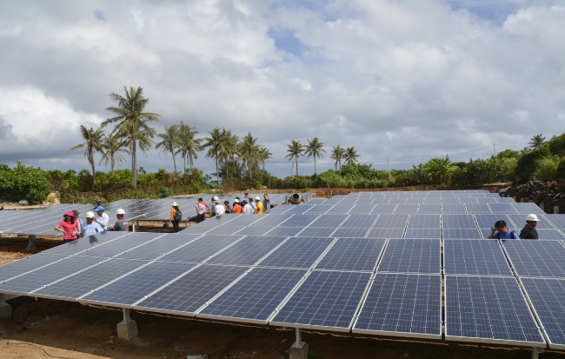
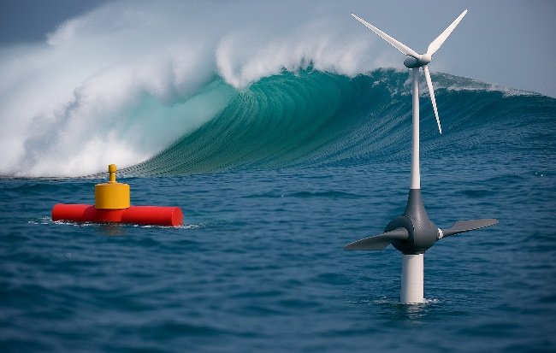
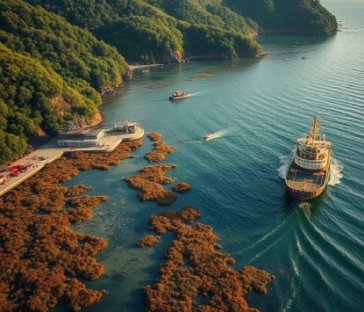
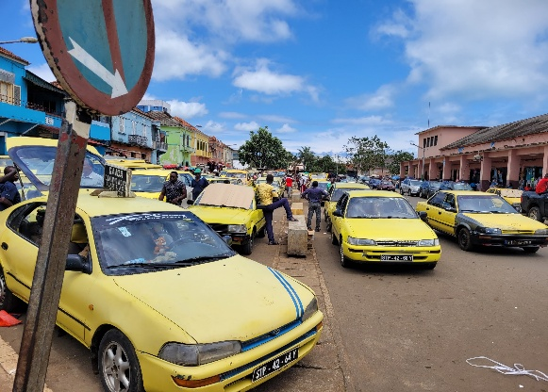
Overall objective and focus
To enhance the adaptive capacity of SIDS energy systems through the adoption of climate-resilient renewable energy solutions, reducing dependence on fossil fuels and GHG emissions while strengthening energy security and generating productivity gains and climate adaptation co-benefits across key value chains (e.g. tourism, agri-food, blue economy)
Climate-proven renewable energy and storage solutions
Renewable energy integration and decentralisation, grid flexibilization and hardening (hurricane-resistant mounting and battery storage, corrosion-resistant materials, grid-forming inverters, heat resistant and water efficient generation and transmission), renewables from climate-resilient productive uses of MSMEs)
Resilient intelligent energy systems
Disaster-proven smart grid, storage and mobility systems, digital energy management systems, AI applications for real-time grid balancing, automated load-shedding, early warning systems that anticipate disasters, renewable output projections
Low-carbon and resilient transportation
Integrated electric mobility and renewable power systems, low-carbon and climate-resilient shipping and ports, green-blue economic corridors, alternative transport technologies and fuels, incl. green hydrogen
Energy efficient and nature-based solutions
Climate-resilient MEPS for appliances and efficient heat-resistant construction methods, productive use equipment agrivoltaics and aquaponics, nature-based heat protection, organic waste to energy (incl. sargassum), renewable ocean energy, restoring mangroves and wetlands for energy infrastructure protection

Slide 7
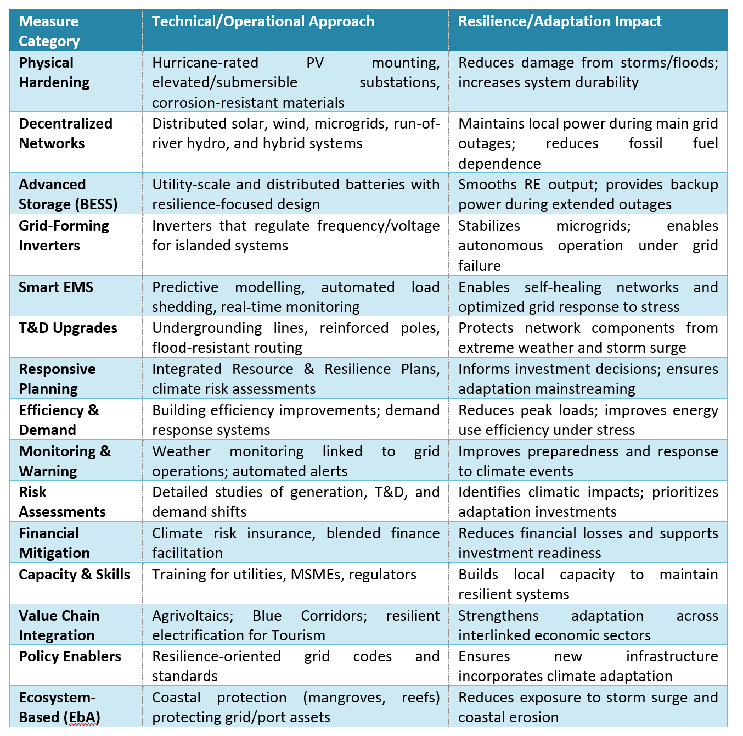
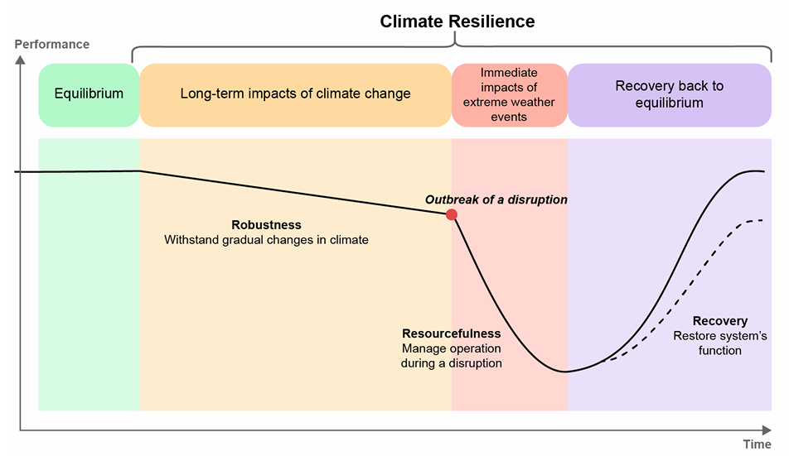
Mainstreaming climate-resilience throughout
the energy system
Direct beneficiaries:
Utilities, regulators, ministries, local authorities, IPPs
MSMEs in key island value chains

Slide 8
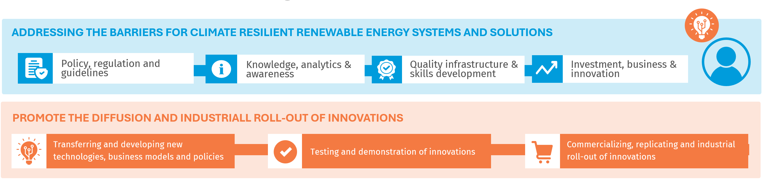
G-RES Objective
Enhance the adaptive capacity of SIDS energy systems through climate-resilient RE systems
G-RES Outcomes
Economic Impact
Environmental
Impact
Social
Impact
CREATE LOCAL DEMAND
Energy consumers
CREATE LOCAL QUALITY SUPPLY
Energy Businesses
Contribute to national policy objectives and priorities
Contribute to global policy objectives and priorities

Slide 9



Integrated global-regional-national implementation approach
Programme comprises a global-regional component and a growing portfolio of national projects to be implemented simultaneously and through a coherent approach
Global-regional component
Provides coherence and knowledge exchange
Promotes coordination among national projects
Accelerates national progress through regional policies, regulations, standards, tools and blended financing
Facilitates SIDS-SIDS and triangular cooperation
National projects
National projects to be funded by GEF STAR, SCCF and other climate funds
So far six countries: Antigua and Barbuda, Barbados, St. Kitts and Nevis, Saint Lucia, Papua New Guinea and Palau
Countries can opt-in anytime
Implemented by
UNIDO in partnership with the Global Network of Regional Sustainable Energy Centres (GN-SEC), including PCREEE, CCREEE, ECREEE, SACREEE and CEREEAC, SIDS DOCK and other regional and global partners
Implemented by
National ministries and entities in partnership with regional (e.g. CCREEE, PCREEE, others) and international partners
Current overall budget:
USD 16 million (to be expanded) from GEF and Austria

Slide 10
Ministerial Decision
Acknowledge the Vienna Call to Action on on green industrialization, sustainable energy, climate and security and its focus on SIDS
Endorse the Global Programe on Climate Resilient Renewable Energy Systems for SIDS (G-RES) and launch the Pacific Component
Recognize the important contribution of GEF and the Austrian Government and encourage other donors and partners to join the programme
Direct UNIDO, PCREEE, SIDS DOCK to expand the program and promote SIDS-SIDS cooperation on climate-resilient renewable energy solutions

Slide 11

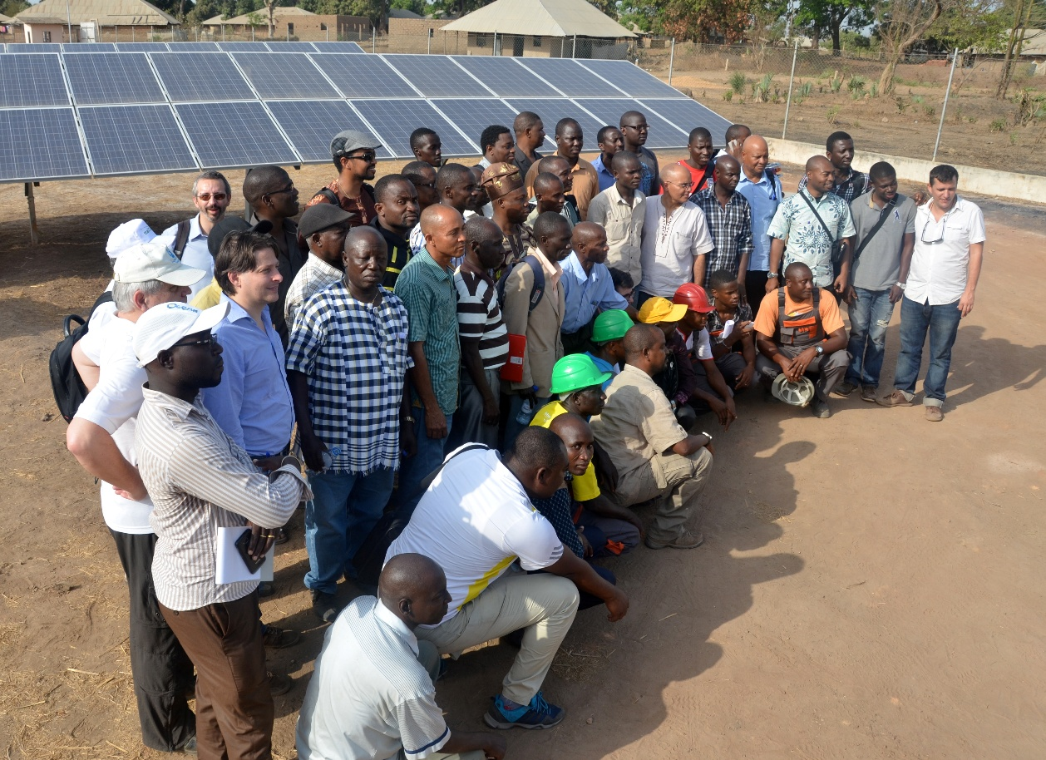
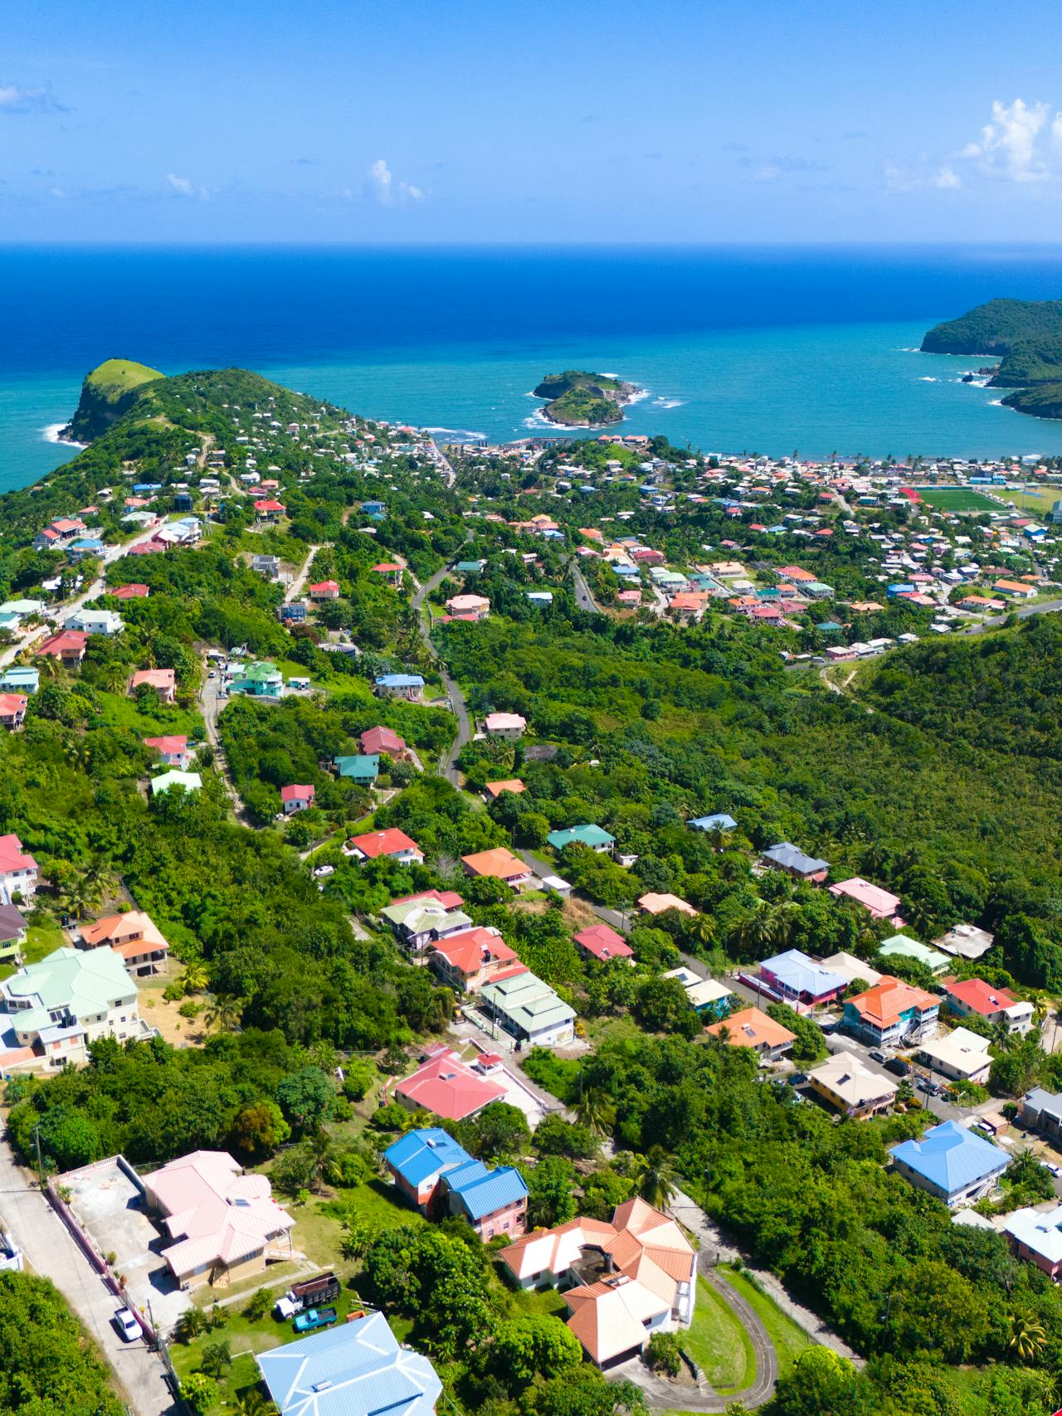

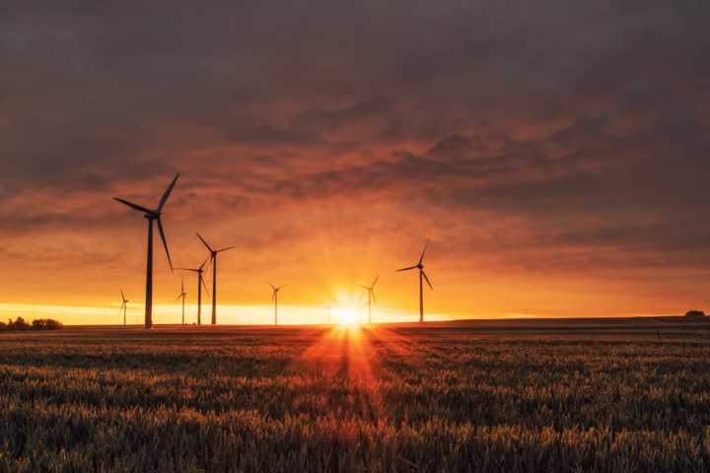
Thank you!
G-RES Contact:
Mr. Martin Lugmayr,
Industrial Development Expert,
Sustainable and Just Energy Transition Unit,
Energy and Climate Action Division, UNIDO
m.lugmayr@unido.org
Website: www.g-res.org

