Slide 1
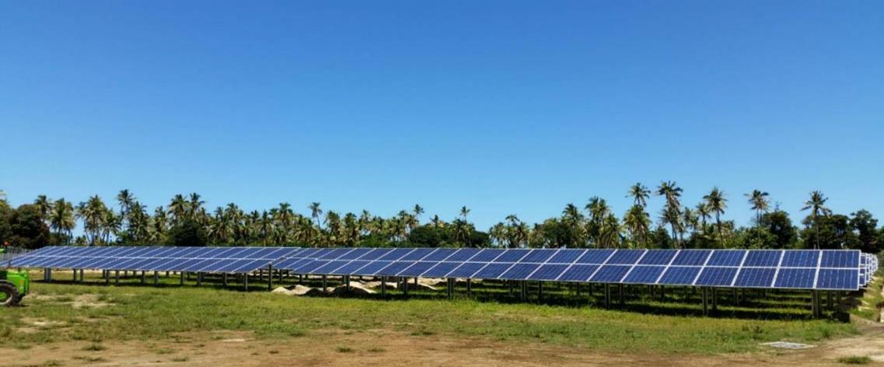
TONGA ENERGY SECTOR STAKEHOLDERS AND JOINT DEVELOPMENT PARTNERS MEETING (Dec 2019).
Outer Island Renewable Energy Project (OIREP).

Slide 2





Project Stakeholders
Ministry of Meteorology, Energy, Information, Disaster Management, Environment, Climate Change and Communications (MEIDECC)
Nuku’alofa, Tonga
Ministry of FINANCE (MOF)
Nuku’alofa, Tonga
Tonga Outer Island Electricity Committees and Communities
Second Danish Cooperation Fund

Slide 3
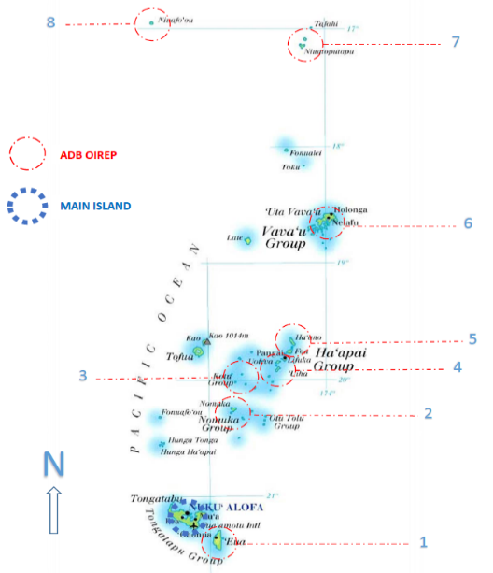
OIREP Islands

Slide 4
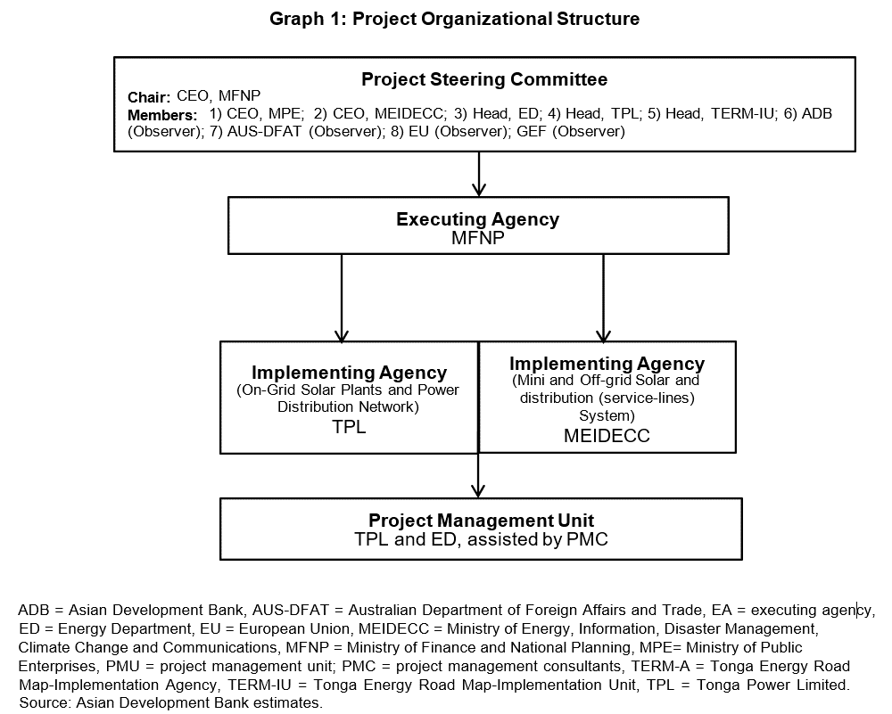

Slide 5
Background of OIREP
Objectives;
  Help meet the GoT target of 50% renewable energy by 2020 (OIREP shall contribute 3.3% due to the relatively small diesel consumption of the outer islands).
  Help meet the GoT target of 100% accessibility to electricity by 2020 (OIREP achieves 100% on each of its 9 islands).
  Help meet the GoT target on improved energy efficiency (line losses) (OIREP reduced line losses from approx. 15% to the 7% target on each of its 9 islands).
  Help meet the GoT target of a cheaper tariff (OIREP shall make the tariff more affordable on each of its 9 islands, but the exact amount depends on the operating regime that the islands uses).
To achieve this, the OIREP Project is split into 4 separate Phases (each with its own outputs explained in following slides);
  Phase 1: Generation (solar and batteries).
  Phase 2: Generation (solar and batteries)
  Phase 3: Distribution (power poles and wires)
  Phase 4: Distribution (power poles and wires)
  Overall cost is approx. ≈US$26M spread over 5 years.
  Estimated spend directly in Tonga is approx. ≈US$4M (TOP$8M).

Slide 6
Phase 1 Scope and Output;
  Scope = 550kWp of solar with 300kWh of energy storage on Lifuka. Output = This has brought the island to 50% RE penetration.
  Scope = 200kWp of solar (no batteries) on ‘Eua. Output = This has brought the island to 20% RE penetration.
  Total Contract Value = US$3M.
  Timeline = Ran from 2016 to 2017.
Phase 2 Scope and Output;
  Scope = Solar, batteries and a back up diesel on 5 outer islands. Output = This shall bring those islands to 50% RE penetration.
  Scope = Solar home systems on Niuafo’ou. Output = This has brought the island to over 50% RE penetration.
  Total Contract Value = US$3.9M.
  Timeline = Due to finish in Q1 2020.

Slide 7
Phase 3 Scope and Output;
  Scope = 100% Distribution network upgrade on ‘Eua. Output = Improved energy efficiency with 100% accessibility to electricity.
  Scope = 75% Distribution network upgrade on Vava’u. Output = Improved energy efficiency with 100% accessibility to electricity.
  Total Contract Value = US$10.4M.
  Timeline = ‘Eua ran from mid-2016 to mid-2017. Vava’u running from mid-2017 to mid 2020.
Phase 4 Scope and Output;
  Scope = 100% rebuild of existing min-grid networks and household wiring on 4 outer islands. Output = Improved energy efficiency with 100% accessibility to electricity.
  Scope = 100% Brand new mini-grid on Niuatoputapu including new house wiring. Output = Improved energy efficiency with 100% accessibility to electricity.
  Total Contract Value = US$6M.
  Timeline = Currently going through the procurement process with the crew on the ground in Q2 2020 for 13 months.

Slide 8
Safeguards
Environmental: all EIA’s and building permits achieved.
Social: Community consultations achieved. No involuntary resettlement.
Gender: achieved between 30% and 50% female workforce and community participation.
Land: all the land was either bought or gifted. All the necessary paperwork, leases and permitry achieved.

Slide 9
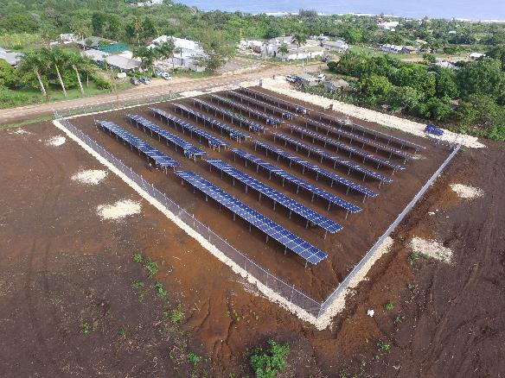
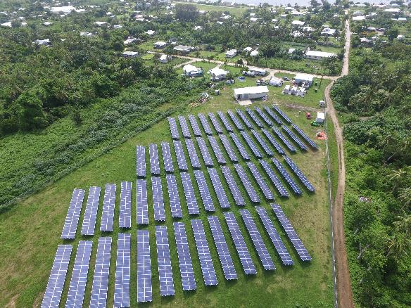
Photos (Phase 1);

Slide 10
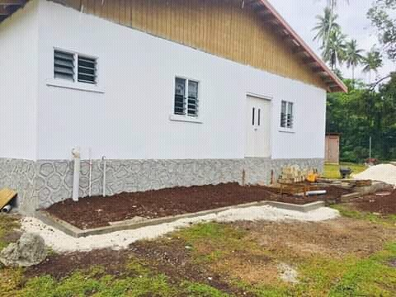
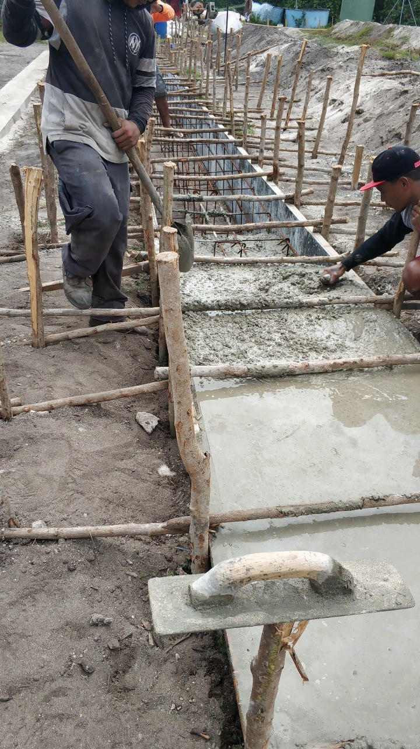
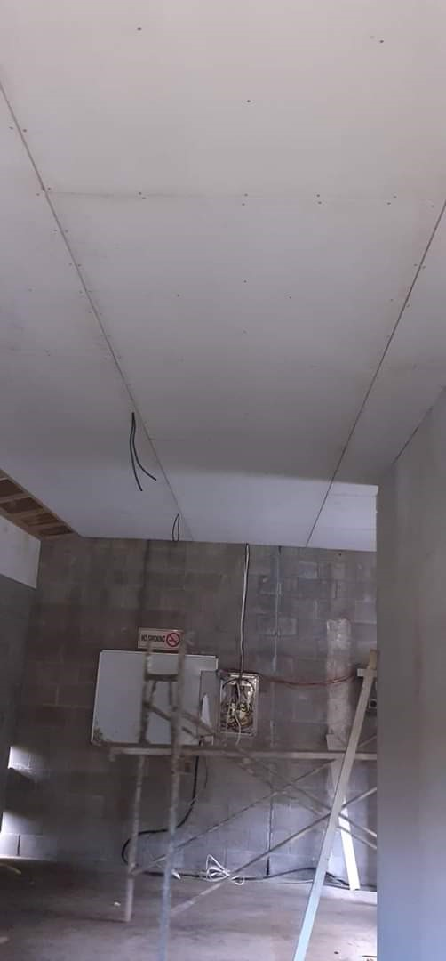
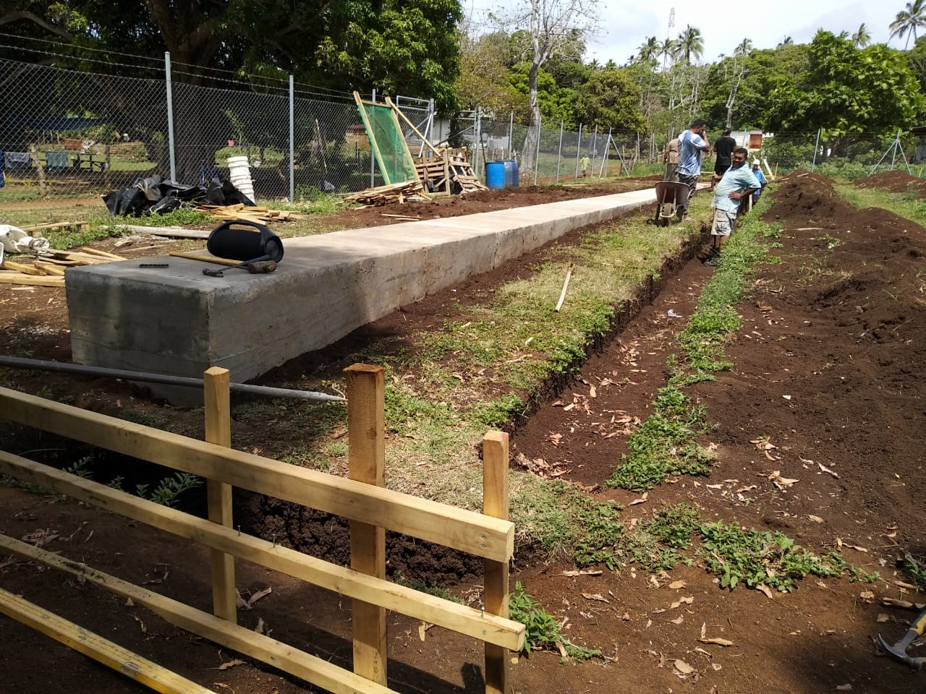
Photos (Phase 2);

Slide 11
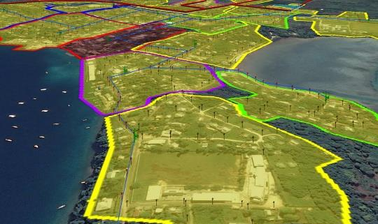
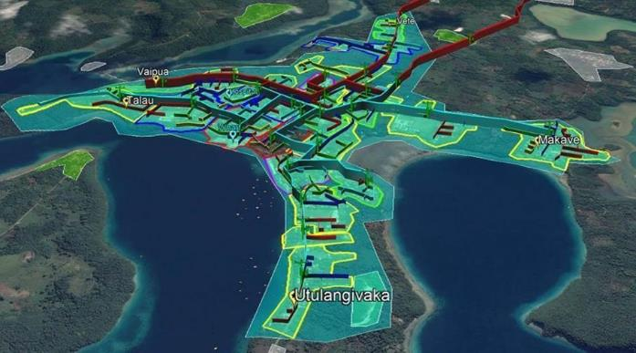
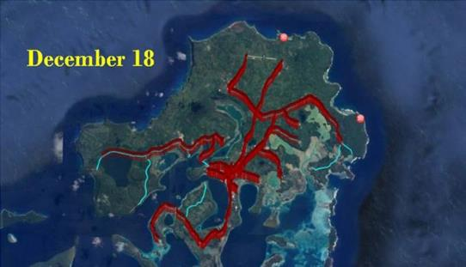
Photos (Phase 3 Scope):

Slide 12
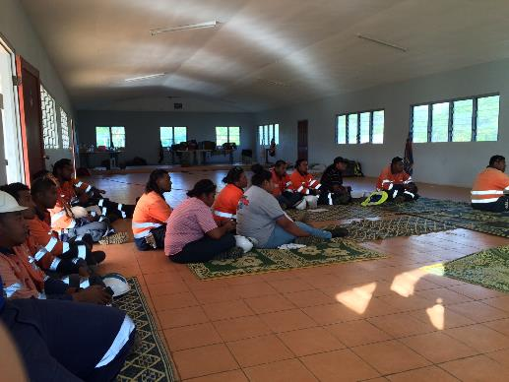
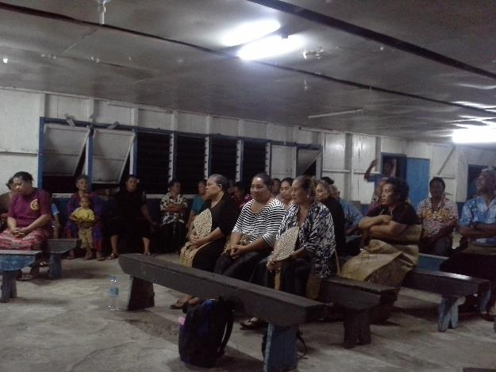
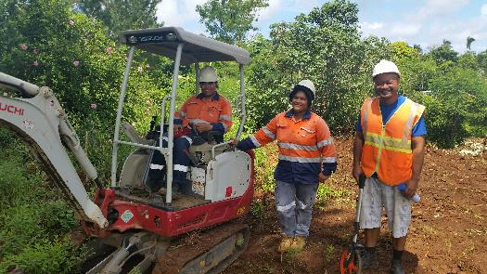
Photos (Phase 3 Safety):

Slide 13
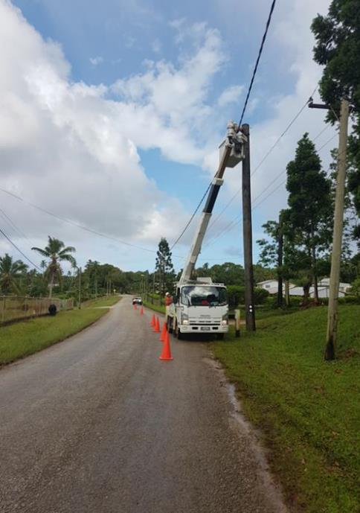
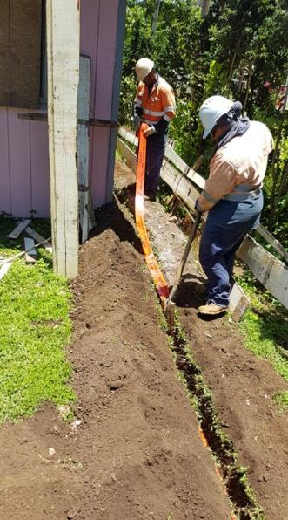
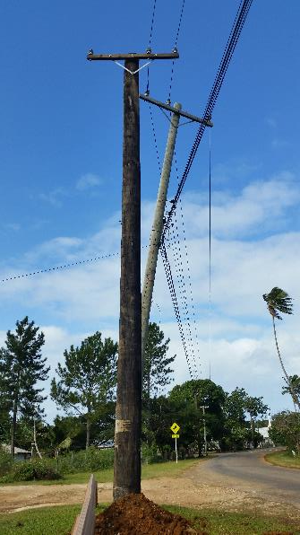
Photos (Phase 3 Works):

Slide 14
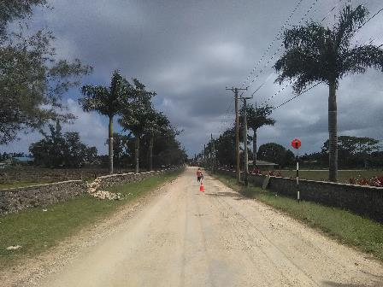
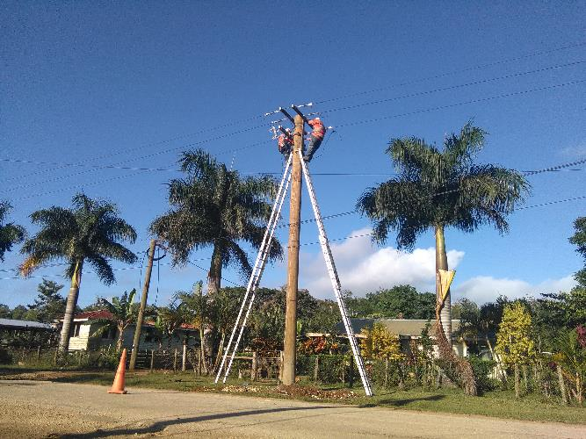
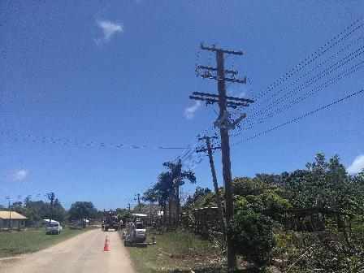
Photos (Phase 3 Works):

Slide 15
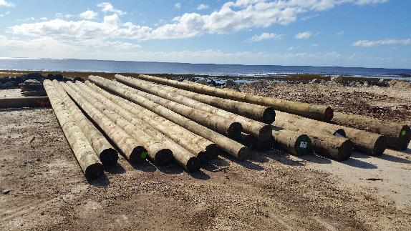
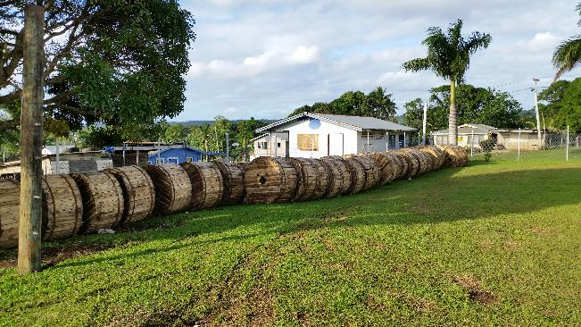
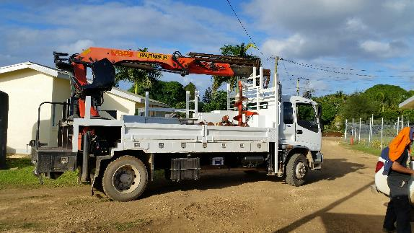
Photos (Phase 3 Materials):

Slide 16
Photos (Phase 4):
To start in Q2 2020.

Slide 17
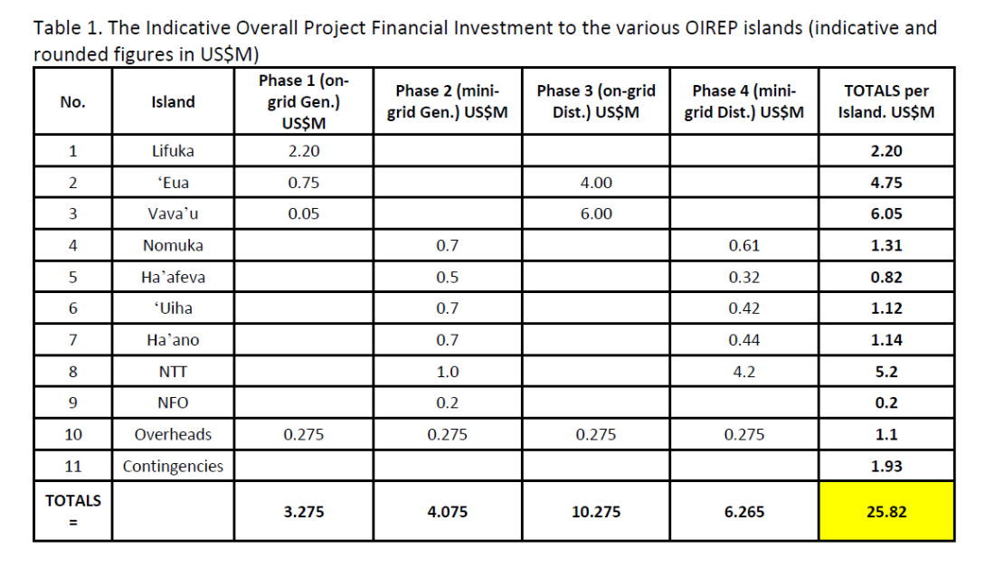
Overall Project Financial Allocation

Slide 18
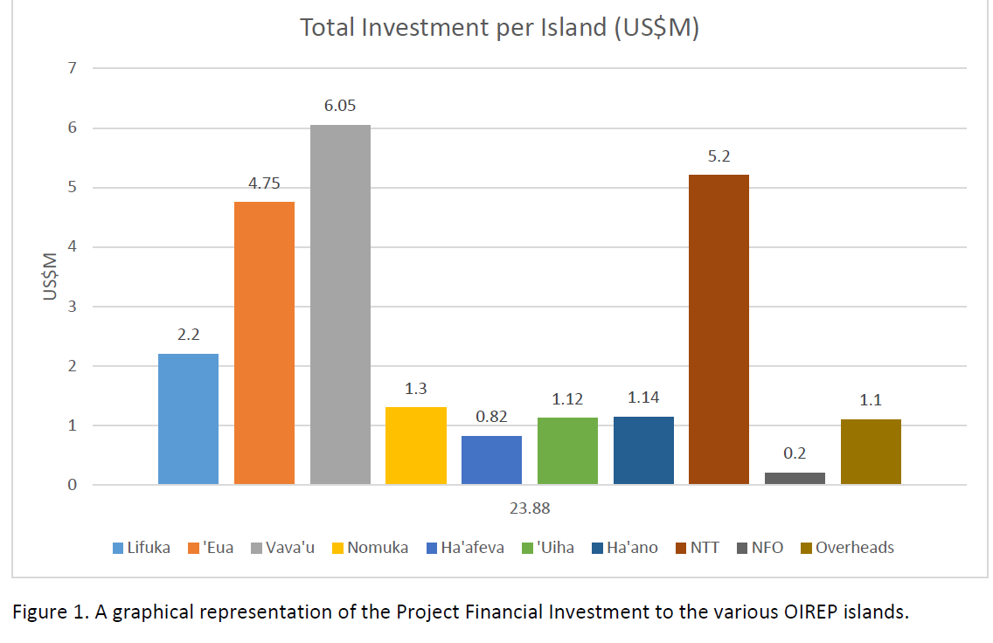
Project Financials (per island)

Slide 19
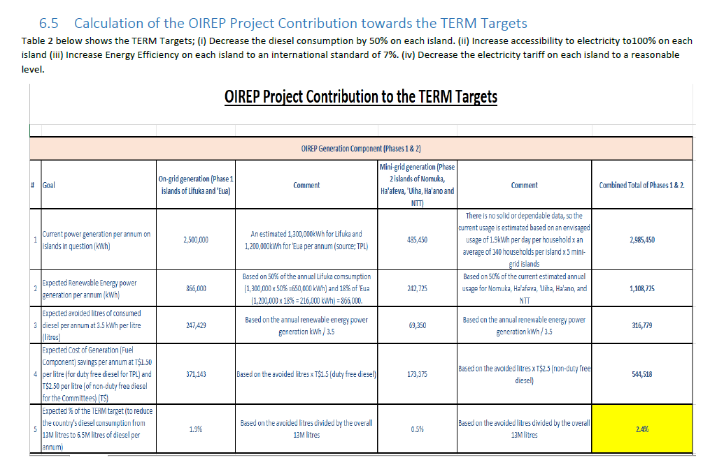
Numbers behind the OIREP Contribution to TERM

Slide 20
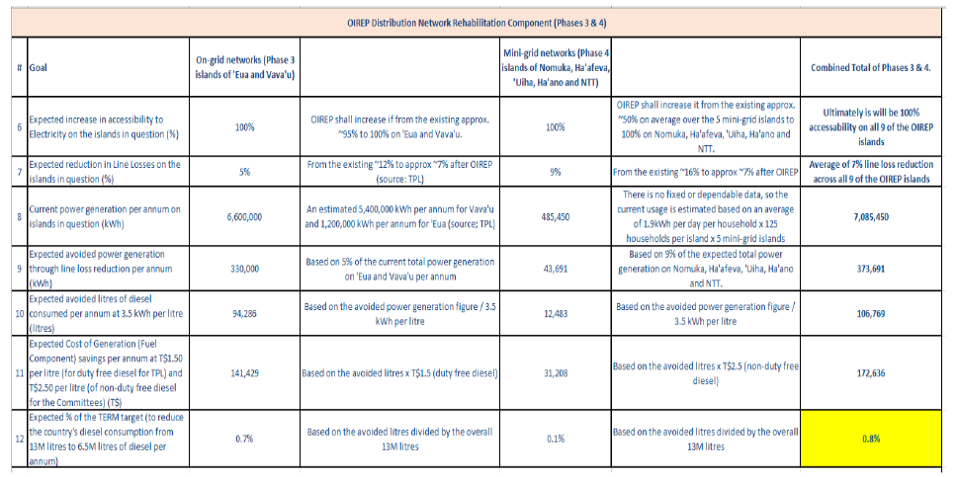
Numbers behind the OIREP Contribution to TERM (cont’)

Slide 21
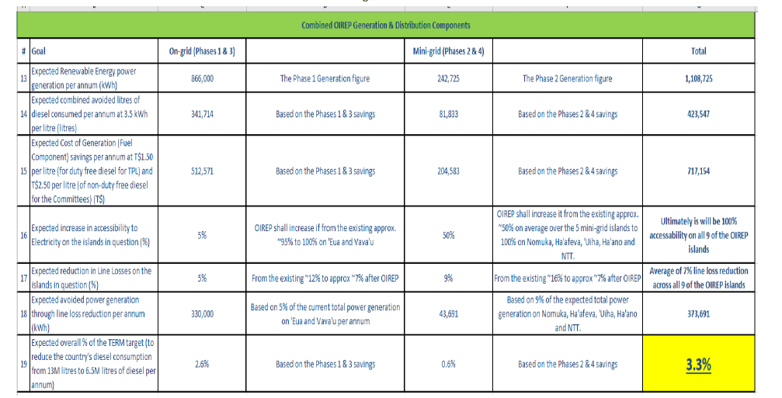
Numbers behind the OIREP Contribution to TERM (cont’)

Slide 22
Challenges / Lessons Learned:
Phase 1:
  Time required to develop the project with stakeholders. Mitigation = seek a bigger scope and start earlier.
Phase 2:
  Land related delays. Mitigation = start the land transfer process earlier or buy the land.
  Sustainable O&M. Mitigation = better support, O&M contracts and early sign-ups.
  Holes and ambiguities in the Tender Docs and Contract. Mitigation = plug the holes and repair the docs.
  IA responsibilities and actions. Mitigation = Get them to stick to their obligations.
Phase 3:
  Material delivery delays. Mitigation = use less procurement packages but bigger. Also order the materials earlier.
Phase 4:
  Material procurement delays. Mitigation = use less procurement packages but bigger. Also order the materials earlier.

Slide 23
Q&A.
Malo ‘aupito.

