Slide 1








TONGA ENERGY ROADMAP OFF-GRID
ELECTRIFICATION PROJECTS UPDATE
Ofa Sefana Department of Energy Ministry of MEIDECC

Slide 2



- To provide Off-Grid communities⁽¹⁾ with access to electricity options from renewable sources that are sustainable and also provide for their varied power needs.
(1) Communities which are not currently supplied with electricity from
Tonga Power Ltd.
- To cultivate quality of life and potential to increase economic activity of the outer islands communities that the Tonga Off- Grid Initiative aims.

Slide 3

Development Initiatives | Baseline 2009 | TARGET as of Year 2010 | BY Year | Current Achievements
1) RE Power Generation | 0.2% | 50% | 2020 | Updated
 | 50% | 70% | 2030 | Updated
 | 70% | 100% | 2035 | Updated
2) Line Loss Reduction | 18% | 9% | 2020 | Updated
3) Electricity Access¹ | 83% | 100% | 2020 | 91%
4) Sector Emissions Anticipated [Power] | 0.12% | 11% | 2020 | 2.53%
[Transport/Waste/Agr- Forestry] | Not Set | Not Set | Not Set | Not Set
1.

Slide 4
 1988 – First SHS (Mango and Taunga Is.)
 1993 – LOME Convention (Vava’u Outer Islands)
 1995 – NZAid/GoT (Niuafo’ou/’Atataa and Tafahi Islands)
 2000 – PREFACE/SPC/France/AusAID (Ha’apai Islands)
 2005 – IUCN/Austria/Italy (Ha’apai Islands)
 2010 – TERM Initiative

Slide 5
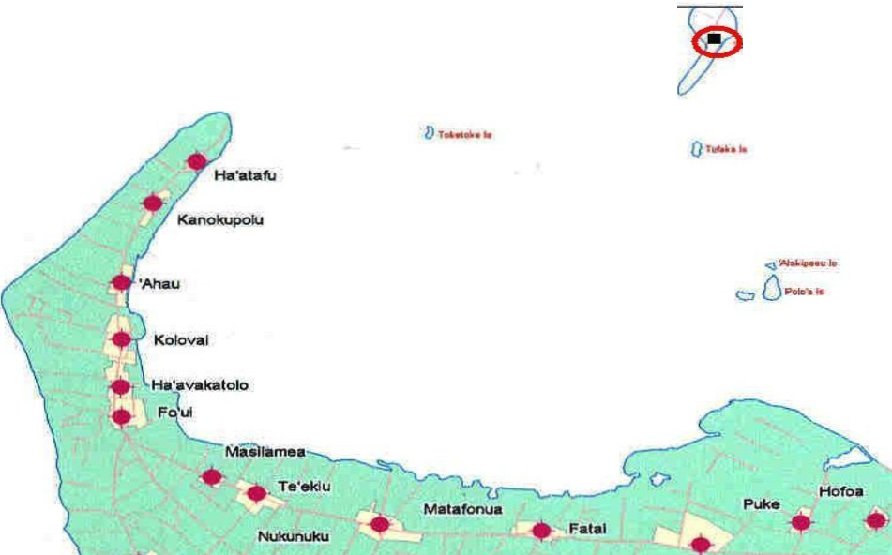


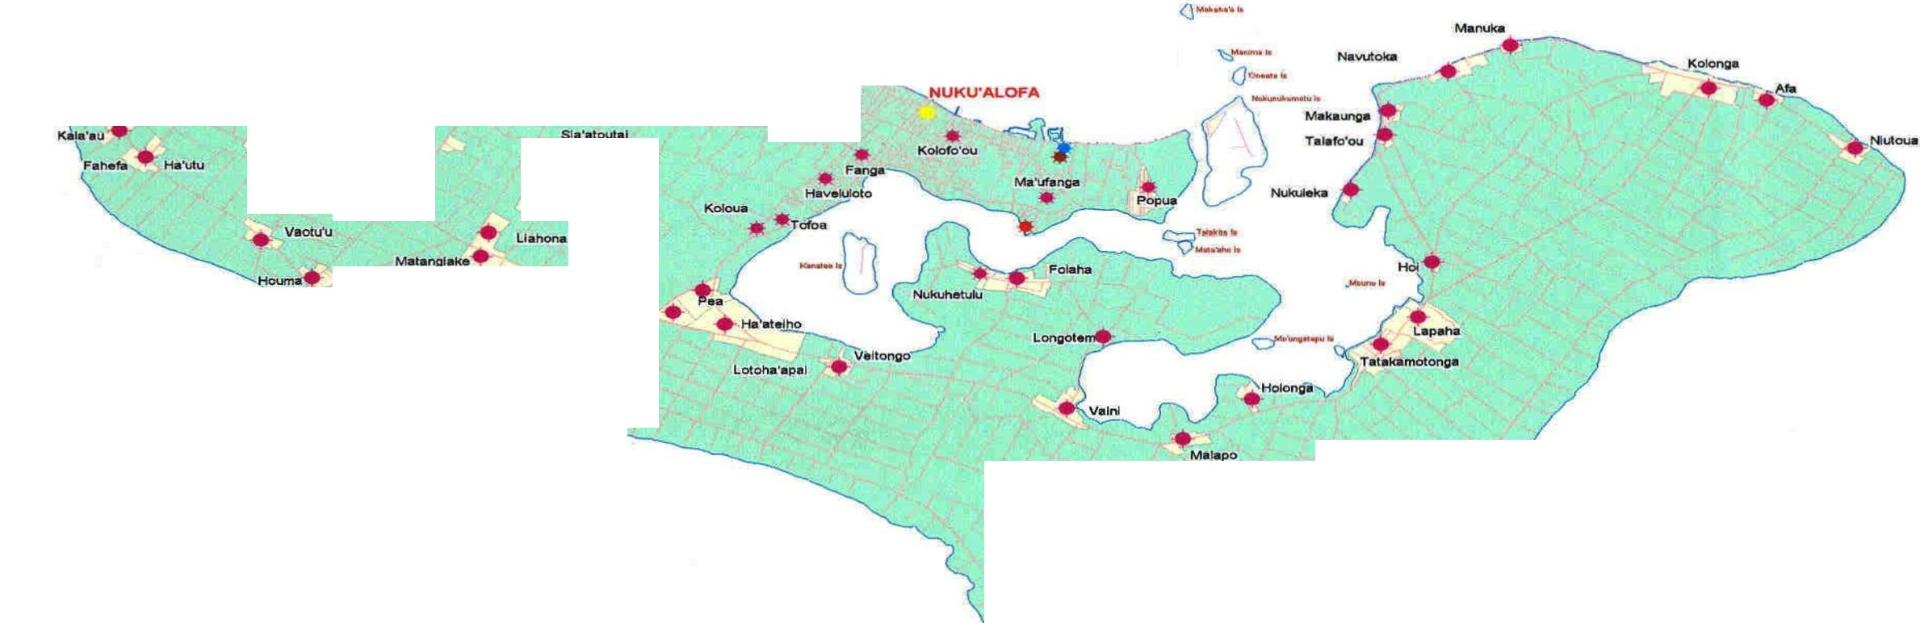
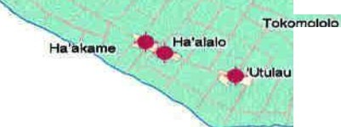
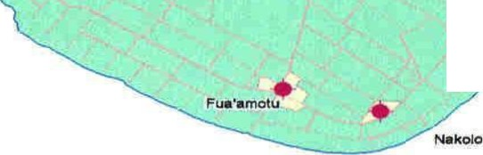
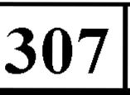
.'ATATAA
TONGATAPU GROUP
0
-·
.,_.....
<=> -•
-
'EUEIKI
Kotom
-·0
...Matahau
Lakepa
... Kahoua
. ₊₋ Velullku
...Pelehake
L_{L}a ._onga .
LEGEND Major Population Area + Shoreline Ltd + British Petroleum (Home Gas) Shell Company Village Grid Diesel Electricity marks
"""'- | Road
Faturnu
•
ssl
0
2
4
kllome:to,..
Produced by ISCT Unit,Ministry of Lands, Survey and Natural Resources

Slide 6


V.AV.A•LJ GRC>LJP -- , ,., e HA'ALAUFULI ^{LEIMATU'A} HA ^{• •o•Ono•} DISTRICT HAKE LEIMATU'A DISTRICT _{..-MANGIA,....,_.} LONGO APH1 H1FO DIS-TR·ICT N• •A• "' - oKoA ·-..- eHoLEvA ^{TEFIS.I} -^{TA}.-^{O}·^{A} - e TU .Y. !:§ UTUI HOUMA - ' KOLOA -;?. ;-;; ;,-:, -·k• TU'AN U• 'UT GAK E LEI NEIAFU !'!:-' .. ..•.. ......a ^{H}•^{UNGA} Luftn""OkO Ia ^{TAL}₋^{IHAU} _{-­} I -·--.... Ia .£1STRIC"f•oLO'UA OTEA . - PANGAIMOTU NUAPAPU_{-··#">,..no-.•} ....WPANGAIMOTU DISTRICT _{• OFU t}l"'<_{:r}e-:n:':-.-₋4_{w}1:1•.1 MATA MAKA _{FALEVAI.} t<.f"',t-"'A _{tal'""'o-M.I} ^{l"l n l I}...^{U}....⁴...¹..¹,.^{.. t}.<.,^{.v}.,^{t},º_, •LAPE ^{- N\ k'- •} I OU<Dhh..•k­ ^{t 81..AN0} _{:.'7::! MOTU} DISTRICT KAPA ^{OVAK}•^{A} ........... . .TA UNGA.•• •••..no NgMu l•l,.. d - ·c.v KA ot".eo ........('1 ••"-•'•"""' _{,;:o,...va•-...u-..g•} ................., ,.,......_...... .. I, ......,.._.• ........u _{'"'' na} *'-L.O.t.o'u.o l'<o<,-.1 L EGE N D : L,.v,l,l,!.t.n..•.a•::w> f l!lolf"_..U.:I
-SOLAR PUMP SYSTE MS SITES •SOLAR FREEZER SYSTE MS SITES & EXISTING SHS SITES TPL NATIONAL MAINS GRID EXISTI NG SPS SYSTE MS | ..... hoiO.UIU _{............ Q} I 10921 4921 W-..o l uf'.,.tuh.... _{• •na"M" ••to} 1 ('W")o •••nn••.,.n• ••••no .........-.,o,....,.. LU.IQII .Sca ob41r _{•••t:'Or'Od} •••,....c;: ""'.......,.. klton"'\etera --roula _{0 75 C5} .......('1 •••.,....d
....,.,.... ,
I ._....•.,.t..,t<r;ohg....

Slide 7





HA'APAI GRC>UP
(I HA'ANO
Mo'unga 'one l!!ll DISTRICT
Ha"ano Is
Fatarna•o UIHA DIST R ICT
Latofo.a Is
.J( Lifuka ls
PANGAI J
;DISTRICT
Fotuha'a ..
Lof anga
LULU NGA
Kotu Matuk
Tungu
DISTRICT m.gauli -
Ha"ateva ts
I
I
-u.o.....
LEGEND
MICRO-GRID ELECTRIFICATION
SHS SITES & PROPOSED SFS UNDER PEC
TPL MAINS ELECTRICITY GRID
..'"'--
_
uoau_ .Hl•rDu
Hat a.
'O'ua
LilT• • •
Tokuku Is
Nomuka I
-=.
Fonoifua
T IE'tI"v"a- • U
r an ••a..lu "'>
Mango
Labaa ;
IVIU'OIVIU'A
DISTRICT re...t.IToag ..
,.. - H••ga •ga "'­
"•"• l>
!
H• a Ha" IIIO v
31561
0
SCALE BAR
15
--
kilometers
30
5

Slide 8
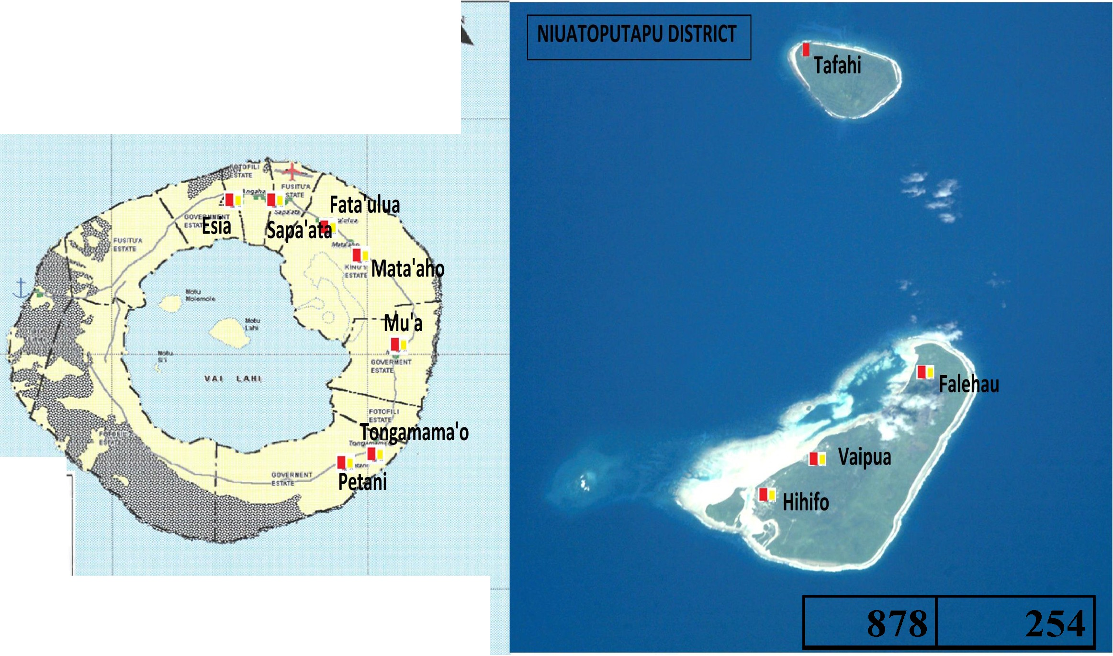
Niua Group
' INIUAFO'OU DISTRICT I
I
I I I
.l^{i}.._.
!
11·-·--··--···········-·--· ·-'·-·- ·· ...................1--··--
... -
LEGEND
: i:: ogrid ' --r----- e .--646 r- --------i281

Slide 9
2010 | 2019
Vast Geographical Locations | Will never be removed – Cost of inter- island transport continues to increase
High Capital Cost of RE Equipment | Slightly decreasing
Dependence on Donor – longer lead time | Improved
Donor strict rules | Removed
Government Duty and Levies | Totally removed
Lacking in technical skills | Improved dramatically – Utility/Private/GoT
Tropical harsh salty conditions | Will never be removed – Technology improved
Lack of public awareness | Improved – Schools, Communities, NGOs, Private Sector
Data Gaps

Slide 10

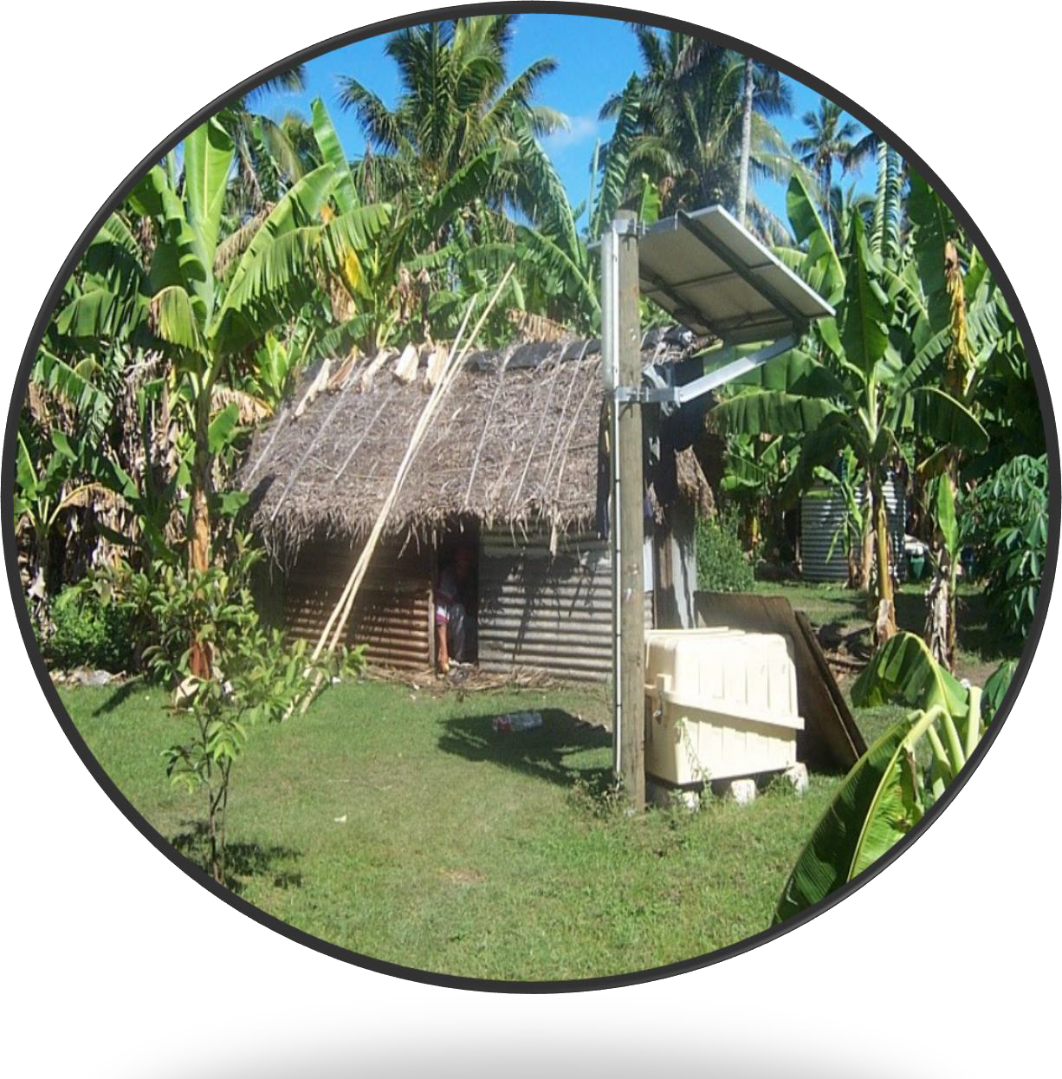
Solar Home Systems - Offgrid
Donors | Japan, Italy/Austria, Canada
Funds | USD5.42M
Total Capacity | 0.31kWp
Approaches | Bilateral and Regional
GHG Emission Reduction | 0.1Gg CO2 Equivalent
Benefits | Rural Communities socio- economic/livelihood improved, Lower Operation/Maintenance costs & tariff, BUT limited electricity service.
Management | District based Management established under Incorporated Society Act

Slide 11
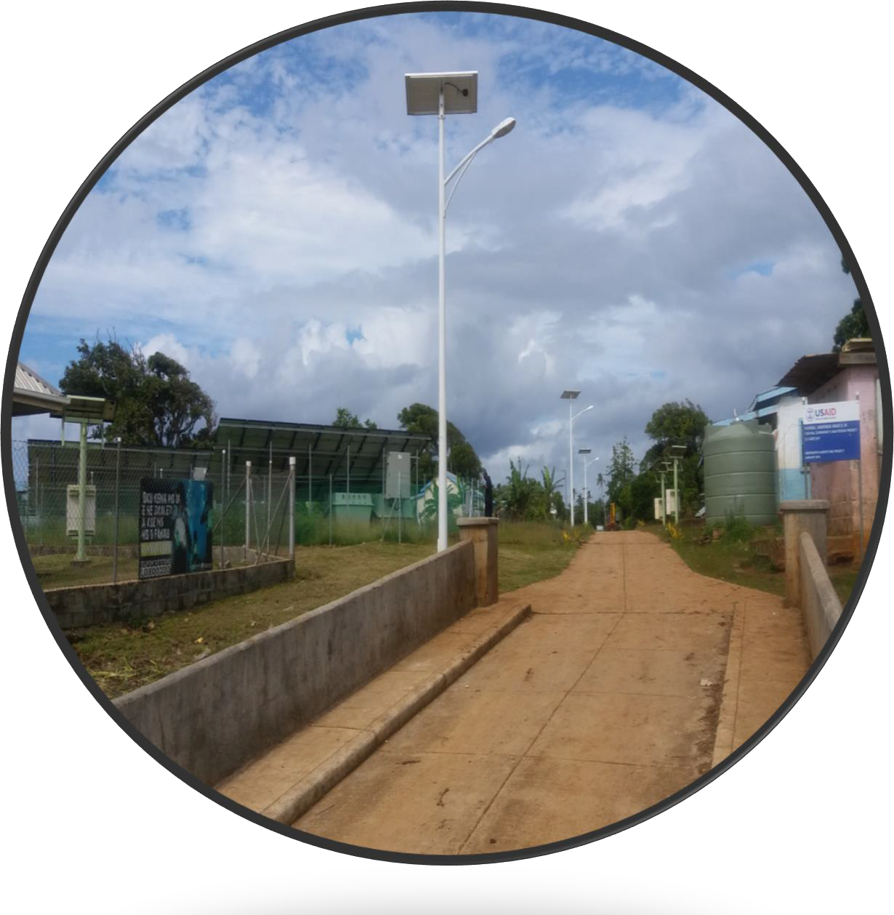
Solar Streetlight Systems - Offgrid
Donors | China/Private
Funds | USD3.42M worth of equipment
Total Capacity | 230kWp
Approaches | Bilateral
GHG Emission Reduction | 0.7Gg CO2 Equivalent
Benefits | Safety at all times; GoT provides maintenance; helps in times of major power blackouts during TCs particularly on main islands.
Management | District based Management established under Incorporated Society Act

Slide 12

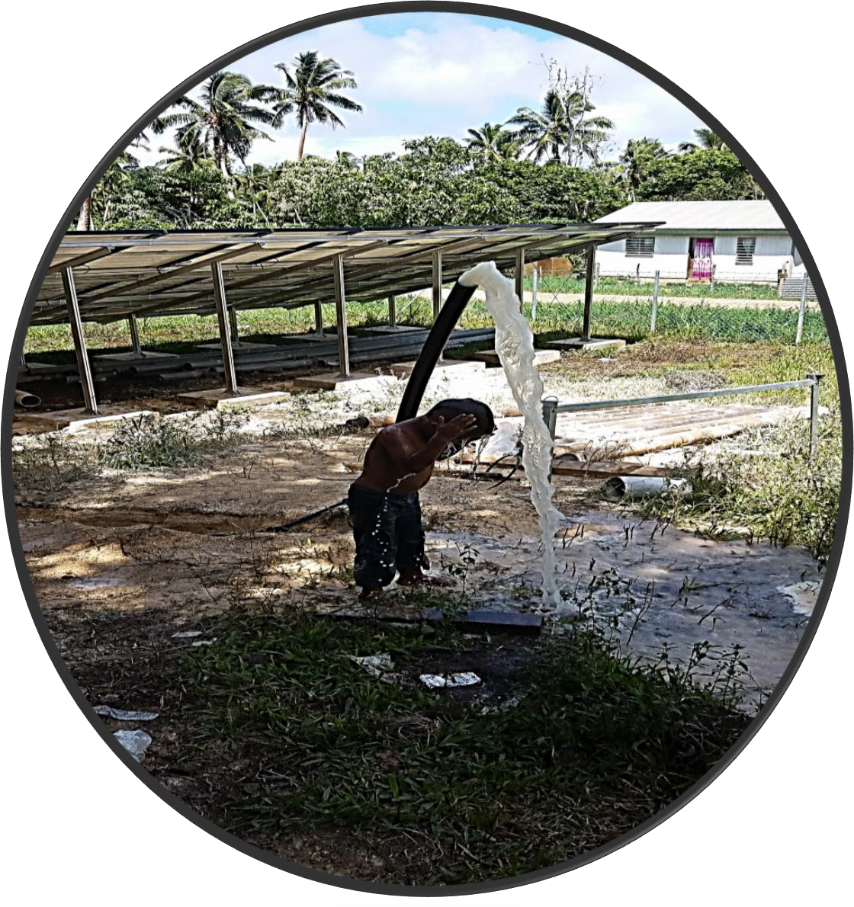
Solar Water Pump Systems - Offgrid
Donors | Japan, Italy/Austria, Canada
Funds | USD3.42M
Total Capacity | 180kWp
Approaches | Bilateral and Regional
GHG Emission Reduction | 1.1Gg CO2 Equivalent
Benefits | Rural Communities Hygienic, Lower Operation/Maintenance costs & tariff, Diesel Based Pumping put off, Water quality improved.
Management | District based Management established under Incorporated Society Act

Slide 13

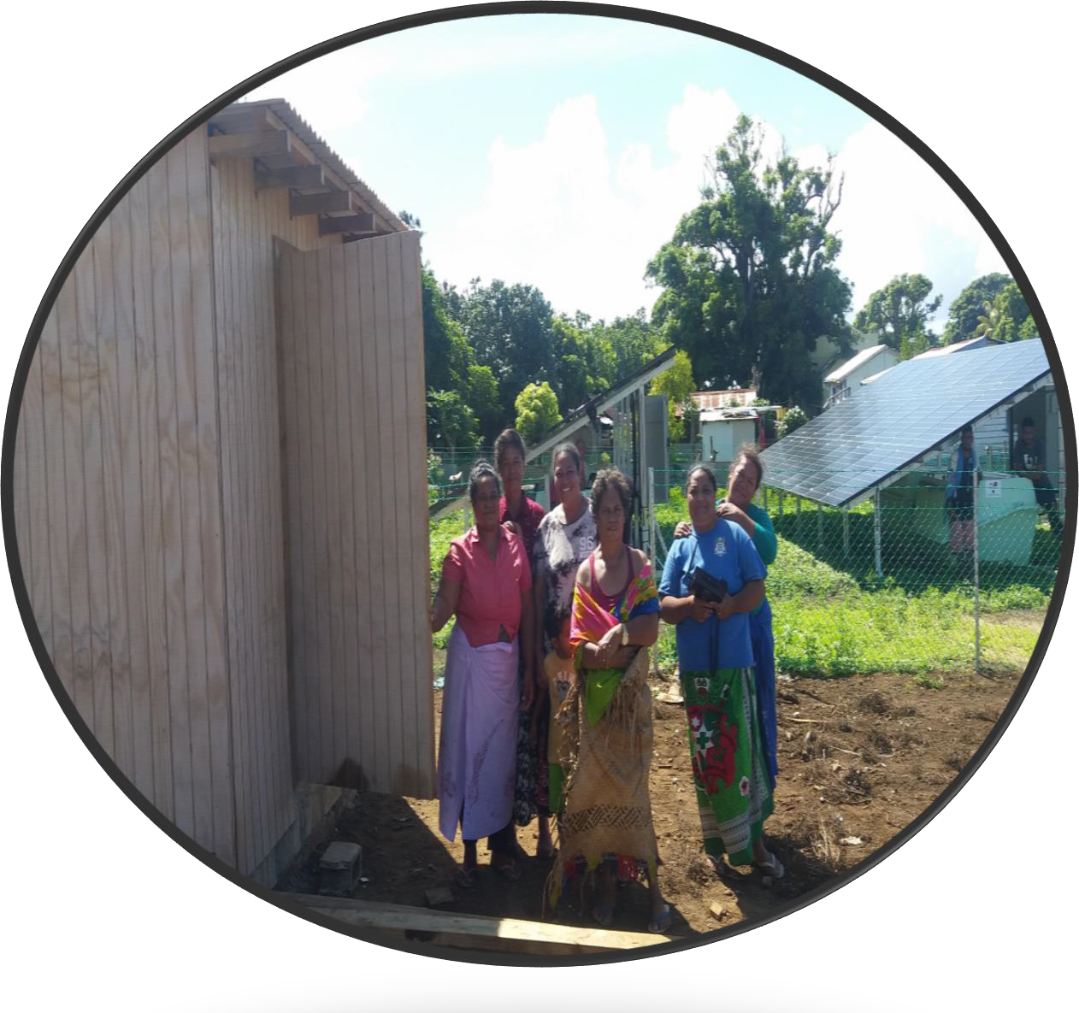
Solar Freezer Systems-Offgrid
Donors | Japan
Funds | USD3.2M
Total Capacity | 308kWp
Approaches | Regional
GHG Emission Reduction | 2.2Gg CO2 Equivalent
Benefits | Rural Communities Hygienic, Create Business Opportunity for women/youth – Empowerment, Additional income for households.
Management | District based Management established under Incorporated Society Act

Slide 14
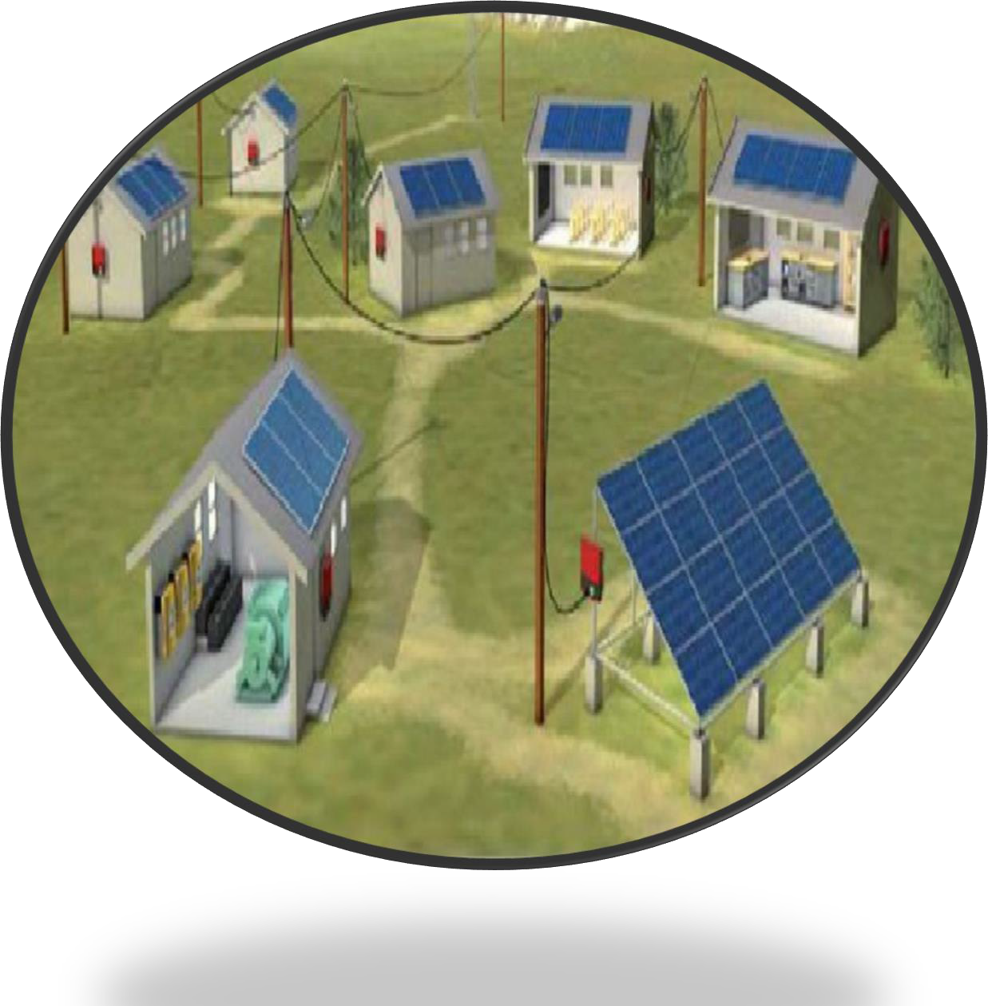
Solar Migro-Grid Systems - Offgrid
Donors | GCF, AusAid, ADB
Funds | USD22.4M
Total Capacity | 180kWp
Approaches | Bilateral and Regional
GHG Emission Reduction | 1.1Gg CO2 Equivalent
Benefits | Rural Communities Hygienic, Lower Operation/Maintenance costs & tariff, Diesel Based Pumping put off, Water quality improved.
Management | Community based Management Established under Cooperative Society Act

Slide 15

MONTHLY TARRIF PER SYSTEM SET BY
MANAGEMENT - TOP
 | TOISES Inc | HOISES Inc | VOISES Inc | NIUA Inc
SHS | 15 | 13 | 13 | 15
SSS | GoT | GoT | GoT | GoT
SPS | 30% | 30% | 30% | 30%
SFS | 100 | 100 | 100 | 100
SMS | - | 60/2-3/kWh | - | -

Slide 16

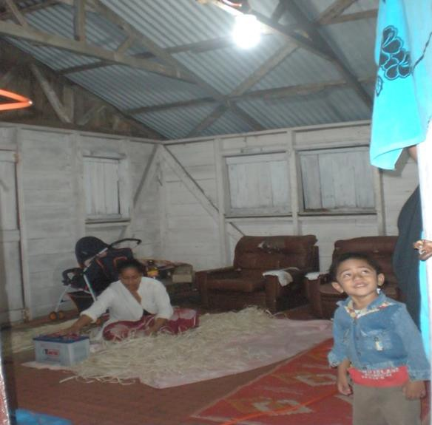
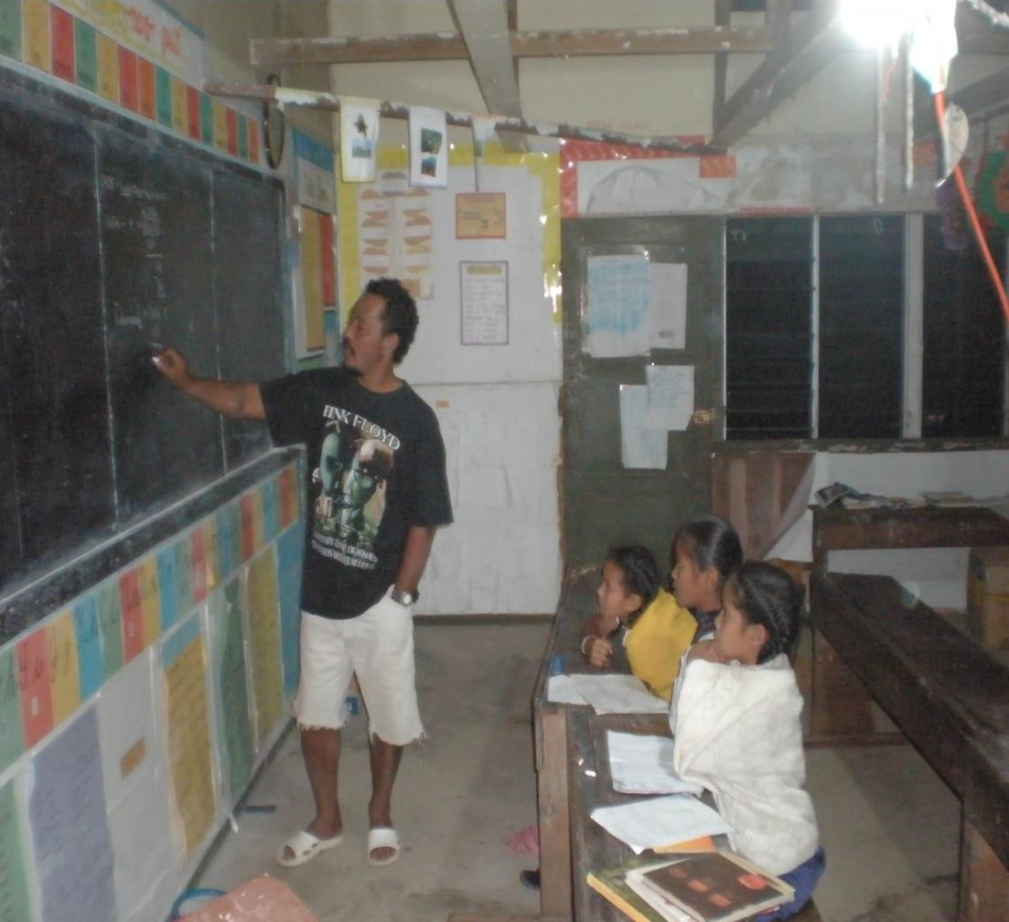
BENEFIT$

Slide 17
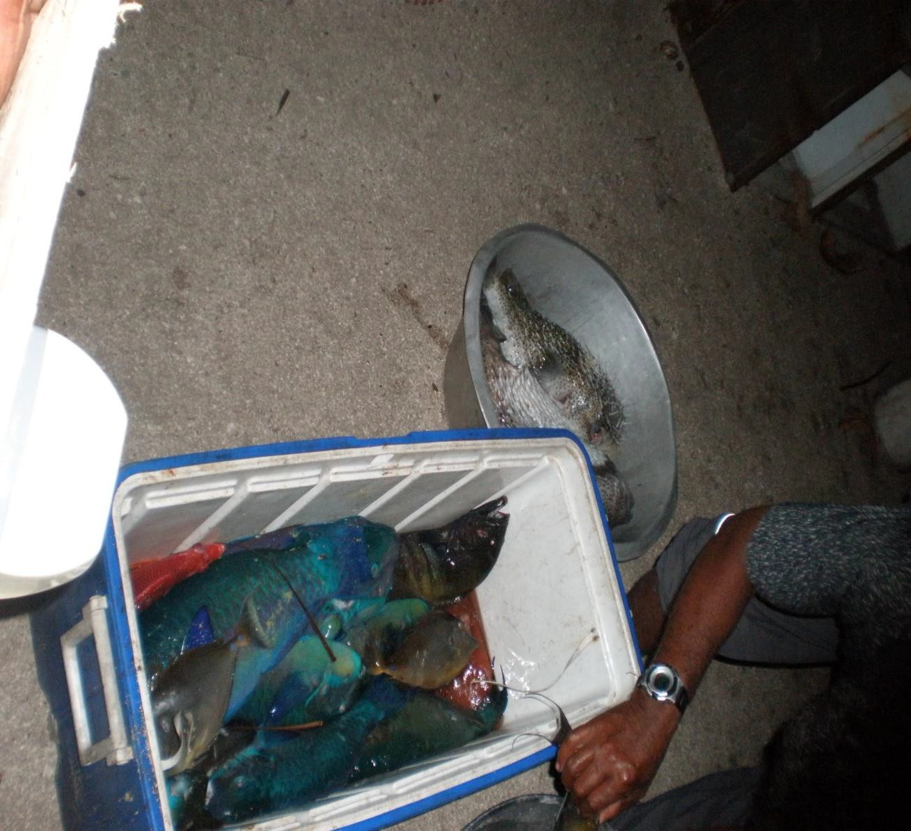
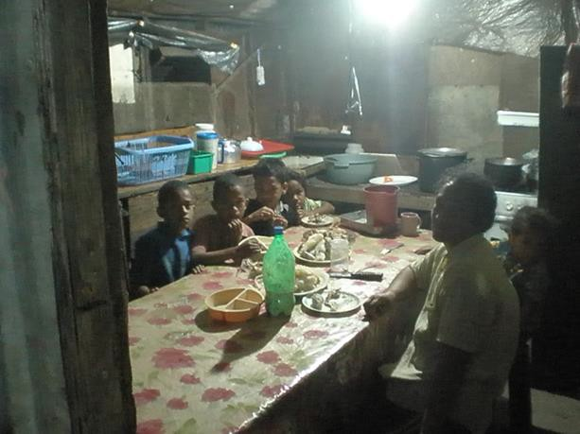
BENEFIT$

Slide 18











OFF-GRID INITIATIVES ELECTRICITY USED - calculated kWh
60000
50000
40000
30000
20000
10000
0
SHS
SSS
SPS
SFS
SMS

Slide 19
AVERAGE MONTHLY GENERATION 2015-2019
TPL Diesel
TPL RE
Off--Grid

Slide 20




1000000
2000000
3000000
4000000
5000000
6000000
7000000
8000000
Jan-15 Mar-15 May-15 Jul-15 Sep-15 Nov-15 Jan-16 Mar-16 May-16 Jul-16 Sep-16 Nov-16 Jan-17 Mar-17 May-17 Jul-17 Sep-17 Nov-17 Jan-18 Mar-18 May-18 Jul-18 Sep-18 Nov-18 Jan-19 Mar-19 May-19 Jul-19 Sep-19
0
TPL Diesel
MONTHLY GENERATION kWh
TPL RE
Off--Grid

Slide 21
 That service quality is priority: reliable hardware, a
responsible organization, sound finance for operation, maintenance and spares, and appropriate knowledge.
 That the design must fit needs: One size does not fit all.
 That the solution must be attractive: Users, energy has to open better life opportunities and allow for possible economic activity.
 That the institutional framework must function: The current institutional framework governing energy in Tonga must be upgraded to cope with development in the sector.

Slide 22
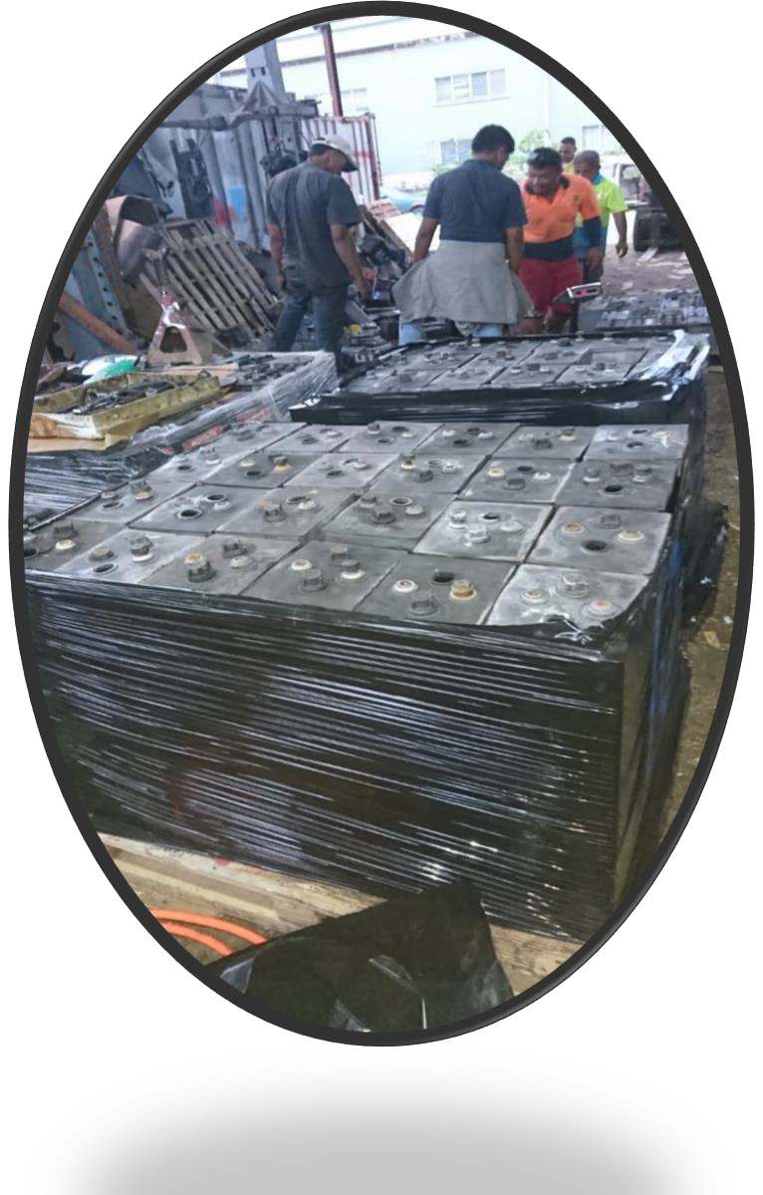
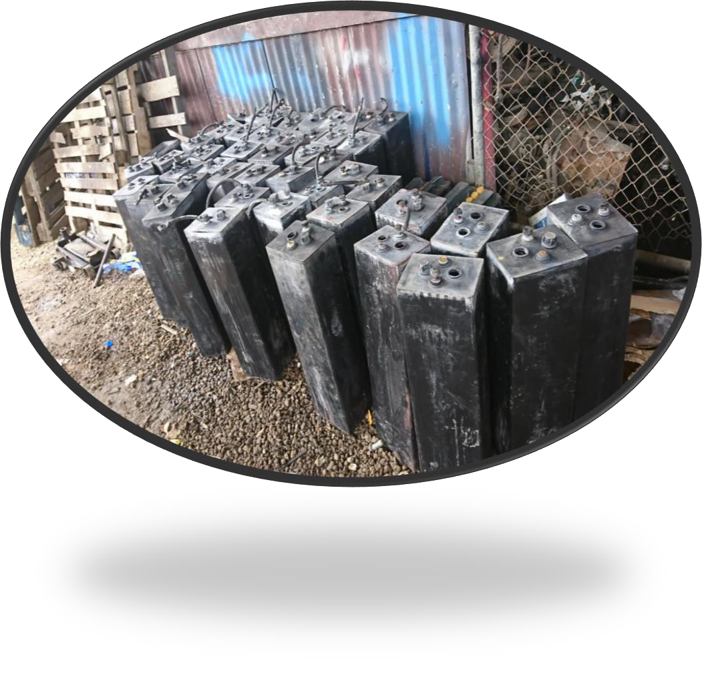

Slide 23
 THAT AWARENESS AND REFRESHER TRAINING FOR USERS AND OPERATORS ARE NEEDED DUE TO CHANGES IN TECHNOLOGY
 GoT/DONORS TO CONTINUE PROVIDING ADVISORY ROLES TO
COMMUNITY MANAGEMENT SETUPS
 COMMUNITY MANAGEMENT SETUPS MUST ALSO ASSIST GoT ON BEARING COSTS OF OPERATION AND MAINTENANCE

Slide 24


