Slide 1
Kingdom Energy & Electrical Services/Supply
Notes:
The register name of this company name here in Tonga as known KEESS since from 2005

Slide 2
Vava’u & Ha’apai Project Rural electrification Project

Slide 3
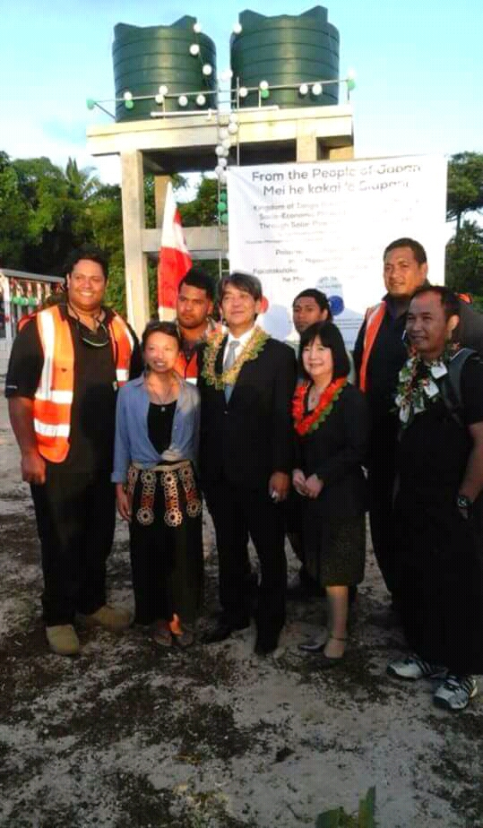
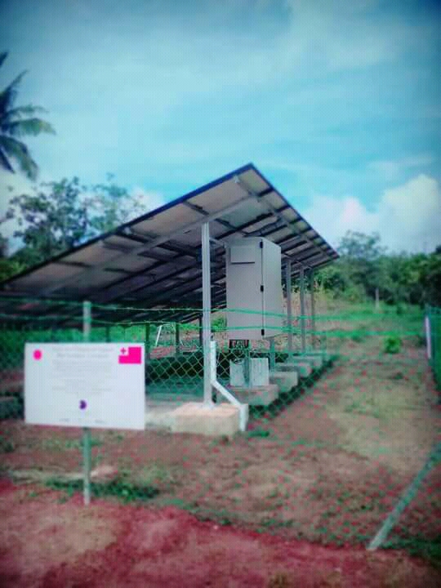
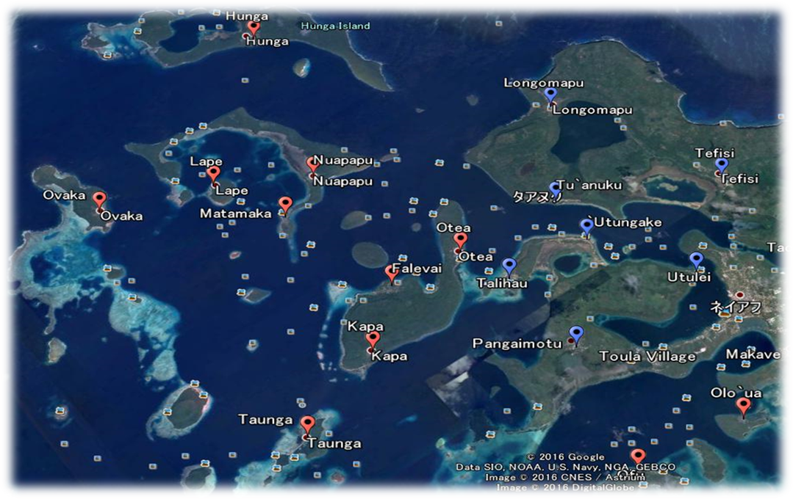
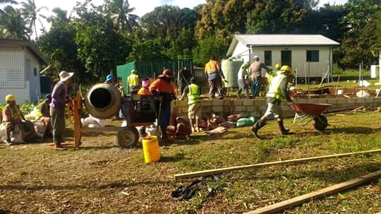
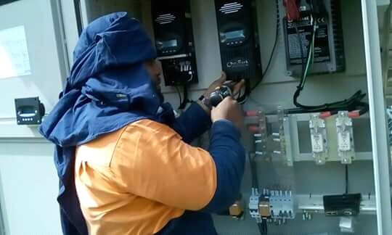
installed Solar Pump System 93 KW at Vava’u Main Island.
Installed Solar Freezer System
Notes:
Vava`u rural area were knee to help ,no difficulties during work.

Slide 4
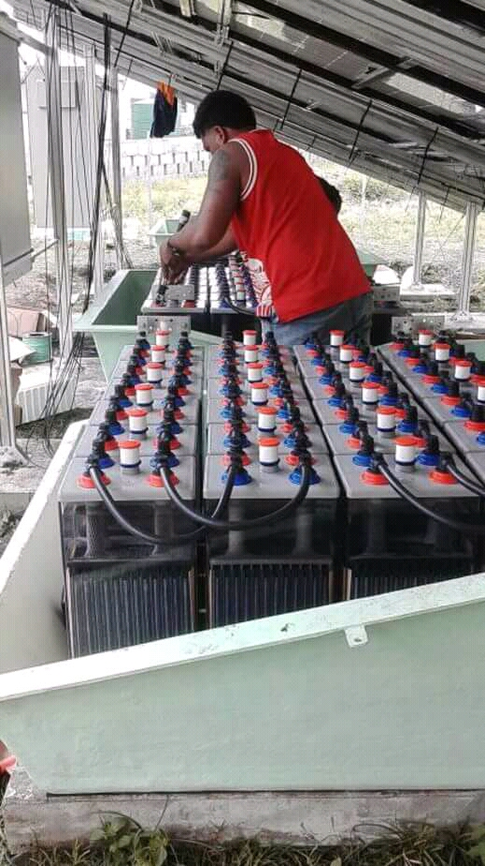
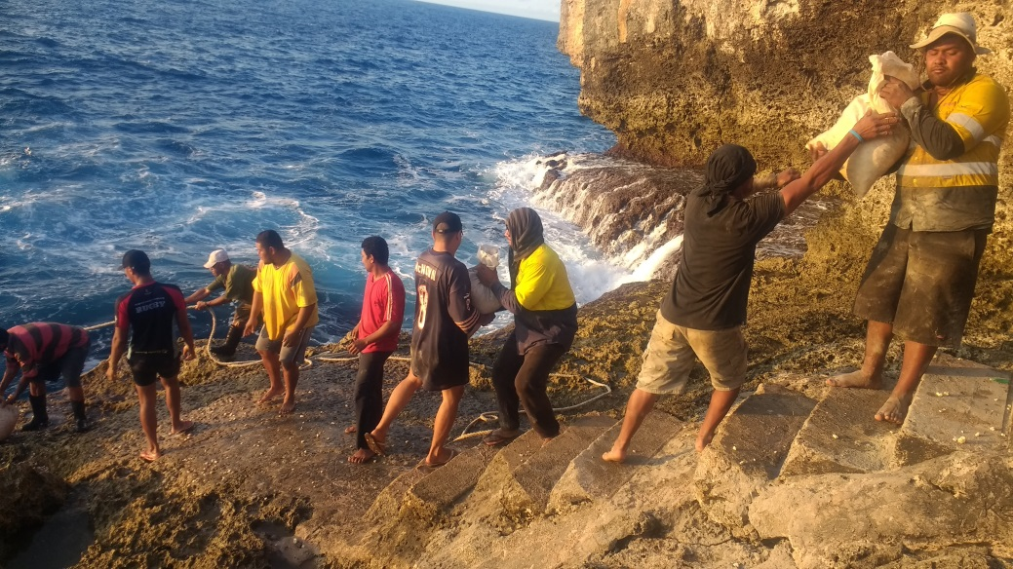
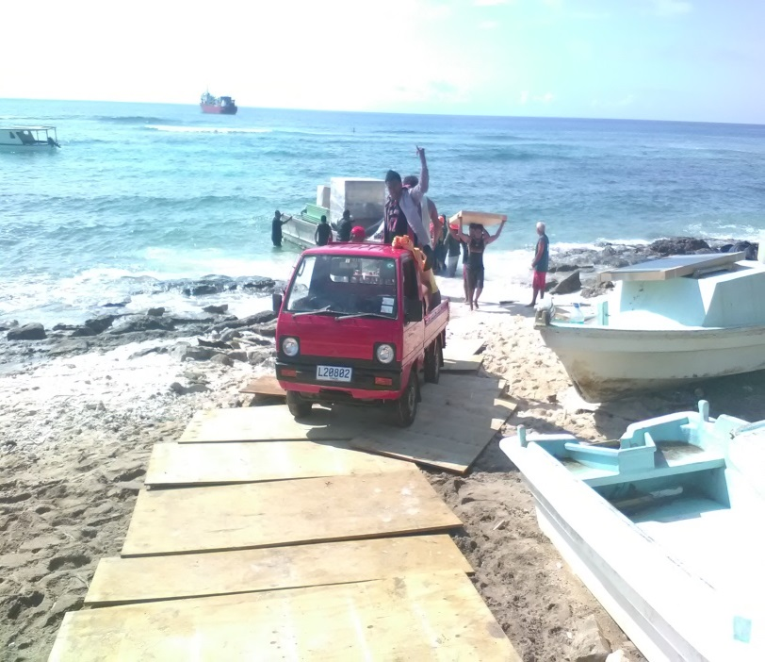
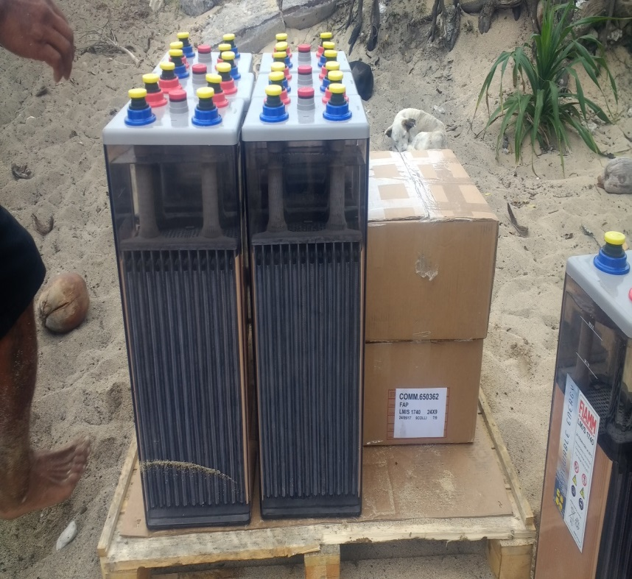
2017 Installed Solar Freezer system 136KW at Ha’apai 9 Island.
Notes:
See Fotuha`a everything has to pass like a rugby ball, batteries is about 90kg
People very helpful

Slide 5
Work Experiences
Kingdom Energy was established on May 2005. It was started from scratch in a small shop then became to noticed the improvement of this private sector.
In 2001 the company participate in installing the SHS(Solar Home Systems in Ha’apai group 190units(30.4Kw). SPC/Tonga Energy
2011 installed 2.7kW off-grid at LDS MQ(Missionary Quarter).
2015 installed 4kW grid-tie system at Green Lodge Tongatapu.
2016 Tonga High School exterior solar light
2017-2018 installed Solar Pump System 93 KW at Vava’u Main Island.
Installed Solar Freezer system 136Kw at Haapai 9 Island. Installed Solar Freezer System 128.5Kw at Vava`u 11 Island.
2019 Contract with Island Technology for service and maintenance their
Grid tie systems, Utu`one Lodge, Sew View Lodge, Tavina bar, Ha`amoko Bakery, St Andrew High School, Kelana High School VV.
Notes:
2001 I was involv

Slide 6
TRAINING PARTICIPANTS
2009 Certificate for Solar Photovoltaic Generation & Application in Tonga
2011 Certificate on Designing and implementing solar energy based livelihood projects for rural communities in Teri, India.
2013 SEAPI Grid Connection On Line course
2015 Pac-TVET Solar Curriculum in Nandi, Fiji by PECREEE
2017 Grid-tie system in Suva, Fiji SPC./PECREEE
2018 ACEF Asia Clean Energy Forum (Manila Philippines)
2018 Renewable energy Workshop Training SEAPI/TPL
2018 Itec Programme in Solar Energy for Master Trainers from ISA member countries
2019 Renewable energy Workshop Training SEAPI/TPL
Notes:
Opportunity to one of my technician to participate at training in India

Slide 7
Out Look for 2020
Under designed FWC Grid Ties Solar System for High School include Sia`atoutai
LDS church Temple Accommodation 140kw designed completed
Next phase to Approved from Tonga Power and to implement by 2021
Notes:
Currently designed FWC Solar Grid. 530kw
LDS designed completed for 140kw.

Slide 8
Challenges
Weather / Communication barrier
Transportation of heavier equipment to the island.

Slide 9
AMREC
Association Member Register Electrical Contractor
Goals : To uplift the technical skills of all Register Electrical Contractor to meet with new technology include RE.
: United we stand to help disaster /Emergency
Eg; Cyclone Gida All Electrical contractor worked under the Authority of Electricity Commission to inspects the houses were damage before reconnected by TPL with free of charge.
Notes:
Amrec was 1st indroduce in18th -20th Most of that board member were pass away to the other sde of the veil. Now we have new board and new consitution. Now one of the goal to uplift the level of technical skill to meet with the standard set by Act –by laws of EC. Not only that and to meet with new Technology like RE

Slide 10
Challenges
Not enough member involve on RE Training
Not enough Practical in RE
Under control bush electrian.
Notes:
Only small no. they have knowledge and skills for RE, Level of training, workshop, were done in Tonga but only a few show up.
We wish some how, to include 1 member from each contractor to practically involve in the big project , like new Solar Farm, in that way the speed of training will go fast, when the young technician see and touch,. Cross Training.
We wish if there any help with security/ and procurement to motivate private sector to involve at Tender project.

Slide 11
2020 Forecast
AMREC new Planning to implement in Feb 2020

Slide 12
MAHALO
MAlo

