Slide 1
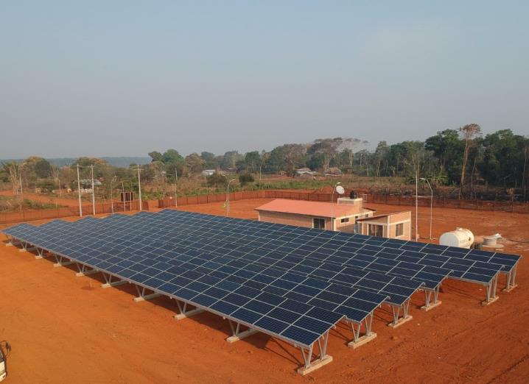
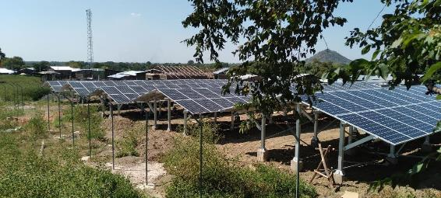
1.1 Electrification Planning
MG in Bolivia by TTA
Unlocking MG for sustainable development
Suva, Fiji
June 26th-30th, 2023
MG in Ethiopia by TTA
Roger SALLENT Regional Team Leader for Asia – Pacific Trama TecnoAmbiental, S.L.
roger.sallent@tta.com.es

Slide 2
CONTENTS
Session Objectives
Electrification Options
Geospatial analysis
Digital tools Available

Slide 3
1. Session objectives

Slide 4
SESSION OBJECTIVES
Understand the diferente electrification options
Present different geospatial tools

Slide 5
2. Electrification options

Slide 6
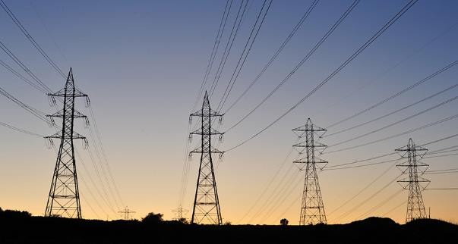
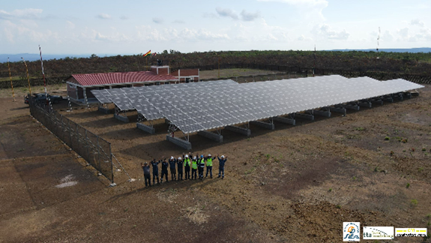
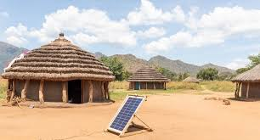
ELECTRIFICATION OPTIONS
(1) GRID EXTENSION
(2) MINI-GRID
(3) STAND-ALONE
Notes:
Grid extension is favourable in areas with high demands, which often correlates with high population density and close distance (<50 km) to the grid network
Mini-grids are favourable in medium to high demand levels, which normally correlates with the density of population in areas located further away from existing grid lines
Stand-alone systems are favourable in areas where demand levels are low, typically in small rural settlements and/or sparsely populated areas

Slide 7
ELECTRIFICATION OPTIONS: Grid Extension
(1) GRID EXTENSION
(2) MINI-GRID
(3) STAND-ALONE
Centralized electricity generation, followed by transmission and distribution lines
Capital intensive
Economies of scale

Slide 8
ELECTRIFICATION OPTIONS: Mini-Grid
(1) GRID EXTENSION
(2) MINI-GRID
(3) STAND-ALONE
Supply medium/high demand levels
Requires clustered customers
No transmission, but distribution.
Lower economies of scale

Slide 9
ELECTRIFICATION OPTIONS: Stand-alone PV systems
(1) GRID EXTENSION
(2) MINI-GRID
(3) STAND-ALONE
Supply low demand levels
Does not require clustered customers
No transmission, no distribution.
Lower upfront capital cost
Lower economies of scale

Slide 10
ELECTRIFICATION OPTIONS: Least-Cost Electrification Analysis
In order to ensure cost-effective electrification strategies, and assess the best electrification option, often LCOE is used as key optimization parameter
Levelized cost of energy (LCOE): average net present cost of electricity unit (kWh) generation for a generator over its lifetime.
Formula
$$LCOE= \frac{\sum_{t=1}^{n}{\frac{I_{t}+M_{t}+F_{t}}{{(1+r)}^{t}}}}{\sum_{t=1}^{n}{\frac{E_{t}}{{(1+r)}^{t}}}}$$
It = Investment expenditures in year t (including financing) - CAPEX
Mt = Operations and Maintenance expenditures in year t - OPEX
Ft = Fuel expenditures in year t
Et = Electricity generation in year t
R = Discount rate
N = Life of the system

Slide 11
3. Geospatial analysis

Slide 12
GEOSPATIAL ANALYSIS
Geospatial analysis tools are becoming key tools for planning electrification. Geospatial analysis tools allow for a least-cost electrification analysis using Geographic Information System (GIS) software.
Geospatial approach allows to incorporate in the analysis, geolocated attributes such as:
Existing grid infrastructure
Local renewable energy generation potential
Demand and supply of electricity data
Demographic data (population density and growth patterns)
Social infrastructure (schools, health centers, administrative offices)
Socio-economic indicators (household income, poverty, willingness to pay)
Economic activities (productive uses of electricity)
Geospatial analysis DO NOT replace the need of feasibility studies, but can help defining the least-cost electrification plan identifying beforehand the electrification option best suited to local circumstances.
(*) Source: Energy Sector Management Assistance Program. 2022. Mini Grids for Half a Billion People: Market Outlook and Handbook for Decision Makers. Washington, DC: World Bank. www.esmap.org/ mini_grids_for_half_a_billion_people.

Slide 13
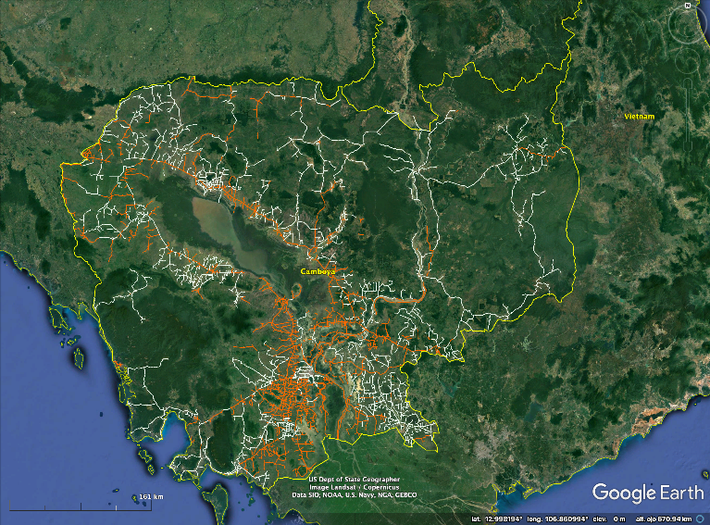
GEOSPATIAL ANALYSIS. INPUTS: Existing Infrastructure
Existing network:
Transmission lines
Distribution lines
GIS MV data available previous to the assignment
GIS MV data manually created by consultant
Cambodia LCEA, TTA 2020

Slide 14
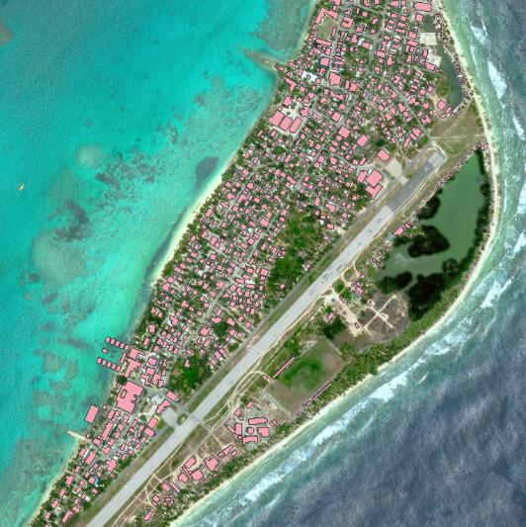
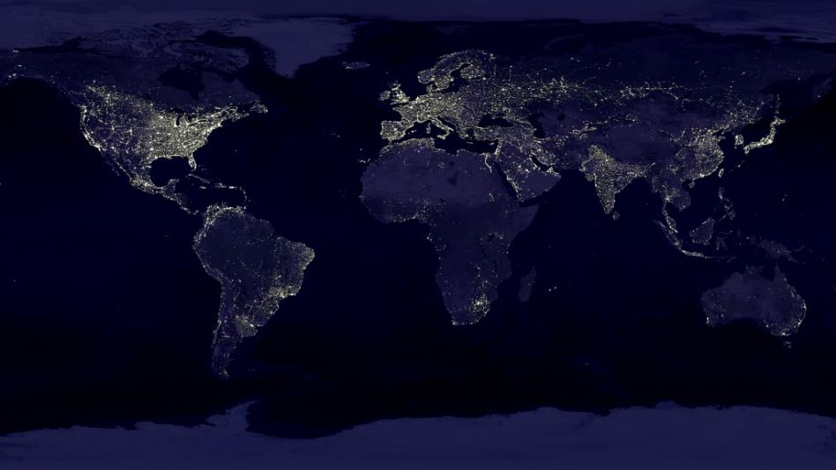
GEOSPATIAL ANALYSIS. INPUTS: Demographics
Typical resources for demographics data:
Census data from the country
Machine vision and A.I.
Many open databases available: OpenStreet Map (identification of roofs), High Resolution Settlement Layer –HRSL- (High resolution population dataset from Facebook), Nighttime Lights data, etc.
Rooftop analysis, TTA 2021
Worldwide nighttime light

Slide 15
GEOSPATIAL ANALYSIS. INPUTS: Power demand
Typical inputs for demand data:
Demand profiles, identification of different types and definition of profile
Use of tiers (ESMAP/SE4ALL)
Demand profile for a specific customer archetype (TTA)

Slide 16
GEOSPATIAL ANALYSIS. INPUTS: Costs and other assumptions
Typical inputs needed for costs and other assumptions:
Catalogue from utility (voltage levels, wiring, etc).
Cost of electricity from national grid
Unit costs per components
Diesel cost
Discount rate
Reliability
…

Slide 17
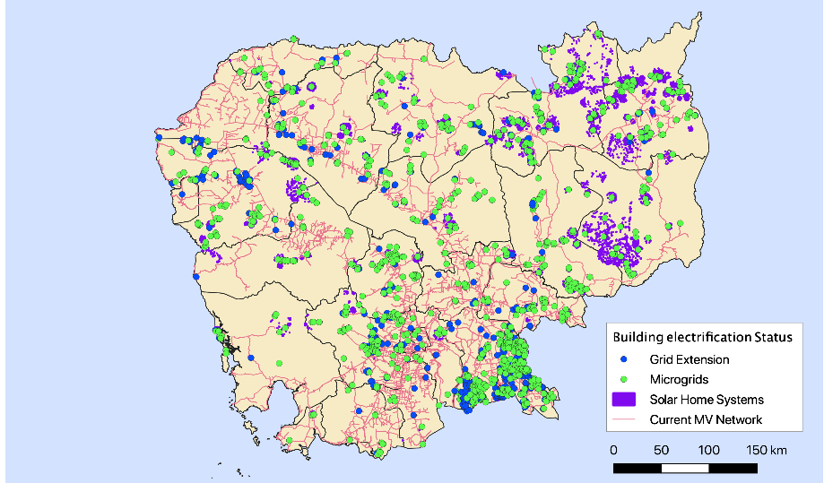
GEOSPATIAL ANALYSIS. RESULTS: EXAMPLE (CAMBODIA)
Country: Cambodia
Client: 3i, Cambodia
Year: 2020
Scope: Nationwide least-cost electrification analysis.
Consultant:
TTA + MIT-COMILLAS
Digital Tool: REM
Cambodia LCEA, TTA 2020

Slide 18
GEOSPATIAL ANALYSIS. RESULTS: EXAMPLE (CAMBODIA)
Table 1. Least-cost electrification solution summary for all 1000+ unelectrified villages in Cambodia
Parameter | Unit | Mini-grids | Isolated Systems | Grid Extensions | TOTAL
Number of Customers | Households | 66,096 | 24,414 | 68,780 | 159,290
 | % of total | 41% | 15% | 43% | 100%
Average CAPEX Per Customer | USD / customer | 911 | 500 | 673 | 694.6
Annual OPEX Per Customer | USD / customer - year | 25.25 | 0 | 44.51 | 69.76
Total CAPEX (Overnight cost) | Million USD | 60.2 | 12.2 | 46 | 118.4
 | % of total | 51% | 10% | 39% | 100%
Total OPEX | Million USD/year | 1.66 | 0 | 3.06 | 4.72
Fraction of Demand Served | p.u. | 0.957 | 1 | 1
Cost Per kWh of Demand Served | USD / kWh | 0.59 | 0.92 | 0.51

Slide 19
GEOSPATIAL ANALYSIS. IMPORTANT CONSIDERATIONS
Governments/public have qualitative ideas on the future development of the country and its energy system. Energy system models provide frameworks to quantitatively assess the implications of different energy policy / development options on the energy supply system
Models cannot predict the future, and models cannot make decisions.
Sensitivity analysis are essential.
Notes:
Energy models create a simplified image of the real-life energy systems by translating the components (e.g., power plants) and flows in the energy system into mathematical formulations. These equations represent a rule-based interaction between the key system components. These interactions are described using formulas. A very important thing to note about energy modelling is that energy modelling can provide insights but not answers. An energy model can help us understand the consequences of certain decisions or how we can meet a specific target.
Governments/public have qualitative ideas on the future development of the country and its energy system, for example: Policy goals (e.g., economic development, financial constraints, environmental constraints, energy security, rural development…), Preferred technology options (e.g., using domestic resources, increasing renewable energy share…), Future availability and prices of energy forms…, Public perception: may prefer some technologies over others. Energy system models can provide a framework to quantitatively assess the implications of different energy policies or different development options in the supply system. This means that the energy system modelling process can provide numbers to these qualitative goals to indicate what is the magnitude of cost for implementing a certain policy or trying to reach a specific electrification target. In addition, the modelling can give an indication about technology choices, for example, perhaps half the population would be electrified by stand-alone technologies vs. mini-grid or grid. Other conditions can be set by the stakeholders or result from external factors. These can change according to different national developments or the implementation of different policies.
Models cannot predict the future. There will always be uncertainties in the input parameters for a model that models future development. Uncertain parameters can be how the diesel price will evolve in the future, how PV panels costs will be reduced over the next 10 years, or what we believe that the energy demand will be. All of these are estimations based on different sets of information, but they can never predict what will happen in the future as there are so many uncertainties. What the model can help us with is to understand the future better. This allows the decision makers to stay prepared and take informed decisions. Exploring a plethora of different futures, strategies that are robust and will work under many different developments can be developed. However, one important thing to point out is that models cannot make decisions. The energy model can indicate a certain technology mix in order to meet a specific demand, under certain cost structures and technology options. However, under other cost structures or other demands the model can choose another mix with different investment costs and technologies.
Sensitivity
1. Decision-Making or Development of Recommendations for Decision Makers
Testing the robustness of an optimal solution.
Identifying critical values, thresholds, or breakeven values where the optimal strategy changes.
Identifying sensitive or important variables.
Investigating sub-optimal solutions.
Developing flexible recommendations which depend on circumstances.
Comparing the values of simple and complex decision strategies.
Assessing the "riskiness" of a strategy or scenario.
2. Communication
2.1 Making recommendations more credible, understandable, compelling, or persuasive
2.2 Allowing decision makers to select assumptions
2.3 Conveying lack of commitment to any single strategy
3. Increased Understanding or Quantification of the System
3.1 Estimating relationships between input and output variables
3.2 Understanding relationships between input and output variables
3.3 Developing hypotheses for testing
4. Model Development
4.1 Testing the model for validity or accuracy.
4.2 Seaching for errors in the model.
4.3 Simplifying the model.
4.4 Calibrating the model.
4.5 Coping with poor or missing data.
4.6 Prioritizing acquisition of information.

Slide 20
4. DIGITAL TOOLS AVAILABLE

Slide 21
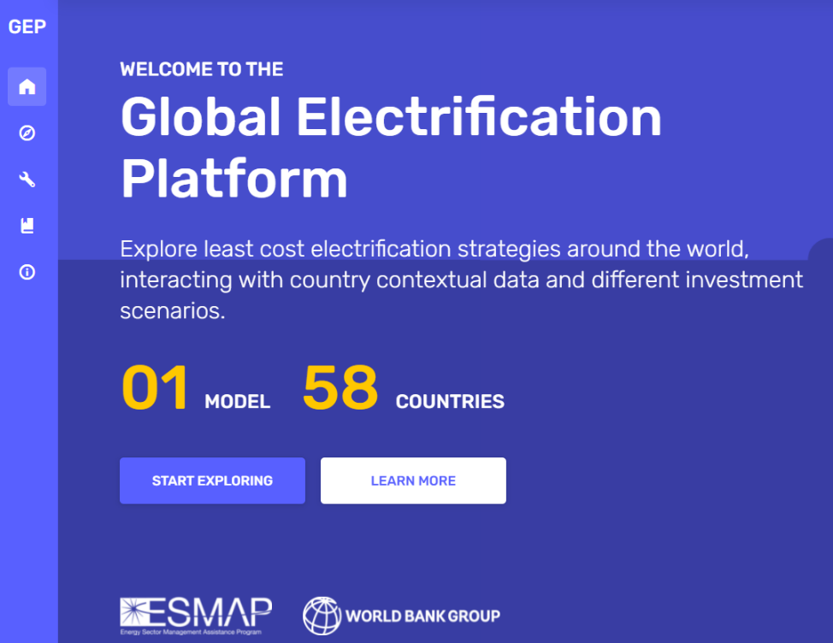
TOOLS. GLOBAL ELECTRIFICATION PLATFORM (GEP)
Free, Opensource
Since 2019
World Bank / ESMAP
Based on ONSSET model
58 countries. In the Pacific:
FSM
PNG
Vanuatu
Solomon Islands
Link:
https://electrifynow.energydata.info/
Notes:
Global Electrification Platform (GEP) which was developed by the consortium of following institutions:
World Bank, ESMAP, KTH, Development Seed, World Resources Institute, ABB, GOOGLE, and the University of Cambridge.
The GEP platform was launched in 2019 and is an open portal for electrification investment data, analysis, and research. It is being designed upon the principles of openness and transparency and aspires to enable reusability, replicability, and reproducibility of embedded processes and data. Based on these principles, GEP output is available in three levels:
Level 1 - GEP Explorer: Up-to-date and openly accessible electrification investment outlooks
Level 2 - GEP Generator: Open source User Interface (UI) for generating electrification outlooks on the fly
Level 3 - GEP Toolbox: Open access documentation and training material
There are four main target audiences for the GEP:
High-level decision makers that will use output from the GEP Explorer that produces geo-infographic investment options for all target countries.
Policy and investment analysts that will use the GEP Scenario Generator to develop tailored scenarios to meet specific policy or investment goals.
Data producers and ICT developers that will use the GEP Toolbox and have a target into which additional information and methods can be utilized (with global impact).
Global development organizations that will have a platform for country outreach. The software provides a springboard for tailored analysis and engagement from academia to project developers.

Slide 22
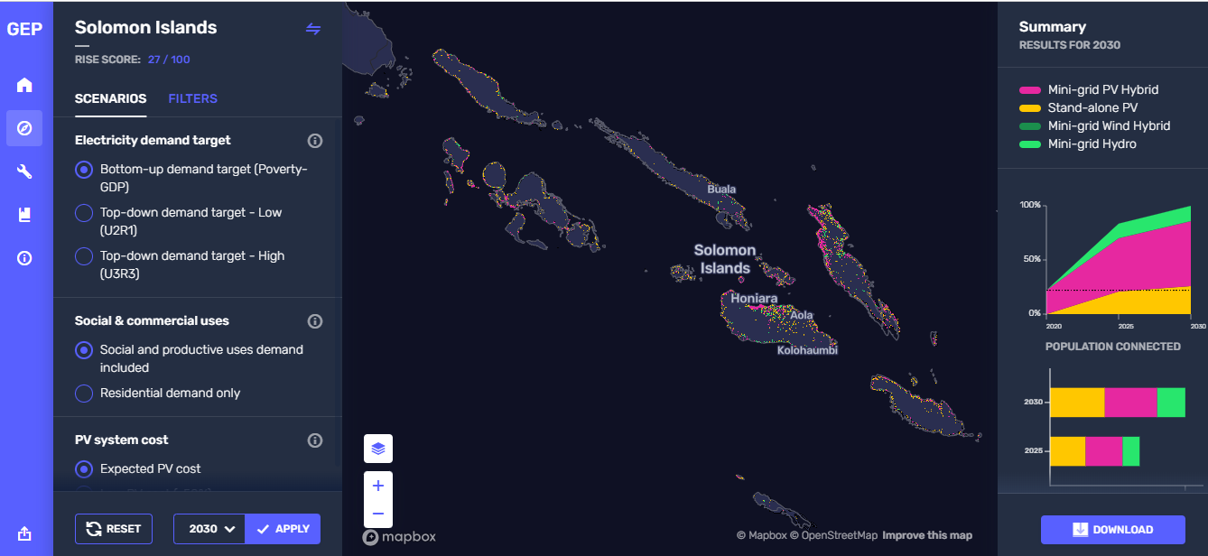
TOOLS. GLOBAL ELECTRIFICATION PLATFORM (GEP)
Notes:
GEP Explorer is an open access website where you can browse through different electrification scenarios. On the website there are up to 96 scenarios, per country for 58 countries. The results on the platform have been generated using the OnSSET model. These scenarios explore the least-cost electrification options for different demand targets, technology costs, and other important aspects.
From GEP you can also download the input data that you have used and you can run your own model on your computer using the OnSSET code, which is available on GitHub.
For your first hands-on you will use the GEP Explorer to explore the results.

Slide 23
TOOLS. Network Planner
Since 2013
Developed by Earth’s Institute, Columbia University (USA)
Characteristics:
The tool is freely available
Does not require advanced knowledge of GIS

Slide 24
TOOLS. OnSSET
Open Source Spatial Electrification Tool
Since 2015, developed by KTH Royal University of Technology (Sweden)
Characteristics:
Open Source model
Implemented in Python and QGIS
Notes:
As the name suggests, OnSSET is an open source model, which means anyone can access it through our GitHub repository (where repository is a directory or storage space online where your projects can live). And in order to run an analysis using OnSSET, you also need two other open source tools. The first tool is Python, which is a programming language that's needed to run the OnSSET code itself. And the second one is Q.G.I.S, which is a geospatial information system. This is software that is used to collect and process the geospatial data that is needed as input to the OnSSET code. It should be noted that you don’t have to be a programmer to use the OnSSET tool – it is only about having Python available on your computer. Also, the Q.G.I.S process could be replaced using other G I S software, such as Arc G.I.S or GeoPandas.
This tool is suited for national analysis, where every settlement is modelled individually. However, this tool does not provide a solution down to every single household. Instead, it provides the overall solution for every single settlement. Finally, the model can be customized to reflect the different contexts that might apply to different countries. There are around 15 geospatial datasets and 150 other input variables that can easily be updated for the specific country or region you're studying. This includes population and population growth, information on urbanization trends, the expected demand for electricity and target access rates, the costs of different technology options, and other technical factors such as loss of transmission and distribution (or T&D) networks.

Slide 25
TOOLS. Reference Electrification Model (REM)
Since 2015
Developed by Comillas Universal Energy Access Laboratory (UEA Lab) of Massachusetts Institute of Technology (MIT), USA in collaboration with IIT‐Comillas in Madrid, Spain
Characteristics:
Proprietary tool
High-level of spatial granularity
Solutions at the individual level
Takes into account grid reliability

Slide 26
TOOLS. Village Data Analytics (VIDA)
Since 2015
Developed by TFE Energy
Characteristics:
Proprietary tool
Good visualization platform
More info:
https://www.vida.place/

Slide 27
TOOLS. Odissey
Developed by TFE Energy
Characteristics:
Vertical integration, from financing to Procurement.
More info:
https://odysseyenergysolutions.com/

Slide 28
TOOLS. Examples
Pakistan (VIDA)
https://vida.villagedata.io
PNG (Fraym)
https://dashboard.pngelectrification.org/account/login/?next=/dashboard/

Slide 29
5. ADDITIONAL RESOURCES

Slide 30
Vinaka!
Roger SALLENT
Regional Team Leader for Asia – Pacific Trama TecnoAmbiental roger.sallent@tta.com.es

