Slide 1
Ministry of Meteorology, Energy, Information, Disaster Management, Environment, Climate Change & Environment and Communications (MEIDECC)
TONGA ENERGY ROAD MAP (TERM)
10 YEARS PLAN
(2010-2020)
PARTNERSHIP BETWEEN DONORS, DEVELOPMENT PARTNERS AND GOVERNMENT OF TONGA

Slide 2
Ministry of Meteorology, Energy, Information, Disaster Management, Environment, Climate Change & Environment and Communications (MEIDECC)
Contents
Socio-Economic and Environment Characteristics of Tonga in 2009 Compare to FOUR Other Pacific Islands
The Justified 3 Phases of the Tonga Energy Road Map (TERM)-2010-2020
Funded Development Activities under Each Phase of TERM (2010-2020)
Lessons Learnt
Recommendations for Donors Meeting

Slide 3
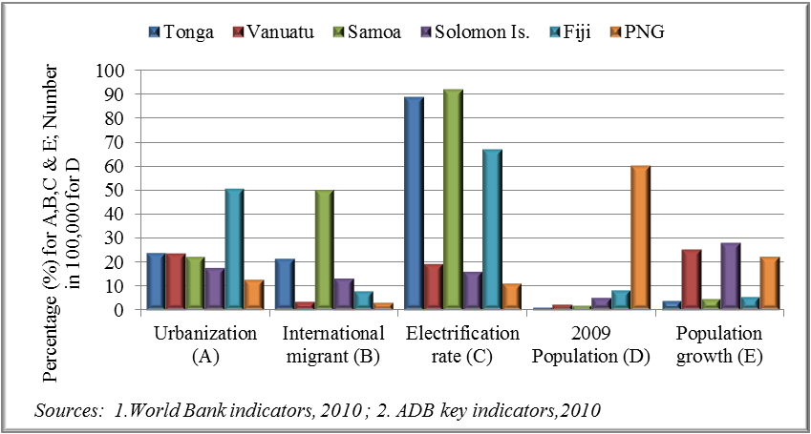
Ministry of Meteorology, Energy, Information, Disaster Management, Environment, Climate Change & Environment and Communications (MEIDECC)
Notes: A = Average urbanization rate; % in total population (2005-2009); B = International migrants as % of total population mid 2010 (X 10); C = Electrification rate in % of total households (ADB key Indicators for Asia Pacific 2010 (Latest Year) ; D = 2009 total population; in 100,000; E = Average population growth 2000-2009; in % (times 10)
Figure 3.2: Population and electrification rate

Slide 4
Ministry of Meteorology, Energy, Information, Disaster Management, Environment, Climate Change & Environment and Communications (MEIDECC)
High Migration and Urbanization in Tonga can influenced electricity investment in the country.
Urbanization raised consumption of energy and
Migration is reducing consumption of energy
Prepayment Meter[pay before use]
Fixed Electricity Tariffs[cross subsidy]
Regulation of tariffs

Slide 5
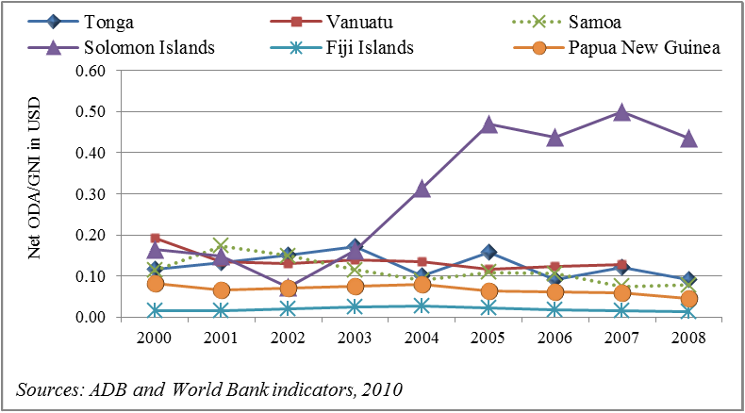
Ministry of Meteorology, Energy, Information, Disaster Management, Environment, Climate Change & Environment and Communications (MEIDECC)
Figure 3.3: Net ODA as a proportion of gross national income

Slide 6
Ministry of Meteorology, Energy, Information, Disaster Management, Environment, Climate Change & Environment and Communications (MEIDECC)
Recent ODA to the PIFDS has been doubled which should lead to improved efforts in the Policy Reform in all sectors
More reliance on ODA, so Energy Policy Reform to allow Private Sector Investment Environment
Private Investment Policy Incentives
PPA/IPP policy in Tonga
Regulatory Roles for PPA

Slide 7
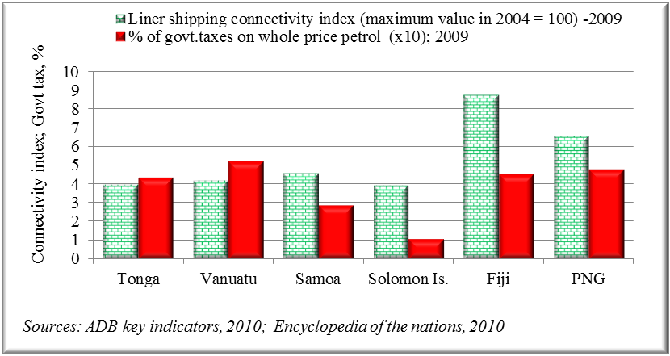
Ministry of Meteorology, Energy, Information, Disaster Management, Environment, Climate Change & Environment and Communications (MEIDECC)
Figure 3.5: Shipping connectivity index and government tax

Slide 8
Ministry of Meteorology, Energy, Information, Disaster Management, Environment, Climate Change & Environment and Communications (MEIDECC)
The values on the shipping connectivity index for PNG, Fiji and Samoa are higher than for Tonga, Vanuatu and Solomon Islands, and Petroleum Prices reflect the difference.
High Transport Cost for Isolation
Required Petroleum Business Model
MRX to reduce prices as occurred in Samoa

Slide 9
Ministry of Meteorology, Energy, Information, Disaster Management, Environment, Climate Change & Environment and Communications (MEIDECC)
Table 3.1: Economic indicators and electricity prices

Slide 10
Ministry of Meteorology, Energy, Information, Disaster Management, Environment, Climate Change & Environment and Communications (MEIDECC)
Table 3.1 indicates residential and commercial electricity prices in the countries. Countries with high electricity tariffs like Tonga have high debts and high fuel imports as % of GDP. PNG and Fiji show low debts and low electricity tariffs.
Some high debts countries can demonstrate cheaper tariffs due to Petroleum Business Model Adopted by the country
Reducing Dependence/Electricity Tariffs by increasing share of RE in Electricity Generation

Slide 11
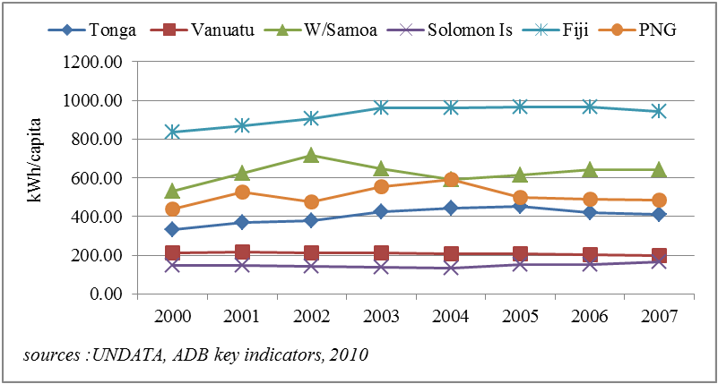
Ministry of Meteorology, Energy, Information, Disaster Management, Environment, Climate Change & Environment and Communications (MEIDECC)
Figure 3.7: Electricity consumption

Slide 12
Ministry of Meteorology, Energy, Information, Disaster Management, Environment, Climate Change & Environment and Communications (MEIDECC)
It reveals the higher level of investments which have taken place in Fiji, PNG and Samoa, to raise electricity consumption per capita to levels above the minimum consumption of 500 kWh/capita established by the World Energy Council(WEC) in 2007. In the case of Tonga, Vanuatu and the Solomon Islands, electricity consumption per capita was also below 500 kWh/capita.
Incentivised Private Investment and Business Environment are vital Policy Reform

Slide 13
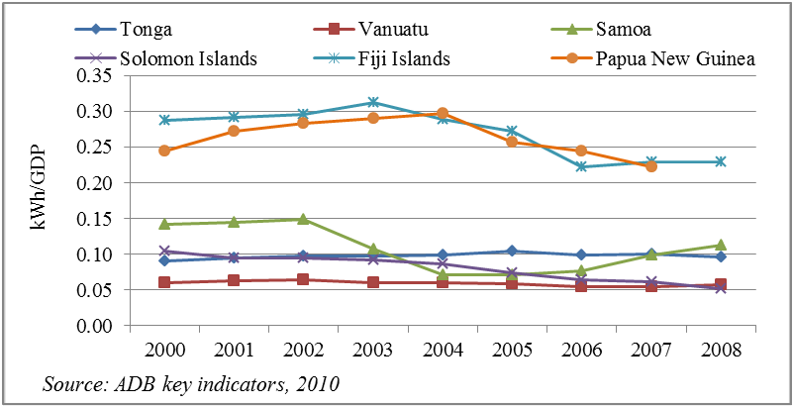
Ministry of Meteorology, Energy, Information, Disaster Management, Environment, Climate Change & Environment and Communications (MEIDECC)
Figure 3.8: Electricity intensity

Slide 14
Ministry of Meteorology, Energy, Information, Disaster Management, Environment, Climate Change & Environment and Communications (MEIDECC)
The decreasing trends of electricity intensities in the Solomon Islands and Vanuatu reflect their improved consumption efficiency.
Government political will and policies to Regulate and Monitor electricity intensity would help identify inefficient economic policies in each country.

Slide 15
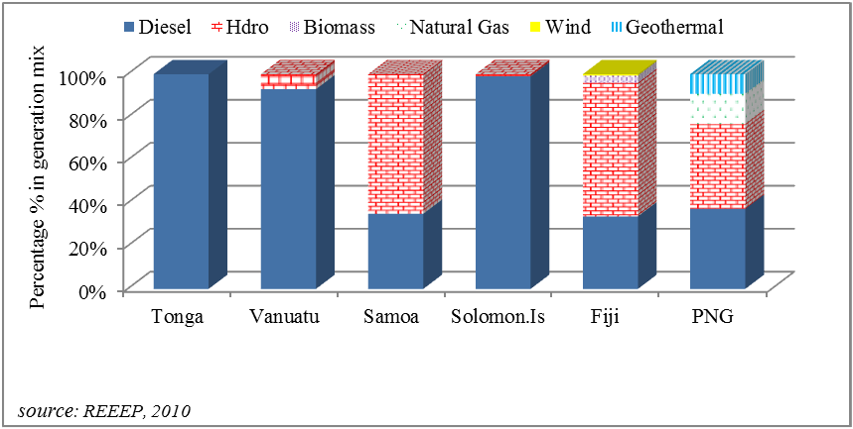
Ministry of Meteorology, Energy, Information, Disaster Management, Environment, Climate Change & Environment and Communications (MEIDECC)
Figure 3.9: Countries’ electricity generation mix

Slide 16
Ministry of Meteorology, Energy, Information, Disaster Management, Environment, Climate Change & Environment and Communications (MEIDECC)
The low generation mix in Tonga, the Solomon Islands and Vanuatu are both affected by their capacity to identify feasible alternative fuel resources.
Greater coordination between key stakeholders in assessing local renewable energy resources would help to overcome this problem. PRIVATE INVESTMENT , IPP , PPA on RE and EE is key to diversity of Generation Mix

Slide 17
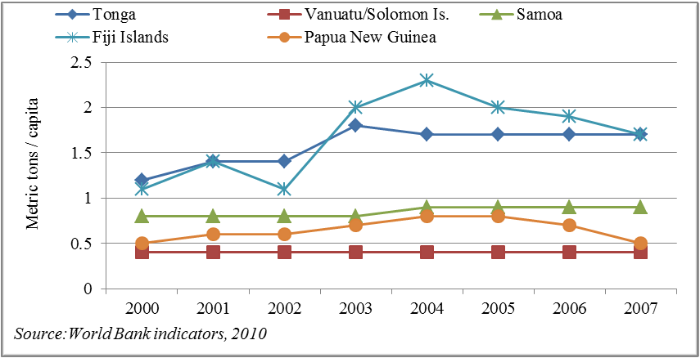
Ministry of Meteorology, Energy, Information, Disaster Management, Environment, Climate Change & Environment and Communications (MEIDECC)
Figure 3.11: Carbon emissions per capita

Slide 18
Ministry of Meteorology, Energy, Information, Disaster Management, Environment, Climate Change & Environment and Communications (MEIDECC)
Carbon dioxide emissions in Fiji felt from 2004 due to increasing use of hydropower and other renewable sources of electricity. Increasing needs for RE and EE projects

Slide 19
Ministry of Meteorology, Energy, Information, Disaster Management, Environment, Climate Change & Environment and Communications (MEIDECC)
TERM encompasses three phases:
Phase 0: Policy and Institutional Strengthening[Policy and Law]
Phase 1: Hardware Renewable Energy & EE projects Implementation.
Phase 2: Private Sector Participation, Efficiency and Renewable Energy Investments, and Regulatory Reform

Slide 20
Ministry of Meteorology, Energy, Information, Disaster Management, Environment, Climate Change & Environment and Communications (MEIDECC)
Phase 0 ACTIVITIES : Policy and Institutional Reform | STATUS
Petroleum Supply Chain Study and Reform are considered by GoT and decisions made on: Petroleum MRX _Cabinet endorsed [in 2019] Nationalization of Petroleum Supply/Storage in 2019 [20m T$ BUDGET] | No financial commitment; Not progressing well
2. Formulation of Energy Bill [Current], Cabinet also directed [2018] to Review, Modernize and MERGE all related Energy Acts with the Energy Bill | Progressing Well [EU EDF] TA and Financial Commitment
3. Data gathering activities and data collection and ENERGY data system[PRDR /SPC] ; and Energy data analysis [ESCAP /IEA] | Progressing Well SPC /ESCAP Commitment
4. Endorsement of Minimum Energy Performances for Electricity Appliances in Tonga; Formulation of Energy Efficiency Bill | Not Progressing Well
5. Finalization and Launching of Tonga Energy Efficiency Master Plan | Progressing Well GCF and CTCN TA/Financial
6. TERM PLUS AND REEEP III Policy and Institutional Reform | Progressing Well EU/EDF TA
7. Review of Off-grid electrification Policy and Institutional business model programme launched | Progressing Well GCF Readiness
8. Review of 10 Mini-grid Operational and Maintenance Cooperative Society Policy and Institutional Model | Progressing Well ADB/DFAT/EU/GEF
9. REVIEW and endorsement of Policy for implementation of TVNUPP and NUPP | Progress Well , MFAT
10. Feasibility Study of Concept Coconut Oil (660,000l/yr) + a 160kW Waste Gasifier Project. Operation, maintenance and training contract in place | Slowly Progressing
Implementation of independent power producer (IPP) Policy | Ongoing

Slide 21
Ministry of Meteorology, Energy, Information, Disaster Management, Environment, Climate Change & Environment and Communications (MEIDECC)
Phase 1 ACTIVITIES : HARDWARE RE AND EE | STATUS
1. Implementation of second-generation end-use efficiency DSM measures and supply side energy efficientstreet lights (200,000 USD) | Completed ; DFAT WORLD BANK
2. Implementation of 1 MW on-grid solar PV on Tongatapu in 2009 and 0.5 MW in Vava’u in 2012 (15m USD) | Completed MFAT and UAE
3. 1MW SOLAR on-grid and Battery Storage ( 10m USD) | Completed, JICA
4. On-grid solar power 200 KW on ‘Eua, ; 550 KW on Ha’apai, and Network Upgrde inVava’u in 2017-2018 under OIREP ( 13 m USD) | Completed ; ADB DFAT
5. Solar power Minigrids Nomuka Island ( 70 KW) Haafeva (150 KW), Uiha (100KW) Haano (70KW) and Niuatoputapu (150 KW) ( 9.60 Mm USD) | Ongoing ADB, DFAT
6. Solar Home Systems NIUFO’OU and Solar Hospital (0.2M USD) | Completed DFAT , ADB
7. Tonga Village Network Upgrade Project (28 m NZD | COMPLETED , MFAT
8 Nukualofa Network Upgrade Project (52.3 m NZD) | on-going , MFAT
9. Pacific Environment Community ; Solar Water Pump ( 4m USD) | Completed
10. Climate Change Appliances (40 m USD) | Completed , China
11. Tonga Renewable Energy Project (52.3 m USD) | Currently Installed ;GCF, ADB, GEF
12. EU Energy Budget Support (EU EDF 11TH ) 11m EURO | EU
13. 258 Solar Pump (40m USD) | International Solar Alliance, ISA , Currently Procured
14..

Slide 22
Ministry of Meteorology, Energy, Information, Disaster Management, Environment, Climate Change & Environment and Communications (MEIDECC)
Phase 2 ACTIVITIES : REGULATORY AND PRIVATIZATION | STATUS
A formal analysis of the data and findings from the hardware projects | Progressing
2. Experiences from the Private Sector Investment power purchase agreement; IPP | Progress
3. Stakeholders Consultations on Formulation of National Energy Bill | Progress
4. Review , Modernize and Merge Energy Related Acts and Bylaws | Progress
5. Most of Energy Issues , including energy tariffs are finalized by government , until the Energy Bill is passed | Progress
Energy Efficiency Bill will be formulated and finalized to umbrella the implementation of Pacific Appliances Labelling and Standard | Seek Funding

Slide 23
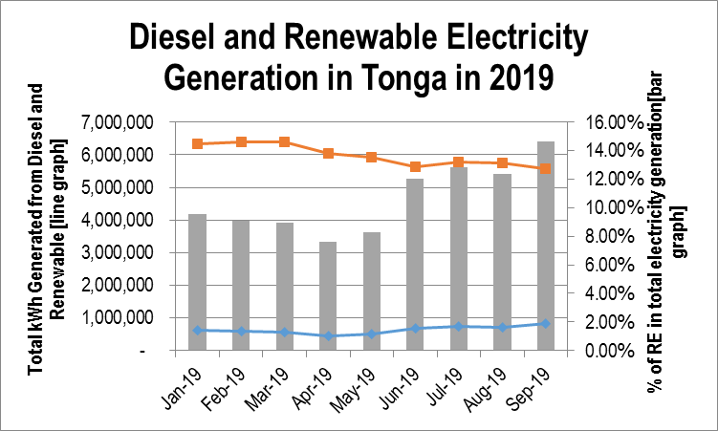
Ministry of Meteorology, Energy, Information, Disaster Management, Environment, Climate Change & Environment and Communications (MEIDECC)
Total Electricity Generation and Total Share (%) of Renewable Energy in 2019.

Slide 24
Ministry of Meteorology, Energy, Information, Disaster Management, Environment, Climate Change & Environment and Communications (MEIDECC)
Lessons LEARNT :
Very Timely Policy and Institutional Reform
People is keen to know the impact of CLIMATE Changes on environment, but more interesting on impacts of RE on electricity tariffs
Very slow to achieve target on share of RE in Total Electricity Generation.
Very Fast and Easy to ACHIEVE the target for reducing network losses up to 11%, due to electricity network upgrade project
Private Sector Investment has occurred in the Generation Sector , so we may need to improve IPP & PPA , but especially the regulatory roles and incentives in the generation sector.
Very hard to improve and achieve the TERM outputs without sufficient donors assistances.

Slide 25
Ministry of Meteorology, Energy, Information, Disaster Management, Environment, Climate Change & Environment and Communications (MEIDECC)
RECOMMENDATIONS.
We have evidences that Samoas have nationalized their Petroleum Supply and Distribution, which has great impacts on dropping energy prices in the countries. Cabinet in Tonga has already endorsed the Nationalization of Petroleum Supply and Distribution in 2019. That Government ,Development Partners, Oil Companies and Donors put together capable technical and financial efforts to nationalize the petroleum industry in Tonga
While the whole World is moving towards fulfilling their commitments on NDC under Climate Change Agreement. That DONORS, Government , Development Partners and Private Sector continue to build partnerships on Policy,and Regulatory Reform as well as Installation of Least Cost Approach RE and EE hardware
While there is great need for future transfer of new technologies[50%;70%;100%] to small islands countries like Tonga, That transfer of software knowledges capacity building to recipient country , be included in the programme and project budget.
That Research and Innovation on RE and EE technologies be promoted and enforced in Tonga, through including budget in development programme.

Slide 26
THANK YOU

