Slide 1
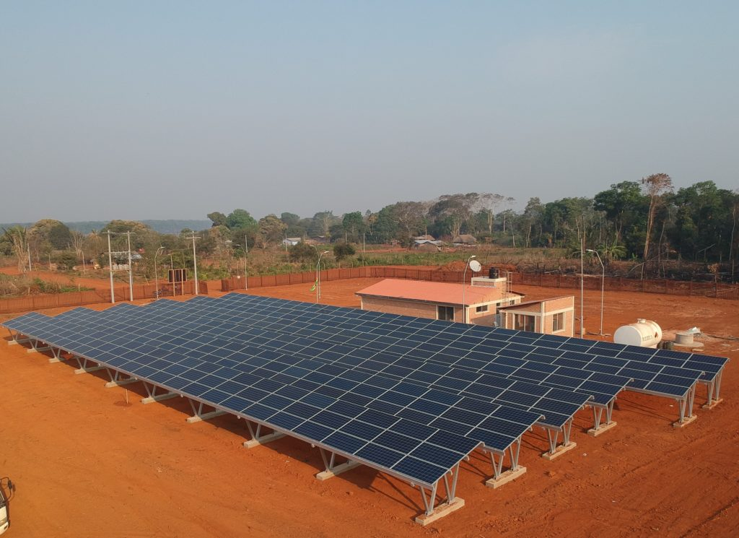
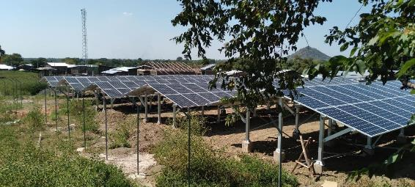
0.2 Mini-Grid Introduction
MG in Bolivia by TTA
Unlocking MG for sustainable development
Suva, Fiji
June 26th-30th, 2023
MG in Ethiopia by TTA
Roger SALLENT Regional Team Leader for Asia – Pacific Trama TecnoAmbiental, S.L.
roger.sallent@tta.com.es

Slide 2
CONTENTS
Session objectives
Grid vs Off-grid
Mini-grid definition
The role of Mini-grids

Slide 3
1. Session objectives

Slide 4
SESSION OBJECTIVES
Understand the key characteristics of off-grid projects
Highlight the importance of mini-grids globally

Slide 5
2. GRID VS OFF-GRID

Slide 6
GRID VS OFF-GRID
When working in rural electrification projects, we are very often tempted to look at the conventional main grids as a reference.
This section highlights some of the key differences between off-grid projects and conventional main grids and proves that the later are a misleading reference for electrification projects.
Along this document “main grid” refer to power grids supplying main urban areas in a country, and typically with a high reliance on fossil-fuel generation. On the other hand, “off-grid” refers to electrification based primarily on renewable energies and including both collective and individual power systems (mini-grids and stand-alone systems, respectively).

Slide 7
GRID VS OFF-GRID. ELECTRIFICATION PLANNING
 | MAIN GRID | OFF-GRID
PLANNING | Very substantial capital investments needed to expand infrastructure. There are no middle-ground solutions Technical standardization is critical to ensure compatibility. Infrastructure is typically operated by a single entity nationwide or for large region (utility). → TOP-DOWN and CENTRALIZED planning is typically needed. | Multiple operators, owners and developers other than the main utility might be possible depending on the country. The need for technical standardization is not so strong. Interconnection chances might be low in some communities, and even if they are high, existing technology facilitates interconnection. It might not be feasible to centralize under a single entity the planning and implementation of all off-grid projects in a country if electrification needs are high. The resources (human capital, funds, etc) might not be affordable. → In addition to the top-down and centralized approach, BOTTOM-UP and DECENTRALIZED approach might be an alternative.

Slide 8
GRID VS OFF-GRID. ELECTRIFICATION PLANNING
 | MAIN GRID | OFF-GRID
LEAST-COST ELECTRIFICATION APPROACH | High energy demands justify dedicated grid extensions and service drop lines for every single customer → APPROACH: GRID EXTENSION | Low energy demands and/or remoteness of customers do not justify their connection to a grid → APPROACH: Combination of: MINI-GRIDS: for those customers with higher demands, with higher abilities to pay, and which are more clustered; STAND-ALONE SYSTEMS: for those customers with lower demands or that are geographically more isolated; and SOLAR KIOSKS: for those customers with very low and sporadic energy needs (e.g.: cellphone or lantern charging).

Slide 9
GRID VS OFF-GRID. DEMAND CONSTRAINTS
 | MAIN GRID | OFF-GRID
CAPACITY (kW) | CONSTRAINED by distribution grid and service drop line cable sections and protections. → Main circuit breaker needed to protect the system. | CONSTRAINED by distribution grid and service drop line cable sections and protections. → Main circuit breaker needed to protect the system.
ENERGY (kWh) | NOT CONSTRAINED, it is unlimited from the customer’s perspective. From a generation stand-point higher demands can generally be satisfied by using more fuel. | CONSTRAINED by generation and storage capacities. From a generation perspective, there is no control over the renewable energy resource (e.g.: sun) so there is less flexibility to accommodate fluctuating demands. → Energy limiter would be suitable to ration available energy.

Slide 10
GRID VS OFF-GRID. COSTS & TARIFFS
 | MAIN GRID | OFF-GRID
GENERATION COSTS | Dominance of VARIABLE costs: primarily fuel costs. | Dominance of FIXED costs: primarily CAPEX costs. There are little or no fuel costs at all.
TARIFF APPROACH | → Variable (USD/kWh) to recognize the marginal cost of energy or → Two-part (USD/kW/month + USD/kWh) if fixed costs are to be reflected also | → Fixed (USD/month)* to recognize the investment costs of the system, or at least two-part tariff, but never variable. (*) with different levels depending on EDA.

Slide 11
GRID VS OFF-GRID. INDOOR WIRING AND APPLIANCES
 | MAIN GRID | OFF-GRID
INDOOR WIRING | Buildings are robust and can withstand conventional indoor wiring, switches and sockets. Customers can easily reach qualified technicians to install wiring or fix it. → Electricity service ends at the meter, indoor wiring is done by the customer. | Buildings often do not follow same standards as in urban settings Access to qualified personnel might be challenging. Customers might not have financial capacity to pay for the indoor wiring. → Indoor wiring should be included as part of the intervention (electrification project)
APPLIANCES | Customers can easily find appliances in the market. After-sales services are available and in the need of repair there are technicians Customers are well educated in energy efficient options → Electricity service ends at the meter, no appliances are included as part of service | Customers can hardly access appliance shops and even less after-sales services or technicians to fix the appliances in case of failure. Market information is limited, and customers are not versed in energy efficiency → Basic appliances should be included for residential customers

Slide 12
GRID VS OFF-GRID. INTEGRATION OF SERVICES
 | MAIN GRID | OFF-GRID
INTEGRATION APPROACH | Global trend towards the promotion of unbundling electric utilities into their basic business segments (generation, transmission, distribution, retail) to promote their efficiency. → Unbundled power utilities, different companies for different segments (generation, transmission, distribution and retail) → Specialized companies, different for the supply of power, water, telecommunications, gas, etc* (*) Small countries with public utilities often combine the provision of multiple services. Likewise, in some countries with liberalized utilities, companies are combining more than one service (e.g. electricity and domestic gas) | Limited scale and limited abilities to pay do not allow for dedicated staff for the provision of each service separately. Small team (1 person in most of the cases) can handle O&M and customer management of multiple utility services (electricity, water, telecommunications, and or gas) There are strong synergies in the integration of the different services during construction stage (e.g: use same poles or trenches for the distribution of different services) and also during O&M. → Bundled Service Providers, offering multiple services. The benefits of integrating the services can help in making the business case more compelling while keeping tariffs affordable and maximizing the impact on local development.

Slide 13
GRID VS OFF-GRID. GRID STANDARDS
 | MAIN GRID | OFF-GRID
GRID STANDARDS | Historical heritage. Historical reasons determine the grid and service standards. Compatibility is a priority. Changes not possible. Large scale do not facilitate changes or innovative approaches → Technical requirements are unified at national level and are difficult to change. They are based on AC current. | Complexity. Main grid standards might not be adjusted to local needs in rural contexts, which are characterized by lower energy demands than in urban areas. Absence of qualified personnel. Grid standards might be difficult to achieve due to the lack of local technical capacity, specially in Medium Voltage. Safety. Safety becomes critical as infrastructure in remote locations tends to follow lower standards (including the households). Space for innovation. Smaller and new infrastructures allow to innovate with different approaches, including swarm-grids DC appliances. The offer of appliances that can be connected directly in DC is continuously growing. → Both AC and DC services can be observed. The use of low voltage facilitates both installation and later O&M as no specialized linesmen are needed.

Slide 14
GRID VS OFF-GRID. E-WASTE
 | MAIN GRID | OFF-GRID
ELECTRIC AND ELECTRONIC WASTE MANAGEMENT | Consolidated waste management streams. Urban areas typically have waste management policies in place, population is informed about how to handle the waste, and there are collection points for each type of waste more or less available. → Electricity provider is not concerned about waste, as this is being handled independently. | New stream of waste. Electrification comes with the generation of a new stream of waste for the community, composed by batteries from stand-alone systems, but also from the appliances at the end of their life-cycle. No information on e-waste. Since electrification comes for first time with the intervention, the population is not well informed on how to deal with waste. No waste management habits. Typically off-grid areas do not have waste management policies implemented. Waste is often burned and in the case of e-waste, it is typically dumped uncontrolledly. → The Service Provider should play a role in the management of all the e-waste generated in the community.

Slide 15
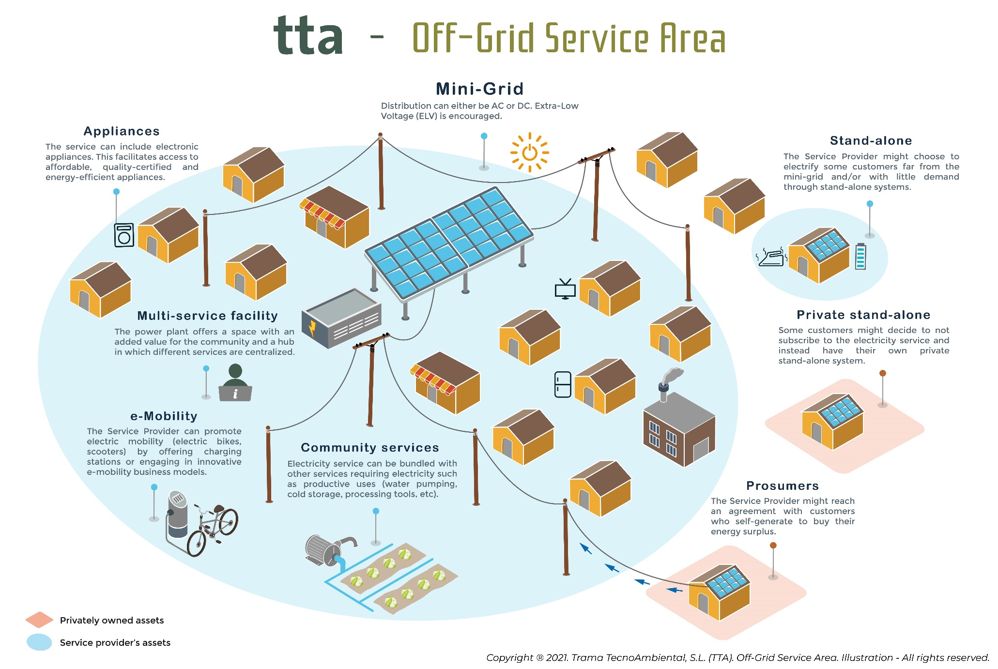

Slide 16
3. MINI-GRID DEFINITION

Slide 17
MINI-GRID DEFINITION
A mini grid, also sometimes referred to as a "micro grid or isolated grid", can be defined as a set of electricity generators and possibly energy storage systems interconnected to a distribution network that supplies electricity to a localized group of customers.
Sizing: There is no one single definition about the size of the mini-grids. Some organizations define mini-grids in terms of the generation capacity i.e. between 10 kW to 10 MW. Others define it in terms of customers reached i.e. mini-grids reaching 20-100 customers are called micro mini-grids and mini-grids reaching over 500 customers are called full mini-grids. A general consensus is that mini-grids should supply more than a few kW of electricity to multiple consumers such as community, hospitals or schools.
Source: Energypedia
https://energypedia.info/wiki/Mini_Grids#Definition_and_Overview

Slide 18
4. The role of mini-grids

Slide 19
ENERGY ACCESS WORLDWIDE. ACHIEVING SDG 7
Source: IEA, IRENA, UNSD, World Bank, WHO. 2023. Tracking SDG 7: The Energy Progress Report. World Bank, Washington DC. © World Bank. License: Creative Commons Attribution—NonCommercial 3.0 IGO (CC BY-NC 3.0 IGO).

Slide 20
SDG7. THE ROLE O FMINIGRIDS
Where we need to be to reach universal access by 2030:
490 million people served at least cost by 217,000 mini grids, almost all solar-powered, requiring an investment of $127 billion.
Source: Energy Sector Management Assistance Program. 2022. Mini Grids for Half a Billion People: Market Outlook and Handbook for Decision Makers. Washington, DC: World Bank. www.esmap.org/ mini_grids_for_half_a_billion_people.

Slide 21
MINI-GRID PROJECTS. WHY ARE THEY SO CHALLENGING (& BEAUTIFUL)
Technical
Financial
Legal
Political
Economic
Social
Environmental
Mini-grids projects are not just a simple engineering project, but rather a complex system that requires multidisciplinary perspective.

Slide 22
Vinaka!
Roger SALLENT
Regional Team Leader for Asia – Pacific Trama TecnoAmbiental roger.sallent@tta.com.es

