Slide 1
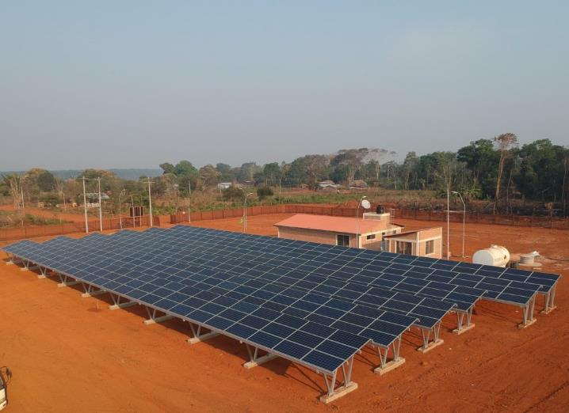
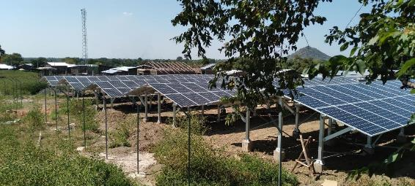
0.1 Workshop Introduction
MG in Bolivia by TTA
Unlocking MG for sustainable development
Suva, Fiji
June 26th-30th, 2023
MG in Ethiopia by TTA
Roger SALLENT Regional Team Leader for Asia – Pacific Trama TecnoAmbiental, S.L.
roger.sallent@tta.com.es

Slide 2
CONTENTS
About TTA
About the Audience
About this Workshop

Slide 3
1. About tta

Slide 4
Who are we?
Trama TecnoAmbiental, S.L (TTA) is a global consulting and engineering company with headquarters in Barcelona, Spain. Since its founding in 1986, it has been fully committed to a sustainable energy development. TTA has been providing specialized services in distributed renewable energy generation, energy management and efficiency, rural electrification, self-generation, integration of renewables in buildings, sustainable architecture, as well as specialized trainings and capacity building.
Policy and regulation, energy planning, delivery models, technical and economic due diligence, feasibility studies, procurement and transaction advice.
CONSULTANCY
Concept and detailed design engineering, owner’s engineering.
ENGINEERING
Capacity building, trainings for users and technicians, organization of the S-@ccess International Conference
KNOWLEDGE
HUB
Turn-key projects (EPC), O&M
WORKS
Product development for special energy access applications (energy dispensers and remote monitoring and control for mini-grids)
+35 years of experience in the off-grid sector worldwide +200 projects successfully implemented across 6 continents
PRODUCT DEVELOPMENT

Slide 5
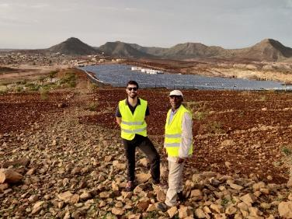
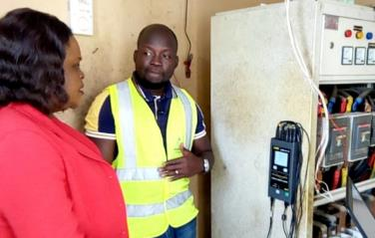
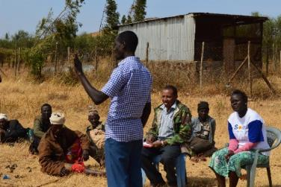
Consultancy services
Full range of cross-cutting engineering and consulting services for Energy Access and Renewable Energy projects (on-grid and off-grid)
-Distributed generation with Renewable Energy sources (PV, wind, micro-hydro, biomass):
Autonomous micro-grids and mini-grids (isolated/peri-urban)
Generation plants off-grid/grid-connected
Individual standalone systems
-Energy management and increased efficiency
-Integration of Renewable Energy systems into buildings
Inception
Energy Audits, Situational analysis, strategic planning and least-cost analysis
Feasibility
Technical, economic and environmental feasibility study, preliminary design
Engineering
Detailed engineering and technical specification for tenders
Construction
Work and construction supervision or Turn-key
Technical and HSE Due Diligence assessments in Sub-Sharan African projects
Notes:
Project identification and evaluation;
Technical and Economic feasibility studies;
Assessment of renewable energy sources;
Engineering studies;
Social and environmental impact assessments;
Owners Engineering services;
Preparation of technical specifications and bidding documents;
Support during procurement;
Construction supervision;
Monitoring services;
Operation and Management services;
Project promotion and dissemination.

Slide 6
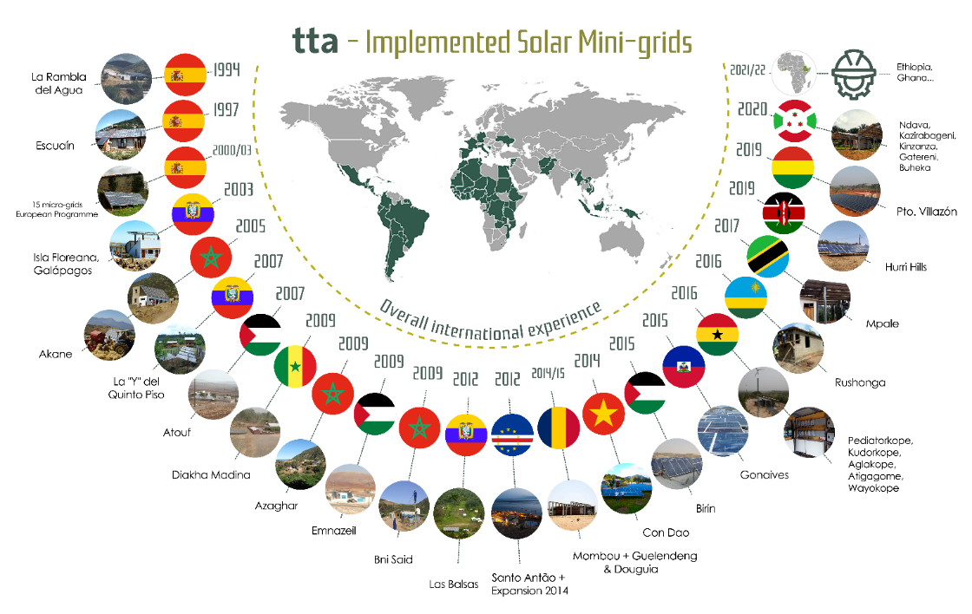
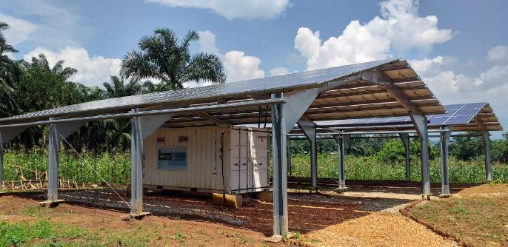
Engineering Procurement & Construction (EPC)
TTA has implemented mini-grids as EPC contractor in Burundi, Ghana, Chad, Cape Verde, Ecuador, Palestine, Morocco, etc. some of which have been operated and maintained by TTA itself.
Some Videos:
Tanzania: https://youtu.be/Pd3NCphnOs0
Chad: https://youtu.be/J0YmR0fRMuc
Ghana: https://youtu.be/NIbFpRHK8YU
Burundi: https://youtu.be/EOkjXVC2Q0c
Mini-grid implemented by TTA in Kenya

Slide 7
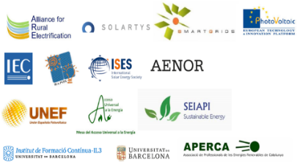
Other activities
Policies and Regulation support
Trainings and Capacity Building
R&D
“S-@ccess International Conference on Solar Technologies & Hybrid Mini Grids to Improve Energy Access”
TTA’s expertise in off-grid electrification is demonstrated by its continuous participation in the forefront of the sector. In terms of publications, TTA participated in the publication of Kenya Market Assessment for Off-grid Electrification, and it is author of the World Bank’s ESMAP Benchmarking study of Solar PV mini-grids investment costs (2017). Another significant milestone in the sector is TTA’s lead organization of the International Conference on Solar Technologies & Hybrid Mini-grids to improve energy access, a relevant sector event which is supported by organizations such as EnDev, GIZ, SNV or the World Bank.
TTA is an active member of European and International Technology Committees, among others: International Electro-technical Commission (IEC), IEA PVPS, EU PV Platform, EU Smart-Grids Platform. TTA is a founding member of the Alliance for Rural Electrification (ARE) and its Director served as Board member for three years until 2015.
Member of:

Slide 8
Some of our clients

Slide 9
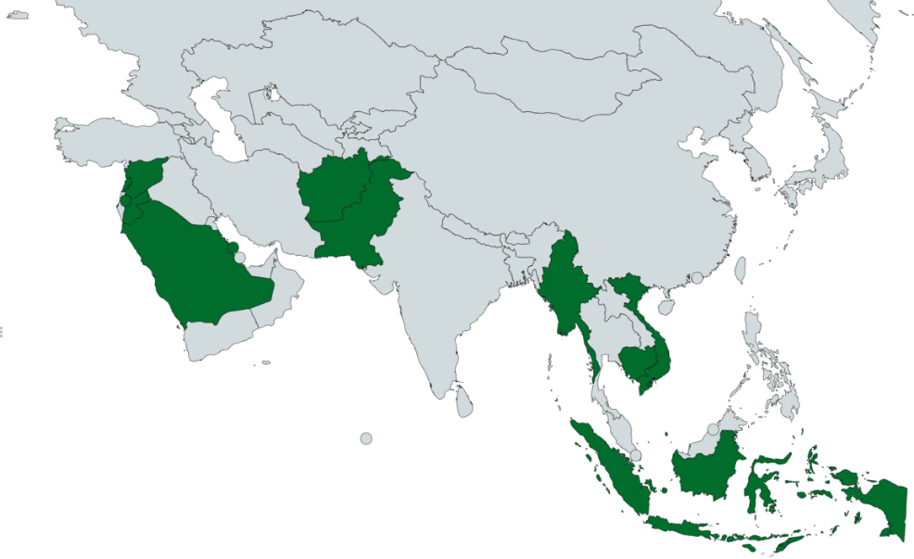
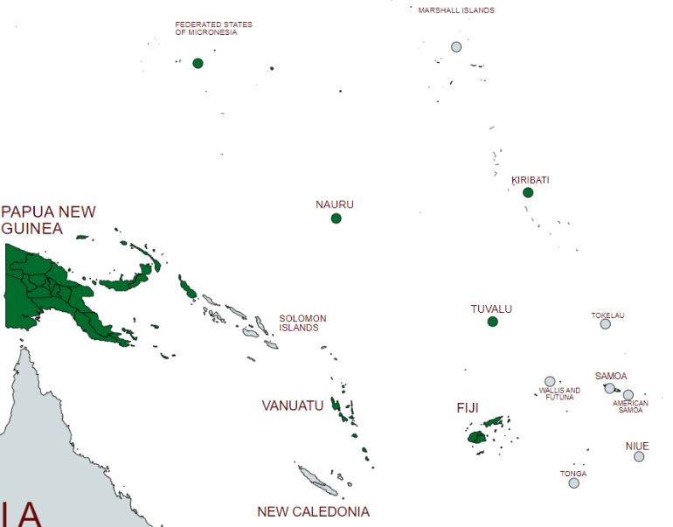
Project references IN ASIA-PACIFIC
+40 projects across Asia and Pacific regions
Wide variety of services offered
TTA’s project experience in Asia and Pacific regions

Slide 10
Project references APAC
Title of Project | Client | Country | Major Activities
Homer Pro Training to URA Staff | Utilities Regulatory Authority (URA) | Vanuatu | Three HOMER Pro® Training Sessions were provided for 14 URA and DoE staff. Build in-house capacity in the Vanuatu's regulator team to assess technical and financial feasibilty of project, informed through system simulations.
PNG Small Grid - Technical Consultant | IFC/WB | Papua New Guinea | IFC is manded by PPL to explore what it can do to attract the private sector for power generation in remote centers, to improve the reliability and the quality of power supply and reduce financial losses. IFC has contracted TTA to provide technical support during due diligence, transaction structuring and tender process implementation.
BPA General Energy Transition Consultancy Services (INA) | UNOPS | Indonesia | Prioritization of projects and development of Concept Notes to get funding from the Energy Transition Partnership (ETP)
International RE&EE Project Implementation Expert | Department of Climate Change and National Resilience (DCCNR) | Nauru | Support in the identification and implementation of pilot projects related to Renewable Energies and Energy Efficiency.
Sustainable Energy Financing in the Pacific | Economic Consulting Associates Ltd (ECA) | Fiji, Papua New Guinea, Vanuatu | Developing a concrete pipeline of projects and exploring how specific financing instruments can be used to support these projects. This will be supported by a comprehensive market and enabling environment assessment.
Design regional e-mobility policy framework and technical guidelines in the Pacific Island Countries (PICs) | ECA - Economic Consulting Associates | Pacific Islands Countries (PICs) | The key objective of this assignment is to assess the potential costs and benefits of more widespread e-mobility uptake across the PICs and develop concrete recommendations on how the key barriers can be overcome. By producing specific assessments and guidelines to support stakeholders to overcome key barriers such as managing the impact on renewable-heavy grid systems and the rollout of charging facilities, there is the potential to develop a range of bankable investments in the sector and develop a coherent policy which will ultimately reduce total greenhouse emissions from the transport sector.

Slide 11
Project references APAC
Title of Project | Client | Country | Major Activities
Sustainable Energy for Telefomin, Papua New Guinea : Scoping Mission | UNOPS | Papua New Guinea (PNG) | The project’s main objectives were to develop practical and sustainable solutions to the provision of energy access in Telefomin, one of PNG's most remote and inaccessible districts, thereby introducing pathways between reliable electricity and development outcomes such as better incomes, health and increased education. The services consisted of providing a framework for introducing an optimal set of technologies for the local mini-grid using a solar PV/hydropower hybrid system. The existing electricity distribution network was not operating due to the malfunction of the primary transformer at the hydropower station. Public services, businesses and residents were relying on stand-alone diesel generators and solar PV arrays.
Updated Feasibility Study & Detailed Design of a Hybrid Power System, at Mirwais Regional Hospital in Kandahar | International Committee of the Red Cross (ICRC) | Afghanistan | Feasibility study and design of a Photovoltaic solar system adapted to the existing site conditions and to be able to operate in the most efficient way depending on the load and the availability of the existing power sources.
Least-Cost Electrification Study & Mini-grid Portfolio Readiness Assessment for Pakistan | Instituto de Investigación y Tecnologia (IIT) / World Bank | Pakistan | The objective is the execution of a Geospatial-based least-cost electrification study that identifies the optimal route for electrification through grid expansion and off-grid services in Pakistan, as well as recommendations for implementation of policies, actions and investments to achieve universal electricity access. The work also includes detailed analysis on potential mini-grid clusters to support future development of identified mini-grid potential.
Owners Engineer (OE) for demo Pico Hydro PV solar Hybrid mini-grid at Loltong on Pentecost | Department of Energy (DoE) Vanuatu | Vanuatu | Within the context of the UNDP implemented and GEF funded “Support to the Government of Vanuatu on Barrier Removal for Achieving National Energy Road Map Target of Vanuatu (BRANTV)” project, the overall objective of this specific assignment consisted of assisting DoE with the implementation of a Pico Hydro PV solar Hybrid mini-grid to electrify 107 users in Loltong, North Pentecost. As Owner’s Engineer, the services of this mandate included the required supervision and support to ensure the implementation of the project with a high standard of design and workmanship, on schedule and within budget. The project has been envisioned as a demonstration to provide the DoE with the required tools to develop a total of 12 additional similar projects in other regions of the country.
Consultancy Services for the Design of Mini-grids in Udot | Department of Resources and Development (National Government of the FSM) | Federated States of Micronesia (FSM) | The general objective was to provide technical support, as Owner’s Engineer, to the FSM’s Department of Resources & Development (DRD) and the Chuuk Public Utility Corporation (CPUC) to validate field data for the design of the microgrids and provide technical information for the bidding documents for installation of microgrids in Udot, Chuuk State.
Site Assessment Services for Design of Solar Panel Systems in Three Hospitals in Papua New Guinea | United Nations Office for Project Services (UNOPS) | Papua New Guinea | Support UNOPS with the gathering of specific site-related information including through field visits, and presenting site assessment reports, to be used for the system design and sizing of anticipated battery-backup solar photovoltaic (PV) systems, at three hospitals in Papua New Guinea: Daru Hospital (Western Province), Kerema Hospital (Gulf Province), Popondetta Hospital (Oro Province).

Slide 12
Project references APAC
Title of Project | Client | Country | Major Activities
Engineering Services for Renewable Energy Projects in Funafuti | Tuvalu Electricity Corporation (TEC) | Tuvalu | The Energy Sector Development Project (ESDP) aims at enhancing Tuvalu’s energy security by reducing its dependence on imported fuel for power generation and by improving the efficiency and sustainability of its electricity system. Under ESDP, the Tuvalu Electricity Corporation (TEC) has implemented with the support of TTA: (i) the supply and installation of 768kW solar PVs and 1MWh battery storage in Fogafale, (ii) evaluation of an electric motorbike pilot, (iii) feasibility study for floating large solar PV, (iv) preparation of supporting scheme for solar PV rooftop, and (v) diagnosis of existing PV plants in the main island and preparation of an O&M Plan for TEC; a workshop to disseminate results providing an opportunity to stakeholders to discuss next steps.
Provision of consultancy services to deliver Papua New Guinea Off-Grid Code and Associated Regulations (Phase I and Phase II) | United Nations Development Programme (UNDP) | Papua New Guinea | UNDP has supported the strengthening of the regulatory framework governing the use of off-grid renewable energy systems in Papua New Guinea. It is envisaged that the Papua New Guinea off-grid electricity code will promote commercially renewable energy applications in off-grid areas which will attract and stimulate growth in non-grid connected areas. TTA’s mandate, undertaken in 2 phases, included: Phase 1: i) Definition of tariff guidelines for off-grid operators; ii) Grid interconnection regulations and procedures; iii) Quality-of-service regulations. Phase 2: i) Draft of regulations governing tariff for off-grid, feed-in tariff and power purchase agreements; ii) Complete off-grid (mini-grid) code; iii) Capacity Building for Key Officials.
Technical Backstopping Services to provide the necessary technical support for the effective design, implementation and validation of energy efficiency and renewable energy activities | UNDP - CEDRO | Lebanon | The aim of the project was the provision of sustainable energy solutions that, first and foremost, increase the Lebanese Armed Forces-LAF’s energy autonomy in the region through energy efficiency (EE) and renewable energy (RE) projects. This sought to enhance the general energy services that contribute to achieve a higher ability to observe and carry out the respective security-based operations. TTA’s services consisted of: • Task 1: Support in the implementation, design or validation of end-use EE and RE projects LAF’s buildings and facilities on the north-eastern border, including elaboration of technical specifications for various technologies, such as PV and Wind with storage, pellet boilers, building envelope retrofit etc. • Task 2: Support the process of technology transfer for specific EE and RE applications for Lebanon, including preparation and delivery of capacity building program.
Assessment and Recommendations for the Design of a Hybrid Mini-Grid on Udot, Chuuk State | Department of Resources and Development (DRD), Government of the FSM | Federated States of Micronesia (FSM) | The objective of this assignment was to provide consultancy assessment services to DRD and the Chuuk Public Utility Corporation (CPUC) to review the design and the tender documents for the supply, installation and commissioning of a hybrid solar PV/diesel mini-grid in Udot island. This project was included as part of the WB Sustainable Energy Development and Access Project (SEDAP), which supports efforts to increase access to electricity, while improving quality of delivery and reducing the reliance on fossil fuels for generation in the FSM.
Assessment of off-grid electrification Cambodia | Investing in Infrastructure (3i) / The Palladium group | Cambodia | The objective of this assignment was to assess the least-cost electrification options for providing grid or near grid quality electricity to population clusters not covered by the existing and planned electricity transmission and distribution grid. The results will also assist the Ministry of Mines and Energy with the update of the National Power Development Plan 2019-2030 and the Renewable Energy Master Plan 2019-2030.
Assistance to the Development of the Strategic Plan for the Pacific Centre for Renewable Energy and Energy Efficiency (PCREEE) covering the period 2020–2030 | UNIDO - PCREEE | Pacific Region | Development of PCREEE’s Strategic Plan 2020 to 2030, which establishes its vision and mission, scope of mandate, long-term planning and resource framework and sustainability scenario. This Plan aims at contributing to the cross-cutting objectives of Sustainable Development Goals, SDG 7 on Sustainable Energy, SDG 9 on inclusive and sustainable industrial development, SDG-13 on climate change mitigation and adaptation, SDG-12 on responsible consumption and SDG-17 on multi-stakeholder partnerships.

Slide 13
Project references APAC
Title of Project | Client | Country | Major Activities
Owner’s Engineer for mini grids under Vanuatu Rural Electrification Project Stage II (VREP II) | Department of Energy, Ministry of Climate Change, Government of the Republic of Vanuatu | Vanuatu | The Vanuatu Rural Electrification Project (VREP) is a key initiative to increase energy access in the rural communities of Vanuatu through the deployment of renewable energy systems. The VREP is being undertaken in two stages. The first stage (VREP I) involved subsidizing ‘plug and play’ solar home systems (SHS) for remote dispersed rural households. The second stage (VREP II) involves extending the subsidies to larger technician-installed SHS and micro grids together with the development of up to five (5) mini grids in rural communities of Vanuatu. Under VREP II, TTA’s assignment consists of providing full owner’s engineering services for the end-to-end delivery of up to 5 mini grids. The scope of work includes activities related to: identification and selection of locations/sites, conceptual design and functional specifications, environmental & social safeguards arrangement, regulatory aspects, bid documents and supervision of construction and commissioning, among others.
Technical Screening and Institutional Structuring of Off-Grid Areas Electrification | World Bank | Indonesia | The overall objective of this specific assignment consisted of proposing cost-competitive technical and financial solutions to electrify the off-grid areas in the pre-identified islands and develop sustainable business models involving private sector and the key stakeholders in Indonesia. The assignment focused on 10 islands within the Eastern Islands. The services involved: mapping and technical assessment of off-grid areas, including data collection and characterization of the islands, as well as the technical and financial assessment and least-cost technical solution; business models and structuring for mini-grids and solar home systems (SHS), which entails regulatory framework review among other aspects.
Consultancy Services for Owners Engineer for CPUC Solar | Government of the FSM, Department of Resources and Development (DRD) and Chuuk Power Utility Corporation (CPUC) | Federated States of Micronesia (FSM) | Provision of Owner’s Engineer services to support CPUC in the overall activities related to the implementation of this state’s first utility-scale solar plant of 2 MW in Weno island, through the Sustainable Energy Development and Access Project (SEDAP), a US$30 million World Bank’s financed project. The services included: site visits, assessment on the various aspects such suitability of site locations, soil studies, accessibility, etc., design and engineering phase, bidding phase including preparation of tender documents, technical specifications and support in proposals evaluation and contract negotiations.
Technical and Financial Training for Mini-Grid Developers | Deutsche Gesellschaft für Internationale Zusammenarbeit (GIZ) | Myanmar | The overall objective of this assignment was to support local project developers and, secondarily, the Department of Rural Development (DRD) NEP Project Management Office (PMO) in planning and implementing successful mini-grid proposals over the course of Call for Proposals 3. Specifically, this assignment aimed to enhance the capacity of prospective mini-grid developers and operators on the technical, financial and community aspects of engineering, procurement, construction and operation of mini-grid systems. TTA’s services consisted of planning, developing materials and conducting a series of training sessions spread out throughout the contract period, January 2019 to December 2019; TTA conducted one 10-days training and two 6-days trainings during this period aiming to strengthen the capacity of mini-grid developers (local companies entering or interested in the mini-grid sector), in the design and implementation of successful projects, covering several key subjects.
Technical Assistance for the preparation of PPAs for solar PV distributed generation | Sustainable Energy Unit (SEU), Minister of Electricity and Water Affairs of the Kingdom of Bahrain. United Nations Development Program (UNDP) | Bahrain | The objective within the National Renewable Energy Action Plan (NREAP) has been to establish Tender-based Feed-in Tariffs (FiT), as Bahrain focuses on distributed renewable energy rather than large solar PV power plants and intends to attract private sector investment to reach its targets. UNDP’s aim was to implement a pilot project in 40 government buildings (8 different compounds), to install a total of 3 MWp of PV capacity. These buildings are to offer their available space to install distributed solar PV plants (either roof or ground mounted). Such space will be offered to potential independent Power Producers (IPP) under a lease agreement. The selected IPPs will build, own and operate the PV plant and will sell the electricity at a specified FiT to the building owners under a Power Purchase Agreement (PPA). The main objectives of the services provided by TTA were (i) to prepare the tender documents and associated contracts for the implementation of the pilot project, (ii) to review and evaluate the received bids and (iii) to extrapolate the results to provide recommendations on the level of Feed-in Tariffs needed in Bahrain.

Slide 14
ABOUT ROGER
ROGER SALLENT. TTA Regional Team Leader for Asia-Pacific (based in Barcelona, Spain)
Industrial Engineer with +15 years of experience in renewable energies, energy efficiency and green building.
International Experience : Afghanistan, Bahrain, Cambodia, Cameroon, China, Equatorial Guinea, FSM, Indonesia, Lebanon, Laos, Myanmar, Nauru, Nigeria, Palestine, Pakistan, PNG, Suriname, Tuvalu, Ukraine, Vanuatu.
Project Manager of multiple projects in Asia and Pacific, including regulation, energy access planning, feasibility studies and engineering designs, construction supervision, electric mobility, water-energy integration, etc.
Relevant previous work (before TTA)
Inter-American Development Bank (IDB). Energy specialist in Suriname

Slide 15
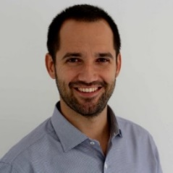
ABOUT ALBERTO
ALBERTO JERÓNIMO. TTA Resident coordinator in the Pacific (based in Vanuatu)
Electrical Engineer with +15 years of experience in the renewable energies sector.
International Experience : Afghanistan, China Laos, Liberia, FSM, Cambodia, Fiji, Kiribati, Myanmar, PNG, Solomon Island, Tuvalu, Vanuatu.
Project Manager of multiple projects from in the Pacific, including regional studies, feasibility studies and engineering designs for solar and hydro mini-grids, solar PV rooftop, utility scale solar and BESS, construction supervision, etc.
Relevant Previous work (before TTA)
Myanmar
Laos

Slide 16
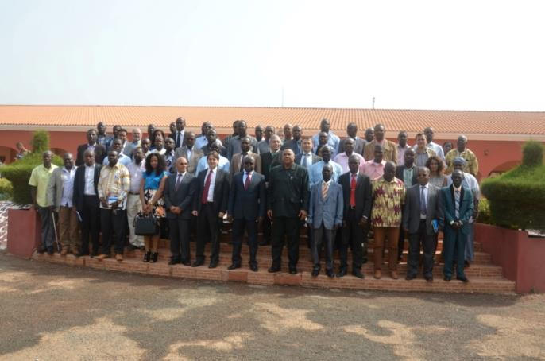
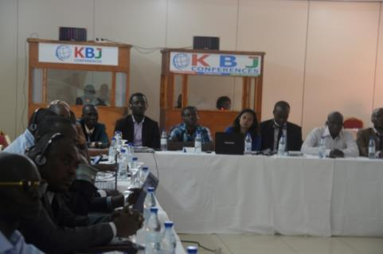
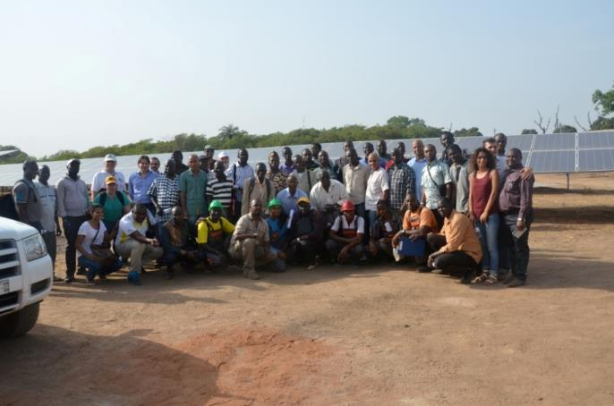
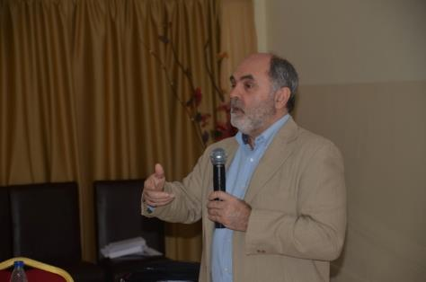
RE HYBRID MINI-GRID WORKSHOP IN WEST AFRICA
“Renewable Eenrgy Hybrid Mini-Grid Systems for Rural Electrification in West Africa”
Organized by ECOWAS Centre for Renewable Energy and Energy Efficiency (ECREEEE)
Guinea Bissau, March 2015

Slide 17
2. About the audience
Notes:
To really understand how decisions are taken when designing a solar facility, we need to start from the basics of solar radiation.

Slide 18
SHORT INTRODUCTION
Please kindly introduce yourself in 3-5 min indicating, at least:
Your role: Organization, position.
Previous experience in off-grid. Share briefly if you had any exposure to mini-grid projects or energy access projects in general.
Training expectations. What brings you to this training, what would you like to learn

Slide 19
3. About THIS WORKSHOP

Slide 20
WORKSHOP OBJECTIVES
To support the capacity of government officials and the private sector in the design, installation and maintenance of solar mini-grids systems.
To support the capacity of government officials to develop effective policies, legislation, business and operational models, as well as incentives for sustainable mini-grid market uptake.
To strengthen the capacity of the Energy Regulators to effectively inspect and participate in the commissioning of mini-grid systems and their subsequent monitoring of their performance.
To assist PICs in dealing effectively with the common technical challenges relating to the reliability, safety and resilience of electricity services from RE mini-grids systems.
To strengthen the capacity of government officials in the initial stages of project development (planning) to design interventions that maximize their positive impact and ensure their sustainability.
To present and discuss delivery models and different strategies for private sector involvement through Public-Private Partnerships.
To provide inputs for the final design of the PCREEE Mini-grid Program and tap into best practices from other GN-SEC regions.

Slide 21
WORKSHOP EXPECTED OUTCOMES
Strengthened capacities of participants on practical mini-grid issues
An updated stocktake of progress with mini-grids in the region
Collected inputs for the PCREEE Mini-grid Program
Strengthened partnerships and coordination of mini-grid effort in the PICTs

Slide 22
WORKSHOP AGENDA
Monday
How to establish an enabling framework for the promotion of mini-grids
Tuesday
Key technical aspects for mini-grid design
Wednesday
Mini-grid project implementation and operation
Thursday
PICs Case Studies and Site Visits
Energy Projects Briefing & Wrap Up
Friday

Slide 23
WORKSHOP AGENDA
Monday
How to establish an enabling framework for the promotion of mini-grids
Introduction
Electrification Planning
===LUNCH===
Regulatory Framework
Tariff Definition
Subsidies

Slide 24
HOUSEKEEPING RULES AND LOGISTICS
PLEASE at any time interrupt to
Ask something that is not clear
Question something being presented
Contribute with an observation or personal experience

Slide 25
Vinaka!
Roger SALLENT
Regional Team Leader for Asia – Pacific Trama TecnoAmbiental roger.sallent@tta.com.es

