Slide 1
Tim Ellis Infratec Business Skills Training

Slide 2
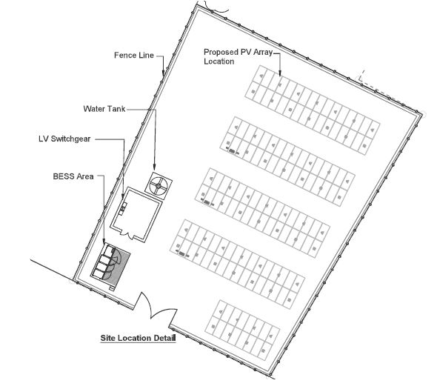
Business Skills Training

Slide 3
Business Skills Training
Solar Panels
Batteries
Switchboard
PV Inverter
Inverter / Charger
Consumers 240V DC

Slide 4
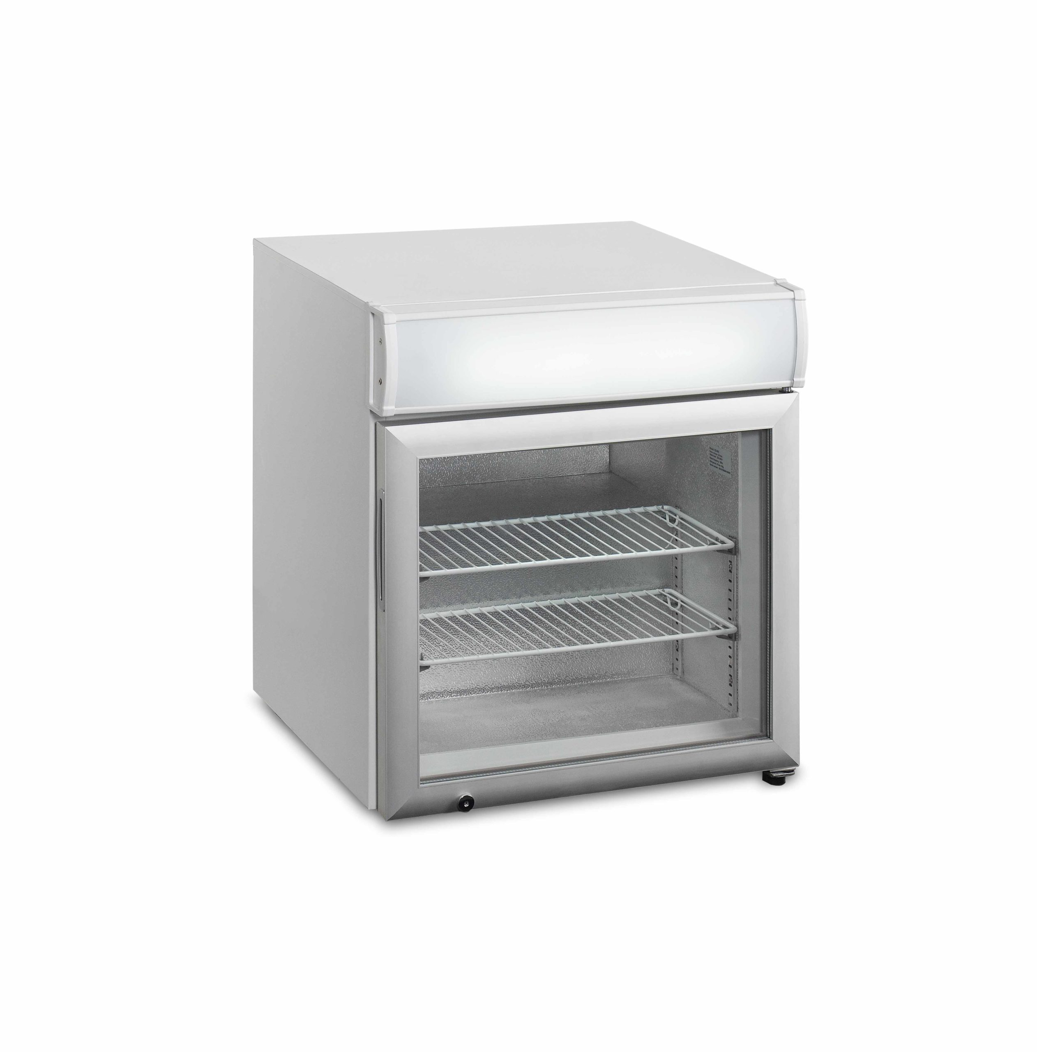
Business Skills Training
Refrigerator -150 Watt
Freezer 50 Watt

Slide 5
Business Skills Training
Microwave Oven 800W
Jug-Kettle 1500W

Slide 6
Business Skills Training
Toaster 1000W
Washing Machine 450W

Slide 7
Business Skills Training
Sewing Machine 80W
Iron 1000W

Slide 8
Business Skills Training
Power Tools 800W
Rechargeable Power tools 100W

Slide 9
Business Skills Training
Laptop-Computer 60W
Fan 50W

Slide 10
Business Skills Training
Printer/Copier 50W
Phone Charger 7W

Slide 11
Business Skills Training
Engraving Tools-100W
Water Pump-250W

Slide 12
Business Skills Training
Floodlights-100W
Hair Clippers-100W

Slide 13
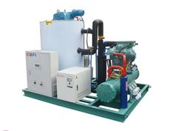
Business Skills Training
Flake Ice Machine-2500W+
Starlink kits-100W

